Slide 1
Android Training
Introduction to Design Patterns

Slide 2

Agenda
Understanding the need for design patterns
What are design patterns
Using design patterns
Overview:
  Singleton
  Factory
  Observable
  Pipeline
  Façade Design Pattern

Slide 3
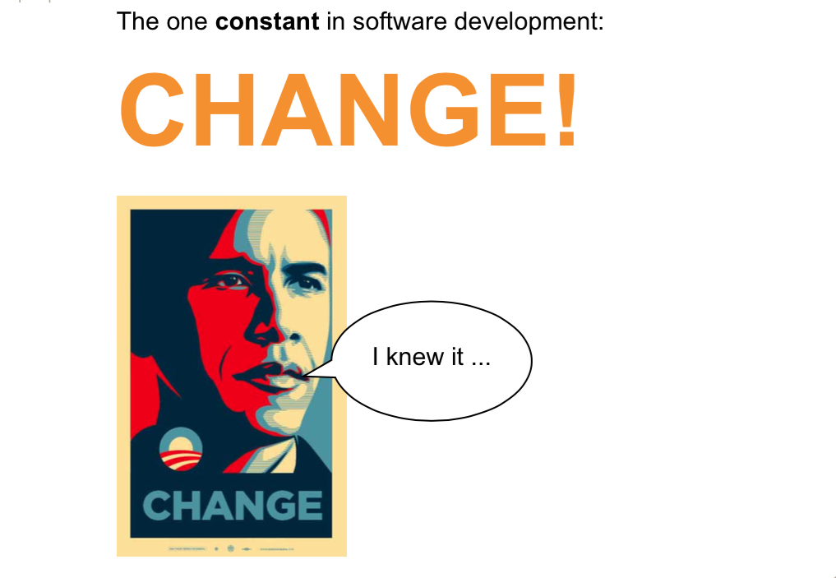
The need for Design Patterns

Slide 4
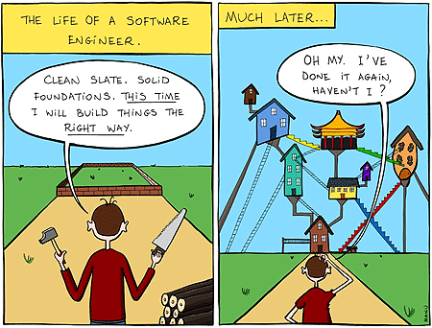
The need for Design Patterns
Software changes
We need to add a new features - boss
There is a change in the specification - customer
We have found a big bug – team
Flexible code
Maintainable Code
Dealing with change
Software has lots of ways to change
There are many design pattern to deal with changes
Design patterns address many of the ways software changes over time
You will create more flexible and maintainable code

Slide 5

What are Design Patterns
iOS consists of number of different software layers, each provide several frameworks which can be used to create apps.
Any fool can write code that a computer can understand but good programmers
write code that humans can understand.
- Martin Fowler
Design patterns are general solutions to common problems
Design patterns are solutions to software design problems you find again
and again in real-world application development.
Tells how classes and objects are structured to solve certain problem.
Are the concepts and are platform independent.
A pattern is a guideline for flexible and resilient code design
It does not go in detail of implementation
There is no DP for Banking system and other for games
It is a general solution for common problem in software development

Slide 6
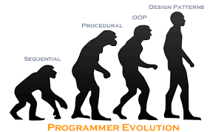
What are Design Patterns
iOS consists of number of different software layers, each provide several frameworks which can be used to create apps.
“I have a problem, when one of my object changes , I need to let all other objects
know. Is there a good way to do that?”
This is a common problem in software development
There is a proven method to solve it : The Observer Pattern
How to use it
A design pattern is not a library, module or package
It’s a guideline for how to solve a problem
Higher level than a library
First understand the pattern, and then use its design in your software

Slide 7
Characteristics of a good design
Ease of maintenance
Software is always highly unstable.
It is expected to undergo maintenance and changes in feature.
The design should be self-explanatory and easy to understand for other programmers.
Minimal complexity
Simplicity is the soul of efficiency(– Austin Freeman) .
Design for simplicity. A complex design is often difficult to extend, maintain and understand.
There are factors like many interconnections and relations, non-trivial algorithm, behaviors or rules, etc. causes the complexity in design.
Loose coupling and extensibility
All components in your design should be loosely coupled to the maximum extend.
This will make the system modularized and each components can be tested separately before it is integrated to a whole larger system.
You can change a piece of the system without affecting other pieces. If there is a defect in one component in your software, then it won’t bug much to the other components.

Slide 8
Characteristics of a good design
Portability
How easy would it be to move the system to another environment.
Reusability
Design software component, that can be easily used in other system or software.
Standard techniques
Don’t hate things, because you don’t know or you don’t like them.
Before designing your software evaluate and use the industry suggested patterns that are appropriate for your requirements.

Slide 9
Gangs-Of-Four Design Patterns
Design Patterns - Elements of Reusable Object-Oriented Software
Gang-Of-Four also called as foundation patterns are the 23 basic design patterns that provides solution to common recurring problems in software design. They categorized into three major categories, based on behaviour and characteristics.
Creational patterns
Structural patterns
Behavioral Patterns
Design patterns are primarily based on the following principles of object orientated design.
Program to an interface not an implementation
Favor object composition over inheritance

Slide 10
GOF
S.N. | Pattern & Description
1. | Creational Patterns These design patterns provide a way to create objects while hiding the creation logic, rather than instantiating objects directly using new operator. This gives program more flexibility in deciding which objects need to be created for a given use case.
2. | Structural Patterns These design patterns concern class and object composition. Concept of inheritance is used to compose interfaces and define ways to compose objects to obtain new functionalities.
3. | Behavioral Patterns These design patterns are specifically concerned with communication between objects.
4. | J2EE Patterns These design patterns are specifically concerned with the presentation tier. These patterns are identified by Sun Java Center.

Slide 11
Singleton

Slide 12
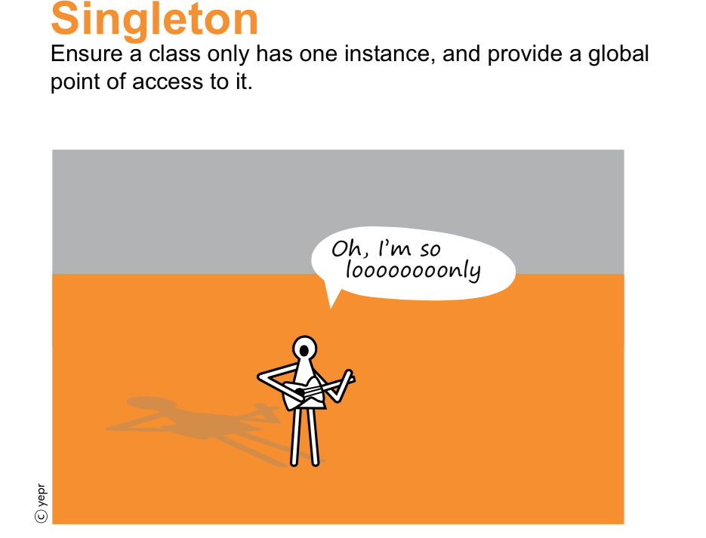
What is Singleton Pattern?

Slide 13
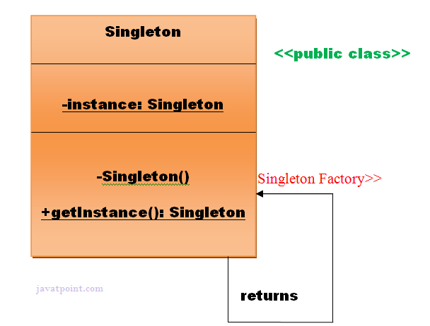
What is Singleton Pattern?
Singleton pattern is one of the simplest design patterns in Java.
This type of design pattern comes under creational pattern as this pattern provides one of the best ways to create an object.
Involves a single class which is responsible to create an object while making sure that only single object gets created.
This class provides a way to access its only object which can be accessed directly without need to instantiate the object of the class.
Intent
Ensure that only one instance of a class is created.
Provide a global point of access to the object.

Slide 14
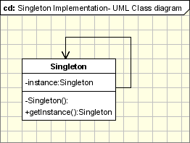
Steps:
//Step 1: Create a static object of class
public class SingleObject {
private static SingleObject instance=new SingleObject();
//Step 2: Create the private constructor of the class so that this class cannaot be instantiated
private SingleObject(){}
//Step 3: Create a static method which returns object of the class
public static SingleObject getInstance(){
return instance;
}
public void showMessage(){
System.out.println("I AM CALLED FROM Singleton class");
}

Slide 15
Steps:
public class SingletonPatternDemo {
/**
* @param args the command line arguments
*/
public static void main(String[] args) {
//illegal way:
// compile type error: The constructor of SingleObject is not visible
// SingleObject object = new SingleObject();
//Step 4:Get the only object available
SingleObject object=SingleObject.getInstance();
object.showMessage();
}

Slide 16
Applicability & Examples
Example 1 - Logger Classes
This classes are usually implemented as a singletons, and provides a global logging access point in all the application components without being necessary to create an object each time a logging operations is performed.
Example 2 - Configuration Classes
Design the classes which provides the configuration settings for an application.
By implementing configuration classes as Singleton not only that we provide a global access point, but we also keep the instance we use as a cache object.
Example 3 - Accessing resources in shared mode
It can be used in the design of an application that needs to work with the serial port.
Let's say that there are many classes in the application, working in an multi-threading environment, which needs to operate actions on the serial port.
In this case a singleton with synchronized methods could be used to be used to manage all the operations on the serial port.

Slide 17
Applicability & Examples
Example 4 - Thread-safe implementation for multi-threading use
Singletons can be used specifically in multi-threaded application to make sure the reads/writes are synchronized.
public static Singleton getInstance()
{
if (instance == null)
{
synchronized(Singleton.class)
{
if (instance == null)
{
System.out.println("getInstance(): First time getInstance was invoked!");
instance = new Singleton();
}
}
}
return instance;

Slide 18
Factory

Slide 19
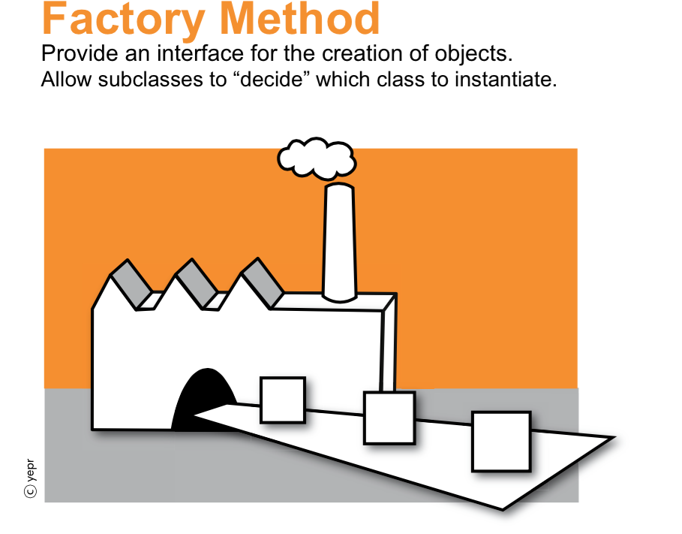
Implementation
A Factory Pattern or Factory Method Pattern says that just define an interface or abstract class for creating an object but let the subclasses decide which class to instantiate.
In other words, subclasses are responsible to create the instance of the class.
The Factory Method Pattern is also known as Virtual Constructor.

Slide 20
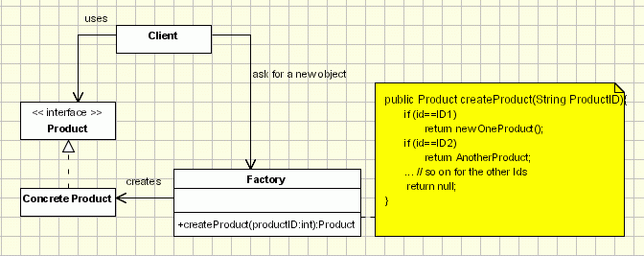
Implementation
Intent
Creates objects without exposing the instantiation logic to
the client.
Refers to the newly created object through a common
interface.
Implementation
The client needs a product, but instead of creating it directly using the new operator,
it asks the factory object for a new product, providing the information about the type of object it needs.
The factory instantiates a new concrete product and then returns to the client the newly created product(casted to abstract product class).
The client uses the products as abstract products without being aware about their concrete implementation.

Slide 21
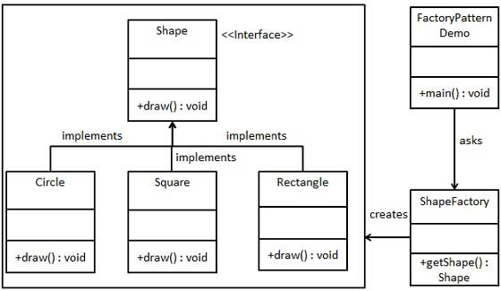
Implementation

Slide 22
Advantage of Factory Design Pattern
Factory Method Pattern allows the sub-classes to choose the type of objects to create.
It promotes the loose-coupling by eliminating the need to bind application-specific classes into the code.
That means the code interacts solely with the resultant interface or abstract class, so that it will work with any classes that implement that interface or that extends that abstract class.

Slide 23
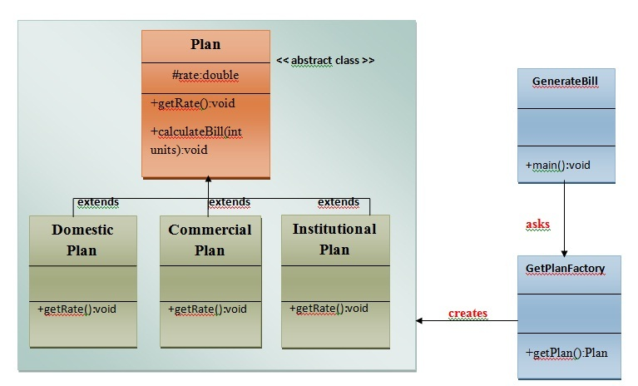
UML for Factory Method Pattern
We are going to create a Plan abstract class and concrete classes that extends the Plan abstract class.
A factory class GetPlanFactory is defined as a next step.
GenerateBill class will use GetPlanFactory to get a Plan object. It will pass information (DOMESTICPLAN / COMMERCIALPLAN / INSTITUTIONALPLAN) to GetPalnFactory to get the type of object it needs.

Slide 24
Calculate Electricity Bill : A Real World Example of Factory Method
Step 1: Create a Plan abstract class.
import java.io.*;
abstract class Plan{
protected double rate;
abstract void getRate();
public void calculateBill(int units){
System.out.println(units*rate);
}
}//end of Plan class.
Step 2: Create the concrete classes that extends Plan abstract class.
class DomesticPlan extends Plan{
//@override
public void getRate(){
rate=3.50;
}
}//end of DomesticPlan class.
class CommercialPlan extends Plan{
//@override
public void getRate(){
rate=7.50;
}
/end of CommercialPlan class.
class InstitutionalPlan extends Plan{
//@override
public void getRate(){
rate=5.50;
}
/end of InstitutionalPlan class.

Slide 25
Calculate Electricity Bill : A Real World Example of Factory Method
Step 3: Create a GetPlanFactory to generate object of concrete classes based on given information..
class GetPlanFactory{
//use getPlan method to get object of type Plan
public Plan getPlan(String planType){
if(planType == null){
return null;
}
if(planType.equalsIgnoreCase("DOMESTICPLAN")) {
return new DomesticPlan();
}
else if(planType.equalsIgnoreCase("COMMERCIALPLAN")){
return new CommercialPlan();
}
else if(planType.equalsIgnoreCase("INSTITUTIONALPLAN")) {
return new InstitutionalPlan();
}
return null;
}
}//end of GetPlanFactory class.

Slide 26
Calculate Electricity Bill : A Real World Example of Factory Method
Step 4: Generate Bill by using the GetPlanFactory to get the object of concrete classes by passing an information such as type of plan DOMESTICPLAN or COMMERCIALPLAN or INSTITUTIONALPLAN.
import java.io.*;
class GenerateBill{
public static void main(String args[])throws IOException{
GetPlanFactory planFactory = new GetPlanFactory();
System.out.print("Enter the name of plan for which the bill will be generated: ");
BufferedReader br=new BufferedReader(new InputStreamReader(System.in));
String planName=br.readLine();
System.out.print("Enter the number of units for bill will be calculated: ");
int units=Integer.parseInt(br.readLine());
Plan p = planFactory.getPlan(planName);
//call getRate() method and calculateBill()method of DomesticPaln.
System.out.print("Bill amount for "+planName+" of "+units+" units is: ");
p.getRate();
p.calculateBill(units);
}
}//end of GenerateBill class.

Slide 27
Organization tips for Android projects

Slide 28
The packages
com.example
activities
  Contains all the activities. Classes are all named with Activity at the end. That way, you can immediately know what it is when reading Java code that doesn't have its full package name.
adapters
  Contains all the adapters.
authenticator
  Contains any class related to signing a user in. I create a local account and having all related classes together is very handy.
data
  Contains all classes related to data management such as ContentProvider and SQLiteHelper.
fragments
Contains all fragments.
helpers
Contains helper classes. A helper class is a place to put code that is used in more than one place. I have a DateHelper for instance. Most of the methods are static.

Slide 29
The packages
com.example
interfaces
Contains all interfaces.
models
Contains all local models. When syncing from an HTTP API I parse the JSON into these Java objects using Jackson. I also pull Cursor rows into these models as well.
preferences
Contains all classes for custom preferences. When creating the preferences I required a custom PreferenceDialog as well as a custom PreferenceCategory. They live here.
util - utility classes, such as services, BroadcastReceivers, or other background processes
conf - contains your configuration files, such as those containing constants (static final variables)

Slide 30
The res folder
Naming of layouts
activity_dashboard.xml
activity_profile_list.xml
activity_map.xml
dialog_about.xml
dialog_eula.xml
list_item_profile.xml
list_item_setting.xml
fragment_classname.xml
You can also use abbreviations, if you prefer them.
a_dashboard.xml
d_about.xml
li_profile.xml
f_classname.xml

Slide 31
Naming of Ids
Give only those widgets an id, that you'll need in your code.
So mostly you can remove the id-attribute of layouts and scrollviews. To keep the overview over your ids,
Put the layout name and the widget name in front of the id name. <layout>_<widget>_name activity_dashboard_btn_profile or a_dashboard_btn_profile
d_about_ibtn_info
li_profile_tv_name
Widget names
Button = btn
ImageButton = ibtn
EditText = et
TextView = tv
ImageView = iv

Slide 32
Naming of drawables
This is similar to layouts and ids. ac_bgr.xml (a shape)
ac_btn_bgr.9.png (9-patch drawables)
ac_seperator.xml
ic_info.png
ac = actionbar, ic = icon, bgr = background
String.xml
<string name="error.message.network">Network error</string>
<string name="error.message.call">Call failed</string>
<string name="error.message.map">Map loading failed</string>

Slide 33
Organizing Logs

Slide 34
Create Log Class
public class Log {
static final boolean LOG = KleekApplication.ENABLE_LOGGING;
public static void i(String tag, String string) {
if (LOG) android.util.Log.i(tag,string);
}
public static void e(String tag, String string) {
if (LOG) android.util.Log.e(tag, string);
}
public static void d(String tag, String string) {
if (LOG) android.util.Log.d(tag, string);
}
public static void v(String tag, String string) {
if (LOG) android.util.Log.v(tag, string);
}
public static void w(String tag, String string) {
if (LOG) android.util.Log.w(tag, string);
}
}
Create a class Log

Slide 35
Create Log Class
public class KleekApplication extends Application
{
private static KleekApplication mInstance;
// don't output logging.
public static final Boolean ENABLE_LOGGING = false;
//**************************************************************************/
public static KleekApplication getInstance()
{
return mInstance;
}
don't output logging.

Slide 36
Create Log Class
<application
android:name=".KleekApplication"
android:enabled="true"
android:icon="@drawable/ic_launcher"
android:label="@string/app_name"
android:theme="@style/AppTheme" >
Register application class in manifest
Use in the class
public void onPause()
{
super.onPause();
Log.i(mLogTag, "onPause:" + this + " Live count = " + String.valueOf(mLiveCount));
}

Slide 37
Javadoc Code Documentation

Slide 38
What is Javadoc?
Javadoc is a utility provided with the Java SDK that allows developers to generate code documentation from Java source files.
Javadoc documentation uses a combination of processing the source code (and inspecting types, parameters, etc.) and reading special comment tags that the developer provides as metadata associated with a section of code.
A Javadoc-style comment must come just before the code it is associated with.
For example, a Javadoc comment for a class should be just above the class declaration and a comment for a method should be just above the method declaration.
.

Slide 39
What is Javadoc?
Some important tags include:
@author – who wrote this code
@version – when was it changed
@param – describe method parameters
@return – describe method return values
@throws – describe exceptions thrown
@see – link to other, related items (e.g. “See also…”)
@since – describe when code was introduced (e.g. API Level)
@deprecated - describe deprecated item and what alternative to use instead
.

Slide 40
Describes a class
/**
* Activity for loading layout resources
*
* This activity is used to display different layout resources for a tutorial on user interface design.
*
* @author LED
* @version 2010.1105
* @since 1.0
*/
public class LayoutActivity extends Activity {

Slide 41
Describes a field within a class
/** * Debug Tag for use logging debug output to LogCat */
private static final String DEBUG_TAG = "MyActivityDebugTag";

Slide 42
Describes a method within a class
/**
* Method that adds two integers together
*
* @param a The first integer to add
* @param b The second integer to add
* @return The resulting sum of a and b
*/
public int addIntegers(int a, int b)
{
return(a+b);
}

Slide 43
But throws an exception
/**
This method simply throws an Exception if the incoming parameter a is not a positive number, just for fun.
*
* @param a Whether or not to throw an exception
* @throws Exception
*/
public void throwException(boolean shouldThrow) throws Exception {
if(shouldThrow == true)
{
throw new Exception();
}
}

Slide 44
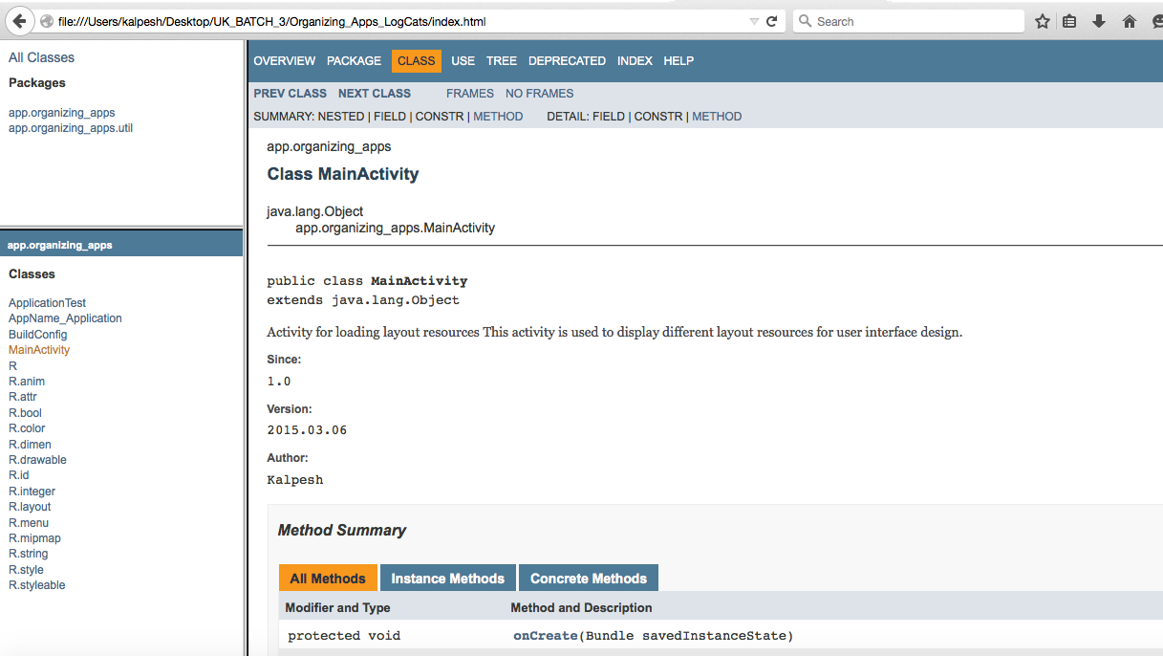
Screen

Slide 45
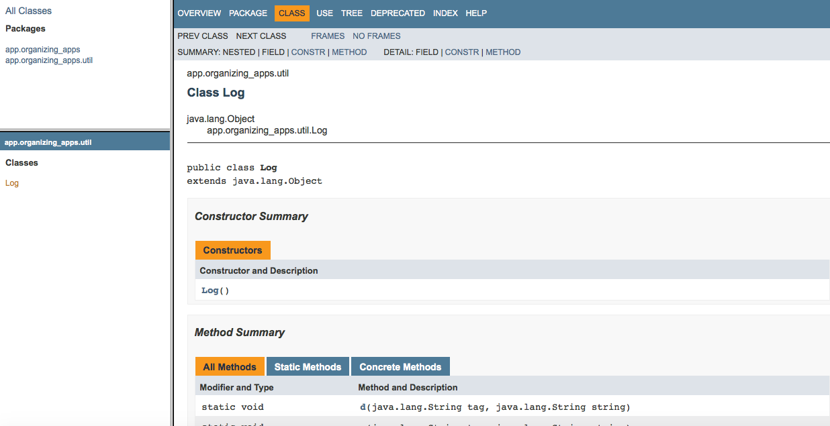
Screen

Slide 46
MVC

Slide 47
Observer

Slide 48
MVP

Slide 49
What is MVP?
The Model-View-Presenter design pattern is a modern pattern to separate the view from the underlying model.
MVP is a derivative of the model–view–controller (MVC) software pattern, also used mostly for building user interfaces.
.

Slide 50
What is MVP?
The model is the data that will be displayed in the view (user interface).
The view is an interface that displays data (the model) and routes user commands (events) to the presenter to act upon that data. The view usually has a reference to its presenter.
The presenter is the “middle-man” and has references to both, view and model. Presenter handles all the business logic that retrieves or manipulates a Model. For instance: If you have a database with User and your View wants to display a list of User, then the Presenter would have a reference to your database business logic (like a DAO) from where the presenter will query a list of Users.
.

Slide 51
Why Presenter?
Separating the presentation of the application’s UI from the logic of its UI is usually a good idea.
This separation of concerns creates more de-coupled code, which is much cleaner, and even allows for more unit testing coverage.
Android bundles the UI and UI logic into the Activity class, which necessitates Instrumentation to test the Activity.
Since Instrumentation is introduced, it is much more difficult (or impossible) to properly unit test your UI logic when the dependencies in the code cannot be mocked.
However, a simple MVP pattern will help de-couple the UI and UI logic in Android applications.
.

Slide 52
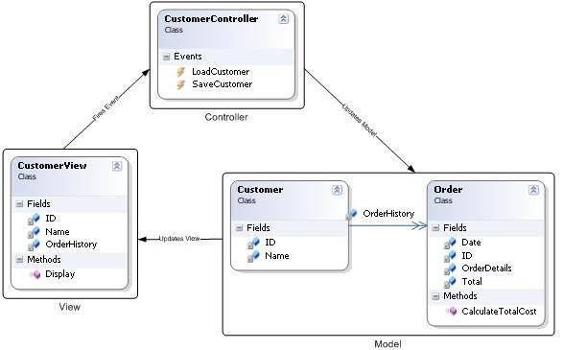
MVC Diagram
.

Slide 53
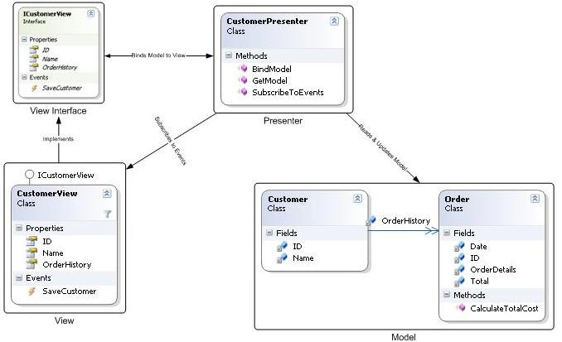
MVP Diagram
.

Slide 54
Why Presenter?
MVP Pattern
View is more loosely coupled to the model. The presenter is responsible for binding the model to the view.
Easier to unit test because interaction with the view is through an interface
Usually view to presenter map one to one. Complex views may have multi presenters.
MVC Pattern
Controller are based on behaviors and can be shared across views
Can be responsible for determining which view to display
.

Slide 55
Why Presenter?
Loose coupling
Clear separation of concerns/responsibility
Test Driven
Code
Hide Data
Flexibility/Adaptable
MVP Advantages
.

Slide 56
Why Presenter?
Loose coupling
Clear separation of concerns/responsibility
Test Driven
Code
Hide Data
Flexibility/Adaptable
.

