Slide 1
Android Training: Day 1
Java Basics

Slide 2
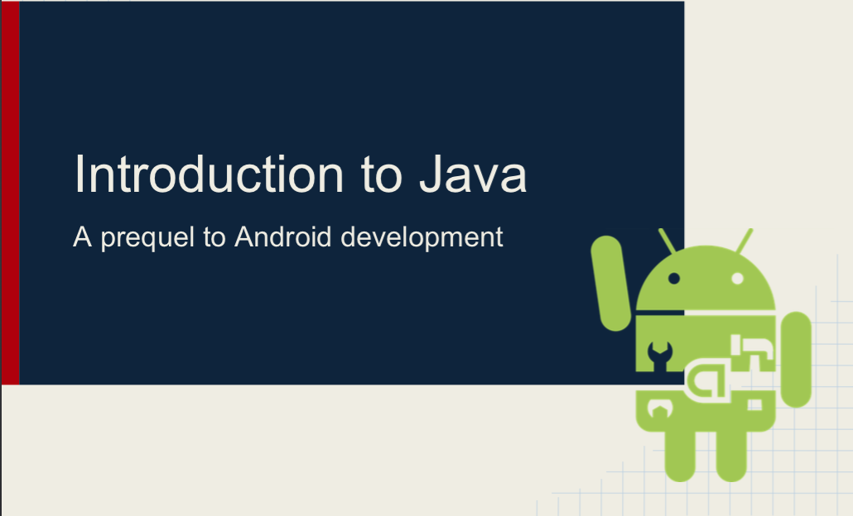

Slide 3

Agenda
Understanding Java Collections Framework
Android: SparseArray
String, StringBuilder and StringBuffer
Interface

Slide 4
Java Collections Framework
The Java Collections Framework is a collection of interfaces and classes which helps in storing and processing the data efficiently.
This framework has several useful classes which have tons of useful functions which makes a programmer task super easy.
Common Types:
List
Set
Map
Iterators

Slide 5

Java Collections

Slide 6
1#Java String Array
Collection of Similar objects
First, we declare a string array with an initial size of 4 elements and then add 4 elements.
If you try to add one more element, you will have java.lang.ArrayIndexOutOfBoundsException, as the capacity of the array is fixed and cannot be resized once created.
If you want a dynamically sized array where you can add and remove the objects and the size is adjusted accordingly, you should use an ArrayList.

Slide 7
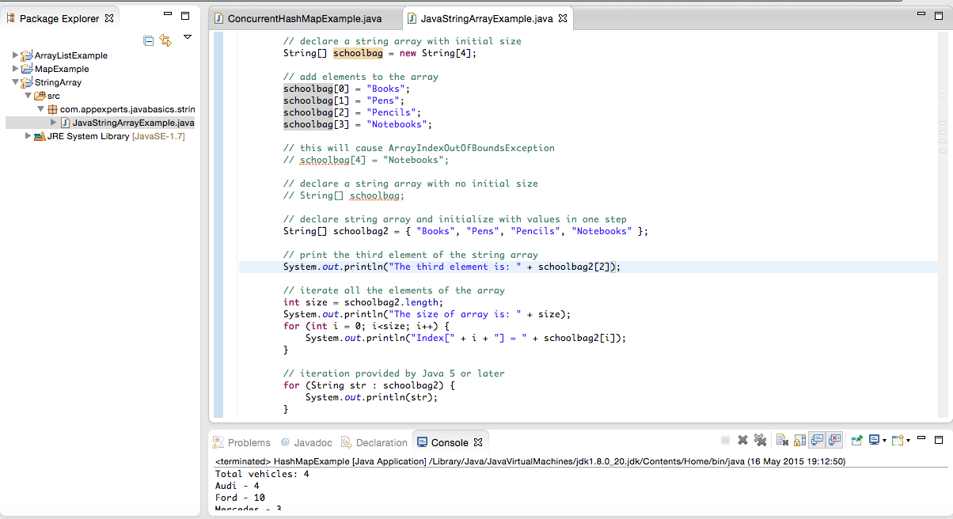
Code
Package Explorer
Console /outputView

Slide 8
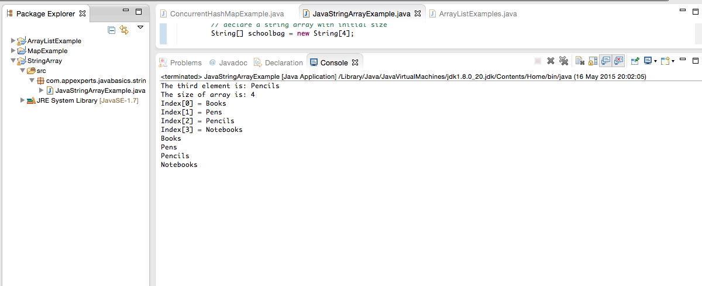
Output

Slide 9
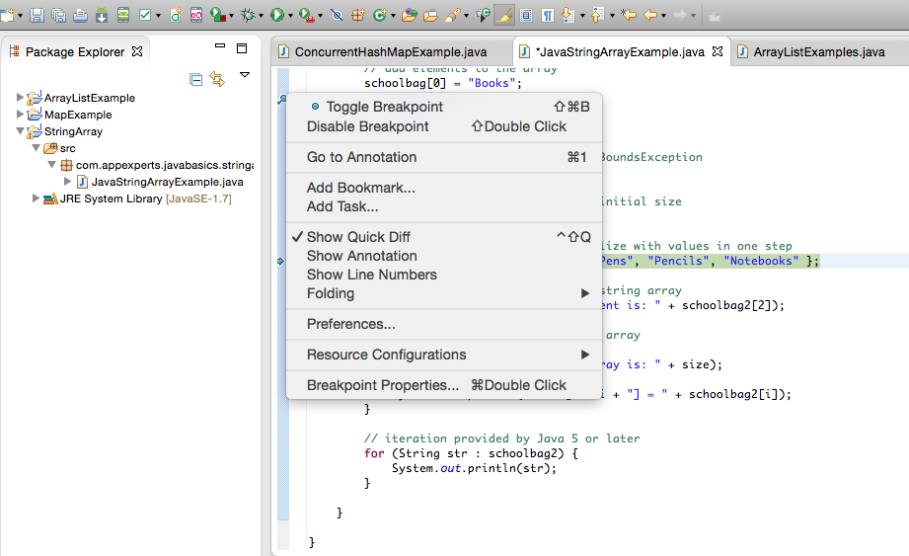
Debugging
Right click on sidebar

Slide 10
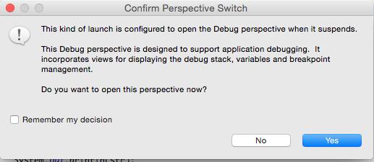
Debugging Confirmation

Slide 11
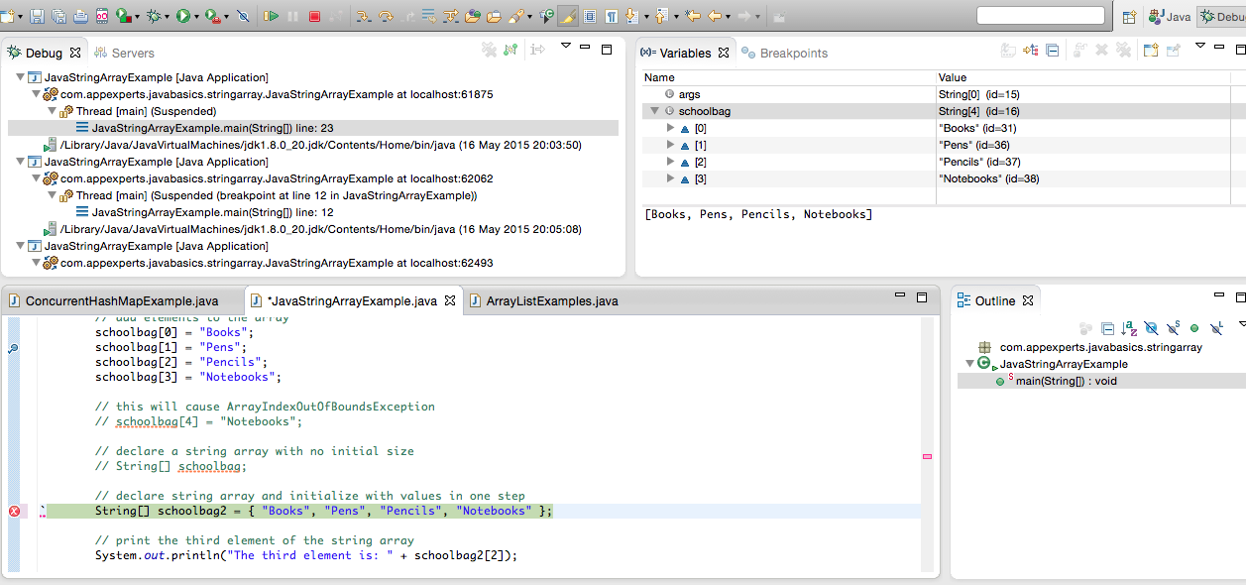
Debug Window

Slide 12
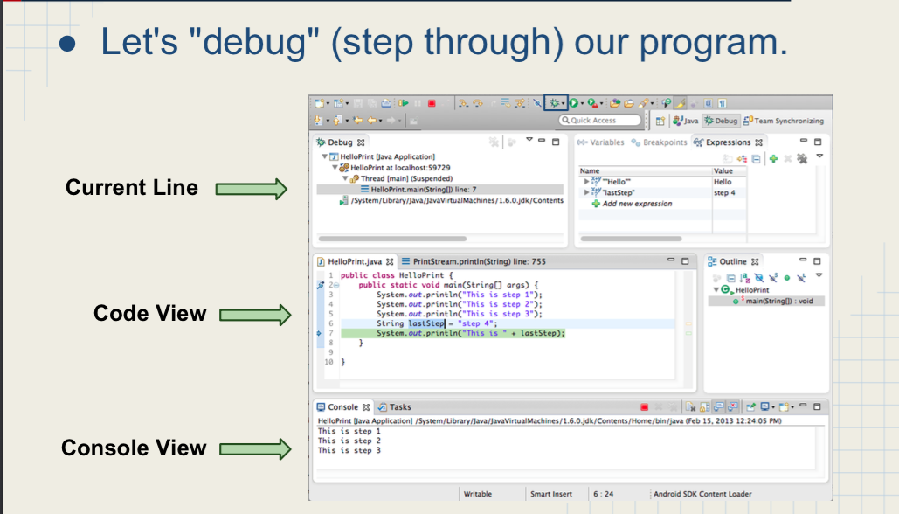
Debug Window

Slide 13
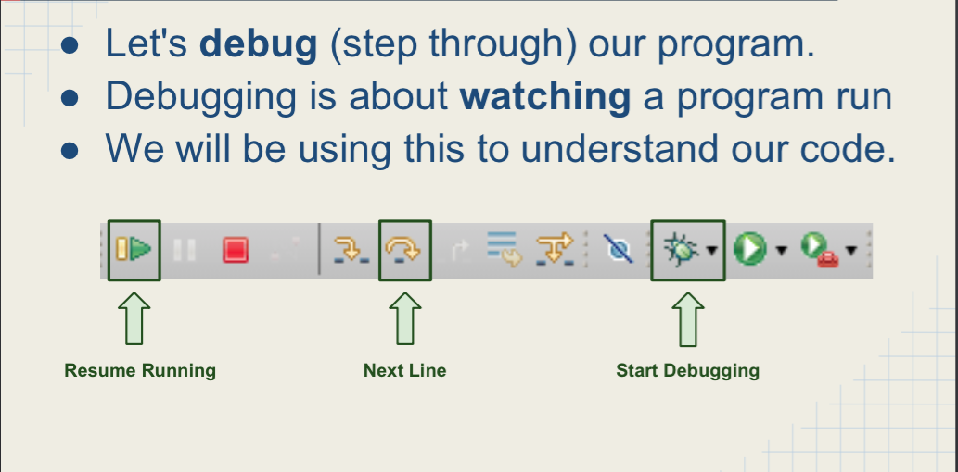
Debug Window

Slide 14
2#ArrayList
The class java.util.ArrayList provides resizable-array, which means that items can be added and removed from the list. It implements the List interface.
A major question related to arraylists is about when to use arraylists instead of arrays and vice versa.
An ArrayList is a dynamic data structure so it can be used when there is no upper bound on the number of elements.
From the other side, a simple Array in java is a static data structure, because the initial size of array cannot be changed, so it can be used only when the data has a known number of elements.
Most of the developers choose Arraylist over Array as it’s a very good alternative of traditional java arrays.
Apart from these benefits ArrayList class enables us to use predefined methods of it which makes our task easy.

Slide 15
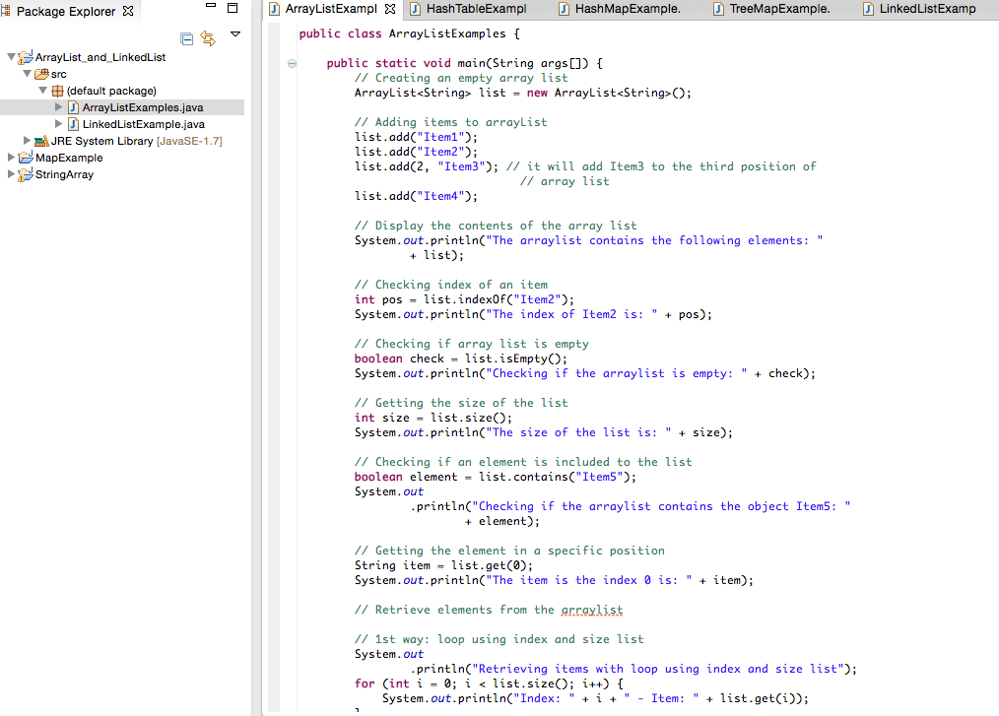
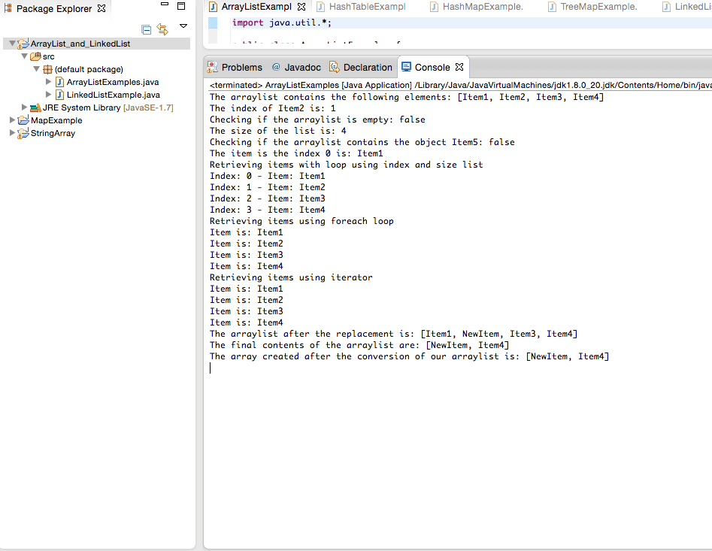
3#LinkedList

Slide 16
3#LinkedList

Slide 17
3#LinkedList
Linked Lists are an alternative to ArrayLists that Computer Scientists have come up with.
While an ArrayList uses an array internally to store the data, a LinkedList uses nodes to hold the elements.
These nodes then point to each other, thus leading to the name "Linked" List. There are three types of Linked Lists: singly-linked lists, doubly-linked lists and circularly-linked lists.
Key methods from the List interface including
add(elem),
add(index, elem),
set(index, elem),
get(index),
get(elem),
remove(index),
remove(elem), and
indexOf(elem)

Slide 18
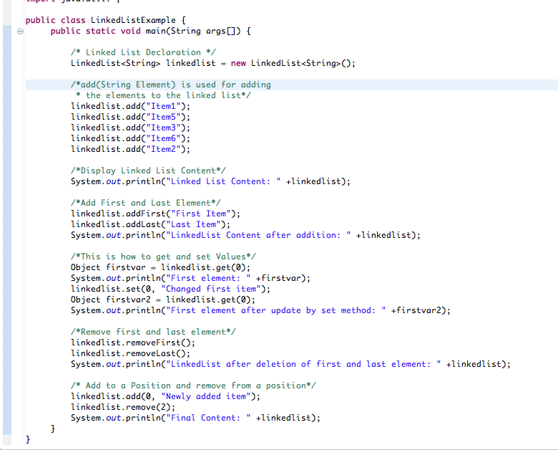
3#LinkedList

Slide 19
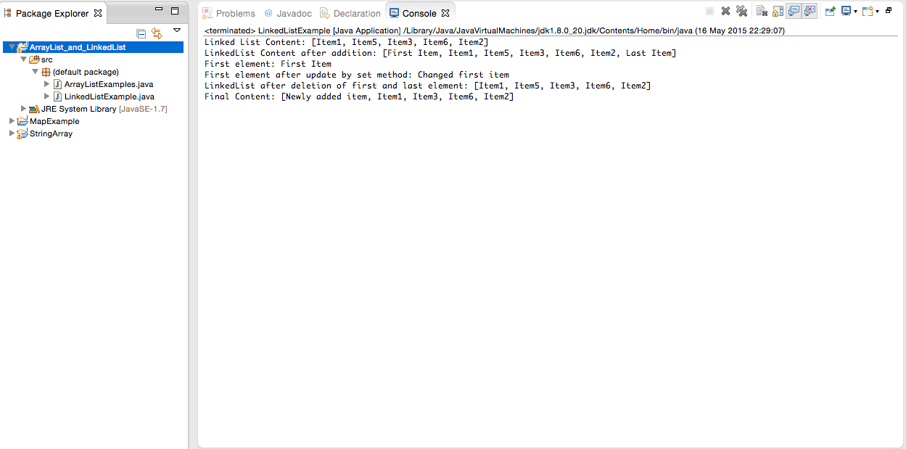
Output

Slide 20
ArrayList vs LinkedList
ArrayList | LinkedList
1) ArrayList internally uses dynamic array to store the elements. | LinkedList internally uses doubly linked list to store the elements.
2) Manipulation with ArrayList is slow because it internally uses array. If any element is removed from the array, all the bits are shifted in memory. | Manipulation with LinkedList is faster than ArrayList because it uses doubly linked list so no bit shifting is required in memory.
3) ArrayList class can act as a list only because it implements List only. | LinkedList class can act as a list and queue both because it implements List and Deque interfaces.
4) ArrayList is better for storing and accessing data. | LinkedList is better for manipulating data.

Slide 21
MAP
A Map is an object that maps keys to values. A map cannot contain duplicate keys. There are three main implementations of Map interfaces: HashMap, TreeMap, and LinkedHashMap.
HashMap: it makes no guarantees concerning the order of iteration
TreeMap: It stores its elements in a red-black tree, orders its elements based on their values; it is substantially slower than HashMap.
LinkedHashMap: It orders its elements based on the order in which they were inserted into the set (insertion-order).

Slide 22
1#HashMap
HashMap is a Map based collection class that is used for storing Key & value pairs.
This class makes no guarantees as to the order of the map. It is similar to the Hashtable class except that it is unsynchronized and permits nulls(null values and null key).
Key Methods:
void clear(): It removes all the key and value pairs from the specified Map. Object clone(): It returns a copy of all the mappings of a map and used for cloning them into another map.
boolean containsKey(Object key): It is a boolean function which returns true or false based on whether the specified key is found in the map.
Value get(Object key): It returns the value for the specified key. boolean isEmpty(): It checks whether the map is empty. If there are no key-value mapping present in the map then this function returns true else false.
value put(Key k, Value v): Inserts key value mapping into the map. Used in the above example.

Slide 23
1#HashMap
int size(): Returns the size of the map – Number of key-value mappings.
Collection values(): It returns a collection of values of map.
Value remove(Object key): It removes the key-value pair for the specified key. Used in the above example.
void putAll(Map m): Copies all the elements of a map to the another specified map.

Slide 24
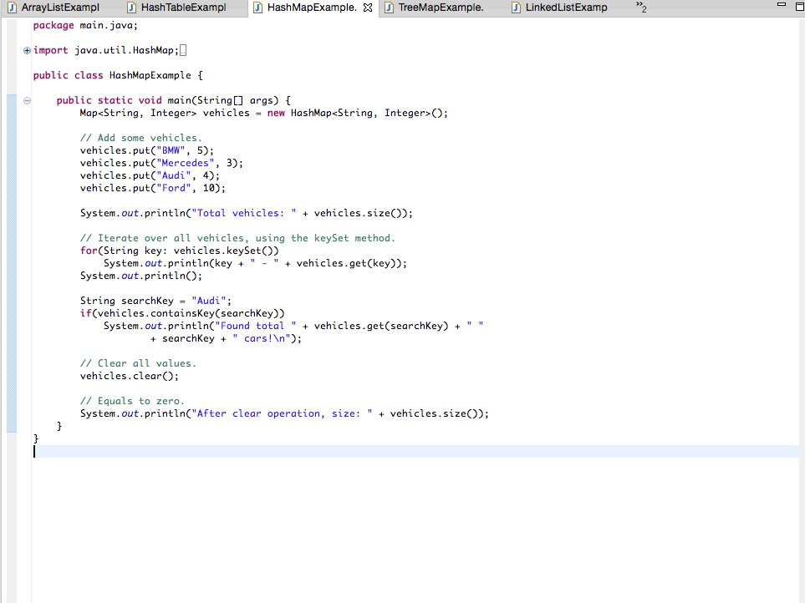
3#LinkedList

Slide 25
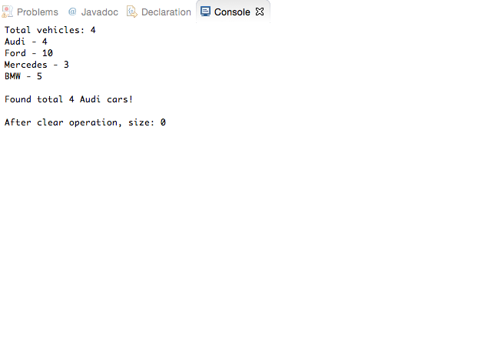
Output

Slide 26
ArrayList vs HashMap
ArrayList | HashMap
1) ArrayList stores the element’s value alone and internally maintains the indexes for each element. | HashMap stores key & value pair. For each value there must be a key associated in HashMap. That clearly shows that memory consumption is high in HashMap compared to the ArrayList.
2) ArrayList maintains the insertion order | HashMap doesn’t maintain insertion.
3) ArrayList allows duplicate elements | HashMap doesn’t allow duplicate keys
4). ArrayList can have any number of null elements. | HashMap allows one null key and any number of null values.
5). In ArrayList we can get the element by specifying the index of it. | In HashMap the elements is being fetched by specifying the corresponding key.

Slide 27
Android: SparseArray
SparseArrays map integers to Objects.
Unlike a normal array of Objects, there can be gaps in the indices.
It is intended to be more memory efficient than using a HashMap to map Integers to Objects, both because it avoids auto-boxing keys and its data structure doesn't rely on an extra entry object for each mapping.
The SparseArray keeps its mappings in an array data structure and uses binary search to find keys.
The array data structure allows primitives to be stored as the indices, but unlike a normal array, gaps between the indices are allowed, hence the term “sparse” array.

Slide 28
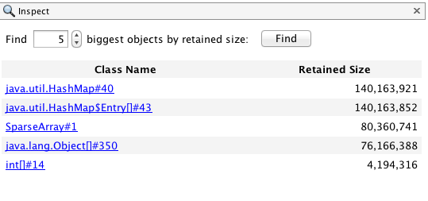
Android: SparseArray
The main interest of the SparseArray is that it saves memory by using primitives instead of objects as the key.
For instance the screenshot below (courtesy of visualVM), shows the memory used when storing 1,000,000 elements in an sparse array of <int, String> vs an HashMap of <Integer,String> :

Slide 29
Code Comparison
Old code with HashMap
Map<Integer, Bitmap> _bitmapCache = new HashMap<Integer, Bitmap>();
private void fillBitmapCache() {
_bitmapCache.put(R.drawable.icon, BitmapFactory.decodeResource(getResources(), R.drawable.icon));
_bitmapCache.put(R.drawable.abstrakt, BitmapFactory.decodeResource(getResources(), R.drawable.abstrakt));
}
Bitmap bm = _bitmapCache.get(R.drawable.icon);
New code with SparseArray
SparseArray<Bitmap> _bitmapCache = new SparseArray<Bitmap>();
private void fillBitmapCache() {
_bitmapCache.put(R.drawable.icon, BitmapFactory.decodeResource(getResources(), R.drawable.icon));
_bitmapCache.put(R.drawable.abstrakt, BitmapFactory.decodeResource(getResources(), R.drawable.abstrakt));
Bitmap bm = _bitmapCache.get(R.drawable.icon);

Slide 30
String, StringBuffer and StringBuilder
String
String is immutable (once created can not be changed) object .
The object created as a String is stored in the Constant String Pool .
Every immutable object in Java is thread safe, that implies String is also thread safe .
String cannot be used by two threads simultaneously.
String once assigned cannot be changed.
String demo = " hello " ;
// The above object is stored in constant string pool and its value can not be modified.
demo="Bye" ; //new "Bye" string is created in constant pool and referenced by the demo variable
// "hello" string still exists in string constant pool and its value is not overrided but we lost reference to the "hello"string

Slide 31
String, StringBuffer and StringBuilder
StringBuffer
StringBuffer is mutable means one can change the value of the object .
The object created through StringBuffer is stored in the heap
StringBuffer has the same methods as the StringBuilder , but each method in StringBuffer is synchronized that is StringBuffer is thread safe .
Due to this it does not allow two threads to simultaneously access the same method .
Each method can be accessed by one thread at a time .
StringBuffer demo1 = new StringBuffer("Hello") ;
// The above object stored in heap and its value can be changed .
demo1=new StringBuffer("Bye");
// Above statement is right as it modifies the value which is allowed in the StringBuffer

Slide 32
String, StringBuffer and StringBuilder
StringBuilder
StringBuilder is same as the StringBuffer , that is it stores the object in heap and it can also be modified .
The main difference between the StringBuffer and StringBuilder is that StringBuilder is also not thread safe.
StringBuilder is fast as it is not thread safe.
StringBuilder demo2= new StringBuilder("Hello");
// The above object too is stored in the heap and its value can be modified
demo2=new StringBuilder("Bye");
// Above statement is right as it modifies the value which is allowed in the StringBuilder

Slide 33
String, StringBuffer and StringBuilder
----------------------------------------------------------------------------------
String StringBuffer StringBuilder
----------------------------------------------------------------------------------
Storage Area | Constant String Pool Heap Heap
Modifiable | No (immutable) Yes( mutable) Yes( mutable )
Thread Safe | Yes Yes No
Performance | Fast Very slow Fast
----------------------------------------------------------------------------------

Slide 34
Interface
Implementing an interface allows a class to become more formal about the behavior it promises to provide.
Interfaces form a contract between the class and the outside world, and this contract is enforced at build time by the compiler.
If your class claims to implement an interface, all methods defined by that interface must appear in its source code before the class will successfully compile.
Why we use it? Also, java programming language does not support multiple inheritance, using interfaces we can achieve this as a class can implement more than one interfaces, however it cannot extend more than one classes.

Slide 35
References
http://beginnersbook.com/2013/04/oops-concepts/
http://www.tutorialspoint.com/java/index.htm
http://jeffcardillo.com/blog/2015/01/22/sparsearray-vs-hashmap/

