Slide 1
Android Training: Day 2

Slide 2
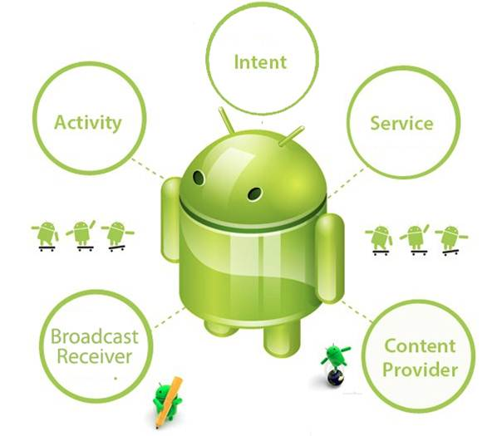

Intent: Important Building Block
May & June 2012 Recruiting Plan
Recruit 70 “Best Fit” Consulting Employees
Build out a Marketing team dedicated to recruiting
Formalize training program for new recruiters
Build out fully functioning offshore recruiting team
Implement call quality feedback loops
Coach and Mentor recruiters
Improve daily efficiency for recruiting team
© 2014 Unbounded Solutions
2

Slide 3
Intents

Slide 4


What are Intents?
May & June 2012 Recruiting Plan
An Android Intent is an object carrying an intent ie. message from one component to another component with-in the application or outside the application.
Think of intent as a message to communicate an action.
It is a description of what you want done, example: VIEW VIDEO, PLAY GAME etc.
Recruit 70 “Best Fit” Consulting Employees
Build out a Marketing team dedicated to recruiting
Formalize training program for new recruiters
Build out fully functioning offshore recruiting team
Implement call quality feedback loops
Coach and Mentor recruiters
Improve daily efficiency for recruiting team
© 2014 Unbounded Solutions
4

Slide 5
What are Intents?
May & June 2012 Recruiting Plan
The intents can communicate messages among any of the three core components of an application - activities, services, and broadcast receivers.
Recruit 70 “Best Fit” Consulting Employees
Build out a Marketing team dedicated to recruiting
Formalize training program for new recruiters
Build out fully functioning offshore recruiting team
Implement call quality feedback loops
Coach and Mentor recruiters
Improve daily efficiency for recruiting team
Intents
Activity
Services
Broadcast Receivers
© 2014 Unbounded Solutions
5

Slide 6
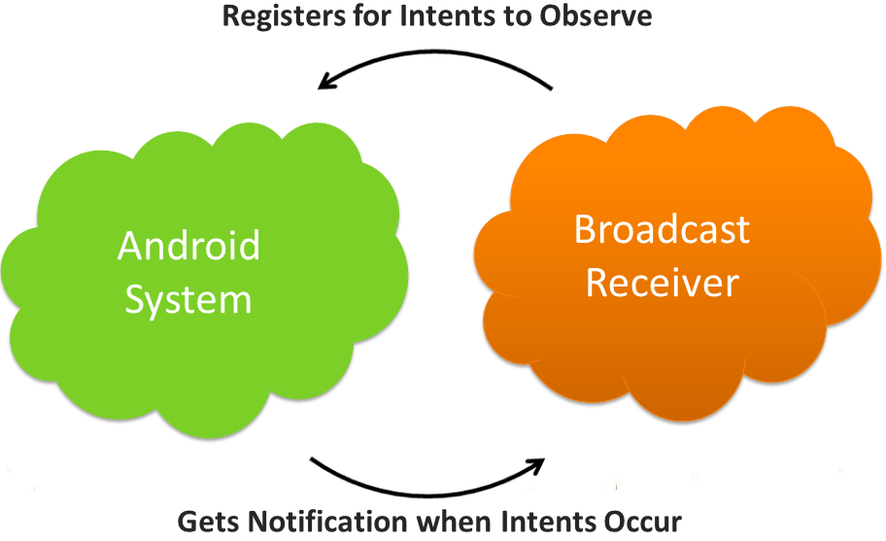
Intents and Broadcast Receivers
May & June 2012 Recruiting Plan
Only an Intent (for which it is registered) can bring it into action. The Broadcast Receiver’s job is to pass a notification to the user, in case a specific event occurs.
Using a Broadcast Receiver, applications can register for a particular event. Once the event occurs, the system will notify all the registered applications.
Recruit 70 “Best Fit” Consulting Employees
Build out a Marketing team dedicated to recruiting
Formalize training program for new recruiters
Build out fully functioning offshore recruiting team
Implement call quality feedback loops
Coach and Mentor recruiters
Improve daily efficiency for recruiting team
© 2014 Unbounded Solutions
6

Slide 7
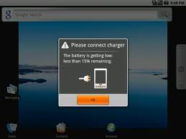
Intents and Broadcast Receivers
May & June 2012 Recruiting Plan
For instance, a Broadcast receiver triggers battery Low notification that you see on your mobile screen.
You can deliver a broadcast to other apps by passing an Intent to sendBroadcast(), sendOrderedBroadcast(), or sendStickyBroadcast().
Recruit 70 “Best Fit” Consulting Employees
Build out a Marketing team dedicated to recruiting
Formalize training program for new recruiters
Build out fully functioning offshore recruiting team
Implement call quality feedback loops
Coach and Mentor recruiters
Improve daily efficiency for recruiting team
© 2014 Unbounded Solutions
7

Slide 8
Intents and Activities
May & June 2012 Recruiting Plan
To start an activity:
Intent int_obj = new Intent (Activity1.this , Activity2.class);
startActivity (int_obj);
Recruit 70 “Best Fit” Consulting Employees
Build out a Marketing team dedicated to recruiting
Formalize training program for new recruiters
Build out fully functioning offshore recruiting team
Implement call quality feedback loops
Coach and Mentor recruiters
Improve daily efficiency for recruiting team
ACCTIVTY 1
ACTIVITY 2
© 2014 Unbounded Solutions
8

Slide 9
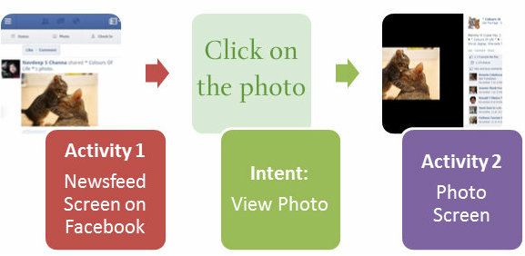
EXAMPLE 1
May & June 2012 Recruiting Plan
Suppose you are on the news feed screen (which is one Activity), and want to view a pic posted by our friend. When you click on the photo, the intent associated with the click event of photo is fired which communicates the message, and the Photo page opens (which is a new Activity).
Recruit 70 “Best Fit” Consulting Employees
Build out a Marketing team dedicated to recruiting
Formalize training program for new recruiters
Build out fully functioning offshore recruiting team
Implement call quality feedback loops
Coach and Mentor recruiters
Improve daily efficiency for recruiting team
© 2014 Unbounded Solutions
9

Slide 10
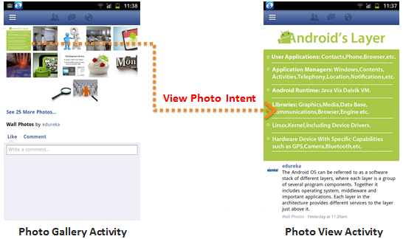
EXAMPLE 2
May & June 2012 Recruiting Plan
The example below assumes that you are on the Photo Gallery Activity, and want to view a specific photo (which would open in its own activity). This is how the Intent associated with the click photo event is fired:.
Recruit 70 “Best Fit” Consulting Employees
Build out a Marketing team dedicated to recruiting
Formalize training program for new recruiters
Build out fully functioning offshore recruiting team
Implement call quality feedback loops
Coach and Mentor recruiters
Improve daily efficiency for recruiting team
© 2014 Unbounded Solutions
10

Slide 11
EXAMPLE 2
May & June 2012 Recruiting Plan
Let’s take another example of the Domino’s Pizza app. Let us suppose you are viewing the Menu Screen (Activity) of the application, and want to select a pizza.
When you select the Mexican Wave pizza, and click on Customize button, another screen (activity) pops up, where you can further specify the size of the pizza, type of crust you want etc.
Here, the Click Action (Select Pizza Intent) on the Menu communicated the message to open the new popup window (new activity).
Recruit 70 “Best Fit” Consulting Employees
Build out a Marketing team dedicated to recruiting
Formalize training program for new recruiters
Build out fully functioning offshore recruiting team
Implement call quality feedback loops
Coach and Mentor recruiters
Improve daily efficiency for recruiting team
© 2014 Unbounded Solutions
11

Slide 12
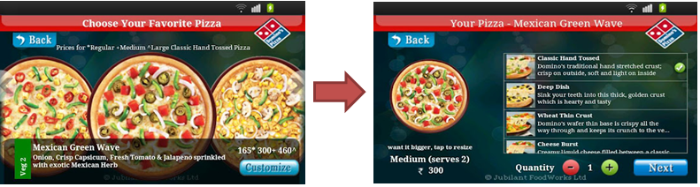
EXAMPLE 3
May & June 2012 Recruiting Plan
ACTIVITY 1
ACTIVITY 2
Recruit 70 “Best Fit” Consulting Employees
Build out a Marketing team dedicated to recruiting
Formalize training program for new recruiters
Build out fully functioning offshore recruiting team
Implement call quality feedback loops
Coach and Mentor recruiters
Improve daily efficiency for recruiting team
© 2014 Unbounded Solutions
12

Slide 13

Intents and Services
May & June 2012 Recruiting Plan
To start a service:
You can start a service to perform a one-time operation (such as download a file) by passing an Intent to startService(). The Intent describes the service to start and carries any necessary data.;
Recruit 70 “Best Fit” Consulting Employees
Build out a Marketing team dedicated to recruiting
Formalize training program for new recruiters
Build out fully functioning offshore recruiting team
Implement call quality feedback loops
Coach and Mentor recruiters
Improve daily efficiency for recruiting team
Download a file
Intent = startService()
© 2014 Unbounded Solutions
13

Slide 14
What are Intents?
May & June 2012 Recruiting Plan
The intents can communicate messages among any of the three core components of an application - activities, services, and broadcast receivers.
Recruit 70 “Best Fit” Consulting Employees
Build out a Marketing team dedicated to recruiting
Formalize training program for new recruiters
Build out fully functioning offshore recruiting team
Implement call quality feedback loops
Coach and Mentor recruiters
Improve daily efficiency for recruiting team
Intents
Activity
Services
Broadcast Receivers
© 2014 Unbounded Solutions
14

Slide 15
Types of Intents
May & June 2012 Recruiting Plan
There are two types of intents:
Recruit 70 “Best Fit” Consulting Employees
Build out a Marketing team dedicated to recruiting
Formalize training program for new recruiters
Build out fully functioning offshore recruiting team
Implement call quality feedback loops
Coach and Mentor recruiters
Improve daily efficiency for recruiting team
Implicit
Explicit
© 2014 Unbounded Solutions
15

Slide 16

Topic #1
May & June 2012 Recruiting Plan
Recruit 70 “Best Fit” Consulting Employees
Build out a Marketing team dedicated to recruiting
Formalize training program for new recruiters
Build out fully functioning offshore recruiting team
Implement call quality feedback loops
Coach and Mentor recruiters
Improve daily efficiency for recruiting team
Explicit Intents
© 2014 Unbounded Solutions
16

Slide 17
Explicit Intents
May & June 2012 Recruiting Plan
Explicit intents specify the component to start by name (the fully-qualified class name).
You'll typically use an explicit intent to start a component in your own app, because you know the class name of the activity or service you want to start.
Starting an activity from within own package or application.
When you create an explicit intent to start an activity or service, the system immediately starts the app component specified in the Intent object.
Recruit 70 “Best Fit” Consulting Employees
Build out a Marketing team dedicated to recruiting
Formalize training program for new recruiters
Build out fully functioning offshore recruiting team
Implement call quality feedback loops
Coach and Mentor recruiters
Improve daily efficiency for recruiting team
© 2014 Unbounded Solutions
17

Slide 18
Explicit Intents
May & June 2012 Recruiting Plan
ACTIVITY 1
ACTIVITY 2
Recruit 70 “Best Fit” Consulting Employees
Build out a Marketing team dedicated to recruiting
Formalize training program for new recruiters
Build out fully functioning offshore recruiting team
Implement call quality feedback loops
Coach and Mentor recruiters
Improve daily efficiency for recruiting team
© 2014 Unbounded Solutions
18

Slide 19
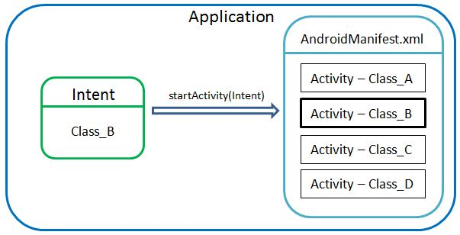
Explicit Invocation
Explicit invocation
Invoking Activity with such an Intent is an explicit invocation. That is, using the class we explicitly specify which Activity we would like to see. It is usually used inside one application. It can be illustrated in the following way:
© 2014 Unbounded Solutions
19
Notes:
http://www.vogella.com/articles/AndroidIntent/article.html#explicit_intentsbackoverview

Slide 20

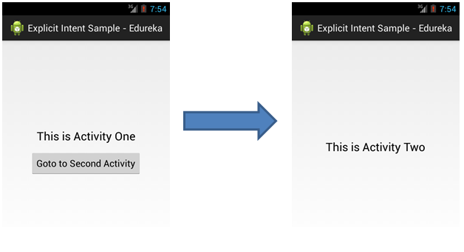
Invocation Example
© 2014 Unbounded Solutions
20
Notes:
http://xjaphx.wordpress.com/2011/07/09/create-and-use-a-compound-control/
http://mobile.cs.fsu.edu/creating-a-simple-compound-component-in-android/

Slide 21
Explicit Intents : Code
May & June 2012 Recruiting Plan
Explicit intents specify the component to start by name (the fully-qualified class name).
For example, if you built a service in your app, named DownloadService, designed to download a file from the web, you can start it with the following code:
Intent downloadIntent = new Intent (this, DownloadService.class);
downloadIntent.setData(Uri.parse(fileUrl));
startService(downloadIntent)
Recruit 70 “Best Fit” Consulting Employees
Build out a Marketing team dedicated to recruiting
Formalize training program for new recruiters
Build out fully functioning offshore recruiting team
Implement call quality feedback loops
Coach and Mentor recruiters
Improve daily efficiency for recruiting team
© 2014 Unbounded Solutions
21

Slide 22
Code Example: Switching Screens
May & June 2012 Recruiting Plan
In Android user interface is displayed through an activity. In Android app development you might face situations where you need to switch between one Activity (Screen/View) to another.
In this tutorial I will be discussing about switching between one Activity to another and sending data between activities.
Recruit 70 “Best Fit” Consulting Employees
Build out a Marketing team dedicated to recruiting
Formalize training program for new recruiters
Build out fully functioning offshore recruiting team
Implement call quality feedback loops
Coach and Mentor recruiters
Improve daily efficiency for recruiting team
© 2014 Unbounded Solutions
22

Slide 23
Code Example: Switching Screens
May & June 2012 Recruiting Plan
So now we have all the code snippets related to activities.
In this tutorial I created two xml layouts(screen1.xml, screen2.xml) and two Acvities(FirstScreenActivity.java, SecondScreenActivity.java).
The following diagram will give you an idea about the file structure you will be need in this tutorial.
Recruit 70 “Best Fit” Consulting Employees
Build out a Marketing team dedicated to recruiting
Formalize training program for new recruiters
Build out fully functioning offshore recruiting team
Implement call quality feedback loops
Coach and Mentor recruiters
Improve daily efficiency for recruiting team
© 2014 Unbounded Solutions
23

Slide 24
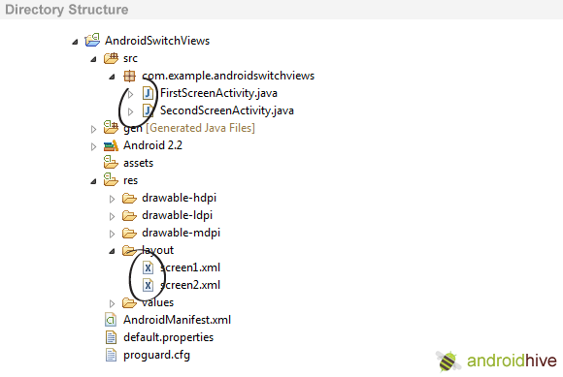
Directory Structure
May & June 2012 Recruiting Plan
Recruit 70 “Best Fit” Consulting Employees
Build out a Marketing team dedicated to recruiting
Formalize training program for new recruiters
Build out fully functioning offshore recruiting team
Implement call quality feedback loops
Coach and Mentor recruiters
Improve daily efficiency for recruiting team
© 2014 Unbounded Solutions
24

Slide 25
Now lets start by creating a simple project.
May & June 2012 Recruiting Plan
Create a new project File -> Android Project. While creating a new project give activity name as FirstScreenActivity.
Now you need to create user interface for the FirstScreenActivity.java
Create a new xml file in layout folder or rename the main.xml to screen1.xml
Right Click on Layout -> New -> Android XML file and name it as screen1.xml
Now insert the following code in screen1.xml to design a small layout. This layout contains simple form with a button.
Recruit 70 “Best Fit” Consulting Employees
Build out a Marketing team dedicated to recruiting
Formalize training program for new recruiters
Build out fully functioning offshore recruiting team
Implement call quality feedback loops
Coach and Mentor recruiters
Improve daily efficiency for recruiting team
© 2014 Unbounded Solutions
25

Slide 26
screen1.xml
May & June 2012 Recruiting Plan
<?xml version="1.0" encoding="utf-8"?>
<LinearLayout xmlns:android="http://schemas.android.com/apk/res/android"
android:orientation="vertical"
android:layout_width="fill_parent"
android:layout_height="fill_parent"
>
<TextView android:layout_width="fill_parent"
android:layout_height="wrap_content"
android:text="Name: "/>
<EditText android:id="@+id/name"
android:layout_width="fill_parent"
android:layout_height="wrap_content"
android:layout_marginBottom="10dip"/>
<TextView
android:layout_width="fill_parent"
android:layout_height="wrap_content"
android:text="Email: "
/>
Recruit 70 “Best Fit” Consulting Employees
Build out a Marketing team dedicated to recruiting
Formalize training program for new recruiters
Build out fully functioning offshore recruiting team
Implement call quality feedback loops
Coach and Mentor recruiters
Improve daily efficiency for recruiting team
© 2014 Unbounded Solutions
26

Slide 27
screen1.xml
May & June 2012 Recruiting Plan
<EditText android:id="@+id/email"
android:layout_width="fill_parent"
android:layout_height="wrap_content"
android:layout_marginBottom="10dip"/>
<Button android:id="@+id/btnNextScreen"
android:layout_width="fill_parent"
android:layout_height="wrap_content"
android:text="Send to Next Screen"
android:layout_marginTop="15dip"/>
</LinearLayout>
Recruit 70 “Best Fit” Consulting Employees
Build out a Marketing team dedicated to recruiting
Formalize training program for new recruiters
Build out fully functioning offshore recruiting team
Implement call quality feedback loops
Coach and Mentor recruiters
Improve daily efficiency for recruiting team
© 2014 Unbounded Solutions
27

Slide 28
screen1.xml
May & June 2012 Recruiting Plan
<EditText android:id="@+id/email"
android:layout_width="fill_parent"
android:layout_height="wrap_content"
android:layout_marginBottom="10dip"/>
<Button android:id="@+id/btnNextScreen"
android:layout_width="fill_parent"
android:layout_height="wrap_content"
android:text="Send to Next Screen"
android:layout_marginTop="15dip"/>
</LinearLayout>
Recruit 70 “Best Fit” Consulting Employees
Build out a Marketing team dedicated to recruiting
Formalize training program for new recruiters
Build out fully functioning offshore recruiting team
Implement call quality feedback loops
Coach and Mentor recruiters
Improve daily efficiency for recruiting team
© 2014 Unbounded Solutions
28

Slide 29
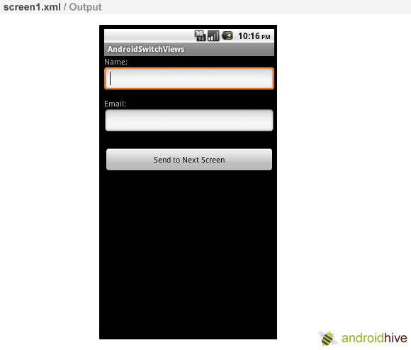
screen1.xml
May & June 2012 Recruiting Plan
Recruit 70 “Best Fit” Consulting Employees
Build out a Marketing team dedicated to recruiting
Formalize training program for new recruiters
Build out fully functioning offshore recruiting team
Implement call quality feedback loops
Coach and Mentor recruiters
Improve daily efficiency for recruiting team
© 2014 Unbounded Solutions
29

Slide 30
FirstScreenActivity.java
May & June 2012 Recruiting Plan
public class FirstScreenActivity extends Activity {
// Initializing variables
EditText inputName;
EditText inputEmail;
@Override
public void onCreate(Bundle savedInstanceState) {
super.onCreate(savedInstanceState);
setContentView(R.layout.screen1);
inputName = (EditText) findViewById(R.id.name);
inputEmail = (EditText) findViewById(R.id.email);
Button btnNextScreen = (Button) findViewById(R.id.btnNextScreen);
Recruit 70 “Best Fit” Consulting Employees
Build out a Marketing team dedicated to recruiting
Formalize training program for new recruiters
Build out fully functioning offshore recruiting team
Implement call quality feedback loops
Coach and Mentor recruiters
Improve daily efficiency for recruiting team
© 2014 Unbounded Solutions
30

Slide 31
FirstScreenActivity.java
May & June 2012 Recruiting Plan
//Listening to button event
btnNextScreen.setOnClickListener(new View.OnClickListener() {public void onClick(View arg0) {
//Starting a new Intent
Intent nextScreen = new Intent(getApplicationContext(), SecondScreenActivity.class);
//Sending data to another Activity
nextScreen.putExtra("name", inputName.getText().toString());
nextScreen.putExtra("email", inputEmail.getText().toString());
Log.e("n", inputName.getText()+"."+ inputEmail.getText());
startActivity(nextScreen);
}
});
Recruit 70 “Best Fit” Consulting Employees
Build out a Marketing team dedicated to recruiting
Formalize training program for new recruiters
Build out fully functioning offshore recruiting team
Implement call quality feedback loops
Coach and Mentor recruiters
Improve daily efficiency for recruiting team
© 2014 Unbounded Solutions
31

Slide 32
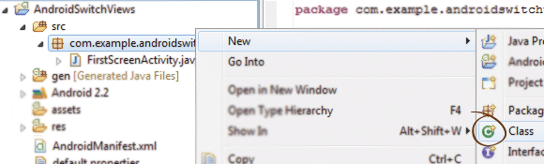
SecondScreenActivity.java
May & June 2012 Recruiting Plan
Create a class called SecondScreenActivity.java.
Right Click on src/yourpackagefolder -> New -> Class and name it as SecondScreenActivity.java
Now we need interface for our Second Actvity. Create a new xml file and name it as screen2.xml.
Right Click on Layout -> New -> Android XML file and name it as screen2.xml. Insert the following code in screen2.xml.
Recruit 70 “Best Fit” Consulting Employees
Build out a Marketing team dedicated to recruiting
Formalize training program for new recruiters
Build out fully functioning offshore recruiting team
Implement call quality feedback loops
Coach and Mentor recruiters
Improve daily efficiency for recruiting team
© 2014 Unbounded Solutions
32

Slide 33
screen2.xml
May & June 2012 Recruiting Plan
<LinearLayout
xmlns:android="http://schemas.android.com/apk/res/android"
android:orientation="vertical"
android:layout_width="match_parent"
android:layout_height="match_parent">
<TextView android:layout_width="fill_parent"
android:layout_height="wrap_content"
android:text="You Entered..."
android:textSize="25dip"
android:gravity="center"
android:layout_margin="15dip"/>
<TextView android:id="@+id/txtName"
android:layout_width="fill_parent"
android:layout_height="wrap_content"
android:layout_margin="15dip"
android:textSize="18dip"/>
Recruit 70 “Best Fit” Consulting Employees
Build out a Marketing team dedicated to recruiting
Formalize training program for new recruiters
Build out fully functioning offshore recruiting team
Implement call quality feedback loops
Coach and Mentor recruiters
Improve daily efficiency for recruiting team
© 2014 Unbounded Solutions
33

Slide 34
screen2.xml
May & June 2012 Recruiting Plan
<TextView android:id="@+id/txtEmail"
android:layout_width="fill_parent"
android:layout_height="wrap_content"
android:layout_margin="15dip"
android:textSize="18dip"/>
<Button android:id="@+id/btnClose"
android:layout_width="fill_parent"
android:layout_height="wrap_content"
android:layout_marginTop="15dip"
android:text="Close"/>
</LinearLayout>
Recruit 70 “Best Fit” Consulting Employees
Build out a Marketing team dedicated to recruiting
Formalize training program for new recruiters
Build out fully functioning offshore recruiting team
Implement call quality feedback loops
Coach and Mentor recruiters
Improve daily efficiency for recruiting team
© 2014 Unbounded Solutions
34

Slide 35
SecondScreenActivity.java
May & June 2012 Recruiting Plan
public class SecondScreenActivity extends Activity {
/** Called when the activity is first created. */
@Override
public void onCreate(Bundle savedInstanceState) {
super.onCreate(savedInstanceState);
setContentView(R.layout.screen2);
TextView txtName = (TextView) findViewById(R.id.txtName);
TextView txtEmail = (TextView) findViewById(R.id.txtEmail);
Button btnClose = (Button) findViewById(R.id.btnClose);
Recruit 70 “Best Fit” Consulting Employees
Build out a Marketing team dedicated to recruiting
Formalize training program for new recruiters
Build out fully functioning offshore recruiting team
Implement call quality feedback loops
Coach and Mentor recruiters
Improve daily efficiency for recruiting team
© 2014 Unbounded Solutions
35

Slide 36
SecondScreenActivity.java
May & June 2012 Recruiting Plan
Intent i = getIntent();
// Receiving the Data
String name = i.getStringExtra("name");
String email = i.getStringExtra("email");
Log.e("Second Screen", name + "." + email);
// Displaying Received data
txtName.setText(name);
txtEmail.setText(email);
// Binding Click event to Button
btnClose.setOnClickListener(new View.OnClickListener() {
public void onClick(View arg0) {
//Closing SecondScreen Activity
finish();
}
Recruit 70 “Best Fit” Consulting Employees
Build out a Marketing team dedicated to recruiting
Formalize training program for new recruiters
Build out fully functioning offshore recruiting team
Implement call quality feedback loops
Coach and Mentor recruiters
Improve daily efficiency for recruiting team
© 2014 Unbounded Solutions
36

Slide 37
AndroidManifest.xml
May & June 2012 Recruiting Plan
<application android:icon="@drawable/icon" android:label="@string/app_name">
<activity android:name=".FirstScreenActivity"
android:label="@string/app_name">
<intent-filter>
<action android:name="android.intent.action.MAIN" />
<category android:name="android.intent.category.LAUNCHER" />
</intent-filter>
</activity>
<!-- Add new Activity class name here --->
<activity android:name=".SecondScreen"></activity>
</application>
Recruit 70 “Best Fit” Consulting Employees
Build out a Marketing team dedicated to recruiting
Formalize training program for new recruiters
Build out fully functioning offshore recruiting team
Implement call quality feedback loops
Coach and Mentor recruiters
Improve daily efficiency for recruiting team
© 2014 Unbounded Solutions
37

Slide 38
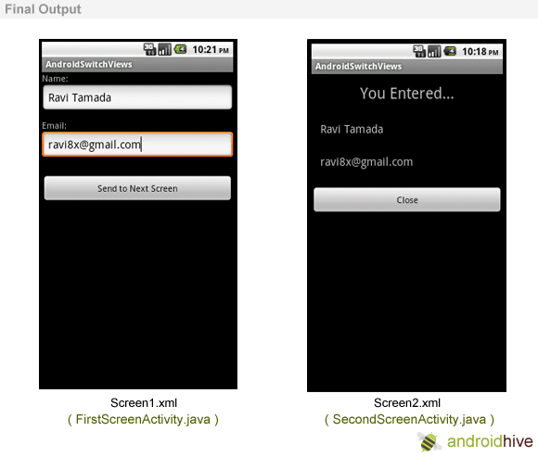
Output
May & June 2012 Recruiting Plan
Recruit 70 “Best Fit” Consulting Employees
Build out a Marketing team dedicated to recruiting
Formalize training program for new recruiters
Build out fully functioning offshore recruiting team
Implement call quality feedback loops
Coach and Mentor recruiters
Improve daily efficiency for recruiting team
© 2014 Unbounded Solutions
38

Slide 39
Topic #2
May & June 2012 Recruiting Plan
Recruit 70 “Best Fit” Consulting Employees
Build out a Marketing team dedicated to recruiting
Formalize training program for new recruiters
Build out fully functioning offshore recruiting team
Implement call quality feedback loops
Coach and Mentor recruiters
Improve daily efficiency for recruiting team
Implicit Intents
© 2014 Unbounded Solutions
39

Slide 40
Implicit Intents
May & June 2012 Recruiting Plan
Implicit intents do not name a specific component, but instead declare a general action to perform, which allows a component from another app to handle it.
For example, if you want to show the user a location on a map, you can use an implicit intent to request that another capable app show a specified location on a map.
Example : Initialing a dialer app , messaging app
Application activity calls other application activity .
Recruit 70 “Best Fit” Consulting Employees
Build out a Marketing team dedicated to recruiting
Formalize training program for new recruiters
Build out fully functioning offshore recruiting team
Implement call quality feedback loops
Coach and Mentor recruiters
Improve daily efficiency for recruiting team
© 2014 Unbounded Solutions
40

Slide 41
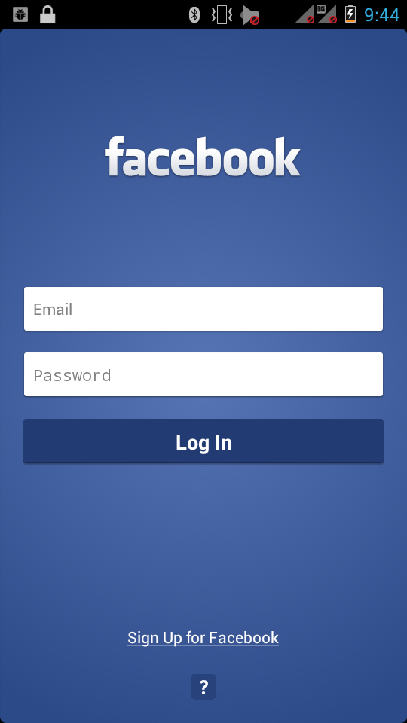
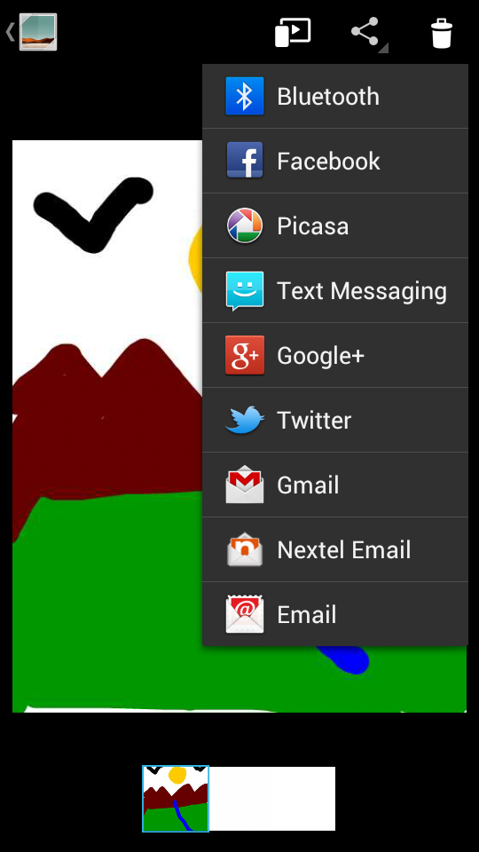

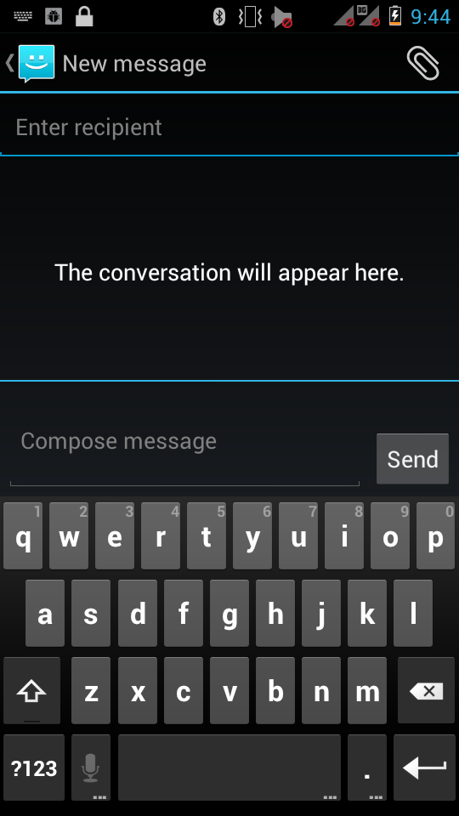
Implicit Intents: Inter-App Interaction
May & June 2012 Recruiting Plan
External APP
Recruit 70 “Best Fit” Consulting Employees
Build out a Marketing team dedicated to recruiting
Formalize training program for new recruiters
Build out fully functioning offshore recruiting team
Implement call quality feedback loops
Coach and Mentor recruiters
Improve daily efficiency for recruiting team
Activity 3
© 2014 Unbounded Solutions
41

Slide 42
Implicit Intents : Code
May & June 2012 Recruiting Plan
For example, if you have content you want the user to share with other people, create an intent with the ACTION_SEND action and add extras that specify the content to share.
When you call startActivity() with that intent, the user can pick an app through which to share the content.
// Create the text message with a string
Intent sendIntent = new Intent();
sendIntent.setAction(Intent.ACTION_SEND);
sendIntent.putExtra(Intent.EXTRA_TEXT, textMessage);
sendIntent.setType(HTTP.PLAIN_TEXT_TYPE); // "text/plain" MIME type
startActivity(sendIntent);
Recruit 70 “Best Fit” Consulting Employees
Build out a Marketing team dedicated to recruiting
Formalize training program for new recruiters
Build out fully functioning offshore recruiting team
Implement call quality feedback loops
Coach and Mentor recruiters
Improve daily efficiency for recruiting team
© 2014 Unbounded Solutions
42

Slide 43
Implicit Intents: Mechanism
May & June 2012 Recruiting Plan
When you create an implicit intent, the Android system finds the appropriate component to start by comparing the contents of the intent to the intent filters declared in the manifest file of other apps on the device.
If the intent matches an intent filter, the system starts that component and delivers it the Intent object.
If multiple intent filters are compatible, the system displays a dialog so the user can pick which app to use.
Recruit 70 “Best Fit” Consulting Employees
Build out a Marketing team dedicated to recruiting
Formalize training program for new recruiters
Build out fully functioning offshore recruiting team
Implement call quality feedback loops
Coach and Mentor recruiters
Improve daily efficiency for recruiting team
© 2014 Unbounded Solutions
43

Slide 44
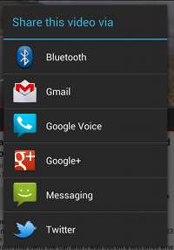
Implicit Intents : App chooser
May & June 2012 Recruiting Plan
Recruit 70 “Best Fit” Consulting Employees
Build out a Marketing team dedicated to recruiting
Formalize training program for new recruiters
Build out fully functioning offshore recruiting team
Implement call quality feedback loops
Coach and Mentor recruiters
Improve daily efficiency for recruiting team
Share the Video
Activity Share
All have capable features to handle
© 2014 Unbounded Solutions
44

Slide 45
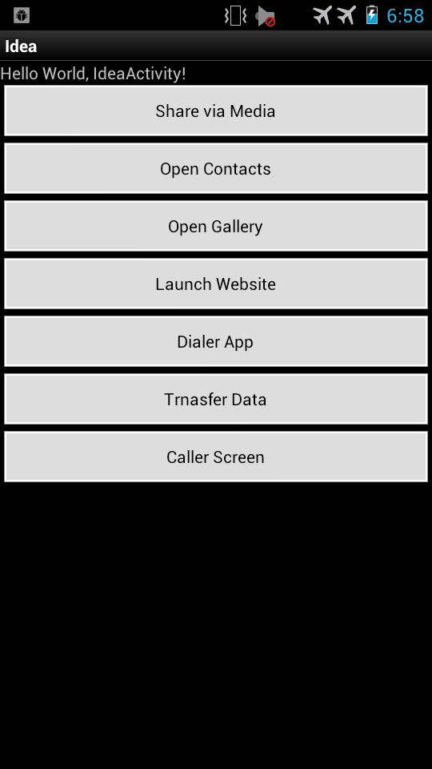
Implicit Intents : Code Example
May & June 2012 Recruiting Plan
Recruit 70 “Best Fit” Consulting Employees
Build out a Marketing team dedicated to recruiting
Formalize training program for new recruiters
Build out fully functioning offshore recruiting team
Implement call quality feedback loops
Coach and Mentor recruiters
Improve daily efficiency for recruiting team
Implicit Intents
© 2014 Unbounded Solutions
45

Slide 46
Activity1 XML laout (main.xml)
May & June 2012 Recruiting Plan
<?xml version="1.0" encoding="utf-8"?>
<LinearLayout xmlns:android="http://schemas.android.com/apk/res/android"
android:layout_width="fill_parent"
android:layout_height="fill_parent"
android:orientation="vertical" >
<Button
android:id="@+id/button1"
android:layout_width="fill_parent"
android:layout_height="wrap_content"
android:text="Share via Media" />
<Button
android:id="@+id/button2"
android:layout_width="fill_parent"
android:layout_height="wrap_content"
android:text="Open Contacts" />
Recruit 70 “Best Fit” Consulting Employees
Build out a Marketing team dedicated to recruiting
Formalize training program for new recruiters
Build out fully functioning offshore recruiting team
Implement call quality feedback loops
Coach and Mentor recruiters
Improve daily efficiency for recruiting team
© 2014 Unbounded Solutions
46

Slide 47
Activity1 XML laout (main.xml)
May & June 2012 Recruiting Plan
<Button
android:id="@+id/button4"
android:layout_width="fill_parent"
android:layout_height="wrap_content"
android:text="Launch Website" />
<Button
android:id="@+id/button5"
android:layout_width="fill_parent"
android:layout_height="wrap_content"
android:text="Dialer App" />
<Button
android:id="@+id/button6"
android:layout_width="fill_parent"
android:layout_height="wrap_content"
android:text="Trnasfer Data" />
Recruit 70 “Best Fit” Consulting Employees
Build out a Marketing team dedicated to recruiting
Formalize training program for new recruiters
Build out fully functioning offshore recruiting team
Implement call quality feedback loops
Coach and Mentor recruiters
Improve daily efficiency for recruiting team
© 2014 Unbounded Solutions
47

Slide 48
Activity1 XML laout (main.xml)
May & June 2012 Recruiting Plan
<Button
android:id="@+id/button7"
android:layout_width="fill_parent"
android:layout_height="wrap_content"
android:text="Caller Screen" />
</LinearLayout>
Recruit 70 “Best Fit” Consulting Employees
Build out a Marketing team dedicated to recruiting
Formalize training program for new recruiters
Build out fully functioning offshore recruiting team
Implement call quality feedback loops
Coach and Mentor recruiters
Improve daily efficiency for recruiting team
© 2014 Unbounded Solutions
48

Slide 49
Implicit Intents : Code Example
May & June 2012 Recruiting Plan
<Button
android:id="@+id/button7"
android:layout_width="fill_parent"
android:layout_height="wrap_content"
android:text="Caller Screen" />
</LinearLayout>
Recruit 70 “Best Fit” Consulting Employees
Build out a Marketing team dedicated to recruiting
Formalize training program for new recruiters
Build out fully functioning offshore recruiting team
Implement call quality feedback loops
Coach and Mentor recruiters
Improve daily efficiency for recruiting team
© 2014 Unbounded Solutions
49

Slide 50
Activity2 XML laout (main2.xml)
May & June 2012 Recruiting Plan
<LinearLayout xmlns:android="http://schemas.android.com/apk/res/android"
android:layout_width="match_parent"
android:layout_height="match_parent"
android:orientation="vertical" >
<TextView
android:id="@+id/textView1"
android:layout_width="wrap_content"
android:layout_height="wrap_content"
android:text="Large Text"
android:textAppearance="?android:attr/textAppearanceLarge" />
</LinearLayout>
Recruit 70 “Best Fit” Consulting Employees
Build out a Marketing team dedicated to recruiting
Formalize training program for new recruiters
Build out fully functioning offshore recruiting team
Implement call quality feedback loops
Coach and Mentor recruiters
Improve daily efficiency for recruiting team
Get Data Textview
© 2014 Unbounded Solutions
50

Slide 51
Activity1 Java Code
May & June 2012 Recruiting Plan
public class IdeaActivity extends Activity {
Button btn1;
Button btn2;
Button btn3;
Button btn4;
Button btn5;
Button btn6;
@Override
public void onCreate(Bundle savedInstanceState) {
super.onCreate(savedInstanceState);
setContentView(R.layout.main);
btn1=(Button)findViewById(R.id.button1);
btn2=(Button)findViewById(R.id.button2);
btn3=(Button)findViewById(R.id.button3);
btn4=(Button)findViewById(R.id.button4);
btn5=(Button)findViewById(R.id.button5);
btn6=(Button)findViewById(R.id.button6);
btn7=(Button)findViewById(R.id.button7);
Recruit 70 “Best Fit” Consulting Employees
Build out a Marketing team dedicated to recruiting
Formalize training program for new recruiters
Build out fully functioning offshore recruiting team
Implement call quality feedback loops
Coach and Mentor recruiters
Improve daily efficiency for recruiting team
© 2014 Unbounded Solutions
51

Slide 52
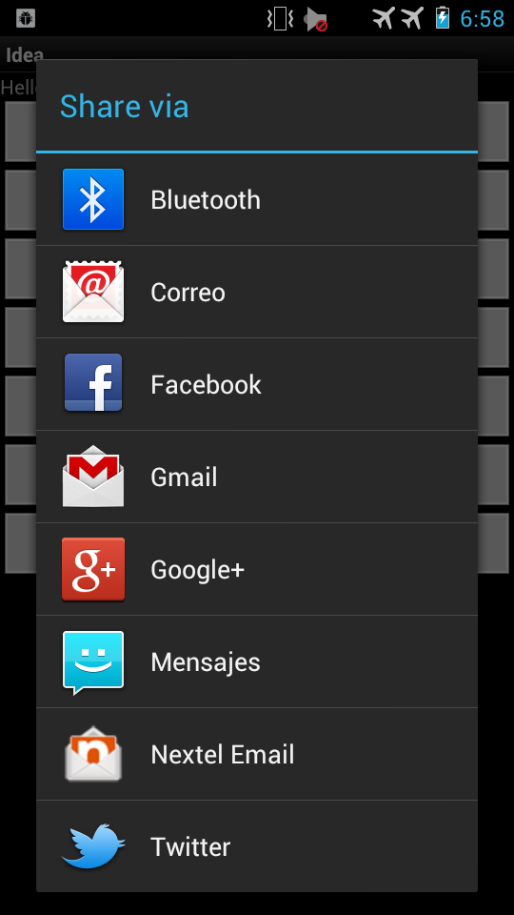
1# Share via Media
May & June 2012 Recruiting Plan
Recruit 70 “Best Fit” Consulting Employees
Build out a Marketing team dedicated to recruiting
Formalize training program for new recruiters
Build out fully functioning offshore recruiting team
Implement call quality feedback loops
Coach and Mentor recruiters
Improve daily efficiency for recruiting team
© 2014 Unbounded Solutions
52

Slide 53
1# Share via Media
May & June 2012 Recruiting Plan
btn1.setOnClickListener(new View.OnClickListener() {
@Override
public void onClick(View arg0) {//share data btn app
Intent shareIntent = new Intent(android.content.Intent.ACTION_SEND);
shareIntent.setType("text/plain");
String shareBody = "This is the body to be shared";
shareIntent.putExtra(android.content.Intent.EXTRA_SUBJECT, "Subject of the text");
shareIntent.putExtra(android.content.Intent.EXTRA_TEXT, shareBody);
startActivity(Intent.createChooser(shareIntent,"Share via"));
Recruit 70 “Best Fit” Consulting Employees
Build out a Marketing team dedicated to recruiting
Formalize training program for new recruiters
Build out fully functioning offshore recruiting team
Implement call quality feedback loops
Coach and Mentor recruiters
Improve daily efficiency for recruiting team
© 2014 Unbounded Solutions
53

Slide 54
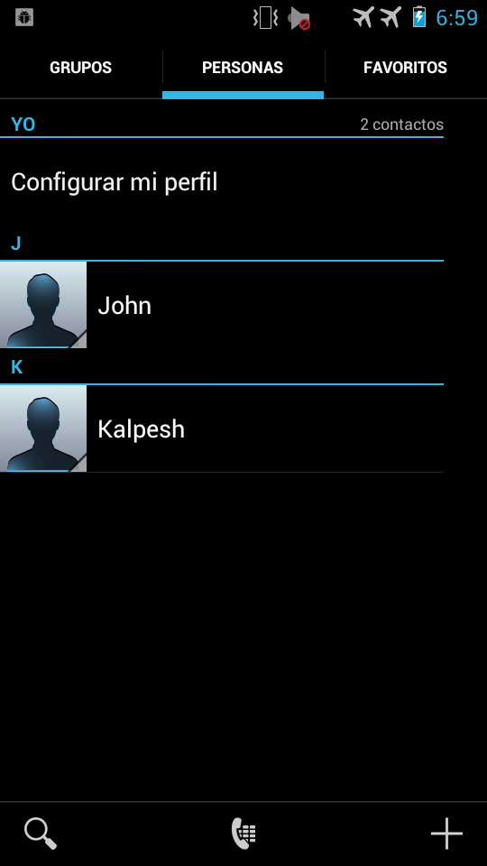
2# Open Contacts App
May & June 2012 Recruiting Plan
Recruit 70 “Best Fit” Consulting Employees
Build out a Marketing team dedicated to recruiting
Formalize training program for new recruiters
Build out fully functioning offshore recruiting team
Implement call quality feedback loops
Coach and Mentor recruiters
Improve daily efficiency for recruiting team
© 2014 Unbounded Solutions
54

Slide 55
2# Open Contacts Code
May & June 2012 Recruiting Plan
@Override
public void onClick(View arg0) {
Intent intent = new Intent(Intent.ACTION_VIEW,
Uri.parse("content://contacts/people/"));
startActivity(intent);
}
Recruit 70 “Best Fit” Consulting Employees
Build out a Marketing team dedicated to recruiting
Formalize training program for new recruiters
Build out fully functioning offshore recruiting team
Implement call quality feedback loops
Coach and Mentor recruiters
Improve daily efficiency for recruiting team
Two @params
Repeated common mtd in all intents
© 2014 Unbounded Solutions
55

Slide 56

3# Open Gallery App
May & June 2012 Recruiting Plan
Recruit 70 “Best Fit” Consulting Employees
Build out a Marketing team dedicated to recruiting
Formalize training program for new recruiters
Build out fully functioning offshore recruiting team
Implement call quality feedback loops
Coach and Mentor recruiters
Improve daily efficiency for recruiting team
© 2014 Unbounded Solutions
56

Slide 57
3# Open Gallery App
May & June 2012 Recruiting Plan
btn3.setOnClickListener(new View.OnClickListener() {
@Override
public void onClick(View arg0) {
Intent intent = new Intent(Intent.ACTION_VIEW,
Uri.parse("content://media/internal/images/media"));
startActivity(intent);
}
});
Recruit 70 “Best Fit” Consulting Employees
Build out a Marketing team dedicated to recruiting
Formalize training program for new recruiters
Build out fully functioning offshore recruiting team
Implement call quality feedback loops
Coach and Mentor recruiters
Improve daily efficiency for recruiting team
© 2014 Unbounded Solutions
57

Slide 58
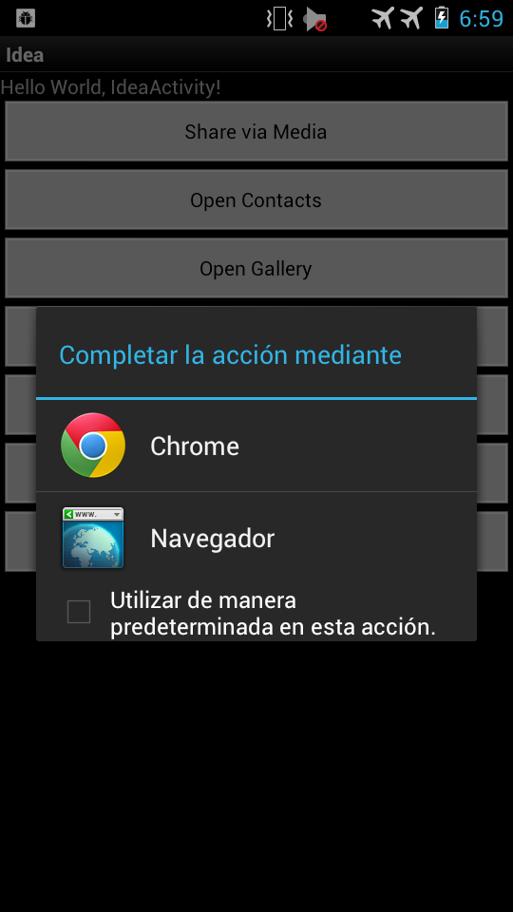
4# Launch Website
May & June 2012 Recruiting Plan
Recruit 70 “Best Fit” Consulting Employees
Build out a Marketing team dedicated to recruiting
Formalize training program for new recruiters
Build out fully functioning offshore recruiting team
Implement call quality feedback loops
Coach and Mentor recruiters
Improve daily efficiency for recruiting team
© 2014 Unbounded Solutions
58

Slide 59
4# Launch Website
May & June 2012 Recruiting Plan
btn4.setOnClickListener(newView.OnClickListener() {
@Override
public void onClick(View arg0) {
Intent browserIntent = new Intent(Intent.ACTION_VIEW, Uri.parse("http://www.google.com"));
startActivity(browserIntent);
}
});
Recruit 70 “Best Fit” Consulting Employees
Build out a Marketing team dedicated to recruiting
Formalize training program for new recruiters
Build out fully functioning offshore recruiting team
Implement call quality feedback loops
Coach and Mentor recruiters
Improve daily efficiency for recruiting team
© 2014 Unbounded Solutions
59

Slide 60

5# Transfer Data between Activities
May & June 2012 Recruiting Plan
Recruit 70 “Best Fit” Consulting Employees
Build out a Marketing team dedicated to recruiting
Formalize training program for new recruiters
Build out fully functioning offshore recruiting team
Implement call quality feedback loops
Coach and Mentor recruiters
Improve daily efficiency for recruiting team
© 2014 Unbounded Solutions
60

Slide 61
Activity #1
May & June 2012 Recruiting Plan
btn6.setOnClickListener(new View.OnClickListener() {
@Override
public void onClick(View arg0) {
//Transfer data
Intent i = new Intent(getApplicationContext(), NewActivity.class);
i.putExtra("Name","Kalpesh");
i.addFlags(Intent.FLAG_ACTIVITY_CLEAR_TOP);
startActivity(i);
}
});
Recruit 70 “Best Fit” Consulting Employees
Build out a Marketing team dedicated to recruiting
Formalize training program for new recruiters
Build out fully functioning offshore recruiting team
Implement call quality feedback loops
Coach and Mentor recruiters
Improve daily efficiency for recruiting team
© 2014 Unbounded Solutions
61

Slide 62
Activity #2
May & June 2012 Recruiting Plan
public class NewActivity extends Activity{
TextView t1;
@Override
protected void onCreate(Bundle savedInstanceState) {super.onCreate(savedInstanceState);
setContentView(R.layout.main2);
t1=(TextView)findViewById(R.id.textView1);
String value = getIntent().getExtras().getString("Name");
t1.setText("Welcome "+ value);
}
Recruit 70 “Best Fit” Consulting Employees
Build out a Marketing team dedicated to recruiting
Formalize training program for new recruiters
Build out fully functioning offshore recruiting team
Implement call quality feedback loops
Coach and Mentor recruiters
Improve daily efficiency for recruiting team
© 2014 Unbounded Solutions
62

Slide 63
AndroidManifest
May & June 2012 Recruiting Plan
<manifest xmlns:android="http://schemas.android.com/apk/res/android"
package="com.app.ex"
android:versionCode="1"
android:versionName="1.0" >
<uses-sdk android:minSdkVersion="8" />
<uses-permission android:name="android.permission.INTERNET"/>
<uses-permission android:name="android.permission.CALL_PHONE"/>
<uses-permission android:name="android.permission.CAMERA" >
</uses-permission>
Recruit 70 “Best Fit” Consulting Employees
Build out a Marketing team dedicated to recruiting
Formalize training program for new recruiters
Build out fully functioning offshore recruiting team
Implement call quality feedback loops
Coach and Mentor recruiters
Improve daily efficiency for recruiting team
© 2014 Unbounded Solutions
63

Slide 64
AndroidManifest
May & June 2012 Recruiting Plan
<application
android:icon="@drawable/ic_launcher"
android:label="@string/app_name" >
<activity
android:name=".IdeaActivity"
android:label="@string/app_name" >
<intent-filter>
<action android:name="android.intent.action.MAIN" />
<category android:name="android.intent.category.LAUNCHER" />
</intent-filter>
</activity>
<activity
android:name=".NewActivity"
android:label="@string/app_name" >
</activity>
Recruit 70 “Best Fit” Consulting Employees
Build out a Marketing team dedicated to recruiting
Formalize training program for new recruiters
Build out fully functioning offshore recruiting team
Implement call quality feedback loops
Coach and Mentor recruiters
Improve daily efficiency for recruiting team
© 2014 Unbounded Solutions
64

Slide 65
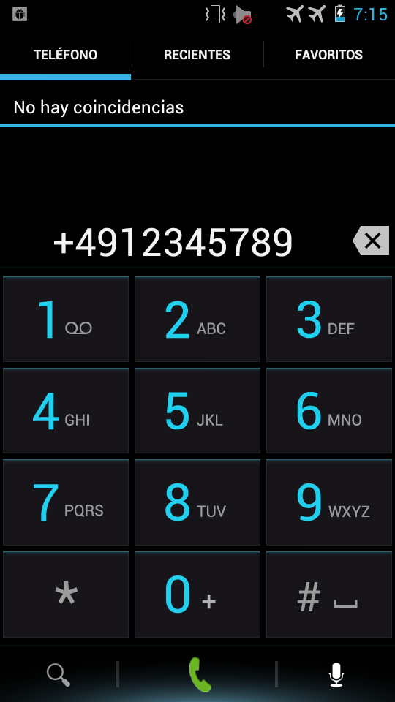
7# Launch a Dialer
May & June 2012 Recruiting Plan
Recruit 70 “Best Fit” Consulting Employees
Build out a Marketing team dedicated to recruiting
Formalize training program for new recruiters
Build out fully functioning offshore recruiting team
Implement call quality feedback loops
Coach and Mentor recruiters
Improve daily efficiency for recruiting team
© 2014 Unbounded Solutions
65

Slide 66
7# Launch a Dialer
May & June 2012 Recruiting Plan
btn7.setOnClickListener(new View.OnClickListener() {
@Override
public void onClick(View arg0) {
Intent intent = new Intent(Intent.ACTION_DIAL,
Uri.parse("tel:(+49)12345789"));
startActivity(intent);
}
});
}
Recruit 70 “Best Fit” Consulting Employees
Build out a Marketing team dedicated to recruiting
Formalize training program for new recruiters
Build out fully functioning offshore recruiting team
Implement call quality feedback loops
Coach and Mentor recruiters
Improve daily efficiency for recruiting team
© 2014 Unbounded Solutions
66

Slide 67
Topic #3
May & June 2012 Recruiting Plan
Parcelable vs. Java Serialization
© 2014 Unbounded Solutions
67

Slide 68
What is Serialization?
May & June 2012 Recruiting Plan
By default, the serialization mechanism encodes an object's class name, the names of its non-transient fields (including non-public fields), and the values of all of those fields.
The output is an opaque sequence of bytes.
Those bytes can be decoded into a new, equivalent instance as long as the decoder has compatible versions of the originating classes.
Recruit 70 “Best Fit” Consulting Employees
Build out a Marketing team dedicated to recruiting
Formalize training program for new recruiters
Build out fully functioning offshore recruiting team
Implement call quality feedback loops
Coach and Mentor recruiters
Improve daily efficiency for recruiting team
© 2014 Unbounded Solutions
68

Slide 69
Serializable, the Master of Simplicity
May & June 2012 Recruiting Plan
The beauty of serializable is that you only need to implement the Serializable interface on a class and its children.
It is a marker interface, meaning that there is no method to implement, Java will simply do its best effort to serialize it efficiently.
Disadvantages:
Slow Process
Creates a lot of temporary objects
Cause quite a bit of garbage collection.
Recruit 70 “Best Fit” Consulting Employees
Build out a Marketing team dedicated to recruiting
Formalize training program for new recruiters
Build out fully functioning offshore recruiting team
Implement call quality feedback loops
Coach and Mentor recruiters
Improve daily efficiency for recruiting team
© 2014 Unbounded Solutions
69

Slide 70
Understand the serialVersionUID
May & June 2012 Recruiting Plan
The serialVersionUID is used as a version control in a Serializable class.
If you do not explicitly declare a serialVersionUID, JVM will do it for you automatically, based on various aspects of your Serializable class.
The serialVersionUID have to match during the serialization and deserialization process.
Recruit 70 “Best Fit” Consulting Employees
Build out a Marketing team dedicated to recruiting
Formalize training program for new recruiters
Build out fully functioning offshore recruiting team
Implement call quality feedback loops
Coach and Mentor recruiters
Improve daily efficiency for recruiting team
© 2014 Unbounded Solutions
70

Slide 71
Understand the serialVersionUID
May & June 2012 Recruiting Plan
http://www.mkyong.com/java-best-practices/understand-the-serialversionuid/
http://www.mkyong.com/java/how-to-generate-serialversionuid/
Recruit 70 “Best Fit” Consulting Employees
Build out a Marketing team dedicated to recruiting
Formalize training program for new recruiters
Build out fully functioning offshore recruiting team
Implement call quality feedback loops
Coach and Mentor recruiters
Improve daily efficiency for recruiting team
© 2014 Unbounded Solutions
71

Slide 72
Code
May & June 2012 Recruiting Plan
Recruit 70 “Best Fit” Consulting Employees
Build out a Marketing team dedicated to recruiting
Formalize training program for new recruiters
Build out fully functioning offshore recruiting team
Implement call quality feedback loops
Coach and Mentor recruiters
Improve daily efficiency for recruiting team
// access modifiers, accessors and constructors omitted for brevity
public class SerializableDeveloper implements Serializable
String name;
int yearsOfExperience;
List<Skill> skillSet;
float favoriteFloat;
static class Skill implements Serializable {
String name;
boolean programmingRelated;
}
}
© 2014 Unbounded Solutions
72

Slide 73
Tutorial Example
May & June 2012 Recruiting Plan
Passing data using Parceable
© 2014 Unbounded Solutions
73

Slide 74
What is Parcelable?
May & June 2012 Recruiting Plan
Interface for classes whose instances can be written to and restored from a Parcel.
Android Parcelable implementation allows objects to read and write from Parcels which can contain flattened data inside message containers.
If a developer wants to convert a Java object into Parcelable, then the best way to do so is by implementing the Parcelable interface and overriding the writeToParcel() methods in its own class.
Recruit 70 “Best Fit” Consulting Employees
Build out a Marketing team dedicated to recruiting
Formalize training program for new recruiters
Build out fully functioning offshore recruiting team
Implement call quality feedback loops
Coach and Mentor recruiters
Improve daily efficiency for recruiting team
© 2014 Unbounded Solutions
74

Slide 75
Comparison
May & June 2012 Recruiting Plan
Parcelable | Serialization
Parcelable is well documented in the Android SDK | Serialization on the other hand is available in Java.
Developers write custom code for marshaling and unmarshaling | Serialization is a marker interface, which implies the user cannot marshal the data according to their requirements.
Creates less garbage objects in comparison to Serialization | Creating a lot of garbage objects
The performance of Parcelable over Serialization dramatically improves (around two times faster), because of this custom implementation. | In Serialization, a marshaling operation is performed on a Java Virtual Machine (JVM) using the Java reflection API.
Faster | Slower
Recruit 70 “Best Fit” Consulting Employees
Build out a Marketing team dedicated to recruiting
Formalize training program for new recruiters
Build out fully functioning offshore recruiting team
Implement call quality feedback loops
Coach and Mentor recruiters
Improve daily efficiency for recruiting team
© 2014 Unbounded Solutions
75

Slide 76
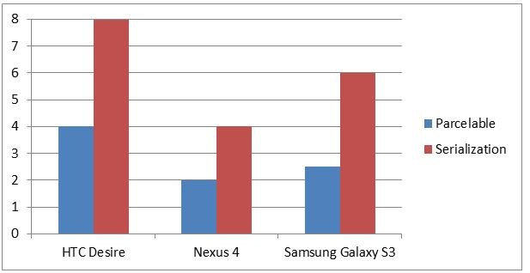
Implementation
May & June 2012 Recruiting Plan
© 2014 Unbounded Solutions
76

Slide 77
Implementation
May & June 2012 Recruiting Plan
public class MyParcelable implements Parcelable {
private int mData;
public int describeContents() {
return 0;
}
public void writeToParcel(Parcel out, int flags) {
out.writeInt(mData);
}
© 2014 Unbounded Solutions
77

Slide 78
Implementation
May & June 2012 Recruiting Plan
public static final Parcelable.Creator<MyParcelable> CREATOR
= new Parcelable.Creator<MyParcelable>() {
public MyParcelable createFromParcel(Parcel in) {
return new MyParcelable(in);
}
public MyParcelable[] newArray(int size) {
return new MyParcelable[size];
}
};
private MyParcelable(Parcel in) {
mData = in.readInt();
}
}
© 2014 Unbounded Solutions
78

Slide 79
Through the class code
May & June 2012 Recruiting Plan
equals(Object o) – not really needed by Parcelable, but we’ll use this method to compare objects in our test case later.
describeContents() – Parcelable’s method; for most use cases it can be left as it is, ie. returning 0
writeToParcel(Parcel out, int flags) – Parcelable’s method; here we perform serialization by writing all member fields as basic data types to out object. Second argument (flags) can be ignored for most cases.
Recruit 70 “Best Fit” Consulting Employees
Build out a Marketing team dedicated to recruiting
Formalize training program for new recruiters
Build out fully functioning offshore recruiting team
Implement call quality feedback loops
Coach and Mentor recruiters
Improve daily efficiency for recruiting team
© 2014 Unbounded Solutions
79

Slide 80
Through the class code
May & June 2012 Recruiting Plan
readFromParcel(Parcel in) –
just a helper; it builds CustomData object using data contained in Parcel.
The key thing is, you have to read all fields in the same order you’ve wrote them into the Parcel in writeToParcel() method.
This is the only error-prone part of the process. CREATOR is a special object used to deserialize our object from Parcel.
All Parceable classes must provide this object and it must be declared as public static final.
Recruit 70 “Best Fit” Consulting Employees
Build out a Marketing team dedicated to recruiting
Formalize training program for new recruiters
Build out fully functioning offshore recruiting team
Implement call quality feedback loops
Coach and Mentor recruiters
Improve daily efficiency for recruiting team
© 2014 Unbounded Solutions
80

Slide 81
Through the class code
May & June 2012 Recruiting Plan
Actual deserialization is done by calling this method.
My implementation uses helper method readFromParcel(), some will prefer to use private constructor, others will deserialize object in place without the helper – whichever you like.
Create an array of Parcelable objects when we deserialize arrays.
Recruit 70 “Best Fit” Consulting Employees
Build out a Marketing team dedicated to recruiting
Formalize training program for new recruiters
Build out fully functioning offshore recruiting team
Implement call quality feedback loops
Coach and Mentor recruiters
Improve daily efficiency for recruiting team
© 2014 Unbounded Solutions
81

Slide 82
Topic #4
May & June 2012 Recruiting Plan
Intent Filter
© 2014 Unbounded Solutions
82

Slide 83
Intent-Filter
May & June 2012 Recruiting Plan
An intent filter is an expression in an app's manifest file that specifies the type of intents that the component would like to receive.
For instance, by declaring an intent filter for an activity, you make it possible for other apps to directly start your activity with a certain kind of intent.
Likewise, if you do not declare any intent filters for an activity, then it can be started only with an explicit intent.
Defined in Android Manifest.
Recruit 70 “Best Fit” Consulting Employees
Build out a Marketing team dedicated to recruiting
Formalize training program for new recruiters
Build out fully functioning offshore recruiting team
Implement call quality feedback loops
Coach and Mentor recruiters
Improve daily efficiency for recruiting team
© 2014 Unbounded Solutions
83

Slide 84
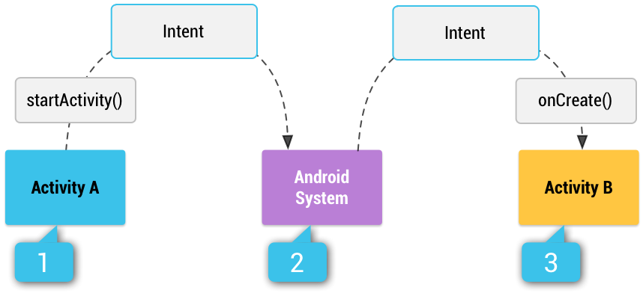
Intent-Filter
May & June 2012 Recruiting Plan
Recruit 70 “Best Fit” Consulting Employees
Build out a Marketing team dedicated to recruiting
Formalize training program for new recruiters
Build out fully functioning offshore recruiting team
Implement call quality feedback loops
Coach and Mentor recruiters
Improve daily efficiency for recruiting team
© 2014 Unbounded Solutions
84

Slide 85
Code
May & June 2012 Recruiting Plan
<activity android:name="com.sevakkalpesh.ChannelLive.MainActivity"
android:label="@string/app_name" >
<intent-filter>
<action android:name="android.intent.action.MAIN" />
<category android:name="android.intent.category.LAUNCHER" />
</intent-filter>
</activity>
Recruit 70 “Best Fit” Consulting Employees
Build out a Marketing team dedicated to recruiting
Formalize training program for new recruiters
Build out fully functioning offshore recruiting team
Implement call quality feedback loops
Coach and Mentor recruiters
Improve daily efficiency for recruiting team
© 2014 Unbounded Solutions
85

Slide 86
Intent Object
May & June 2012 Recruiting Plan
If you wish to make a dinner date with your friend, and are conveying the information through a messenger, you ought to give the messenger details like the name of your friend and the specifics of the desired meeting (time, place, etc.).
Not having given the specifics of the meeting to the messenger, you cannot just assume that they would figure out what to do.
You might write all this information on a piece of paper for the messenger’s reference.
Intent int_obj = new Intent();
Recruit 70 “Best Fit” Consulting Employees
Build out a Marketing team dedicated to recruiting
Formalize training program for new recruiters
Build out fully functioning offshore recruiting team
Implement call quality feedback loops
Coach and Mentor recruiters
Improve daily efficiency for recruiting team
© 2014 Unbounded Solutions
86

Slide 87



Intent Object
May & June 2012 Recruiting Plan
Similarly, as intent is a message, the complete information that it wants to convey must be stored somewhere, right! Intent Object takes care of that.
Recruit 70 “Best Fit” Consulting Employees
Build out a Marketing team dedicated to recruiting
Formalize training program for new recruiters
Build out fully functioning offshore recruiting team
Implement call quality feedback loops
Coach and Mentor recruiters
Improve daily efficiency for recruiting team
What are the details?
© 2014 Unbounded Solutions
87

Slide 88
What information does Intent Object contain?
May & June 2012 Recruiting Plan
Intent Object contains all the information that the ‘Intent’ means to convey:
All the information required by the component receiving the Intent (for instance, the action to take on receiving the Intent).
(In the above example, this would be the information meant for your friend’s knowledge, like the location of the meeting, time of the meeting etc.)
The information required by the Android system (for instance, the description of the Component category the Intent is directed at) is contained in the Intent Object.
(In the above example, the information required by the messenger itself would form a part of this, like the name of the friend, his address etc.)
Recruit 70 “Best Fit” Consulting Employees
Build out a Marketing team dedicated to recruiting
Formalize training program for new recruiters
Build out fully functioning offshore recruiting team
Implement call quality feedback loops
Coach and Mentor recruiters
Improve daily efficiency for recruiting team
© 2014 Unbounded Solutions
88

Slide 89
Parts of Intent Object
May & June 2012 Recruiting Plan
Component name
Action
Category
Data
Extras
Flags
Recruit 70 “Best Fit” Consulting Employees
Build out a Marketing team dedicated to recruiting
Formalize training program for new recruiters
Build out fully functioning offshore recruiting team
Implement call quality feedback loops
Coach and Mentor recruiters
Improve daily efficiency for recruiting team
© 2014 Unbounded Solutions
89

Slide 90
Part 1 # Component name
May & June 2012 Recruiting Plan
This is optional, but it's the critical piece of information that makes an intent explicit, meaning that the intent should be delivered only to the app component defined by the component name.
Without a component name, the intent is implicit and the system decides which component should receive the intent based on the other intent information (such as the action, data, and category—described below).
So if you need to start a specific component in your app, you should specify the component.
Recruit 70 “Best Fit” Consulting Employees
Build out a Marketing team dedicated to recruiting
Formalize training program for new recruiters
Build out fully functioning offshore recruiting team
Implement call quality feedback loops
Coach and Mentor recruiters
Improve daily efficiency for recruiting team
© 2014 Unbounded Solutions
90

Slide 91
Component name rule
May & June 2012 Recruiting Plan
Note: When starting a Service, you should always specify the component name. Otherwise, you cannot be certain what service will respond to the intent, and the user cannot see which service starts.
This field of the Intent is a ComponentName object, which you can specify using a fully qualified class name of the target component, including the package name of the app.
For example, com.example.ExampleActivity.
You can set the component name with setComponent(), setClass(), setClassName(), or with the Intent constructor.
Recruit 70 “Best Fit” Consulting Employees
Build out a Marketing team dedicated to recruiting
Formalize training program for new recruiters
Build out fully functioning offshore recruiting team
Implement call quality feedback loops
Coach and Mentor recruiters
Improve daily efficiency for recruiting team
© 2014 Unbounded Solutions
91

Slide 92
Part 2 # Action
May & June 2012 Recruiting Plan
This piece of information names the action an Android component should take on receiving the Intent, or the action that has already taken place, and is being notified to the system.
A string that specifies the generic action to perform (such as view or pick).
You should usually use action constants defined by the Intent class or other framework classes.
Here are some common actions for starting an activity:
Recruit 70 “Best Fit” Consulting Employees
Build out a Marketing team dedicated to recruiting
Formalize training program for new recruiters
Build out fully functioning offshore recruiting team
Implement call quality feedback loops
Coach and Mentor recruiters
Improve daily efficiency for recruiting team
© 2014 Unbounded Solutions
92

Slide 93
Action Code
May & June 2012 Recruiting Plan
<activity android:launchMode="singleTop"
android:name="com.sevakkalpesh.ChannelLive.MainActivity"
android:label="@string/app_name" >
<intent-filter>
<action android:name="android.intent.action.MAIN" />
<category android:name="android.intent.category.LAUNCHER" />
</intent-filter>
Recruit 70 “Best Fit” Consulting Employees
Build out a Marketing team dedicated to recruiting
Formalize training program for new recruiters
Build out fully functioning offshore recruiting team
Implement call quality feedback loops
Coach and Mentor recruiters
Improve daily efficiency for recruiting team
© 2014 Unbounded Solutions
93

Slide 94
Intent-Filter
May & June 2012 Recruiting Plan
Used mostly for Implicit Intents
Recruit 70 “Best Fit” Consulting Employees
Build out a Marketing team dedicated to recruiting
Formalize training program for new recruiters
Build out fully functioning offshore recruiting team
Implement call quality feedback loops
Coach and Mentor recruiters
Improve daily efficiency for recruiting team
ACTION
CATEGORY
DESTINATION COMPONENT
What to do
© 2014 Unbounded Solutions
94

Slide 95
Action Code
May & June 2012 Recruiting Plan
<intent-filter>
<action android:name="android.intent.action.EDIT" />
<action android:name="android.intent.action.VIEW" />
...
</intent-filter>
Recruit 70 “Best Fit” Consulting Employees
Build out a Marketing team dedicated to recruiting
Formalize training program for new recruiters
Build out fully functioning offshore recruiting team
Implement call quality feedback loops
Coach and Mentor recruiters
Improve daily efficiency for recruiting team
© 2014 Unbounded Solutions
95

Slide 96
Action Code
May & June 2012 Recruiting Plan
Start a dialer app :
Intent i = new Intent(Intent.ACTION_CALL,Uri.parse(“tel:100”)); startActivity(i);
Start a browser app :
Intent web=new Intent(Intent.ACTION_VIEW,Uri.parse("http://www.google.com"));
startActivity(web);
Recruit 70 “Best Fit” Consulting Employees
Build out a Marketing team dedicated to recruiting
Formalize training program for new recruiters
Build out fully functioning offshore recruiting team
Implement call quality feedback loops
Coach and Mentor recruiters
Improve daily efficiency for recruiting team
© 2014 Unbounded Solutions
96

Slide 97
Part 2 # Action
May & June 2012 Recruiting Plan
1 ACTION_ALL_APPS
List all the applications available on the device.
2 ACTION_ANSWER
Handle an incoming phone call.
3 ACTION_ATTACH_DATA
Used to indicate that some piece of data should be attached to some other place
4 ACTION_BATTERY_CHANGED
This is a sticky broadcast containing the charging state, level, and other information about the battery.
5 ACTION_BATTERY_LOW
This broadcast corresponds to the "Low battery warning”
Recruit 70 “Best Fit” Consulting Employees
Build out a Marketing team dedicated to recruiting
Formalize training program for new recruiters
Build out fully functioning offshore recruiting team
Implement call quality feedback loops
Coach and Mentor recruiters
Improve daily efficiency for recruiting team
© 2014 Unbounded Solutions
97

Slide 98
Part 2 # Action
May & June 2012 Recruiting Plan
1 ACTION_ALL_APPS
List all the applications available on the device.
2 ACTION_ANSWER
Handle an incoming phone call.
3 ACTION_ATTACH_DATA
Used to indicate that some piece of data should be attached to some other place
4 ACTION_BATTERY_CHANGED
This is a sticky broadcast containing the charging state, level, and other information about the battery.
5 ACTION_BATTERY_LOW
This broadcast corresponds to the "Low battery warning”
Recruit 70 “Best Fit” Consulting Employees
Build out a Marketing team dedicated to recruiting
Formalize training program for new recruiters
Build out fully functioning offshore recruiting team
Implement call quality feedback loops
Coach and Mentor recruiters
Improve daily efficiency for recruiting team
© 2014 Unbounded Solutions
98

Slide 99
Part 2 # Action examples (refer pdf)
May & June 2012 Recruiting Plan
Refer to site :
http://developer.android.com/reference/android/content/Intent.html
Recruit 70 “Best Fit” Consulting Employees
Build out a Marketing team dedicated to recruiting
Formalize training program for new recruiters
Build out fully functioning offshore recruiting team
Implement call quality feedback loops
Coach and Mentor recruiters
Improve daily efficiency for recruiting team
© 2014 Unbounded Solutions
99

Slide 100
Part 3 # Category
May & June 2012 Recruiting Plan
A string containing additional information about the kind of component that should handle the intent.
Any number of category descriptions can be placed in an intent, but most intents do not require a category. Here are some common categories:
CATEGORY_BROWSABLE : The target activity allows itself to be started by a web browser to display data referenced by a link—such as an image or an e-mail message.
CATEGORY_LAUNCHER : The activity is the initial activity of a task and is listed in the system's application launcher.
Recruit 70 “Best Fit” Consulting Employees
Build out a Marketing team dedicated to recruiting
Formalize training program for new recruiters
Build out fully functioning offshore recruiting team
Implement call quality feedback loops
Coach and Mentor recruiters
Improve daily efficiency for recruiting team
© 2014 Unbounded Solutions
100

Slide 101
Part 3 # Category(refer pdf)
May & June 2012 Recruiting Plan
<activity android:launchMode="singleTop"
android:name="com.sevakkalpesh.ChannelLive.MainActivity"
android:label="@string/app_name" >
<intent-filter>
<action android:name="android.intent.action.MAIN" />
<category android:name="android.intent.category.LAUNCHER" />
</intent-filter>
Recruit 70 “Best Fit” Consulting Employees
Build out a Marketing team dedicated to recruiting
Formalize training program for new recruiters
Build out fully functioning offshore recruiting team
Implement call quality feedback loops
Coach and Mentor recruiters
Improve daily efficiency for recruiting team
© 2014 Unbounded Solutions
101

Slide 102
Part 4 # Extras and Flags
May & June 2012 Recruiting Plan
Extras: This is the additional information that needs delivered to the component handling the intent.
Flags: Many flags can be a part of the information contained in Intent Object. For instance, flags can instruct the Android system to launch an activity in a specific manner (you can specify that the new activity be launched in a new window of the browser.)
Recruit 70 “Best Fit” Consulting Employees
Build out a Marketing team dedicated to recruiting
Formalize training program for new recruiters
Build out fully functioning offshore recruiting team
Implement call quality feedback loops
Coach and Mentor recruiters
Improve daily efficiency for recruiting team
© 2014 Unbounded Solutions
102

Slide 103
Category Code
May & June 2012 Recruiting Plan
<intent-filter>
<category android:name="android.intent.category.DEFAULT" />
<category android:name="android.intent.category.BROWSABLE" />
...
</intent-filter>
Recruit 70 “Best Fit” Consulting Employees
Build out a Marketing team dedicated to recruiting
Formalize training program for new recruiters
Build out fully functioning offshore recruiting team
Implement call quality feedback loops
Coach and Mentor recruiters
Improve daily efficiency for recruiting team
© 2014 Unbounded Solutions
103

Slide 104
Intent Resolution
May & June 2012 Recruiting Plan
When the system receives an implicit intent to start an activity, it searches for the best activity for the intent by comparing the intent to intent filters based on three aspects:
The intent action
The intent data (both URI and data type)
The intent category
The following sections describe how an intents are matched to the appropriate component(s) in terms of how the intent filter is declared in an app's manifest file.
Recruit 70 “Best Fit” Consulting Employees
Build out a Marketing team dedicated to recruiting
Formalize training program for new recruiters
Build out fully functioning offshore recruiting team
Implement call quality feedback loops
Coach and Mentor recruiters
Improve daily efficiency for recruiting team
© 2014 Unbounded Solutions
104

Slide 105

Intent-Resolution
May & June 2012 Recruiting Plan
Package Manager: Info of all filters and components
Recruit 70 “Best Fit” Consulting Employees
Build out a Marketing team dedicated to recruiting
Formalize training program for new recruiters
Build out fully functioning offshore recruiting team
Implement call quality feedback loops
Coach and Mentor recruiters
Improve daily efficiency for recruiting team
ACTION
DATA
CATEGORY
Activities
Services
© 2014 Unbounded Solutions
105

Slide 106
Topic #4
May & June 2012 Recruiting Plan
Recruit 70 “Best Fit” Consulting Employees
Build out a Marketing team dedicated to recruiting
Formalize training program for new recruiters
Build out fully functioning offshore recruiting team
Implement call quality feedback loops
Coach and Mentor recruiters
Improve daily efficiency for recruiting team
startResultForActivity
© 2014 Unbounded Solutions
106

Slide 107
startActivityForResult
May & June 2012 Recruiting Plan
Sometimes there is a need to invoke Activity, complete some actions there and return with a result.
For example when creating an SMS.
You press the button "Add recipient", the system shows the screen with the list from your address book, you choose the recipient you need and return to the SMS creation screen.
That is, you’ve invoked the screen to choose a recipient and it returned a result to your screen.
Recruit 70 “Best Fit” Consulting Employees
Build out a Marketing team dedicated to recruiting
Formalize training program for new recruiters
Build out fully functioning offshore recruiting team
Implement call quality feedback loops
Coach and Mentor recruiters
Improve daily efficiency for recruiting team
© 2014 Unbounded Solutions
107

Slide 108
startActivityForResult
May & June 2012 Recruiting Plan
Let’s observe this in practice. We will create an application with two screens. We will invoke the second screen from the first one, in the second screen we will enter data, press a button and return to the first screen with the data entered. For example, we will ask a name this way.
Let’s create a project:
Project name: SimpleActivityResult Build Target: Android 4.4
Application name: SimpleActivityResult Package name: com.example.startResultDemo
Recruit 70 “Best Fit” Consulting Employees
Build out a Marketing team dedicated to recruiting
Formalize training program for new recruiters
Build out fully functioning offshore recruiting team
Implement call quality feedback loops
Coach and Mentor recruiters
Improve daily efficiency for recruiting team
© 2014 Unbounded Solutions
108

Slide 109
Main.xml
May & June 2012 Recruiting Plan
<LinearLayout
xmlns:android="http://schemas.android.com/apk/res/android"
android:layout_width="fill_parent"
android:layout_height="fill_parent"
android:orientation="vertical">
<Button
android:id="@+id/btnName"
android:layout_width="wrap_content"
android:layout_height="wrap_content"
android:layout_gravity="center_horizontal"
android:layout_margin="20dp"
android:text="Input name">
</Button>
Recruit 70 “Best Fit” Consulting Employees
Build out a Marketing team dedicated to recruiting
Formalize training program for new recruiters
Build out fully functioning offshore recruiting team
Implement call quality feedback loops
Coach and Mentor recruiters
Improve daily efficiency for recruiting team
© 2014 Unbounded Solutions
109

Slide 110
Main.xml
May & June 2012 Recruiting Plan
<TextView
android:id="@+id/tvName"
android:layout_width="wrap_content"
android:layout_height="wrap_content"
android:layout_gravity="center_horizontal"
android:text="Your name is ">
</TextView>
</LinearLayout>
There is a TextView on the screen that will display name and a button that will invoke the screen for input.
Recruit 70 “Best Fit” Consulting Employees
Build out a Marketing team dedicated to recruiting
Formalize training program for new recruiters
Build out fully functioning offshore recruiting team
Implement call quality feedback loops
Coach and Mentor recruiters
Improve daily efficiency for recruiting team
© 2014 Unbounded Solutions
110

Slide 111
Code for MainActivity.java
May & June 2012 Recruiting Plan
public class MainActivity extends Activity implements OnClickListener {
TextView tvName;
Button btnName;
/** Called when the activity is first created. */
@Override
public void onCreate(Bundle savedInstanceState) {
super.onCreate(savedInstanceState);
setContentView(R.layout.main);
tvName = (TextView) findViewById(R.id.tvName);
btnName = (Button) findViewById(R.id.btnName);
btnName.setOnClickListener(this);
}
Recruit 70 “Best Fit” Consulting Employees
Build out a Marketing team dedicated to recruiting
Formalize training program for new recruiters
Build out fully functioning offshore recruiting team
Implement call quality feedback loops
Coach and Mentor recruiters
Improve daily efficiency for recruiting team
© 2014 Unbounded Solutions
111

Slide 112
Code for MainActivity.java
May & June 2012 Recruiting Plan
@Override
public void onClick(View v) {
Intent intent = new Intent(this, NameActivity.class);
startActivityForResult(intent, 1);
}
@Override
protected void onActivityResult(int requestCode, int resultCode, Intent data) {
if (data == null) {return;}
String name = data.getStringExtra("name");
tvName.setText("Your name is " + name);
}
}
Recruit 70 “Best Fit” Consulting Employees
Build out a Marketing team dedicated to recruiting
Formalize training program for new recruiters
Build out fully functioning offshore recruiting team
Implement call quality feedback loops
Coach and Mentor recruiters
Improve daily efficiency for recruiting team
© 2014 Unbounded Solutions
112

Slide 113
Explaination
May & June 2012 Recruiting Plan
For sending Intent we will use startActivityForResult method.
The difference from the simple startActivity is that MainActivity becomes a "parent" for NameActivity.
And when NameActivity is closed, onActivityResult method is invoked in the MainActivity, letting us to know that Activity which we invoked using startActivityForResult method had been closed.
Recruit 70 “Best Fit” Consulting Employees
Build out a Marketing team dedicated to recruiting
Formalize training program for new recruiters
Build out fully functioning offshore recruiting team
Implement call quality feedback loops
Coach and Mentor recruiters
Improve daily efficiency for recruiting team
© 2014 Unbounded Solutions
113

Slide 114
Explaination
May & June 2012 Recruiting Plan
In onActivityResult we can see the following parameters:
requestCode - the same identifier as in startActivityForResult. By it we define from which Activity the result came from.
resultCode - return code. Defines whether the invocation was successful.
data - Intent, inside which data is returned.
Recruit 70 “Best Fit” Consulting Employees
Build out a Marketing team dedicated to recruiting
Formalize training program for new recruiters
Build out fully functioning offshore recruiting team
Implement call quality feedback loops
Coach and Mentor recruiters
Improve daily efficiency for recruiting team
© 2014 Unbounded Solutions
114

Slide 115
name.xml
May & June 2012 Recruiting Plan
<LinearLayout
xmlns:android="http://schemas.android.com/apk/res/android"
android:layout_width="match_parent"
android:layout_height="match_parent"
android:orientation="vertical">
<LinearLayout
android:id="@+id/linearLayout1"
android:layout_width="match_parent"
android:layout_height="wrap_content"
android:layout_margin="10dp">
<TextView
android:id="@+id/textView1"
android:layout_width="wrap_content"
android:layout_height="wrap_content"
android:text="Name">
</TextView>
Recruit 70 “Best Fit” Consulting Employees
Build out a Marketing team dedicated to recruiting
Formalize training program for new recruiters
Build out fully functioning offshore recruiting team
Implement call quality feedback loops
Coach and Mentor recruiters
Improve daily efficiency for recruiting team
© 2014 Unbounded Solutions
115

Slide 116
name.xml
May & June 2012 Recruiting Plan
<EditText
android:id="@+id/etName"
android:layout_width="wrap_content"
android:layout_height="wrap_content"
android:layout_marginLeft="10dp"
android:layout_weight="1">
</EditText>
</LinearLayout>
<Button
android:id="@+id/btnOK"
android:layout_width="wrap_content"
android:layout_height="wrap_content"
android:layout_gravity="center_horizontal"
android:text="OK">
</Button>
</LinearLayout>
Recruit 70 “Best Fit” Consulting Employees
Build out a Marketing team dedicated to recruiting
Formalize training program for new recruiters
Build out fully functioning offshore recruiting team
Implement call quality feedback loops
Coach and Mentor recruiters
Improve daily efficiency for recruiting team
© 2014 Unbounded Solutions
116

Slide 117
NameActivity.java
May & June 2012 Recruiting Plan
public class NameActivity extends Activity implements OnClickListener {
EditText etName;
Button btnOK;
@Override
protected void onCreate(Bundle savedInstanceState) {
// TODO Auto-generated method stub
super.onCreate(savedInstanceState);
setContentView(R.layout.name);
etName = (EditText) findViewById(R.id.etName);
btnOK = (Button) findViewById(R.id.btnOK);
btnOK.setOnClickListener(this);
}
Recruit 70 “Best Fit” Consulting Employees
Build out a Marketing team dedicated to recruiting
Formalize training program for new recruiters
Build out fully functioning offshore recruiting team
Implement call quality feedback loops
Coach and Mentor recruiters
Improve daily efficiency for recruiting team
© 2014 Unbounded Solutions
117

Slide 118
NameActivity.java
May & June 2012 Recruiting Plan
@Override
public void onClick(View v) {
Intent intent = new Intent();
intent.putExtra("name", etName.getText().toString());
setResult(RESULT_OK, intent);
finish();
}
}
Recruit 70 “Best Fit” Consulting Employees
Build out a Marketing team dedicated to recruiting
Formalize training program for new recruiters
Build out fully functioning offshore recruiting team
Implement call quality feedback loops
Coach and Mentor recruiters
Improve daily efficiency for recruiting team
© 2014 Unbounded Solutions
118

Slide 119
Explaination
May & June 2012 Recruiting Plan
Inside onClick method we create Intent and put data from the input field named name inside.
Note that we are not addressing this Intent in any way.
That is, we don’t specify class or action. And it looks like it is undefined where this Intent will go.
But setResult method knows where to address it - to the "parent" Activity where startActivityForResultMethod was invoked.
Recruit 70 “Best Fit” Consulting Employees
Build out a Marketing team dedicated to recruiting
Formalize training program for new recruiters
Build out fully functioning offshore recruiting team
Implement call quality feedback loops
Coach and Mentor recruiters
Improve daily efficiency for recruiting team
© 2014 Unbounded Solutions
119

Slide 120
Explaination
May & June 2012 Recruiting Plan
Also inside setResult we pass a constant value RESULT_OK, which indicates successful invocation.
Exactly this constant will be passed as a parameter (resultCode) to the onActivityResult method in MainActivity.java.
Recruit 70 “Best Fit” Consulting Employees
Build out a Marketing team dedicated to recruiting
Formalize training program for new recruiters
Build out fully functioning offshore recruiting team
Implement call quality feedback loops
Coach and Mentor recruiters
Improve daily efficiency for recruiting team
© 2014 Unbounded Solutions
120

Slide 121
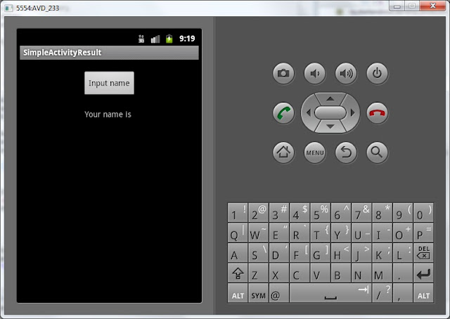
See the first screen
May & June 2012 Recruiting Plan
Recruit 70 “Best Fit” Consulting Employees
Build out a Marketing team dedicated to recruiting
Formalize training program for new recruiters
Build out fully functioning offshore recruiting team
Implement call quality feedback loops
Coach and Mentor recruiters
Improve daily efficiency for recruiting team
© 2014 Unbounded Solutions
121

Slide 122
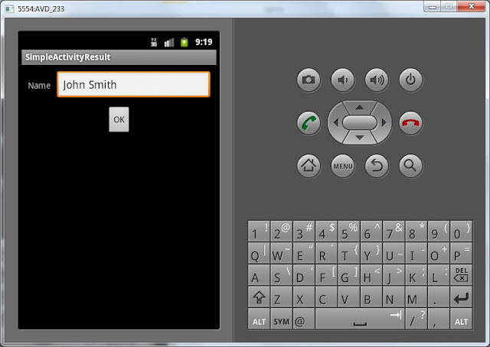
Input the name and click OK
May & June 2012 Recruiting Plan
Recruit 70 “Best Fit” Consulting Employees
Build out a Marketing team dedicated to recruiting
Formalize training program for new recruiters
Build out fully functioning offshore recruiting team
Implement call quality feedback loops
Coach and Mentor recruiters
Improve daily efficiency for recruiting team
© 2014 Unbounded Solutions
122

Slide 123
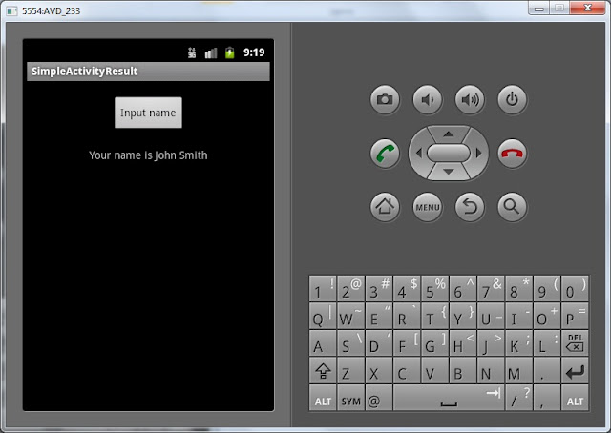
Again the first screen displaying data that was returned
May & June 2012 Recruiting Plan
Recruit 70 “Best Fit” Consulting Employees
Build out a Marketing team dedicated to recruiting
Formalize training program for new recruiters
Build out fully functioning offshore recruiting team
Implement call quality feedback loops
Coach and Mentor recruiters
Improve daily efficiency for recruiting team
© 2014 Unbounded Solutions
123

Slide 124
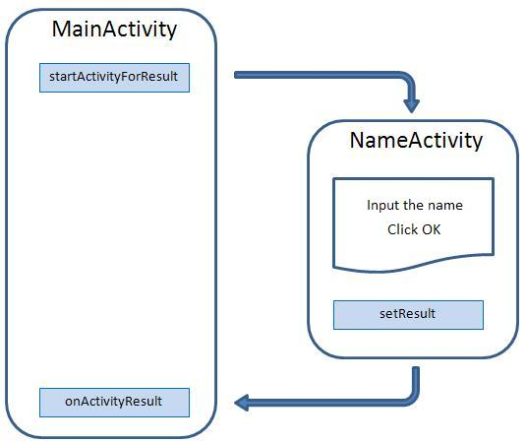
Scheme of Invocation and Returning
May & June 2012 Recruiting Plan
Recruit 70 “Best Fit” Consulting Employees
Build out a Marketing team dedicated to recruiting
Formalize training program for new recruiters
Build out fully functioning offshore recruiting team
Implement call quality feedback loops
Coach and Mentor recruiters
Improve daily efficiency for recruiting team
© 2014 Unbounded Solutions
124

Slide 125
Summerize
May & June 2012 Recruiting Plan
In MainActivity we have created an Intent and explicitly specified NameActivity class.
We launched this intent using startActivityForResult method. NameActivity was displayed, we entered name and clicked the button.
The Intent has been created, inside which the name that we had entered was placed. setResult method knows that Intent has to be returned to Activity that invoked startActivityForResult, that is - MainActivity.
In MainActivity method onActivityResult is responsible for receiving results. Inside this method we have unpacked Intent and displayed the received data in our TextView.
Recruit 70 “Best Fit” Consulting Employees
Build out a Marketing team dedicated to recruiting
Formalize training program for new recruiters
Build out fully functioning offshore recruiting team
Implement call quality feedback loops
Coach and Mentor recruiters
Improve daily efficiency for recruiting team
© 2014 Unbounded Solutions
125

Slide 126
Interview Questions
What is an intent-filter?
What is an implicit intent?
What is an explicit intent?
How do you pass data between activities?
What is the difference between parcelable and serializable?

Slide 127
Exercise

