Slide 1

ActionBar in Android

Slide 2
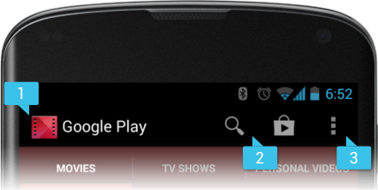

What is ActionBar?
May & June 2012 Recruiting Plan
The ActionBar is a window feature that identifies the user location, and provides user actions and navigation modes.
The action bar is a dedicated piece of real estate at the top of each screen that is generally persistent throughout the app.
Recruit 70 “Best Fit” Consulting Employees
Build out a Marketing team dedicated to recruiting
Formalize training program for new recruiters
Build out fully functioning offshore recruiting team
Implement call quality feedback loops
Coach and Mentor recruiters
Improve daily efficiency for recruiting team
© 2014 Unbounded Solutions
2

Slide 3

Key Functions
May & June 2012 Recruiting Plan
Makes important actions prominent and accessible in a predictable way (such as New or Search).
Supports consistent navigation and view switching within apps.
Reduces clutter by providing an action overflow for rarely used actions.
Provides a dedicated space for giving your app an identity.
Recruit 70 “Best Fit” Consulting Employees
Build out a Marketing team dedicated to recruiting
Formalize training program for new recruiters
Build out fully functioning offshore recruiting team
Implement call quality feedback loops
Coach and Mentor recruiters
Improve daily efficiency for recruiting team
© 2014 Unbounded Solutions
3

Slide 4
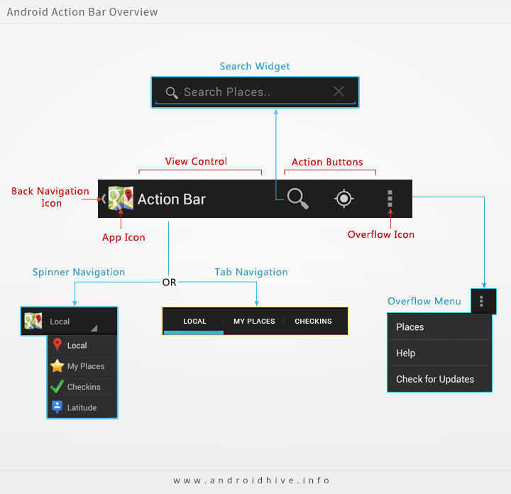
Overview of ActionBar
May & June 2012 Recruiting Plan
Recruit 70 “Best Fit” Consulting Employees
Build out a Marketing team dedicated to recruiting
Formalize training program for new recruiters
Build out fully functioning offshore recruiting team
Implement call quality feedback loops
Coach and Mentor recruiters
Improve daily efficiency for recruiting team
© 2014 Unbounded Solutions
4

Slide 5
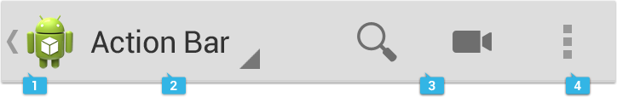
General Organization
May & June 2012 Recruiting Plan
Action bar mainly contains four functional areas.
They are app icon, view control, action buttons and action overflow.
Recruit 70 “Best Fit” Consulting Employees
Build out a Marketing team dedicated to recruiting
Formalize training program for new recruiters
Build out fully functioning offshore recruiting team
Implement call quality feedback loops
Coach and Mentor recruiters
Improve daily efficiency for recruiting team
© 2014 Unbounded Solutions
5

Slide 6

1#App Icon
May & June 2012 Recruiting Plan
The app icon establishes your app's identity. It can be replaced with a different logo or branding if you wish.
Important: If the app is currently not displaying the top-level screen, be sure to display the Up caret to the left of the app icon, so the user can navigate up the hierarchy.
For more discussion of Up navigation, see the Navigation pattern.
Recruit 70 “Best Fit” Consulting Employees
Build out a Marketing team dedicated to recruiting
Formalize training program for new recruiters
Build out fully functioning offshore recruiting team
Implement call quality feedback loops
Coach and Mentor recruiters
Improve daily efficiency for recruiting team
© 2014 Unbounded Solutions
6

Slide 7
2#View Control
May & June 2012 Recruiting Plan
If your app displays data in different views, this segment of the action bar allows users to switch views.
Examples of view-switching controls are drop-down menus or tab controls. For more information on view-switching, see the App Structure pattern.
If your app doesn't support different views, you can also use this space to display non-interactive content, such as an app title or longer branding information.
Recruit 70 “Best Fit” Consulting Employees
Build out a Marketing team dedicated to recruiting
Formalize training program for new recruiters
Build out fully functioning offshore recruiting team
Implement call quality feedback loops
Coach and Mentor recruiters
Improve daily efficiency for recruiting team
© 2014 Unbounded Solutions
7

Slide 8
3#Action Buttons
May & June 2012 Recruiting Plan
Action buttons on the action bar surface your app's most important activities.
Think about which buttons will get used most often, and order them accordingly.
Depending on available screen real estate, the system shows your most important actions as action buttons and moves the rest to the action overflow.
Recruit 70 “Best Fit” Consulting Employees
Build out a Marketing team dedicated to recruiting
Formalize training program for new recruiters
Build out fully functioning offshore recruiting team
Implement call quality feedback loops
Coach and Mentor recruiters
Improve daily efficiency for recruiting team
© 2014 Unbounded Solutions
8

Slide 9
3#Action Buttons
May & June 2012 Recruiting Plan
The action bar should show only those actions that are available to the user.
If an action is unavailable in the current context, hide it. Do not show it as disabled.
For guidance on prioritizing actions, use the FIT scheme.
Recruit 70 “Best Fit” Consulting Employees
Build out a Marketing team dedicated to recruiting
Formalize training program for new recruiters
Build out fully functioning offshore recruiting team
Implement call quality feedback loops
Coach and Mentor recruiters
Improve daily efficiency for recruiting team
© 2014 Unbounded Solutions
9

Slide 10
FIT Scheme
May & June 2012 Recruiting Plan
F — Frequent
Will people use this action at least 7 out of 10 times they visit the screen?
Will they typically use it several times in a row?
Would taking an extra step every time truly be burdensome?
I — Important
Do you want everyone to discover this action because it's especially cool or a selling point?
Is it something that needs to be effortless in the rare cases it's needed?
T — Typical
Is it typically presented as a first-class action in similar apps?
Given the context, would people be surprised if it were buried in the action overflow?
Recruit 70 “Best Fit” Consulting Employees
Build out a Marketing team dedicated to recruiting
Formalize training program for new recruiters
Build out fully functioning offshore recruiting team
Implement call quality feedback loops
Coach and Mentor recruiters
Improve daily efficiency for recruiting team
© 2014 Unbounded Solutions
10

Slide 11
4#Action Overflow
May & June 2012 Recruiting Plan
The action overflow in the action bar provides access to your app's less frequently used actions.
The overflow icon only appears on phones that have no menu hardware keys.
Phones with menu keys display the action overflow when the user presses the key.
Recruit 70 “Best Fit” Consulting Employees
Build out a Marketing team dedicated to recruiting
Formalize training program for new recruiters
Build out fully functioning offshore recruiting team
Implement call quality feedback loops
Coach and Mentor recruiters
Improve daily efficiency for recruiting team
© 2014 Unbounded Solutions
11

Slide 12
How many actions will fit in the main action bar?
May & June 2012 Recruiting Plan
Action buttons in the main action bar may not occupy more than 50% of the bar's width. Action buttons on bottom action bars can use the entire width.
The screen width in density-independent pixels (dp) determine the number of items that will fit in the main action bar:
smaller than 360 dp = 2 icons
360-499 dp = 3 icons
500-599 dp = 4 icons
600 dp and larger = 5 icons
Recruit 70 “Best Fit” Consulting Employees
Build out a Marketing team dedicated to recruiting
Formalize training program for new recruiters
Build out fully functioning offshore recruiting team
Implement call quality feedback loops
Coach and Mentor recruiters
Improve daily efficiency for recruiting team
© 2014 Unbounded Solutions
12

Slide 13
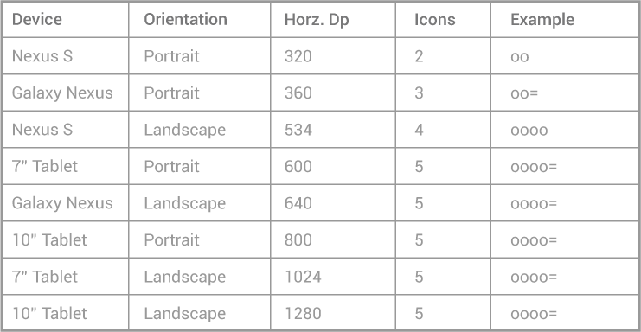
ActionBar Pattern Table
May & June 2012 Recruiting Plan
Recruit 70 “Best Fit” Consulting Employees
Build out a Marketing team dedicated to recruiting
Formalize training program for new recruiters
Build out fully functioning offshore recruiting team
Implement call quality feedback loops
Coach and Mentor recruiters
Improve daily efficiency for recruiting team
In the above table "o" denotes an action bar item and "=" an overflow icon.
© 2014 Unbounded Solutions
13

Slide 14
Layout Considerations
May & June 2012 Recruiting Plan
When splitting up content across multiple action bars, you generally have three possible locations for action bar content:
Main action bar
Top bar
Bottom bar
If the user can navigate up the hierarchy from a given screen, the main action bar contains the up caret, at a minimum.
To allow the user to quickly switch between the views your app provides, use tabs or a spinner in the top bar.
To display actions and, if necessary, the action overflow, use the bottom bar..
Recruit 70 “Best Fit” Consulting Employees
Build out a Marketing team dedicated to recruiting
Formalize training program for new recruiters
Build out fully functioning offshore recruiting team
Implement call quality feedback loops
Coach and Mentor recruiters
Improve daily efficiency for recruiting team
© 2014 Unbounded Solutions
14

Slide 15
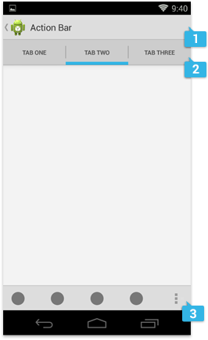
Layout Considerations
May & June 2012 Recruiting Plan
Recruit 70 “Best Fit” Consulting Employees
Build out a Marketing team dedicated to recruiting
Formalize training program for new recruiters
Build out fully functioning offshore recruiting team
Implement call quality feedback loops
Coach and Mentor recruiters
Improve daily efficiency for recruiting team
© 2014 Unbounded Solutions
15

Slide 16

Tutorial#1
May & June 2012 Recruiting Plan
Recruit 70 “Best Fit” Consulting Employees
Build out a Marketing team dedicated to recruiting
Formalize training program for new recruiters
Build out fully functioning offshore recruiting team
Implement call quality feedback loops
Coach and Mentor recruiters
Improve daily efficiency for recruiting team
Implemetation of ActionBar
© 2014 Unbounded Solutions
16

Slide 17
STEPS
May & June 2012 Recruiting Plan
Set theActionBar Theme
Create items in Menu with ActionBar defined Attributes
Inflate in onCreateOptions Menu
Use OptionsMenuItem click for Events
Recruit 70 “Best Fit” Consulting Employees
Build out a Marketing team dedicated to recruiting
Formalize training program for new recruiters
Build out fully functioning offshore recruiting team
Implement call quality feedback loops
Coach and Mentor recruiters
Improve daily efficiency for recruiting team
© 2014 Unbounded Solutions
17

Slide 18
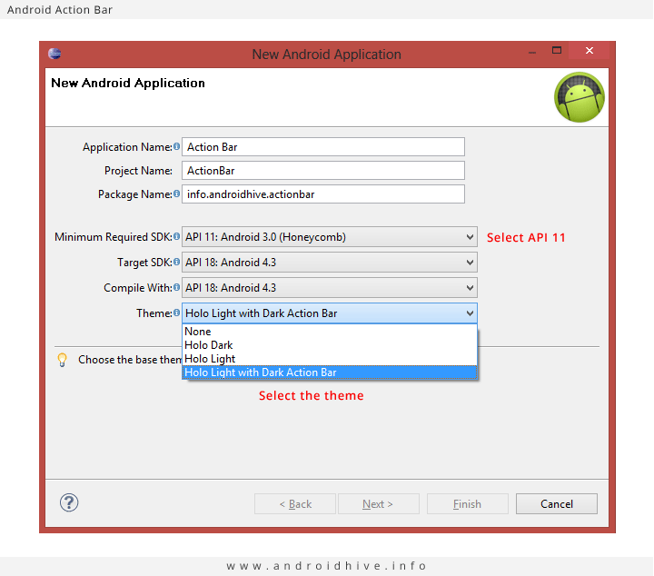
1#Create New App
May & June 2012 Recruiting Plan
Create a new project in Eclipse from File ⇒ New ⇒ Android Application Project. While creating the project select Minimum SDK version to API 11 and select a theme with action bar. (I left my main activity name as MainActivity.java)
Recruit 70 “Best Fit” Consulting Employees
Build out a Marketing team dedicated to recruiting
Formalize training program for new recruiters
Build out fully functioning offshore recruiting team
Implement call quality feedback loops
Coach and Mentor recruiters
Improve daily efficiency for recruiting team
© 2014 Unbounded Solutions
18

Slide 19
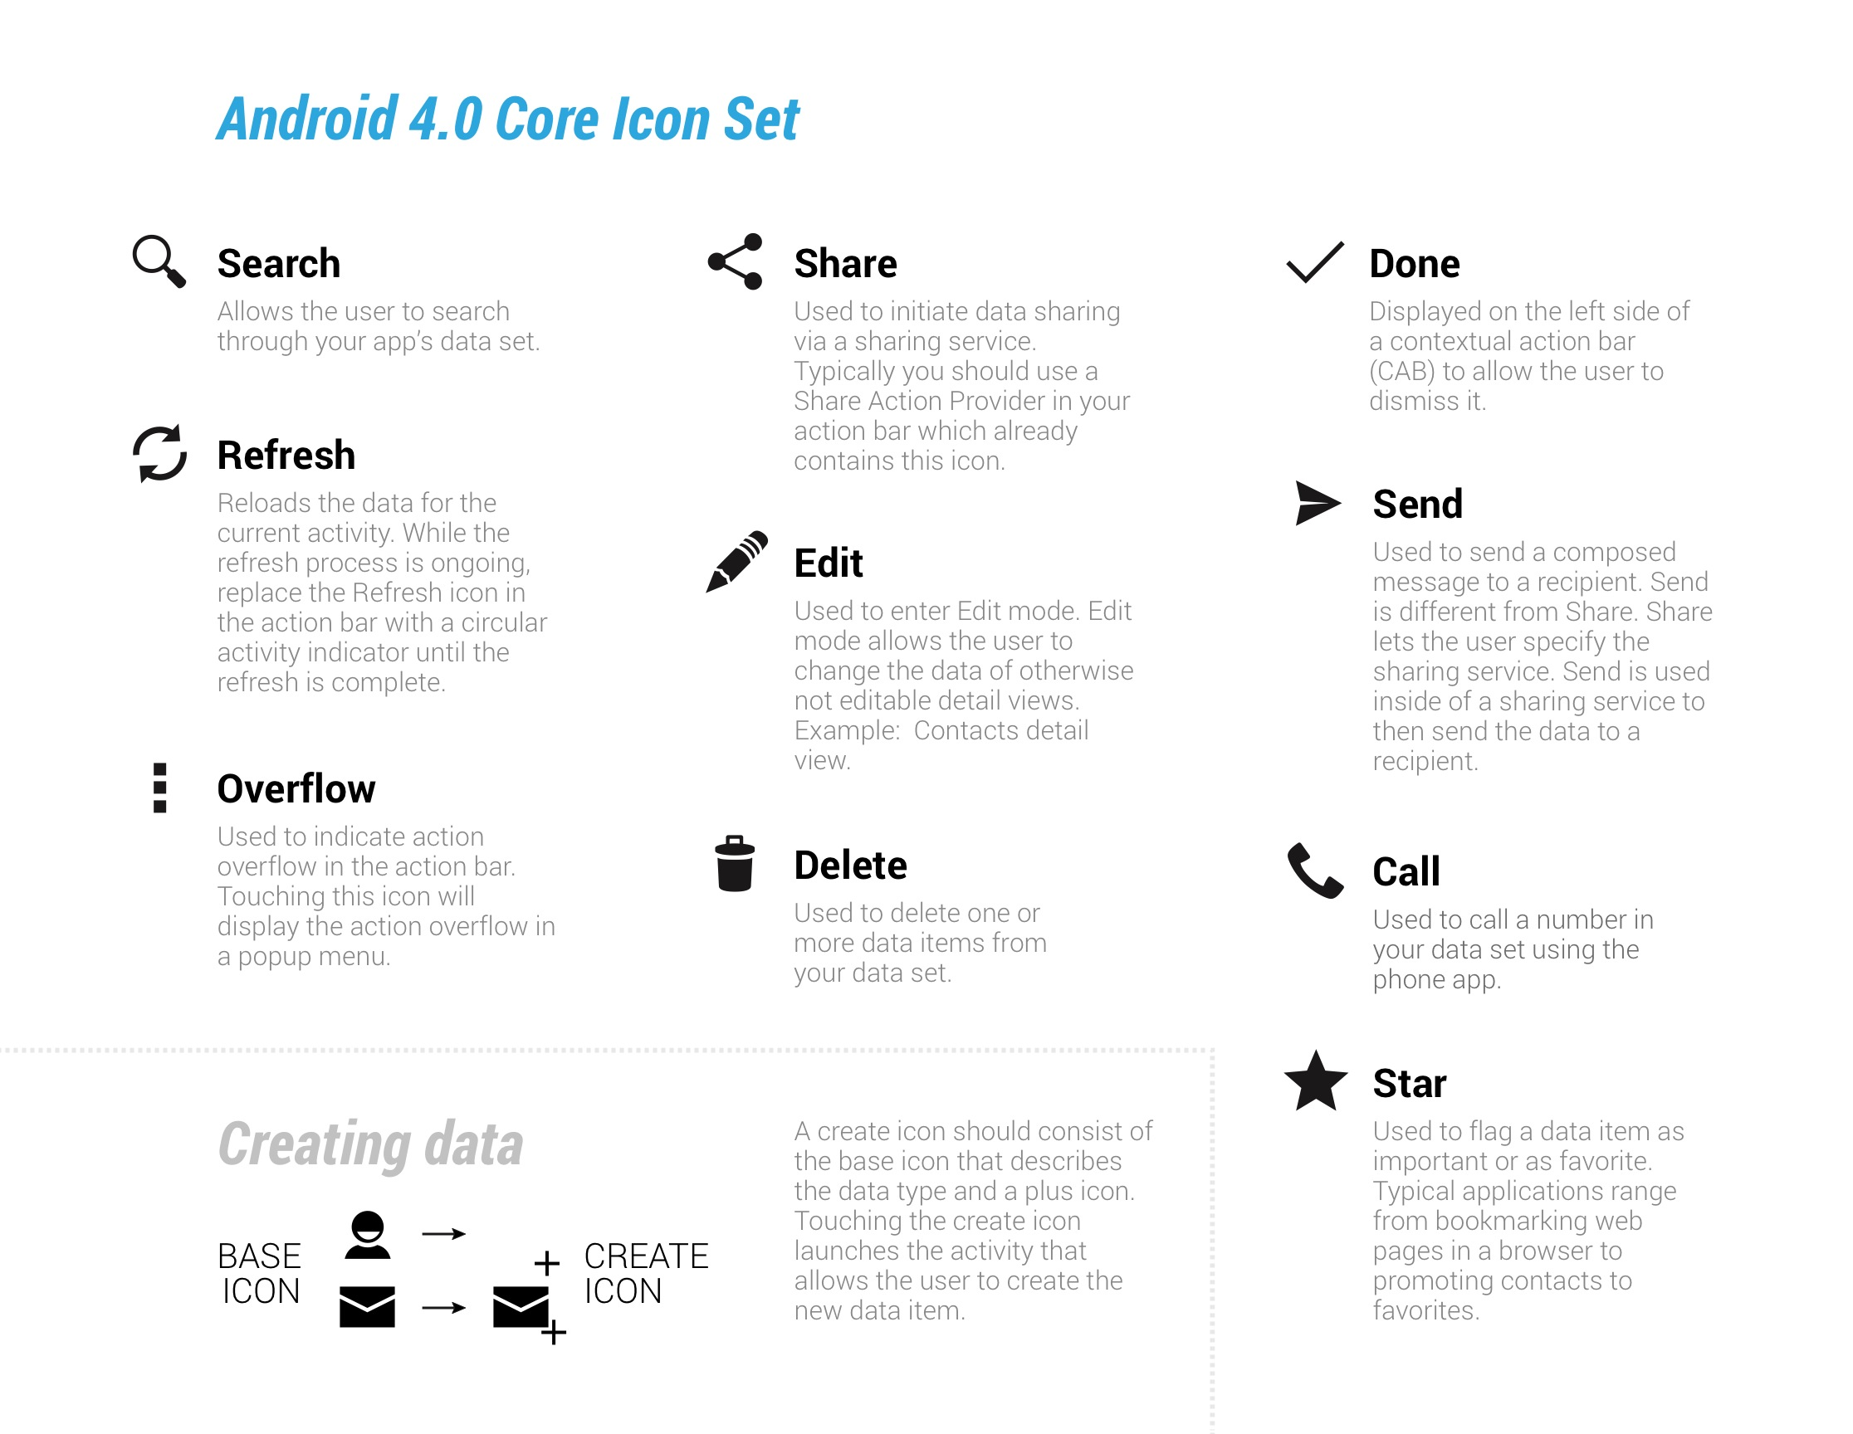
2#Adding Action Bar Icons
May & June 2012 Recruiting Plan
Android. provides some useful icons for action bar.
2.1 Download the Action Bar Icon Set and select the required icons and add them to the project.
2.2 Copy each icon with all resolutions (xxhdpi, xhdpi, hdpi, mdpi) into respected folders in Eclipse project under res ⇒ drawable→folders.
© 2014 Unbounded Solutions
19

Slide 20
3#Create a new xml file
May & June 2012 Recruiting Plan
Create a new xml file under res ⇒ menu named activity_main_actions.xml and add the following code. Here each <item> indicates each action item.
Recruit 70 “Best Fit” Consulting Employees
Build out a Marketing team dedicated to recruiting
Formalize training program for new recruiters
Build out fully functioning offshore recruiting team
Implement call quality feedback loops
Coach and Mentor recruiters
Improve daily efficiency for recruiting team
activity_main_actions.xml
<?xml version="1.0" encoding="utf-8"?>
<menu xmlns:android="http://schemas.android.com/apk/res/android" >
<!-- Search / will display always -->
<item android:id="@+id/action_search"
android:icon="@drawable/ic_action_search"
android:title="@string/action_search"
android:showAsAction="ifRoom"/>
<!-- Location Found -->
<item android:id="@+id/action_location_found"
android:icon="@drawable/ic_action_location_found"
android:title="@string/action_location_found"
android:showAsAction="ifRoom" />
<!-- Refresh -->
<item android:id="@+id/action_refresh"
android:icon="@drawable/ic_action_refresh"
android:title="@string/action_refresh"
© 2014 Unbounded Solutions
20

Slide 21
3#Create a new xml file
May& June 2012 Recruiting Plan
<!-- Help -->
<item android:id="@+id/action_help"
android:icon="@drawable/ic_action_help"
android:title="@string/action_help"
android:showAsAction="never"/>
<!-- Check updates -->
<item android:id="@+id/action_check_updates"
android:icon="@drawable/ic_action_refresh"
android:title="@string/action_check_updates"
android:showAsAction="never" />
</menu>
Recruit 70 “Best Fit” Consulting Employees
Build out a Marketing team dedicated to recruiting
Formalize training program for new recruiters
Build out fully functioning offshore recruiting team
Implement call quality feedback loops
Coach and Mentor recruiters
Improve daily efficiency for recruiting team
© 2014 Unbounded Solutions
21

Slide 22
Important Attributes
May & June 2012 Recruiting Plan
Here the important xml attributes should be known are
android:icon – Defines the icon of the action item.
android:title – Title for the icon.
android:showAsAction – Defines the visibility of the action item.
Recruit 70 “Best Fit” Consulting Employees
Build out a Marketing team dedicated to recruiting
Formalize training program for new recruiters
Build out fully functioning offshore recruiting team
Implement call quality feedback loops
Coach and Mentor recruiters
Improve daily efficiency for recruiting team
© 2014 Unbounded Solutions
22

Slide 23
android:showAsAction
May & June 2012 Recruiting Plan
ifRoom: Displays the icon if there is space available on the screen
never: Never places this icon on the action bar
always: Forces to display the icon always irrespective of space available. This way is not suggested.
withText: Displays a text along with the icon. Normally the text value defined by android:title will be displayed
collapseActionView: Defines the action layout associated with it. This action view defined using android:actionLayout or android:actionViewClass
Recruit 70 “Best Fit” Consulting Employees
Build out a Marketing team dedicated to recruiting
Formalize training program for new recruiters
Build out fully functioning offshore recruiting team
Implement call quality feedback loops
Coach and Mentor recruiters
Improve daily efficiency for recruiting team
© 2014 Unbounded Solutions
23

Slide 24
4#Inflate the xml
May& June 2012 Recruiting Plan
4. Now open your main activity class and do the following in onCreateOptionsMenu() method.
Recruit 70 “Best Fit” Consulting Employees
Build out a Marketing team dedicated to recruiting
Formalize training program for new recruiters
Build out fully functioning offshore recruiting team
Implement call quality feedback loops
Coach and Mentor recruiters
Improve daily efficiency for recruiting team
public class MainActivity extends Activity{
@Override
protected void onCreate(Bundle savedInstanceState) {
super.onCreate(savedInstanceState);
setContentView(R.layout.activity_main);
}
@Override
public boolean onCreateOptionsMenu(Menu menu) {
MenuInflater inflater = getMenuInflater();
inflater.inflate(R.menu.activity_main_actions, menu);
return super.onCreateOptionsMenu(menu);
}
}
© 2014 Unbounded Solutions
24

Slide 25
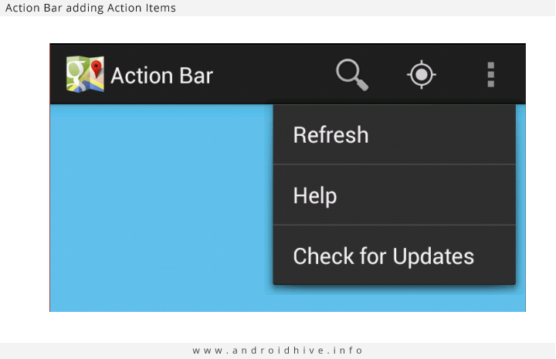
Output
May& June 2012 Recruiting Plan
© 2014 Unbounded Solutions
25

Slide 26
5#Handling Action Bar Icon Click Events
May& June 2012 Recruiting Plan
5.1 Open your main activity and override onOptionsItemSelected() method.
5.2 This method accepts menu item as a parameter. Selected action item can be identified by using it’s id.
5.3 Normally a switch case statement is suggested for this purpose. You can perform appropriate action in the matched case block.
© 2014 Unbounded Solutions
26

Slide 27
5#Handling Action Bar Icon Click Events
May& June 2012 Recruiting Plan
public class MainActivity extends Activity{
...
...
/**
* On selecting action bar icons
* */
@Override
public boolean onOptionsItemSelected(MenuItem item) {
// Take appropriate action for each action item click
switch (item.getItemId()) {
case R.id.action_search:
// search action
return true;
case R.id.action_location_found:
// location found
LocationFound();
return true;
© 2014 Unbounded Solutions
27

Slide 28
5#Handling Action Bar Icon Click Events
May& June 2012 Recruiting Plan
case R.id.action_refresh:
// refresh
return true;
case R.id.action_help:
// help action
return true;
case R.id.action_check_updates:
// check for updates action
return true;
default:
return super.onOptionsItemSelected(item);
}
}
/**
* Launching new activity
* */
private void LocationFound() {
Intent i = new Intent(MainActivity.this, LocationFound.class); startActivity(i);}
© 2014 Unbounded Solutions
28

Slide 29
Tutorial#2
May & June 2012 Recruiting Plan
Recruit 70 “Best Fit” Consulting Employees
Build out a Marketing team dedicated to recruiting
Formalize training program for new recruiters
Build out fully functioning offshore recruiting team
Implement call quality feedback loops
Coach and Mentor recruiters
Improve daily efficiency for recruiting team
Back Navigation
© 2014 Unbounded Solutions
29

Slide 30
Enabling Up / Back Navigation
May & June 2012 Recruiting Plan
Action bar also provides the feasibility of back navigation when the app involves hierarchical relationship between screens.
Please note that this behavior is not the same as android system back button.
A small back arrow icon will be displayed before action bar icon when up navigation is enabled. Follow these steps to enable up navigation.
Recruit 70 “Best Fit” Consulting Employees
Build out a Marketing team dedicated to recruiting
Formalize training program for new recruiters
Build out fully functioning offshore recruiting team
Implement call quality feedback loops
Coach and Mentor recruiters
Improve daily efficiency for recruiting team
© 2014 Unbounded Solutions
30

Slide 31
STEPS
May & June 2012 Recruiting Plan
Defining the parent activity in the AndroidManifest.xml file
Enabling the up navigation in the activity class.
Recruit 70 “Best Fit” Consulting Employees
Build out a Marketing team dedicated to recruiting
Formalize training program for new recruiters
Build out fully functioning offshore recruiting team
Implement call quality feedback loops
Coach and Mentor recruiters
Improve daily efficiency for recruiting team
© 2014 Unbounded Solutions
31

Slide 32
1#Create the layout file
May& June 2012 Recruiting Plan
Create the layout file for this activity named activity_location_found.xml under res ⇒ layout folder.
activity_location_found.xml
<?xml version="1.0" encoding="utf-8"?>
<LinearLayout xmlns:android="http://schemas.android.com/apk/res/android"
android:layout_width="match_parent"
android:layout_height="match_parent"
android:orientation="vertical"
android:padding="10dp">
<TextView android:layout_width="fill_parent"
android:layout_height="wrap_content"
android:text="Location is found. Drop a Message here"/>
</LinearLayout>
© 2014 Unbounded Solutions
32

Slide 33
2#Create the Class
May& June 2012 Recruiting Plan
Create a new class under you main package named LocationFound.java.
Action bar Up navigation can be enabled by calling setDisplayHomeAsUpEnabled(true) method on to action bar.
By calling this function a back arrow will be displayed on the action bar.
© 2014 Unbounded Solutions
33

Slide 34
2#Create the Class
May& June 2012 Recruiting Plan
public class LocationFound extends Activity {
@Override
protected void onCreate(Bundle savedInstanceState) {
super.onCreate(savedInstanceState);
setContentView(R.layout.activity_location_found);
// STEP 1:get action bar
ActionBar actionBar = getActionBar();
// step2: Enabling Up / Back navigation
actionBar.setDisplayHomeAsUpEnabled(true);
}
}
© 2014 Unbounded Solutions
34

Slide 35
3#AndroidManifest
May& June 2012 Recruiting Plan
<!-- Location found activity -->
<activity
android:name="info.androidhive.actionbar.LocationFound"
android:label="@string/activity_new_message »
android:parentActivityName=parentClassName" >
</activity>
© 2014 Unbounded Solutions
35

Slide 36
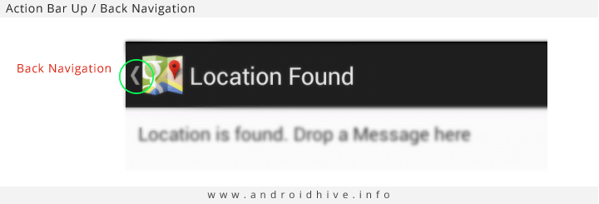
Output
May& June 2012 Recruiting Plan
© 2014 Unbounded Solutions
36

Slide 37
Changing the Action Bar Icon
May& June 2012 Recruiting Plan
Action bar by default displays the application icon which was set using android:icon in the AndroidManifest.xml file.
So if you want to change the action bar icon, you can do it by calling setIcon(drawable) on to action bar.
ActionBar actionBar = getActionBar();
// set the icon
actionBar.setIcon(R.drawable.ico_actionbar);
© 2014 Unbounded Solutions
37

Slide 38
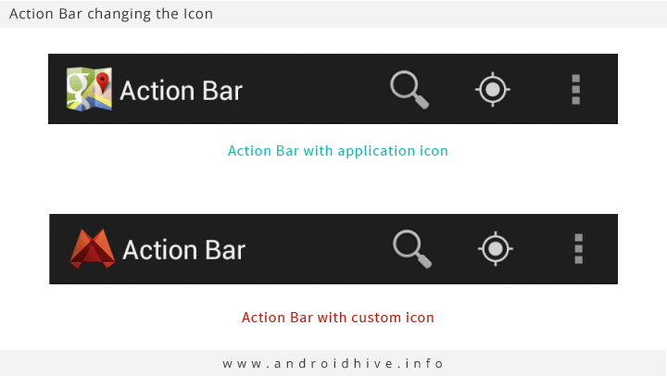
Output
May& June 2012 Recruiting Plan
© 2014 Unbounded Solutions
38

Slide 39
Enabling Split Action Bars
May& June 2012 Recruiting Plan
Split action bar provides a separate bar at the bottom of the screen. This option will be useful when you want to display the action items at the bottom of the screen by leaving some space on the title bar.
To enable split action bar add uiOptions=”splitActionBarWhenNarrow” to all the <activity> tags or to the <application> tag directly in AndroidManifest.xml file.
Also we need to add <meta-data> with the value android.support.UI_OPTIONS to support older version below API level 14.
© 2014 Unbounded Solutions
39

Slide 40
Enabling Split Action Bars
May& June 2012 Recruiting Plan
<!-- Location found activity -->
<activity
android:name="info.androidhive.actionbar.LocationFound"
android:label="@string/activity_location_found"
android:parentActivityName="info.androidhive.actionbar.MainActivity" >
<!-- To support below API Level 14 -->
<meta-data android:name="android.support.UI_OPTIONS"
android:value="splitActionBarWhenNarrow" />
</activity>
© 2014 Unbounded Solutions
40

Slide 41
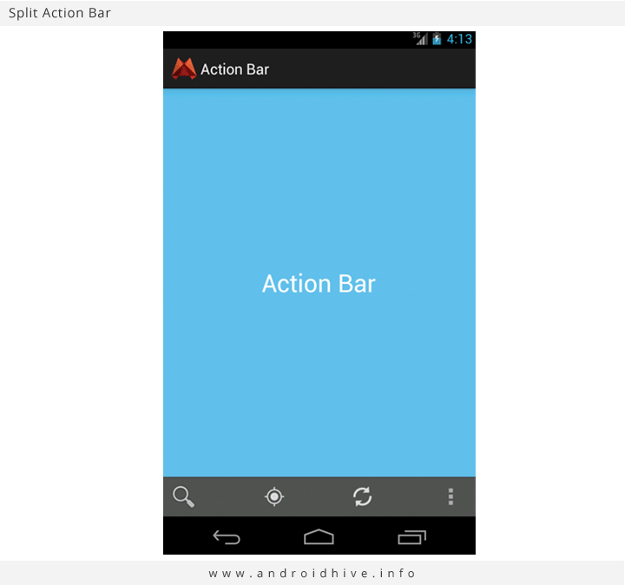
Output
May& June 2012 Recruiting Plan
© 2014 Unbounded Solutions
41

Slide 42
Tutorial #3
May & June 2012 Recruiting Plan
Recruit 70 “Best Fit” Consulting Employees
Build out a Marketing team dedicated to recruiting
Formalize training program for new recruiters
Build out fully functioning offshore recruiting team
Implement call quality feedback loops
Coach and Mentor recruiters
Improve daily efficiency for recruiting team
Adding Search Widget to ActionBar
© 2014 Unbounded Solutions
42

Slide 43
Adding Search Widget
May & June 2012 Recruiting Plan
Another most useful feature of action bar is adding widgets to it. For example like adding search widget to action bar.
Search widget will be useful when user wants to search for something in the app or across android OS.
Adding search widget involves these steps.
Recruit 70 “Best Fit” Consulting Employees
Build out a Marketing team dedicated to recruiting
Formalize training program for new recruiters
Build out fully functioning offshore recruiting team
Implement call quality feedback loops
Coach and Mentor recruiters
Improve daily efficiency for recruiting team
© 2014 Unbounded Solutions
43

Slide 44
STEPS
May & June 2012 Recruiting Plan
Adding the Search Widget to action bar action item
Defining the searchable configuration in the xml
Creating the activity to handle search query and display the results
Defining the default searchable activity and SEARCH intent filter in AndroidManifest.xml file
Recruit 70 “Best Fit” Consulting Employees
Build out a Marketing team dedicated to recruiting
Formalize training program for new recruiters
Build out fully functioning offshore recruiting team
Implement call quality feedback loops
Coach and Mentor recruiters
Improve daily efficiency for recruiting team
© 2014 Unbounded Solutions
44

Slide 45
1#Add the search widget to action bar
May& June 2012 Recruiting Plan
So first we add the search widget to action bar.
Open your activity_main_actions.xml which is located under menu folder and add search widget to search action item as below. android:actionViewClass=”android.widget.SearchView
activity_main_actions.xml
<!-- Search Widget -->
<item android:id="@+id/action_search"
android:icon="@drawable/ic_action_search"
android:title="@string/action_search"
android:showAsAction="always"
android:actionViewClass="android.widget.SearchView"/>
© 2014 Unbounded Solutions
45

Slide 46
2#Create a searchable configuration file
May& June 2012 Recruiting Plan
Create a searchable configuration file under res ⇒ xml folder named searchable.xml (If you don’t see xml folder under res, create a new folder with the name xml).
searchable.xml
<?xml version="1.0" encoding="utf-8"?>
<searchable xmlns:android="http://schemas.android.com/apk/res/android"
android:hint="@string/search_hint"
android:label="@string/app_name" />
© 2014 Unbounded Solutions
46

Slide 47
3#Code in the onCreateOptionsMenu()
May& June 2012 Recruiting Plan
Create a searchable configuration file under res ⇒ xml folder named searchable.xml (If you don’t see xml folder under res, create a new folder with the name xml).
MainActivity.java
@Override
public boolean onCreateOptionsMenu(Menu menu) {
MenuInflater inflater = getMenuInflater();
inflater.inflate(R.menu.activity_main_actions, menu);
// Associate searchable configuration with the SearchView
SearchManager searchManager = (SearchManager) getSystemService(Context.SEARCH_SERVICE);
SearchView searchView = (SearchView) menu.findItem(R.id.action_search)
.getActionView();
searchView.setSearchableInfo(searchManager
.getSearchableInfo(getComponentName())););
}
© 2014 Unbounded Solutions
47

Slide 48
4#SearchResultsActivity.java
May& June 2012 Recruiting Plan
We need another activity to handle search query and results. Create a new class named SearchResultsActivity.java and paste following code.
Also create layout file too named activity_search_results.xml.
Here I just passed the search query to another activity.
You have to take appropriate action to display the search results using the query either from SQLite database or making a request to server and getting the results or some other way.
© 2014 Unbounded Solutions
48

Slide 49
activity_search_results.xml
May& June 2012 Recruiting Plan
activity_search_results.xml
<RelativeLayout xmlns:android="http://schemas.android.com/apk/res/android"
xmlns:tools="http://schemas.android.com/tools"
android:layout_width="match_parent"
android:layout_height="match_parent"
android:paddingBottom="@dimen/activity_vertical_margin"
android:paddingLeft="@dimen/activity_horizontal_margin"
android:paddingRight="@dimen/activity_horizontal_margin"
android:paddingTop="@dimen/activity_vertical_margin"
tools:context=".MainActivity" >
<TextView
android:id="@+id/txtQuery"
android:layout_width="wrap_content"
android:layout_height="wrap_content" />
</RelativeLayout>
© 2014 Unbounded Solutions
49

Slide 50
SearchResultsActivity.java
May& June 2012 Recruiting Plan
public class SearchResultsActivity extends Activity {
private TextView txtQuery;
@Override
protected void onCreate(Bundle savedInstanceState) {
super.onCreate(savedInstanceState);
setContentView(R.layout.activity_search_results);
// get the action bar
ActionBar actionBar = getActionBar();
// Enabling Back navigation on Action Bar icon
actionBar.setDisplayHomeAsUpEnabled(true);
txtQuery = (TextView) findViewById(R.id.txtQuery);
handleIntent(getIntent());
}
© 2014 Unbounded Solutions
50

Slide 51
SearchResultsActivity.java
May& June 2012 Recruiting Plan
@Override
protected void onNewIntent(Intent intent) {
setIntent(intent);
handleIntent(intent);
}
/**
* Handling intent data
*/
private void handleIntent(Intent intent) {
if (Intent.ACTION_SEARCH.equals(intent.getAction())) {
String query = intent.getStringExtra(SearchManager.QUERY);
/**
* Use this query to display search results like
* 1. Getting the data from SQLite and showing in listview
* 2. Making webrequest and displaying the data
* For now we just display the query only
*/
txtQuery.setText("Search Query: " + query);
}
© 2014 Unbounded Solutions
51

Slide 52
5#Searchable Configuration,
May& June 2012 Recruiting Plan
Finally in the AndroidManifest.xml file define the searchable configuration, default searchable activity and the activity performing the search.
android.app.default_searchable – Defines the default searchable activity handle search. You can add this block anywhere in the manifest file either inside <application> tag or <activity> tag.
android.app.searchable – Defines the searchable configuration which was written in searchable.xml file
android.intent.action.SEARCH – Should be defined as a intent filter for the activity which receives the search query.
© 2014 Unbounded Solutions
52

Slide 53
5.1#Searchable Configuration,
May& June 2012 Recruiting Plan
<activity
android:name="info.androidhive.actionbar.MainActivity"
android:label="@string/app_name">
<meta-data
android:name="android.app.default_searchable"
android:value=".SearchResultsActivity" />
<intent-filter>
<action android:name="android.intent.action.MAIN" />
<category android:name="android.intent.category.LAUNCHER" />
</intent-filter>
</activity>
© 2014 Unbounded Solutions
53

Slide 54
5.2#Searchable Configuration,
May& June 2012 Recruiting Plan
<!-- Search results activity -->
<activity android:name=".SearchResultsActivity”
android:parentActivityName="info.androidhive.actionbar.MainActivity" >
<intent-filter>
<action android:name="android.intent.action.SEARCH" />
</intent-filter>
<meta-data
android:name="android.app.searchable"
android:resource="@xml/searchable" />
</activity>
© 2014 Unbounded Solutions
54

Slide 55
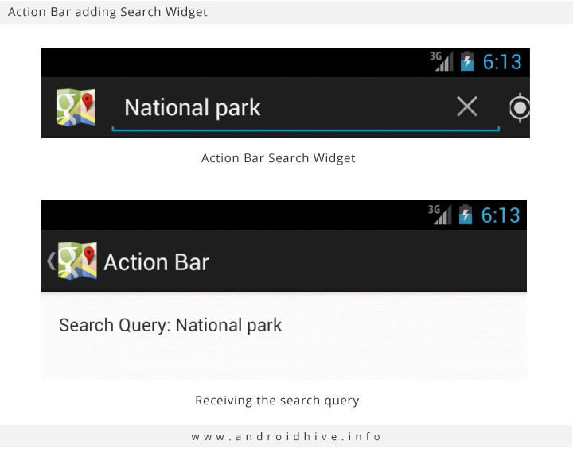
Output
May& June 2012 Recruiting Plan
© 2014 Unbounded Solutions
55

Slide 56
Tutorial#2
May & June 2012 Recruiting Plan
Recruit 70 “Best Fit” Consulting Employees
Build out a Marketing team dedicated to recruiting
Formalize training program for new recruiters
Build out fully functioning offshore recruiting team
Implement call quality feedback loops
Coach and Mentor recruiters
Improve daily efficiency for recruiting team
ShareActionProvider in ActionBar
© 2014 Unbounded Solutions
56

Slide 57
ShareProvider ActionBar
May & June 2012 Recruiting Plan
Whenever your app permits sharing of data, such as images or movie clips, use a share action provider in your action bar.
The share action provider is designed to speed up sharing by displaying the most recently used sharing service next to a spinner button that contains other sharing options.
Recruit 70 “Best Fit” Consulting Employees
Build out a Marketing team dedicated to recruiting
Formalize training program for new recruiters
Build out fully functioning offshore recruiting team
Implement call quality feedback loops
Coach and Mentor recruiters
Improve daily efficiency for recruiting team
© 2014 Unbounded Solutions
57

Slide 58
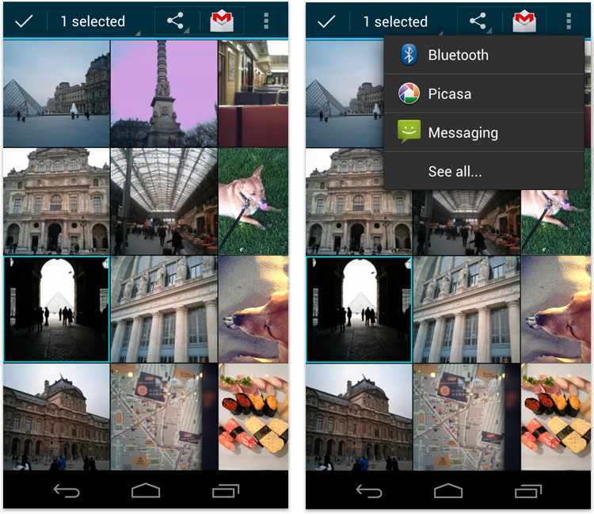
ShareProvider ActionBar
May & June 2012 Recruiting Plan
Recruit 70 “Best Fit” Consulting Employees
Build out a Marketing team dedicated to recruiting
Formalize training program for new recruiters
Build out fully functioning offshore recruiting team
Implement call quality feedback loops
Coach and Mentor recruiters
Improve daily efficiency for recruiting team
© 2014 Unbounded Solutions
58

Slide 59
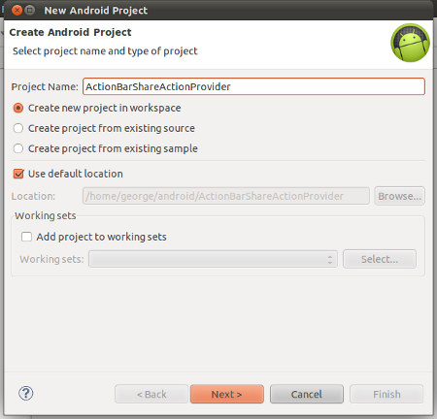
ShareProvider ActionBar
May & June 2012 Recruiting Plan
© 2014 Unbounded Solutions
59

Slide 60
Step1# res/menu/items.xml
May & June 2012 Recruiting Plan
<?xml version="1.0" encoding="utf-8"?>
<menu xmlns:android="http://schemas.android.com/apk/res/android" >
<item
android:id="@+id/share"
android:title="@string/share »
android:showAsAction="ifRoom »
android:actionProviderClass="android.widget.ShareActionProvider"
/>
</menu>
© 2014 Unbounded Solutions
60

Slide 61
Step2# Code in OnCreateOptionsMenus
May & June 2012 Recruiting Plan
@Override
public boolean onCreateOptionsMenu(Menu menu) {
/** Inflating the current activity's menu with res/menu/items.xml */
getMenuInflater().inflate(R.menu.items, menu);
/** Getting the actionprovider associated with the menu item whose id is share */
mShareActionProvider = (ShareActionProvider) menu.findItem(R.id.share).getActionProvider();
/** Setting a share intent */
mShareActionProvider.setShareIntent(getDefaultShareIntent());
return super.onCreateOptionsMenu(menu);
}
© 2014 Unbounded Solutions
61

Slide 62
Step3# Returns a share intent
May & June 2012 Recruiting Plan
/** Returns a share intent */
private Intent getDefaultShareIntent(){
Intent intent = new Intent(Intent.ACTION_SEND);
intent.setType("text/plain");
intent.putExtra(Intent.EXTRA_SUBJECT, "SUBJECT");
intent.putExtra(Intent.EXTRA_TEXT,"Extra Text");
return intent;
}
© 2014 Unbounded Solutions
62

Slide 63
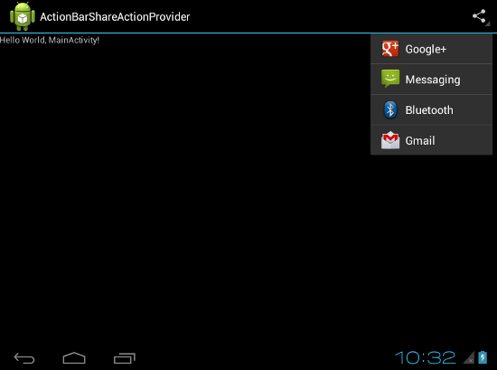
ShareProvider ActionBar
May & June 2012 Recruiting Plan
© 2014 Unbounded Solutions
63

Slide 64
Tutorial#5
May & June 2012 Recruiting Plan
Adding Custom Action View to Action Bar
© 2014 Unbounded Solutions
64

Slide 65
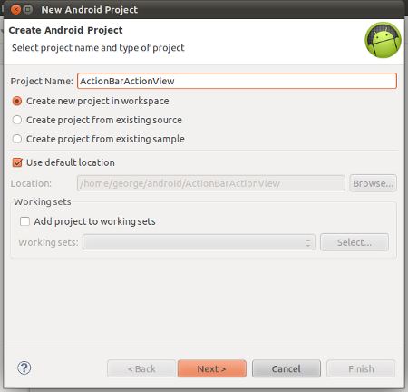
Custom Action View
May & June 2012 Recruiting Plan
© 2014 Unbounded Solutions
65

Slide 66
search_layout.xml
May & June 2012 Recruiting Plan
<LinearLayout xmlns:android="http://schemas.android.com/apk/res/android"
android:layout_width="fill_parent"
android:layout_height="match_parent"
android:orientation="horizontal" >
<EditText
android:id="@+id/txt_search"
android:inputType="text"
android:layout_width="fill_parent"
android:layout_height="wrap_content"
/>
</LinearLayout>
© 2014 Unbounded Solutions
66

Slide 67
search_layout.xml
May & June 2012 Recruiting Plan
/** Callback function */
@Override
public boolean onCreateOptionsMenu(Menu menu) {
/** Create an option menu from res/menu/items.xml */
getMenuInflater().inflate(R.menu.items, menu);
/** Get the action view of the menu item whose id is search */
View v = (View) menu.findItem(R.id.search).getActionView();
/** Get the edit text from the action view */
EditText txtSearch = ( EditText ) v.findViewById(R.id.txt_search);
/** Setting an action listener */
txtSearch.setOnEditorActionListener(new OnEditorActionListener() {
@Override
public boolean onEditorAction(TextView v, int actionId, KeyEvent event) {
Toast.makeText(getBaseContext(), "Search : " + v.getText(), Toast.LENGTH_SHORT).show();
return false;
}
});
return super.onCreateOptionsMenu(menu);
}
© 2014 Unbounded Solutions
67

Slide 68
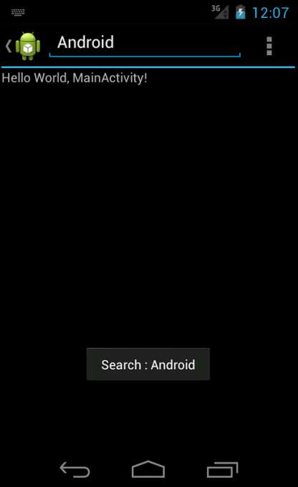
Custom Action View
May & June 2012 Recruiting Plan
© 2014 Unbounded Solutions
68

Slide 69
Tutorial#7
May & June 2012 Recruiting Plan
Recruit 70 “Best Fit” Consulting Employees
Build out a Marketing team dedicated to recruiting
Formalize training program for new recruiters
Build out fully functioning offshore recruiting team
Implement call quality feedback loops
Coach and Mentor recruiters
Improve daily efficiency for recruiting team
Setting up Sherlock library for action bar in pre Honeycomb Android Applications
© 2014 Unbounded Solutions
69

Slide 70
ActionBarSherlock
May & June 2012 Recruiting Plan
ActionBarSherlock is an extension of the support library designed to facilitate the use of the action bar design pattern across all versions of Android with a single API.
The library will automatically use the native action bar when appropriate or will automatically wrap a custom implementation around your layouts.
This allows you to easily develop an application with an action bar for every version of Android from 2.x and up.
Recruit 70 “Best Fit” Consulting Employees
Build out a Marketing team dedicated to recruiting
Formalize training program for new recruiters
Build out fully functioning offshore recruiting team
Implement call quality feedback loops
Coach and Mentor recruiters
Improve daily efficiency for recruiting team
© 2014 Unbounded Solutions
70

Slide 71
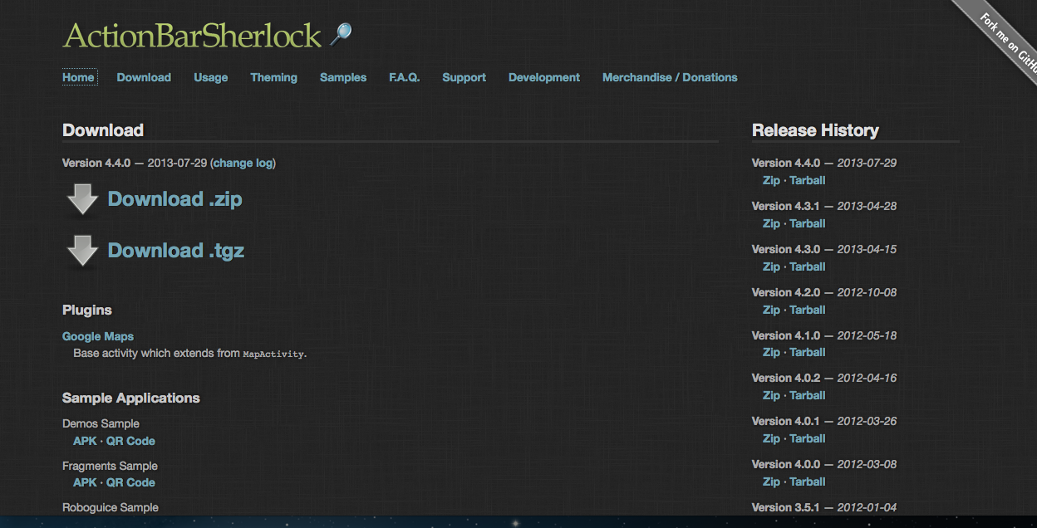
How to do it?
May & June 2012 Recruiting Plan
Download the latest version(4.1.0) of sherlock library
http://actionbarsherlock.com/download.html
Recruit 70 “Best Fit” Consulting Employees
Build out a Marketing team dedicated to recruiting
Formalize training program for new recruiters
Build out fully functioning offshore recruiting team
Implement call quality feedback loops
Coach and Mentor recruiters
Improve daily efficiency for recruiting team
© 2014 Unbounded Solutions
71

Slide 72
How to do it?
May & June 2012 Recruiting Plan
Extract the downloaded file to a local directory
Open Eclipse IDE and click the menu File->New->Other->Android->Android Project from Existing Code
Recruit 70 “Best Fit” Consulting Employees
Build out a Marketing team dedicated to recruiting
Formalize training program for new recruiters
Build out fully functioning offshore recruiting team
Implement call quality feedback loops
Coach and Mentor recruiters
Improve daily efficiency for recruiting team
© 2014 Unbounded Solutions
72

Slide 73
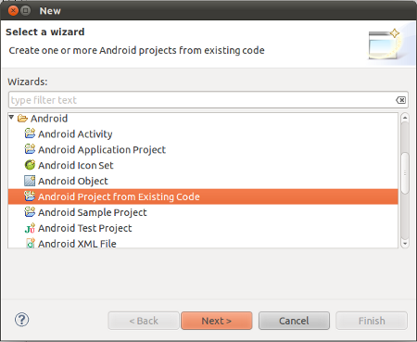
How to do it?
May & June 2012 Recruiting Plan
Recruit 70 “Best Fit” Consulting Employees
Build out a Marketing team dedicated to recruiting
Formalize training program for new recruiters
Build out fully functioning offshore recruiting team
Implement call quality feedback loops
Coach and Mentor recruiters
Improve daily efficiency for recruiting team
© 2014 Unbounded Solutions
73

Slide 74
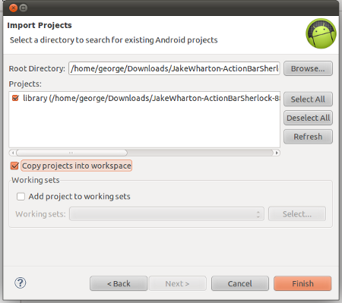
Select the “library” directory as the root directory of the new project
May & June 2012 Recruiting Plan
© 2014 Unbounded Solutions
74

Slide 75
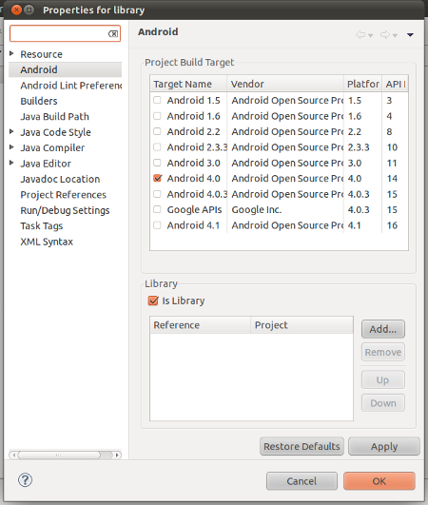
Ensure that this project is a library.
May & June 2012 Recruiting Plan
For this right click the new project created in the above step in Project Explorer and click the menu “Properties” and tick the checkbox “Is Library” as shown below and click OK.
© 2014 Unbounded Solutions
75

Slide 76
Note: Add it while building
May & June 2012 Recruiting Plan
For this right click the new project created in the above step in Project Explorer and click the menu “Properties” and tick the checkbox “Is Library” as shown below and click OK.
Add Action Bar Sherlock library to this project
Open Project Explorer
Right click the project
Open Properties
Select “Android” tab from the Properties Window
Then the given below screen will be appeared
Using Add button, add the Sherlock library to this project
© 2014 Unbounded Solutions
76

Slide 77
EXERCISE

