Slide 1
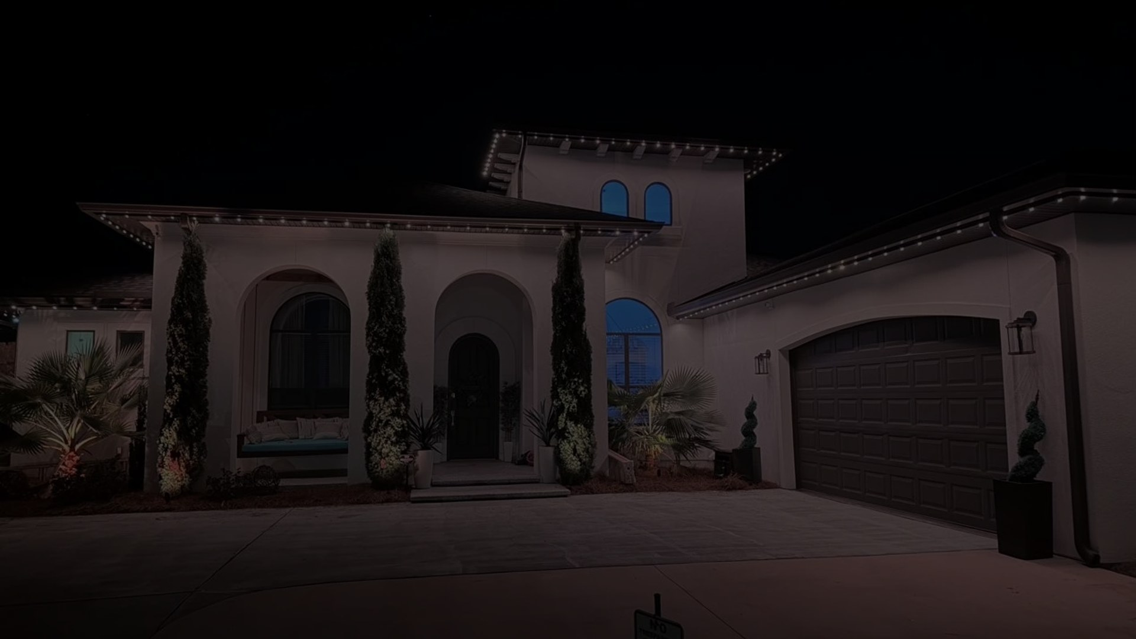

LIGHTING PARTNER PROGRAM
You run the jobs.
We run your growth. Launch and beyond.
A full lighting business build out, paid for as a sliding share of what you actually earn. Every fee dollar buys you the site outright.
Brighter Nights Lighting Technologies · Founding round, 10 seats nationwide

Slide 2

Every contractor hits the same wall
Getting into permanent lighting is easy. Getting found, quoting fast, and closing is the hard part.
No website that converts
Nobody teaches lighting sales
Marketing agencies do not know lighting
Template sites, no estimator, no booking, no photos of real installs.
Bids, upsells, controller demos, seasonal programming. You learn it the expensive way.
$2K to $10K a month, 4 to 8 months to launch, and the site disappears when you cancel.
No proof to show homeowners
Franchises take the upside
Your first jobs are your only portfolio.
$20K to $75K upfront plus 6 to 10% forever, and you build their brand.
Source: Scorpion, Blue Corona, Hook Agency published pricing 2026; FMS Franchise, Franchise Creator royalty benchmarks 2026
BRIGHTER NIGHTS · LIGHTING PARTNER PROGRAM
2

Slide 3

The promise
We build the whole growth engine around your brand, and we keep running it.
Launch
Train
Grow
Own
Website, SEO, instant estimates, online booking, AI assistant, tracking, ad accounts, photo and video library.
Masters of Lighting Academy, three playbooks, sales and bid support, install troubleshooting.
Weekly rankings report, standing check ins, competitor site reviews, matched ad spend, ongoing builds.
Every fee dollar credits toward the site. Earn it out and it is yours, domain, content, ad accounts.
BRIGHTER NIGHTS · LIGHTING PARTNER PROGRAM
3

Slide 4

Who this is for
Founding round is 10 seats, one per county, two onboarded per month.
Contractors already in a trade (roofing, electrical, landscape, pool, gutters) adding permanent lighting
Owner operators who can install and want to stop chasing leads
Willing to match 30% of our fee into local marketing
Exclusive county territory, your own brand name, no franchise
Pass a short qualification screen before a seat is offered
10
founding seats nationwide
1 per county
exclusive territory, your name on the truck
BRIGHTER NIGHTS · LIGHTING PARTNER PROGRAM
4

Slide 5
What you get
Twelve pieces that normally cost $95K to $189K if you bought them one at a time.
Custom lighting website
SEO foundation and local rankings
Instant estimate tool
Online booking with deposits
AI assistant trained on lighting
Tracking and rankings dashboard
Photo and video library, thousands of installs
CRM built into the site
Ad accounts and landing pages
White labeled sales collateral
Three contractor playbooks
Masters of Lighting Academy
Add install photos here before presenting
BRIGHTER NIGHTS · LIGHTING PARTNER PROGRAM
5

Slide 6
Masters of Lighting Academy
Training and a partner community, so you are never figuring this out alone.
Contractor Mastery Series, sales, bidding, install, troubleshooting
Live partner community, partners answer partners, moderators before Austen
Weekly office hours and standing check ins
Certified installer directory listing on brighternights.com
MOLA is training. MOL (Masters of Light) is our rep program. Different things.
Your time with us
1 to 2 hours a week with your partner manager. The rest of our time goes into building and ranking your site.
BRIGHTER NIGHTS · LIGHTING PARTNER PROGRAM
6

Slide 7
How it is paid for
No upfront bill. A sliding share of gross lighting revenue that drops as you grow.
Your annual gross revenue | Fee on that portion
First $250,000 | 7%
$250,000 to $500,000 | 6%
$500,000 to $750,000 | 5%
$750,000 to $1,000,000 | 4%
Above $1,000,000 | 3%
Marginal, like tax brackets
Each tier only applies to the dollars inside it. At $1M gross the blended rate is 5.5%. At $1.5M it is 4.7%.
We reinvest 30% of our fee into your ads. You match that 30% locally.
BRIGHTER NIGHTS · LIGHTING PARTNER PROGRAM
7

Slide 8
What it looks like in dollars
Fee by annual gross, marginal tier math. Your profit after fee stays above 90% at every level.
$32,500
fee at $500K gross (6.5% blended)
$55,000
fee at $1M gross (5.5% blended)
$70,000
fee at $1.5M gross (4.7% blended)
BRIGHTER NIGHTS · LIGHTING PARTNER PROGRAM
8

Slide 9
We reinvest in you
30% of every fee dollar goes straight back into your ads. You match it.
Combined ad budget
$19,500 a year at $500K gross
$33,000 a year at $1M gross
$42,000 a year at $1.5M gross
Managed by us, tracked on your dashboard, every lead sourced.
BRIGHTER NIGHTS · LIGHTING PARTNER PROGRAM
9

Slide 10
Your site has a real, stated value
We value every piece we build at what another company would charge, plus what it would cost you to teach an agency lighting.
Part 1 · Market replacement cost | $102,650
Custom site, SEO, estimator, booking, AI assistant, tracking, library, CRM, ads, collateral, playbooks, MOLA, hosting
Part 2 · Your time not spent teaching an agency | $27,000
180 hours explaining lighting, correcting their work, sourcing photos and video, at $150 an hour
Part 3 · Revenue not lost to a 5 month agency delay | $71,750
5 months, $41K a month, 35% of jobs driven by the site
Ledger opening value | $201,400
Live evaluator
Every line item has a low, mid, and high market rate. Check what was built, enter your numbers, and the ledger updates. Weekly report shows the live balance.
Source: 2026 published agency and freelance rates for home service contractors, midpoint used
BRIGHTER NIGHTS · LIGHTING PARTNER PROGRAM
10

Slide 11
Every fee dollar buys the site
100% of what you pay us credits against the ledger. Reach it and the site is yours.
~Year 5
a partner growing $500K to $1.6M owns the site
100%
of every fee dollar credits the ledger
On exit you keep the domain, the content license, and your ad accounts. No more fees.
BRIGHTER NIGHTS · LIGHTING PARTNER PROGRAM
11

Slide 12
Want more than the base site
Add ons are your call. They raise the value of what you own and go on the ledger at rate card.
1
You email the request
2
We price it off the rate card
3
Written quote to you
4
Your written approval, nothing builds without it
5
We ship it
6
Ledger updates on ship date, dashboard next week
Routine maintenance never counts toward the ledger. Only things you ask for. If your add on pace projects a buyout past year 7 we flag it before you approve.
BRIGHTER NIGHTS · LIGHTING PARTNER PROGRAM
12

Slide 13
Beyond launch
This is not a one time build. We keep running your growth.
Rankings dashboard
Weekly report
Standing check ins
Competitor reviews
Keywords, positions, and every lead sourced, updated live.
Ledger balance, buyout price, fee tier, what shipped.
1 to 2 hours a week with your partner manager.
We watch competitor sites and propose what to add.
BRIGHTER NIGHTS · LIGHTING PARTNER PROGRAM
13

Slide 14
The market is moving fast
Outdoor lighting is growing, and permanent lighting is the fastest piece of it.
45 to 60%
annual growth in permanent lighting installs
25 to 45%
typical margins on installed jobs
Source: Grand View Research outdoor lighting 2024 to 2030; Trimlight, Strandr dealer reports 2026
BRIGHTER NIGHTS · LIGHTING PARTNER PROGRAM
14

Slide 15
Ranking is the whole game
Position one on Google gets four times the clicks of position three.
What that means for you
A site built to rank for "permanent lighting" plus your county wins the click before the homeowner ever sees a competitor. Our SEO foundation ships on day one and we report on it weekly.
Source: First Page Sage Google CTR study 2026
BRIGHTER NIGHTS · LIGHTING PARTNER PROGRAM
15

Slide 16
Instant tools close more jobs
Homeowners who can price and book on the spot convert at two to four times the rate.
391%
lift in conversion when a lead is answered inside one minute
24/7
AI assistant answers product and pricing questions while you sleep
Source: PipelineOn, MyQuoteIQ, CallRail home services conversion studies 2026
BRIGHTER NIGHTS · LIGHTING PARTNER PROGRAM
16

Slide 17
Versus a marketing agency
Same money, very different outcome.
 | Lighting Partner Program | Typical agency (Scorpion, Blue Corona, Hook)
Monthly cost | 0 upfront, 3 to 7% of gross | $2,000 to $10,000+ flat, win or lose
Knows permanent lighting | Yes, we make the product | No, you teach them
Time to launch | Weeks | 4 to 8 months
Ownership on cancel | Every fee dollar credits toward owning it | Site disappears
Photo and video | Thousands of real installs included | You supply or they stock
Contract | 3 year, county exclusive, buyout any time | 12 month lock in, no exit value
Source: Agency pricing pages and Built With Dias, Local Service Mastery reviews 2026
BRIGHTER NIGHTS · LIGHTING PARTNER PROGRAM
17

Slide 18
Versus a franchise
You keep your name and the upside.
 | Lighting Partner Program | Home service franchise | Trimlight dealer
Upfront | $0 | $20K to $75K | Product only
Ongoing | 7% down to 3%, credits to ownership | 6 to 10% royalty forever | Materials markup
Your brand | Yes | No | No
Website and tools | Included and earned out | Templated, theirs | Not included
Territory | County exclusive | Assigned | Assigned
Source: FMS Franchise, Franchise Creator, CT Acquisitions 2026; Trimlight dealer program
BRIGHTER NIGHTS · LIGHTING PARTNER PROGRAM
18

Slide 19
How it works
From first call to launch in weeks, not months.
1
Qualification call
2
Territory check and seat offer
3
Agreement signed, 3 year term
4
Site, tools, and ads built (2 to 4 weeks)
5
MOLA onboarding and first bids
6
Launch, weekly reports begin the following week
BRIGHTER NIGHTS · LIGHTING PARTNER PROGRAM
19

Slide 20
The fine print
Plain language now, attorney language in the agreement.
3 year term, county exclusive, your own brand name
Fee is on gross lighting revenue, reported monthly, verified against distributor purchases
Buyout any time: current ledger balance plus 3 months trailing fee, minus 100% of fees already paid
Add ons only at your written approval, added to the ledger at rate card on ship date
Routine maintenance and hosting never raise the ledger
On exit you keep domain, content license, ad accounts. Photo library stays licensed to you
Optional equity conversion clause available, not required
Cancel any time, the ledger math still applies
BRIGHTER NIGHTS · LIGHTING PARTNER PROGRAM
20

Slide 21
What this is, and is not
Not an agency
Not a franchise
Not a one time build
Not generic
We know lighting because we make it. Nothing to teach us.
Your name, your brand, your county. No royalty forever.
Weekly reports, standing check ins, ongoing builds.
Every tool, photo, and playbook is built for permanent lighting.
BRIGHTER NIGHTS · LIGHTING PARTNER PROGRAM
21

Slide 22
Ten seats. One per county.
Two partners onboarded a month. When your county is taken, it is taken.
BOOK A QUALIFICATION CALL
BRIGHTERNIGHTS.COM
407-469-7093 · austen@brighternights.com

