Slide 1

CropXpert
IoT-Enabled, ML-Driven Precision Agriculture Platform with Multilingual Farmer Support Portal
Minor Project | Department of CINTEL, School of Computing | SRM Institute of Science and Technology, Kattankulathur
Team: Adnan Nagdiwala (RA2311026010119) | Chandra Bhayal (RA2311026010072) | Guide: Dr. R. Siva | Academic Year: 2024–2025

Slide 2

The Problem — India's Farming Crisis
40%
50+
31%
Yield Loss
Lab Distance (km)
No 4G Coverage
Yield loss from poor crop-soil matching among 140M+ Indian smallholders
31% of Indian villages have no 4G internet; farmers rely on intuition, not data
No affordable soil testing — nearest lab is 50+ km away for most farmers
Indian farmers need real-time soil intelligence — not a lab appointment.

Slide 3
Introducing CropXpert
CropXpert is an integrated IoT + ML platform that reads soil data in real-time, recommends the most profitable crop using AI, and connects farmers to government welfare — all in their own language, from any device including basic keypad phones.
Real-Time NPK + pH + Moisture Sensing
Random Forest ML (89.2% accuracy, 22 crops)
Complete IoT Hardware: ≈ ₹3,600
Live Market Prices via AGMARKNET API
4 Indian Languages (Hindi, Marathi, Tamil, Telugu)
WhatsApp + SMS CropBot (zero smartphone required)
Government Schemes & Loan Advisory Portal

Slide 4

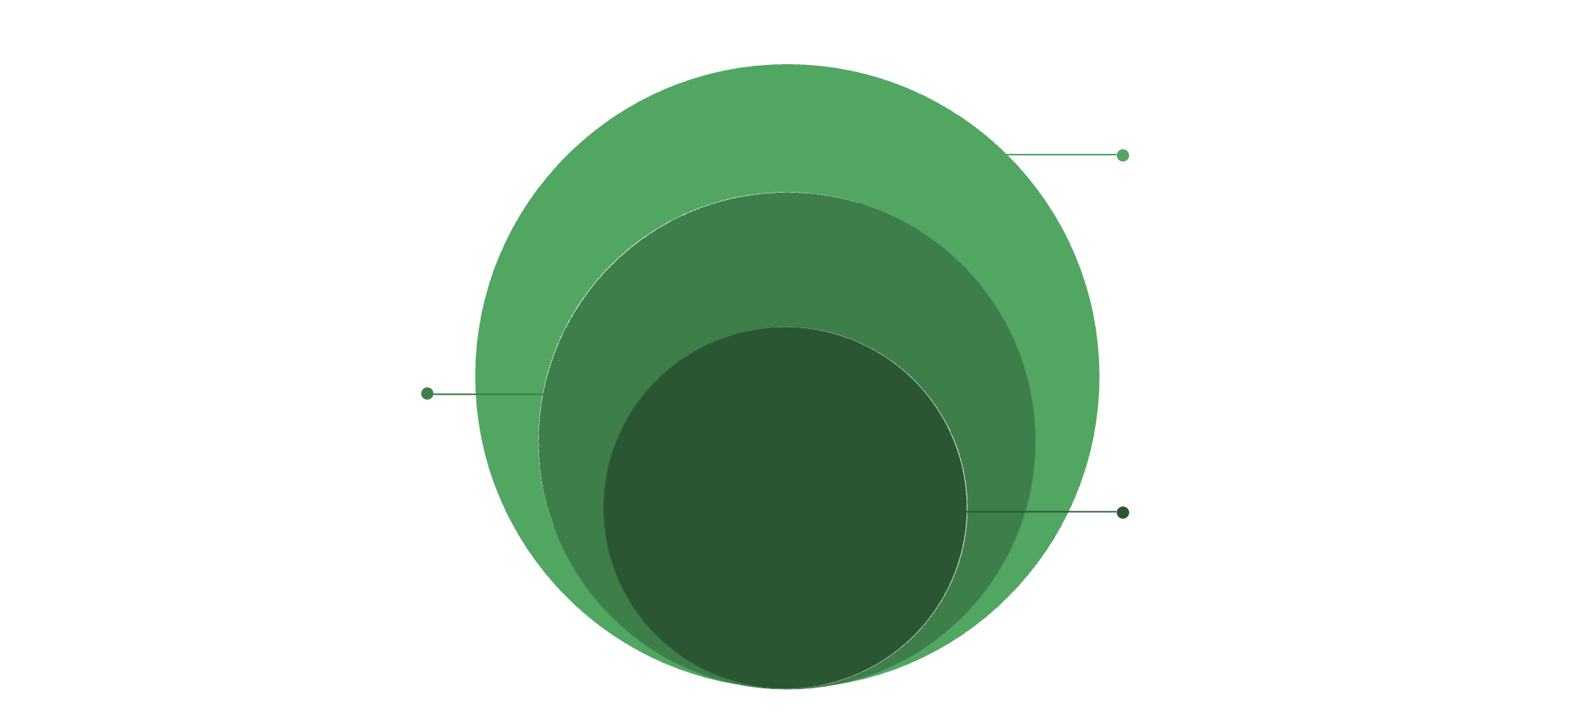
System Architecture — 5-Layer Microservices Design
Processing & Interfaces
ML + DB, Frontend, Twilio for farmers
MQTT Broker
Event-driven message routing
Core IoT Sensors
Field sensors collecting telemetry
Architecture Style: Microservices + Event-Driven (MQTT) | LoRa Extension (v2.0): 5–15 km offline rural coverage

Slide 5
IoT Hardware Module — Field Sensor Unit
Bill of Materials (BOM)
Component
Specification
Cost (₹)
RS485 NPK Sensor
N, P, K in mg/kg
1,800
Soil pH Sensor
Analog, ±0.1 accuracy
350
Capacitive Moisture Sensor
0–100%, corrosion-resistant
200
DHT22 Temp + Humidity
±0.5°C, ±2–5% RH
250
Arduino UNO
ATmega328P
500
ESP8266 Wi-Fi Module
MQTT over Wi-Fi
200
Miscellaneous
Wires, PCB, case
300
TOTAL
—
≈3,600
Data Pipeline: Sensor → MAX485 → Arduino → ESP8266 → MQTT → Cloud

Slide 6
ML Recommendation Engine — 89.2% Accuracy
Dataset Overview
Model Comparison
Feature Importance
2,200 samples, 22 Indian crops
Kaggle + ICAR augmentation
7 features: N, P, K, pH, Moisture, Temp, Rainfall
70/15/15 train/val/test split
5-fold cross-validation
Model
Accuracy
Rainfall: 28.4%
Humidity: 21.7%
NPK combined: 21.5%
pH: 16.3%
Temperature: 12.1%
Random Forest ✓
99.2%
XGBoost
98.7%
LightGBM
98.5%
Inference: 2.3 ms | Model: 4.7 MB
SVM (RBF)
97.8%
MLP (Neural Net)
97.1%

Slide 7

What Makes CropXpert Unique
5 Novel Contributions
Market-Aware Recommendation
Vernacular-First Interface
First Indian crop recommender integrating live AGMARKNET MSP data into AI ranking
Hindi, Marathi, Tamil, Telugu — covering 400M+ Indian farmers who don't read English
Score(c) = 0.60×P_ML + 0.25×MSP_Index + 0.15×SeasonDemand
Zero-Smartphone Access
LoRa Offline Extension (v2.0)
Farmers text CROP N90 P42 K43 PH6.5 DIST PUNE via SMS shortcode — any ₹500 keypad phone
LoRa SX1276 + ESP32 + RAK2245 gateway → 5–15 km rural coverage, 1,000 nodes/gateway
Integrated Welfare Portal
PM-KISAN, PM Fasal Bima, KCC, NABARD loans — all in one place, auto-filtered by state

Slide 8
Farmers Support Portal — Closing the Welfare Gap
Government Schemes
PM-KISAN (₹6,000/yr), PM Fasal Bima Yojana, Soil Health Card Scheme, PMKSY irrigation
Auto-filtered by state | Live apply links | Monthly updates from MyScheme.gov.in
Loan & Financial Guidance
KCC at 0–4% interest, NABARD zero-interest schemes, state loan waivers
EMI calculator for KCC | Eligibility checker
Farm Profit Calculator
Input: crop + acreage + location → Output: estimated input cost, expected yield, net profit
Comparison table for top-3 recommended crops side by side
CropBot (WhatsApp + SMS)
WhatsApp: Natural language in Hindi/English → Twilio webhook → ML API → formatted reply
SMS: Structured shortcode → MSG91 → top-1 crop + MSP price in 160 characters
Coverage: 4 languages | 22 crops | 6 schemes | 5 loan programs | 2 bot channels

Slide 9
Agile Roadmap — 5 Sprints, 30 User Stories
Sprint 1 (Weeks 1–2) — IoT Sensor Module Done
1
5 stories | NPK + pH + Moisture + DHT22 + Rainfall API | 16 days
2
Sprint 2 (Weeks 3–4) — ML Engine + Web App In Progress
6 stories | RF model 99.2% | FastAPI /predict | React dashboard | User auth | 25 days
Sprint 3 (Weeks 5–6) — Market Layer + Portal Pending
3
6 stories | AGMARKNET MSP | Weighted scoring | Govt schemes | Fertiliser advisor | 22 days
4
Sprint 4 (Weeks 7–8) — Multilingual UI + CropBot Backlog
7 stories | 4-language UI | WhatsApp/SMS bot | Offline PWA | Profit calculator | 35 days
Sprint 5 (Future) — LoRa + ESP32 Extension Roadmap
5
3 stories | ESP32 migration | LoRa SX1276 | PM-WANI backhaul | 23 days
MoSCoW Summary: Must: 14 | Should: 10 | Could: 4 | Won't: 2

Slide 10
CropXpert — Impact, SDG Alignment & Future Roadmap
SDG Impact
Future Roadmap (v2.0)
Summary Statistics
SDG 2: Zero Hunger — 40% yield loss reduction through precision soil advisory
LoRa SX1276 field deployment (50 villages, Pune district pilot)
Expand to 50+ crops with ICAR dataset augmentation
Satellite NDVI integration for remote field health monitoring
TensorFlow Lite disease detection from leaf photos
Deployment partnership with KVK (Krishi Vigyan Kendra)
✓ 99.2% ML accuracy across 22 Indian crops
✓ 7-feature real-time sensor pipeline
SDG 8: Decent Work — Farmer income increase via market-aware crop selection
✓ 4 Indian languages, 400M+ potential users
SDG 15: Life on Land — Optimised fertiliser use, reduced soil degradation
✓ ≈ ₹3,600 complete hardware BOM
✓ WhatsApp + SMS = zero smartphone barrier
SDG 9: Innovation — IoT + ML democratised for subsistence farmers at ₹3,600
✓ Guide Accepted | SRMIST CINTEL
Empowering every Indian farmer — regardless of language, literacy, or internet — with the intelligence to farm smarter.

