Slide 1
9999
9999
5 | 5 | 5
arr
arr[0]
arr[1]
arr[2]
10
a
for(int a : arr)
System.out.print(a);

Slide 2
0x9999
0x9999
100 | 20 | 30 | 40 | 50
score
[0] [1] [2] [3] [4]
0x9999
int[] score = {100,20,30,40,50};
int[] s = score;
int i = 10;
int j = i
s

Slide 3
0x9999
0x9999
100 | 20 | 30 | 40 | 50
score
[0] [1] [2] [3] [4]
0x1111
99 | 20 | 99 | 40 | 50
0x1111
[0] [1] [2] [3] [4]
s
int[] score = {100,20,30,40,50};
int[] s = score;

Slide 4
0x9999
0x9999
“영희” | “철수” | “길동” | “영수” | “말자”
names
[0] [1] [2] [3] [4]
0x1111
160 | 190 | 170 | 180 | 158
0x1111
[0] [1] [2] [3] [4]
heights

Slide 5
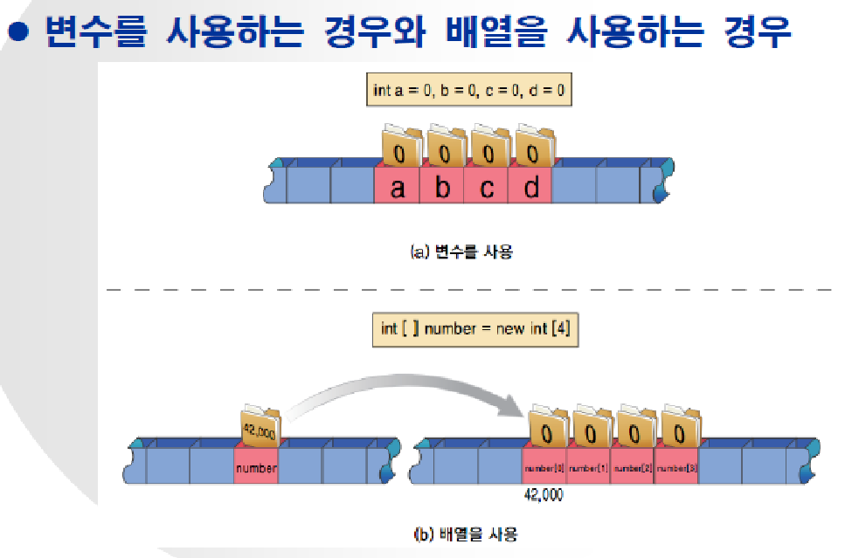

Slide 6
int test[2][3] = new int[2][3];
test[0][1] = 200;
test[0][0] | test[0][1] | test[0][2]
test[1][0] | test[1][1] | test[1][2]

Slide 7
Int[][] test = new int[2][3];
test[0][1] = 200;
0x8888
test[0] : 0x1111 | test[1] : 0x2222
0x8888
test
0x1111
test[0][0] | test[0][1] | test[0][2]
0x2222
test[1][0] | test[1][1]

