Slide 1
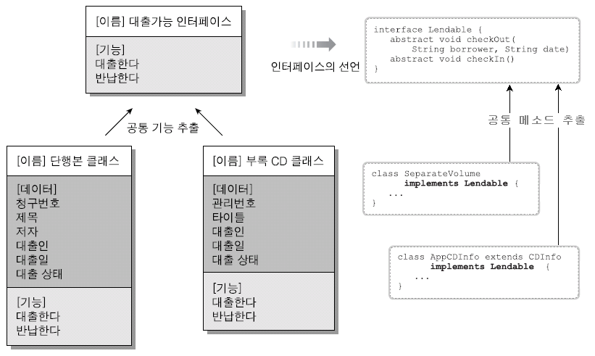
상속과 인터페이스

Slide 2
1:대출처리(책이름,대출인,대출일)
2:반납처리(책번호)
ILendable
STATE_BORROWED=1
STATE_NORMAL=0
checkOut(String, String);
checkIn();
printState();
BookInfo
String bookNo
String bookTitle
String writer
Object
String bookNo
String bookTitle
String writer
String borrower
String checkOutDate
byte state
checkOut(String, String);
checkIn();
printState();
extends
implements
BookLib
String borrower
String checkoutDate
byte state (0, 1)

Slide 3
1:책대출 2:CD대출 3:책반납 4:CD반납 0:종료
BookInfo
String bookNo
String bookTitle
String writer
ILendable
STATE_BORROWED=1
STATE_NORMAL=0
checkOut(String, String);
checkIn();
printState();
CDInfo
String cdNo
String cdTitle
Sting bookNo
extends
implements
implements
extends
BookLib
String borrower
String checkoutDate
byte state (0, 1)
CDLib
String borrower
String checkoutDate
byte state (0, 1)

Slide 4
main함수
BookLib[] books = { new BookLib("a01", "java", "신용권"),
new BookLib("a02", "jsp", "아무개"),
new BookLib("a03", "Oracle", "홍길동"),
new BookLib("a04", "mySQL", "이마이"),
new BookLib("a05", "Servlet", "서블리") };
CDLib[] cds = { new CDLib("c01", "java_cd", "a01"),
new CDLib("c02", "ITtrend", null),
new CDLib("c03", "jsp", "a02") };
Scanner sc = new Scanner(System.in);
int fn, idx;
do {
System.out.print("1:책대출 | 2:CD대출 | 3:책반납 | 4:CD반납 | 0:종료 ?");
fn = sc.nextInt()
switch(fn){
case 1: //책대출
case 2: //CD대출
case 3: //책반납
case 4: //CD반납
}
}while(fn!=0);
// books 과 cds 배열의 상태를 출력

Slide 5
Account
String accountNo
String ownerName
int balance
void deposit(int amount)
int withdraw(int amount)
void printAccount()
Account a1 = new Account(“111-1111”,”홍길동”,10);
Account a1 = new Account(“111-1111”,”홍길동”);
계좌번호 뭐, 예금주 누구, 잔액 얼마
CheckingAccount String cardNo
int pay(String cardNo, int amount)
CkeckingAccount ca1 =
new CkeckingAccount(“111-1111”,”김길동”,[1000,] ”1234-1234-1234-1234”);
카드 번호가 틀리면 ?
CreditLineAccount long creditLine;
int pay(String cardNo, int amount)
CreditLineAccount cla1 =
new Account(“111-1111”,”박길동”,[1000,]
”1234-1234-1234-1234”,
2200000000L);

Slide 6
public static void main(String[] args) {
Account a1 = new Account("111-1111", "홍길동");
CheckingAccount a2 = new CheckingAccount("222-2222", "성춘향", 2000, "1234-1234-1234-1323");
CheckingAccount a3 = new CreaditLineAccount("222-2222", "성춘향", 2000, "1234-1234-1234-1323", 2000);
a1.deposit(3000);
a2.withdraw(200);
a3.deposit(3000);
a1.printAccount();
a2.pay("1234-1234-1234-1323", 200);
a3.pay("1234-1234-1234-1323", 5000);
}

