Slide 1
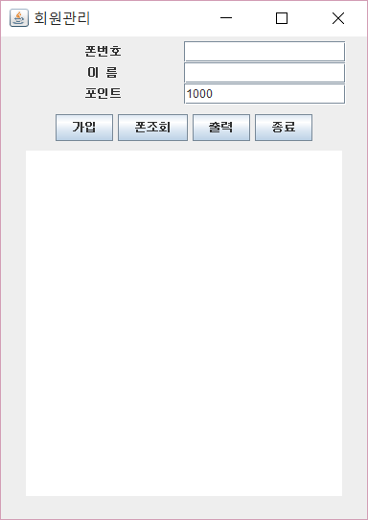
15
jtxtPhone;JTextField
jtxtName
jtxtPoint
JLabel
Jpanel ; jpup
Jpanel ; jpdown
JButton
jbtnJoin jbtnSearch jbtnOutput jbtnExit
15
contenPane;Container
30
jta(JTextArea) – 자동 JScrollPane 생성

