Slide 1
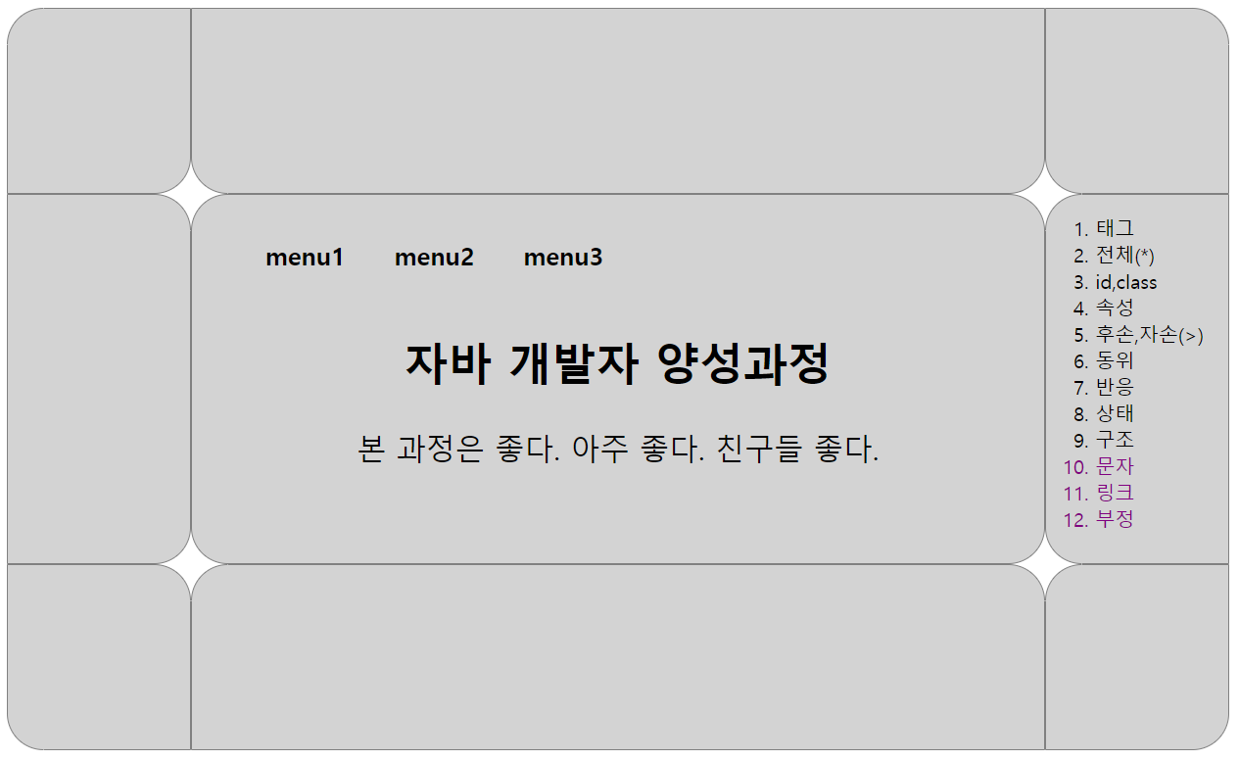
1000px
id=header
class=left
class=center
class=right
id=content
300px
id=footer
150px
150px

