Slide 1
BVCOG- Contract Management
Fall 2024
Chi-Ming Lee, Xinyi Zhao, Jingrui Mao, Kumaran Gowrisankar, Zhicheng Chen, Jingyuan Mu, Zhaoming Xu, Nathaniel Bright,

Slide 2
01
Introduction

Slide 3

Introduction
-Brazos Valley Council of governments is looking for a tailored software to manage their contracts.
-We worked on the third iteration of the project, focusing on adding key functionalities to make the software desirable to the client.
-Highlighting the Agile method, allowed us to update and refine the software to their exact needs.

Slide 4
02
Primary Areas of Improvement

Slide 5
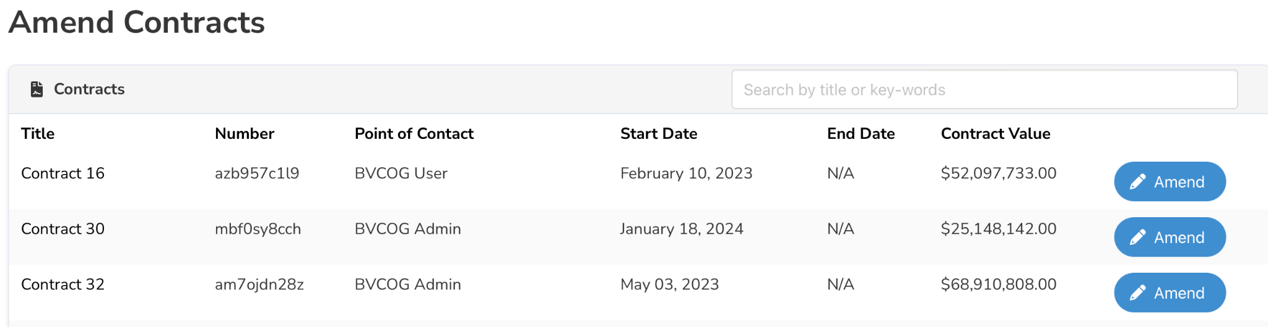
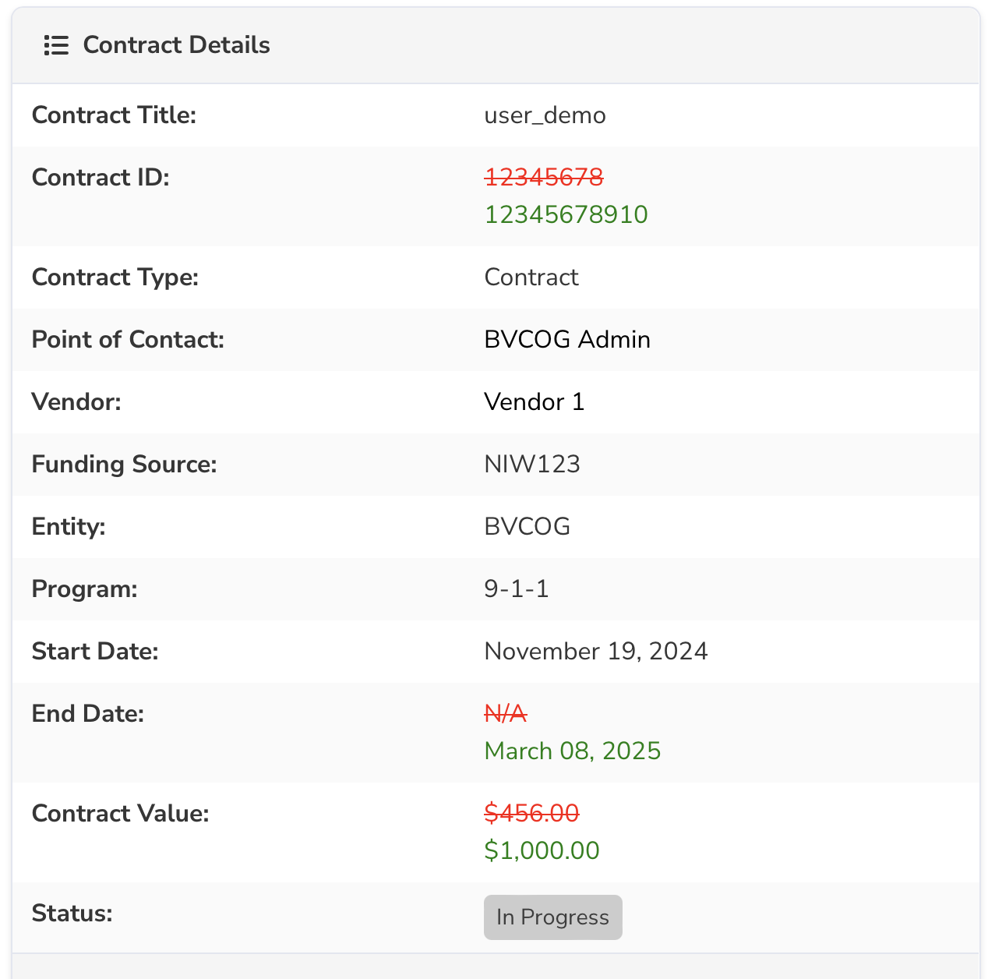
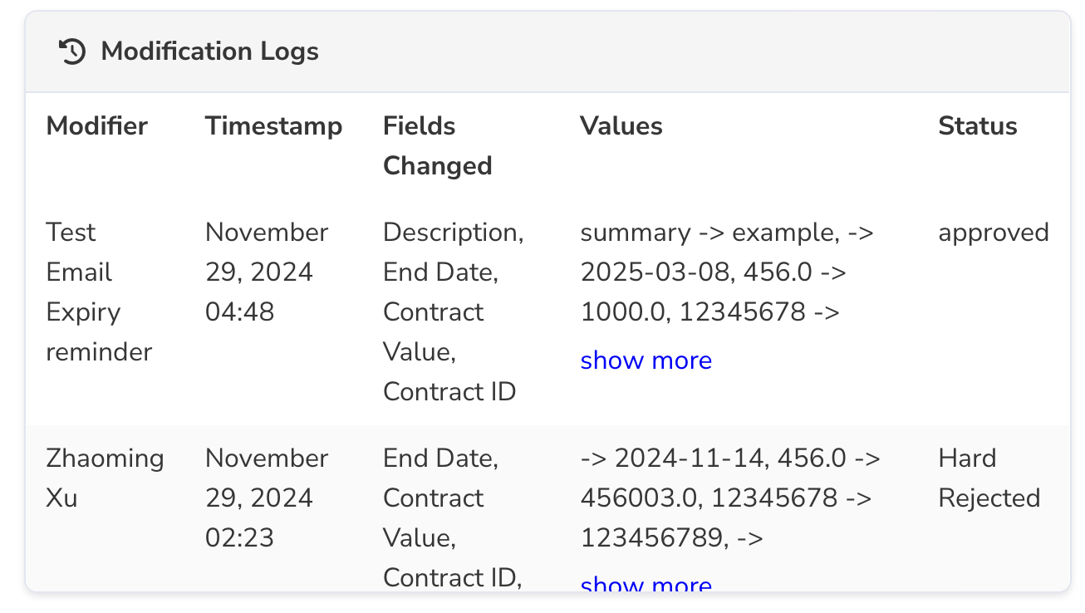
Amend Contract Page
Added a page to amend contracts, primarily for extending contract duration.
Displays changes between old and new values in the UI before approval.
Once approved, saves the modification details (old and new values) in a modification log.
Past modifications are displayed on the contract details page.
Notes:
Challenge: Designing a database to store modification records by creating a new modification log linked to contracts. It records details such as old and new values, the modifier, and other relevant information.

Slide 6
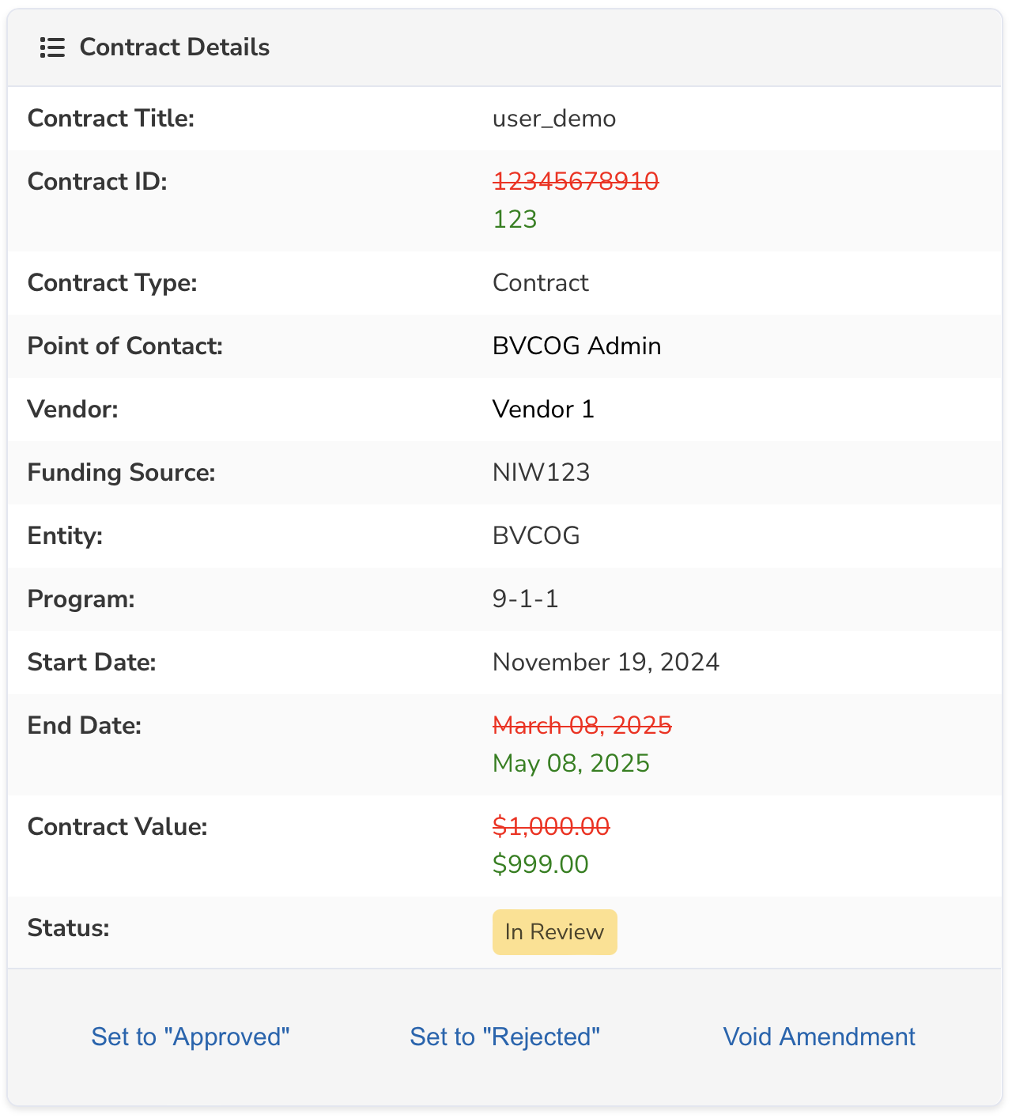
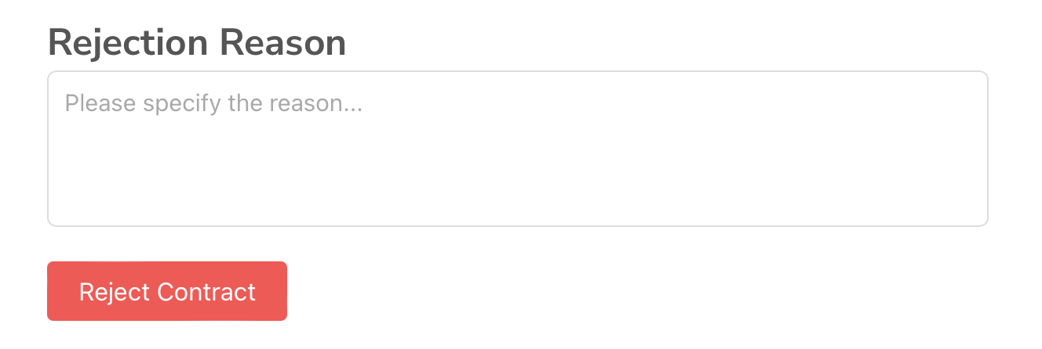
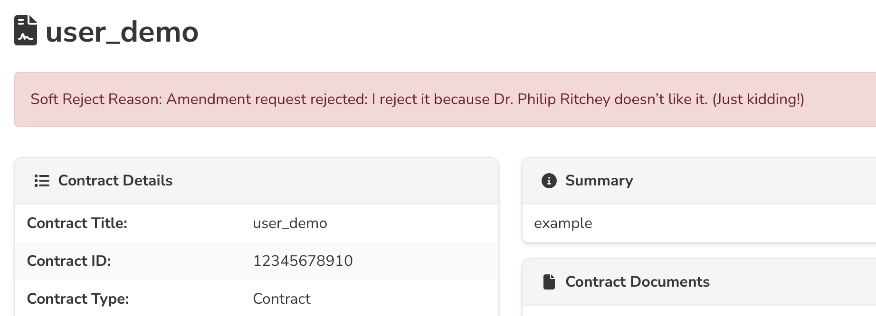
Hard/Soft Rejection
Gatekeepers can approve, reject, or void contract amendments.
Reject: The contract remains "in progress," allowing users to edit and resubmit the amendment for review.
Void: The amendment is marked as invalid, requiring no further action or edits.
Notes:
Challenge:
Contracts can have three statuses: approved, in review, and in progress, each with different contexts. For instance, in review could apply to either contract creation approval or amendment approval, while in progress could refer to the creation process or an ongoing amendment. Additionally, with three possible actions (approve, reject, and void) and three different user levels, designing a consistent and functional contract amendment workflow became highly challenging. The UI needed to dynamically adjust to display appropriate information based on various scenarios.

Slide 7
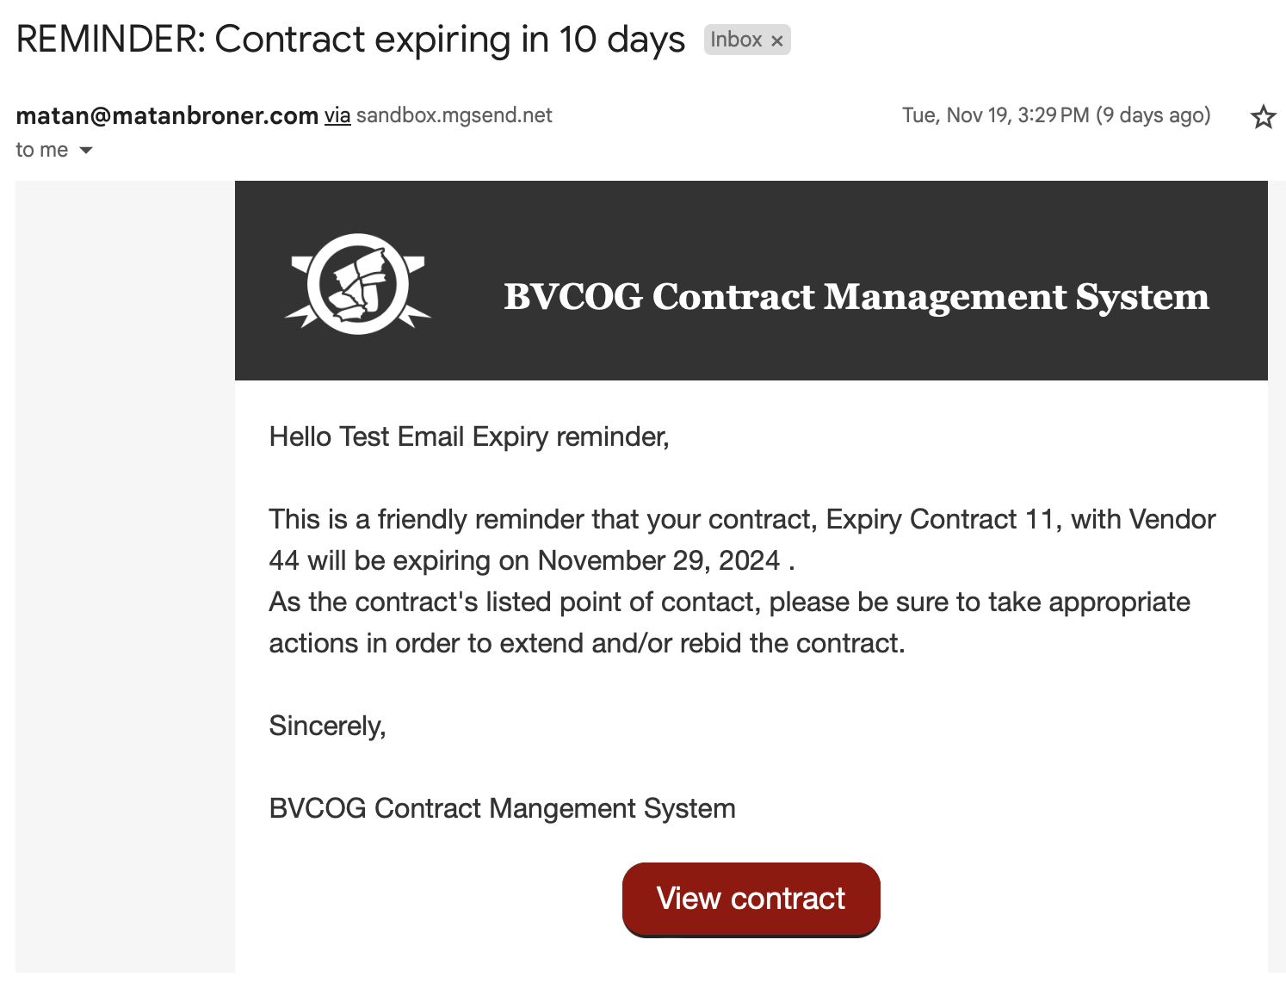
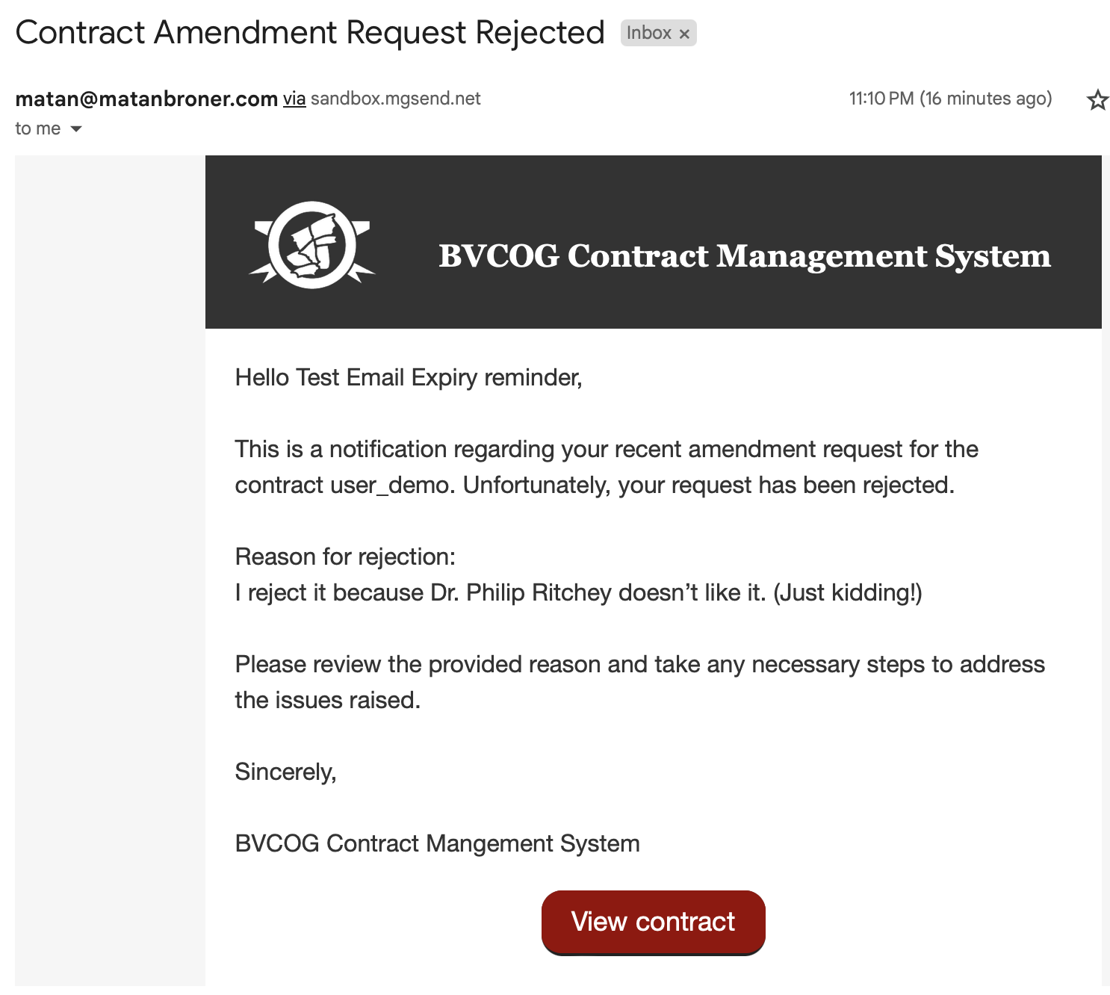
Email Functionalities
Expiry Reminder: Sends notifications to users for contracts nearing expiration.
Expiration Report: Monthly report listing all contracts approaching expiration.
Reject Amendment: Sends rejection reason and contract link to the requester.
Void Amendment: Sends void reason and contract link to the requester.

Slide 8
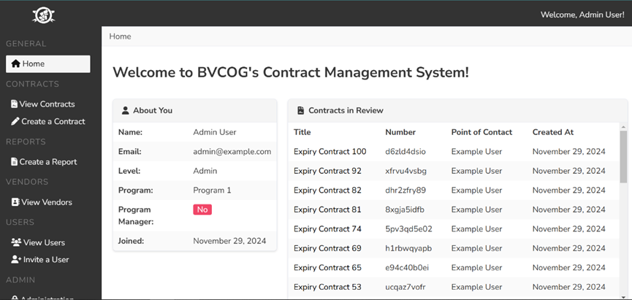
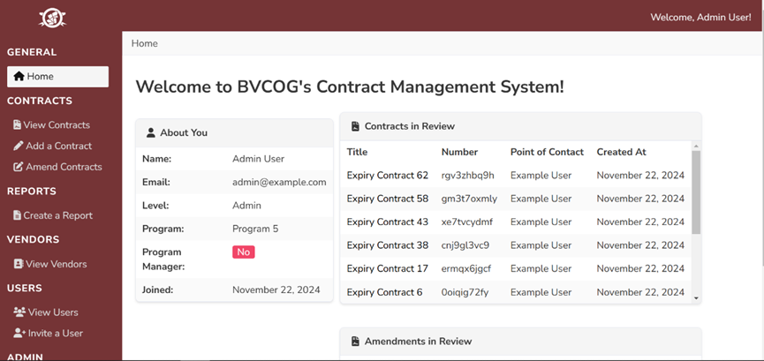
UI design & Visual Changes —— General Page
Changed the color of the page: the original black page has been changed to A&M's unique burgundy page.

Slide 9
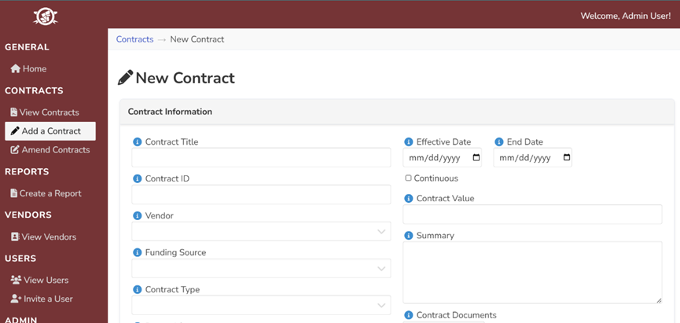
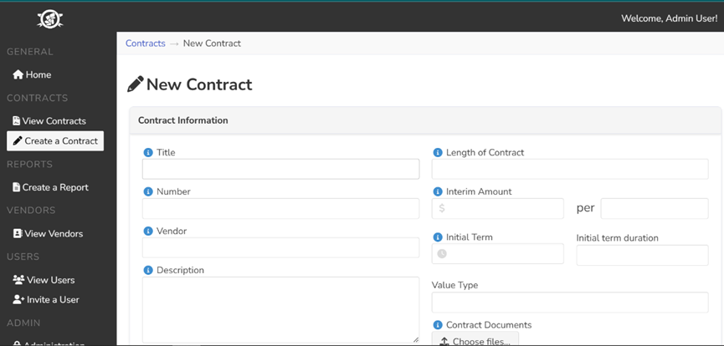
UI design & Visual Changes —— Contract Page
We have made changes in the following features in the contract page：
Hint close button
Dropdown changes
Field changes

Slide 10
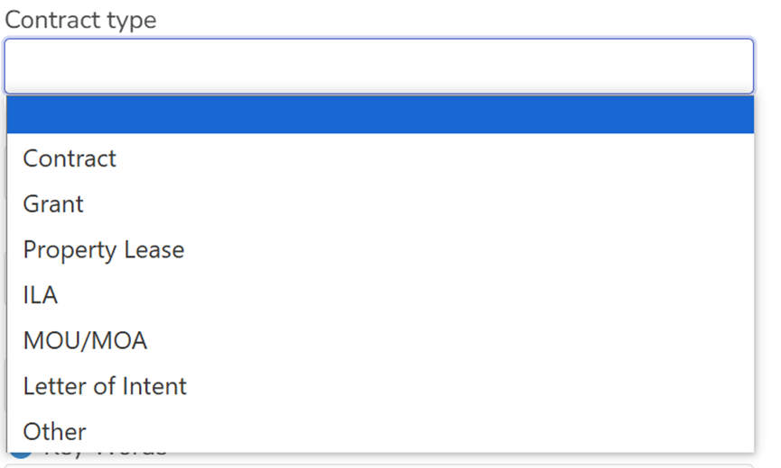
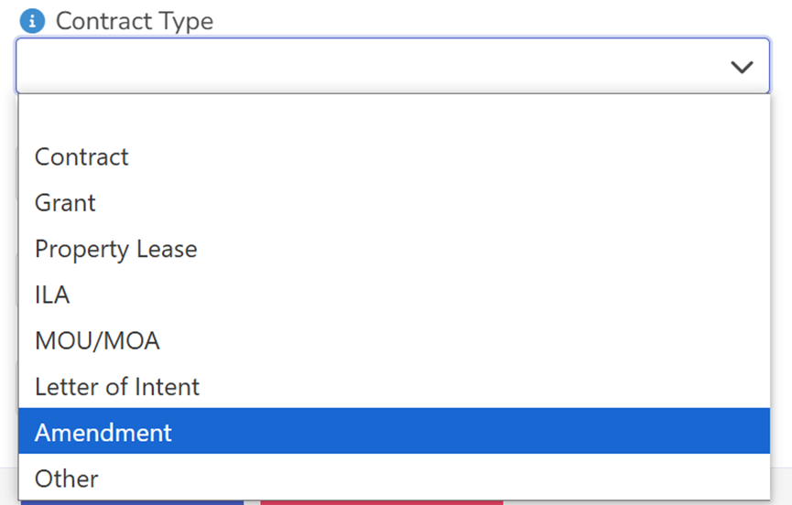
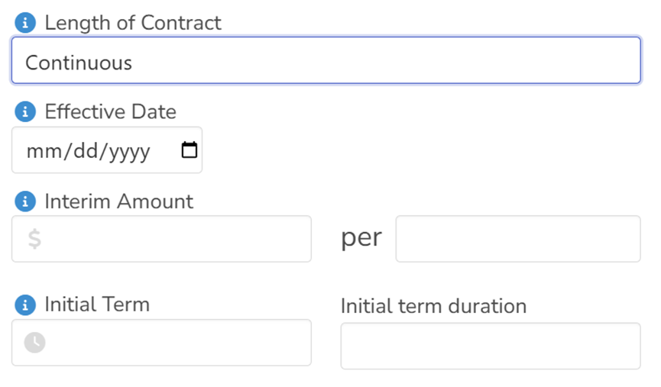
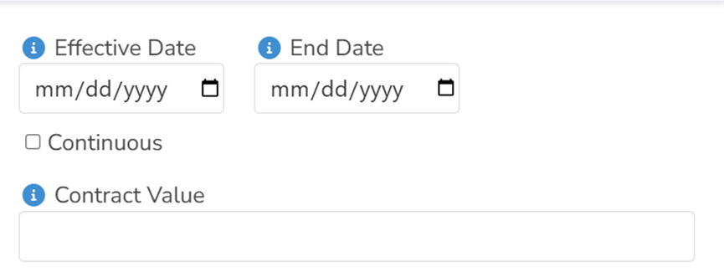
UI design & Visual Changes —— Contract Page
Added amendment option
Removed the contract timeframe option and replaced it with the option to only enter the start and end dates of the contract
Change the original contract amount from phased calculation to directly enter the total amount, so that the overall simplicity and aesthetics, without the need for complex calculations

Slide 11
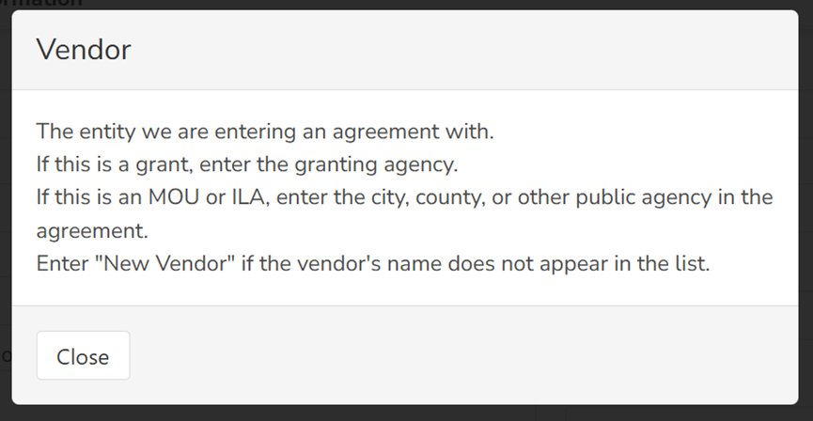
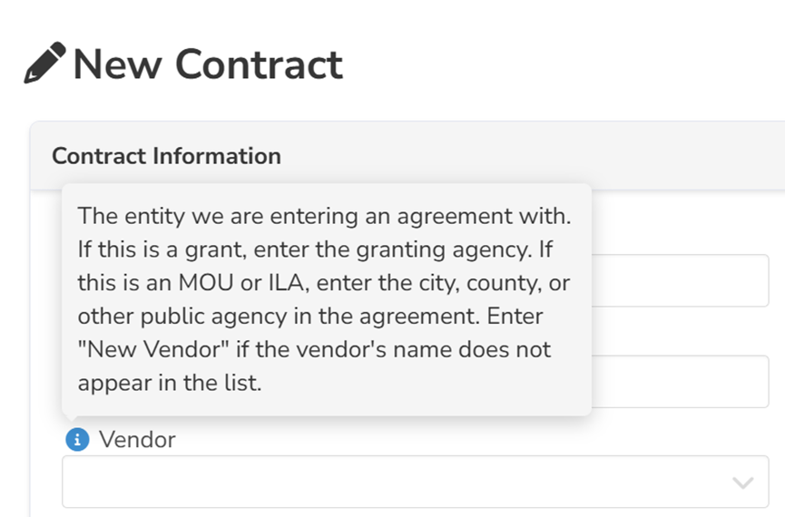
UI design & Visual Changes —— Contract Page
Older hints required clicking the hint button to open and then clicking the close button to close, which was a time-consuming operation. The new feature allows you to display the contents of the hints by moving the cursor to the hints, and closes them automatically when you move the cursor.

Slide 12
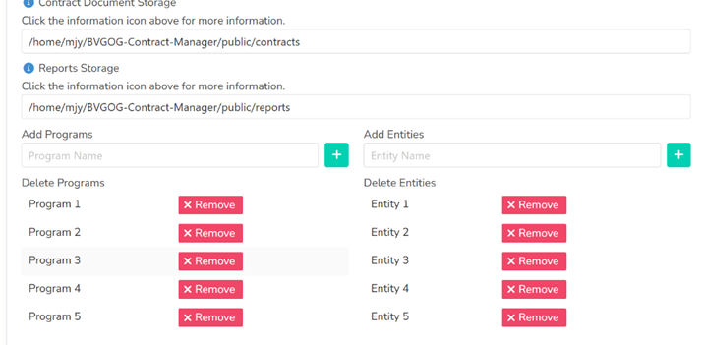
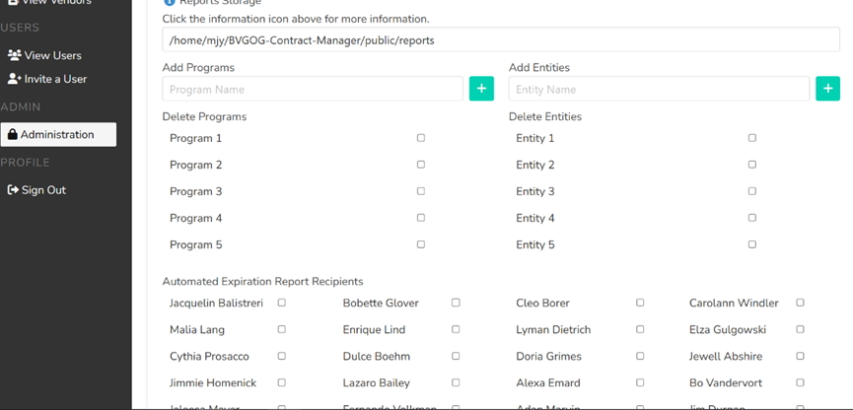
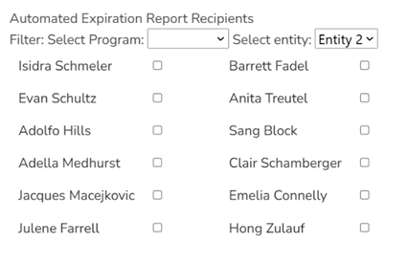
Administration Changes
In the old version, you can only delete a program by selecting it and clicking the save button, which is a cumbersome process. After the modification, you can click remove to realize one-click deletion.
Introduces filters to enable user filtering for specific programs/entities.

Slide 13
03
Conclusion

Slide 14
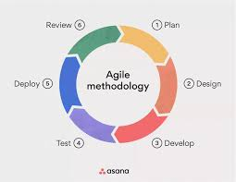
Conclusion
Overall, we worked well together to develop and refine the software.
However, we did stumble and learn important lessons along the way, namely:
-Point estimation is important and should be carefully considered.
-Communication across distance and schedules can be tough and should be organized beforehand.
-Leader roles should be respected developers should aim to support them in their roles.
-In essence, organization is critical. It is tempting to jump in and leave things to be swept up later, though it creates more work.

Slide 15
THANK YOU

