Slide 1

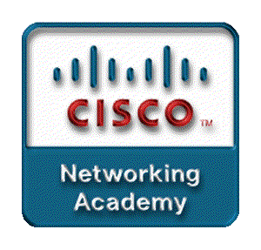
Chapter 6
Open Shortest Path First
OSPF

Slide 2
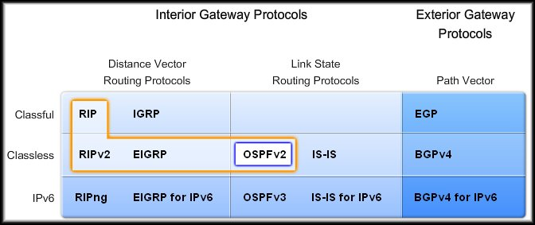
OSPF
1. Introduction to OSPF

Slide 3
1.1 Introduction to OSPF
OSPF is a classless, link-state routing protocol that uses the concept of areas for scalability.
RFC 2328 defines the OSPF metric as an arbitrary value called cost.
  Cisco IOS software uses bandwidth to calculate the OSPF cost metric.

Slide 4
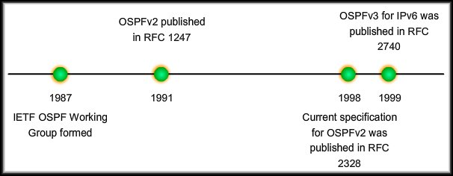
Development Timeline

Slide 5
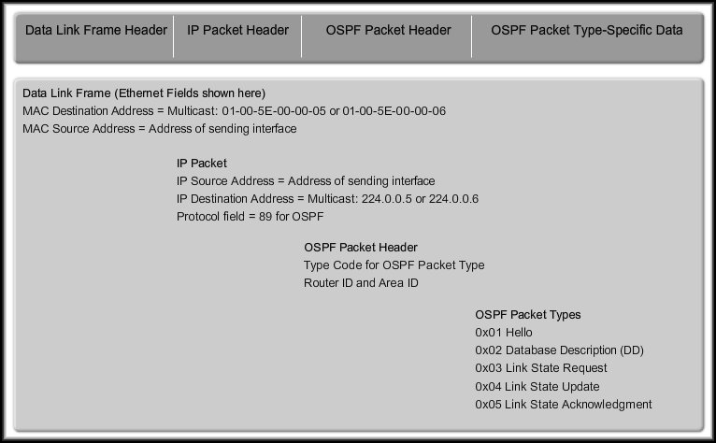
1.2 OSPF Message Encapsulation (Ethernet)

Slide 6
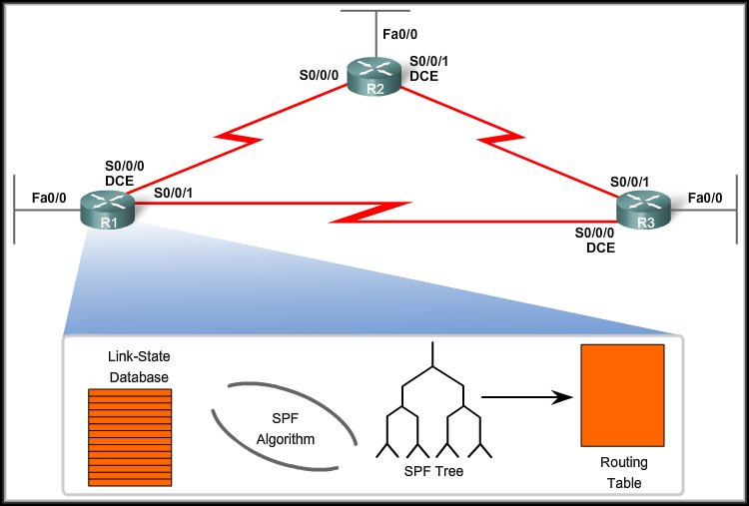
1.3 OSPF Algorithm
OSPF uses Dijkstra’s Algorithm
1
2
3
4

Slide 7
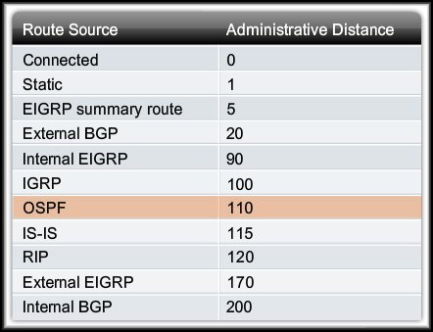
1.4 Administrative Distance
Administrative Distance (AD) is the trustworthiness (or preference) of the route source.

Slide 8
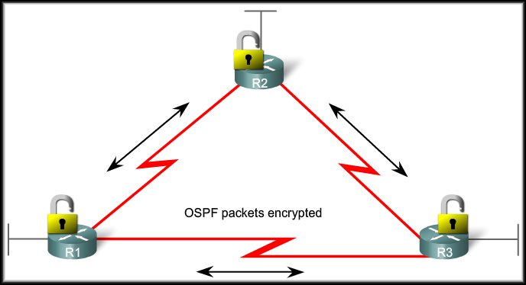
1.5 Authentication
Like other routing protocols, OSPF can be configured for authentication.
Authentication ensures that routers will only accept routing information from other routers that have been configured with the same password or authentication information.

Slide 9
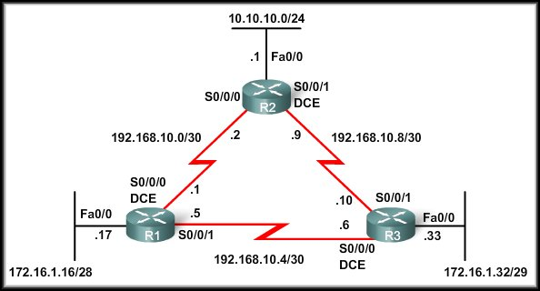
OSPF
2. Basic OSPF Configuration

Slide 10
2.1 Topology
Notice that the addressing scheme is discontiguous.
OSPF is a classless routing protocol so we will include the subnet mask as part of our configuration.
There are three serial links of various bandwidths and each router has multiple paths to each remote network.

Slide 11

2.2 The router ospf Command
Like EIGRP, OSPF requires a Process ID.
  Between 1 and 65,535 and chosen by the network administrator.
For consistency, we will enable OSPF on all three routers using the same Process ID of 1.

Slide 12

2.3 The network Command
The network command used with OSPF has the same function as when used with other IGP routing protocols:
  Any interfaces on a router that match the network address in the network command will be enabled to send and receive OSPF packets.
  This network (or subnet) will be included in OSPF routing updates.

Slide 13
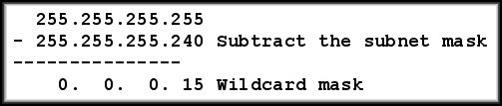
The network Command
OSPF requires the wildcard mask.
  The network address, along with the wildcard mask, is used to specify the interface or range of interfaces that will be enabled for OSPF using this network command.

Slide 14
The network Command
The area area-id refers to the OSPF area.
  An OSPF area is a group of routers that share link-state information.
  All OSPF routers in the same area must have the same link-state information in their link-state databases.

Slide 15
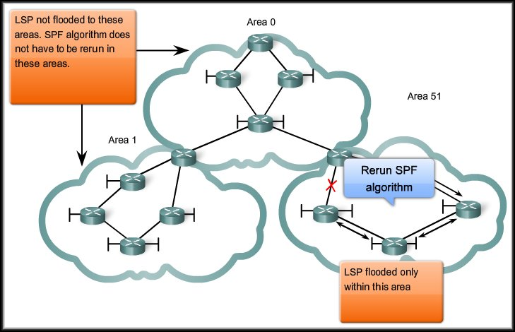
Hierarchical Design
Link-state
routing protocols
such as OSPF
and IS-IS use
the concept of
areas.
Multiple areas create a hierarchical design to networks, allowing better route aggregation (summarization) and the isolation of routing issues within an area.

Slide 16
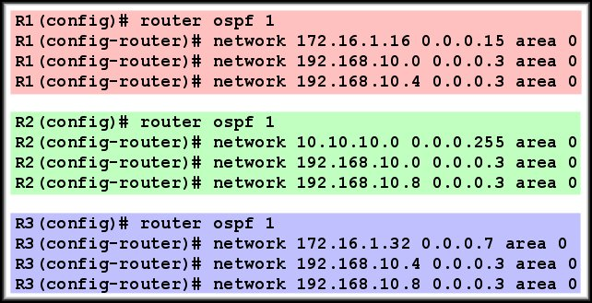
The network Command
network commands for all three routers, enabling OSPF on all interfaces.
At this point, all routers should be able to ping all networks.

Slide 17
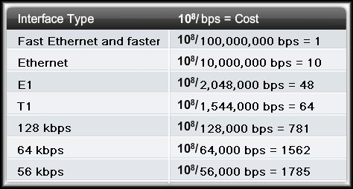
OSPF
3. The OSPF Metric

Slide 18
3.1 OSPF Metric
The OSPF metric is called cost.
From RFC 2328: "A cost is associated with the output side of each router interface. This cost is configurable by the system administrator. The lower the cost, the more likely the interface is to be used to forward data traffic."

Slide 19
OSPF Metric
The Cisco IOS uses the cumulative bandwidths of the outgoing interfaces from the router to the destination network as the cost value.
Cisco IOS Cost for OSPF = 10⁸/bandwidth in bps

Slide 20
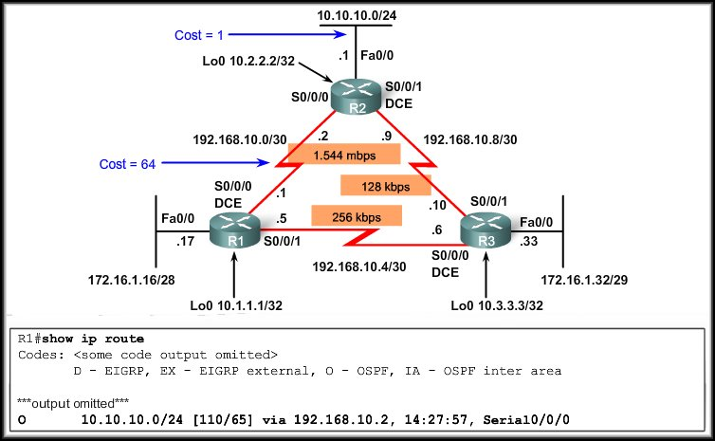
OSPF Accumulates Costs
Accumulated Cost = 65

Slide 21
END

Slide 22
Wildcard Mask
Inverse of subnet mask
255.255.255.255
-
255.255.255. 0
0 . 0 . 0 .255

Slide 23
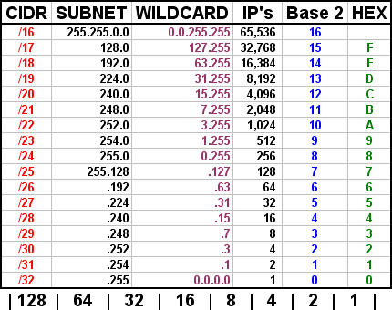

Slide 24
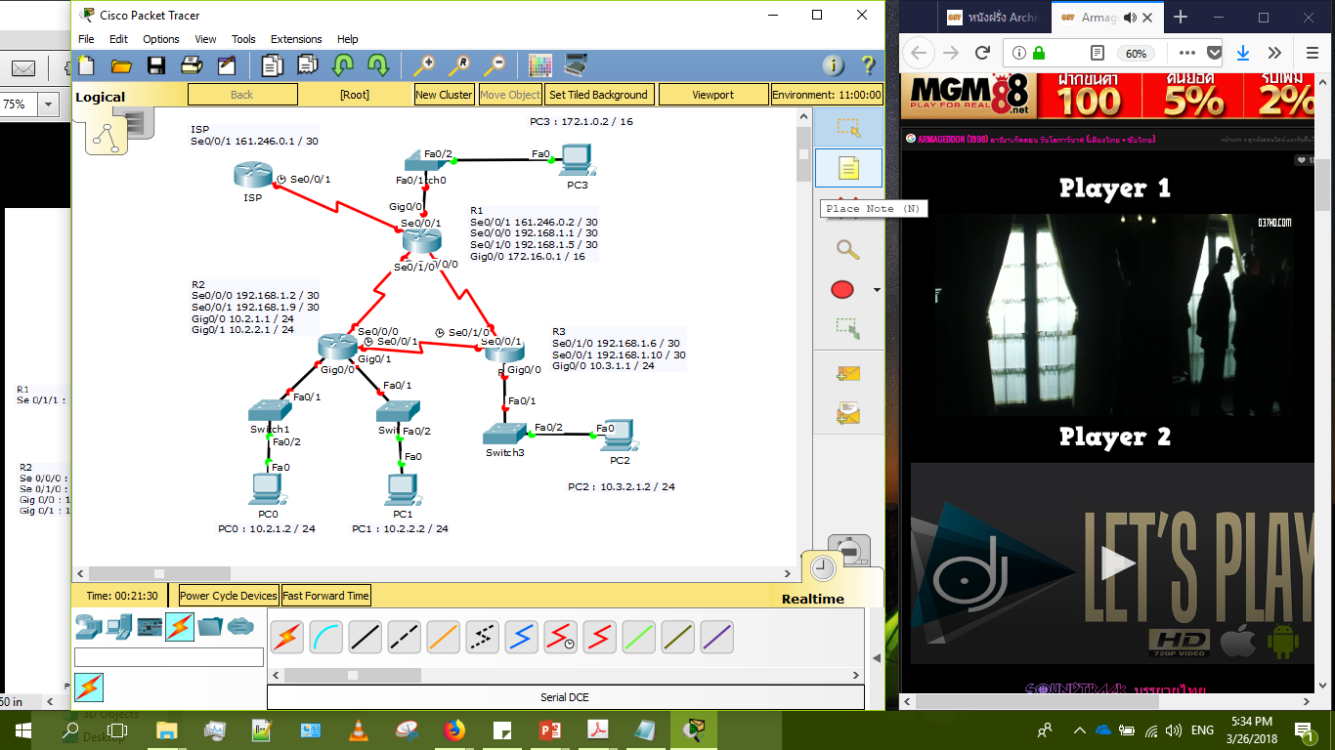

Slide 25
R1# configure terminal
R1(config)# route ospf 1

Slide 26
R1(config-router)# network 161.246.0.0 0.0.0.3 area 0
R1(config-router)# network 172.16.0.0 0.0.255.255 area 0
R1(config-router)# network 192.168.1.0 0.0.0.3 area 0
R1(config-router)# network 192.168.1.4 0.0.0.3 area 0

Slide 27
R2(config-router)# network 10.2.1.0 0.0.0.255 area 0
R2(config-router)# network 10.2.1.0 0.0.0.255 area 0
R2(config-router)# network 192.168.1.0 0.0.0.3 area 0
R2(config-router)# network 192.168.1.8 0.0.0.3 area 0

Slide 28
R3(config-router)# network
R3(config-router)# network
R3(config-router)# network

Slide 29
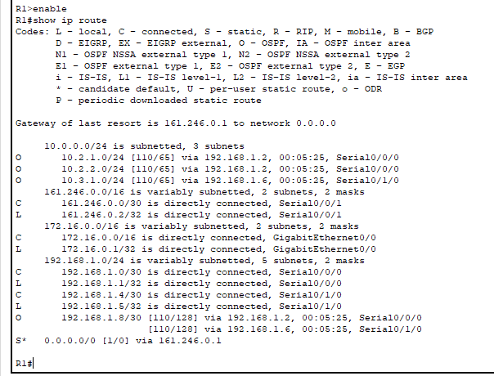
R1# show ip route

Slide 30
R1(config-router)# passive-interface Gig0/0

Slide 31
R1(config)# ip route 0.0.0.0 0.0.0.0 161.246.0.1
R1(config)# router ospf 1
R1(config-router)# default-information originate

