Slide 1


Who is the Ultimate Fighter?
Brianne Ng
UWA Data Analytics Bootcamp

Slide 2

About me
Brianne Ng, CA
Financial Planning and Analysis Analyst
LinkedIn: linkedin.com/in/brianneng/
Github: github.com/briginmis
Passions:
Data analytics
Cats
Food
Martial arts

Slide 3
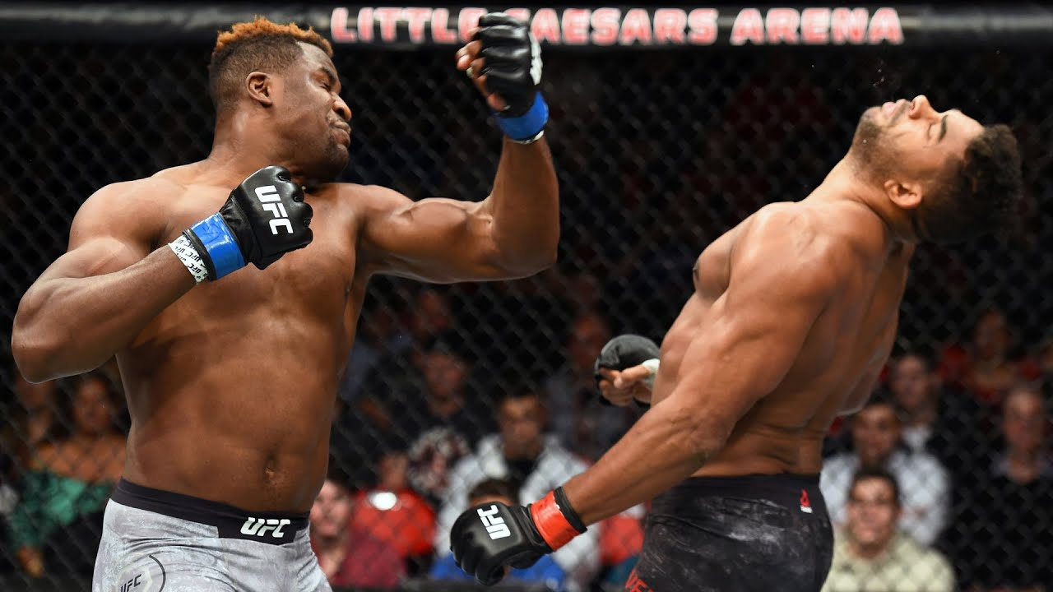
Project motivation
UFC is the largest Mixed Martial Arts promotion in the world
MMA incorporates different styles e.g. muay thai, BJJ, wrestling
MMA rules: 3/5 x 5 min rounds
Win by:
Knock out (KO)
Technical knock out (TKO)
Submission
Decision
Question - “Who is the pound-for-pound greatest fighter in the world?”

Slide 4

Solution
Create machine learning model to predict outcome of fights
Use features from model to determine who is the Greatest Fighter of All Time
Identify any other factors which characterize a winner e.g. hometown, style

Slide 5
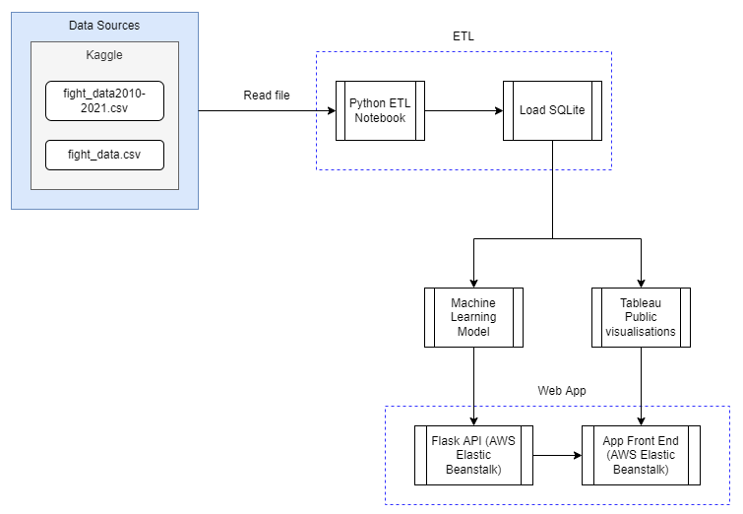
Solution architecture

Slide 6
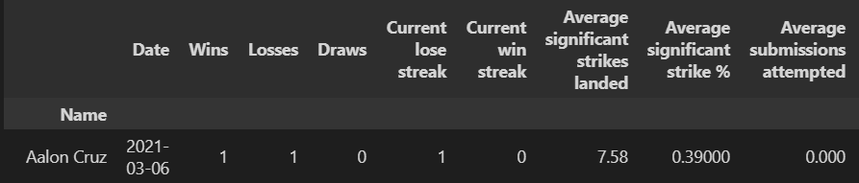
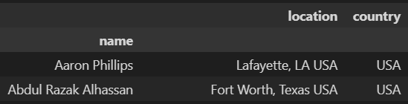
Extract, transform, load
Drop unwanted columns and rows
Clean data for consistent formatting
Create new calculated columns
Load into SQLite file
Extract from CSV
Source: Fight data scraped from UFC website 2010-2021, Kaggle
Data set 1: data to train machine learning model
Data set 2: for end users selection of two fighters
Data set 3: hometown data for analysis and visualisation

Slide 7
Train machine learning model
Step 1: assign data and target
Step 2: convert categorical data using Pandas ‘get dummies’
Step 3: split data for training and testing
Step 4: scale data using ‘StandardScaler’
Step 5: label encode data set
Model | Accuracy
Logistic Regression | 61.26%
Deep Neural Network (2 layers, 100 hidden nodes, 100 epochs) | 54.41%
Random Forest Model | 58.43%

Slide 8
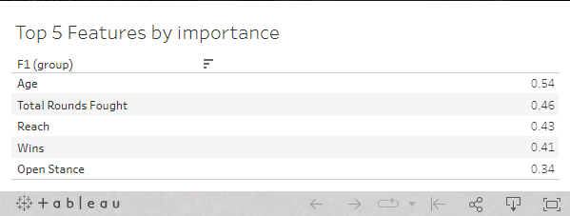
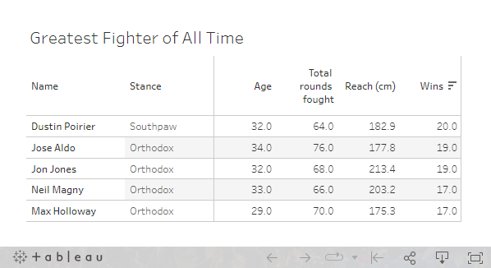

Visualisation
1
Obtain top 5 features from machine learning model
Use absolute value of importance
Group by category
2
Filter data to determine who is the Greatest Fighter of All Time
3
Use Tableau to test hypothesis:
Does country of origin determine whether a fighter will win?
Is there a more superior fighting style?

Slide 9
Create web page
Step 1: create app.py python file
HTML page routes
Create REST API routes using Flask
Link to prediction function
Step 2: create HTML, CSS and Javascript files
Use Bootstrap library for styling
Use D3 to populate dropdowns, tables and predicted winner
Step 3: Deploy application to AWS Elastic Beanstalk

Slide 10

So… Who is the Ultimate Fighter?
Let’s find out!

