Slide 1

Network Hardware Components
Jaringan Komputer – Minggu ke-6

Slide 2
Transceivers
Function : transmit and receive signals simultaneously
Position : layer-1 devices used in Ethernet networks to connect nodes to the physical medium
Serve as :
  Physical connection
  Electrical interface between a node and the physical medium

Slide 3
Transceivers (2)
Usually integrated into NIC (network interface cards)
Support UTP, ThinWire or Fiber-optic cable connection
AUI : Attachment Unit Interface → allows a device to be connected to UTP, thick or thin coaxial, or fiber-optic cable via external transceiver

Slide 4
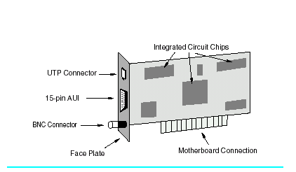
Transceivers (3)
FIGURE 6.5 Sample Ethernet network interface card. This NIC can support any one of three media types: UTP, transceiver cable via an AUI, and ThinWire. NICs are installed into a node by inserting them into an expansion slot on the motherboard.

Slide 5
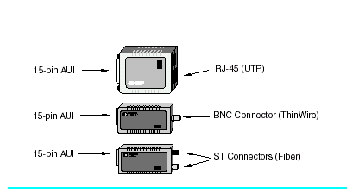
Transceivers (4)
FIGURE 6.4 Three types of Ethernet/802.3 transceivers that serve as media converters. When
connected to a network interface card’s 15-pin AUI connector, the card is able to support
twisted-pair, ThinWire, or fiber-optic cable

Slide 6
Media Converters
Function : enable different network media to be connected to one another
Position : layer-1 devices
Examples :
  Connect a coaxial cable to UTP cable
  Extend the distance between nodes by mixing copper and fiber cable

Slide 7
Repeaters
Also called concentrators
Function : to regenerate and propagate a signal
Examples : to extend the length of the LAN, because cables have a maximum length, in order to provide good signal quality

Slide 8
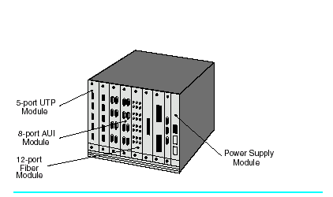
Repeaters (2)
FIGURE 6.8 This multislot chassis-based repeater hub (also called a concentrator) can accommodate
several different media types, including UTP, coax, and fiber. Since each interface module
shares the same backplane as the repeater module, the Ethernet ports on each module use the
same repeater. Thus, repeater hubs are capable of supporting many Ethernet connections using
only a single repeater. For example, if one of the modules is a 12-port ThinWire board, then this
one board can support 12 separate 185-meter ThinWire segments. Since 30 devices can be connected
to one ThinWire segment, this board can support 12 ⋅ 30 = 360 nodes.

Slide 9
Repeater vs Hub
Hub is a device that connects two or more network segments
Functions : repeater hub, switching hub, bridging hub, etc
Not all hubs are repeaters, but every repeater is a hub

Slide 10
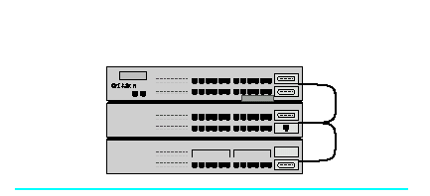
Repeater vs Hub (2)
FIGURE 6.9 Stackable hubs are daisy-chained together using an external cable, which enables them to function as a single hub.

Slide 11
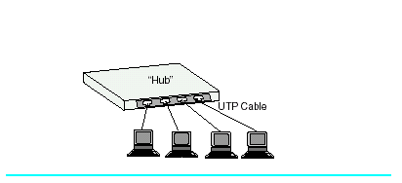
Repeater vs Hub (3)
FIGURE 6.10 A four-port “hub.” Without any type of qualification, we do not know if this is a repeater hub or a switch hub.

Slide 12
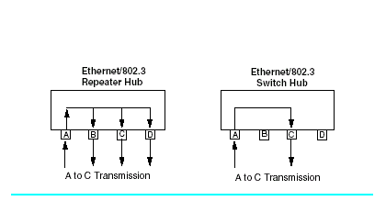
Repeater vs Hub (4)
FIGURE 6.11 In a repeater hub, if data on port A are destined to port C, all ports receive the data. In a switch hub, if data on port A are destined to port C, only port C receives the data.

Slide 13
Network Interface Cards
Abbreviated as NIC
Also called LAN adapters, network adapters, network cards, network boards
Operate at layer-2 of the OSI Model (data link layer)
NIC also have layer-1 components, and hence perform layer-1 activities in addition to layer-2 activities
Not all computer boards have NIC as integral parts, usually NIC are in form of expansion cards

Slide 14
Installation of NIC
General methods :
  Insert the cards into empty expansion slots available (ISA or PCI for IBM PC/compatible computers)
  Optionally assign I/O address and Interrupt Request Number, by using software or switches on the cards
  Install the “network driver” software
Plug and Play Cards :
  No need to shut down the computer
  USB (Universal Serial Bus) interface : no need for empty expansion slots
  PC Cards interface : using PCMCIA slots

Slide 15
NIC Software
Known as LAN driver, Installed according to network protocols and O/S
Incorrect LAN drivers are invariably the source of network performance problems
There are two specification standards:
  NDIS : Network driver interface standards
  ODI : open data-link interface
If a NIC support either NDIS or ODI, the card only needs a single driver and can support multiple network including TCP/IP, IPX/SPX and NetBIOS

Slide 16
Purchasing Considerations
Data bus : 8/16/32 bit → must match the processor (XT, 386 or Pentium)
On board Processor, RAM or both : provide better performance
On board LEDs : provide diagnostic information and activities
Auto sensing of 10/100 Mbps ethernet
Support full duplex networking
Compatible with system bus architecture (ISA/PCI)
Availability of software drivers for O/S requested

Slide 17
PC Cards
Also known as PCMCIA (Personal Computer Memory Card International Association) Cards
Multipurpose plug-in devices : network adapter (LAN/Modem/Fiber optic) or storage
Types :
  Type I : 3,3 mm thick for memory expansions
  Type II : 5 mm thick for network adapters
  Type III : 10.5 mm thick for miniature hard disks or wireless NICs
  Type IV : 16 mm thick for large hard disks

Slide 18
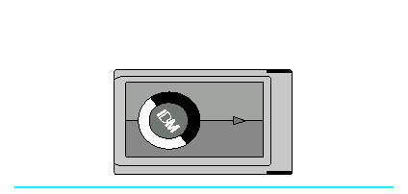
FIGURE 6.12 PC cards are multipurpose plug-in devices for portable computers and can be used as memory devices, modem and network adapters, or hard disk drives.

