Slide 1
Evaluating effects of memory compressed usage on MeeGo

Slide 2
Agenda
  Motivation
  Related work
  Compcache: some details about the project
  Experiments using N9 and N900 + MeeGo
  Final considerations

Slide 3
Why compressed memory?
  Generally, memory is scarce.
  Hardware changes bring more co$ts.
  A software solution can relief the memory scarcity.
  Flash storage suffers from wear-leveling issues, so its useful if we can avoid using them as swap device.

Slide 4
Related work
  1993 – Douglis with first comp. cache implementation.
  1999 – Kaplan with new adaptive scheme.
  Following the same scheme, Rodrigo Castro released an implementation with new compressed storage structures approach and new adaptive re-sizing approach. It was for 2.4.x Linux kernel.
  CRAMES – Compressed RAM for Embedded Systems.

Slide 5
Compcache: previous version
  Changes to the swap write path, page fault handler and page cache lookup functions.
  Intrusive nature.

Slide 6
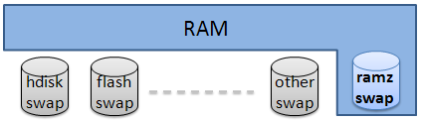
Compcache: ramzswap module
  RAM based block device used as swap disk.
  Swapped pages are compressed and stored in memory itself.
  Requested pages are decompressed before swapped-out.

Slide 7
Compcache: implementation
  Far less intrusive than previous approach.
  Do not compress page cache (filesystem backed) pages.
  Compress anonymous pages only.
  Individual components:
    LZO compressor.
    xvMalloc memory allocator.
    compcache block device driver: ramzswap.
  swapon /dev/ramzswap0

Slide 8
Compcache: memory management
  How manage the variable size of the compressed chunks?
  How reduce the fragmentation?

Slide 9
Compcache: memory management
  xvMalloc: O(1) malloc/free.
  Very low fragmentation as presented on all tests.
  Can use highmem.
  Non-standard allocator interface.

Slide 10
Compcache: limitations
  ramzswap can never know when a compressed page is no longer required.
  Swap discard mechanism: BIO_RW_DISCARD
  If there is no swap operations the stale pages will remain.
  ramzswap can simply forward uncompressible pages to a backing swap disk, but it cannot swap out memory allocated by xvmalloc.

Slide 11
Tests platforms
  N9 + Harmattan
    has ramzswap as default swap device: ~ 256 MB
    Swappiness = 30
    RAM 1GB
  N900 running MeeGo by Community
    has MMC block device as default swap device: ~ 75 MB
    RAM 128 MB
  Tests consists in memory allocation speed (fillmem, scan utilities), and low memory situations: multiple applications running.

Slide 12
Compcache experiments
  Is ramzswap overhead affecting memory allocation speed?
  Is ramzswap enabling other use cases when memory consumption is critical?

Slide 13
N9 experiments
Performance tests
  Memory allocation speed
Memory consumption
  Memory behavior when applications are running and ramzswap is being used or not

Slide 14
N9 experiments
  Performance: Time to allocate 550 MB
Swappiness = 60
Real swap + ramzswap
No ramzswap
Time (s)

Slide 15
N9 experiments
Compressed memory after 550 MB allocated

Slide 16
N9 experiments
Memory consumption
  8 browsers instances
  Calendar
  Video player
  Music player

Slide 17
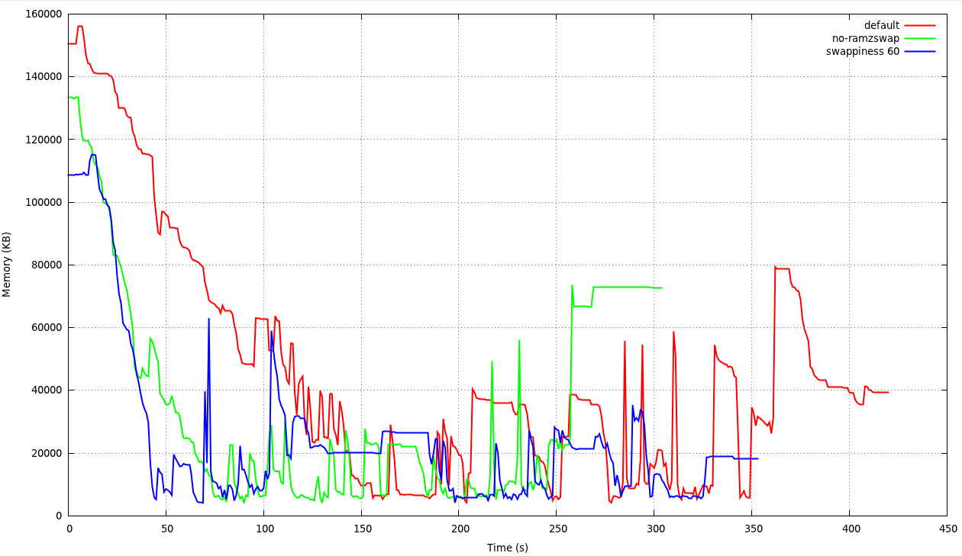
N9 experiments
Memory consumption behavior: MemFree

Slide 18
N9 experiments
Ramzswap stats for memory consumption
Default configuration
Swappiness = 60
DiskSize: 262144 kB
NumReads: 648
NumWrites: 2183
FailedReads: 0
FailedWrites: 0
InvalidIO: 0
NotifyFree: 0
ZeroPages: 68
GoodCompress: 87 %
NoCompress: 1 %
PagesStored: 2115
PagesUsed: 502
OrigDataSize: 8460 kB
ComprDataSize: 1979 kB
MemUsedTotal: 2008 kB
DiskSize: 262144 kB
NumReads: 897
NumWrites: 10576
FailedReads: 0
FailedWrites: 0
InvalidIO: 0
NotifyFree: 0
ZeroPages: 419
GoodCompress: 76 %
NoCompress: 5 %
PagesStored: 10157
PagesUsed: 3206
OrigDataSize: 40628 kB
ComprDataSize: 12682 kB
MemUsedTotal: 12824 kB

Slide 19
N9 experiments
Ramzswap stats for memory consumption
Default configuration
Swappiness = 60
DiskSize: 262144 kB
NumReads: 648
NumWrites: 2183
FailedReads: 0
FailedWrites: 0
InvalidIO: 0
NotifyFree: 0
ZeroPages: 68
GoodCompress: 87 %
NoCompress: 1 %
PagesStored: 2115
PagesUsed: 502
OrigDataSize: 8460 kB
ComprDataSize: 1979 kB
MemUsedTotal: 2008 kB
DiskSize: 262144 kB
NumReads: 897
NumWrites: 10576
FailedReads: 0
FailedWrites: 0
InvalidIO: 0
NotifyFree: 0
ZeroPages: 419
GoodCompress: 76 %
NoCompress: 5 %
PagesStored: 10157
PagesUsed: 3206
OrigDataSize: 40628 kB
ComprDataSize: 12682 kB
MemUsedTotal: 12824 kB

Slide 20
N9 experiments
Memory consumption
  Default configuration
    Good responsiveness but the video did not play.
  No swap
    After the six browser instance the responsiveness was decreasing and the video player did not start.
  With ramzswap
    Responsiveness ok, all applications started and worked properly.

Slide 21
N900 experiments
Performance tests
  Memory allocation speed
Memory consumption
  Memory behavior when applications are running and ramzswap is being used or not

Slide 22
N900 tests
  Performance: Time to allocate 90 MB
Swappiness = 60
Real swap + ramzswap
No ramzswap
Time (s)

Slide 23
N900 tests
  Performance: Time to allocate 90 MB
    System was able to allocate 90 MB bunch of memory in three different swap configurations.
    Swappiness = 60 and ramzswap size = 15% of total memory seems to be the best choice.

Slide 24
N900 experiments
Memory consumption
  8 browsers instances
  Video player
  Photo gallery

Slide 25
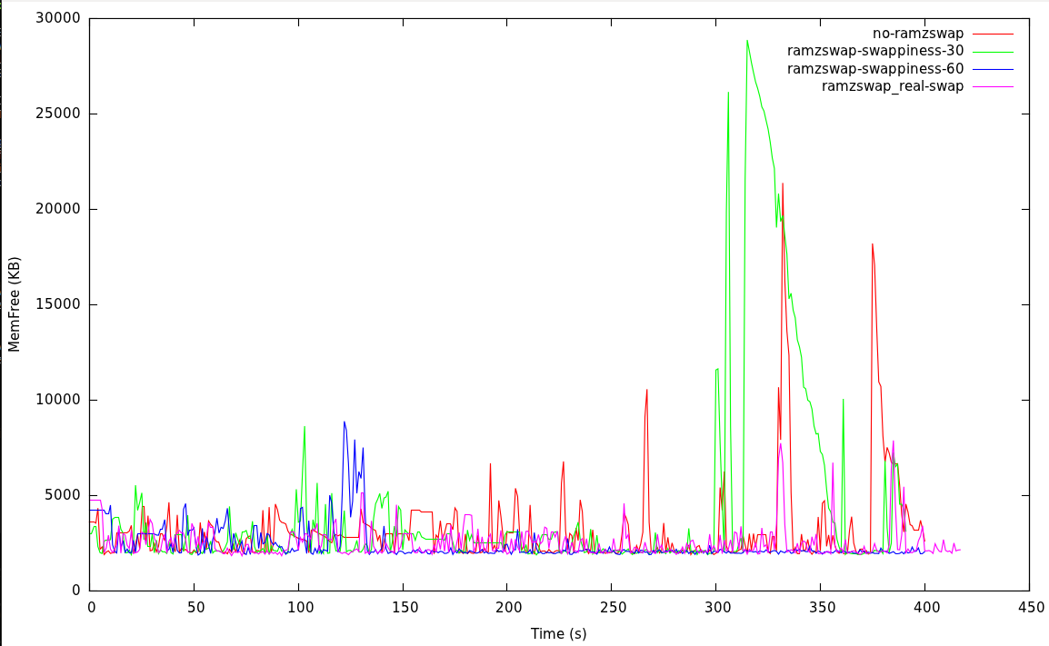
N900 experiments
Memory consumption behavior: MemFree

Slide 26
N900 experiments
Memory consumption
  Default configuration
    No responsiveness after video play, not possible to finish the test.
  With ramzswap (swappiness = 30 or 60)
    No possible to finish the test as well. The device rebooted.
  Ramzswap + real swap (mmc blk device)
    Best choice.
    Ramzswap was configured to have higher priority. MMC blk device as second swap area.

Slide 27
Final considerations
  As presented, memory compressing is an alternative for embedded and memory limited devices.
  The newer Compressed Cache version (using ramzswap), is pretty mature and had abandoned the intrusive nature from previous version.

Slide 28
Final considerations
  N9 experiments showed that the best choice is to combine the fs back storage swap and the ramzswap. Its default configuration already set this.
  The default value for swappiness on N9 is 30. Maybe we should review this since we could have more pages going earlier to compressed memory, increasing the performance.

Slide 29
Final considerations
  N900 experiments showed that the ramzswap usage could bring more benefits than the current configuration.
  Before ramzswap load, we need do configure the amount of memory used since it is not a good idea to have big ramzswap partitions.

Slide 30
Presentation resources
Compcache project website: http://code.google.com/p/compcache
LWN.net article about in-memory compressed swapping: http://lwn.net/Articles/334649/
Documentation about Virtual Memory Management on kernel.

Slide 31
Thanks
anderson.briglia@indt.org.br
anderson.briglia@openbossa.org

