Slide 1

CS611 Assignment 1
Default-risk Prediction (Medallion Architecture for Data Processing)
Chua Khong Chun

Slide 2
Context
Coming up with default-risk predictions to facilitate cash-loaning of the company
Preparing data for machine learning model training with
Target: Binary default flags at Month-on-Books (MOB) = 6, Days past due (DPD) ≥ 30
Cadence: Monthly snapshot partitions, backfilled from 2023-01 to 2024-12

Slide 3
Analysis of Data Sources
Source file | Rows | Cols | Grain | Role
lms_loan_daily.csv | 137,500 | 11 | loan × month | Label source
feature_clickstream.csv | 215,376 | 22 | customer × month | Behavioural features (20 numeric)
features_attributes.csv | 12,500 | 6 | 1 row per customer | Demographics (SCD)
features_financials.csv | 12,500 | 22 | 1 row per customer | Financial profile (SCD)
Design Implications
Clickstream and LMS are time-series (24 and 35 monthly snapshots respectively), while attributes and financials behave as slowly-changing dimensions. Hence, gold table to be joined from clickstream as the spine and left-join the static tables on Customer_ID alone.

Slide 4
Data Processing Pipeline
lms_loan_
daily
.CSV
lms_loan
_daily
.CSV
lms_loan
_daily
.parquet
label_store
.parquet
Data_processing_bronze_table.py
Data_processing_silver_table.py
Data_processing_gold_table.py
feature_
clickstream
.CSV
feature_
clickstream
.CSV
feature_
clickstream
.parquet
Machine Learning Model
Data_processing_bronze_table.py
Data_processing_silver_table.py
…
feature_
attributes
.CSV
feature_
attributes
.CSV
feature_
attributes
.parquet
feature_
store
.parquet
Data_processing_bronze_table.py
Data_processing_silver_table.py
Data_processing_gold_table.py
feature_
financials
.CSV
feature_
financials
.CSV
feature_
financials
.parquet
Data_processing_bronze_table.py
Data_processing_silver_table.py
BRONZE
SILVER
GOLD
Raw integration
Cleaned & typed
ML-ready aggregate
Filter source by snapshot_date and persist as CSV partition. No schema enforcement.
Enforce schema, strip dirty placeholders, parse strings, engineer source-local fields.
Wide feature store (Customer_ID, snapshot_date) + label store (loan_id, snapshot_date).

Slide 5
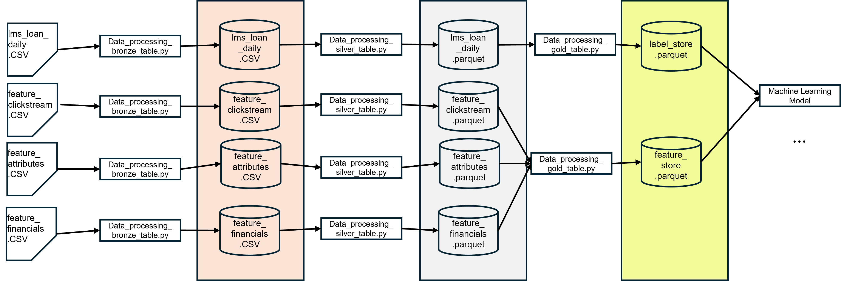
Bronze Layer
Principles
Preserve raw fidelity — no schema enforcement, no cleaning.
Partitioned by snapshot_date so re-processing one month is a single-file replace, not a full reload.
CSV format: human-readable, cheap to differentiate when investigating a source-system issue.
Silver Layer: Single Source of Truth
Principles
Enforce Schema to be followed within each column of data (i.e. float, integer, string)
Cleaning of ‘dirty’ data and filtered accordingly
Field | Symptom in raw data | Adjustment made for Silver Table
Age | Trailing '_' on ~3% of values; out-of-range placeholders | Strip non-digits, cast int, null-out (≤0 or >100)
Annual_Income | String with trailing '_' on dirty rows | Strip '_', cast float
Credit_Mix | '_' placeholder mixed with Good / Bad / Standard | Map '_' → NULL
Payment_of_Min_Amount | 'NM' (no-match) placeholder | Map 'NM' → NULL
Credit_History_Age | Free-text "X Years and Y Months" | Regex parse → Credit_History_Months (int)
Type_of_Loan | Comma-separated free text, 1,400+ unique values | Derive Num_Loan_Types_Listed; drop raw in gold
Name, SSN | Direct PII; SSNs contain garbage like '#F%$D@*&8' | Removed from Silver Table (not predictive, compliance risk)
dpd / overdue_amt / paid_amt | Loan-outcome fields in lms_loan_daily | Computed in silver LMS, isolated to label store

Slide 6
Gold Layer: ML-ready
Feature store schema (gold/feature_store/)
Customer_ID, snapshot_date ← keys
fe_1 … fe_20 ← clickstream
Age, Occupation ← attributes
Annual_Income, Monthly_Inhand_Salary,
Num_Bank_Accounts, Num_Credit_Card,
Interest_Rate, Num_of_Loan,
Outstanding_Debt, Credit_Mix,
Credit_Utilization_Ratio,
Credit_History_Months,
Payment_Behaviour, … ← financials
income_to_debt_ratio, ← engineered
emi_burden ← engineered
End State
Feature Store
46 Columns
1 row per Customer_ID, snapshot_date
24 monthly partitions backfilled
Label Store
5 columns
1 row per Customer_ID+disbursement date, snapshot_date
Initial labels limited for first 6 months because MOB=6 not yet reached. Subsequently, fully-filled
Join logic
Clickstream silver is the spine (monthly, full customer coverage)
LEFT JOIN attributes silver on Customer_ID
LEFT JOIN financials silver on Customer_ID
Engineered ratios computed post-join (income_to_debt, emi_burden)
Numerics imputed 0; categoricals imputed 'Unknown' — silver keeps true NULLs

Slide 7
Risk Control: Keeping Target leakage out
ALLOWED IN FEATURE STORE
BLOCKED — TARGET / FUTURE LEAKAGE
All 20 clickstream behavioural features (fe_1..fe_20)
Demographic attributes known at application: Age, Occupation
Financial profile snapshots: income, credit utilisation, debt, credit history
Customer-level engineered ratios derived from the above
label, label_def — the answer itself (lives only in label store)
overdue_amt, paid_amt, balance, due_amt — repayment outcomes
dpd, installments_missed, first_missed_date — derived from outcomes
loan_id, loan_start_date, mob — loan-level grain not known at application
Name, SSN — direct PII, compliance risk, not predictive

