Slide 1
Student Marks Predictor
Brijkishor gupta(RA1911026010123)
abishek(RA1911026010109)
swaroop (RA1911026010126)

Slide 2
Abstract
Education is very important issue regarding development of a country. The main objective of educational institutions is to provide high quality education to its students. One way to accomplish this is by predicting student's academic performance and thereby taking early steps to improve student's performance and teaching quality.
This system aims to predict student's marks using linear regression. The idea behind this analysis is to predict the marks of students by their studying hours. Through this project we can determine:
How many hours need to do the study to get 99% marks
If I will do study x() hours per day so how much marks I will get. Through these points the school/College can determine the performance of the student.

Slide 3
Objectives
Implementation of linear regression model
Predict marks of the students on basis of study hours.

Slide 4

Imported Libraries

Slide 5
What is NumPy?
NumPy is a Python library used for working with arrays. It also has functions for working in domain of linear algebra, Fourier transform, and matrices. NumPy was created in 2005 by Travis Oliphant. It is an open source project and you can use it freely. NumPy stands for Numerical Python.
Why Use NumPy?
In Python we have lists that serve the purpose of arrays, but they are slow to process.
NumPy aims to provide an array object that is up to 50x faster than traditional Python lists. The array object in NumPy is called ndarray, it provides a lot of supporting functions that make working with ndarray very easy. Arrays are very frequently used in data science, where speed and resources are very important.

Slide 6
What is Pandas?
Pandas is a Python library used for working with data sets.
It has functions for analyzing, cleaning, exploring, and manipulating data.
The name "Pandas" has a reference to both "Panel Data", and "Python Data Analysis" and was created by Wes McKinney in 2008.
Why Use Pandas?
Pandas allows us to analyze big data and make conclusions based on statistical theories.
Pandas can clean messy data sets, and make them readable and relevant.
Relevant data is very important in data science.

Slide 7
What is Matplotlibs?
Matplotlib is a low level graph plotting library in python that serves as a visualization utility.
Matplotlib was created by John D. Hunter.
Matplotlib is open source and we can use it freely.
Matplotlib is mostly written in python, a few segments are written in C, Objective-C and Javascript for Platform compatibility.

Slide 8
What is Scikit Learn ?
Scikit-learn (Sklearn) is the most useful and robust library for machine learning in Python.
It provides a selection of efficient tools for machine learning and statistical modeling including classification, regression, clustering and dimensionality reduction via a consistence interface in Python.
This library, which is largely written in Python, is built upon NumPy, SciPy and Matplotlib.

Slide 9
What is Joblib ?
Joblib is a set of tools to provide lightweight pipelining in Python. In particular:
transparent disk-caching of functions and lazy re-evaluation (memoize pattern)
easy simple parallel computing
Joblib is optimized to be fast and robust on large data in particular and has specific optimizations for numpy arrays. It is BSD-licensed.

Slide 10
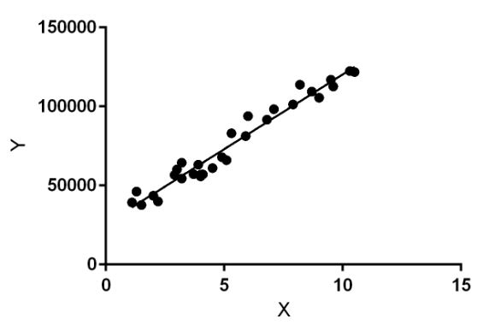
Linear Regression
Linear Regression is a machine learning algorithm based on supervised learning. It performs a regression task
It is mostly used for finding out the relationship between variables and forecasting.
Linear regression algorithm shows a linear relationship between a dependent (y) and one or more independent (y) variables, hence called as linear regression. Since linear regression shows the linear relationship, which means it finds how the value of the dependent variable is changing according to the value of the independent variable.

Slide 11
Model Implementation
Step 1
Load the required data set using pandas library.
CSV file contains two columns one is study hours and second is student marks.
Data-set consist of 200 students.
Step 2
Get information from the data-set. Like count, mean, maximum etc.,
Step 3
Now we visualize the data-set using matplotlib library inorder to decide which model to be used.
X-axis : study hours and Y-axis : marks.

Slide 12
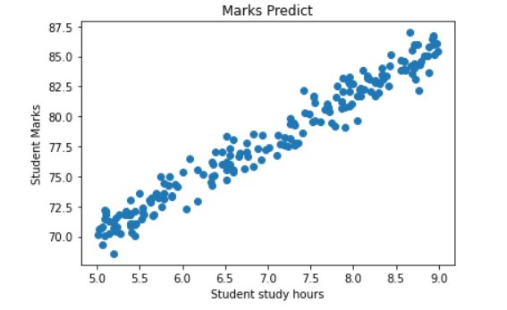
As we can see the Points are quite linear so we can go for Linear Regression Model.

Slide 13
Step 4: Now we perform data cleaning in respective data-set.
Check for the null value.
We rectify 5 null values in study hour column and 0 in study marks.
So we have to fill all that Null value with Mean of data of that particular column.
Step 5: Now split the data-set into training and testing purpose. We allotted 20% of data for testing and 80% for training purpose.
Step 6: We use linear regression model because the visualized graph plotted earlier is linear. As it is Linear model so we use y=m*x+ c (linear Line equation)
Step 7: Now we start training the model on the training data-set.
Step 8: Model have been trained. So our model predict that if a student study for 4 hrs a day then he\She might get 66.19 marks.
Step 9: Now we perform testing in order to calculate the accuracy of the model so using testing data-set.

Slide 14
Result: The calculated model accuracy as per the testing data was 95.14%. Finally we save the model using Joblib library for future usage.
More Information:
Our code base
Github Repository

