Slide 1


Vacuum
A team Omega game

Slide 2
What is Vacuum ?
3rd person Shooting/Evade game
Built in Unity 2017
Written using C#

Slide 3
Main Objective
Evade the asteroids coming towards you
Any Contact with an Asteroid results in instant game over
Survive as long as possible in the game

Slide 4
Build and Run requirements
Unity Editor 2017 or above
Windows 7 or later
Min of 4GB of RAM
About 500MB of free HDD space
At least 2GB of Graphics
To build the Unity Project open the package using Unity editor. Select File>Build Settings>Build.
Note: Make Sure the platform is Windows Standalone or the project won’t work

Slide 5

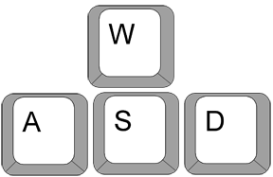
Control Scheme
Movement : Shooting :
Up
Shoot
Left
Right
Down

Slide 6
What can this game help you in ?
The High Sensitivity of the controls ensure that the user develops sharp reflexes
The un-assisted shooting develops a general sense of aim

Slide 7
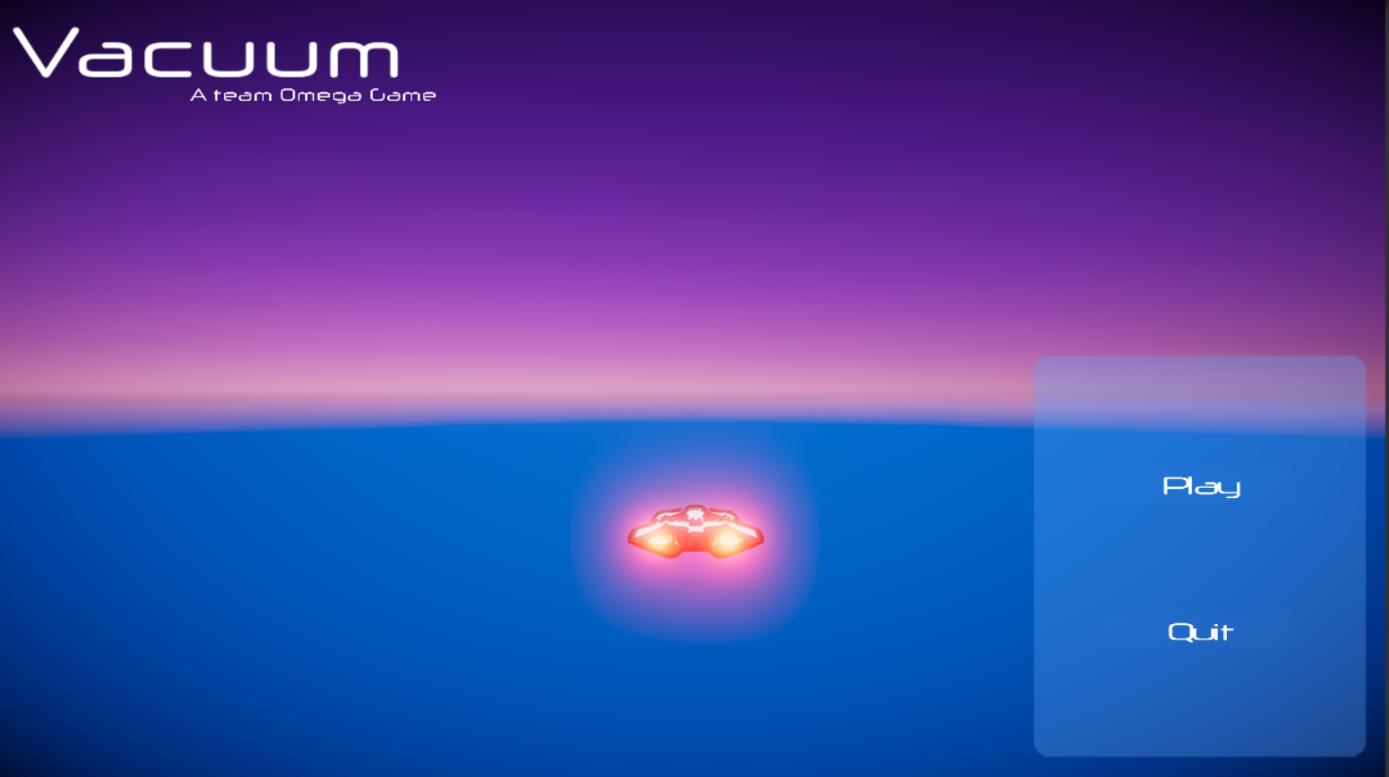
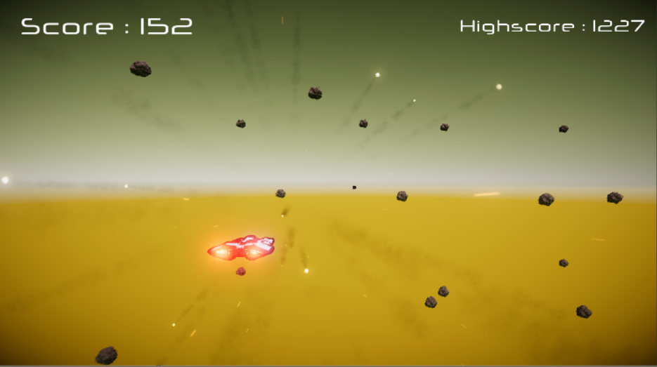
Vacuum in Action

