Slide 1






Analysis Phase Presentation (presentation 3)
by Brij Soni - 21BCA057 & Bhavyarajsinh Rathor - 21BCA052

Slide 2



Various methods for collecting Requirements

Slide 3

Observation:
observing own buisness can help us identify the problems arising in our process and gives the detailed analysis of our work and experimenting new ideas, which later helps for success and progress of our buisness.

Slide 4

Interviewing:
communication is the powerful tool for gathering information, in B2B it’s easy to approach customers (merchants) for any queries. interviewing gives the pov of next person which helps us improve or correct our mistakes.

Slide 5
Requirement Analysis

Slide 6
Observed own buisness and Interviewed 13 other Wholesalers and 49 merchants and analysed what merchants wants and what wholesalers, we’re able to understand the perspective of both sides.

Slide 7

from wholesalers:
1).proper records of accounts
2).stock managment
3). easy to apply system
Analysis
from merchants:
1). clarity of grammage & accounts

Slide 8
Data Flow Diagrams (DFDs)

Slide 9
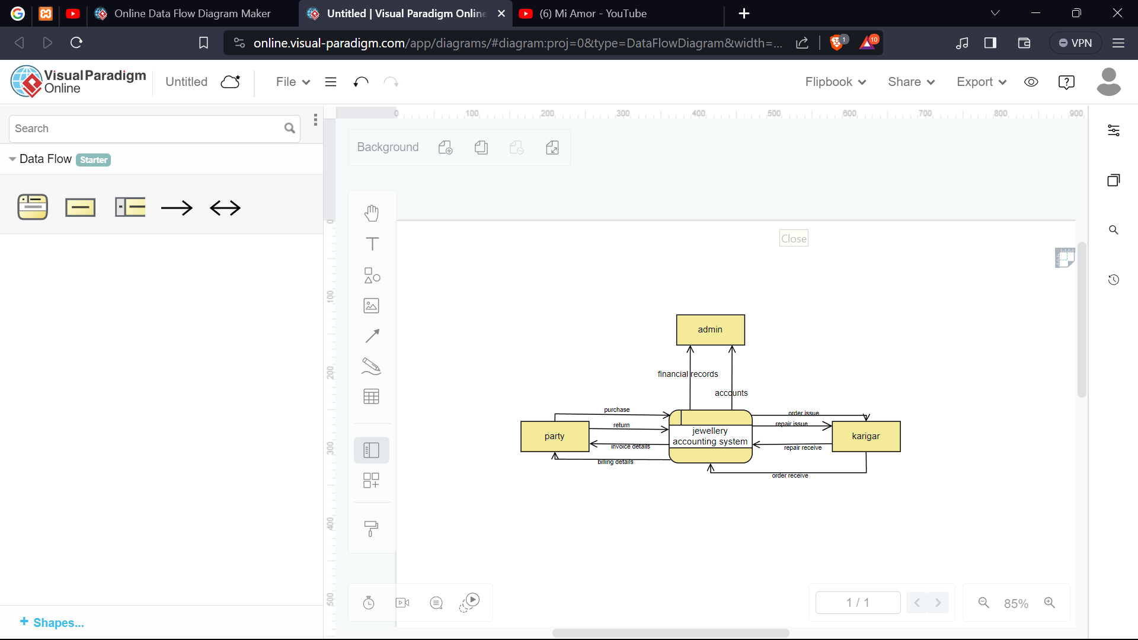
Level 0 DFD

Slide 10
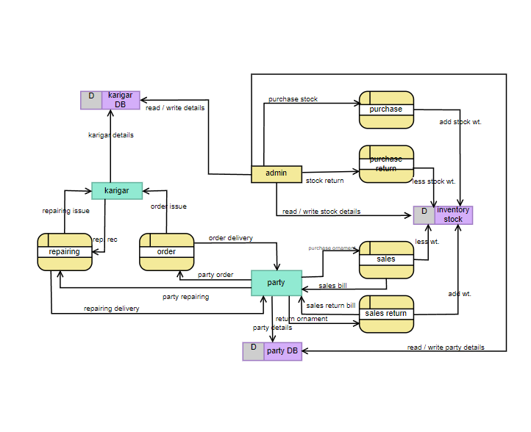
Level 1 DFD

Slide 11
Plan for Design phase

Slide 12
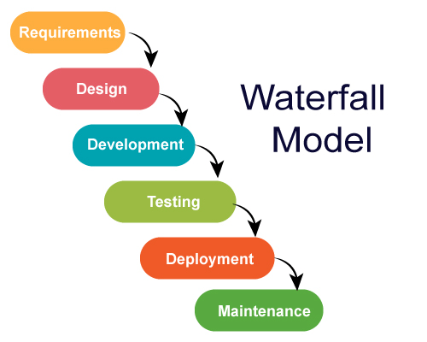
design model
The waterfall model is a breakdown of project activities into linear sequential phases, meaning they are passed down onto each other, where each phase depends on the deliverables of the previous one and corresponds to a specialization of tasks. The approach is typical for certain areas of engineering design.

Slide 13





design phase
front end
UI/UX
publish
database
backend
testing

Slide 14




Thankyou !

