Slide 1

Computational Politics: Advancing Sentiment Analysis through Natural Language Processing in Election Studies
Team project 8:
Harsahib Preet Singh​
Brijesh Hota​
Mundhir-Al Bohri
CSCI 4152/6509 Natural Language Processing
​

Slide 2
Problem
Social media platforms like Twitter and Reddit serve as vital arenas for expressing opinions about candidates and parties.
The challenge lies in accurately understanding sentiments shared by voters online.
Extracting sentiments—positive, negative, neutral—from social media discussions helps political parties adjust strategies, address concerns, and better connect with the electorate.
Extracting sentiments—positive, negative, neutral—from social media discussions helps political parties adjust strategies, address concerns, and better connect with the electorate.

Slide 3
Dataset
Sentiment140:
The sentiment140 dataset contains 1,600,000 tweets extracted using the twitter API.
This dataset is majorly used for the training for our model with the Negative, Neutral and Positive sentiments. Both of our models are fine-tuned based on it.
https://www.kaggle.com/datasets/kazanova/sentiment140/data
US 2020 election data:
The Version 19 of this dataset contains around 1,900,000 tweets extracted using the twitter API till data from 2020 US elections.
This dataset is what our model is used upon to generate sentiments on.
Used with BERT and LLAMMA 2 to generated sentiments based on the tweets of US 2020 Election data.
https://www.kaggle.com/datasets/manchunhui/us-election-2020-tweets/data

Slide 4
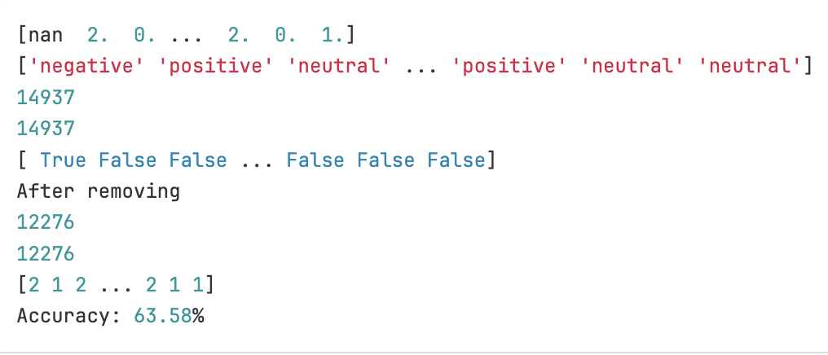
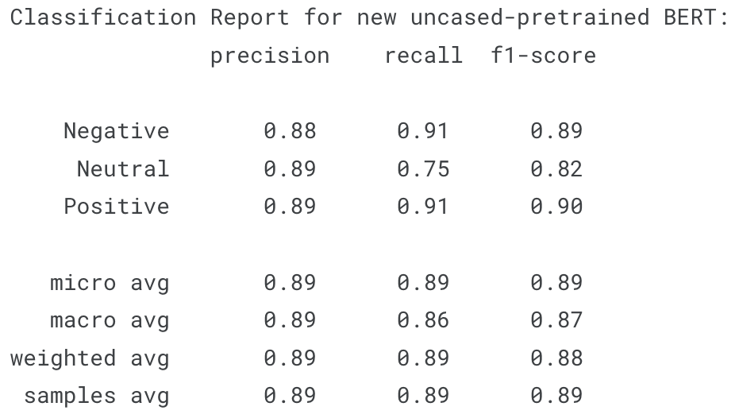
BERT Model (400M parameters)
Fine-Tuning Process:
Model Choice: A BERT (Bidirectional Encoder Representations from Transformers) is a pre-trained transformer-based neural network designed for simplifying NLP tasks.
Objective: Enhance BERT's capabilities specifically for sentiment analysis by using different models and fine-tuning methods.
Training Dataset:
The initial training dataset used contains 1.4M sentiments.
Used to train BERT, enabling it to understand and classify sentiments accurately.

Slide 5

Challenges
1. Computational Complexity: BERT demands substantial GPU power, challenging resource-limited applications.
2. Training Data Size: BERT needs ample data, a challenge in niche sentiment topics.
3. Fine-tuning and Transfer Learning: Adapting BERT requires careful tuning, knowledge transfer isn't straightforward.
4. Tokenization Issues: Subword tokenization hinders word-level sentiment interpretation in BERT.
5. Model Size: Large BERT size challenges memory, consider smaller versions for deployment.

Slide 6

Using GPT 4 Turbo
Generating Custom Validation Data from US 2020 Sentiment Analysis
Challenge: Absence of specific US 2020-related sentiment data.
Solution: Leveraging GPT-4 to create a tailored validation dataset
Method: Utilized GPT-4's advanced text-generation capabilities.
Process: Generated prompts reflecting US 2020 topics, used GPT-4 to create realistic text samples.

Slide 7
Results
Usage & Benefits:
Integration: Incorporated synthetic dataset for model validation.
Advantages: Enhanced model testing for specific context relevancy.
Ethical Consideration:
Transparency: The results presented here serve as a foundational benchmark for our model. They establish a baseline against which we can compare our model's performance.
Purpose: Solely for model validation, respecting ethical AI use.

Slide 8
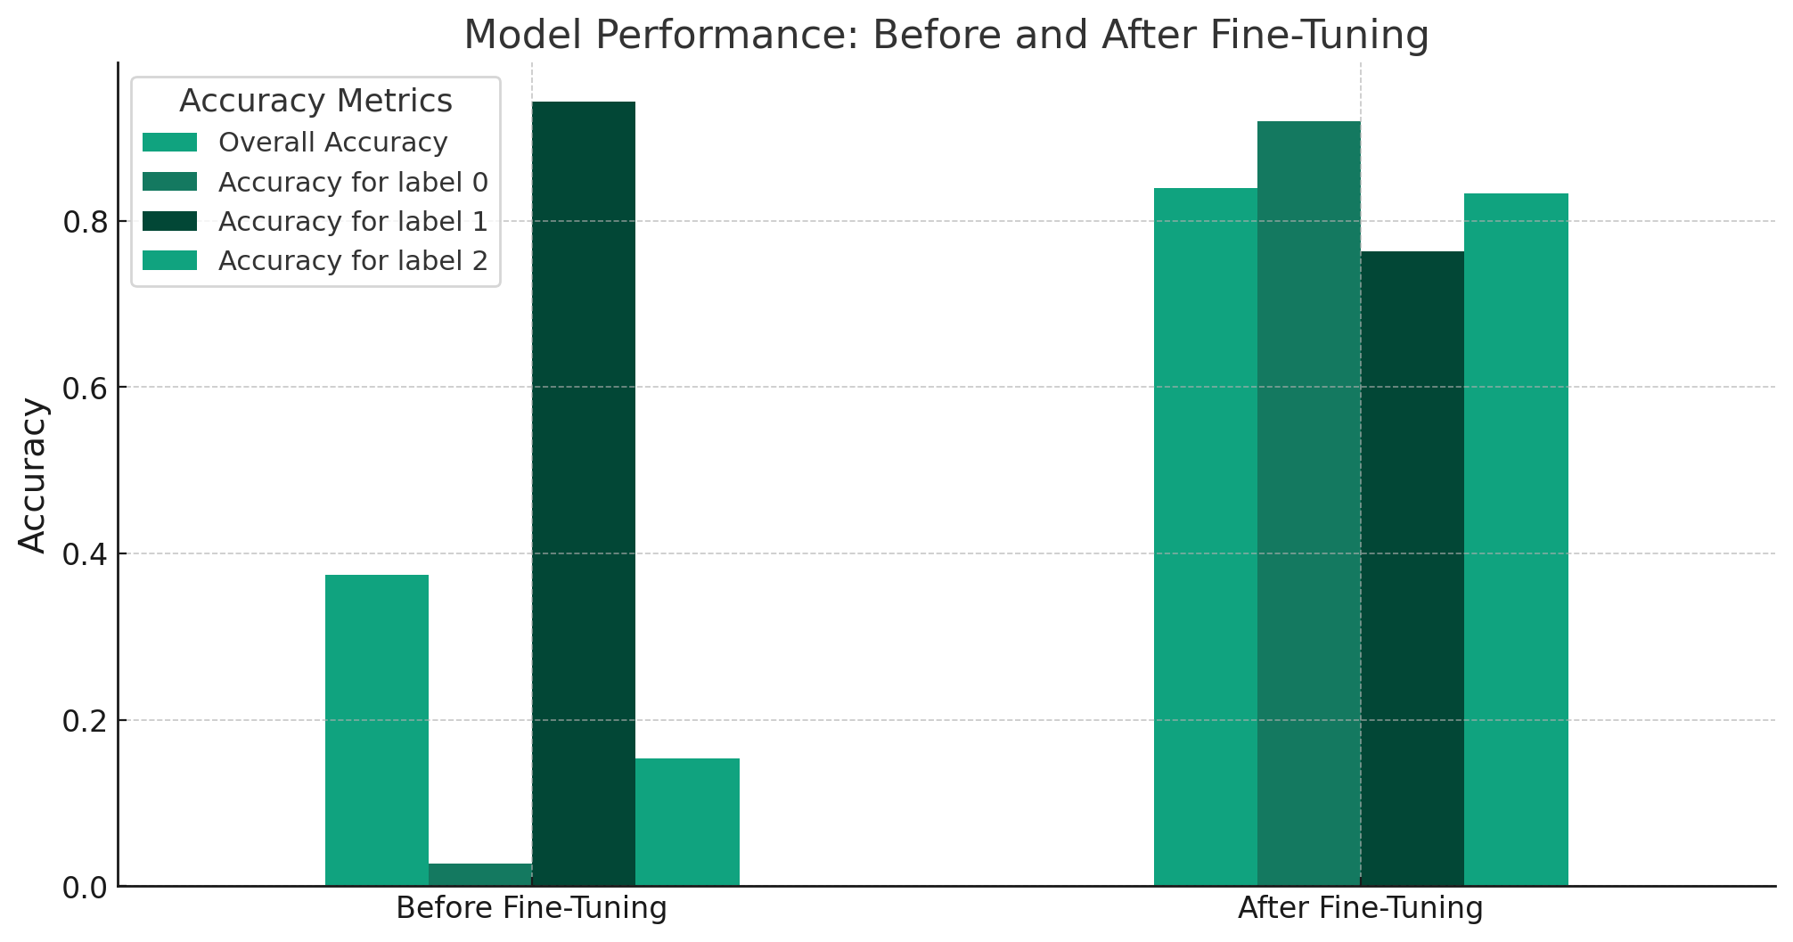
LLAMA 2 (7B parameters)
Fine-Tuning Process:
Model Choice: LLAMA 2, known for its robust performance in natural language understanding.
Objective: Enhance LLAMA 2's capabilities specifically for sentiment analysis.
Training Dataset:
A large-scale dataset tailored for sentiment analysis.
Used to train LLAMA 2, enabling it to understand and classify sentiments accurately.

Slide 9
Challenges
High Resource Demand: LLAMA 2, like many advanced NLP models, requires significant computational resources for training and fine-tuning.
Data Size vs. Resources: The vast size of the Sentiment140 dataset presented a challenge, given the available computing resources.
Balancing Act: To mitigate this, we strategically reduced the training dataset size. This approach aimed to balance the depth and variety of the training data with the practical limitations of our computing capacity

Slide 10

Conclusion
Evolving Capabilities: As large language models (LLMs) like LLAMA 2 become more accessible, they hold significant potential for analyzing political discourse.
Enhanced Understanding: These models can offer deeper insights into public sentiment and political trends, especially during pivotal events like elections.

Slide 11

Future Impact:
Political Sphere: LLMs will play a crucial role in shaping how we understand political narratives, voter sentiment, and campaign effectiveness.
Data-Driven Decisions: Political strategists and analysts could leverage these insights for more informed decision-making.
Public Opinion Analysis: Enhanced ability to gauge public opinion on policies, candidates, and political events in real-time.

