Slide 1
Gramener Case Study Solution Deck
Group Members –
Brijesh Singh
Sourjya Sen
Debraj Ray
Nilanjan Dutta

Slide 2









Loan Approval Process Current Scenario
Approval Process | Challenges / Risks
If the Applicant is likely to repay the loan, then not approving the loan results in a loss of business to the company
If the Applicant is not likely to repay the loan, i.e. he/she is likely to default, then approving the loan may lead to a financial loss for the company
Applicants’ asked by bank to fill Loan Application form
Consumer Finance Company provides Loan to the Applicants’
Applicants’ send Loan Application form to the Consumer Finance Company seeking their requirement
Loan Approval Decision
Approved
Rejected
Consumer Finance Company

Slide 3
Analysis Objective Strategy
Driver Analysis
through available sources
Data landscaping through Univariate & Bivariate means to identify potential drivers led by the applicants who are at default
Driver Analysis
through derived measures
Creating derived metrics using available resources to find patterns around applicants who are at default

Slide 4
Understanding the Data** Landscaping – Overall
Across all the Loans issued by the Consumer Finance Company, 14% Loans were categorized as Default whose Loan Amount equivalent to ~68 MM
Volume of Loans issued across 2007 – 2011
Transaction Amount of Loans across different metrics (in MM)
There has been an increasing trend in the Charged offs observed in the recent years
[YoY %increase counts to 119% for the most recent year]
**Loan Data provided for the Consumer Finance Company and the Loans issued from 2007-2011

Slide 5
Driver Analysis by Categories [through available sources]
Objective around doing Driver Analysis is to create multiple hypotheses around the available data; to see what factors having a significant impact on the Loan default

Slide 6

Hypothesis – I Is there any pattern around the Loan Term?
Distribution of Loan Term across Loan Status
It was observed that Applicants with a longer Loan Term tends to default more than shorter ones
Distribution of Interest Rates across Loan Status
To address the above cause, we looked into the Interest Rates for the Applicants and observed that with the increase in Interest Rates, the chances of getting default also increases.
“With the Increase in Interest rate, the chances of default increases as a Loan with Higher Interest rate generally goes for a longer term.
Consumer Finance Company can take a look at optimizing the Interest rates across types to reduce the proportion of Charge Offs as the Applicants’ Income stability might vary across years.”

Slide 7


Hypothesis – II Does Loan Term also affect other factors?
Distribution of Loan Term across Top 6 Purpose Categories
It was observed that Applicants having Debt Consolidation as the purpose of Loan tends to default with a higher chance over a Loan Term of 60 Months
Credit Card
Debt Consolidation
Home Improvement
Major Purchase
Other
Other Categories
Small Business
Distribution of Loan Term across Verification Status
Applicants whose Verification Status showed Verified were captured more in the Charged off list for the Loan Term of 60 Months
Not Verified
Source Verified
Verified
“Debt Consolidation captured to be a very common purpose for Loan Application. However, applicants opting for a Loan Term of 60 Months have higher chances of getting at default. Also, when looked at the Verification Status, majority of the Applicant were found Verified for the same term. Consumer Finance Company can scrutinize the verification process to understand specific trait of Borrower’s at default.”
”

Slide 8
Hypothesis – III Does Grades impact the Loan Status?
Distribution of Loan Term across Top 6 Purpose Categories
It was observed that Applicants having Debt Consolidation as the purpose of Loan tends to default with a higher chance over a Loan Term of 60 Months
Credit Card
Debt Consolidation
Home Improvement
Major Purchase
Other
Other Categories
Small Business
Distribution of Loan Term across Verification Status
Applicants whose Verification Status showed Verified were captured more in the Charged off list for the Loan Term of 60 Months
Not Verified
Source Verified
Verified
“Debt Consolidation captured to be a very common purpose for Loan Application. However, applicants opting for a Loan Term of 60 Months have higher chances of getting at default. Also, when looked at the Verification Status, majority of the Applicant were found Verified for the same term. Consumer Finance Company can scrutinize the verification process to understand specific trait of Borrower’s at default.”
”

Slide 9
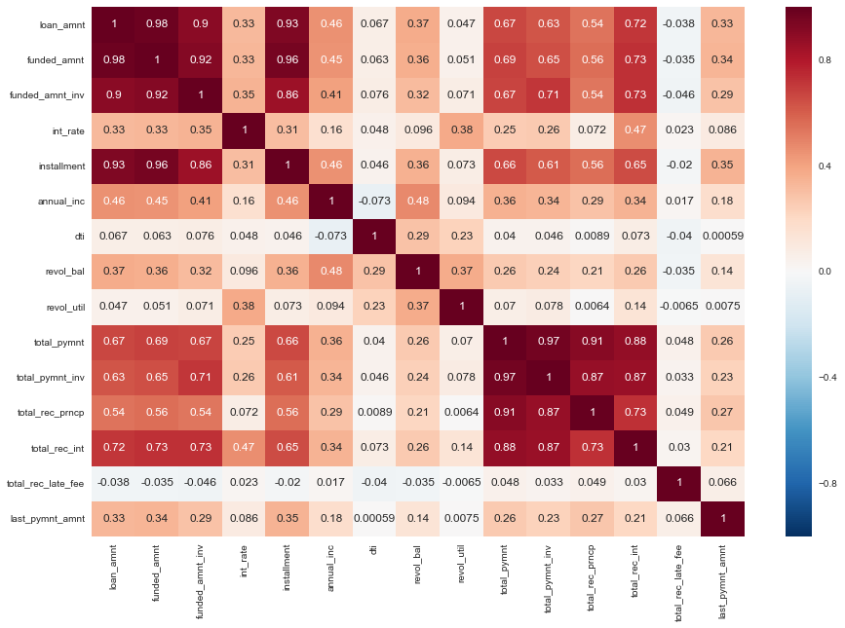
Driver Analysis Continuous Variables
Correlation Matrix
Two clusters which are highly correlated among each other – Loan Fund vs Total Payment

Slide 10
Driver Analysis by Categories [through derived metrics]
Objective around doing Driver Analysis is to create multiple hypotheses around the derived metrics created using available data; to see what factors having a significant impact on the Loan default

Slide 11
Summarizing the findings Recommendations

