Slide 1
Gramener Case Study Solution Deck
Group Members –
Brijesh Singh
Sourjya Sen
Debraj Ray
Nilanjan Dutta

Slide 2







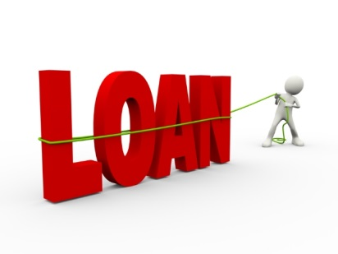

Loan Approval Process Current Scenario
Approval Process | Challenges / Risks
If the Applicant is likely to repay the loan, then not approving the loan results in a loss of business to the company
If the Applicant is not likely to repay the loan, i.e. he/she is likely to default, then approving the loan may lead to a financial loss for the company
Applicants’ asked by bank to fill Loan Application form
Consumer Finance Company provides Loan to the Applicants’
Applicants’ send Loan Application form to the Consumer Finance Company seeking their requirement
Loan Approval Decision
Approved
Rejected
Consumer Finance Company

Slide 3
Analysis Objective Strategy
Driver Analysis
through available sources
Data landscaping through Univariate & Bivariate means to identify potential drivers led by the applicants who are at default
Driver Analysis
through derived measures
Creating derived metrics using available resources to find patterns around applicants who are at default

Slide 4
Understanding the Data** Landscaping – Overall
Across all the Loans issued by the Consumer Finance Company, 14% Loans were categorized as Default whose Loan Amount equivalent to ~68 MM
Volume of Loans issued across 2007 – 2011
Transaction Amount of Loans across different metrics (in MM)
There has been an increasing trend in the Charged offs observed in the recent years
[YoY %increase counts to 119% for the most recent year]
**Loan Data provided for the Consumer Finance Company and the Loans issued from 2007-2011

Slide 5
Driver Analysis by Categories [through available sources]
Objective around doing Driver Analysis is to create multiple hypotheses around the available data; to see what factors having a significant impact on the Loan default

Slide 6

Hypothesis – I Is there any pattern around the Loan Term?
Distribution of Loan Term across Loan Status
It was observed that Applicants with a longer Loan Term tends to default more than shorter ones
Distribution of Interest Rates across Loan Status
To address the above cause, we looked into the Interest Rates for the Applicants and observed that with the increase in Interest Rates, the chances of getting default also increases.
“With the Increase in Interest rate, the chances of default increases as a Loan with Higher Interest rate generally goes for a longer term.
Consumer Finance Company can take a look at optimizing the Interest rates across types to reduce the proportion of Charge Offs as the Applicants’ Income stability might vary across years.”

Slide 7


Hypothesis – II Does Loan Term also affect other factors?
Distribution of Loan Term across Top 6 Purpose Categories
It was observed that Applicants having Debt Consolidation as the purpose of Loan tends to default with a higher chance over a Loan Term of 60 Months
Credit Card
Debt Consolidation
Home Improvement
Major Purchase
Other
Other Categories
Small Business
Distribution of Loan Term across Verification Status
Applicants whose Verification Status showed Verified were captured more in the Charged off list for the Loan Term of 60 Months
Not Verified
Source Verified
Verified
“Debt Consolidation captured to be a very common purpose for Loan Application. However, applicants opting for a Loan Term of 60 Months have higher chances of getting at default. Also, when looked at the Verification Status, majority of the Applicant’s income sources were found Verified for the same term. Consumer Finance Company can scrutinize the verification process to understand specific trait of Borrower’s at default.”

Slide 8
Hypothesis – III Does Grades impact the Loan Status?
Distribution of Grades across Loan Status
Applicants who were rated by categories viz. B, C, D & E grades contributes to ~82% of the total Charge off cases.
Majority of the Loan Applications which were graded by these categories also had a higher volume of Fully Paid cases.
There were certain sub grades which were significant in contributions.
B5, B4, B3, B2
C1, C2, C3, C4
D2, D3, D4
E1
“It was observed that a very high volume of the Loan Applicants across all Loan Status’ were Grade by categories such as B, C, D & E. However, when looked at Charge Offs, it was also found to have followed a similar pattern except for Grade A which had the most count of Fully Paid cases.
It is highly recommended to the Consumer Finance Company to look at the Grading System before the Loan Approval”

Slide 9
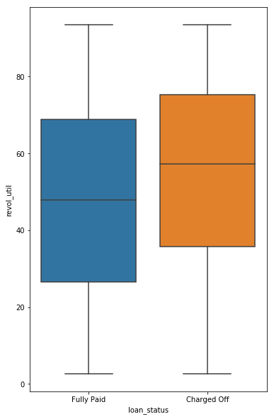
Hypothesis – IV How does Revolving line utilization rate impacts Loan Status?
Distribution of Loan Status across Revolving Line Utilization Rate buckets
Created 10 bins of Revolving Line Utilization rates to observe the capture of Charged Off & Fully Paid cases across the buckets.
From the plots, it can be said that higher the value of this Revolving balance utility rate , greater is the chance of loan default as we can observe the median quite high for defaulted loans.
“With the Increase in revolving line of utilization rate, the chances of default increases. As a recommendation, the Consumer Finance Company while screening the Borrower’s application should look at the Revolve line utilization rate at the lower side”

Slide 10
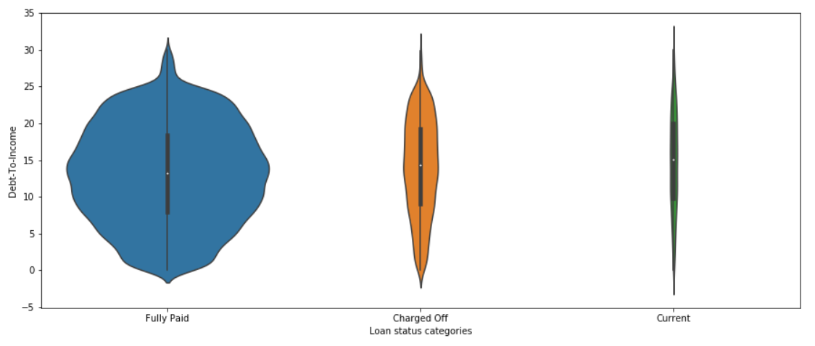
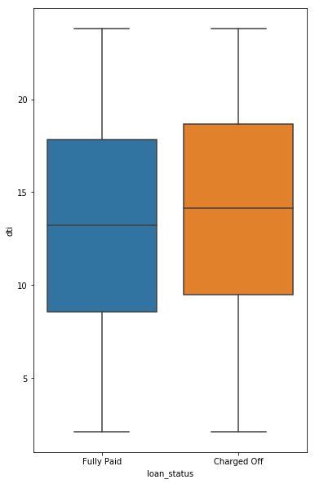
Hypothesis – V Is there any pattern around the debt to income ratio?
It shows that there is an increase in DTI (median and mean) from Fully Paid – Charged Off – Current
[This is concerning for Consumer Finance Company because this indicates that despite having a few loans in the Current loan status, the DTI average is more than the Fully Paid which is nearly 30 times of Current. In other words, if we assume that the DTI rate stays the same as Consumer Finance Company accepts more loans then in the future the number of defaulters could increase significantly]
Higher the value of this debt to income, greater is the chance of loan default.
For Charged off cases, there is a higher spread than the Fully paid loan implying higher the value there, greater is the risk of loan default
“With the Increase in debt to income ratio the chances of default increases is higher. As a recommendation, the Consumer Finance Company while screening the Borrower’s application should look at the debt to income ratio at the lower side”

Slide 11
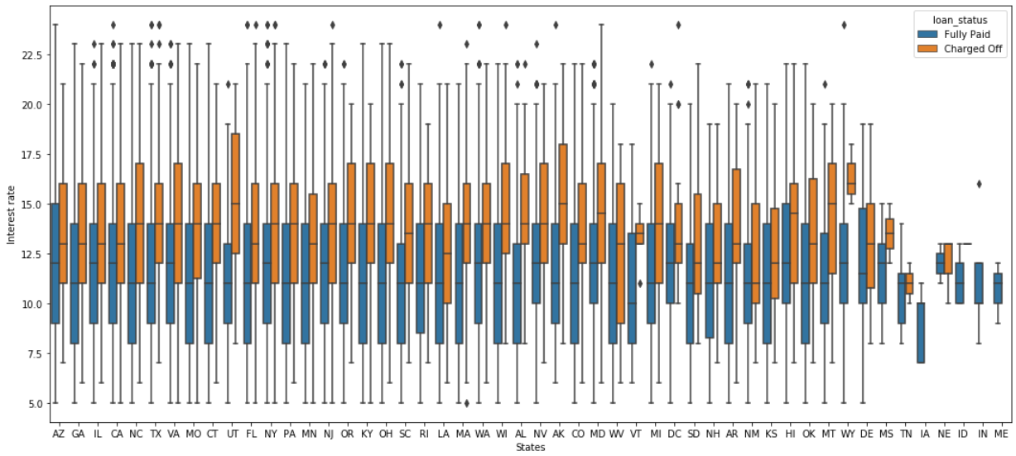
Hypothesis – VI Are there Borrowers from specific States more likely to Charge offs?
It was observed for certain states viz. Utah, Ohio, Nevada, Alaska & Wisconsin that with the increase in interest rates (beyond a threshold), the propensity of Borrowers encountering from Charge offs also increases.
“The Consumer Finance Company while screening the Borrower’s application from specific states (as highlighted) should implement a more robust model to capture their traits in order to minimize the charge offs”

Slide 12
Driver Analysis by Categories [through derived metrics]
Objective around doing Driver Analysis is to create multiple hypotheses around the derived metrics created using available data; to see what factors having a significant impact on the Loan default

Slide 13
Intelligent Features Understanding the Definition / Purpose
Feature Name | Definition/Purpose
Loan Risk Variable | Categorized the Loan Status into two parts Low-Risk (Fully Paid) & Moderate Risk (Charged Offs + Current) It was observed that the Median distribution of Current Status for DTI (Debt to Income) was more than 15%. In terms of business, more the DTI more goes the risk on Loan. Hence, to study a stronger impact across the variables, these two Loan Status’ were combined into one
Outstanding Balance | [Outstanding Balance = Funded Amount – Total Principal Received Amount] To study the impact of Outstanding Balance on different variables
US Regions | Divided 51 US states into 5 Regions viz. Western, South West, South East, Mid West & North East To study the impact of US Regions across different variables
Income Category | Categorized Borrower’s Annual Incomes into 4 segments – High (>90K), High – Medium (Between 60K-90K), Low-Medium (30K-60K) & Low(<30K) [All Income in USD] To study the impact of Categories across DTI

Slide 14
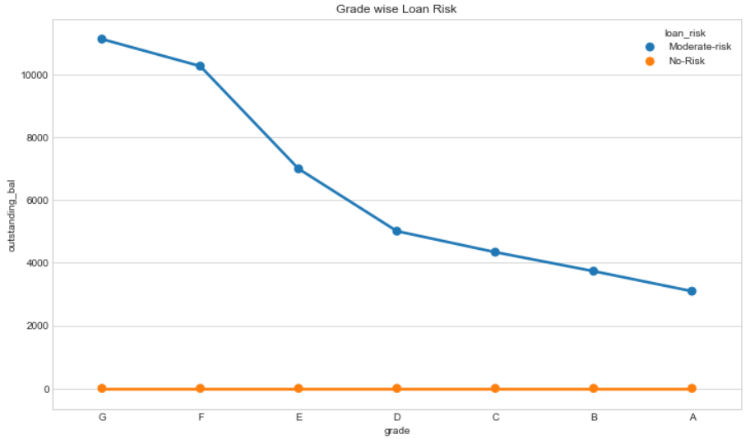
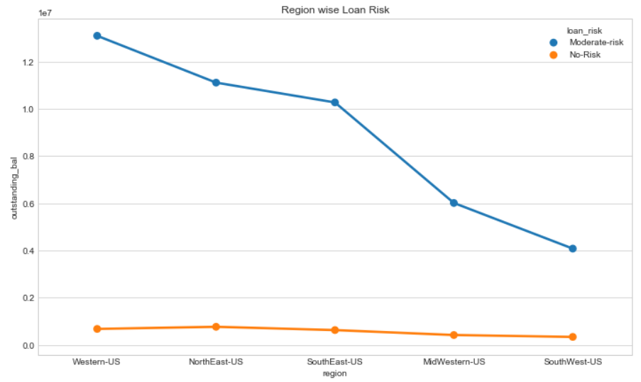

Risk Analysis for Derived Metrics Insights from Intelligent Features – I
Distribution of Grade across Loan Risk
Distribution of US Regions across Loan Risk
As we can see G,F & E category grade are in moderate risk (higher grade category higher moderate risk)
Western-US region is higher on Moderate Risk as total outstanding balance is higher in this region

Slide 15
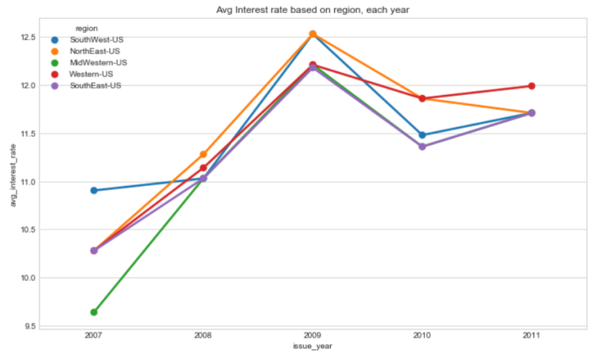
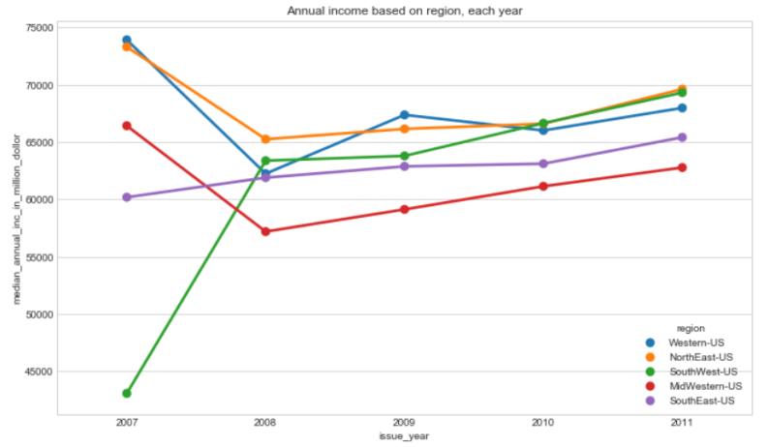
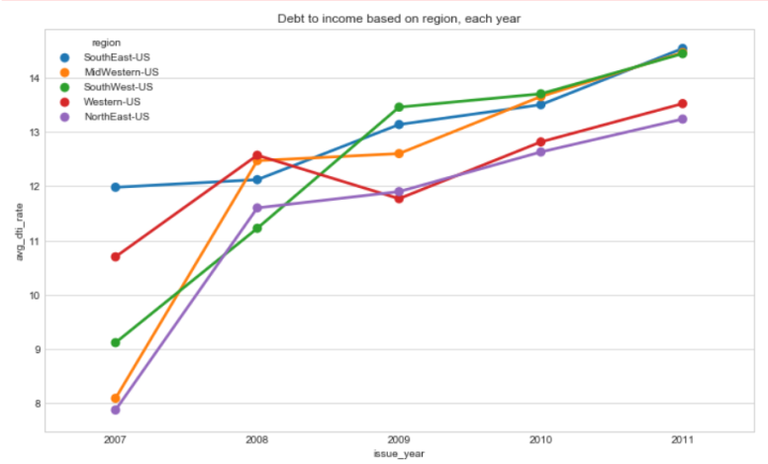
Driver Analysis for Derived Metrics Insights from Intelligent Features – II
Distribution of US Regions
by Average Interest Rate
by Annual Income
by DTI
MidWestern-US, SouthEast-US & SouthWest-US had a rapid increase in debt-to-income starting in 2011
MidWestern-US, SouthEast-US and SouthWest-US had a rapid increase in interest rates (This might explain the increase in debt to income)
DTI is inversely proportional to Annual income because dti=(monthly expenses including loan / monthly income)

Slide 16
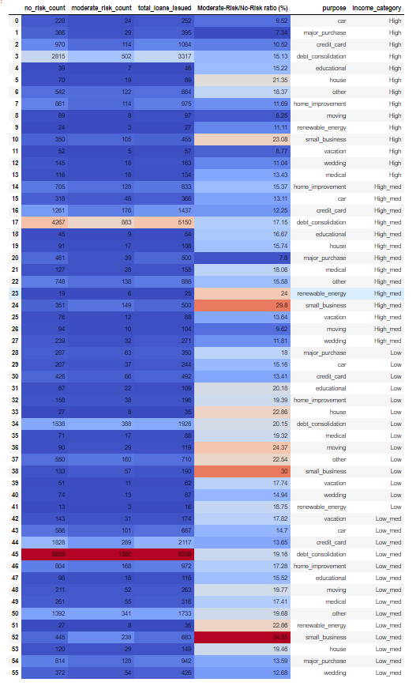
Analysis of Loan Variables Findings through Cross-Tab Analysis
Mostly done to identify distribution with easy. A couple of examples listed below –
Capturing the High Risk Loans– The category of applicants seeking Loans as a purpose of small business tends to have a higher risk of being a default loan. However, the severity would be less as it has a relatively low frequency.
Capturing Frequent Purpose Categories – It was observed that the purpose contributed by debt consolidated had the highest count.

Slide 17
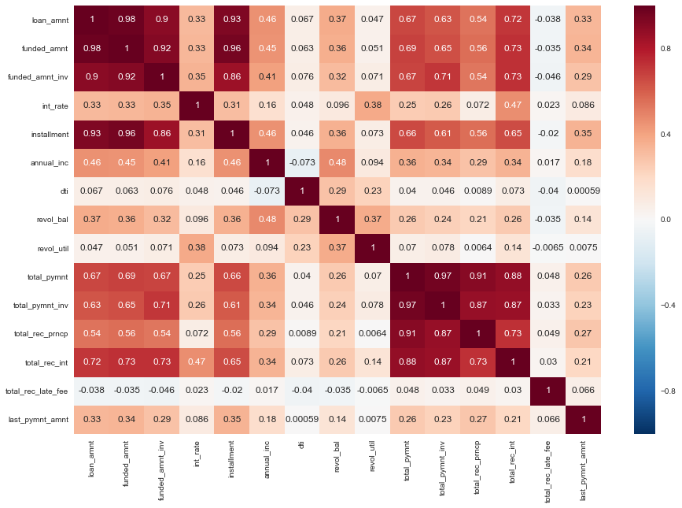
Analysis of Loan Variables Correlation Analysis
Correlation Matrix
Two clusters which are highly correlated among each other –
Loan Amount, Funded Amount & Funded Amount Investment are very highly correlated amongst each other
Total Payment, Total Payment Investment, Total Received Principal & Total Received Interest are highly correlated amongst each other
The cluster variables are positively dependent on each other.
Other variables which were found to be moderately Correlated –
Installment & Total Payment
Annual Income & Revolving Balance.

Slide 18

Summarizing the findings Recommendations for the Consumer Finance Company
Summarizing the analysis done on 6 Hypotheses , below are the key highlights –
Loan Term with longer duration tends to capture the majority of Charged Off cases. Hence, to address the cause for higher interest rates the company can look for an optimization.
Loan Applicants’ Verification System doesn’t have a good impact on the Loan Status. It needs to be revamped.
Borrowers with higher DTI tends to default more. It needs to be screened in a more robust way while processing the loan approval.
While screening the Borrower’s application, the Revolve line utilization rate should be considered at the lower side to minimize the impact of default.
Few Insights from the Derived metrics can be utilized to address the maximum impact and minimize the proportion of default –
Grades such as G,F & E are observed under moderate risk category. During the applicant’s screening process, it needs to be carefully monitored.
Western-US region is higher on Moderate Risk as total outstanding balance is higher in this region. Applicants’ belonging to these regions should be carefully monitored.

