Slide 1
Gramener Case Study Solution Deck
Group Members –
Brijesh Singh
Sourjya Sen
Debraj Ray
Nilanjan Dutta

Slide 2









Loan Approval Process Current Scenario
Approval Process | Challenges / Risks
If the Applicant is likely to repay the loan, then not approving the loan results in a loss of business to the company
If the Applicant is not likely to repay the loan, i.e. he/she is likely to default, then approving the loan may lead to a financial loss for the company
Applicants’ asked by bank to fill Loan Application form
Consumer Finance Company provides Loan to the Applicants’
Applicants’ send Loan Application form to the Consumer Finance Company seeking their requirement
Loan Approval Decision
Approved
Rejected
Consumer Finance Company

Slide 3
Analysis Objective Strategy
Driver Analysis
through available sources
Data landscaping through Univariate & Bivariate means to identify potential drivers led by the applicants who are at default
Driver Analysis
through derived measures
Creating derived metrics using available resources to find patterns around applicants who are at default

Slide 4
Understanding the Data** Landscaping – Overall
Across all the Loans issued by the Consumer Finance Company, 14% Loans were categorized as Default whose Loan Amount equivalent to ~68 MM
Volume of Loans issued across 2007 – 2011
Transaction Amount of Loans across different metrics (in MM)
There has been an increasing trend in the Charged offs observed in the recent years
[YoY increase counts to 119% for the most recent year]
**Loan Data provided for the Consumer Finance Company and the Loans issued from 2007-2011

Slide 5
Driver Analysis Overall Categories

Slide 6
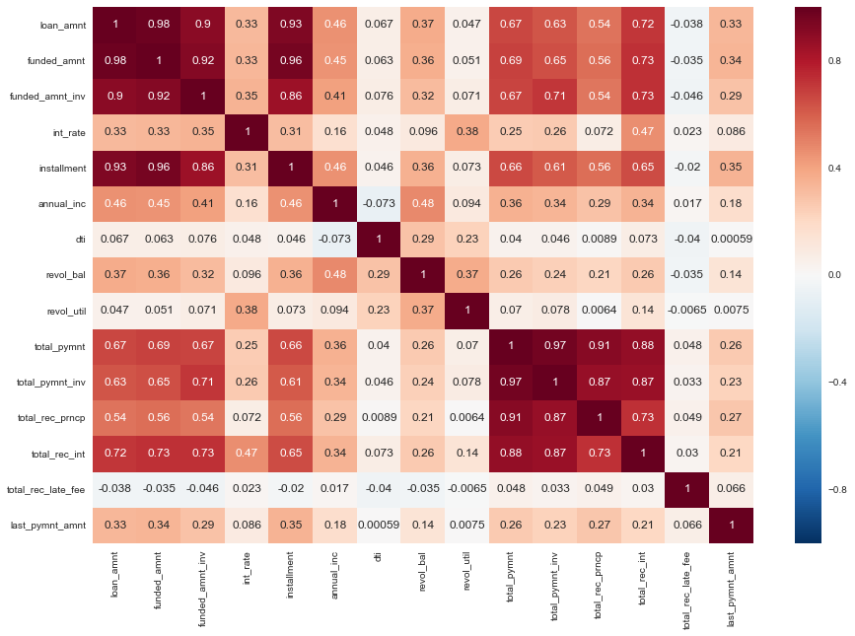
Driver Analysis Continuous Variables
Correlation Matrix
Two clusters which are highly correlated among each other – Loan Fund vs Total Payment

