Slide 1














HYPECHAT

Slide 2
CONTENTS
01 Introduction ,Objectives & scope
02 Tools , Platform and Spec.
03 Modules
04 System Design (CFD , DFD)
05 Database Design
06 Limitations and Future Enhancement

Slide 3



Introduction ,Objectives & Scope
01

Slide 4
Introduction
HypeChat is a straightforward and approachable social networking software that seeks to establish connectivity and improve communication. The development of computer networks and telecommunications technologies share the same goal of enabling communication between people. As a result, this project helps by offering a user-friendly platform that enables connections and communication between users.

Slide 5
Objectives
To provide a reliable platform to connect users across the network.
To allow users to communicate with each other.
To facilitate easy transfer of text messages.
Enabling users to upload posts, like, and comment on other users' posts will give them a regular social media user experience.

Slide 6


Scope
By sending and receiving messages in real time, the chat and social networking application HypeChat makes it simple to communicate with anyone anywhere in the world.By sharing their interests in the form of images or words, users of this software can interact socially with other users.

Slide 7
Tools , Platform and Specs.
02

Slide 8
For Development :
Front End : Android Studio
Back End : Firebase Console
Processor : Min. Intel i3/AMD Ryzen 3
Hardware : CPU 32bit/64bit
Hard Disk : Min.100GB or more
Ram : Min. 8GB

Slide 9
For Implementation :
Software : HypeChat
OS : Android 7.0 & above
Ram : Min. 2GB
Storage : Min. 8GB

Slide 10
Modules
03

Slide 11
Modules :
01 User Registration / LogIn
02 Post Upload
03 Private Chatting
04 User Search

Slide 12
User Reg./LogIn :
This module describes login functionalities for a user of this application. A new user can register using Email , Username and Password/Google Sign IN . An existing user can login using Email and Password/Google Sign IN .User can retain account in case he/she forgets password by password reset method through mail.

Slide 13
Post Upload :
This module handles post uploaded by users and likes and comments on each post.
Private Chatting :
This module defines one to one communication between two users .
User Search :
This module allows users to search other users by entering username , view their profiles and start conversation

Slide 14
System Design
04

Slide 15
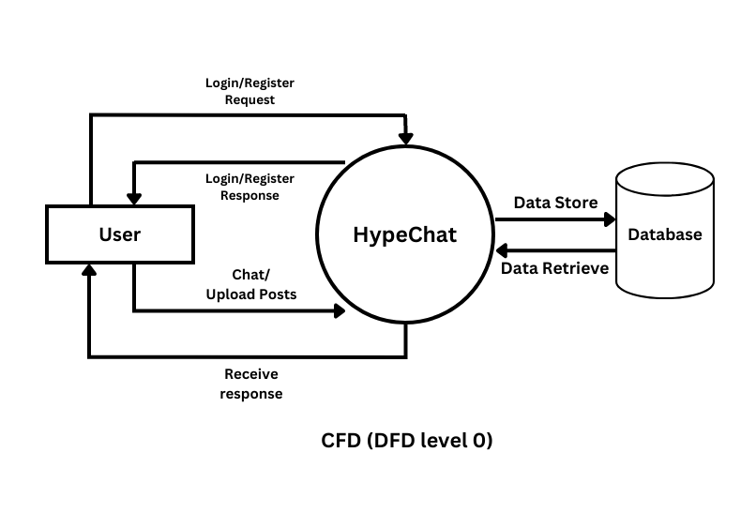
CFD(Context Flow Diagram) :

Slide 16
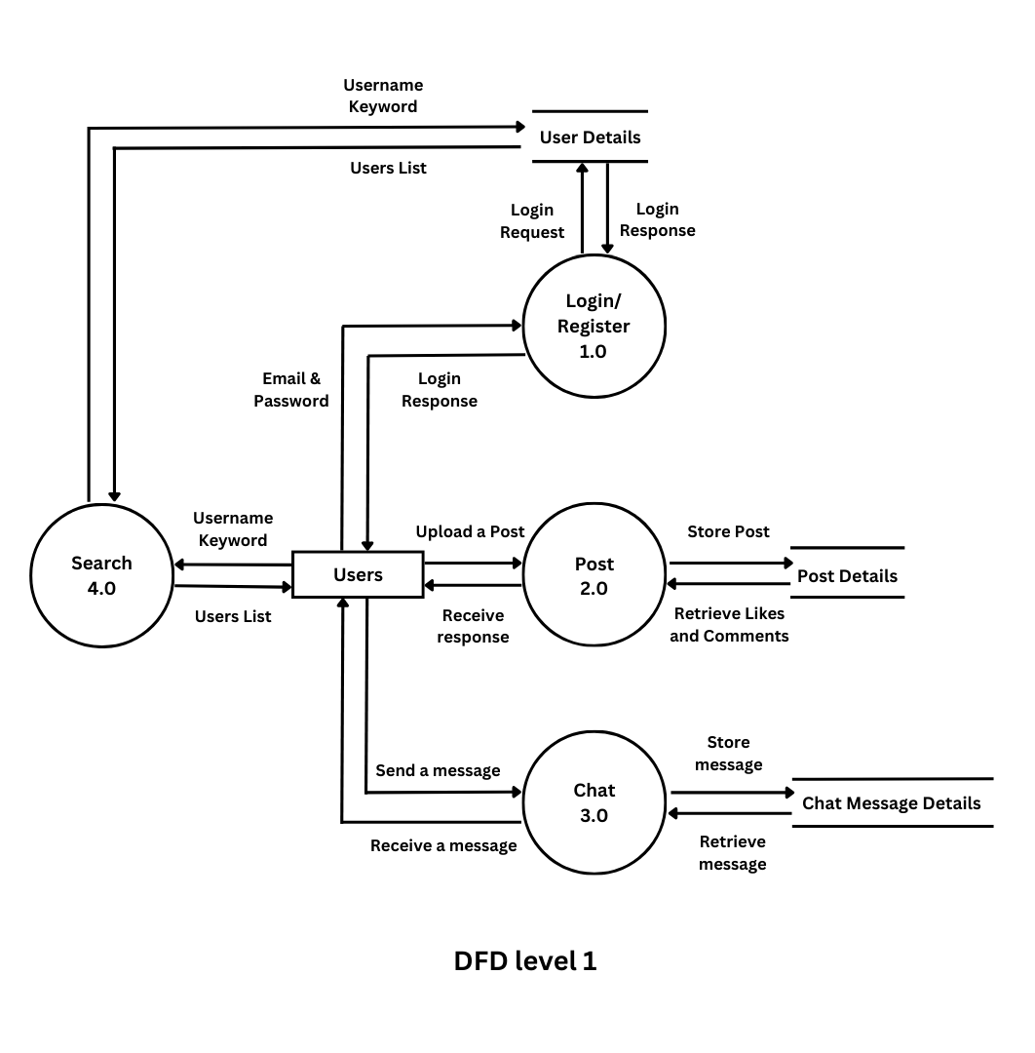
DFD(Data Flow Diagram) :

Slide 17
Database Design
05

Slide 18
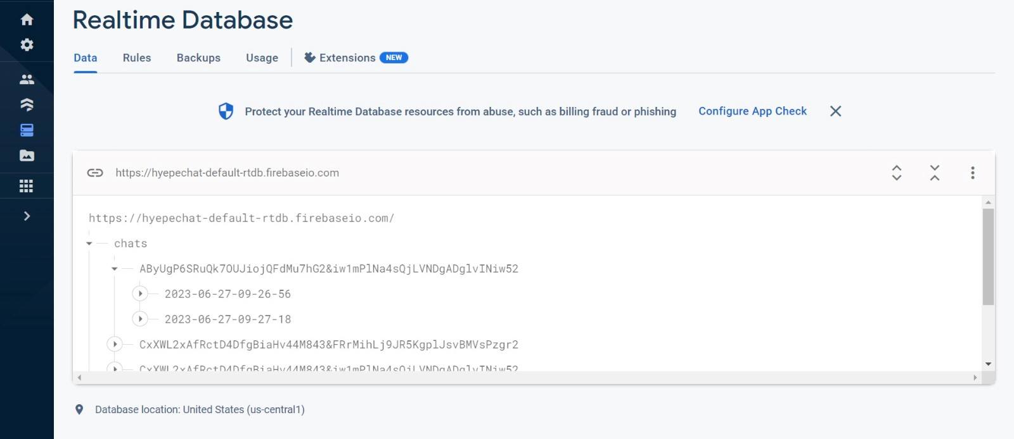
Firebase Realtime DB:

Slide 19
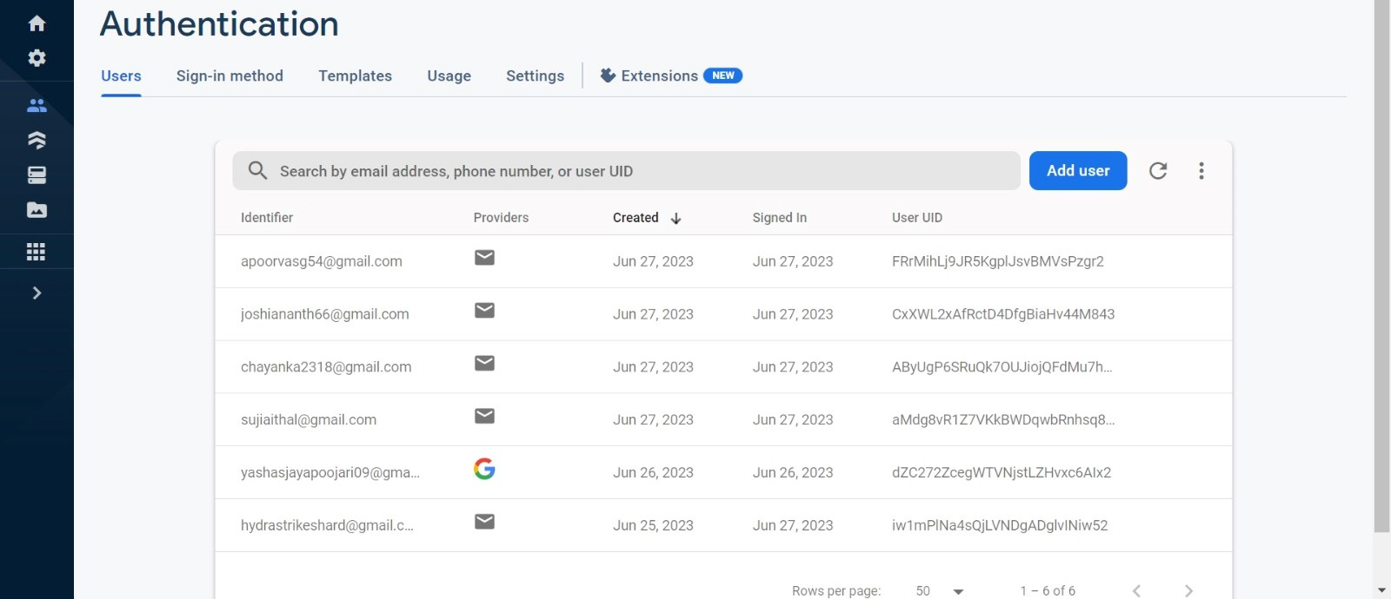
Firebase Authentication :

Slide 20
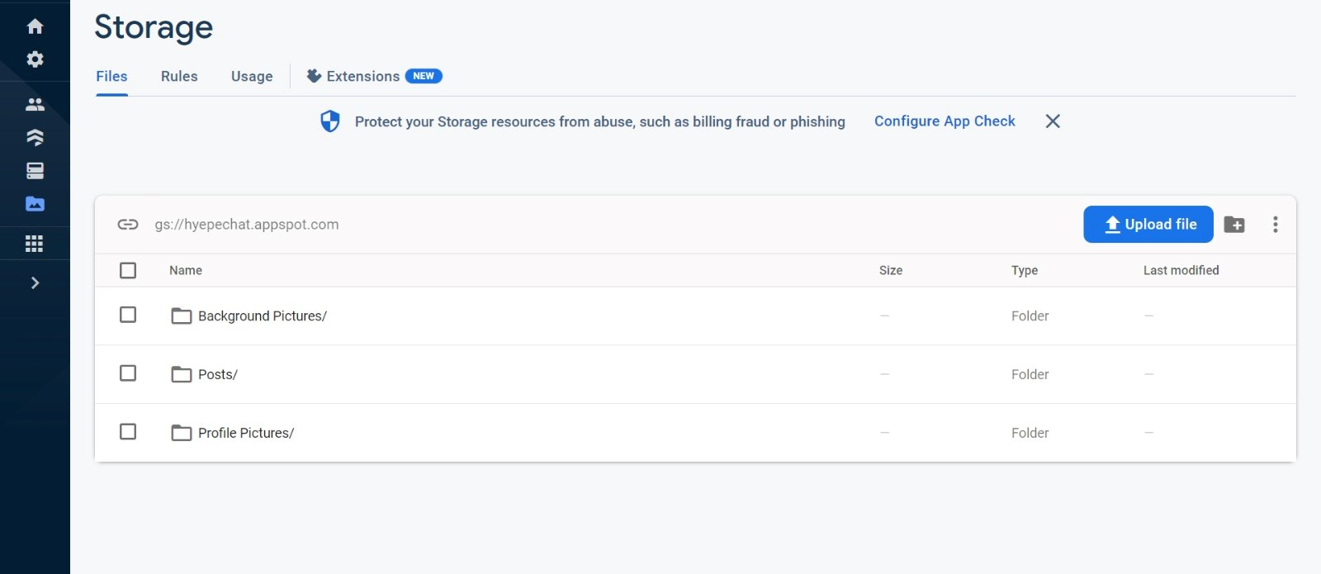
Firebase Storage :

Slide 21
Limitations & Future Scope
06

Slide 22
Limitations :
No Cross platform support.
Face-to-Face conversation(Video Calling) and Voice Call is not supported.
Broadcast Chatting or Group Chatting is not implemented.
Only text - based conversation can be performed.

Slide 23
Future Enhancements :
This application can be developed for Cross Platform.
Images and other file transfers can be made available to the user.
Video call and Voice call functionality can be added.

Slide 24



THANK YOU!

