Slide 1
Parallel implementation of Particle-Mesh mapping using CUDA enabled GPUs
Guide: Prof Bhasker Chaudhury
201101102 Brijesh Kumar

Slide 2
Objective
1 / 11
Particle to grid/mesh interpolation is an important technique which is used in several computational problems, such as the kinetic simulation of plasmas using Particle in cell algorithms. This interpolation procedure is computationally very expensive when the number of particle is more than few millions.

Slide 3
Objective
1 / 11
In this project we are trying to map randomly scattered particle to discrete system. We will use serial and parallel implementation to compare the results.

Slide 4
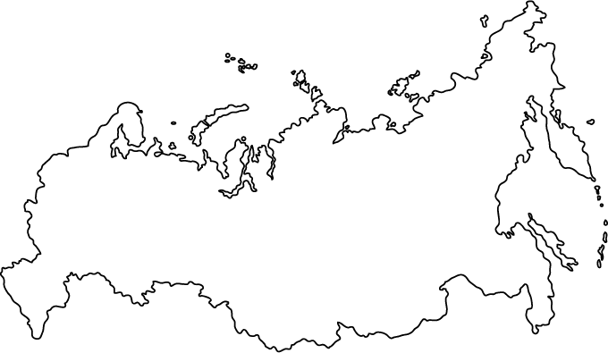




Application
2 / 11
Population distribution

Slide 5
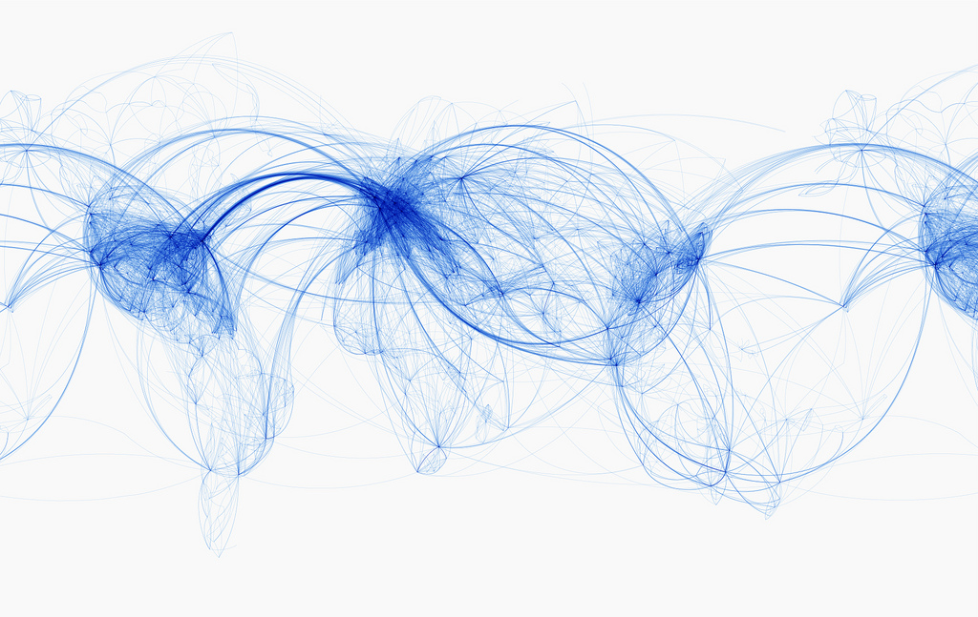

Application
2 / 11
Air traffic control

Slide 6
Application
2 / 11
Physics
gauss law
Lorentz equation
Electrodynamics
Motion
∇ · E = ρ/ε0
F=qE

Slide 7
Mapping Algorithm
3 / 11
P1
P2
for each ( P1 & P2 ) {
Left point = (Floor).position 4 4
Right Point = Left+1 5 5
fLeft = position - Left 1/2 3/4
fRight = Right - position 1/2 1/4
value (left) = (own value) + (fR x magnitude)
value (right) = (own value) + (fL x magnitude)
}
4.5
4.75
1
1/2
1/2
3/4
1/4

Slide 8
Mapping Algorithm
3 / 11
for each particle {
Left point = (Floor).position //coordinate search
Right Point = Left+1
fLeft = position - Left // “ f ” fractional distance
fRight = Right - position
//Update coordinate
value (left) = (own value) + (fR x magnitude)
value (right) = (own value) + (fL x magnitude)
}

Slide 9
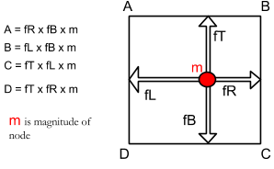
Mapping Algorithm
3 / 11
foreach particle p(i) in list
left = (floor).p(i).x ; //Coordinate search
bottom = (floor).p(i).y ;
right = left+1;
top = bottom+1;
//Fractional distance
fL = p(i).x – left ; fR = 1-fL;
fB = p(i).y-bottom ; fT = 1-fB ;
// updating coordinates
(left, top) = A; (right, top)=B;
(left,bottom)=C; (right,bottom)=D;
end
For each particle mapping approx 10 flops cycle is required

Slide 10
Mapping Algorithm
3 / 11
Normalisation
Variable average = ( total particle ) / (total mesh coordinates);
foreach position in grid
node value = (own value) / (average);
end
// if ratio > 1 means node value is more than average;
// if ratio < 1 means node value is less than average;
1
2
5
2
0
1
8
9
9
2
3
5
9
8
3
1
6
4
9
0
2
3
3
4
1
0.2
0.4
1.0
0.4
0.0
0.2
1.6
1.8
1.8
0.4
E.g. Total particle = 125
Total mesh node = 25
Average particle per node = 5
0.6
1.0
1.8
1.6
0.6
0.2
1.2
0.8
1.8
0.0
0.4
0.6
0.6
0.8
0.2

Slide 11

Serial Implementation
4 / 11
foreach particle i
p(i).x = random position.x;
p(i).y = random position.y;
end
foreach position in mesh
value mesh( x,y ) = 0.0;
end
Property | Details
Cache | 3.0MB
Clock Speed | 2.90 GHz
Number of cores | 4
Thermal design power | 28 W
Max memory bandwidth | 25.6GB/S
Mapping algorithm
Normalization algorithm
open file;
store information;
close file;

Slide 12
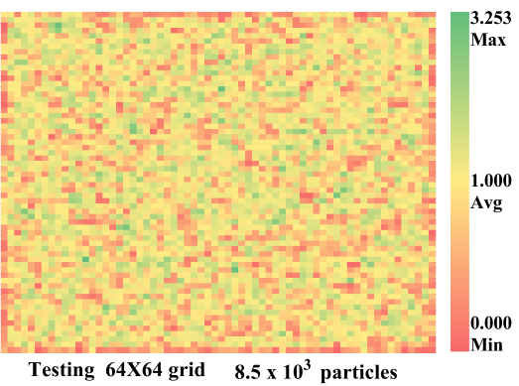
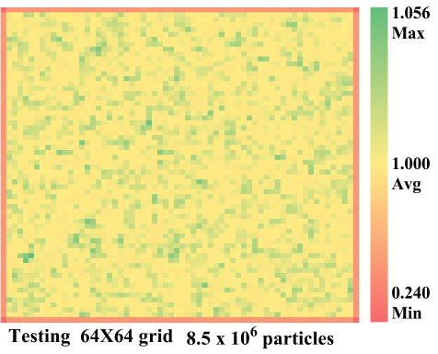
Serial Implementation
4 / 11

Slide 13
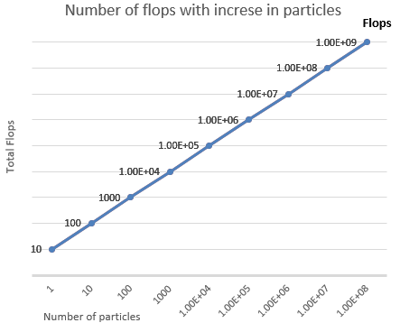
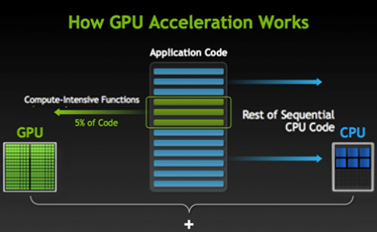
Serial Implementation
4 / 11

Slide 14
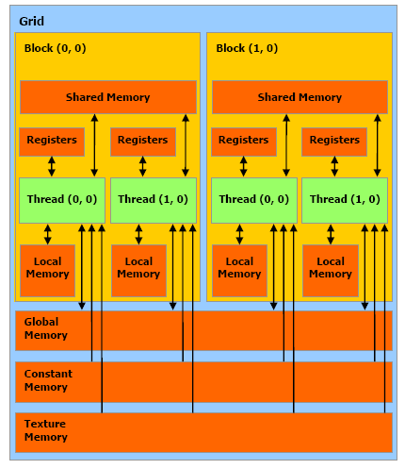
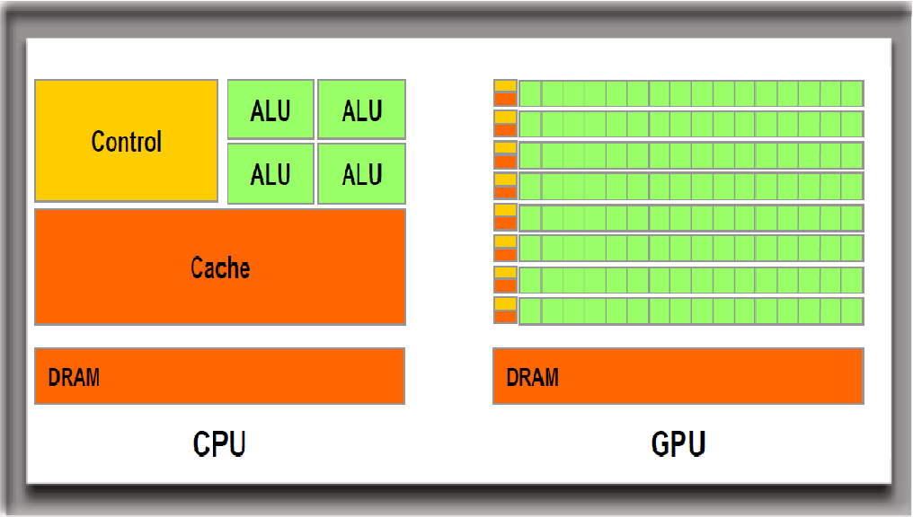
CUDA enabled GPU
5 / 11
CPU
GPU
Memory

Slide 15
CUDA enabled GPU
5 / 11
Process
Declare Host variable
Declare Device Variable
Allocate device memory
Transfer data to device memory
launch parallel threads
process data
Find thread id
Mapping
normalisation
Transfer data from device memory to cpu
store information in file
Deallocate memory

Slide 16
Parallel Implementation
6 / 11
Card K40
Max warp per MP 64
Max thread per MP 2048
Max thread block per MP 16
Registers per MP 65536
Max register per thread 255
MP count 15
Int main(){
Declare host variable;
Declare host variable;
// initialize host variable.
cudaMalloc( );
cudaMemcpy( host to device);
// define block dimension
Dim3 bD; //block dimension;
Dim 3 gD; //grid dimension;
Launch kernel<< bD, gD>> (parameters);
cudaMemcpy(from device to host);
Store data into file;
}
__global__ void parMap( parameters ){
thread ID= blockDim.x*blockIdx.x + threadIdx.x;
// Mapping algorithm
// Normalization algorithm
}

Slide 17
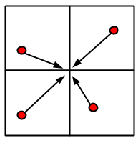
Parallel Implementation
6 / 11
Collison

Slide 18
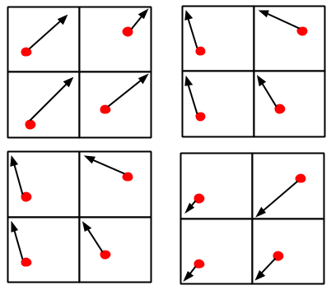
Parallel Implementation
6 / 11
Cyclic memory write

Slide 19
Result
7 / 11
Number of particles | Timing
 | CPU | GPU | Ratio
256 K | 13.1 | 0.7 | 18.7
512 K | 21.9 | 1.3 | 16.8
1 M | 42.1 | 2.7 | 15.6
2 M | 77.2 | 5.3 | 14.5
4 M | 151.1 | 11.2 | 13.4
8 M | 297.2 | 24.1 | 12.3
16 M | 589.6 | 51.2 | 11.5

Slide 20
Result
7 / 11
==1466== Profiling result:
Time(%) Time Calls Avg Min Max Name
88.88% 1.76606s 999 1.7678ms 1.7472ms 1.7985ms parMap(float*, float*, int)
10.94% 217.30ms 1000 217.30us 215.68us 1.0644ms [CUDA memcpy HtoD]
0.18% 3.6073ms 1 3.6073ms 3.6073ms 3.6073ms [CUDA memcpy DtoH]
==1466== API calls:
70.81% 1.92092s 2998 640.73us 3.0620us 1.7994ms cudaEventSynchronize
13.62% 369.53ms 1001 369.16us 336.37us 4.6231ms cudaMemcpy
9.85% 267.20ms 1000 267.20us 162.25us 724.20us cudaMalloc
3.67% 99.650ms 8 12.456ms 1.3830us 99.639ms cudaEventCreate
0.03% 829.41us 166 4.9960us 350ns 174.95us cuDeviceGetAttribute
0.03% 784.52us 999 785ns 627ns 2.9240us cudaConfigureCall
0.02% 427.34us 2 213.67us 171.67us 255.66us cudaFree

Slide 21
Learning’s
8 / 11
GDB compiler
Memory limit
Functions not available: basic host fuction dont work in device
rand
floor
#include <math.h>
range of variables
server lag

Slide 22
Learning’s
8 / 11
ssh
mobaxtream
sftp
nvcc compiler
ocupancy calculater
nvprof

Slide 23
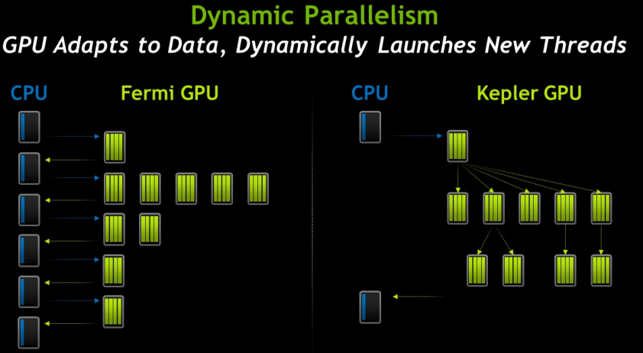
Future work
9 / 11

Slide 24
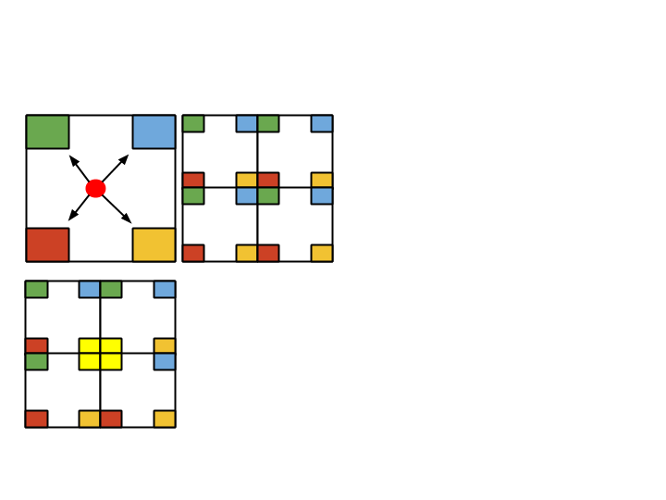
Future work
9 / 11

Slide 25
Acknowledgement
10 / 11
For my project I have used following machines
10.100.71.159 DAIICT,India
103.21.126.139 GSU, US
131.96.5.210 IIT-B,India
147.97.156.17 ASU,US

Slide 26
Acknowledgement
10 / 11
I have used following references
Shane Cook Book ‘CUDA programming , a developer guide’.
David B. Kirk, book ‘Programming massively with parallel processor’
F. Buyukkececi, O. Awile, I.F. Sbalzarini, A portable openCL implementation of generic particle-mesh and mesh-particle interpolation in 2D and 3D, sciencedirect 2013
G.Stantchev, W. Dorland,N.Gumerov, Fast parallel particle-to-grid interpolation for plasma PIC simulation on the GPU, J.Parallel Distrib,comput (2008)

Slide 27
Acknowledgement
10 / 11
I would like to thanks my guide Prof. Bhaskar Chaudhury for his clear guidance.

Slide 28
Thank You
11 / 11

