Slide 1
PWA APPLICATION
By: Brijesh Kumar Yadav

Slide 2
What is a PWA?
Reliable – They should load instantly even if the network conditions are not so good or if there’s no network at all.
Fast – They should be highly interactive and provide fast user experience. I.e. smooth scrolling and animations etc.
Engaging – They should be engaging so the user gets an immersive experience and stays connected with the app.
They’re installable on mobile devices, meaning you can have a link on your home screen to launch the app right away making it easier to access.

Slide 3
PWA Steps
Adding a service worker to your project
ng add @angular/pwa --project *project-name*
The above command completes the following actions:
  Adds the @angular/service-worker package to your project.
  Enables service worker build support in the CLI.
  Imports and registers the service worker in the app module.
  Updates the index.html file:
    Includes a link to add the manifest.json file.
    Adds meta tags for theme-color.
  Installs icon files to support the installed Progressive Web App (PWA).

Slide 4
Creates the service worker configuration file called ngsw-config.json, which specifies the caching behaviors and other settings.
Now, build the project:
ng build --prod

Slide 5
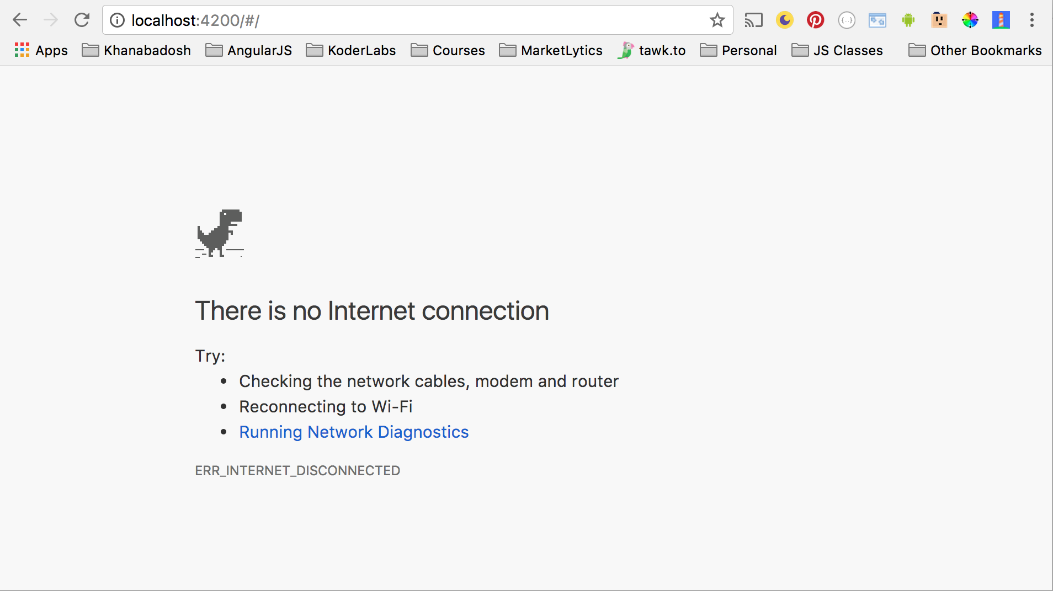
Without PWA

Slide 6
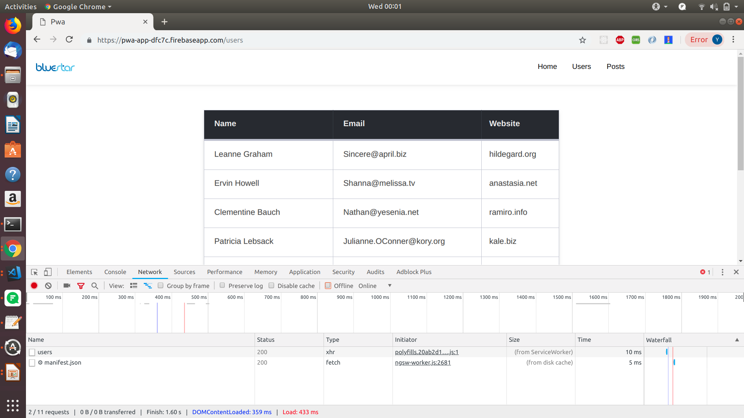
With PWA & Internet

Slide 7

With PWA & No Internet

