Slide 1
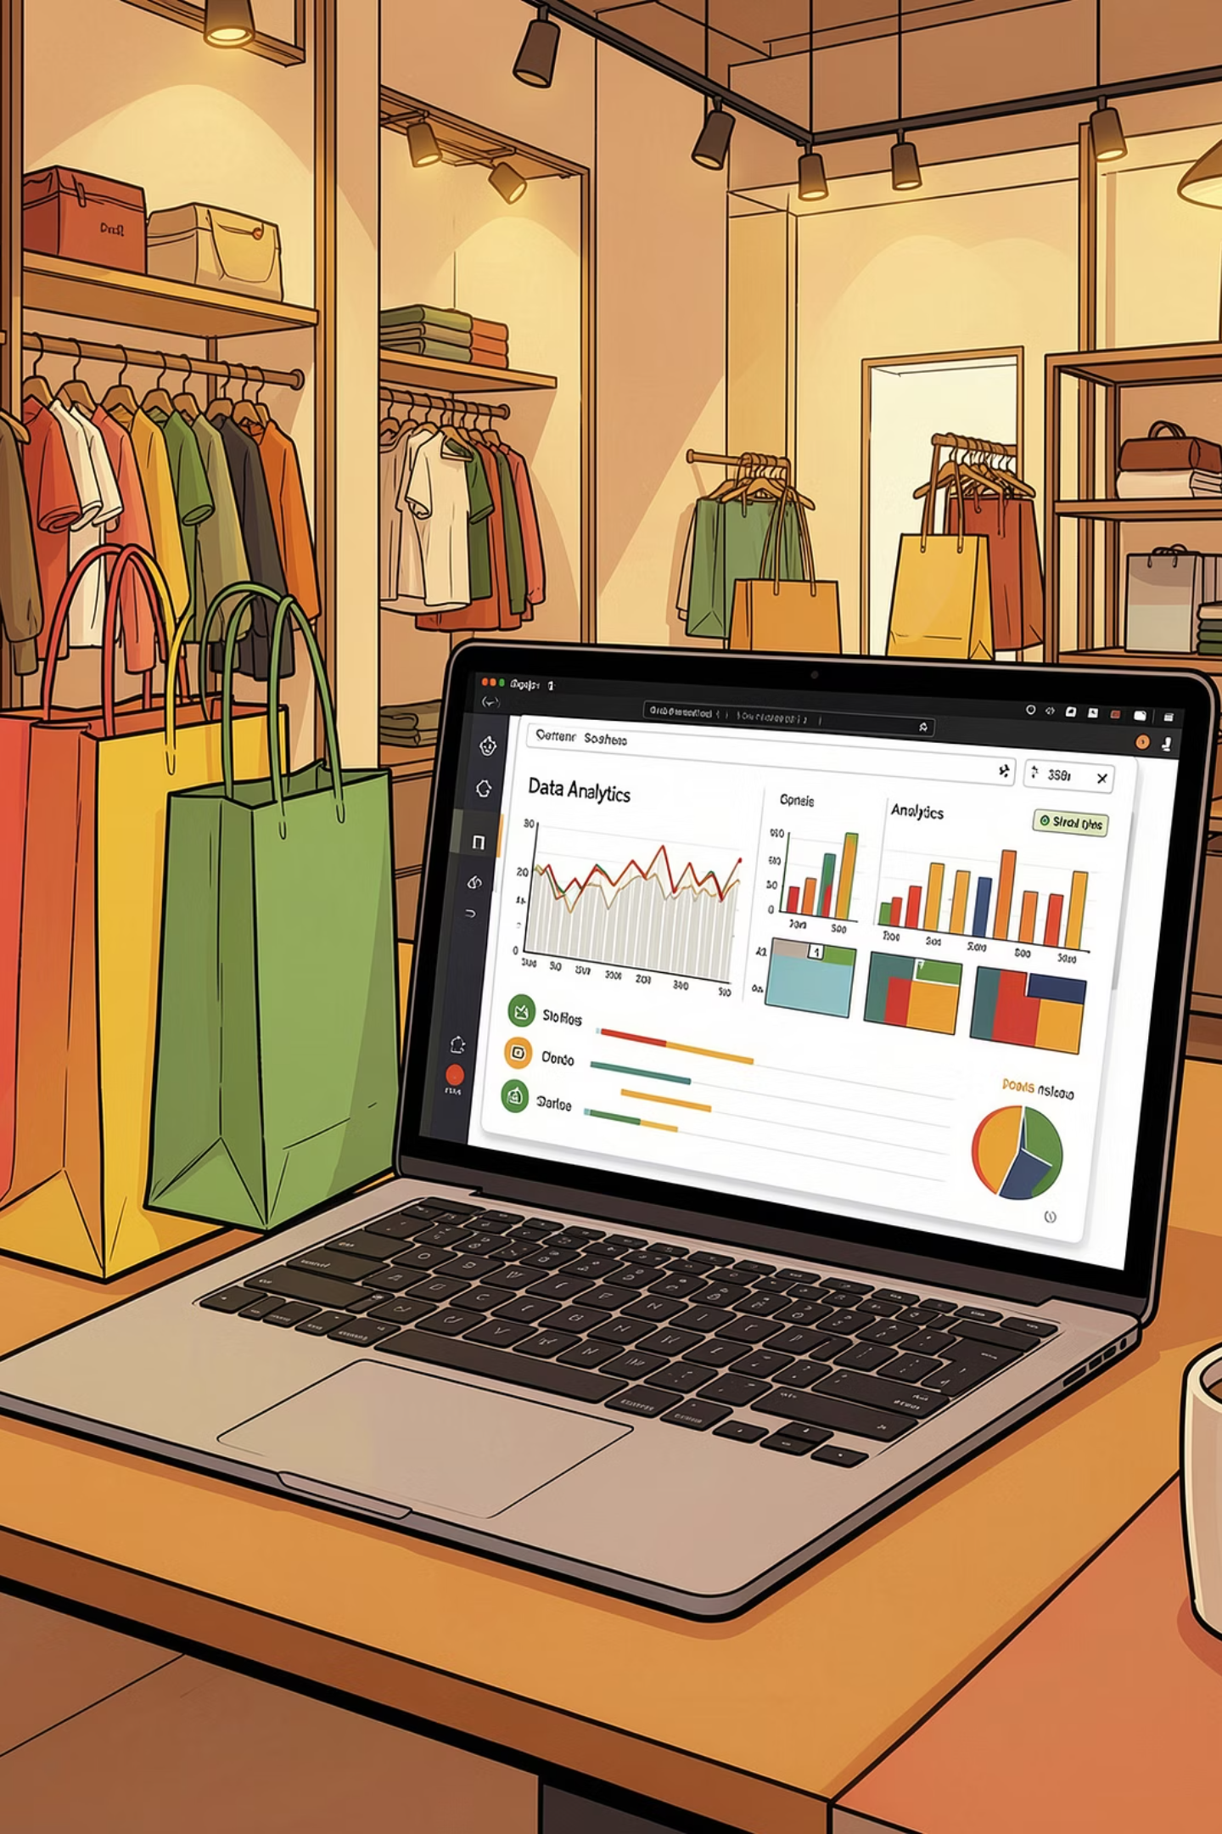
Customer Shopping Behavior Analysis
Uncovering spending patterns, customer segments, and product preferences across 3,900 transactions to guide strategic business decisions.

Slide 2
Dataset at a Glance
3,900
18
37
Total Purchases
Data Columns
Missing Values
Across all product categories
Demographics, behavior & purchases
In Review Rating column only
Customer Demographics
Purchase Details
Age, Gender, Location, Subscription Status
Item, Category, Amount, Season, Size, Color
Shopping Behavior
Discount Applied, Promo Code, Previous Purchases, Frequency, Review Rating, Shipping Type

Slide 3


Data Preparation in Python
Loading & Exploration
Imported dataset via pandas; used df.info() and .describe() for structure and summary statistics.
Cleaning & Standardization
Imputed missing Review Ratings using median per category. Renamed columns to snake_case. Dropped redundant promo_code_used.
Feature Engineering
Created age_group by binning ages and purchase_frequency_days from purchase data.
Database Integration
Loaded cleaned DataFrame into PostgreSQL for SQL-based analysis.

Slide 4
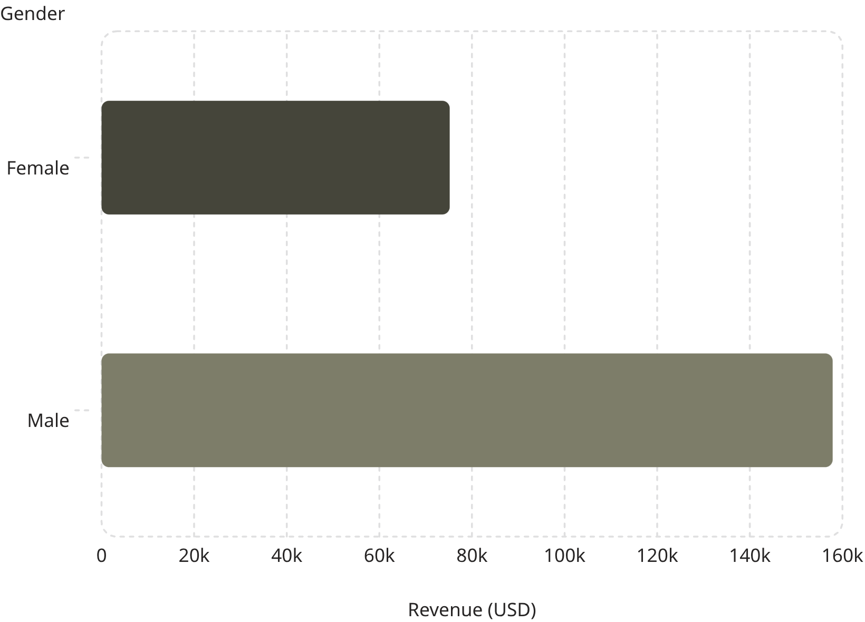
Revenue & High-Spending Customers
Revenue by Gender
Male customers generated over 2x the revenue of female customers — $157,890 vs. $75,191.
High-Spending Discount Users
839 customers used discounts yet still spent above the average purchase amount, representing a valuable segment of deal-savvy high spenders.

Slide 5
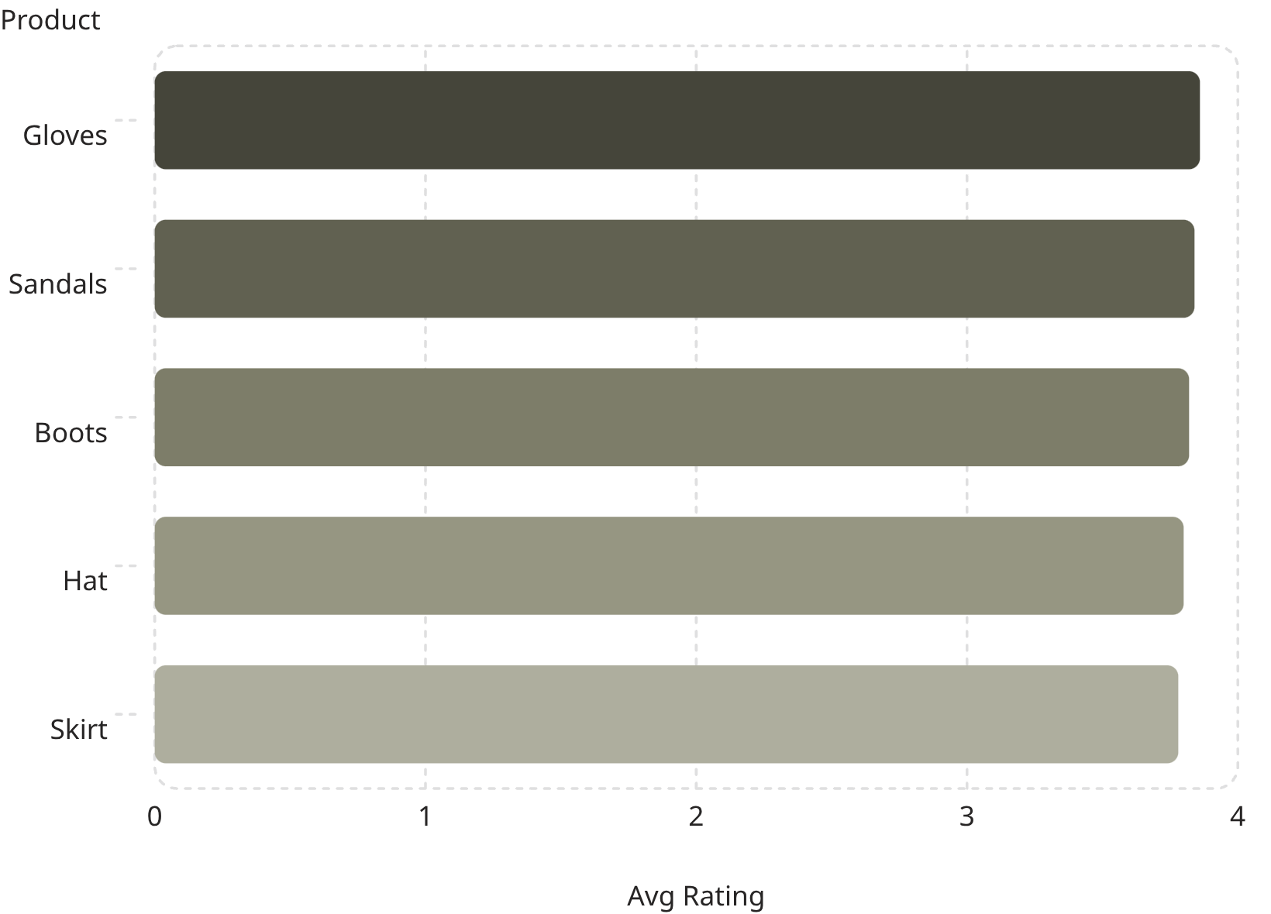
Product Ratings & Shipping Insights
Top 5 Products by Rating
Gloves lead with a 3.86 average rating. All top products cluster tightly between 3.78–3.86.
Shipping Type Comparison
Express shipping customers spend slightly more on average ($60.48) vs. Standard ($58.46), suggesting higher intent among express buyers.

Slide 6
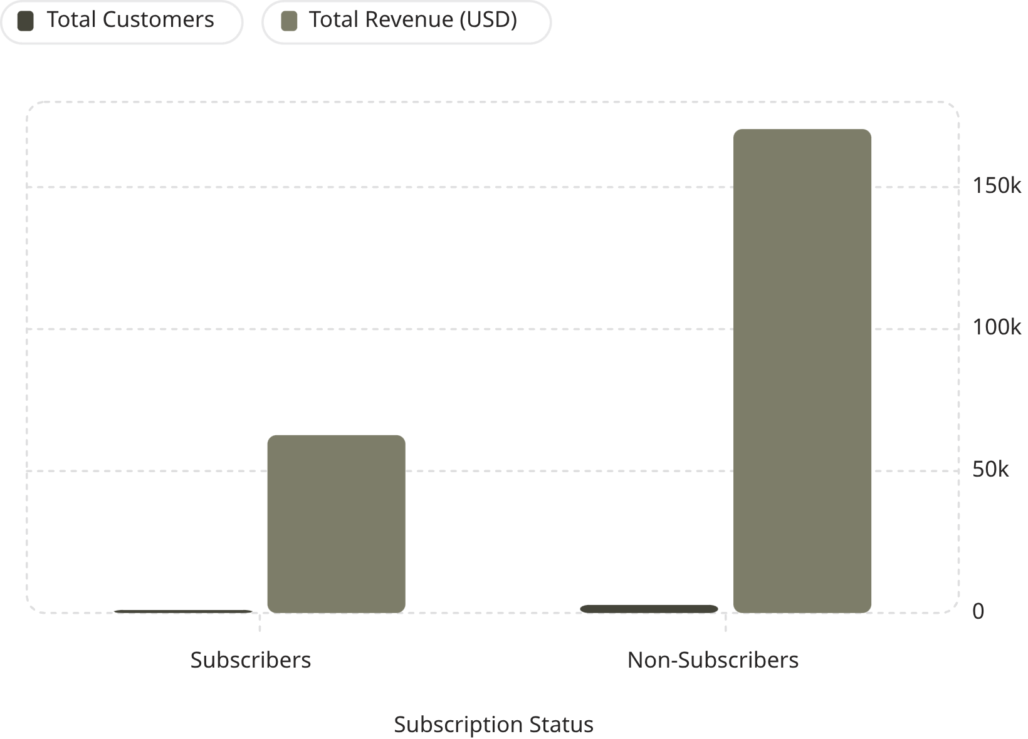

Subscribers vs. Non-Subscribers
Key Findings
Non-subscribers dominate in volume (73% of customers) and total revenue ($170,436 vs. $62,645). However, average spend is nearly identical — $59.87 vs. $59.49 — suggesting subscription status doesn't significantly impact per-transaction value.
Subscribers represent a growth opportunity: similar spend, but far fewer in number.

Slide 7
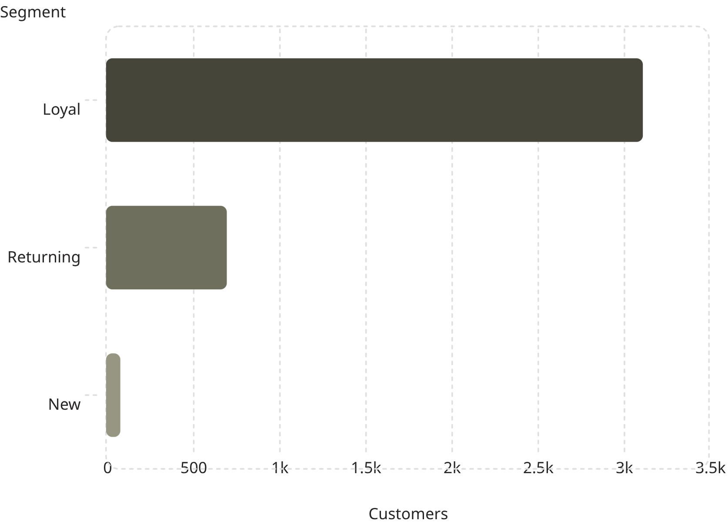
Discount Patterns & Customer Segmentation
Top 5 Discount-Dependent Products
Customer Segments
Product
Discount Rate
Hat
50.00%
Sneakers
49.66%
Coat
49.07%
Sweater
48.17%
Pants
47.37%
Loyal customers make up 80% of the base. Repeat buyers with >5 purchases: 958 subscribers vs. 2,518 non-subscribers.

Slide 8
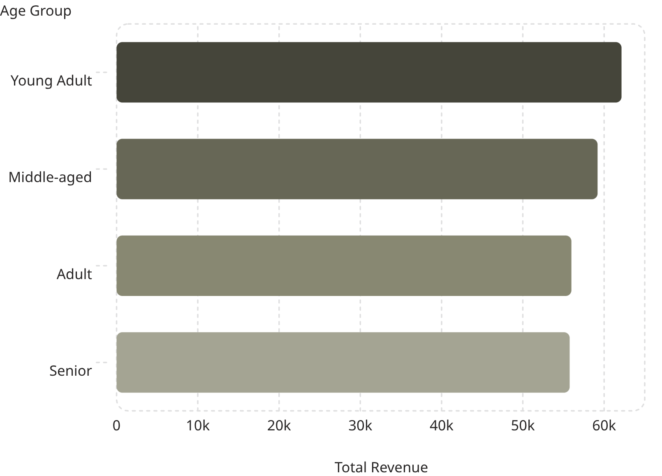
Revenue by Category & Age Group
Top 3 Products per Category
Revenue by Age Group
Category
Product
Orders
Accessories
Jewelry
171
Accessories
Sunglasses
161
Accessories
Belt
161
Clothing
Blouse
171
Clothing
Pants
171
Clothing
Shirt
169
Footwear
Sandals
160
Footwear
Shoes
150
Footwear
Sneakers
145
Outerwear
Jacket
163
Young Adults lead revenue contribution at $62,143. Revenue is relatively evenly distributed across all age groups.
Outerwear
Coat
161

Slide 9

Power BI Dashboard
Key Metrics
3.9K customers · $59.76 avg purchase · 3.75 avg review rating
Subscription Split
Donut chart: 27% subscribers vs. 73% non-subscribers
Category Views
Bar charts for revenue and sales across Clothing, Accessories, Footwear & Outerwear
Age Group Analysis
Horizontal bar charts breaking down revenue and sales by age segment

Slide 10
Business Recommendations
Boost Subscriptions
Loyalty Programs
Review Discount Policy
Promote exclusive subscriber benefits to grow the 27% base.
Reward repeat buyers to move them into the "Loyal" segment (80% of base).
Balance sales boosts with margin control — 5 products show ~47–50% discount rates.
Targeted Marketing
Product Positioning
Focus on high-revenue age groups (Young Adults) and express-shipping users.
Highlight top-rated (Gloves 3.86★) and best-selling products in campaigns.

