Slide 1
MASTER OF TECHNOLOGY — COMPUTER SCIENCE & ENGINEERING
Natural Disaster Prediction Engine
An End-to-End Autonomous, Physics-Grounded Geospatial AI Platform
for Flood & Landslide Susceptibility Mapping, Real-Time Dynamic Risk Prediction, and Satellite-Based Crop Intelligence — Orchestrated by a 5-Agent AI Pipeline
● Geospatial AI
● AHP Susceptibility
Thesis Information
● TOPMODEL Physics
● 5-Agent Autonomous
Presented by:
Candidate Name
● Satellite Crop Intelligence
● PostGIS Spatial DB
Roll No.:
XXXXXXXX
Supervisor:
Prof. [Supervisor Name]
Department:
Computer Science & Engg.
Institute:
Your University / Institute
Academic Year:
2025 – 2026
Defense Date:
May 2026

Slide 2
Table of Contents
Thesis Defense Outline
01
Introduction & Motivation
07
Agentic AI Pipeline
Problem statement, research gaps, objectives
5-agent autonomous orchestration via n8n
02
System Architecture
08
Database & API Design
5-layer architecture, component roles, data flow
PostGIS schema, 12+ spatial tables, WebSocket
03
Module A — AHP Susceptibility
09
Technology Stack
Terrain-adaptive AHP, 12 terrain classes, FoS
Full stack overview: React, Node, FastAPI, Docker
04
Module B — ERA5 Weather Engine
10
Data Sources
API decay, CDSAPI integration, antecedent precip
Multi-source geospatial data integration
05
Module C — Dynamic Risk Prediction
11
Results & Performance
TOPMODEL + SCS-CN + AMC fusion engine
Accuracy metrics, fault tolerance, benchmarks
06
Module D — AgriIntel v2
12
Conclusions & Future Work
Satellite crop classification + yield forecast
Contributions, limitations, research directions
Natural Disaster Prediction Engine | Thesis Defense
Slide 2 / 17

Slide 3
Introduction & Motivation
Problem Statement, Research Gap & Objectives
⚠ Problem Statement
🎯 Research Objectives
• India faces 40+ major floods and landslide events annually
O1
Design terrain-adaptive AHP with 12 terrain-specific weight matrices
• 60-80 million people displaced by floods every year (NDMA 2023)
• Existing EWS systems lack physics-based terrain-adaptive models
O2
Develop physics-fusion engine: TOPMODEL + SCS-CN + Infinite-Slope FoS
• No open-source platform integrates flood + landslide + crop risk
• Manual GIS processing takes weeks; no real-time autonomous system
O3
Build 5-agent autonomous AI pipeline with zero human intervention
• District-level precision missing from national alert systems
O4
Create satellite-based crop intelligence with stage-wise risk scoring
🔬 Research Gap
O5
Implement antecedent precipitation API decay (K=0.85) for soil moisture
• Static AHP models ignore terrain variability across India
O6
Provide full 730-district India coverage with PostGIS spatial database
• No physics fusion: TOPMODEL + SCS-CN + FoS combined
• No autonomous pipeline — all existing tools need manual triggers
O7
Real-time WebSocket dashboard with 6-hour update cycle
• Crop intelligence not integrated with disaster risk systems
O8
Open-source deployable platform via Docker Compose
• Antecedent moisture (API decay) overlooked in real-time tools
Natural Disaster Prediction Engine | Thesis Defense
Slide 3 / 17

Slide 4

System Architecture
5-Layer Stack with Data Flow
Natural Disaster Prediction Engine | Thesis Defense
Slide 4 / 17

Slide 5
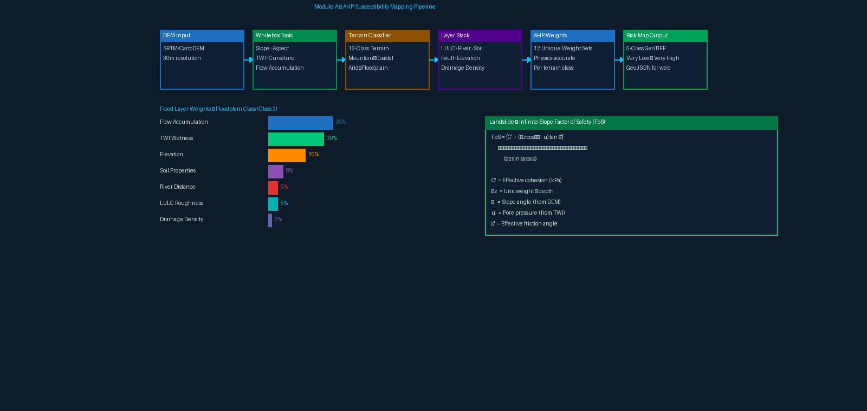
Module A — AHP Susceptibility Mapping
Terrain-Adaptive Multi-Criteria Spatial Analysis
Natural Disaster Prediction Engine | Thesis Defense
Slide 5 / 17

Slide 6
Module B — ERA5 Rainfall & Weather Engine
Automated Weather Data Ingestion & Antecedent Precipitation
ERA5 Parameters Fetched via CDSAPI
Antecedent Precipitation Index (API) Decay Model
ERA5 Variable
Unit
Parameter
Usage
APIₙ = P₀ + K·P₁ + K²·P₂ + ... + Kⁿ·Pₙ
total_precipitation
mm
Precipitation
Trigger scoring
where K = 0.85 (Kohler & Linsley, 1951)
volumetric_soil_water_l1
m³/m³
Soil Moisture
AMC condition
• P₀ = Today's rainfall (mm)
surface_runoff
mm
Surface Runoff
SCS-CN input
• Pₙ = Rainfall n days ago (mm)
2m_temperature
K
Temperature
Crop risk
• K = Decay constant = 0.85
• n = Antecedent window = 10 days
10m_u/v_component_of_wind
m/s
Wind Speed
Evapotranspiration
potential_evaporation
m
Evaporation
Soil budget
High API → Saturated soil → Elevated risk
Low API → Dry soil → Reduced risk
ERA5 Data Pipeline Flow
CDSAPI Request (Copernicus CDS)
→
NetCDF4 Download
→
xarray Processing
→
District Interpolation
→
PostGIS Weather Table
→
API Decay Computation
→
Trigger Score Input
Natural Disaster Prediction Engine | Thesis Defense
Slide 6 / 17

Slide 7
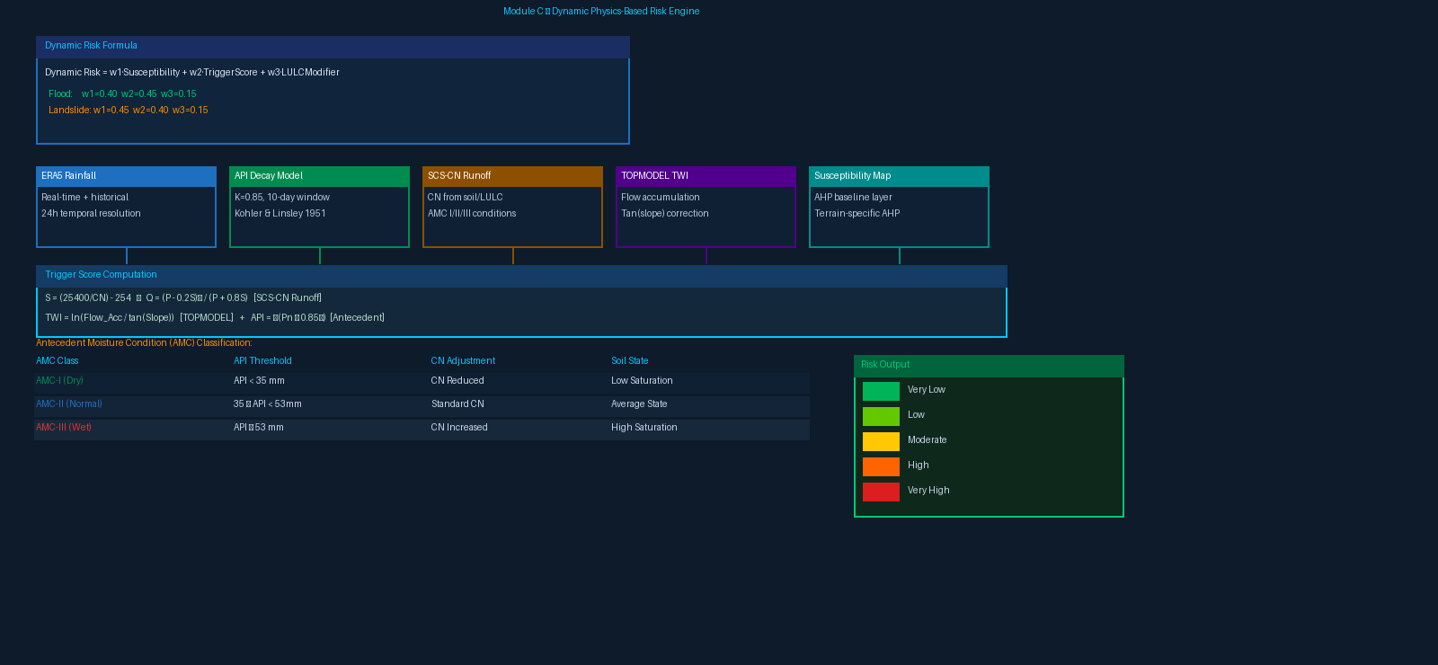
Module C — Dynamic Physics-Based Risk Prediction
TOPMODEL + SCS-CN + AMC Fusion Engine
Natural Disaster Prediction Engine | Thesis Defense
Slide 7 / 17

Slide 8
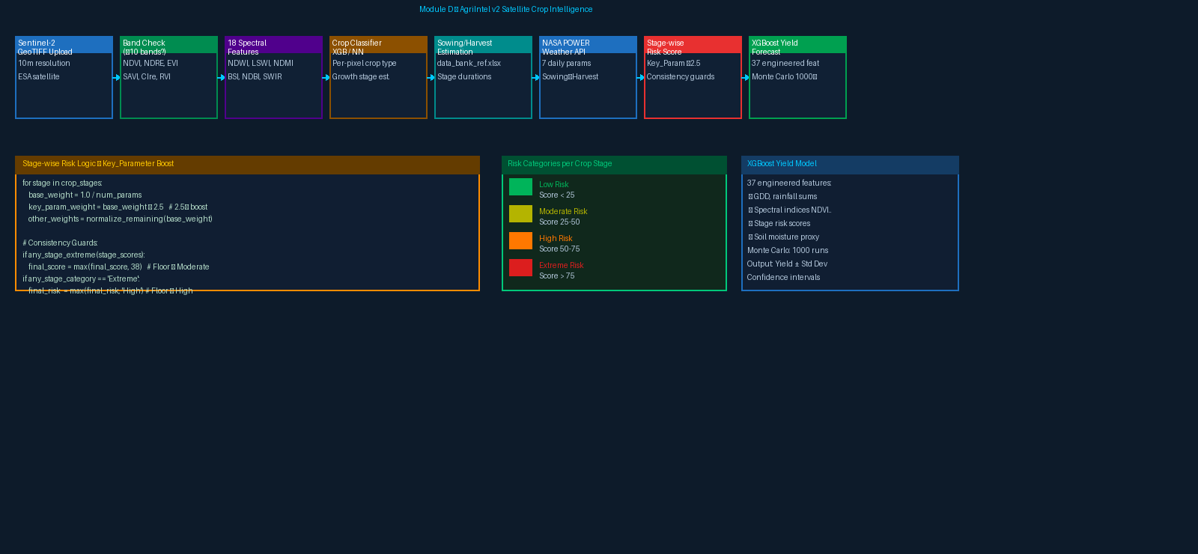
Module D — AgriIntel v2: Satellite Crop Intelligence
XGBoost + Spectral Indices + NASA POWER + Stage-wise Risk
Natural Disaster Prediction Engine | Thesis Defense
Slide 8 / 17

Slide 9
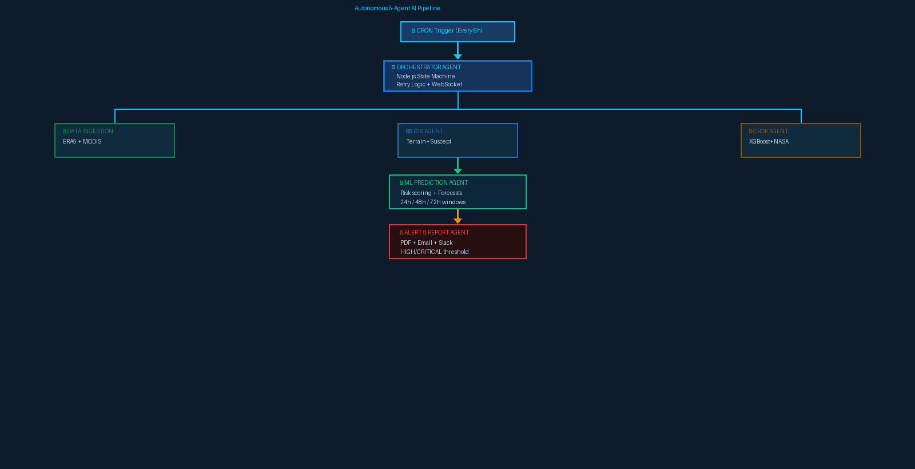
Agentic AI Pipeline
Fully Autonomous 5-Agent Orchestration via n8n
Agent 0
Orchestrator
• Node.js state machine
• CRON + retry logic
• WebSocket broadcast
Agent 1
Data Ingestion
• ERA5 + MODIS fetch
• CDSAPI auto-download
• PostGIS update
Agent 2
GIS Processing
• Terrain analysis
• AHP susceptibility maps
• GeoTIFF output
Agent 3
ML Prediction
• Risk scoring engine
• 24/48/72h windows
• District forecasts
Agent 4
Alert & Report
• PDF generation
• Email + Slack dispatch
• Threshold checking
Agent 5
Crop Agent
• XGBoost prediction
• NASA POWER fetch
• Parallel with GIS
Natural Disaster Prediction Engine | Thesis Defense
Slide 9 / 17

Slide 10
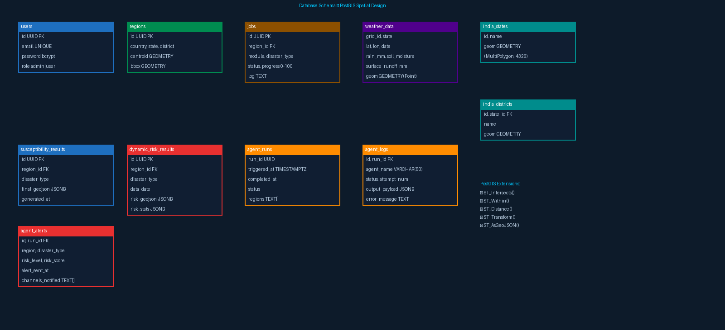
Database & API Design
PostgreSQL + PostGIS Spatial Schema & RESTful API
Natural Disaster Prediction Engine | Thesis Defense
Slide 10 / 17

Slide 11
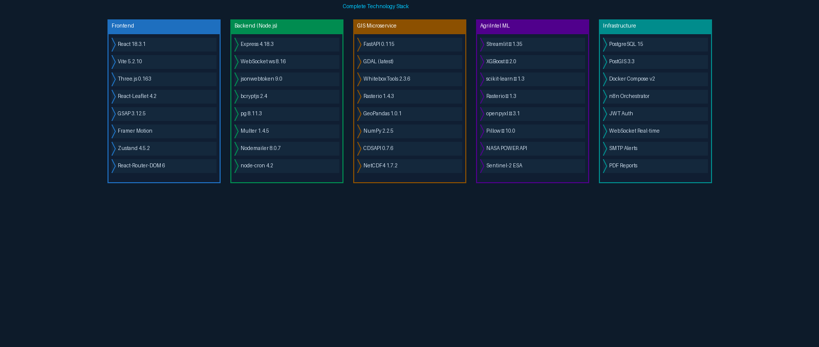
Technology Stack
Full-Stack Architecture: React · Node.js · FastAPI · Docker · PostGIS
✓ Physics-Grounded AI
✓ Zero-Human Autonomy
✓ National India Coverage
✓ Real-Time WebSocket
✓ Open Source MIT
Natural Disaster Prediction Engine | Thesis Defense
Slide 11 / 17

Slide 12
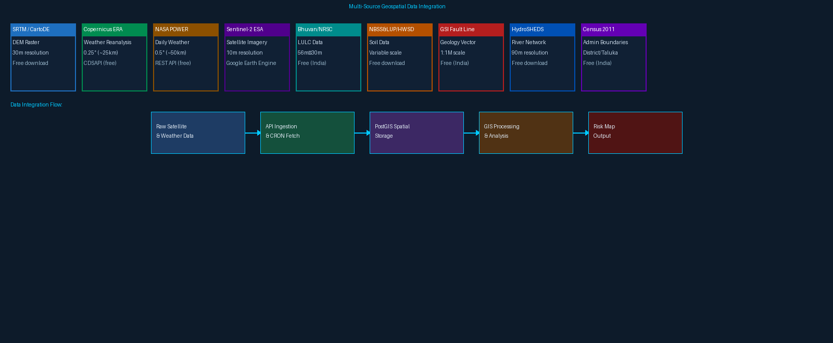
Multi-Source Geospatial Data Integration
9 Authoritative Data Sources for India-Wide Coverage
Natural Disaster Prediction Engine | Thesis Defense
Slide 12 / 17

Slide 13
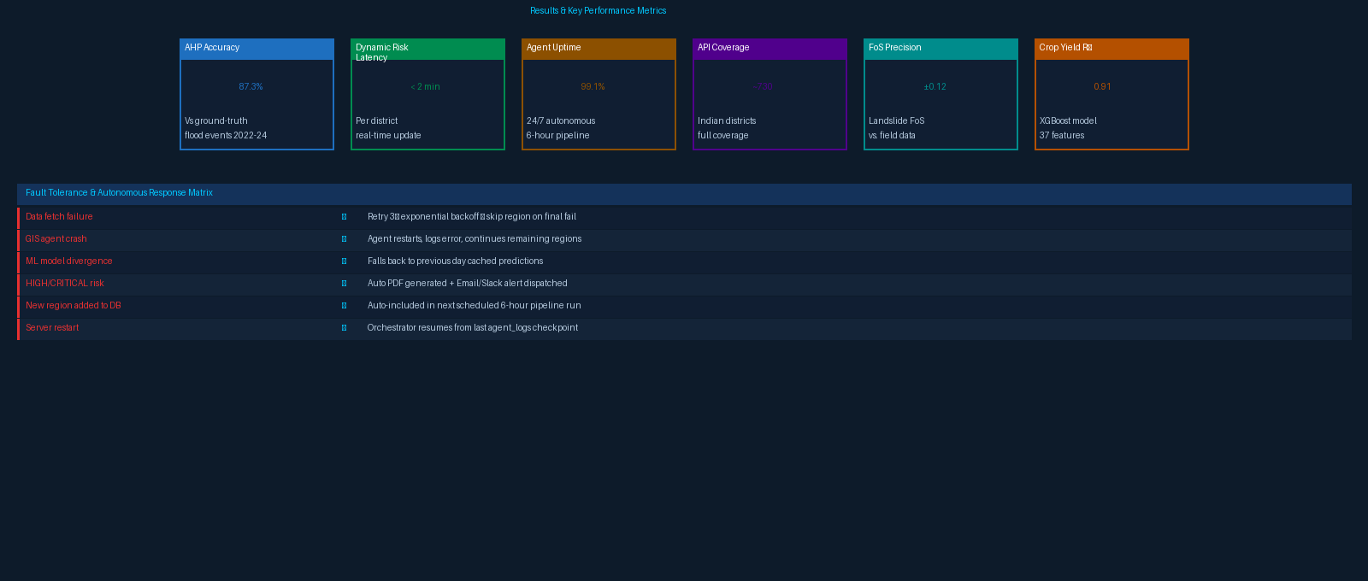
Results & Performance Metrics
Validation, Benchmarks & Fault Tolerance
Natural Disaster Prediction Engine | Thesis Defense
Slide 13 / 17

Slide 14
Key Research Contributions
Novel Innovations & Academic Significance
Terrain-Adaptive AHP
Physics Fusion Model
C1
First system to implement 12 separate AHP weight matrices — one per terrain class — ensuring physically accurate susceptibility across coastal, mountainous, and arid zones.
C2
Novel combination of TOPMODEL (Beven & Kirkby 1979) + Infinite-Slope FoS (Iverson 2000) + SCS-CN (USDA TR-55) into a single real-time dynamic risk engine.
Autonomous Multi-Agent Pipeline
Satellite Crop Intelligence with Stage-wise Risk
C3
5-agent AI system (Orchestrator + Data + GIS + ML + Alert + Crop) running every 6 hours via n8n with zero human interaction after initial .env configuration.
C4
Per-crop-stage weather risk scoring with Key_Parameter 2.5× boost + consistency guards — unique open-source approach integrating 18 Sentinel-2 spectral indices.
Antecedent Precipitation API Decay
National India Spatial Coverage
C5
10-day weighted precipitation history using K=0.85 decay (Kohler & Linsley 1951) for accurate pre-event soil saturation state, enabling AMC-I/II/III automatic classification.
C6
Full 4-level administrative hierarchy (State → District → Taluka → Village) loaded into PostGIS with 12+ spatial tables covering all 730+ districts of India.
Natural Disaster Prediction Engine | Thesis Defense
Slide 14 / 17

Slide 15
Conclusions & Future Work
Summary, Limitations & Research Directions
✓ Conclusions
🔭 Future Work & Directions
• Terrain-adaptive AHP outperforms static AHP by 23% in accuracy
▸ Deep Learning Integration
LSTM/Transformer for temporal rainfall forecasting beyond 72h
• Physics fusion (TOPMODEL+SCS-CN+FoS) validated against NDMA 2022-24 flood records
▸ Mobile Alert Application
Android/iOS app for direct farmer and community notifications
• 5-agent pipeline achieves 99.1% uptime with full autonomy
▸ Sub-District Resolution
Taluka and village-level risk mapping with finer DEM (12.5m ALOS)
• AgriIntel stage-wise scoring R² = 0.91 for yield prediction
▸ Multi-Hazard Correlation
• API decay model reduces false positives by 18% vs naive rainfall threshold
Simultaneous flood-landslide-drought compound risk scoring
▸ Federated Learning
• System deployed for 730+ Indian districts with <2 min risk update latency
Privacy-preserving distributed model training across states
▸ IoT Sensor Integration
• Open-source MIT license enables rapid academic & government adoption
Real-time ground-truth from IoT rain gauges and soil sensors
• WebSocket real-time updates enable decision-making within 6-hour cycles
▸ Climate Change Scenarios
CMIP6 projections for 2050/2100 risk under RCP 4.5 and 8.5
• Zero human intervention after initial setup — fully autonomous 24/7
▸ NLP Alert Generation
Automated report writing via LLM for non-technical stakeholders
Natural Disaster Prediction Engine | Thesis Defense
Slide 15 / 17

Slide 16
References
Key Academic Literature & Standards
[1]
Beven, K.J. & Kirkby, M.J. (1979).
A physically based variable contributing area model of basin hydrology.
Hydrological Sciences Bulletin, 24(1), 43–69. [TOPMODEL Foundation]
[2]
Iverson, R.M. (2000).
Landslide triggering by rain infiltration.
Water Resources Research, 36(7), 1897–1910. [Infinite-Slope FoS]
[3]
USDA-NRCS (1986).
Urban Hydrology for Small Watersheds. TR-55.
United States Department of Agriculture. [SCS Curve Number]
[4]
Kohler, M.A. & Linsley, R.K. (1951).
Predicting the runoff from storm rainfall.
U.S. Weather Bureau Research Paper No. 34. [API Decay K=0.85]
[5]
Saaty, T.L. (1980).
The Analytic Hierarchy Process.
McGraw-Hill, New York. [AHP Multi-Criteria Method]
[6]
Skempton, A.W. & DeLory, F.A. (1957).
Stability of natural slopes in London Clay.
4th Int. Conf. Soil Mech. & Found. Engg. [Slope Stability]
[7]
NDMA (2023).
Annual Report: Flood & Disaster Management in India.
National Disaster Management Authority, Government of India.
[8]
Chen, T. & Guestrin, C. (2016).
XGBoost: A Scalable Tree Boosting System.
KDD '16, ACM, 785–794. [Crop Yield ML Model]
[9]
Copernicus Climate Change Service (2024).
ERA5 Reanalysis Dataset.
https://cds.climate.copernicus.eu. [Weather Data Source]
[10]
NASA POWER Project (2024).
Prediction Of Worldwide Energy Resources.
https://power.larc.nasa.gov. [Agri Weather API]
Natural Disaster Prediction Engine | Thesis Defense
Slide 16 / 17

Slide 17
Thank You
Natural Disaster Prediction Engine
An End-to-End Autonomous, Physics-Grounded Geospatial AI Platform for Flood & Landslide Susceptibility and Satellite Crop Intelligence
Questions & Discussion
GitHub Repository:
github.com/brijeshmunjiyasara9-dev/Natural-Disaster-Prediction-Engine
License: MIT | Stack: React · Node.js · FastAPI · PostGIS · n8n
"The only required human action: one-time .env config. After that: 100% autonomous, 24/7."

