Slide 1
Day 1 - Module 1: Selenium WebDriver
Smita B Kumar

Slide 2
Day 1 - Agenda
Day 1 | Module 1: Selenium WebDriver Selenium Overview Introduction to Selenium WebDriver Architecture Features of Selenium WebDriver Learn -how to create a basic WebDriver project in Eclipse? 1- How to install Eclipse IDE? 2- How to create a project in eclipse? 3- How to download Jar files required for Selenium WebDriver? 4- How to include Jar files in a project? Firefox driver ( GeckoDriver ) for selenium 3.0.1 Drivers, Methods and Classes Exercise on Selenium WebDriver Module 2: Introduction to JUnit Framework and Its Usage in Selenium Script Adding JUnit library in Java project JUnit Annotations Used in Selenium scripts JUnit Assertions Exercise on Junit

Slide 3
Day 1 - Agenda
Day 1 | Module 3: Usage of Selenium Select Class for Handling Dropdown Elements on a Web Page Explanation of Application under Test Hyperlink, Dropdown, Button WebDriver Code using Selenium Select Class Code Walkthrough Exercise on Selenium WebDriver Module 4: Check Visibility of Web Elements Using Various Types WebDriver Commands isDisplayed() isSelected() isEnabled() Module 5:Practical Use of Different types of Selenium WebDriver Waits WebDriver Implicit Wait WebDriver Explicit Wait Expected Condition Navigation Using WebDriver Exercise on Selenium WebDriver

Slide 4
Selenium Overview
What is Selenium?
Selenium is a web Automation tool which can used to perform testing ONLY on Web Applications not Desktop based applications.
There are others tool which can be used to automate both web applications and windows applications like QTP (Quick Test Professional) . As every one aware that QTP is Licensed Tool AND Selenium is Open source tool, download it configure it and enjoy.
This is the main reason why most of the companies choose Selenium whenever they want to automate Web applications

Slide 5
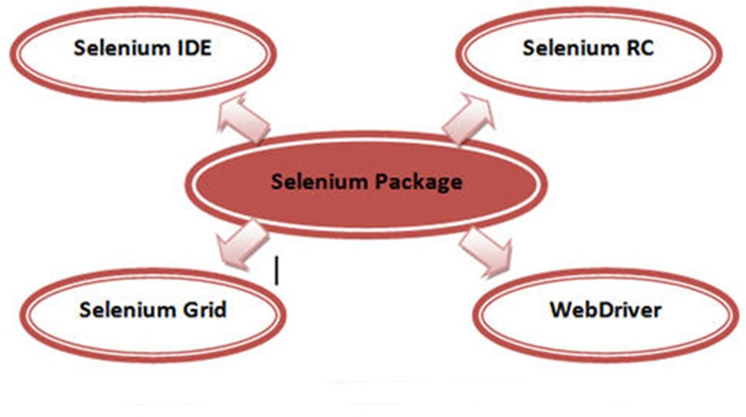
Components of Selenium

Slide 6
Components of Selenium
It has the below components:
Selenium IDE: Which is a firefox plug-in which deals with and playback mechanism. User can create simple scripts and export to selenium RC or Webdriver.
Selenium RC: Is a tool which allows to automate web application using any of the programming language that supports.
Selenium Webdriver: It makes direct calls to the browser using each browser's native support for automation. Webdriver was developed to better support dynamic web pages like Ajax where elements of a page may change without the page itself being reloaded.
Selenium Grid: Is a server that allows tests to use web browser instances running on remote machines.

Slide 7
Introduction to Selenium WebDriver

Slide 8
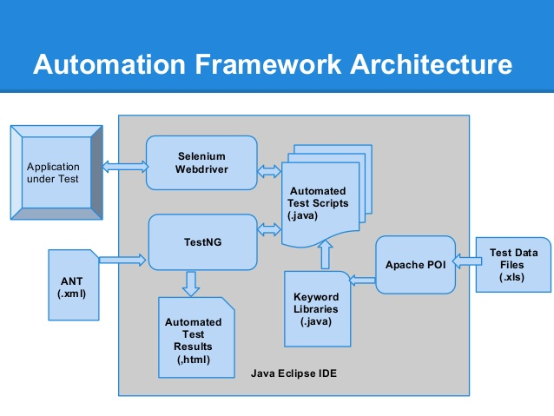
Selenium WebDriver Architecture

