Slide 1


Slide 2
Table of Contents
Day | Module | Topic
Day 1 | Module 1 | What’s the Problem with JavaScript
 | Module 2 | Introduction to jQuery
 | Module 3 | What is jQuery
 | Module 4 | jQuery Core Concepts
 | Module 5 | jQuery Selectors
 | Module 6 | Document Traversal
Day 2 | Module 7 | HTML Manipulation
 | Module 8 | Events
 | Module 9 | Effects
 | Module 10 | AJAX with jQuery

Slide 3
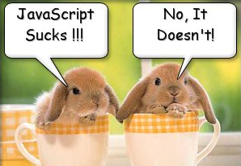
What’s the problem with JavaScript?

Slide 4
JavaScript was a initially introduced in Netscape 2.0B3 in Dec 1995,
a.k.a. Mocha, LiveScript, Jscript, however, it’s official name is
ECMAScript

Slide 5
JavaScript is a C-family, world’s worst named, extremely powerful language (not a script), totally unrelated to Java

Slide 6
JavaScript is a weakly typed, classless, prototype based OO language, that can also be used outside the browser. It is not a browser DOM.

Slide 7

The world’s most misunderstood programming language.
(Douglas Crockford)

Slide 8

Browser DOM really sucks, and this is where jQuery comes to rescue.

Slide 9

This session is about improving your Quality of Life !

Slide 10

Introduction to jQuery

Slide 11
A Quality of Life by jQuery:
$(“#firstName”).text(“Joe Black”);
$(“button”).click(function() {alert “Clicked”;});
$(“.content”).hide();
$(“#main”).load(“content.htm”);
$(“<div/>”).html(“Loading…”).appendTo(“#content”);
Very compact and fluent programming model

Slide 12

What is jQuery?

Slide 13
jQuery is a lightweight, open-source JavaScript library that simplifies interaction between HTML and JavaScript

Slide 14

It was and still being developed
by John Resig from Mozilla and was first announced in January 2006

Slide 15
It has a great community, great documentation, tons of plugins, and it was recently adopted by Microsoft
(how about intellisense in VS?)

Slide 16

The current version is 1.3.2
(as of July 2009)

Slide 17
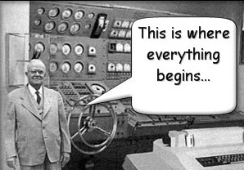
Getting Started

Slide 18
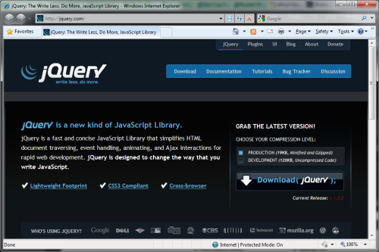
Download the latest version from
http://jquery.com

Slide 19
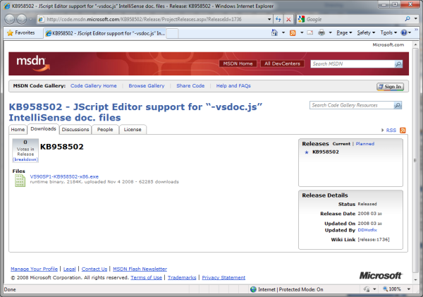
To enable itellisense in VS 2008 SP1
install the –vsdoc hotfix:
VS90SP1-KB958502-x86.exe

Slide 20
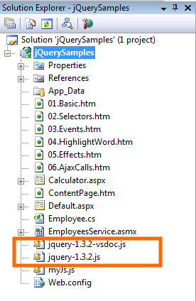
Copy the
jquery.js
and the
jquery-vsdoc.js
into your application folder

Slide 21
Reference it in your markup
  <script src=“jquery.js”/>
No need to reference the –vsdoc.js

Slide 22
Reference it in your JS files:
  ///<reference path=“jquery.js”/>
… or just drag it into the file

Slide 23
You can also reference it from Google
  <script src=“http://ajax.googleapis.com/
  ajax/libs/jquery/1.2.6/
  jquery.min.js”>
  </script>

Slide 24
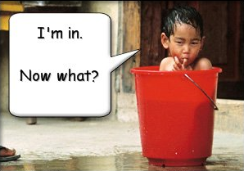
jQuery Core Concepts

Slide 25
The Magic $() function
  var el = $(“<div/>”)
Create HTML elements on the fly

Slide 26
The Magic $() function
  $(window).width()
Manipulate existing DOM elements

Slide 27
The Magic $() function
  $(“div”).hide();
  $(“div”, $(“p”)).hide();
Selects document elements
(more in a moment…)

Slide 28
The Magic $() function
  $(function(){…});
Fired when the document is ready for programming.
Better use the full syntax:
  $(document).ready(function(){…});

Slide 29
The full name of $() function is
  jQuery(“div”);
It may be used in case of conflict with other frameworks.

Slide 30
The library is designed to be isolated
  (function(){
  var
  jQuery=window.jQuery=window.$=function(){
  // …
  };
  })();
jQuery uses closures for isolation

Slide 31
Avoid $() conflict with other frameworks
  var foo = jQuery.noConflict();
  // now foo() is the jQuery main function
  foo(“div”).hide();
  // remove the conflicting $ and jQuery
  var foo = jQuery.noConflict(true);

Slide 32
jQuery’s programming philosophy is:
GET >> ACT
  $(“div”).hide()
  $(“<span/>”).appendTo(“body”)
  $(“:button”).click()

Slide 33
Almost every function returns jQuery, which provides a fluent programming interface and chainability:
  $(“div”).show()
  .addClass(“main”)
  .html(“Hello jQuery”);

Slide 34


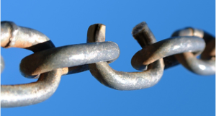
Three Major Concepts of jQuery
The $() function
Get > Act
Chainability

Slide 35

jQuery Selectors

Slide 36
All Selector
  $(“*”) // find everything
Selectors return a pseudo-array of jQuery elements

Slide 37
Basic Selectors
By Tag:
  $(“div”)
  // <div>Hello jQuery</div>
By ID:
  $(“#usr”)
  // <span id=“usr”>John</span>
By Class:
  $(“.menu”)
  // <ul class=“menu”>Home</ul>
Yes, jQuery implements CSS Selectors!

Slide 38
More Precise Selectors
  $(“div.main”) // tag and class
  $(“table#data”) // tag and id

Slide 39
Combination of Selectors
  // find by id + by class
  $(“#content, .menu”)
  // multiple combination
  $(“h1, h2, h3, div.content”)

Slide 40
Hierarchy Selectors
  $(“table td”) // descendants
  $(“tr > td”) // children
  $(“label + input”) // next
  $(“#content ~ div”) // siblings

Slide 41
Selection Index Filters
  $(“tr:first”) // first element
  $(“tr:last”) // last element
  $(“tr:lt(2)”) // index less than
  $(“tr:gt(2)”) // index gr. than
  $(“tr:eq(2)”) // index equals

Slide 42
Visibility Filters
  $(“div:visible”) // if visible
  $(“div:hidden”) // if not

Slide 43
Attribute Filters
  $(“div[id]”) // has attribute
  $(“div[dir=‘rtl’]”) // equals to
  $(“div[id^=‘main’]”) // starts with
  $(“div[id$=‘name’]”) // ends with
  $(“a[href*=‘msdn’]”) // contains

Slide 44
Forms Selectors
  $(“input:checkbox”) // checkboxes
  $(“input:radio”) // radio buttons
  $(“:button”) // buttons
  $(“:text”) // text inputs

Slide 45
Forms Filters
  $(“input:checked”) // checked
  $(“input:selected”) // selected
  $(“input:enabled”) // enabled
  $(“input:disabled”) // disabled

Slide 46
Find Dropdown Selected Item
  <select name=“cities”>
    <option value=“1”>Tel-Aviv</option>
    <option value=“2” selected=“selected”>Yavne</option>
    <option value=“3”>Raanana</option>
  </select>
  $(“select[name=‘ddl’] option:selected”).val()

Slide 47
SELECTORS DEMO

Slide 48


Slide 49
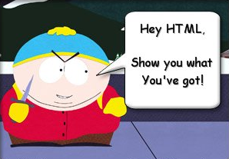
Document Traversal

Slide 50
A Selector returns a pseudo array of jQuery objects
  $(“div”).length
Returns number of selected elements.
It is the best way to check selector.

Slide 51
Getting a specific DOM element
  $(“div”).get(2) or $(“div”)[2]
Returns a 2nd DOM element of the selection

Slide 52
Getting a specific jQuery element
  $(“div”).eq(2)
Returns a 2nd jQuery element of the selection

Slide 53
each(fn) traverses every selected element calling fn()
  var sum = 0;
  $(“div.number”).each(
  function(){
  sum += (+this.innerHTML);
  });
this – is a current DOM element

Slide 54
each(fn) also passes an indexer
  $(“table tr”).each(
  function(i){
  if (i % 2)
  $(this).addClass(“odd”);
  });
$(this) – convert DOM to jQuery
i - index of the current element

Slide 55
Traversing HTML
  .next(expr) // next sibling
  .prev(expr) // previous sibling
  .siblings(expr) // siblings
  .children(expr) // children
  .parent(expr) // parent

Slide 56
Check for expression
  $(“table td”).each(function() {
  if ($(this).is(“:first-child”)) {
  $(this).addClass(“firstCol”);
  }
  });

Slide 57
Find in selected
  // select paragraph and then find
  // elements with class ‘header’ inside
  $(“p”).find(“.header”).show();
  // equivalent to:
  $(“.header”, $(“p”)).show();

Slide 58
Advanced Chaining
  $(“<li><span></span></li>”) // li
  .find(“span”) // span
  .html(“About Us”) // span
  .andSelf() // span, li
  .addClass(“menu”) // span,li
  .end() // span
  .end() // li
  .appendTo(“ul.main-menu”);

Slide 59
Get Part of Selected Result
  $(“div”)
  .slice(2, 5)
  .not(“.green”)
  .addClass(“middle”);

Slide 60
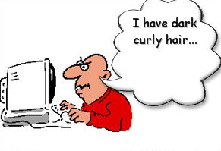
HTML Manipulation

Slide 61
Getting and Setting Inner Content
  $(“p”).html(“<div>Hello $!</div>”);
  // escape the content of div.b
  $(“div.a”).text($(“div.b”).html());

Slide 62
Getting and Setting Values
  // get the value of the checked checkbox
  $(“input:checkbox:checked”).val();
  // set the value of the textbox
  $(“:text[name=‘txt’]”).val(“Hello”);
  // select or check lists or checkboxes
  $(“#lst”).val([“NY”,”IL”,”NS”]);

Slide 63
Handling CSS Classes
  // add and remove class
  $(“p”).removeClass(“blue”).addClass(“red”);
  // add if absent, remove otherwise
  $(“div”).toggleClass(“main”);
  // test for class existance
  if ($(“div”).hasClass(“main”)) { //… }

Slide 64
Inserting new Elements
  // select > append to the end
  $(“h1”).append(“<li>Hello $!</li>”);
  // select > append to the beginning
  $(“ul”).prepend(“<li>Hello $!</li>”);
  // create > append/prepend to selector
  $(“<li/>”).html(“9”).appendTo(“ul”);
  $(“<li/>”).html(“1”).prependTo(“ul”);

Slide 65
Replacing Elements
  // select > replace
  $(“h1”).replaceWith(“<div>Hello</div>”);
  // create > replace selection
  $(“<div>Hello</div>”).replaceAll(“h1”);

Slide 66
Replacing Elements while keeping the content
  $(“h3”).each(function(){
  $(this).replaceWith(“<div>” + $(this).html()
  + ”</div>”);
  });

Slide 67
Deleting Elements
  // remove all children
  $(“#mainContent”).empty();
  // remove selection
  $(“span.names”).remove();
  // change position
  $(“p”).remove(“:not(.red)”) .appendTo(“#main”);

Slide 68
Handling attributes
  $(“a”).attr(“href”,”home.htm”);
  // <a href=“home.htm”>…</a>
  // set the same as the first one
  $(“button:gt(0)”).attr(“disabled”, $(“button:eq(0)”).attr(“disabled));
  // remove attribute - enable
  $(“button”).removeAttr(“disabled”)

Slide 69
Setting multiple attributes
  $(“img”).attr({
  “src” : “/images/smile.jpg”,
  “alt” : “Smile”,
  “width” : 10,
  “height” : 10
  });

Slide 70
CSS Manipulations
  // get style
  $(“div”).css(“background-color”);
  // set style
  $(“div”).css(“float”, “left”);
  // set multiple style properties
  $(“div”).css({“color”:”blue”,
  “padding”: “1em”
  “margin-right”: “0”,
  marginLeft: “10px”});

Slide 71
Dimensions
  // get window height
  var winHeight = $(window).height();
  // set element height
  $(“#main”).height(winHeight);
  //.width() – element
  //.innerWidth() – .width() + padding
  //.outerWidth() – .innerWidth() + border
  //.outerWidth(true) – including margin
The default unit is Pixel (px)

Slide 72
Positioning
  // from the document
  $(“div”).offset().top;
  // from the parent element
  $(“div”).position().left;
  // scrolling position
  $(window).scrollTop();

Slide 73
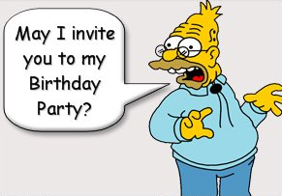
Events

Slide 74
When the DOM is ready…
  $(document).ready(function(){
  //…
  });
Fires when the document is ready for programming.
Uses advanced listeners for detecting.
window.onload() is a fallback.

Slide 75
Attach Event
  // execute always
  $(“div”).bind(“click”, fn);
  // execute only once
  $(“div”).one(“click”, fn);
Possible event values:
blur, focus, load, resize, scroll, unload, beforeunload, click, dblclick, mousedown, mouseup, mousemove, mouseover, mouseout, mouseenter, mouseleave, change, select, submit, keydown, keypress, keyup, error
(or any custom event)

Slide 76
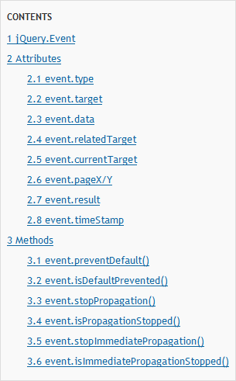
jQuery.Event object

Slide 77
Detaching Events
  $(“div”).unbind(“click”, fn);
(Unique ID added to every attached function)

Slide 78
Events Triggering
  $(“div”).trigger(“click”);
Triggers browser’s event action as well.
Can trigger custom events.
Triggered events bubble up.

Slide 79
Events Helpers
  // attach / trigger
  elem.blur(fn) / elem.blur()
  elem.focus(fn) / elem.focus()
  elem.click(fn) / elem.click()
  elem.change(fn) / elem.change()
And many others…

Slide 80
Preventing Browser Default Action
  // use different triggering function
  $(“div”).triggerHandler(“click”);
  // prevent default action in handler
  function clickHandler(e) {
  e.preventDefault();
  }
  // or just return false
  function clickHandler(e) {return false;}

Slide 81

Preventing Bubbling
  // stop bubbling, keep other handler
  function clickHandler(e) {
  e.stopPropagation();
  }
  // stop bubbling and other handlers
  function clickHandler(e) {
  e.stopImmediatePropagation();
  }
  // or just return false
  function clickHandler(e) {return false;}

Slide 82
Live Events
  // attach live event
  (“div”).live(“click”, fn);
  // detach live event
  (“div”).die(“click”, fn);
Currently supported events:
click, dblclick, mousedown, mouseup, mousemove, mouseover, mouseout, keydown, keypress, keyup

Slide 83
EVENTS DEMO

Slide 84

Effects

Slide 85
Showing or Hiding Element
  // just show
  $(“div”).show();
  // reveal slowly, slow=600ms
  $(“div”).show(“slow”);
  // hide fast, fast=200ms
  $(“div”).hide(“fast”);
  // hide or show in 100ms $(“div”).toggle(100);

Slide 86
Sliding Elements
  $(“div”).slideUp();
  $(“div”).slideDown(“fast”);
  $(“div”).slideToggle(1000);

Slide 87
Fading Elements
  $(“div”).fadeIn(“fast”);
  $(“div”).fadeOut(“normal”);
  // fade to a custom opacity
  $(“div”).fadeTo (“fast”, 0.5);
Fading === changing opacity

Slide 88
Detecting animation completion
  $(“div”).hide(“slow”, function() {
  alert(“The DIV is hidden”);
  });
  $(“div”).show(“fast”, function() {
  $(this).html(“Hello jQuery”);
  }); // this is a current DOM element
Every effect function has a (speed, callback) overload

Slide 89
Custom Animation
  // .animate(options, duration)
  $(“div”).animate({
  width: “90%”,
  opacity: 0.5,
  borderWidth: “5px”
  }, 1000);

Slide 90
Chaining Animation
  $(“div”).animate({width: “90%”},100)
  .animate({opacity: 0.5},200)
  .animate({borderWidth: “5px”});
By default animations are queued and than performed one by one

Slide 91
Controlling Animations Sync
  $(“div”)
  .animate({width: “90%”},
  {queue:false, duration:1000})
  .animate({opacity : 0.5});
The first animation will be performed immediately without queuing

Slide 92
EFFECTS DEMO

Slide 93

AJAX with jQuery

Slide 94
Loading content
  $(“div”).load(“content.htm”);
  // passing parameters
  $(“#content”).load(“getcontent.aspx”,
  {“id”:”33”, “type”:”main”});

Slide 95
Sending GET/POST requests
  $.get(“test.aspx”, {id:1},
  function(data){alert(data);});
  $.post(“test.aspx”, {id:1},
  function(data){alert(data);});

Slide 96
Retrieving JSON Data
  $.getJSON(“users.aspx”, {id:1},
  function(users)
  {
  alert(users[0].name);
  });

Slide 97
Retrieving JS Files
  $.getScript(“script.js”,
  function()
  {
  doSomeFunction();
  });

Slide 98
AJAX DEMO

Slide 99
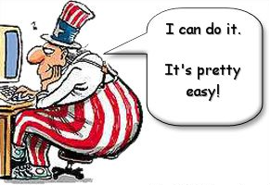
Extending the Library

Slide 100
Adding Methods
  // definition
  jQuery.fn.printLine = function(s) {
  return jQuery(this).each(function() { this.append(“<div>”+ s +“</div>”);
  });
  };
  // usage
  $(“#log”).printLine(“Hello”);
Do not use $ in the method
(at least not until next slide)

Slide 101
Closure to solve the $ issue
  (function ($) {
  jQuery.fn.printLine = function(s) {
  return $(this).each(function() { this.append(“<div>”+ s +“</div>”);
  });
  };
  })(jQuery);

Slide 102
Custom Selectors
  $.expr[‘:’].test = function(o, i, m, s) {
  // o – current object in the selection
  // i – loop index in the stack
  // m – meta data about your selector
  // s – stack of all the elements
  // return true to include the element
  // return false to exclude the element
  };

Slide 103
LIBRARY EXTENSION DEMO

Slide 104

More things to explore
More Functionality on every aspect
URL parameters parser
Browser and features detection
Data Cache
Utilities Helper functions
Various Plug-ins

Slide 105

Where to go next
jQuery web-site: http://jquery.com
jQuery API: http://api.jquery.com
Many many blogs
jQuery in Action book:

