Slide 1
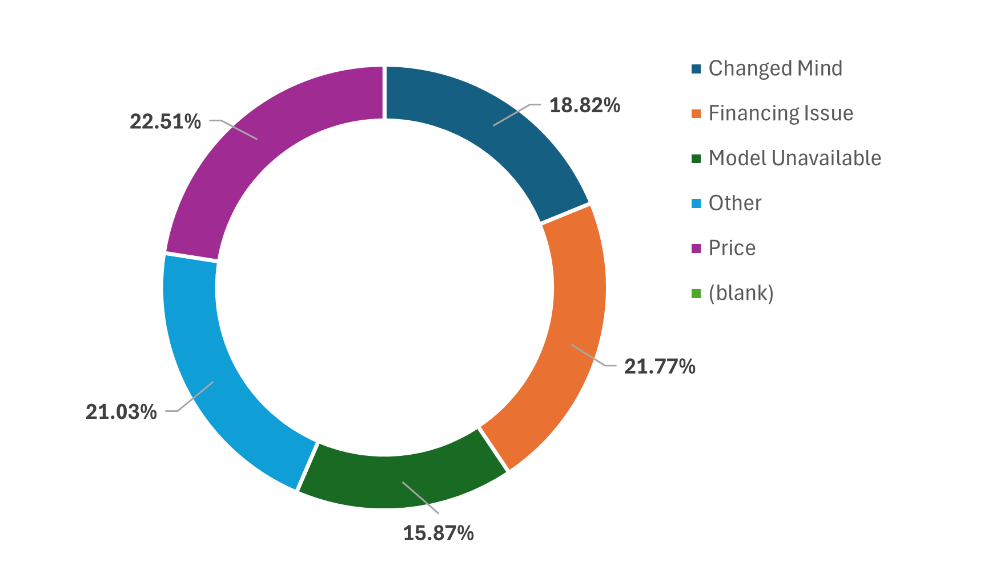
Lead-to-Delivery Funnel Analysis
Key Insights
Cancellations
The Overall Conversion Rate from
Leads —> pre-booking —> Booking —> Delivery
is around 80% and conversion from prebooking to booking is 100%.
The TAT(Turnaround Time) at different stages is 3 days in Pre-Booking and Booking and 4-5 days in Delivery.
Detractors (ratings below 7) are the primary area of concern, accounting for approximately 50% of the total responses.
Price and Financing issue both are approx. 45% of reason for Cancellation.

Slide 2
Summary
Store Performance
Turnaround Time (TAT) Metrics
Mumbai MBC has the lowest cancellation rate at 24.05%.
Delhi MBC has the highest cancellation rate at 29.28%.
Bangalore MBC and Chennai MBC have similar cancellation rates of 27.38% and 27.83%, respectively.
Average TAT Pre-Booking: 3.06 days.
Average TAT Booking: 3.07 days.
Average TAT Delivery: 4.46 days.
The delivery stage has the longest average turnaround time, which could be an area to improve processes.
These differences imply that some stores are better at converting leads or managing potential cancellations
Lead Performance by type
Lead cancellations are high at 27.1%, mainly due to price, financing, and model availability. Cold leads often cancel, while hot leads seldom do. Mumbai MBC performs the best, and Delhi MBC performs the worst. Delivery takes the longest time. The average customer rating is 4.85. To improve conversion and satisfaction, focus on pricing, financing, and delivery.
Cold Leads: All cold leads (100%) are cancelled. This indicates that cold leads do not convert into sales and may need a different approach or better qualification.
Hot Leads: Hot leads have a very low cancellation rate of 8.58%, showing high conversion efficiency.
Warm Leads: Warm leads have a cancellation rate of 11.20%, which is better than cold leads but still higher than hot leads.

