Slide 1
MMed-RAG – Versatile Multimodal RAG System
for Medical Vision-Language Models
Brij Kishor
Roll: 2411MC09
M.Tech (Mathematics and Computing)
Under the Supervision of
Dr. Jimson Mathew
Department of Computer Science & Engineering
Indian Institute of Technology Patna

Slide 2
Problem Statement
Develop a domain-aware, retrieval-augmented framework that enhances medical LVLMs by reducing hallucinations, improving factual consistency, and enabling generalization across diverse medical imaging domains.

Slide 3
Literature Survey
Earlier Med-LVLMs like Med-Flamingo, RadFM, LLaVA-Med show strong visual-language alignment but high hallucination rates.
Prior RAG systems (e.g., RULE, MedDr, FactMM-RAG) improved factuality but lacked domain specialization or alignment control.
RAG in general AI improved factual grounding but medical RAGs struggled with domain mismatch and over-reliance on retrieval.

Slide 4
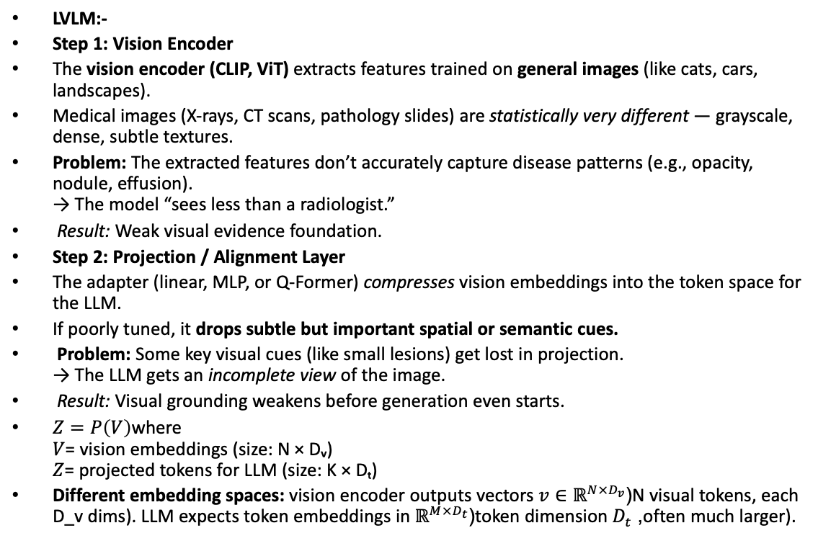
LVLM:-
Step 1: Vision Encoder
The vision encoder (CLIP, ViT) extracts features trained on general images (like cats, cars, landscapes).
Medical images (X-rays, CT scans, pathology slides) are statistically very different — grayscale, dense, subtle textures.
Problem: The extracted features don’t accurately capture disease patterns (e.g., opacity, nodule, effusion).
→ The model “sees less than a radiologist.”
Result: Weak visual evidence foundation.
Step 2: Projection / Alignment Layer
The adapter (linear, MLP, or Q-Former) compresses vision embeddings into the token space for the LLM.
If poorly tuned, it drops subtle but important spatial or semantic cues.
Problem: Some key visual cues (like small lesions) get lost in projection.
→ The LLM gets an incomplete view of the image.
Result: Visual grounding weakens before generation even starts.
$Z=P\left(V\right)$where
$V$= vision embeddings (size: N × Dᵥ)
$Z$= projected tokens for LLM (size: K × Dₜ)
Different embedding spaces: vision encoder outputs vectors $v∈ℝ^{N×D_{v}}$(N visual tokens, each D_v dims). LLM expects token embeddings in $ℝ^{M×D_{t}}$(token dimension $D_{t}$, often much larger).

Slide 5
Step 3: Language Model (LLM) Decoding
Now the LLM receives a partial visual embedding and a question/prompt.
It starts generating text based on:
  The incomplete visual input
  Its internal textual priors learned from web or report text
This is the critical hallucination zone.
The LLM has learned linguistic correlations like:
“X-ray → pneumonia” or “lung opacity → infection”
When uncertain about the image, it guesses based on these priors.
This leads to fluent but wrong statements — “looks plausible” but not true.
Result: Text sounds professional but is factually incorrect.
Step 4: Output Generation
There’s no verification step.
The model never checks:
  “Is this fact consistent with actual image data?”
  “Is this diagnosis found in clinical databases?”
Final problem: Hallucination is not detected or corrected.
Result: False yet confident report or diagnosis.

Slide 6

LLaVA-Med
Origin: Based on LLaVA (Large Language and Vision Assistant)
Goal: Enable medical visual conversation (e.g., “Explain this X-ray to me.”)
Architecture Used
Vision Encoder: CLIP ViT-L/14 (frozen)
Alignment Layer: MLP Projection (2-layer adapter)
  Converts CLIP image features into the embedding dimension of LLaMA.
  Non-linear mapping → better preserves complex medical semantics.
Language Model: LLaMA / LLaMA-2 fine-tuned on medical dialogues (PubMed, MIMIC reports)
How It Works
Extract visual features from CLIP.
Pass through a 2-layer MLP:
$z=\text{MLP}\left(v\right)=W_{2}\left(\text{GELU}\left(W_{1}v\right)\right)$
Feed these visual tokens + textual question into the LLaMA model.
The model then generates a grounded textual explanation.

Slide 7
Methodology Overview
MMed-RAG introduces three modules:
1. Domain-Aware Retrieval – ensures correct medical domain context.
2. Adaptive Context Selection – dynamically chooses the most relevant retrieved text.
3. RAG-Based Preference Fine-Tuning – trains the model to use both image and retrieved info properly, align the model both with the input image and with correct use of retrieved information, avoiding spurious or hallucinated answers when using RAG.

Slide 8
Domain-Aware Retrieval : MMed-RAG first classifies the input image into a domain (e.g. radiology vs pathology) using a vision-language model (BiomedCLIP) that was fine-tuned on a small labeled set. Once the domain is known, the image is passed to a retriever trained in that domain. Each retriever uses contrastive learning to align images and text: it learns to embed images and example reports into vectors so that matching pairs have high similarity. Concretely, the model computes a similarity score between the image and each possible report; it then selects the top-k most similar reports. Those become the retrieved contexts for that image
Adaptive Context Selection: Second, instead of always taking a fixed number of retrieved documents, MMed-RAG dynamically decides how many to use based on how similar they are to the image. In many retrieval tasks, the relevance of documents drops sharply after a point. For example, the 5th most relevant report might be almost as good as the 1st, but by the 10th report the similarity score suddenly drops.

Slide 9
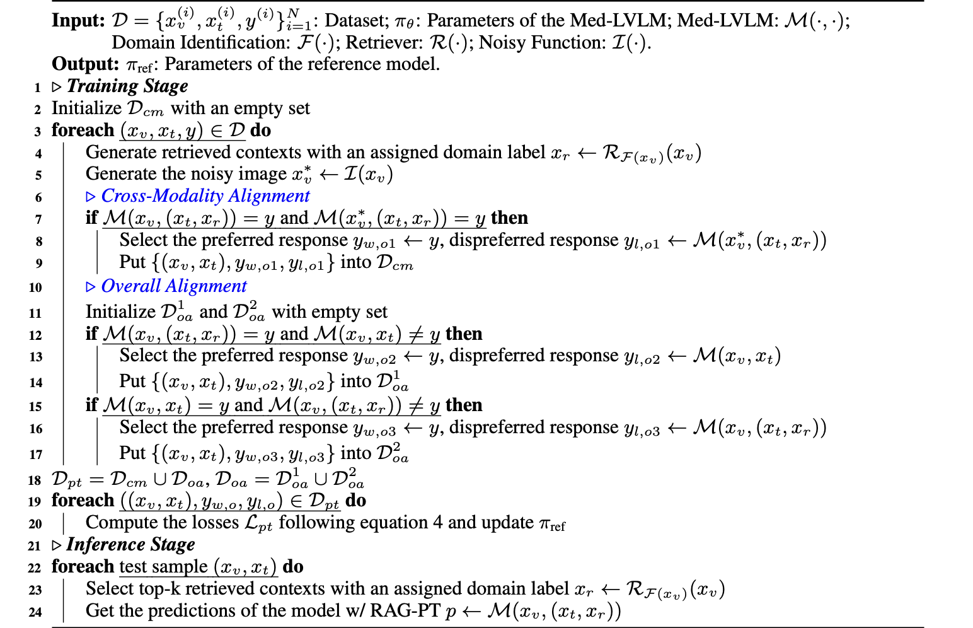
RAG-Based Preference Fine-Tuning

Slide 10
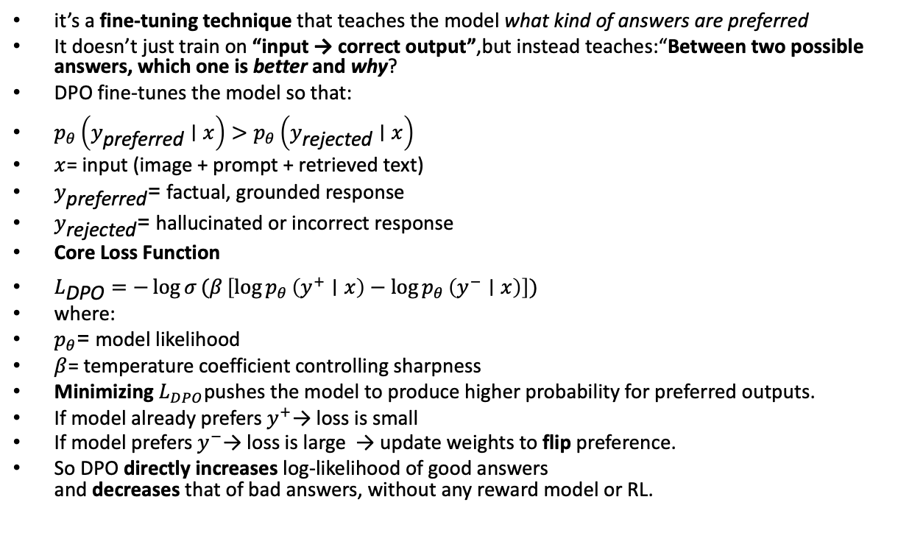
it’s a fine-tuning technique that teaches the model what kind of answers are preferred
It doesn’t just train on “input → correct output”,but instead teaches:“Between two possible answers, which one is better and why?
DPO fine-tunes the model so that:
$p_{θ}\left(y_{\text{preferred}}∣x\right)>p_{θ}\left(y_{\text{rejected}}∣x\right)$
$x$= input (image + prompt + retrieved text)
$y_{\text{preferred}}$= factual, grounded response
$y_{\text{rejected}}$= hallucinated or incorrect response
Core Loss Function
$L_{\text{DPO}}=−\log{σ}(β \left[\log{p_{θ}}\left(y^{+}∣x\right)−\log{p_{θ}}\left(y^{−}∣x\right)\right])$
where:
$p_{θ}$= model likelihood
$β$= temperature coefficient controlling sharpness
Minimizing $L_{DPO}$pushes the model to produce higher probability for preferred outputs.
If model already prefers $y^{+}$→ loss is small
If model prefers $y^{−}$→ loss is large → update weights to flip preference.
So DPO directly increases log-likelihood of good answers
and decreases that of bad answers, without any reward model or RL.

Slide 11
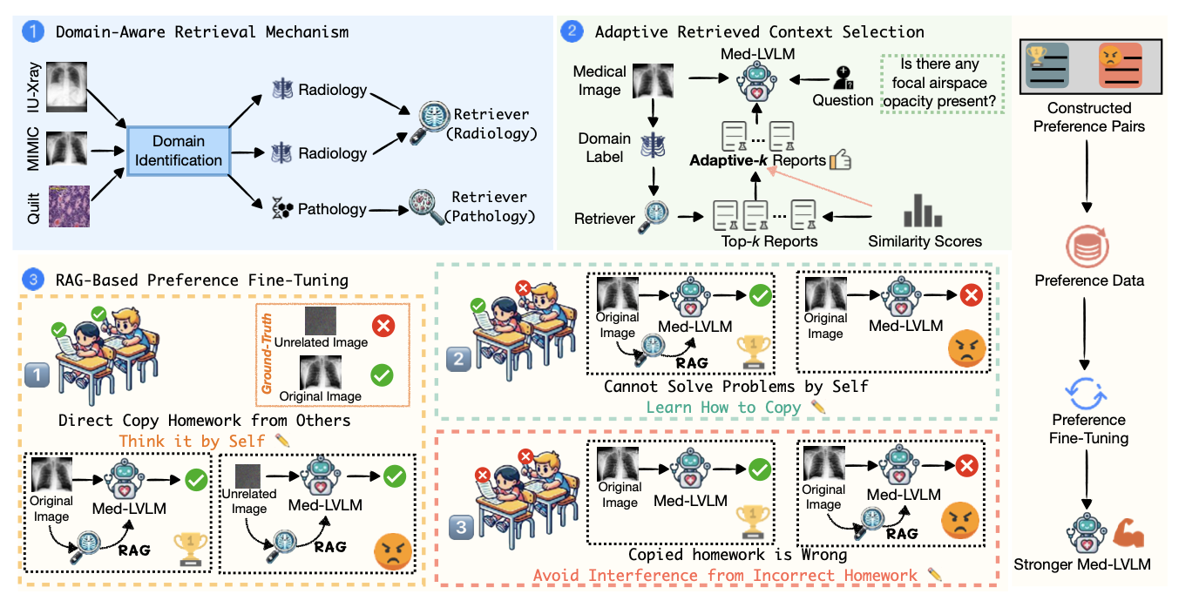
Architecture

Slide 12
Dataset Description
Five diverse medical datasets were used:
1. MIMIC-CXR – chest X-rays and radiology reports.
2. IU-Xray – paired X-rays and short textual summaries.
3. FairVLMed (Ophthalmology) – retinal fundus images.
4. Quilt-1M – multimodal ophthalmic dataset.
5. PMC-Pathology – microscopic pathology images with annotations.
Tasks include Visual Question Answering (VQA) and Report Generation.

Slide 13
Results
Precision- Of all the cases the model predicted as positive, how many were actually correct?”
Recall-"Of all the cases that were actually positive, how many did the model correctly identify?"
Key quantitative results:
- Factual accuracy improved by +43.8% over base model.
- VQA accuracy improved by +18.5%.
- Report generation BLEU/ROUGE scores improved by +69.1%.
MMed-RAG outperformed baselines like RULE, Med-Flamingo, RadFM, and LLaVA-Med across all metrics.
Hallucination reduction: Copy-Reference 55%→28%, Over-Reliance 43%→8%.

Slide 14
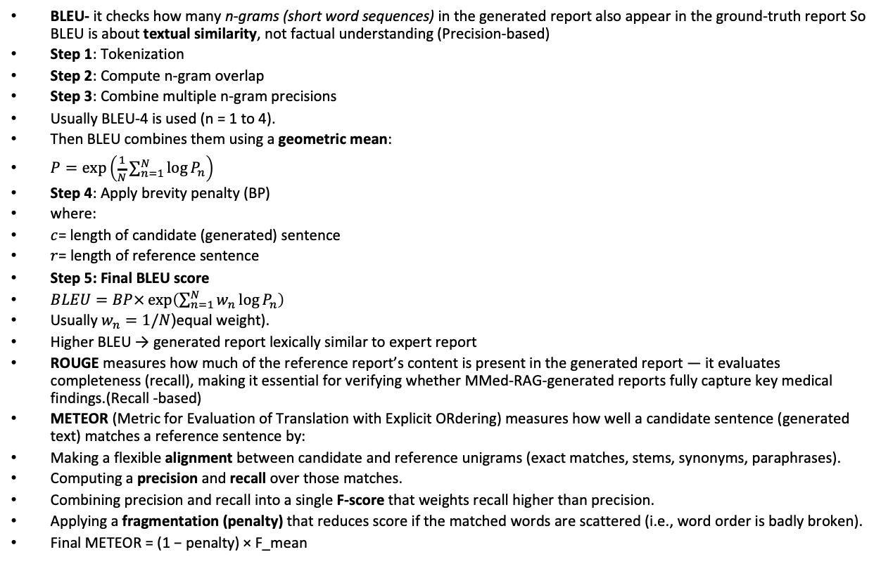
BLEU- it checks how many n-grams (short word sequences) in the generated report also appear in the ground-truth report So BLEU is about textual similarity, not factual understanding (Precision-based)
Step 1: Tokenization
Step 2: Compute n-gram overlap
Step 3: Combine multiple n-gram precisions
Usually BLEU-4 is used (n = 1 to 4).
Then BLEU combines them using a geometric mean:
$P=\exp\left(\frac{1}{N}\sum_{n=1}^{N}{log}{P_{n}}\right)$
Step 4: Apply brevity penalty (BP)
where:
$c$= length of candidate (generated) sentence
$r$= length of reference sentence
Step 5: Final BLEU score
$BLEU=BP×\exp\left(\sum_{n=1}^{N}{w_{n}}\log{P_{n}}\right)$
Usually $w_{n}=1/N$(equal weight).
Higher BLEU → generated report lexically similar to expert report
ROUGE measures how much of the reference report’s content is present in the generated report — it evaluates completeness (recall), making it essential for verifying whether MMed-RAG-generated reports fully capture key medical findings.(Recall -based)
METEOR (Metric for Evaluation of Translation with Explicit ORdering) measures how well a candidate sentence (generated text) matches a reference sentence by:
Making a flexible alignment between candidate and reference unigrams (exact matches, stems, synonyms, paraphrases).
Computing a precision and recall over those matches.
Combining precision and recall into a single F-score that weights recall higher than precision.
Applying a fragmentation (penalty) that reduces score if the matched words are scattered (i.e., word order is badly broken).
Final METEOR = (1 − penalty) × F_mean

Slide 15
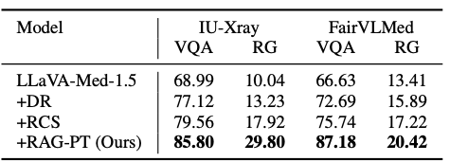
Ablation studies show:
- Domain Retrieval adds +17–18% accuracy.
- Adaptive Context Selection adds +6–19%.
- Preference Fine-Tuning adds +16–37%.
Theoretical validation ensures increased image dependence and better retrieval alignment.
Attention visualization confirmed stronger grounding on image regions post fine-tuning.

Slide 16

Future Work and Enhancements
Integrate
Integrate real-time factual verification using medical knowledge graphs (UMLS, RadGraph).
Implement
Implement dynamic RAG activation – use retrieval only when model uncertainty is high.
Introduce
Introduce attention-based explainability dashboards for clinical transparency.
Extend
Extend MMed-RAG to multilingual medical datasets for global adaptability.
Explore
Explore integration with continual learning to adapt to evolving medical knowledge.

Slide 17
Conclusion
MMed-RAG effectively addresses hallucination issues in medical multimodal models.
Combines retrieval grounding with fine-tuning alignment for factual and explainable outputs.
Provides a scalable framework for cross-domain medical reasoning.
Lays foundation for future factuality-aware, interpretable, and trustworthy medical AI systems.

