Slide 1
Sign Language recognition System
Presented By: -
Alankrita Agrawal
Brijkishor Soni
Harsh Kumar Jarwal

Slide 2
Outline
Introduction
Motivation
Problem statement
Applicability of this project
Practical application
Features
Technologies used
Working
Conclusion & future scope

Slide 3

Introduction.
Motivation
A person with speaking disorders face major problems of expressing their emotions as freely in this world.
“Not able to utilize” some of the new technologies.

Slide 4
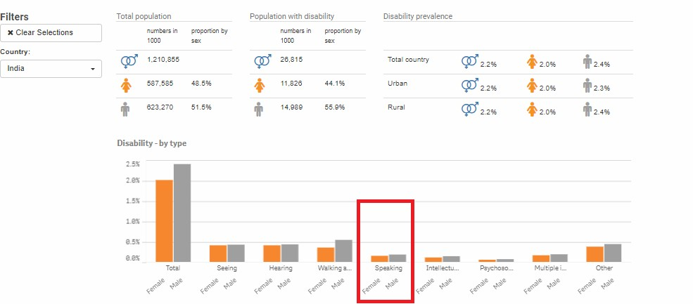
Statistics retrieved from
United Nation Statistics Division

Slide 5
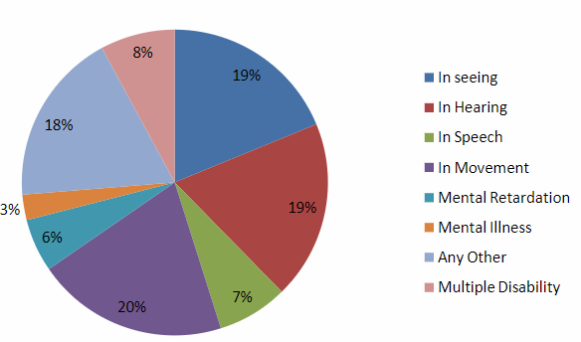
Disabled population by type of disability in India census 2011

Slide 6
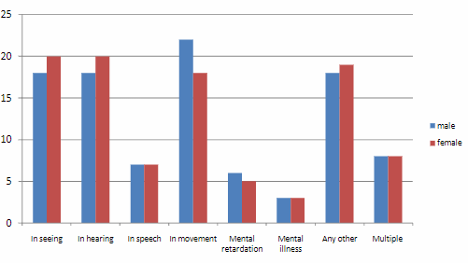
Distribution disabled person by sex and by type of disability (%) in India Census 2011

Slide 7
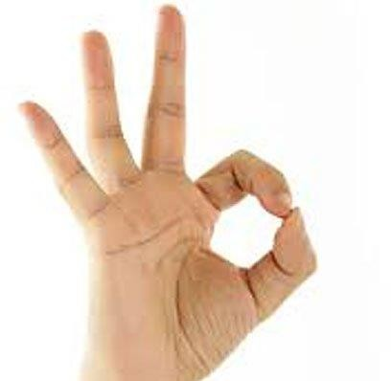
Problem Statement
Given a hand gesture, implementing such an application which detects pre- defined sign language (SL) in a real time through hand gestures and providing facility for the user to be able to store the result of the character detected in a txt file, also allowing such users to build their customized gesture so that the problems faced by persons who aren’t able to talk vocally can be accommodated with technological assistance and the barrier of expressing can be overshadowed.

Slide 8
Outline
Introduction
Motivation
Problem statement
Applicability of this project
Practical Application
Features
Technologies used
Working
Conclusion & future scope

Slide 9
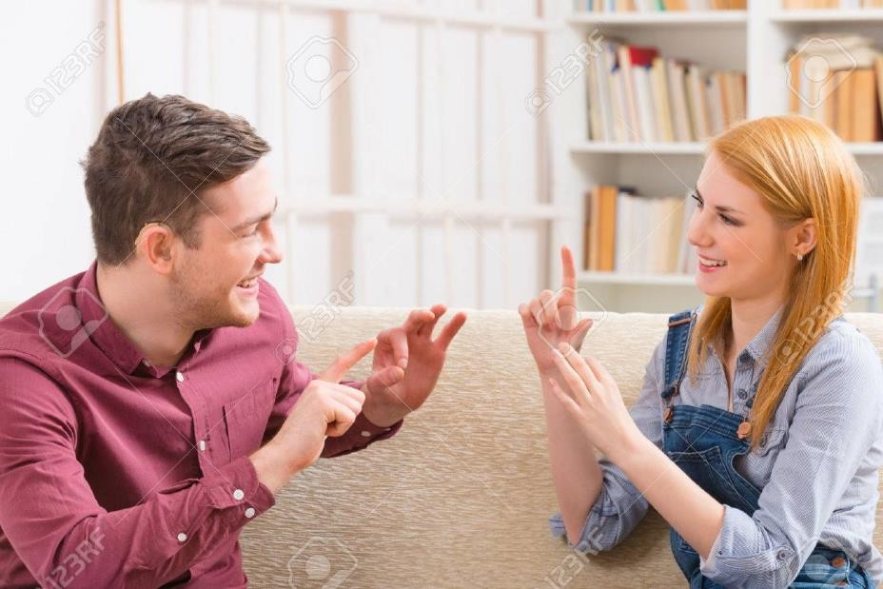
Practical application
Serves the person who wants to learn and talk in sign languages
A user need not be a literate person

Slide 10
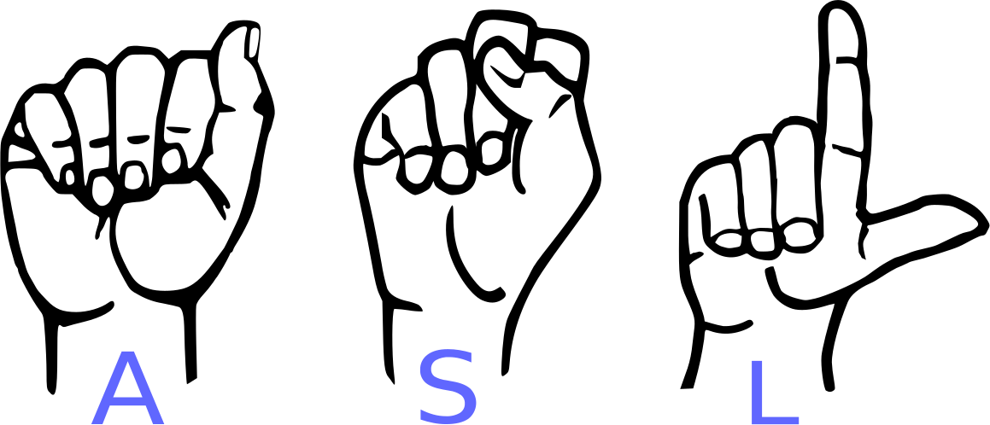
Features of this application
Real time (ASL) detection based on gesture made by user.
Customized gesture generation.
Forming a stream of sentences.
TTS (Text to speech) assistance mechanisms concerning to the illiterate people.

Slide 11







Technologies Used
Python 3.6.
TensorFlow framework, Keras API
Real-time computer vision using OpenCV
Industrial standard GUI application (PyQT5), Tkinter.
Offline TTS assistance for python (pyttsx3 lib)

Slide 12
Core Modules
Data Pre-Processing
Scan Single Gesture
Create gesture
Formation of sentence
Exporting

Slide 13
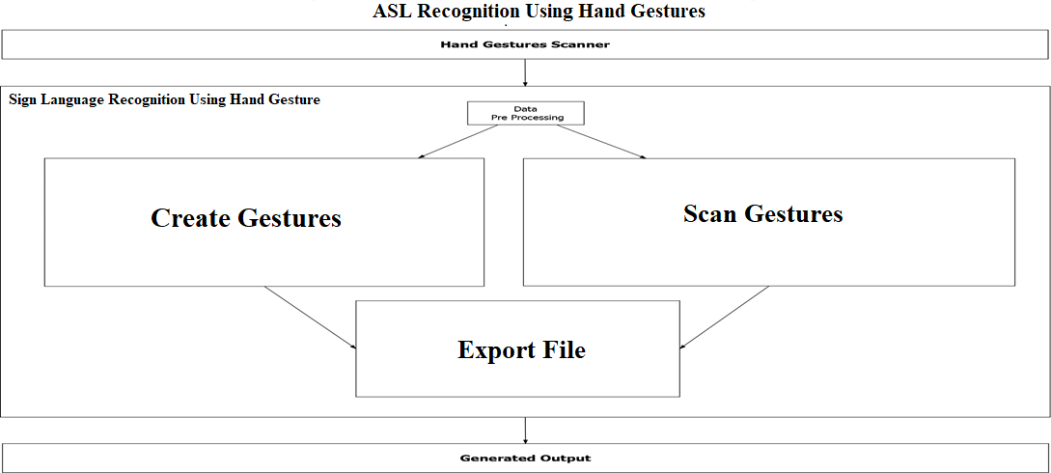

Slide 14
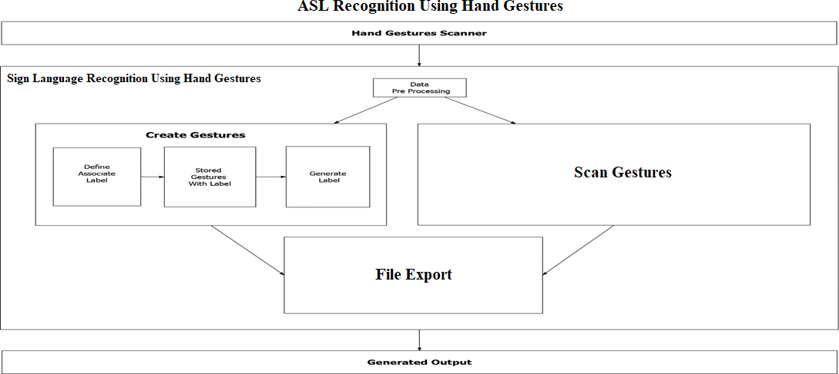

Slide 15
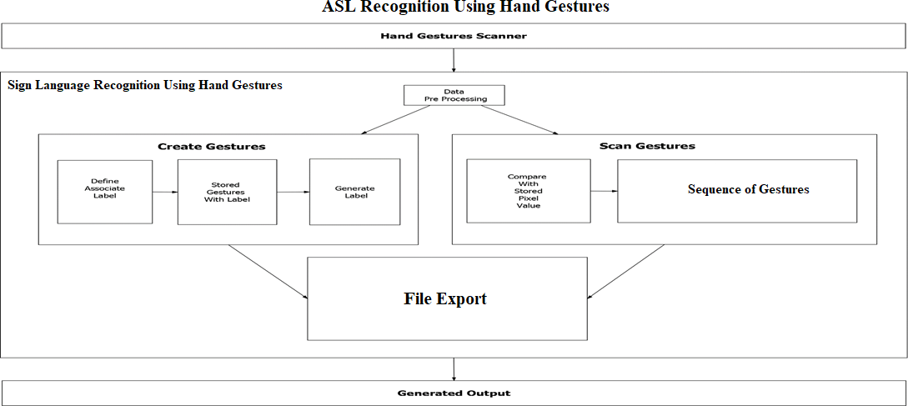


Slide 16
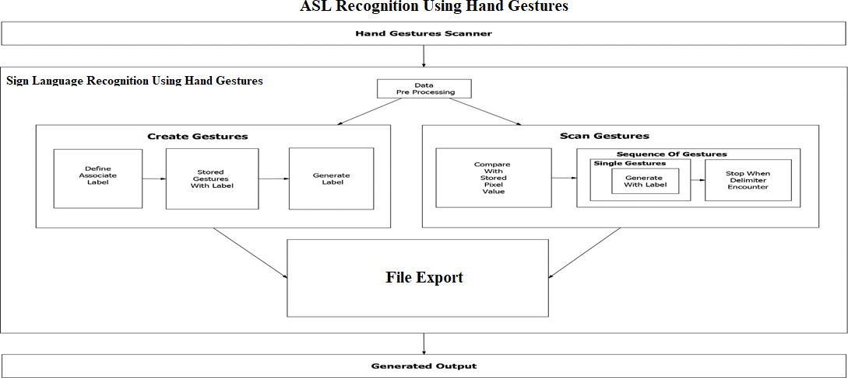

Slide 17
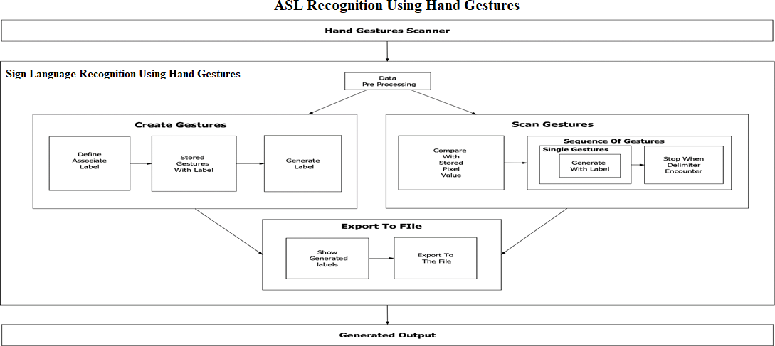


Slide 18
Conclusion
Overshadowing some of the major problems faced by the persons having speech
disorders.
They can quickly learn what alphabet is assigned to which gesture with this
application.
Add-on to this custom gesture facility is also provided along with sentence
formation.

Slide 19
Future Scope
Integration to search engines and texting application.
Detection of motion video sequence with TTS assistance.

Slide 20
References
http://mospi.nic.in/sites/default/files/publication_reports/Disabled_ persons_in_India_2016.pdf
https://www.quora.com/What-are-some-problems-faced-by-deaf- and-dumb-people-whileusing-todays-common-tech-like-phones-and- PCs
https://www.nidcd.nih.gov/health/american-sign-language

