Slide 1


Recent approaches towards speaker anonymization
Brij Mohan Lal Srivastava
PhD student at INRIA
15 Sep, 2020

Slide 2
Outline
Objectives and Roadmap
Anonymization via Adversarial Representation Learning
Anonymization via X-vector based Voice Conversion
Conclusion
Notes:
3 key take-aways

Slide 3
Speaker recognition = Biometric identification
Non-invasive / without contact
Distinctive and replicable templates can be generated (x-vectors).
Speaker identification and verification/authentication error rates are close to zero : X-vector + PLDA yields 2-3% error rate (Garcia-Romero et al. 2019)
Increasing privacy threats require more research on speaker anonymization.

Slide 4
Two objectives of anonymization
(Privacy) Data shared by the speaker cannot be linked back to the speaker.
Amount of privacy protection must be reported in all possible attack scenarios.
All attributes of speaker’s identity such as speaking rate, timbre, emotional traits, health conditions, etc. must be handled.
(Utility) Anonymization should not affect the utility of speech, e.g. linguistic variability and content.
Output must be usable for further processing, e.g. pitch extraction, phonetic analysis, etc.
Output must be intelligible and suitable for annotation and training of automatic speech recognition (ASR) systems.

Slide 5
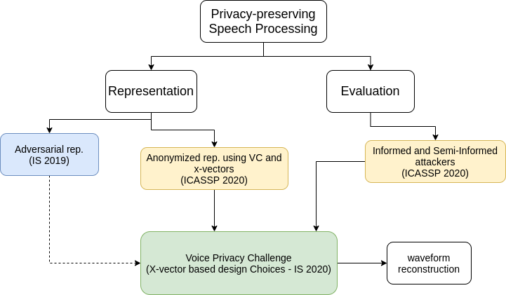
Roadmap
Notes:
Our research focuses on two directions in term do speaker anpnymization

Slide 6
Outline
Objectives and Roadmap
Anonymization via Adversarial Representation Learning
Anonymization via X-vector based Voice Conversion
Conclusion
Notes:
3 key take-aways

Slide 7
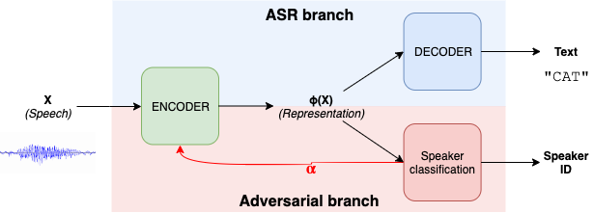
Adversarial anonymization
The Adversary neural network (red) tries to learn relevant speaker-specific features
Provides feedback to Encoder network scaled by a parameter (𝛼) which decides the strength of anonymization
Automatic Speech Recognition
branch

Slide 8
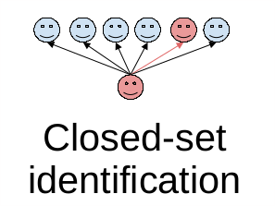
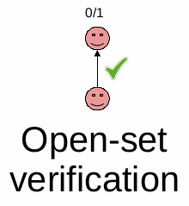
Attacker scenarios - evaluation schemes
Inside the adversarial ASR
X-Vector based Speaker Verification

Slide 9
Results (open vs closed set)
 | Raw speech | Blue branch only | Adversarial Learning
Word Error Rate (ASR) |  | 9.40 | 11.30
Classification Error (closed) | 2.78 | 51.37 | 94.40
Equal Error Rate (open) | 4.31 | 24.77 | 25.97
WER increases slightly indicating bearable utility loss.
Speaker classification error (closed-set) increases significantly = significant privacy gain.
Speaker verification error only increases slightly = insignificant privacy gain
Notes:
indicating that adversarial training does not immediately generalize over unseen speakers = open set does not mirror the privacy gains noticed in closed-set.

Slide 10
Outline
Objectives and Roadmap
Anonymization via Adversarial Representation Learning
Anonymization via X-vector based Voice Conversion
Conclusion

Slide 11

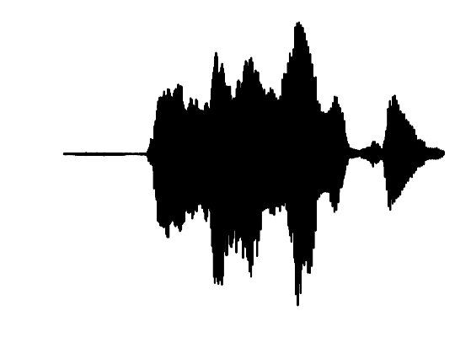

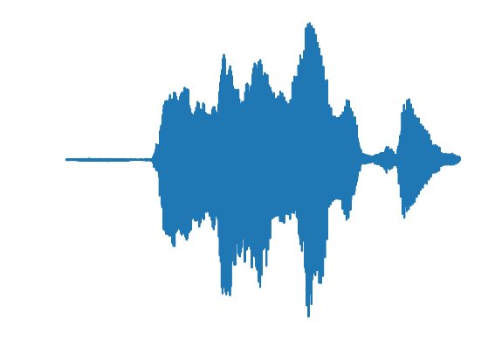


Voice Conversion vs Voice Transformation
Adversarial Learning (VT technique) because we define what we do not want.
In VC we define what we do want.
VT
Algorithm
Target not defined
VC Algorithm
Well-defined target
Notes:
Target selection becomes crucial

Slide 12








Voice Privacy Challenge
The challenge is to develop anonymization solutions which suppress personally identifiable information contained within speech signals.
Using freely available datasets.
https://www.voiceprivacychallenge.org/
Baseline recipe available at:
https://github.com/Voice-Privacy-Challenge/Voice-Privacy-Challenge-2020
Organized by:
Supported by:

Slide 13
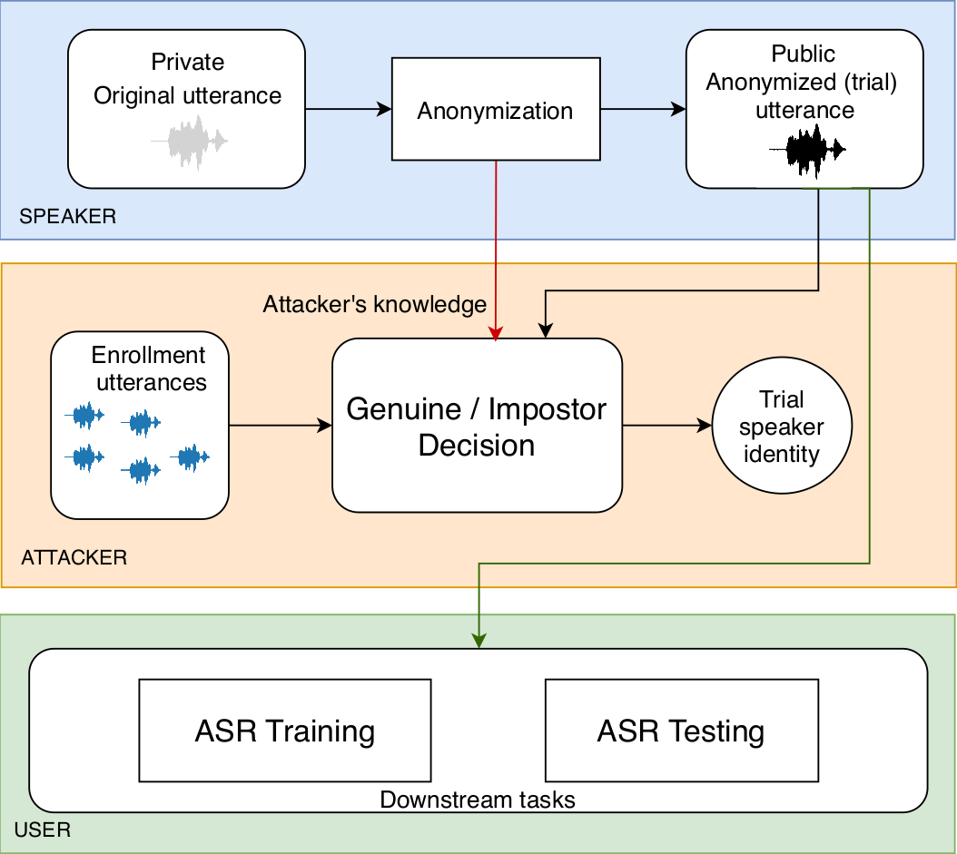
Threat model
Actors:
Speaker
Attacker
User

Slide 14
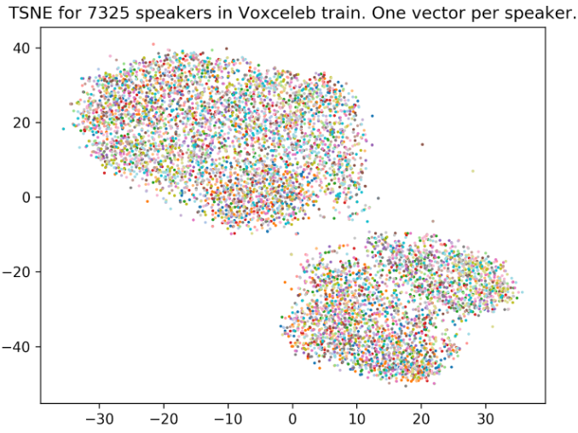
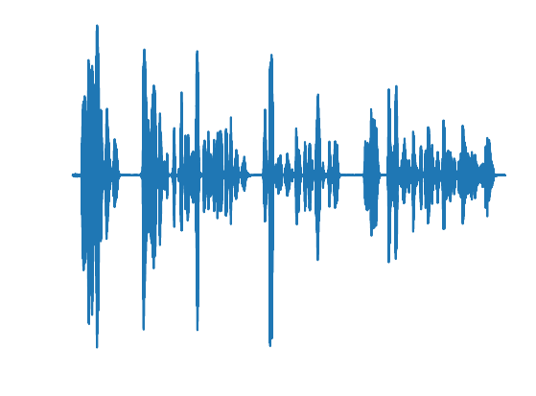
X-vectors
Behind the state-of-the-art biometric identification techniques
Fixed length vector to represent an utterance regardless of duration.
Intermediate layer of a neural network trained to classify speaker
0.2
-1.6
.
.
.
2.5
-0.3
512 dimension
2 seconds
0.7
-4.4
.
.
.
0.5
-5
512 dimension
20 seconds

Slide 15
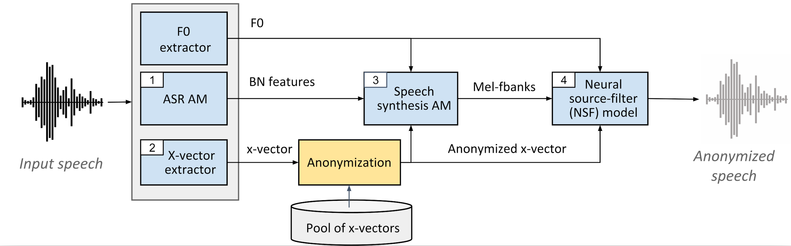
X-vector based speaker anonymization framework
Pitch
Phonetic features
Speech Synthesis
Anonymized x-vector (target)

Slide 16
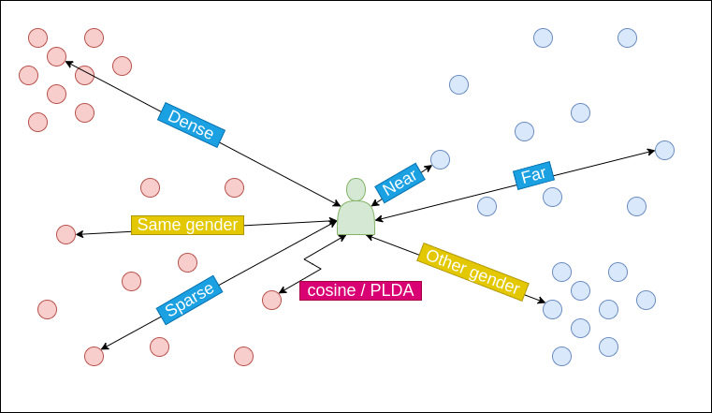
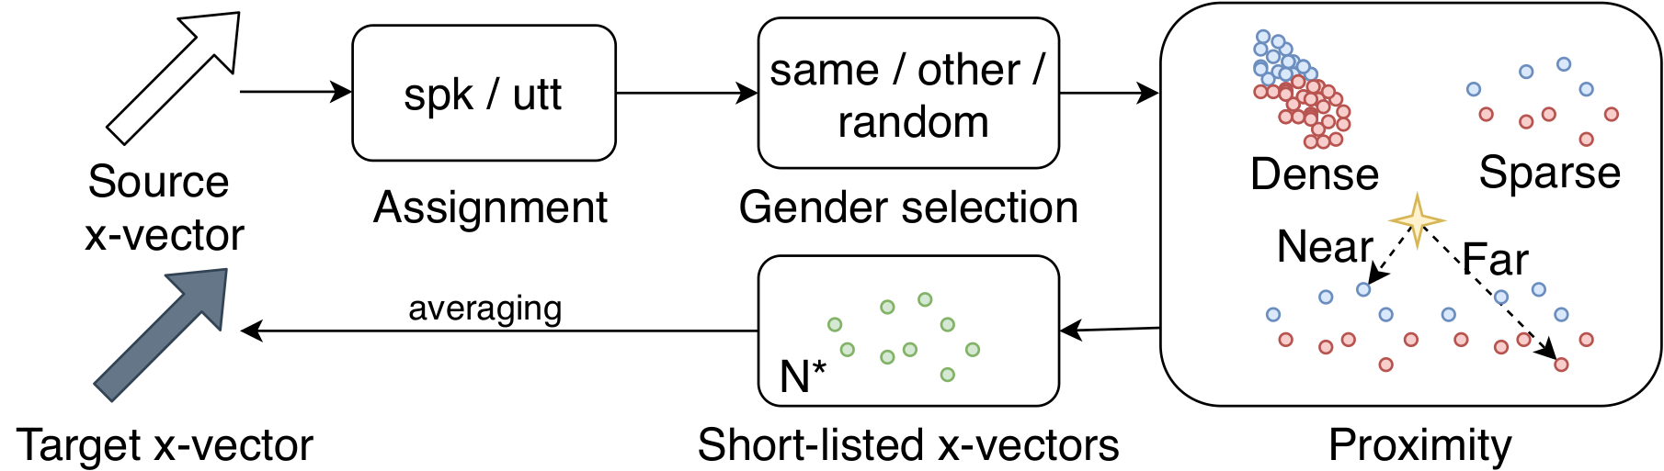
How to optimally select target speakers from a small pool of speakers? (Speaker’s Perspective)

Slide 17
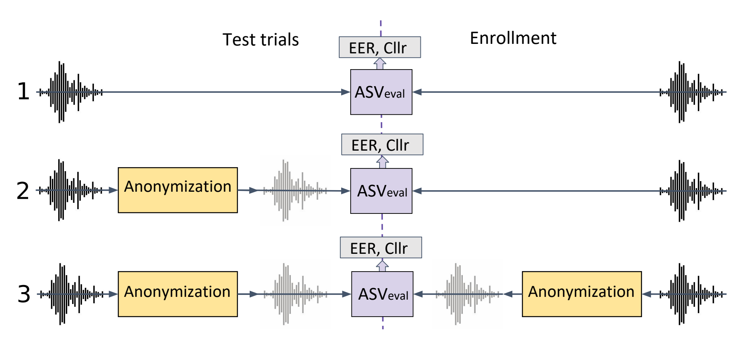
Privacy Evaluation - Attackers
Baseline
Ignorant
Semi-Ignorant
Semi-Informed
(Re-trained ASVeval model)
4
ASVeval

Slide 18
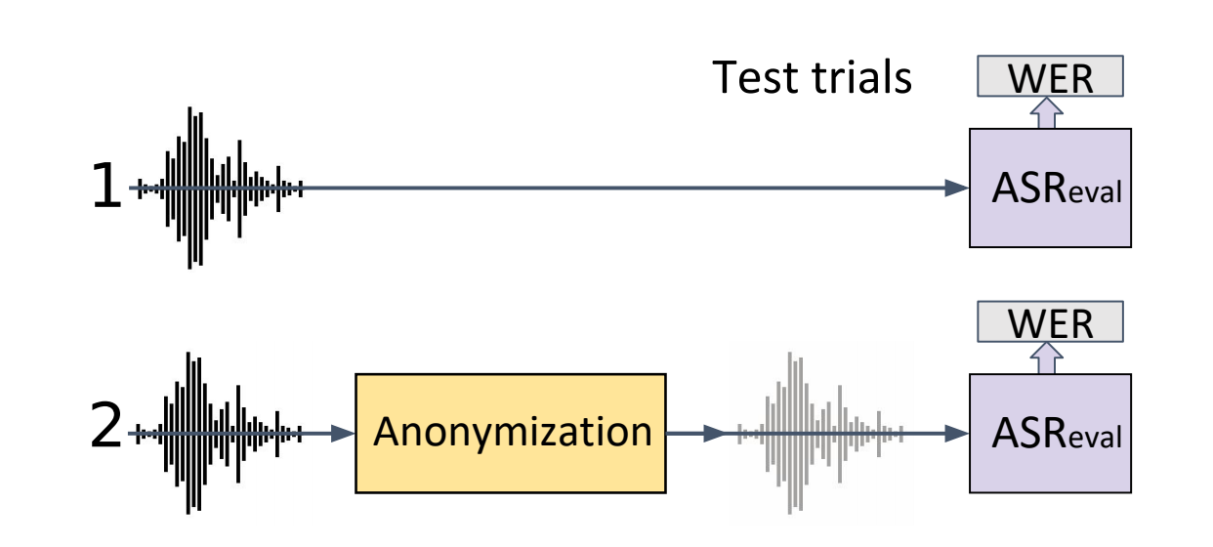
Utility Evaluation

Slide 19
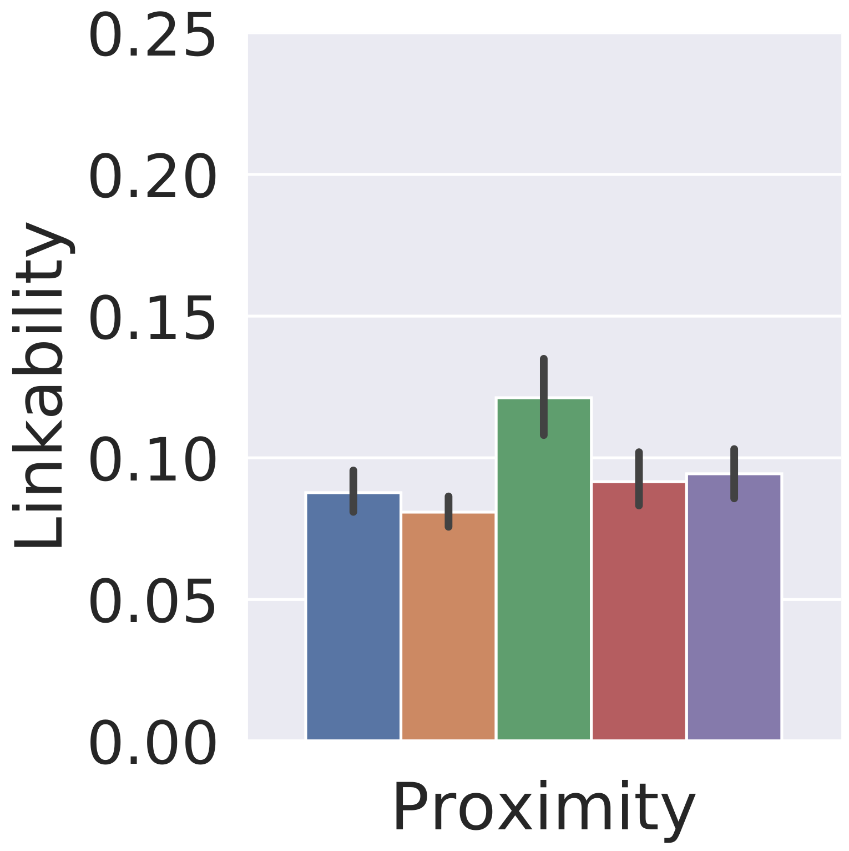
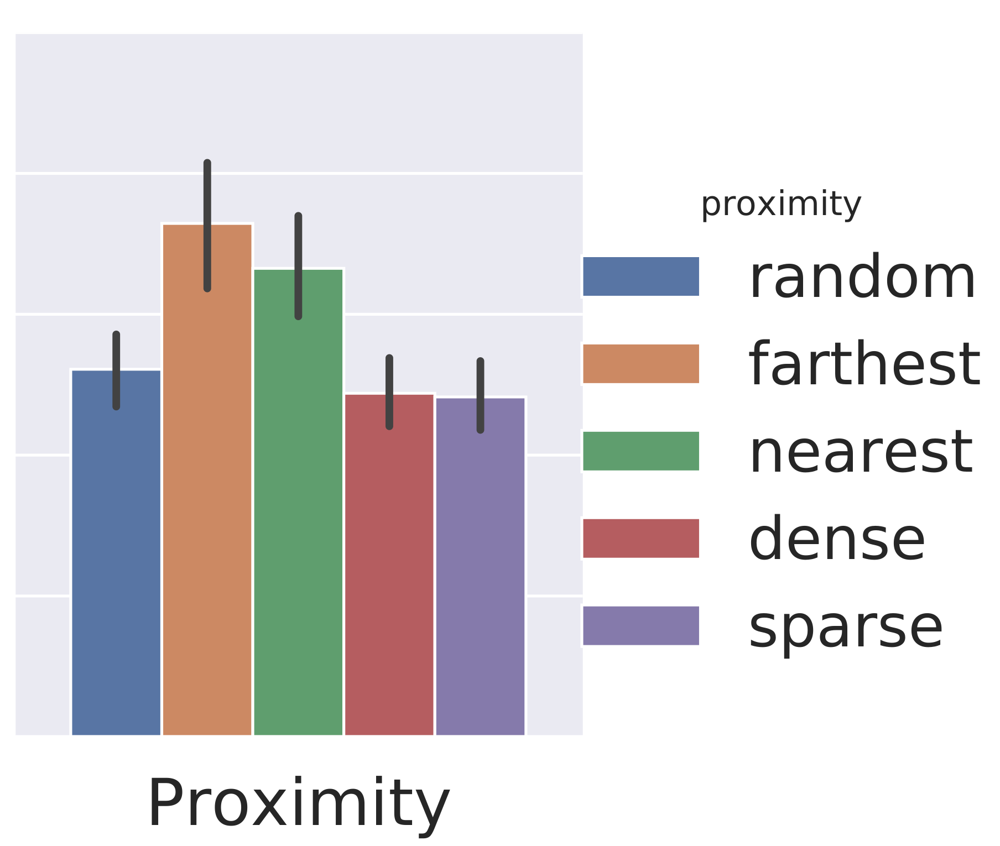
Proximity (Privacy)
Lower Privacy
Higher Privacy
Ignorant Semi-Ignorant
Baseline = 0.86
Mapping in DENSE region can be considered as “losing your identity in the crowd”.

Slide 20
User’s perspective
Is the resulting speech corpus suitable for downstream tasks?
Preserve speech quality in terms of naturalness and intelligibility
Measured using viability to train ASR models

Slide 21
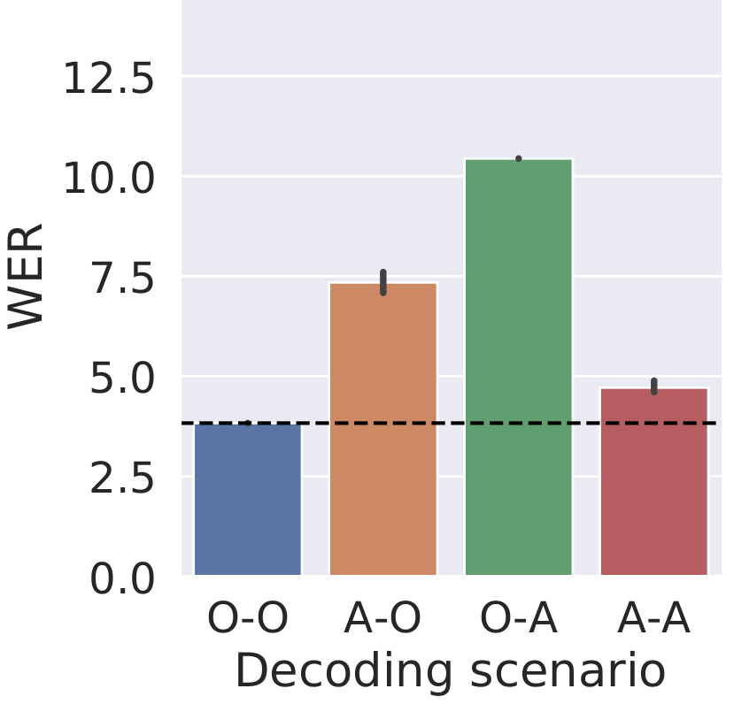
Informed ASR (Proximity: DENSE)
X-Y = Decoding X using ASR trained on Y
O = Original
A = Anonymized

Slide 22
Attacker’s Questions
Does the information about anonymization help discover the speaker’s identity? How to use this information?
How to optimize the search space using side-information to efficiently discover the speaker’s identity?

Slide 23
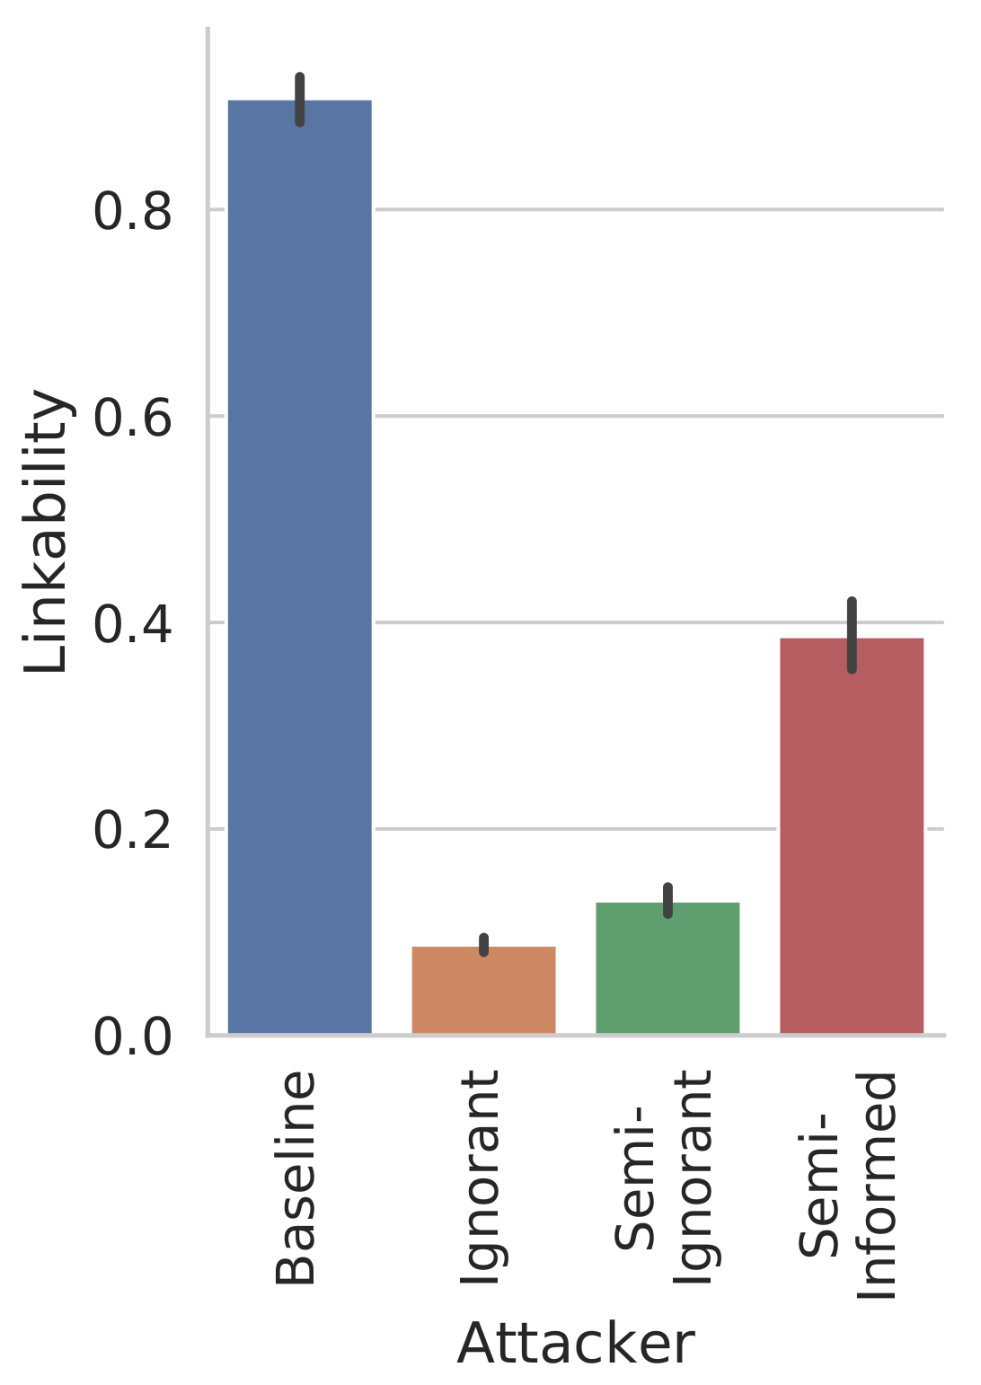
Informed ASV (Proximity: DENSE)
Lower Privacy
Higher Privacy

Slide 24
Conclusion
Adversarial Training effectively removes speaker’s information in a closet-set but does not generalizes to open-set speakers.
During Voice Conversion, mapping the “target speaker” in dense region with random gender selection produces state-of-the-art speaker anonymization.
The resulting speech corpus can be utilised for tasks such as: training an ASR model.
X-vector based target selection proves to be robust against “Semi-Ignorant” and “Semi-Informed” attacks.

Slide 25

Thanks for your attention!
More details on :
https://brijmohan.github.io/
Email : brij.srivastava@inria.fr

