Slide 1

Hygiener – Thinking about wellness
Aditee Rele
Brij Raj Singh Deepthi Anantharam
Manish Sharma
Shubham Choudhary
Hackathon – DX India

Slide 2
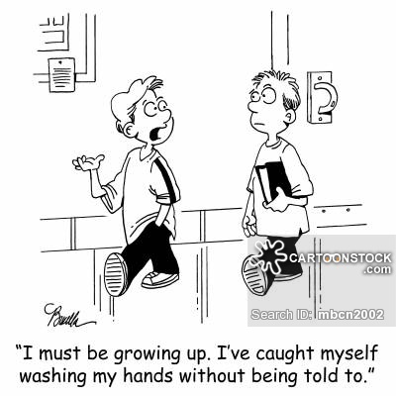
Typical Story of “Tom”
But
Not everyone is “Tom”
48%
People don’t wash follow health hygiene
26%
times there is no liquid hand wash available

Slide 3

A guy really was sad with this.
He shared his misery with his friend.
They decided to do something about it.
&
Introducing Hygiener

Slide 4
What is Hygiener?
Hygiener is a state of art device which uses novel tech IoT, ML, Power BI among others to maintain hygiene

Slide 5



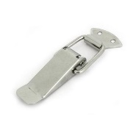
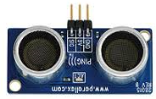

Technical Architecture
Door toggle device
Ultrasonic sensor
Passes 1 with Epoch
Every time door opens
Predict Hygiene

