Slide 1

Image Analysis in Python
Brian Keating
Image Analysis Consultant
brikeats@uchicago.edu
rcc.uchicago.edu

Slide 2
Course Materials
Go to https://github.com/brikeats/Image-Analysis-in-Python (or search github for “image analysis python workshop”). Click the “Download zip” file in the upper-right corner, and extract the downloaded zip file.

Slide 3
Starting the Notebook
Make sure you have the prerequisites: Open up a terminal (OSX) or command prompt (Windows) and start python. Type “import numpy”, “import scipy”, “import skimage” and “import matplotlib”. If there are no errors, you're good to go.
Change to the folder with the course materials, and run the command “ipython notebook”. This will open a page in your web browser with a list of files. Click on Intro to “Image Analysis in Python.ipynb” to follow along with the code demo.
If you're missing an prerequisites, it may be easier to use midway. Log in through your thinlinc client (or go to https://midway-login1.rcc.uchicago.edu/main/), open a terminal, type “sinteractive”, “cd /project/rcc/brikeats/ImageAnalysis-in-Python”, “module load python” and, “ipython notebook”.

Slide 4
Outline
Libraries + tools
Filtering: transforming grayscale images
Thresholding: converting images to binary (black & white)
Morphology: manipulating binary images
Example: segmentation of a microscopy image

Slide 5
General Programming Advice
Use meaningful variable names
Use meaningful variable names
Use meaningful variable names
Comment and document
Use library functions. Rule of thumb: fewer “for” loops is better, fewer indices is better
Use version control (git or subversion)
Check out software carpentry (http://software-carpentry.org/lessons/)

Slide 6
Image Analysis Libraries
Numpy – numerical computing (matrices)
Scipy – ndimage, signal processing, optimization
Matplotlib – basic graphing + plotting
Skimage – solid image analysis library

Slide 7
Other Useful Software
ipython – useful development environment for python
Scikit learn – general-purpose machine learning
OpenCV – powerful, but less user friendly than skimage. Geared toward real-time applications
Pims – load imagej-style tiff stacks
ITK – 3D analysis, mainly for medical imaging
GIMP – poor man's Photoshop

Slide 8
Numpy
Main numerical computing library for python
Images represented by 2D or 3D numpy arrays
Typically images are 8-bit, which means pixel values range from 0 (dark) to 255 (light). Scientific images are often higher-precision (e.g., 16-bit).
Designed look like Matlab syntax
C backend means it's fast

Slide 9
Matplotlib
Plotting library
Important functions: imread, imsave, imshow, plot
Defaults can be ugly – requires some tweaking to produce publication-quality plots
Be careful with the coordinates!
  Imshow puts the y axis origin at the top of the frame (i.e., the y axis is “upside down”)
  Coordinates are usually represented as (x, y), but matrices are indexed (row, col)

Slide 10
Typical Analysis Pipeline
Preprocessing: conversion to grayscale
Filtering: blurring, edge detection, blob detection, etc
Binarization: thresholding
Morphology: clean up shapes & analyzing shapes
Tracking

Slide 11
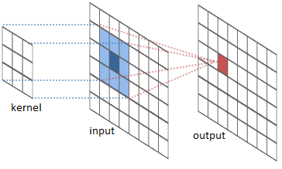
Filtering
In image filtering means we process an image to produce another image. We refer to the output image as the “response”
The idea is to select a small square “kernel” which defines what kind of shape we're interested in. We then slide the kernel over the image and compute the response pixel-by-pixel. This is called “convolution”
To compute response: multiply pixels in the input (blue) by kernel and sum to get the output (red)

Slide 12
Filtering: Blurring
Blurring means to average nearby pixels
A small amount of blurring eliminates noise; too much eliminates important details
If the kernel pixels all have the same weight, it is a uniform filter
Using 2d gaussian (normal) often produces a “nicer” blur

Slide 13
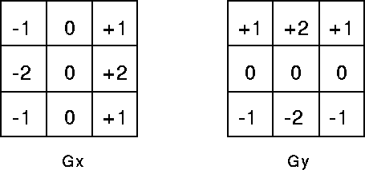
Filtering: Gradients
The gradient is the derivative (change) of an image. Large gradients indicate edges
To compute vertical gradients, we subtract pixel values below from pixel values above
Equivalently we filter with Sobel kernels
Sobel kernels

Slide 14
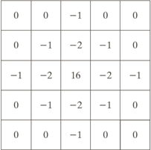
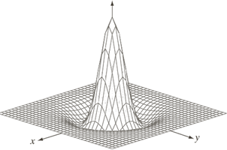
Filtering: Blobs
We can consider an area a “blob” if the pixels in that area are brighter than the surrounding pixels
Blob filters are sensitive to scale – to get a high response, your filter must be the same size
The skimage library has functions that will search over a range of scales for you

Slide 15
Thresholding
After filtering, you should have an image that is bright in the areas of interest and dark elsewhere
We want to convert it to a binary image by selecting a threshold. Pixels brighter than the threshold are set to white; dark pixels are set to black
The threshold is usually set based on the shape of the histogram

Slide 16
Morphology
After thresholding/binarization, you often get a lot of spurious specks and holes
Morphology is useful for cleaning up binary images
The main operations are dilation, erosion, opening, and closing
  Dilation makes white objects bigger
  Erosion makes white objects thinner
  Opening expands space between white objects
  Closing fills in black holes

Slide 17
Morphology
Skimage's morphology and measure modules contains functions for:
  Labeling objects
  Computing the center of objects (for tracking)
  Computing the area of objects
  Getting rid of tiny objects (which are usually noise)
  Characterizing the shape of objects

Slide 18
How to Learn On Your Own
Determine state-of-the art: read the literature in your field
Browse the online APIs of popular libraries
Choose a small (but real!) example project
Search stackoverflow & google when you're stuck
Computer & Machine Vision by Davies is my go-to reference
Computer Vision: Models, Learning, and Inference by Prince is also good, but more advanced
Email me brikeats@uchicago.edu, help@rcc.chicago.edu, or drop-in to Reg 216

Slide 19
Outline
Libraries + tools
Filtering: transforming grayscale images
Thresholding: converting images to binary (black & white)
Morphology: manipulating binary images
Example: segmentation of a microscopy image

Slide 20
Other Things to Mention
Use skimage functions to convert image types (rather than numpy's astype method)
Use rcparam or matplotlibrc to set saner plotting defaults
This tutorial is in ML, but is easily transferred to python: http://www.mathworks.com/matlabcentral/fileexchange/25157-image-segmentation-tutorial

