Slide 1
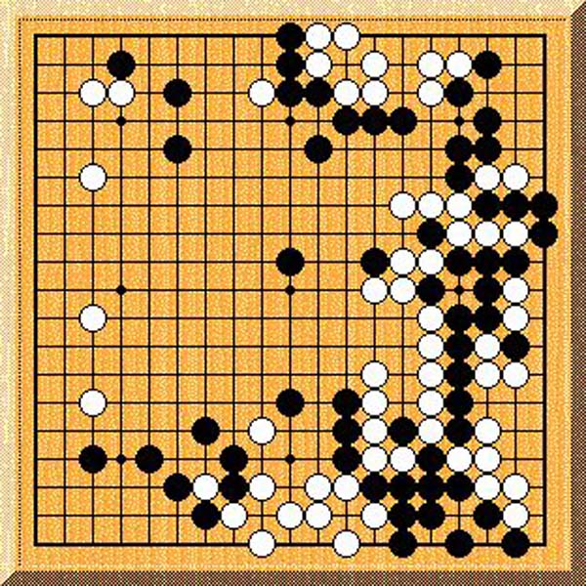
GO/WEIQI
the world’s most complex game
more possibilities than atoms in the universe
still unconquered by computers
but also the most fun
slaying dragons! making ladders! poking out eyes!
and “eating” stones!
Want a free teaching game?
or
Want to start a club?
GO/WEIQI
the world’s most complex game
more possibilities than atoms in the universe
still unconquered by computers
but also the most fun
slaying dragons! making ladders! poking out eyes!
and “eating” stones!
Want a free teaching game?
or
Want to start a club?
If so, email $YOUR_NAME at $YOUR_EMAIL_ADDRESS
If so, email $YOUR_NAME at $YOUR_EMAIL_ADDRESS
If so, email $YOUR_NAME at $YOUR_EMAIL_ADDRESS
If so, email $YOUR_NAME at $YOUR_EMAIL_ADDRESS
GO/WEIQI
the world’s most complex game
more possibilities than atoms in the universe
still unconquered by computers
but also the most fun
slaying dragons! making ladders! poking out eyes!
and “eating” stones!
Want a free teaching game?
or
Want to start a club?
GO/WEIQI
the world’s most complex game
more possibilities than atoms in the universe
still unconquered by computers
but also the most fun
slaying dragons! making ladders! poking out eyes!
and “eating” stones!
Want a free teaching game?
or
Want to start a club?

