Slide 1
Church Management System
KIPLAGAT BRIAN KIPKEMBOI
8th April 2024

Slide 2
Introduction:
The introduction of Church Management Systems (CMS) has revolutionized the way churches organize their operations and communicate with their members
This introduction sets the stage for understanding the significance and functionality of a Church Management System
CMS is a software solution specifically designed to assist churches in managing their administrative tasks, congregational data, and communication channels in a centralized and user-friendly manner.

Slide 3
Literature Review:
System review involves analyzing existing systems in the market to understand their functionalities, advantages, and disadvantages, thereby guiding the development of our system to address existing gaps.
. In the context of our study on church management systems, this review is essential for comparing different systems, functionalities, and perspectives to inform the development of a more efficient and user-friendly system.
Traditional church management systems often lack member management functionalities. Existing standalone systems are often unsuitable for church settings.

Slide 4
Methodology:
1. Comprehensive requirement analysis involving key stakeholders: Engage with church administrators, pastors, volunteers, and members through interviews, surveys, and consultations to understand challenges, workflows, communication needs, and expectations.
2. Detailed requirement specification document: Outcome of the analysis phase will be a document outlining functional and non-functional requirements of the CMS, guiding the development team in designing, implementing, and testing the system to meet the church community's unique needs.
3. Iterative design processes and user engagement: Designers interact with users through usability testing, prototyping, and feedback sessions to create intuitive interfaces and functionalities, emphasizing understanding user behaviors, preferences, and tasks.
4. Agile Development methodology: Prioritizes collaboration, flexibility, and customer feedback by breaking down development into small iterations (sprints) where cross-functional teams work on delivering functional increments. Agile methodologies promote adaptability to changing requirements and continuous improvement throughout the development lifecycle.

Slide 5
Results:
Male occupied the highest position than female. Additionally, the distribution of members across different counties, hostel and ministries were as follows
Most of the members in the church are male

Slide 6
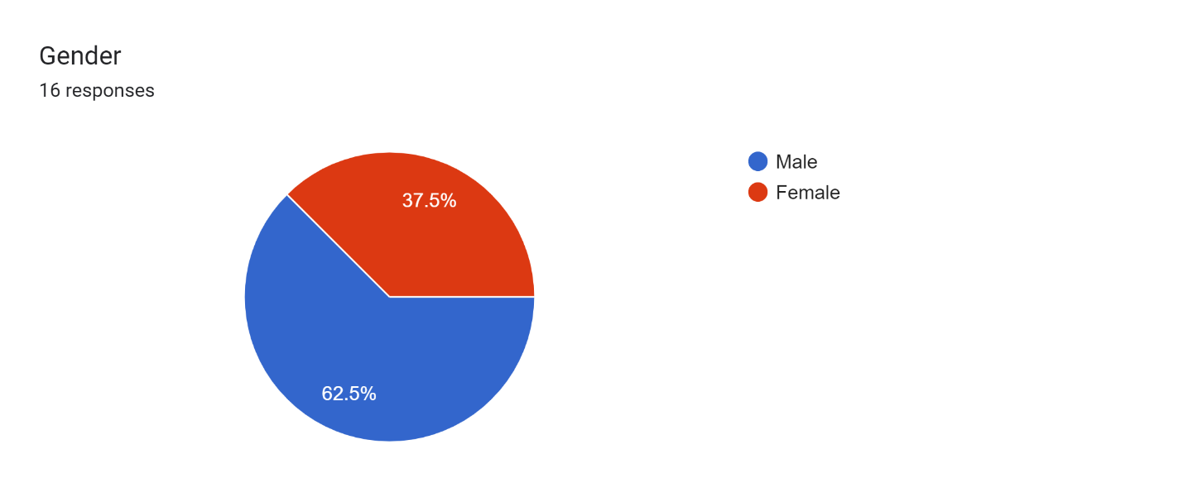
Pie Chart:

Slide 7
Discussion:
With regards to my research objectives, I came to a conclusion that most of the churches are operating with the paper work system.
The new Church management system measures are to be implemented.
After doing research we found that the CMS simplifies 100% of the work that are taking place in the churches

Slide 8
Conclusion:
In conclusion, the implementation of multi-factor authentication stands as a pivotal measure towards bolstering the security infrastructure of the church management system. Despite potential challenges, the advantages of multi-factor authentication far outweigh any drawbacks, positioning it as an indispensable tool in safeguarding church member information and organizational assets.
As the landscape of church administration technology advances, it is imperative for religious institutions to prioritize the adoption of robust security protocols, including multi-factor authentication, to uphold the integrity of their operations and foster continued trust among their members in the digital realm

Slide 9
References:
Below are the URL of the websites I referred to when doing the literature review:
History of mobile banking: https://finanteq.com/blog/fintech-trends/history-of-mobile-banking-how-it-all-started/
Mobile banking security: https://fastercapital.com/topics/the-rise-of-mobile-banking-and-the-need-for-security.html
Effectiveness of multi-factor authentication: https://www.miniorange.com/blog/why-mfa-for-banks-and-financial-institutions/

Slide 10
Appreciation:
I would like to appreciate everyone who participated in the data collection process by availing themselves for the interview and also participating in filling questionnaire.
I would also like to extend my gratitude to my supervisor who guided me through the whole time of writing the proposal and finally the implementation of the mobile banking application with enhanced security measures.
THANK YOU!

