Slide 1
How the GAVD3 S-JEPA study evolved
What changed, what improved, and what still remains untested GAVD3 S-JEPA tutorial

Slide 2
The goal is feature learning, not diagnosis
A 64-frame skeleton becomes 528 joint-time tokens.
The student sees visible tokens.
A slow teacher sees the complete sequence.
A predictor estimates teacher features at hidden locations.
The research question is whether the learned vector retains useful gait structure.
Scope: exploratory representation research. Folder labels are not diagnoses verified by this project.
The student predicts hidden teacher features rather than pixels or raw coordinates. Sources: Abdelfattah and Alahi, ECCV 2024; Assran et al., CVPR 2023.
Notes:
Start with the learning task. Each sequence has 64 normalized frames, 33 MediaPipe landmark identities, and three coordinate values. Four frames for one joint form one token. This creates 16 time patches times 33 joints, or 528 possible tokens. The student encoder receives only the visible tokens. The predictor fills the selected hidden positions in feature space. The target encoder sees the full sequence and changes slowly through an exponential moving average, or EMA. It supplies a stable feature target and does not receive a gradient. This is latent prediction, not video generation and not a clinical diagnosis. The project uses GAVD folder names as dataset labels. The added normal clips were not independently clinically reviewed. Sources: references 1 through 4.

Slide 3
The project improved in three different ways
The evolution separates model changes, evaluation repairs, and work that has not yet been run. Source: current notebooks, artifacts, and result ledger.
Notes:
Read this timeline from left to right. The legacy system was a useful prototype, but its normal training data came from one video. The failure audit then exposed source-video overlap, detector missingness, lost temporal order, and the absence of an independent outer test. The current model broadens the normal data, expands the target whitelist, adds two loss jobs, and continues through five stages. The latest Lane C change repaired the classifier fold definition without changing the encoder. The final card is different: it describes the experiment still needed for an unseen-video estimate. A model improvement, an evaluation improvement, and a reporting improvement are all valuable. They do not support the same claim.

Slide 4
The first prototype exposed four limits
Audit finding | Concrete evidence | Response and remaining limit
One normal source | 12 windows from 1 video | Add 63 accepted windows from 17 videos, while keeping their provenance separate
Rows were split, not videos | All 16 A1 test videos also occur in classifier training | Add grouped Random Forest audits; the encoder still saw every row
Detector missingness carried labels | Visibility-only A1 accuracy was 0.448 | Keep a missingness control beside the learned readout
Mean and standard deviation remove order | The readout compresses all time patches into 384 values | Document the limit; temporal pooling remains a proposed ablation
Notes:
The prototype did its job because it made the hidden assumptions measurable. First, twelve windows from one source video are correlated observations, not twelve independent people or camera settings. Second, a row-level split can put different windows from one video on both sides. In A1, every one of the 16 test videos also appears in classifier training. Third, a 97-value visibility-only control reached 0.448 accuracy on A1. That means pose success and failure are related to the labels and form a meaningful shortcut floor. Fourth, the downstream vector uses means and standard deviations, so it cannot tell the Random Forest when an event happened. The current work addresses some of these limits, documents the rest, and does not pretend that one new score solved all four.

Slide 5
More normal videos increased breadth and added a provenance risk
Stage 0 grew from one normal video to 18, while the final curriculum reached 159 sequences from 35 videos.
Notes:
The canonical GAVD cohort remains locked at 96 sequences from 18 videos. The project added normal walking windows through a separate extraction path. That path proposed 64 candidates from 17 additional videos. Sixty-three passed the authorized-landmark coverage threshold of 0.45. One candidate had coverage 0.027 and was rejected. Stage 0 therefore contains 12 canonical normal sequences plus 63 added-normal sequences, or 75 sequences from 18 videos. This is a real gain in source breadth. It also creates a new risk: 63 of 75 normal rows use the added extraction path, while every abnormal row uses the canonical path. A classifier can learn camera, crop, detector, or bounding-box differences. The scientific unit of diversity is 17 added videos, not 63 independent people.

Slide 6
A fixed target rule turns joints into a learnable question
The configured 0.60 fraction is applied to the smallest valid eligible-token count in the batch.
Notes:
Work through the figure in three steps. First, 64 frames divided by four frames per patch gives 16 time patches. Multiplying by 33 joints gives 528 possible tokens. All 33 joint identities may provide visible context, but only 12 may become hidden targets: both shoulders, hips, knees, ankles, heels, and foot indices. Second, the mask builder counts valid eligible tokens for every sample in a batch. It takes 60 percent of the smallest count and gives every sample that common target count. Therefore, samples with more valid eligible tokens have a smaller realized fraction. The phrase 60 percent of each sample is not correct. Third, the saved endpoint means were 0.551 at Stage 0 and 0.423 at Stage 4. Targets are drawn uniformly. No velocity, displacement, acceleration, or learned motion score is used, and no forbidden joint is substituted.

Slide 7
The objective changed from one job to three
JEPA predicts hidden features, VICReg resists collapse, and the group term shapes condition geometry after Stage 0.
Notes:
The legacy objective contained only the JEPA prediction term. The current objective adds two jobs. JEPA still asks the predictor to match teacher features at authorized hidden tokens. VICReg keeps two views of the same sequence close, pushes feature dimensions to retain variance, and reduces redundant covariance. This is active anti-collapse pressure. The group term uses condition labels to make same-label vectors more compact and penalize nearby group centers. Its weight is zero during normal-only Stage 0 and 0.25 during Stages 1 through 4. The saved total is JEPA plus 0.05 times VICReg plus 0.25 times the group term. Because the group term reads labels, only Stage 0 is label-free. The later stages are label-informed representation fine-tuning. Sources: references 1, 2, and 5.

Slide 8
One model continues through five ordered stages
Model-side state continues, while each stage starts a fresh optimizer and schedule.
Notes:
This is one continuing model lineage. The student encoder, target encoder, predictor, centering state, and VICReg projector continue from one stage to the next. Each stage starts a fresh AdamW optimizer, learning-rate scheduler, warmup, and EMA schedule position. Stage 0 trains on 75 normal sequences for 300 epochs. Four 75-epoch stages then add Parkinson’s, stroke, myopathic gait, and cerebral palsy. Condition-balanced replay keeps earlier groups in later batches. The final total is 600 curriculum epochs and 11,400 optimizer updates. Every stage records a fingerprint tied to its parent, cohort, mask rule, loss settings, and configuration. The fingerprint identifies experiment lineage. It is not a byte checksum of the checkpoint file.

Slide 9
Training avoided total collapse, but normal features drifted
The five-stage run stayed finite, retained nonzero spread, and moved away from its Stage 0 normal reference.
Notes:
Do not read a falling loss as proof of a useful representation. Use the diagnostics together. The JEPA and VICReg losses stayed finite. Final feature standard deviation was 0.414, so the extreme case in which every sequence becomes one identical vector did not occur. Final pair cosine was 0.609, another signal against complete collapse. At the same time, normal-anchor cosine fell from 0.954 after Stage 1 to 0.594 after Stage 4. The normal reference therefore changed substantially as condition groups entered. The Stage 4 margin penalty remained 0.038, so the requested training-corpus group margin was not fully met. Balanced replay reduced the risk of forgetting, but it did not prevent this drift. These are training diagnostics, not held-out accuracy.

Slide 10
The 384-value summary contains signal, but groups overlap
The smallest condition-centroid distance is lower than the average spread inside a condition.
Notes:
Notebook 05 freezes the final target encoder before any Random Forest is fitted. For each canonical sequence, it joins four 96-value summaries: global mean, global standard deviation, authorized-target mean, and authorized-target standard deviation. This makes a 384-value vector. On the 96 canonical rows, the mean within-condition cosine distance was 0.120. The smallest distance between condition centers was only 0.037, between myopathic and cerebral-palsy rows. Cosine silhouette was 0.009, close to the point where within-group and nearest-other-group distances balance. The representation contains label-related structure, but these numbers do not show five clean clusters. The same rows and labels shaped the later training stages, so this geometry is descriptive and label-informed. Source for silhouette theory: reference 9.

Slide 11
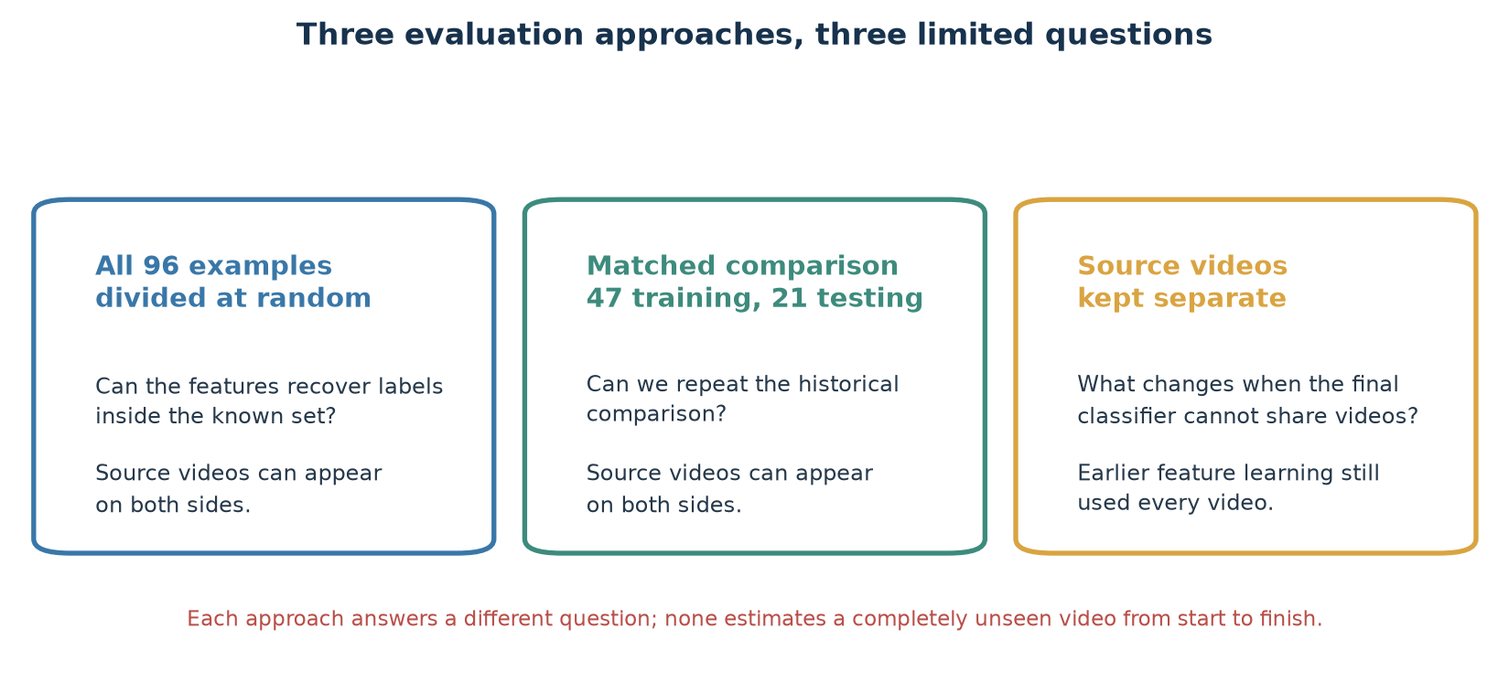
Three evaluation approaches answer three limited questions
Each approach answers a different question; none is a fully unseen-video test.
Notes:
The three approaches answer different questions. The first two allow source videos on both sides. The third keeps source videos separate for the final classifier, but every video had already contributed to feature learning.
[Sources]
- Local verified score tables in gavd5/work/artifacts/real
[/Sources]

Slide 12
Dividing 96 examples at random balances conditions, not videos
Every test video also appears in training, so 72.4% accuracy describes this known collection.
Notes:
The random division uses 67 examples for training and 29 for testing. It reaches 72.4% accuracy and a 75.0% F1 score. Every test video also appears in training.
[Sources]
- Local verified score tables in gavd5/work/artifacts/real
[/Sources]

Slide 13
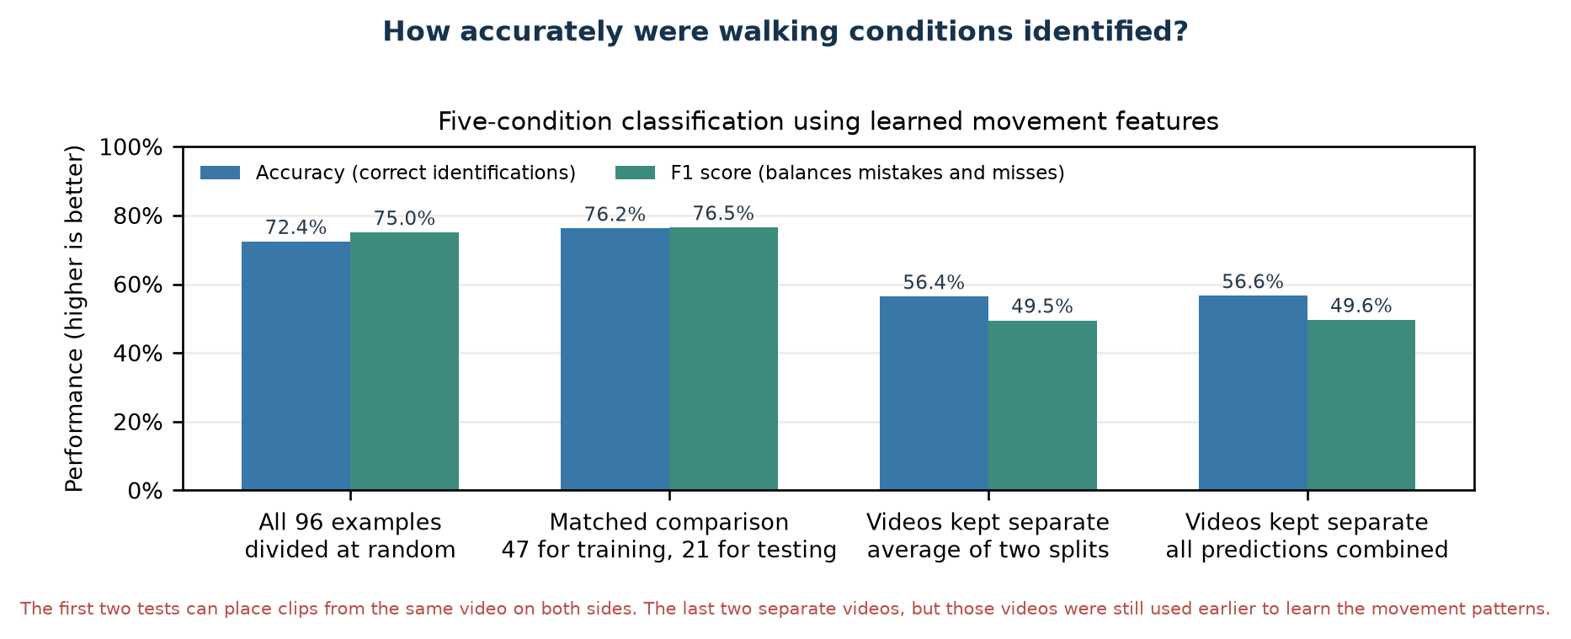
How accurately were the five walking conditions identified?
Accuracy is 76.2% in the matched comparison and 56.6% when source videos are kept separate.
Notes:
The matched comparison reaches 76.2% accuracy and a 76.5% F1 score. The source-video-separated combined result is 56.6% accuracy and a 49.6% F1 score.
[Sources]
- Local verified score tables in gavd5/work/artifacts/real
[/Sources]

Slide 14
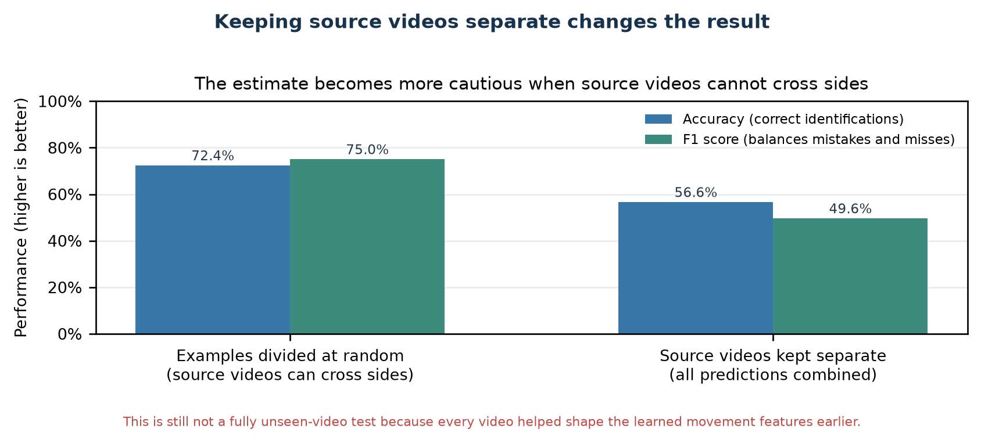
Keeping source videos separate changes the result
The combined accuracy is 56.6%, with a 49.6% F1 score.
Notes:
Keeping source videos separate lowers the combined result to 56.6% accuracy and a 49.6% F1 score. This is more cautious but still not a fully unseen-video estimate.
[Sources]
- Local verified score tables in gavd5/work/artifacts/real
[/Sources]

Slide 15
The next valid test must split videos before learning
A complete outer fold keeps source videos sealed while preprocessing, all five S-JEPA stages, and the classifier are fitted.
Notes:
End with the claim boundary. The current work is a meaningful engineering improvement: it broadens Stage 0 from one normal video to 18, uses 12 target identities, adds active anti-collapse pressure, completes five fingerprinted stages, improves the exact-split descriptive readout, and repairs the Lane C fold definition. It also shows substantial normal drift and weak five-group geometry. The next valid experiment must split complete source videos first. For every outer fold, choose preprocessing only from training videos, start S-JEPA from fresh weights, train all five stages, fit the classifier, and then open the held-out videos once. Save per-fold predictions, class and video support, provenance, and exposure audits. Only that design can estimate how the complete pipeline behaves on unseen videos.

Slide 16
Appendix: legacy and current methods differ at six layers
Data, targets, objective, training, artifacts, and evaluation all changed together.
Notes:
This matrix prevents a common attribution error. The exact-split score changed after six method layers changed together. It is valid to compare the complete legacy and current systems on that fixed assignment. It is not valid to say that VICReg, heel targets, added normal videos, or curriculum order caused the whole change. Controlled ablations are still required.

Slide 17
Appendix: added normal data use a separate extraction path
The added-normal pipeline keeps its candidates, selection rule, coverage threshold, and rejection report separate from canonical GAVD.
Notes:
The added pipeline inspects pose candidates, selects a walker, smooths a bounding-box track, estimates a cycle from ankle separation, proposes overlapping windows, and extracts MediaPipe landmarks. The extraction report is the selection contract used by notebooks 04 and 06. A rejected pose file cannot enter just because it remains on disk. These rows are useful added normal data, not canonical GAVD annotations.

Slide 18
Appendix: the full video must remain available
Cache the complete source video.
Select the annotated frame range.
Crop the intended walker.
Keep failed pose frames explicit.
Center, scale, and resize to 64 frames.
Preserve source-video identity for audits.
MediaPipe depth is relative monocular depth, not calibrated 3D motion.
The CSV frame numbers refer to positions in the original source video, so the complete source is cached before clipping and pose extraction. Sources: GAVD and MediaPipe.
Notes:
The manifest does not point to an already clipped video. Its frame numbers belong to the original source timeline. Caching the full video is therefore required for correct extraction and for a useful notebook preview. Pose failures remain explicit rather than being silently dropped. That allows later coverage and missingness controls. Sources: references 3, 4, and 6.

Slide 19
Appendix: exact cohort and target identities
Canonical folder label | Sequences | Videos
Normal | 12 | 1
Parkinson’s | 9 | 2
Stroke | 12 | 3
Myopathic | 47 | 10
Cerebral palsy | 16 | 2
Total | 96 | 18
Authorized hidden target identities
11, 12: shoulders
23, 24: hips
25, 26: knees
27, 28: ankles
29, 30: heels
31, 32: foot indices
No motion score. No fallback joint. All 33 identities may provide visible context.
Notes:
The current whitelist contains 12 landmark identities. The legacy whitelist contained 10 because heels 29 and 30 were absent. A landmark identity is not one token. Each identity can appear in 16 time patches, so validity determines how many eligible joint-time tokens each sequence contributes.

Slide 20
Appendix: the 384-value readout is deliberately simple
Four 96-value summaries create the current frozen readout; dynamics-preserving alternatives remain proposed.
Notes:
The readout has no trainable sequence head. This keeps variance low for a small dataset and makes the feature probe easy to audit. Its cost is clear: mean and standard deviation cannot preserve the order of 16 time patches, absolute walking rate after resizing, or the timing of left-right asymmetry. The right-hand card is a proposed ablation, not a completed result.

Slide 21
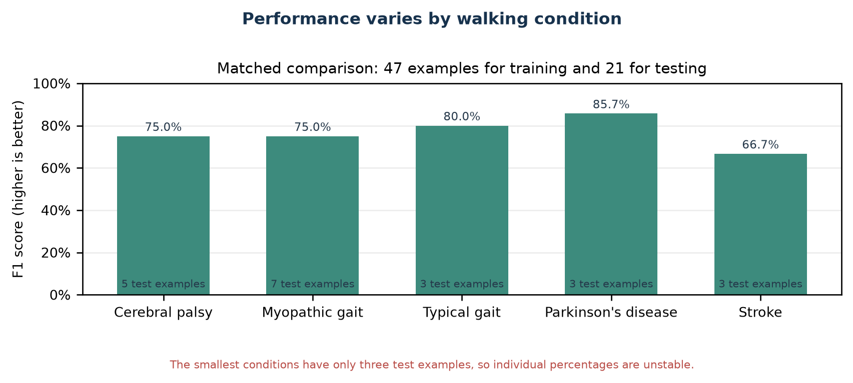
Appendix: performance varies by walking condition
F1 scores range from 66.7% to 85.7%, with only 3 to 7 test examples per condition.
Notes:
Condition-level F1 scores range from 66.7% to 85.7%. Three conditions have only three test examples, so individual percentages are unstable.
[Sources]
- Local verified score tables in gavd5/work/artifacts/real
[/Sources]

Slide 22
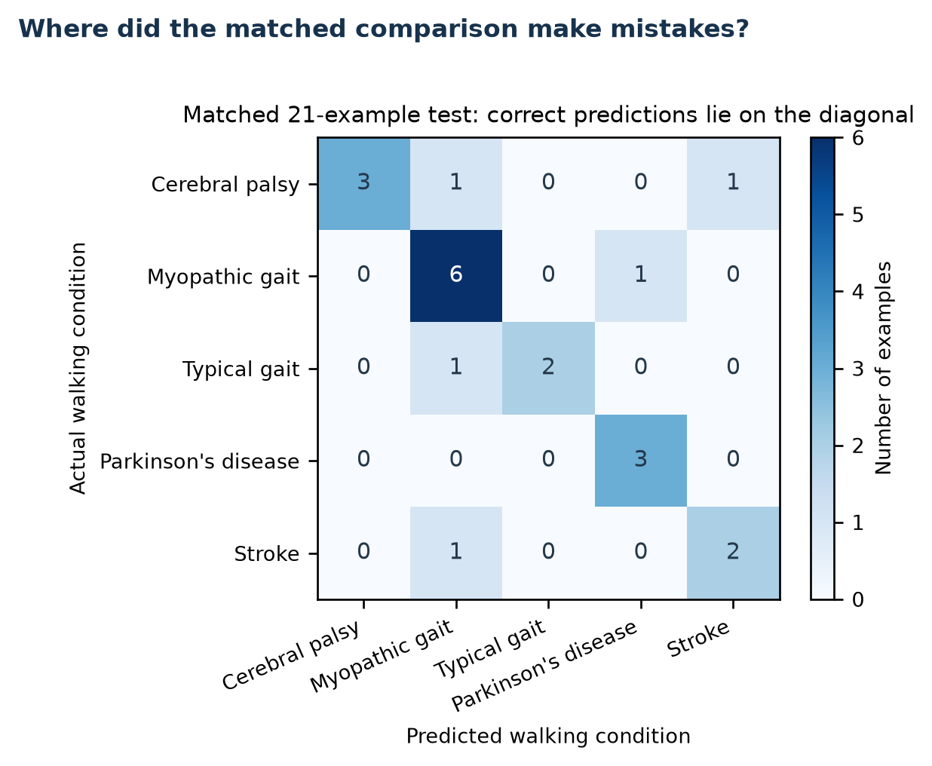
Appendix: where the matched comparison made mistakes
Five mistakes
Two cerebral-palsy examples from one source video went to other conditions.
One myopathic-gait example was assigned to Parkinson's disease.
One typical-gait example was assigned to myopathic gait.
One stroke example was assigned to myopathic gait.
Repeated clips from one video are not independent people.
Sixteen of 21 examples are correct; five errors involve four actual conditions.
Notes:
The matched test has 16 correct predictions and five errors. Two cerebral-palsy errors come from the same source video.
[Sources]
- Local verified score tables in gavd5/work/artifacts/real
[/Sources]

Slide 23
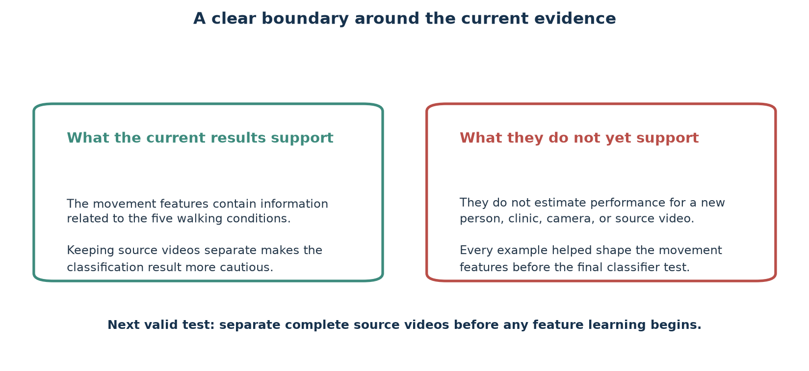
Appendix: what the current evidence can and cannot show
The evidence supports condition-related signal, not fully unseen-video performance.
Notes:
The results support condition-related signal in the known collection. They do not estimate performance for a new person, clinic, camera, or source video.
[Sources]
- Local verified score tables in gavd5/work/artifacts/real
[/Sources]

Slide 24
Appendix: current result ledger
Evaluation approach | Accuracy | Balanced accuracy | F1 score | Meaning
Random 96 | 72.4% | 82.4% | 75.0% | Videos cross
Matched 47 / 21 | 76.2% | 75.8% | 76.5% | Historical test
Video mean | 56.4% | 48.4% | 49.5% | Two splits
Video combined | 56.6% | 50.6% | 49.6% | All predictions
Detection random | 48.3% | 50.7% | 47.7% | No coordinates
Detection matched | 28.6% | 27.0% | 27.7% | No coordinates
Majority baseline | 49.0% | 20.0% | 13.2% | Simple baseline
Notes:
This ledger reports the current verified values in percentages. Accuracy is the share correct. Balanced accuracy gives each condition equal influence. F1 balances misses and incorrect assignments.
[Sources]
- Local verified score tables in gavd5/work/artifacts/real
[/Sources]

Slide 25
Appendix: small two-condition checks are regression checks
Condition compared with typical gait | Accuracy | Balanced accuracy | F1 score | Test examples | Meaning
Parkinson's disease | 100.0% | 100.0% | 100.0% | 7 | Small check
Stroke | 100.0% | 100.0% | 100.0% | 7 | Small check
Myopathic gait | 88.9% | 83.9% | 83.9% | 18 | Small check
Cerebral palsy | 100.0% | 100.0% | 100.0% | 9 | Small check
Notes:
These small two-condition checks use only 7 to 18 test examples. They are regression checks, not independent clinical estimates.
[Sources]
- Local verified score tables in gavd5/work/artifacts/real
[/Sources]

Slide 26
Appendix: controls and simple baselines
Check | Accuracy | Balanced accuracy | F1 score | Additional detail
Detection success only, all 96 | 48.3% | 50.7% | 47.7% | No body coordinates
Detection success only, matched | 28.6% | 27.0% | 27.7% | No body coordinates
Always choose myopathic gait | 49.0% | 20.0% | 13.2% | Largest of 96
Always choose typical gait | 47.2% | 20.0% | 12.8% | Largest of 159
Typical gait versus all others | 78.7% | 83.0% | 76.5% | Source videos separate
Notes:
Detection-success controls show how much condition information exists without body coordinates. The typical-versus-other check answers an easier two-condition question.
[Sources]
- Local verified score tables in gavd5/work/artifacts/real
[/Sources]

Slide 27
Appendix: the artifact contract rejects silent substitution
Checkpoint lineage, embeddings, readouts, and figures must agree on the completed curriculum and experiment fingerprint.
Notes:
Notebook 05 and notebook 06 do not accept an arbitrary file with a familiar name. They check stage completion, target identities, cohort, configuration, and experiment fingerprint. This is the direct fix for the earlier missing-checkpoint problem: the current consumer resolves the final augmented checkpoint and stops when the expected lineage is incomplete or inconsistent.

Slide 28
Appendix: seven notebooks form one audit trail
Each notebook produces an artifact that the next notebook can verify.
Notes:
Notebook 00 defines the learning graph and invariants. Notebook 01 builds the manifest and source-video cache. Notebook 02 extracts and displays skeletons. Notebook 03 proves the target mask rule. Notebook 04 trains and fingerprints the five-stage curriculum. Notebook 05 freezes and inspects the representation. Notebook 06 fits the readouts, controls, overlap audits, and Lane C stress tests. Real mode stops when a required artifact or fingerprint is missing.

Slide 29
Appendix: reproduce the current figures
Saved result files
classifier_metrics.csv
lane_c_video_disjoint_metrics.csv
five_class_classification_report.csv
five_class_confusion_matrix.csv
missingness_only_classifier_metrics.csv
Rebuild
1. Run notebooks 00 through 06 with real data.
2. Run the figure builder:
uv run python slides/make_current_result_figures.py
3. Run the slide builder:
uv run python slides/build_slides.py
Notes:
Recreate the score tables by running notebooks 00 through 06 with real data. The figure script regenerates the result visuals using the same Matplotlib formatting as the rest of the tutorial.
[Sources]
- Local verified score tables in gavd5/work/artifacts/real
[/Sources]

Slide 30
Appendix: separate completed work from proposed work
Only the green column describes the completed checkpoint.
Notes:
The archived improvement notes contain useful hypotheses, but they are not a list of current features. Outer source-video folds, fold-local five-stage training, dynamics-preserving readouts, and uncertainty from independent outer folds remain proposed. The current system does not use motion-ranked targets, does not mask exactly 60 percent of every sample, and does not provide an unseen-video encoder estimate.

Slide 31
Appendix: references and responsible use
Abdelfattah and Alahi. S-JEPA. ECCV, 2024. DOI
Assran et al. I-JEPA. CVPR, 2023. DOI
Ranjan et al. GAVD. IEEE Access, 2025. DOI
Grishchenko et al. BlazePose GHUM Holistic, 2022. DOI
Bardes, Ponce, and LeCun. VICReg. ICLR, 2022. OpenReview
Google AI Edge. Pose Landmark Detection Guide. Documentation
Roberts et al. Group-aware cross-validation. Ecography, 2017. DOI
Bengio and Grandvalet. Variance of K-fold cross-validation. JMLR, 2004. Article
Rousseeuw. Silhouettes for cluster analysis, 1987. DOI
Breiman. Random Forests. Machine Learning, 2001. DOI
Hui et al. Motion-topology masked prediction. Scientific Reports, 2026. DOI
Responsible use: research comparison only. Do not use these outputs for diagnosis, triage, or patient-level decisions.
Notes:
These references cover the S-JEPA and JEPA method family, the GAVD data source, MediaPipe pose extraction, VICReg, grouped evaluation, cross-validation uncertainty, silhouette interpretation, Random Forests, and recent skeleton masking research. The presentation reports dataset-label prediction and representation diagnostics, not clinical validity.

