Slide 1
GAITPARITY
Learning the mirror rule
for gait asymmetry
From transductive geometry audits to participant-held-out force validation
Research overview • motivation, methodology, current evidence, and next gates
2026
Notes:
[Sources]
- /Users/theodoremui/dev/alexpose/experiments/sjepa/gavd6/notes/research/programs/gait_parity/README.md
- /Users/theodoremui/dev/alexpose/experiments/sjepa/gavd6/notes/research/programs/gait_parity/METHODOLOGY.md

Slide 2
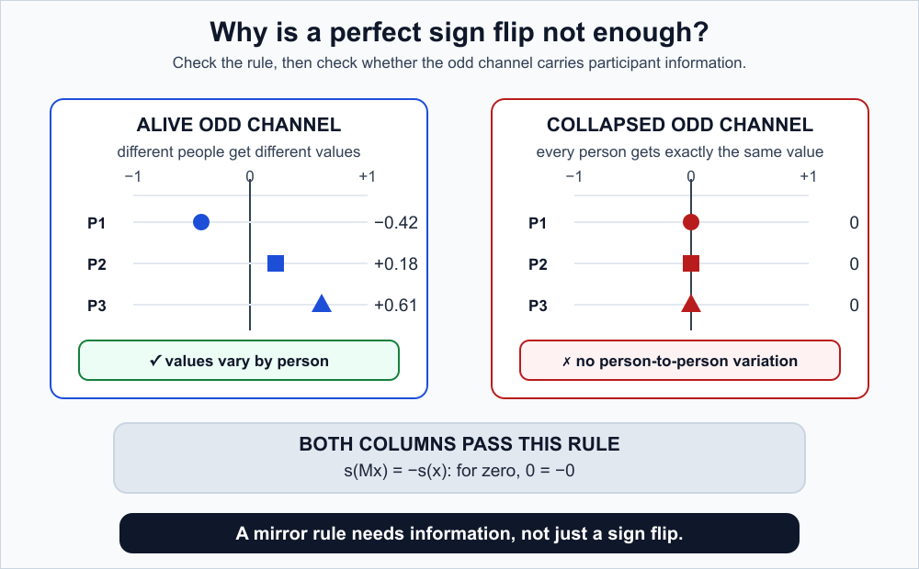
MOTIVATION
Gait asymmetry needs both meaning and geometry
A signed right-minus-left quantity can reveal side-specific movement—but a model can satisfy the sign rule while carrying no useful information.
•
Clinical targets must come from an independent instrument, not from the same coordinates the model receives.
•
A mirror test checks geometry; held-out force prediction checks whether the representation is useful.
•
Passing one test cannot substitute for passing the other.
Necessary ≠ sufficient
GaitParity
02
Notes:
[Sources]
- /Users/theodoremui/dev/alexpose/experiments/sjepa/gavd6/notes/research/programs/gait_parity/README_LONG_TERM.md
- /Users/theodoremui/dev/alexpose/experiments/sjepa/gavd6/notes/research/programs/gait_parity/METHODOLOGY_LONG_TERM.md
- /Users/theodoremui/dev/alexpose/experiments/sjepa/gavd6/notes/research/programs/gait_parity/images/long-term/collapse-trap.svg

Slide 3
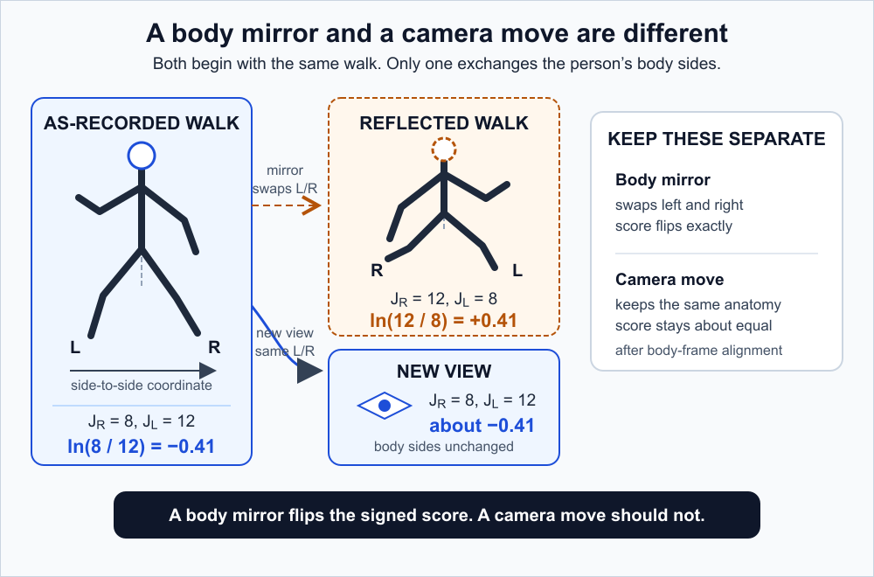
MOTIVATION
A mirror must flip side; a camera must not
Anatomical reflection M
s(Mx) = −s(x)
Negate the side axis, swap left/right joints, and swap visibility or confidence masks.
Viewpoint change V
s(Vx) ≈ s(x)
The person's anatomy is unchanged; only projection, visibility, and pose-estimation error differ.
GaitParity
03
Notes:
[Sources]
- /Users/theodoremui/dev/alexpose/experiments/sjepa/gavd6/notes/research/programs/gait_parity/METHODOLOGY.md
- /Users/theodoremui/dev/alexpose/experiments/sjepa/gavd6/notes/research/programs/gait_parity/README.md
- /Users/theodoremui/dev/alexpose/experiments/sjepa/gavd6/notes/research/programs/gait_parity/images/gait-parity-core.svg

Slide 4
MOTIVATION
The research question decomposes into four tests
1
Signal
2
Geometry
Can a simple readout recover a signed target from held-out people?
Does the prediction flip under reflection and stay stable across real views?
3
Efficiency
4
Physical meaning
Does the rule help most when only 4, 8, or 16 people are labelled?
Does skeleton motion agree with an independent force-plate target?
GaitParity
04
Notes:
[Sources]
- /Users/theodoremui/dev/alexpose/experiments/sjepa/gavd6/notes/research/programs/gait_parity/README.md
- /Users/theodoremui/dev/alexpose/experiments/sjepa/gavd6/notes/research/programs/gait_parity/METHODOLOGY.md

Slide 5
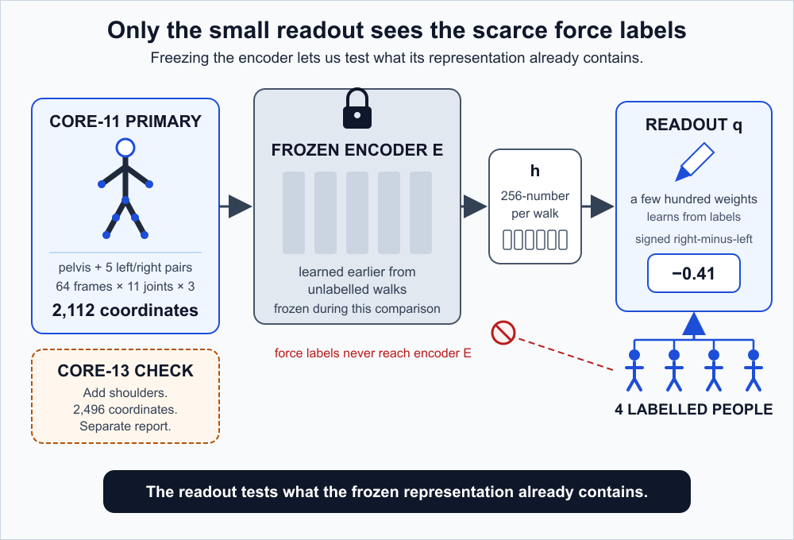
METHODOLOGY
The method links motion, parity, and force
Training and evaluation play different roles
•
Self-supervised JEPA pretraining hides motion and predicts the teacher representation—not raw coordinates.
•
The encoder is frozen before the clinical readout is fitted.
•
Only the small readout sees the scarce force labels.
•
The primary target is signed right-minus-left propulsion, normalized within participant.
Independent target
GaitParity
05
Notes:
[Sources]
- /Users/theodoremui/dev/alexpose/experiments/sjepa/gavd6/notes/research/programs/gait_parity/METHODOLOGY.md
- /Users/theodoremui/dev/alexpose/experiments/sjepa/gavd6/notes/research/programs/gait_parity/README.md
- /Users/theodoremui/dev/alexpose/experiments/sjepa/gavd6/notes/research/programs/gait_parity/images/encoder-and-readout.svg
- https://doi.org/10.1161/01.STR.0000204063.75779.8d

Slide 6
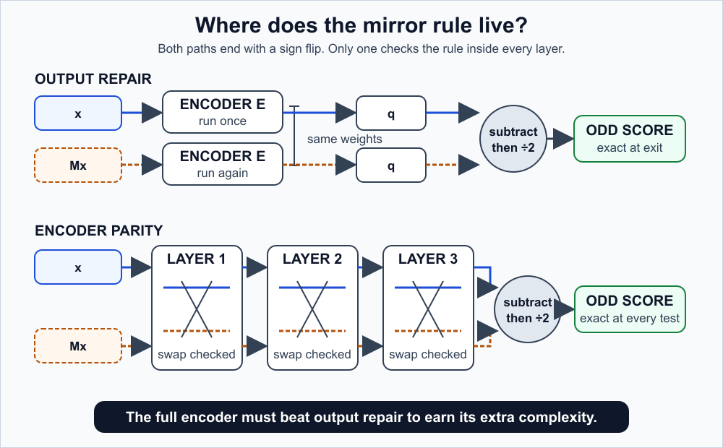
METHODOLOGY
Output repair is the baseline the encoder must beat
Cheap, exact output rule
odd_output(x) =
[r(x) − r(Mx)] / 2
Harder encoder-wide rule
Carry original and mirrored states together; every claimed layer must commute with the swap.
If encoder parity cannot beat the four-symbol output fix, the extra complexity is not justified.
GaitParity
06
Notes:
[Sources]
- /Users/theodoremui/dev/alexpose/experiments/sjepa/gavd6/notes/research/programs/gait_parity/README.md
- /Users/theodoremui/dev/alexpose/experiments/sjepa/gavd6/notes/research/programs/gait_parity/README_LONG_TERM.md
- /Users/theodoremui/dev/alexpose/experiments/sjepa/gavd6/notes/research/programs/gait_parity/METHODOLOGY_LONG_TERM.md
- /Users/theodoremui/dev/alexpose/experiments/sjepa/gavd6/notes/research/programs/gait_parity/images/long-term/output-vs-encoder.svg

Slide 7
METHODOLOGY
Each model isolates one source of advantage
Matched data, masks, widths, optimizers, update counts, and paired random seeds keep the comparison about structure—not extra compute.
Model | What it sees or guarantees | Question it answers
standard_one_view | One walk x | What does the ordinary approach achieve?
two_view_free | E(x) and E(Mx), no parity guarantee | Does a second look explain the gain?
odd_output | Exact sign flip at the output | Is final-output parity sufficient?
paired_unconstrained_encoder | Two fused branches, untied geometry | Does paired fusion alone help?
equivariant_encoder | Swap-consistent state at every layer | Does internal parity add value?
raw_kinematics / nuisance_only | Coordinates / metadata | Did learning beat direct measurement and shortcuts?
Primary comparisons: equivariant vs odd_output and paired_unconstrained
GaitParity
07
Notes:
[Sources]
- /Users/theodoremui/dev/alexpose/experiments/sjepa/gavd6/notes/research/programs/gait_parity/METHODOLOGY.md
- /Users/theodoremui/dev/alexpose/experiments/sjepa/gavd6/notes/research/programs/gait_parity/METHODOLOGY_LONG_TERM.md

Slide 8
METHODOLOGY
Data roles are separated to prevent overclaiming
Source | Role | Hard claim boundary
GAVD | Code and historical-representation audit | Transductive; no participant IDs; coordinate-derived target
AMASS + BABEL | Broad motion, then walking-focused pretraining | No clinical claim
Public stroke cohort | Primary participant-held-out force test | Force coverage must pass the quality gate
MoVi | Calibrated multi-view geometry test | No clinical claim
Parkinson's cohort | Locked replication / optional transfer | Replication and transfer reported separately
Repository boundary
The core-11 AMASS converter exists; the production window loader, matched trainer, and Stage 1 acceptance audit still need implementation before full pretraining can begin.
GaitParity
08
Notes:
[Sources]
- /Users/theodoremui/dev/alexpose/experiments/sjepa/gavd6/notes/research/programs/gait_parity/METHODOLOGY.md
- /Users/theodoremui/dev/alexpose/experiments/sjepa/gavd6/notes/research/programs/gait_parity/METHODOLOGY_LONG_TERM.md
- /Users/theodoremui/dev/alexpose/experiments/sjepa/gavd6/notes/research/programs/gait_parity/tutorials/06-stage-1-broad-amass-pretraining.md

Slide 9
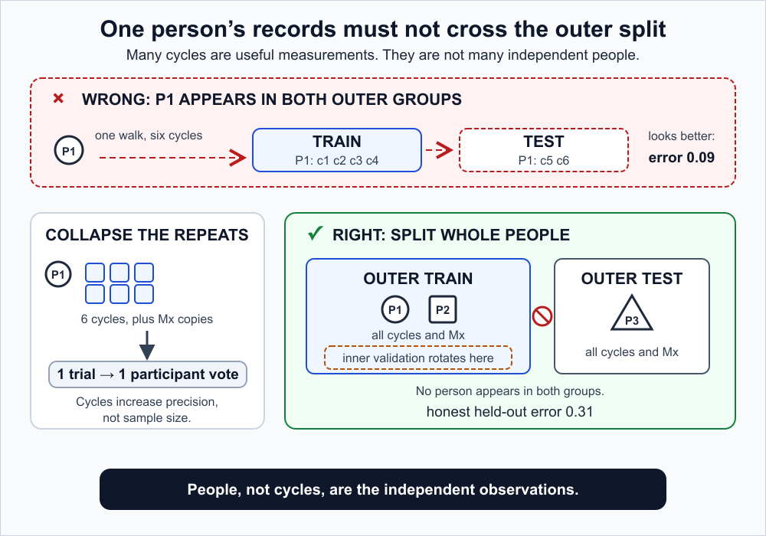
METHODOLOGY
One person gets one vote in every evaluation
Walking cycles from the same participant are related measurements—not independent people.
•
All cycles, reflected copies, and repeated visits stay in the same outer fold.
•
Hyperparameters and label budgets are chosen inside the training participants only.
•
Metrics aggregate at participant level; no participant contributes extra weight by having more cycles.
•
Source-video grouping is the best available fallback for GAVD—but it is not participant-held-out evidence.
People, not cycles
GaitParity
09
Notes:
[Sources]
- /Users/theodoremui/dev/alexpose/experiments/sjepa/gavd6/notes/research/programs/gait_parity/METHODOLOGY.md
- /Users/theodoremui/dev/alexpose/experiments/sjepa/gavd6/notes/research/programs/gait_parity/METHODOLOGY_SHORT_TERM.md
- /Users/theodoremui/dev/alexpose/experiments/sjepa/gavd6/notes/research/programs/gait_parity/images/participant-safe-split.svg

Slide 10
METHODOLOGY
The evaluation separates prediction from geometry
Prediction
Parity geometry
Primary participant-level MAE; report R², CCC, sign accuracy, calibration, and uncertainty separately.
Layerwise swap residuals and output oddness error; exactness is tested, never assumed.
Representation health
Robustness & efficiency
Odd-channel variance, energy, effective rank, cosine similarity, and shuffle controls guard against collapse.
Nested label budgets plus fixed noise, dropout, occlusion, temporal gaps, phase shifts, and identity corruption.
GaitParity
10
Notes:
[Sources]
- /Users/theodoremui/dev/alexpose/experiments/sjepa/gavd6/notes/research/programs/gait_parity/METHODOLOGY.md
- /Users/theodoremui/dev/alexpose/experiments/sjepa/gavd6/notes/research/programs/gait_parity/METHODOLOGY_SHORT_TERM.md
- /Users/theodoremui/dev/alexpose/experiments/sjepa/gavd6/notes/research/programs/gait_parity/METHODOLOGY_LONG_TERM.md

Slide 11
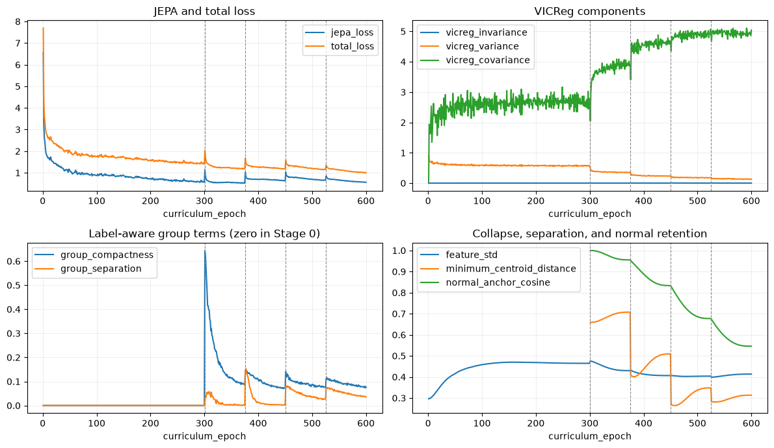
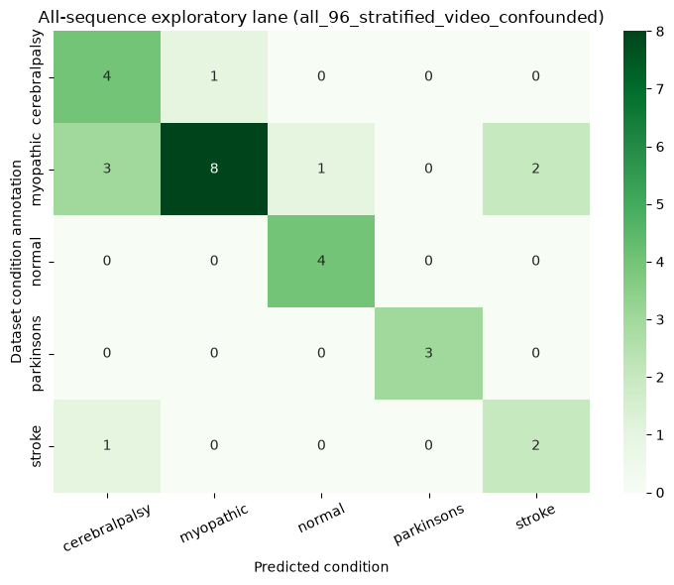
RESULTS
Training worked; label results stay confounded
What the graphs support
•
Loss falls and feature variation persists: the training procedure is nontrivial.
•
Folder-label separation is uneven and may exploit camera, source, missingness, or preparation shortcuts.
Exact saved notebook outputs • not diagnostic or unseen-participant evidence
GaitParity
11
Notes:
Lead with the evidence boundary: successful optimization is not a clinical result.
[Sources]
- /Users/theodoremui/dev/alexpose/experiments/sjepa/gavd6/notebooks/foundations/04_pretrain_sjepa_on_normal.ipynb
- /Users/theodoremui/dev/alexpose/experiments/sjepa/gavd6/notebooks/foundations/06_capstone_health_condition_classifiers.ipynb
- /Users/theodoremui/dev/alexpose/experiments/sjepa/gavd6/notes/research/programs/gait_parity/tutorials/01-foundations-notebooks-00-06.md
- /Users/theodoremui/dev/alexpose/experiments/sjepa/gavd6/notes/research/programs/gait_parity/tutorials/04-notebook-graph-guide.md
- /Users/theodoremui/dev/alexpose/experiments/sjepa/gavd6/notes/research/programs/gait_parity/tutorials/images/notebook-04-curriculum-diagnostics.png
- /Users/theodoremui/dev/alexpose/experiments/sjepa/gavd6/notes/research/programs/gait_parity/tutorials/images/notebook-06-all-sequence-confusion.png

Slide 12
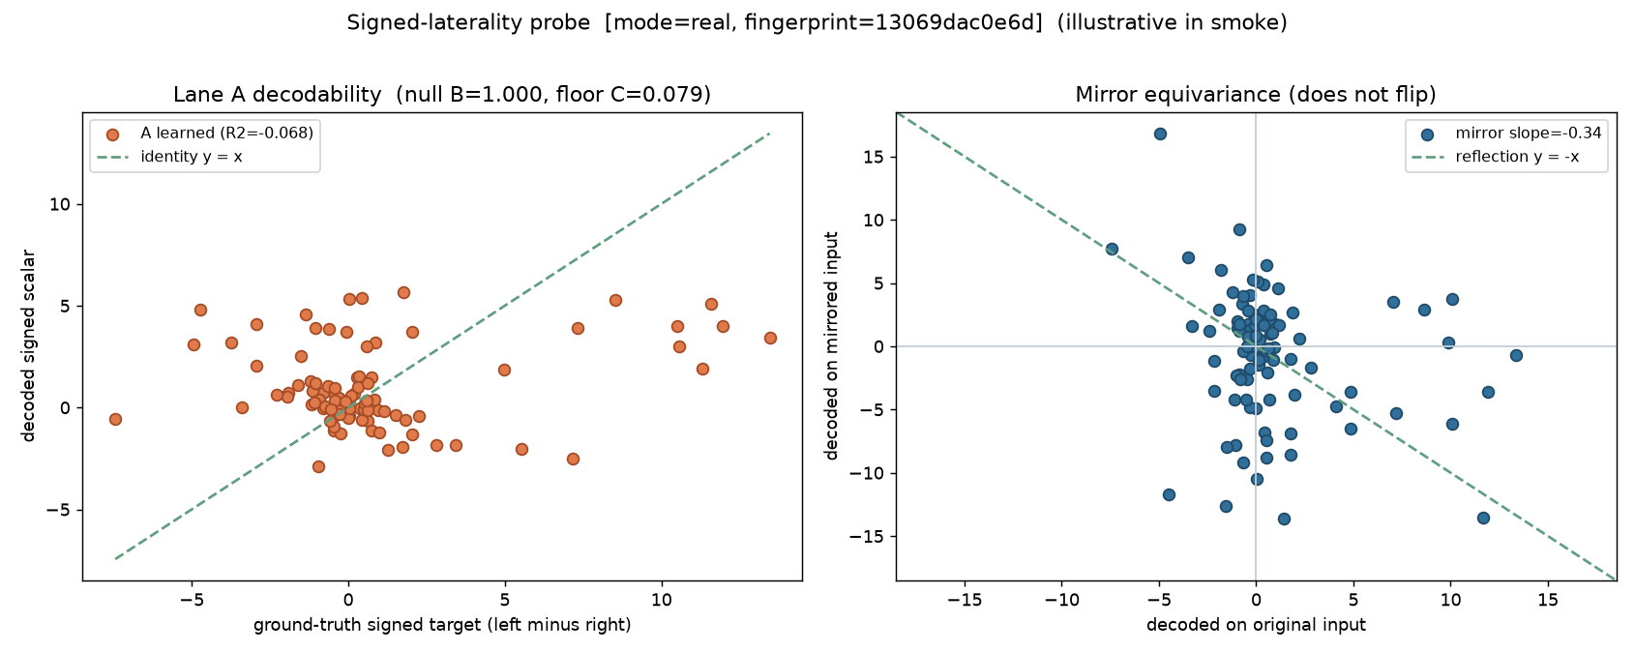
RESULTS
Historical S-JEPA fails the signed-laterality test
Test | Saved result
Held-out-source decoding | R² = −0.068
Mirror slope | −0.34 (target ≈ −1)
Verdict | Informative null
Claim ceiling | Transductive audit
Interpretation
This checkpoint + simple readout did not recover a useful signed axis. The plot does not test force or new people.
Exact saved output from idea05_signed_laterality/01_probe.ipynb
GaitParity
12
Notes:
Treat the null as a result: it prevents a weak signed signal from being reframed as discovery.
[Sources]
- /Users/theodoremui/dev/alexpose/experiments/sjepa/gavd6/notebooks/experiments/idea05_signed_laterality/01_probe.ipynb
- /Users/theodoremui/dev/alexpose/experiments/sjepa/gavd6/notes/research/programs/gait_parity/tutorials/02-current-direction-and-results.md
- /Users/theodoremui/dev/alexpose/experiments/sjepa/gavd6/notes/research/programs/gait_parity/tutorials/04-notebook-graph-guide.md
- /Users/theodoremui/dev/alexpose/experiments/sjepa/gavd6/notes/research/programs/gait_parity/tutorials/images/notebook-05a-signed-laterality-probe.png

Slide 13
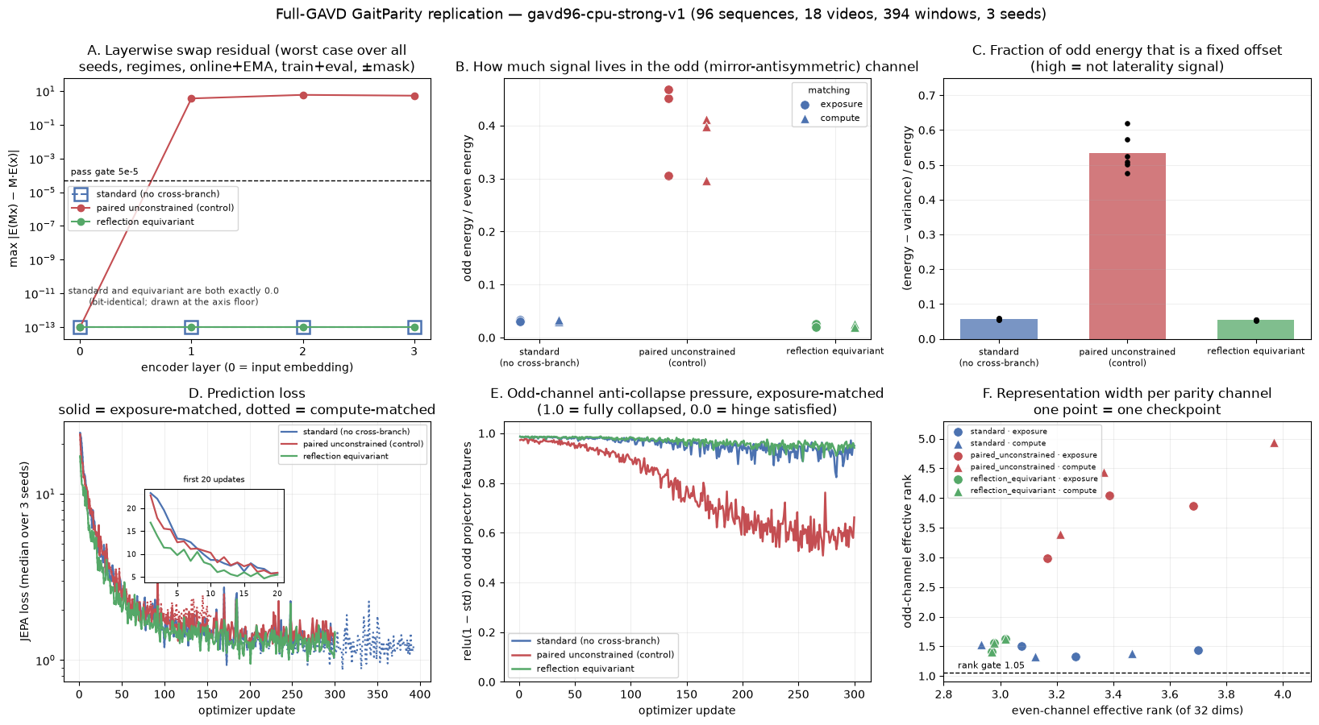
RESULTS
Controlled training validates the audit, not utility
0.0
≈5.9
96 / 18 / 394
Equivariant residual (worst checked)
Unconstrained residual (audit power)
Sequences / videos / windows • 3 seeds
GaitParity
13
Notes:
The unrestricted control is essential: it demonstrates that the test can fail when the geometry is actually broken.
[Sources]
- /Users/theodoremui/dev/alexpose/experiments/sjepa/gavd6/notebooks/experiments/idea09_reflection_equivariance/05_gavd_audit.ipynb
- /Users/theodoremui/dev/alexpose/experiments/sjepa/gavd6/notebooks/experiments/idea09_reflection_equivariance/06_cpu_replication.ipynb
- /Users/theodoremui/dev/alexpose/experiments/sjepa/gavd6/work/artifacts/gait_parity/real/gavd96-cpu-strong-v1/exposure/checkpoint_audit.json
- /Users/theodoremui/dev/alexpose/experiments/sjepa/gavd6/work/artifacts/gait_parity/real/gavd96-cpu-strong-v1/exposure/checkpoint_geometry.csv
- /Users/theodoremui/dev/alexpose/experiments/sjepa/gavd6/notes/research/programs/gait_parity/tutorials/02-current-direction-and-results.md
- /Users/theodoremui/dev/alexpose/experiments/sjepa/gavd6/notes/research/programs/gait_parity/tutorials/04-notebook-graph-guide.md
- /Users/theodoremui/dev/alexpose/experiments/sjepa/gavd6/notes/research/programs/gait_parity/tutorials/images/notebook-09f-full-gavd-audit.png

Slide 14
RESULTS
Current evidence supports feasibility—and only feasibility
Question | Current answer | What is still required
Does the training pipeline run? | Yes | Independent downstream target
Did the historical model expose a signed axis? | No: informative null | Better representation or measurement
Can the equivariant design obey the mirror rule? | Yes, in controlled GAVD audit | Held-out participant test
Can the audit detect a broken control? | Yes | Robustness across real views and corruptions
Does encoder parity improve meaningful prediction? | Unknown | Force-plate comparison vs odd_output + paired control
Do not claim
force prediction • unseen-person generalization • diagnosis • clinical utility • encoder superiority
GaitParity
14
Notes:
[Sources]
- /Users/theodoremui/dev/alexpose/experiments/sjepa/gavd6/notes/research/programs/gait_parity/tutorials/02-current-direction-and-results.md
- /Users/theodoremui/dev/alexpose/experiments/sjepa/gavd6/notes/research/programs/gait_parity/tutorials/04-notebook-graph-guide.md
- /Users/theodoremui/dev/alexpose/experiments/sjepa/gavd6/notes/research/programs/gait_parity/README.md

Slide 15
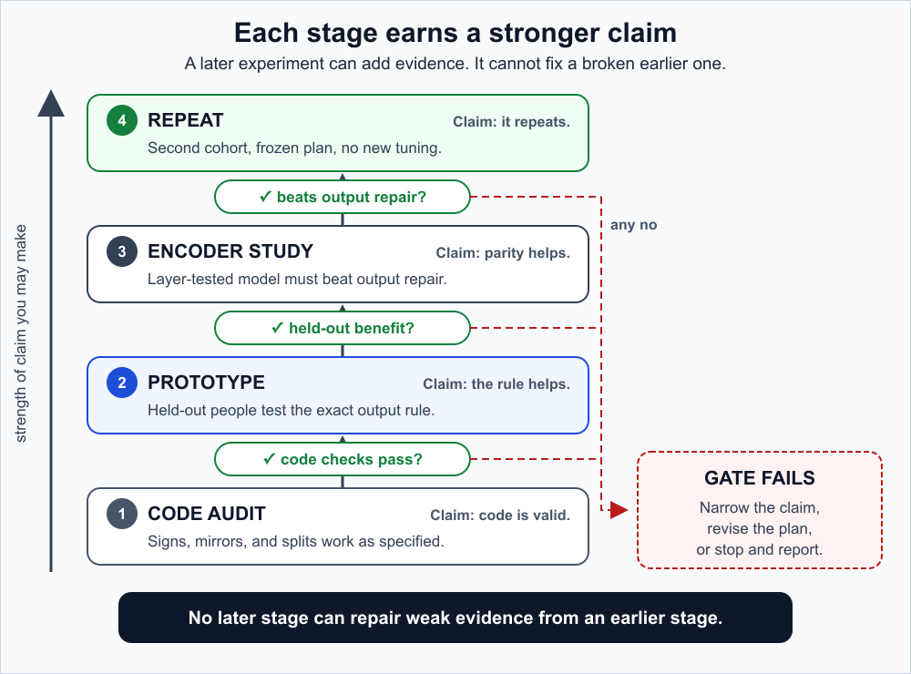
FUTURE WORK
Future work climbs through prespecified gates
1
Finish AMASS infrastructure
Core-11 window loader, matched trainer, checkpoint acceptance audit.
2
Two-stage self-supervision
Broad AMASS motion, then BABEL walking-focused continuation.
3
Prototype on stroke force
Compare two_view_free, odd_output, raw kinematics, and nuisance controls.
4
Full encoder study
Require exact geometry and noncollapsed odd features before reading force results.
5
Lock and repeat
Real-view robustness, corruption suite, then Parkinson's replication/transfer.
GaitParity
15
Notes:
[Sources]
- /Users/theodoremui/dev/alexpose/experiments/sjepa/gavd6/notes/research/programs/gait_parity/tutorials/03-planned-research-direction.md
- /Users/theodoremui/dev/alexpose/experiments/sjepa/gavd6/notes/research/programs/gait_parity/tutorials/05-two-stage-amass-training-overview.md
- /Users/theodoremui/dev/alexpose/experiments/sjepa/gavd6/notes/research/programs/gait_parity/tutorials/06-stage-1-broad-amass-pretraining.md
- /Users/theodoremui/dev/alexpose/experiments/sjepa/gavd6/notes/research/programs/gait_parity/tutorials/07-stage-2-walking-focused-continuation.md
- /Users/theodoremui/dev/alexpose/experiments/sjepa/gavd6/notes/research/programs/gait_parity/images/research-ladder.svg

Slide 16
THE DECISION
The next credible result is
held-out force prediction
Exact mirror geometry is necessary.
Independent participant-level measurement decides whether it is useful.
Build the full encoder only if it beats both the exact odd-output repair and the matched paired-unconstrained control.
GaitParity
Notes:
[Sources]
- /Users/theodoremui/dev/alexpose/experiments/sjepa/gavd6/notes/research/programs/gait_parity/README_LONG_TERM.md
- /Users/theodoremui/dev/alexpose/experiments/sjepa/gavd6/notes/research/programs/gait_parity/METHODOLOGY_LONG_TERM.md
- /Users/theodoremui/dev/alexpose/experiments/sjepa/gavd6/notes/research/programs/gait_parity/tutorials/03-planned-research-direction.md

