Slide 1
​
GAITPARITY
Side-aware representations
for balance-relevant gait analysis
A scientific story from dynamic stability to parity-aware JEPA and independent-force validation
Motivation • measurement • architecture • training • experiments • current evidence
Scientific research presentation • 2026
Notes:
Open with the measurement problem: the goal is not symmetry for its own sake, but a representation that preserves the mechanics needed for credible balance assessment.
[Sources]
- /Users/theodoremui/dev/alexpose/experiments/sjepa/gavd6/notes/research/programs/gait_parity/README.md
- /Users/theodoremui/dev/alexpose/experiments/sjepa/gavd6/notes/research/programs/gait_parity/README_LONG_TERM.md
- /Users/theodoremui/dev/alexpose/experiments/sjepa/gavd6/notes/research/programs/gait_parity/METHODOLOGY_LONG_TERM.md

Slide 2
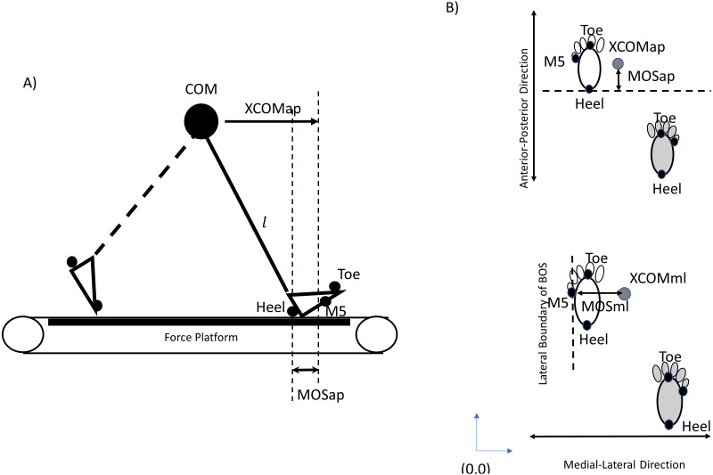
MOTIVATION
Walking is controlled instability, step after step
During gait, the body’s center of mass is outside the base of support for much of the cycle.
​
•
Each step relocates the base of support to redirect the moving body.
•
Foot placement, ankle moments, and push-off regulate forward and mediolateral stability.
•
Balance failure can emerge dynamically even when quiet standing looks adequate.
Dynamic balance is the relation between body state, foot placement, and the forces that redirect motion.
​
STATE → ACTION → STABILITY
Winter, 1995 • Bruijn & van Dieën, 2018 • Ribeiro et al., 2024 figure (CC BY)
GaitParity
02
Notes:
Walking is not static posture repeated. It is continuous regulation of a moving center of mass, so a useful gait representation should preserve the mechanics that distinguish how each side contributes to that regulation.
[Sources]
- https://doi.org/10.1016/0966-6362(96)82849-9
- https://pmc.ncbi.nlm.nih.gov/articles/PMC6030625/
- https://pmc.ncbi.nlm.nih.gov/articles/PMC10883149/
- https://cdn.ncbi.nlm.nih.gov/pmc/blobs/5ea6/10883149/3bfb8ca47aff/peerj-12-16919-g003.jpg

Slide 3
MOTIVATION
Falls make gait a clinically consequential signal
​
​
​
​
​
1 in 4
Prospective evidence
Independent signal
Maki followed 75 older adults for one year: stride-to-stride variability—especially speed variability—predicted future falls more clearly than several slower, more cautious gait adaptations.
In 597 community-dwelling elders, quantitative gait domains predicted incident falls over a mean 20-month follow-up, beyond several clinical risk factors and gait/balance tests.
U.S. adults ≥65 report falling each year
Falls are the leading cause of injury in this age group.
​
The assessment gap
​
Scientific boundary
Instrumented walkways and force plates reveal mechanics, but they are episodic and scarce. Video skeletons are scalable, but ordinary representations may discard laterality or learn camera shortcuts.
Gait markers can inform risk assessment; they are not themselves a diagnosis or a causal proof of falling.
CDC, 2026 • Maki, 1997 • Verghese et al., 2009
GaitParity
03
Notes:
The motivation is not that one gait metric can diagnose falls. It is that prospectively observed gait variability and rhythm contain risk-relevant information, motivating scalable measurement of richer gait mechanics.
[Sources]
- https://www.cdc.gov/falls/data-research/index.html
- https://pubmed.ncbi.nlm.nih.gov/9063277/
- https://pmc.ncbi.nlm.nih.gov/articles/PMC2709543/

Slide 4
MOTIVATION
The missing link is side-specific control
​
​
​
​
​
​
​
​
Neurologic injury
Side-specific force
Compensation
Balance reserve
→
→
→
Unequal motor capacity and timing
Paretic vs nonparetic propulsion
Speed may improve without paretic recovery
Adaptability may fail under challenge
​
​
Why propulsion is the bridge
What GaitParity will test
•
Fore–aft ground-reaction force measures how each limb contributes to forward progression.
Can video-derived skeleton motion preserve enough signed information to estimate an independent right-versus-left force target for a person the model has never seen?
•
Post-stroke training can shift the contribution of paretic and nonparetic propulsion—even when walking speed alone hides the mechanism.
Not yet: prospective fall prediction.
Hsiao et al., 2016 • Bowden/Kautz propulsion framework • Lodha et al., 2025
GaitParity
04
Notes:
Signed propulsion is used because it is a side-specific mechanical measurement from an independent instrument. The talk deliberately stops short of claiming that propulsion asymmetry alone predicts falls.
[Sources]
- https://pubmed.ncbi.nlm.nih.gov/26721869/
- https://www.ahajournals.org/doi/pdf/10.1161/str.37.2.619
- https://pubmed.ncbi.nlm.nih.gov/40250067/
- /Users/theodoremui/dev/alexpose/experiments/sjepa/gavd6/notes/research/programs/gait_parity/METHODOLOGY.md

Slide 5
QUESTION
Scientific hypothesis: geometry can reduce the label burden
​
A parity-aware encoder should make signed propulsion easier to recover from few labelled participants than output repair or an equally capable unconstrained paired model.
​
​
​
​
P1 • Exact geometry
P2 • Informative laterality
Every claimed encoder layer commutes with the left–right branch swap.
The odd channel varies across people and retains healthy effective rank.
​
​
​
​
P3 • Useful mechanics
P4 • Robust measurement
Held-out participant force MAE improves versus both decisive controls.
Benefit persists across label budgets, views, and realistic corruption.
Claims are cumulative: geometry → information → prediction → balance-relevant validation.
GaitParity
05
Notes:
Present the hypothesis as a chain. Exact geometry is necessary but does not establish usefulness; independent force prediction is the key utility test.
[Sources]
- /Users/theodoremui/dev/alexpose/experiments/sjepa/gavd6/notes/research/programs/gait_parity/README_LONG_TERM.md
- /Users/theodoremui/dev/alexpose/experiments/sjepa/gavd6/notes/research/programs/gait_parity/METHODOLOGY_LONG_TERM.md

Slide 6
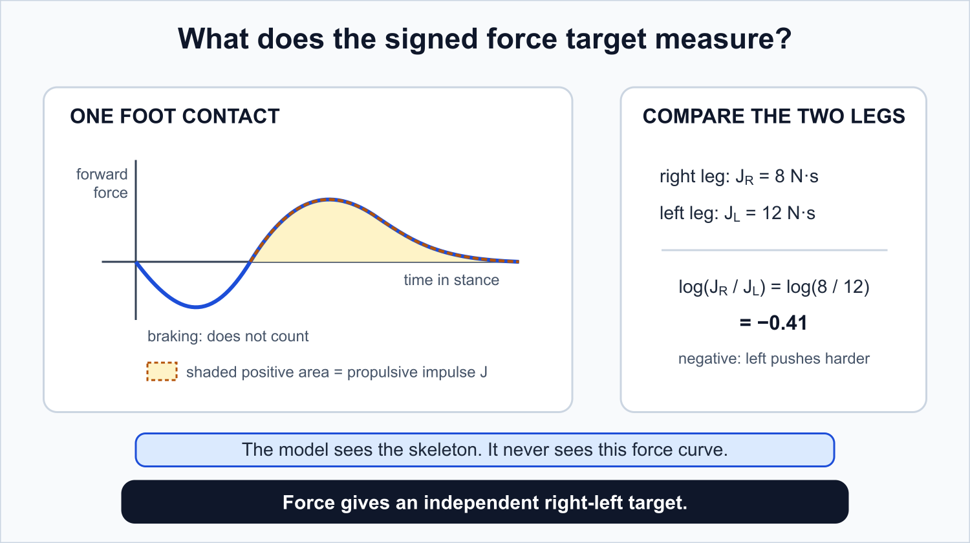
MEASUREMENT
One gait cycle, two instruments, one signed target
​
Skeleton input
x ∈ ℝ⁶⁴×¹¹×³
2.13 s at 30 Hz • core-11 joints • forward/up/side axes • visibility mask carried through
​
Independent force target
y = ln(Jᴿ / Jᴸ)
J is the positive fore–aft ground-reaction impulse during stance. The log ratio is scale-free, centered at zero, and exactly sign-flipping under side exchange.
​
Critical separation
The model sees motion; the target comes from sensors in the floor. Geometry cannot manufacture the answer.
GaitParity
06
Notes:
This is the decisive measurement design. Coordinate-derived asymmetry is acceptable for audits, but the primary study uses force so the input and target are not the same signal in different notation.
[Sources]
- /Users/theodoremui/dev/alexpose/experiments/sjepa/gavd6/notes/research/programs/gait_parity/METHODOLOGY.md
- /Users/theodoremui/dev/alexpose/experiments/sjepa/gavd6/notes/research/programs/gait_parity/images/what-we-predict-propulsion.svg

Slide 7
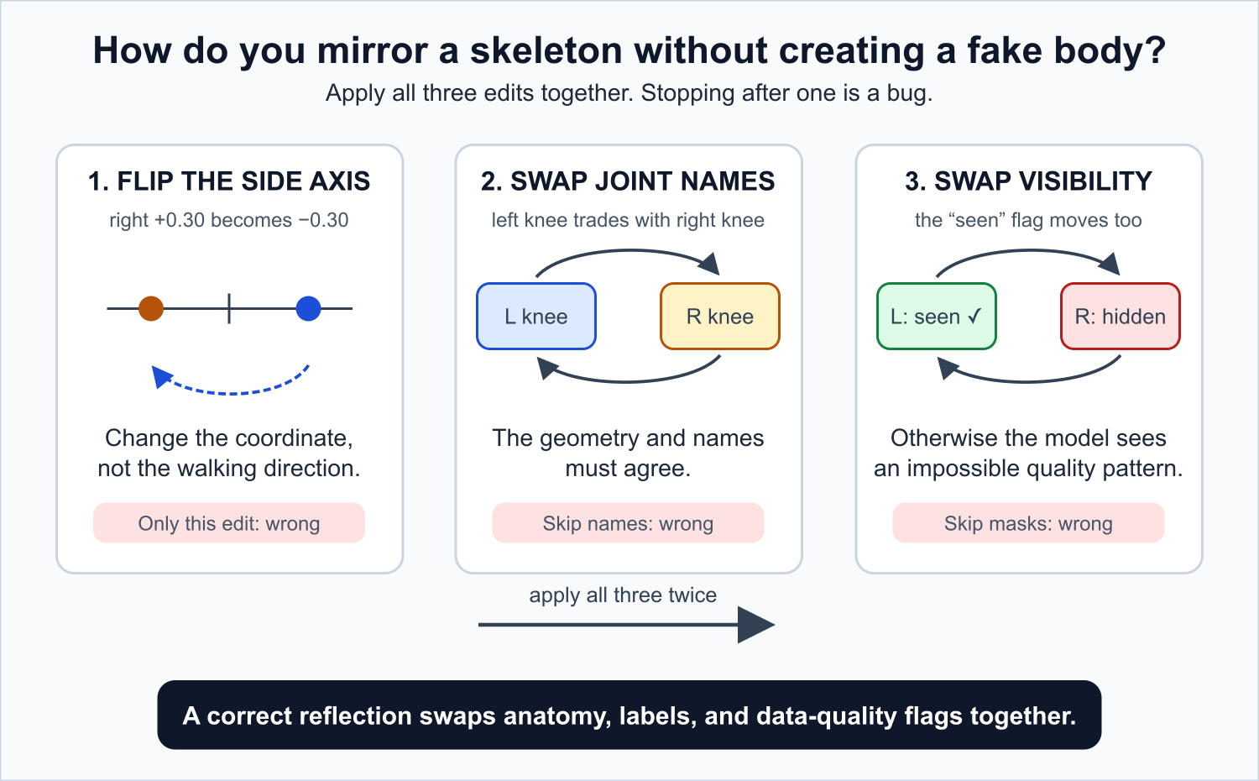
GEOMETRY
Anatomical reflection is not a camera move
​
​
Operator M
Negate the mediolateral coordinate; swap all five bilateral core-11 pairs; swap visibility/confidence; keep time, forward, and vertical unchanged.
​
M(Mx) = x
Involution unit test
​
s(Mx) = −s(x)
Odd signed target • camera view should stay ≈ invariant
Mirror swaps anatomy; camera motion changes projection, visibility, and estimation error.
GaitParity
07
Notes:
Emphasize the visibility-mask swap. Reflecting coordinates without masks creates impossible bodies and lets the model detect the synthetic operation instead of anatomy.
[Sources]
- /Users/theodoremui/dev/alexpose/experiments/sjepa/gavd6/notes/research/programs/gait_parity/METHODOLOGY.md
- /Users/theodoremui/dev/alexpose/experiments/sjepa/gavd6/notes/research/programs/gait_parity/images/reflection-operator-steps.svg

Slide 8
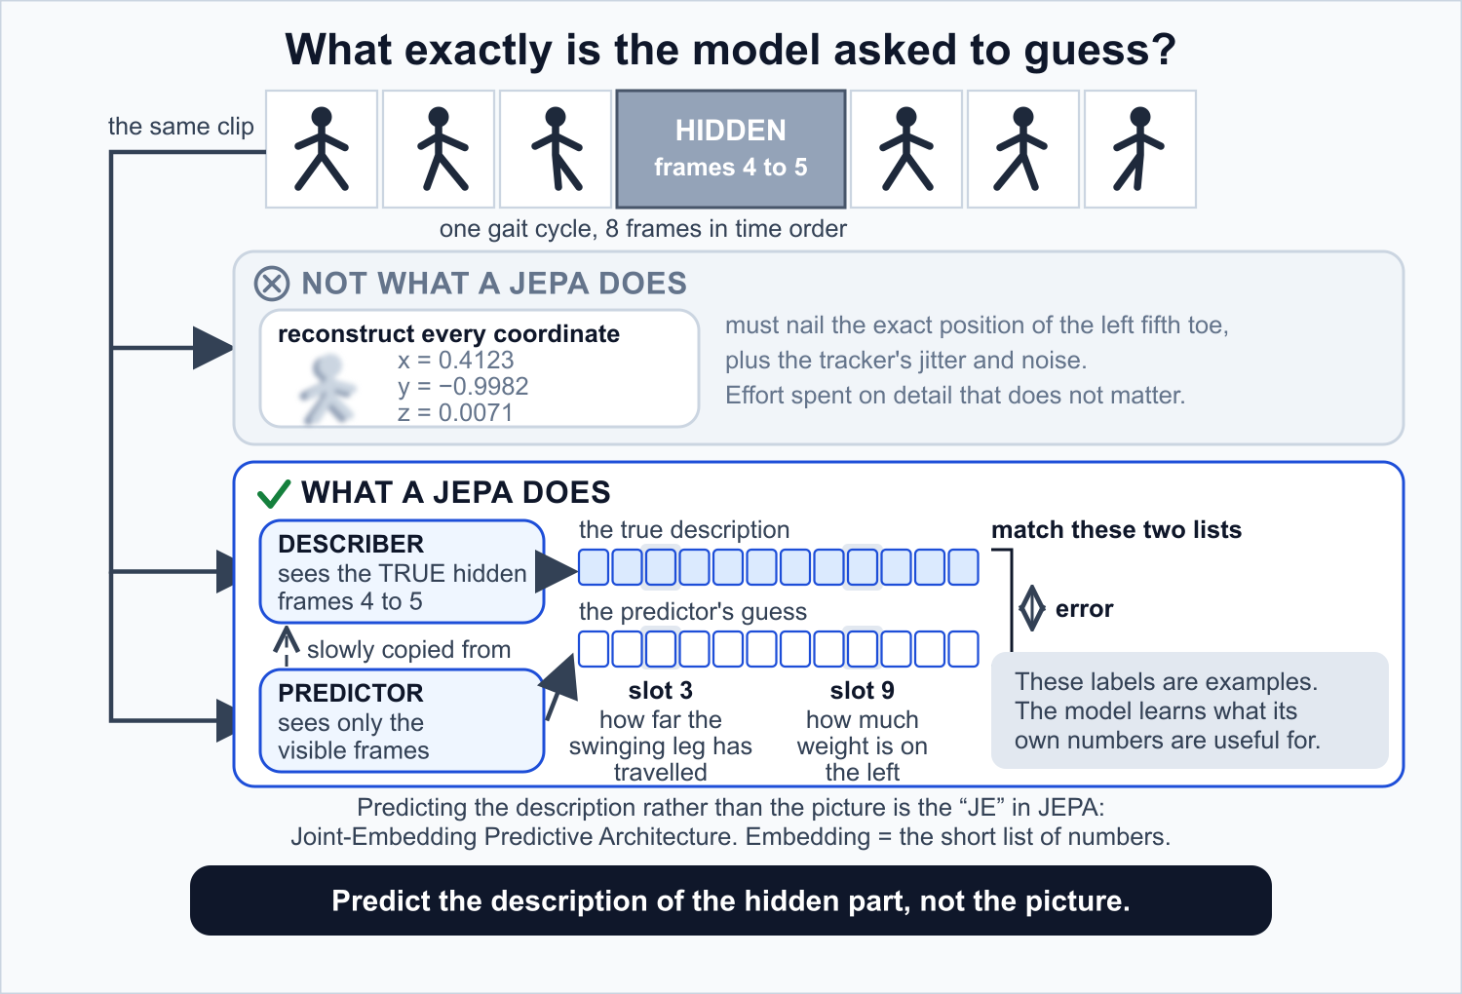
METHODOLOGY
JEPA predicts missing motion in representation space
​
Tokenize
1
64 frames → 16 four-frame patches × 11 joints
​
Mask
2
Hide valid spatiotemporal tokens; Stage 2 example uses 60%
​
Predict
3
Student context + predictor estimate hidden teacher latents
​
Update
4
Teacher encoder follows the student by exponential moving average
​
Audit
5
Variance, covariance rank, cosine similarity, and odd energy
​
No force labels, diagnosis labels, affected-side labels, or BABEL categories enter the pretraining batch.
GaitParity
08
Notes:
The objective is self-supervised: the model predicts a teacher representation of hidden motion, not the missing coordinates and not a clinical label.
[Sources]
- /Users/theodoremui/dev/alexpose/experiments/sjepa/gavd6/notes/research/programs/gait_parity/METHODOLOGY_LONG_TERM.md
- /Users/theodoremui/dev/alexpose/experiments/sjepa/gavd6/notes/research/programs/gait_parity/tutorials/05-two-stage-amass-training-overview.md
- /Users/theodoremui/dev/alexpose/experiments/sjepa/gavd6/notes/research/programs/gait_parity/images/what-a-jepa-predicts.svg
- https://doi.org/10.1007/978-3-031-73411-3_21
- https://arxiv.org/abs/2301.08243

Slide 9
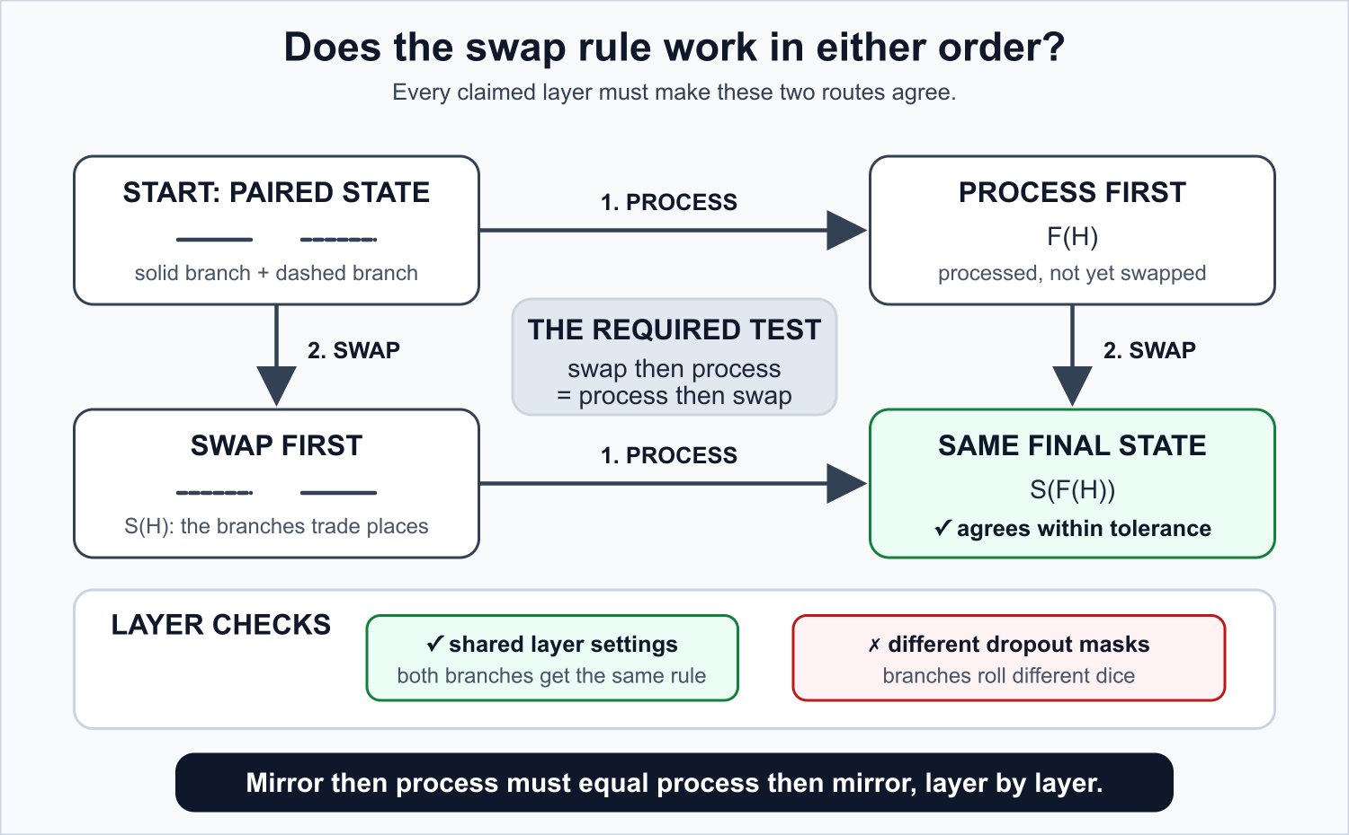
ARCHITECTURE
GaitParity lifts each walk into a two-element reflection orbit
​
H⁰(x) = [φ(x), φ(Mx)]
Mirroring x swaps the two branches—nothing more.
​
Fₗ(SH) = S Fₗ(H)
Swap then process = process then swap, at every layer.
•
Symmetric cross-branch interaction makes the paired interior meaningful.
•
Masks, dropout, normalization, positional encoding, and EMA teacher updates must preserve the swap action.
​
Naming rule
If a claimed layer fails the commutation test, the system is parity-regularized—not equivariant.
GaitParity
09
Notes:
The two-element group C2 makes the construction tractable. The scientific claim rests on layerwise numerical commutation tests, not on the architecture diagram.
[Sources]
- /Users/theodoremui/dev/alexpose/experiments/sjepa/gavd6/notes/research/programs/gait_parity/README_LONG_TERM.md
- /Users/theodoremui/dev/alexpose/experiments/sjepa/gavd6/notes/research/programs/gait_parity/METHODOLOGY_LONG_TERM.md
- /Users/theodoremui/dev/alexpose/experiments/sjepa/gavd6/notes/research/programs/gait_parity/images/long-term/commutation-square.svg
- https://proceedings.mlr.press/v48/cohenc16.html

Slide 10
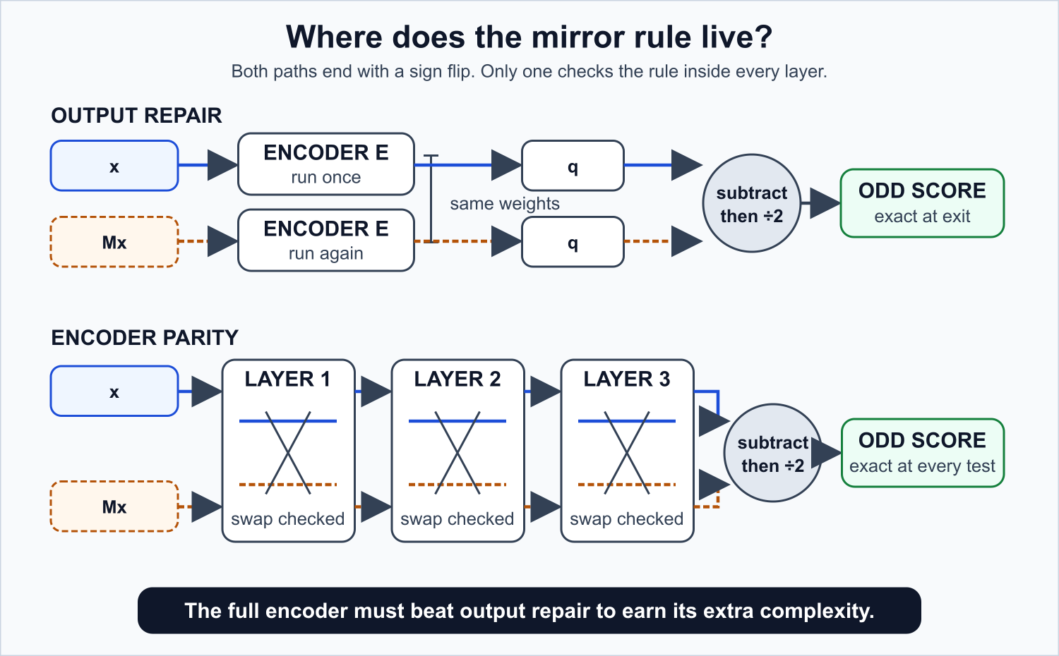
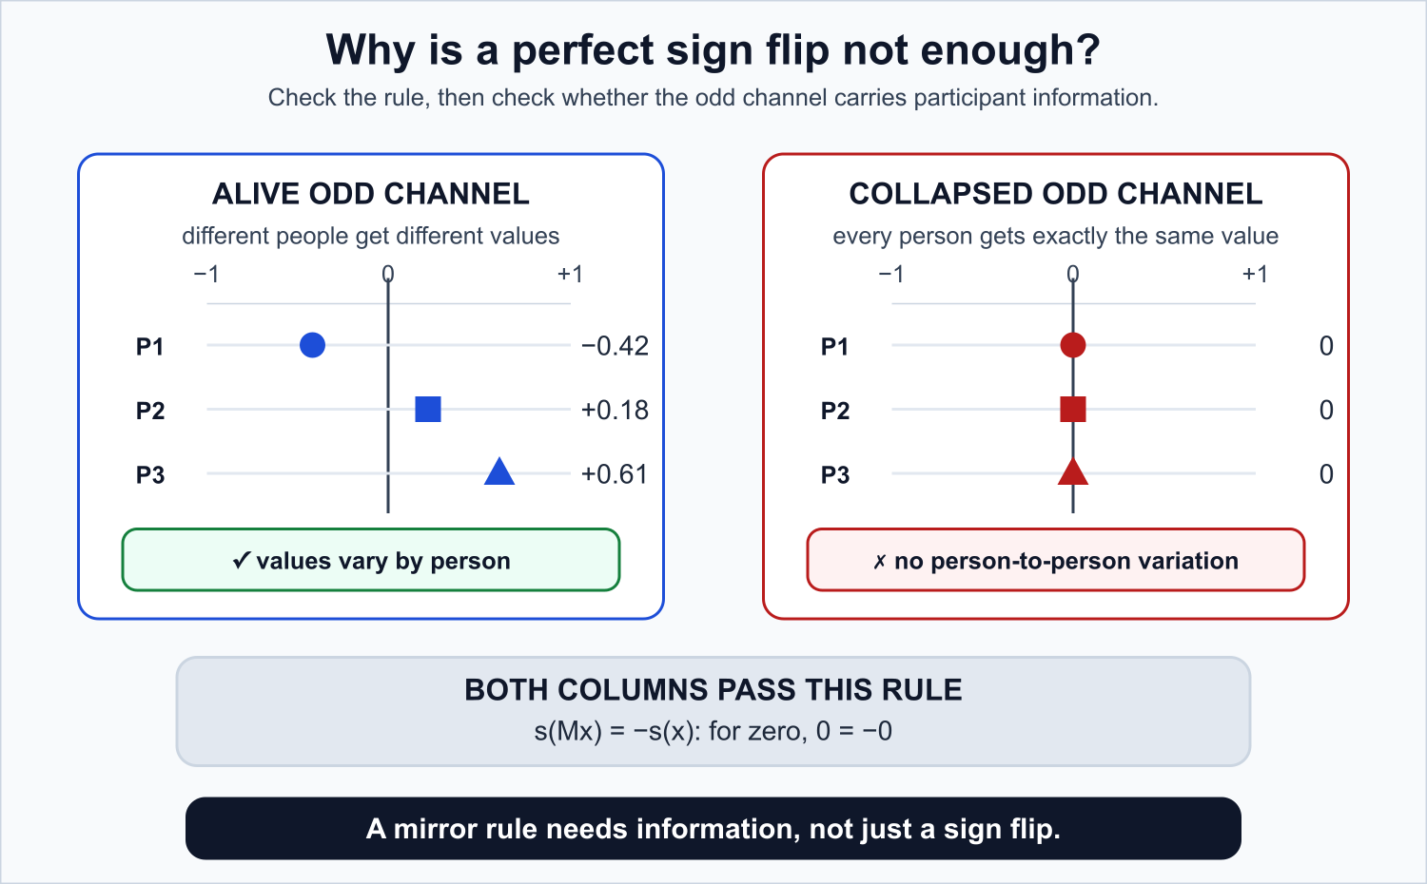
ARCHITECTURE
Exact oddness is easy; useful odd information is hard
​
h_even = (h_orig + h_mirr) / 2
h_odd = (h_orig − h_mirr) / 2
​
​
​
​
Control 1 • odd_output
Control 2 • paired control
Wrap any scalar predictor as [f(x) − f(Mx)]/2. It guarantees the final sign rule with no equivariant encoder.
Same two branches, cross-branch interaction, masks, compute, seeds, and outer odd wrapper—without swap-consistent tying.
​
Representation health gate
Odd-channel variance + covariance effective rank + energy by participant + masked prediction quality. Perfect mirror error with a zero channel is an invalid success.
GaitParity
10
Notes:
The co-primary comparisons are intentionally difficult. The equivariant encoder must beat both cheap output repair and an equally capable paired model without equivariant tying.
[Sources]
- /Users/theodoremui/dev/alexpose/experiments/sjepa/gavd6/notes/research/programs/gait_parity/README_LONG_TERM.md
- /Users/theodoremui/dev/alexpose/experiments/sjepa/gavd6/notes/research/programs/gait_parity/METHODOLOGY_LONG_TERM.md
- /Users/theodoremui/dev/alexpose/experiments/sjepa/gavd6/notes/research/programs/gait_parity/images/long-term/output-vs-encoder.svg
- /Users/theodoremui/dev/alexpose/experiments/sjepa/gavd6/notes/research/programs/gait_parity/images/long-term/collapse-trap.svg

Slide 11
TRAINING
Training is a two-stage, label-free curriculum
​
​
​
​
​
​
Stage 1 • broad AMASS
Traceable handoff
Stage 2 • BABEL walking
Convert participant-disjoint motion to core-11, index 64-frame windows, and train the three matched JEPA variants. Current inventory: 10,941 sequences / 308 candidate subjects; production identity audit and trainer remain to complete.
Load student, teacher, predictor, projector, centering state, and model buffers. Record the exact parent hash. Reset optimizer, learning-rate schedule, step counter, and early-stopping state.
Continue the same masked objective on clean walking intervals cut from the same AMASS universe. BABEL changes which windows are sampled; categories never enter the batch. Freeze the encoder before clinical readouts.
→
→
​
​
​
​
64 × 11 × 3
4 frames
60%
5 × 10⁻⁵
Frozen window and skeleton contract
Temporal patch size → 16 time patches
Stage 2 example mask fraction
Stage 2 example AdamW learning rate
​
Protocol status: the production AMASS converter, BABEL manifest builder, and full trainer are planned interfaces—not completed experiments.
GaitParity
11
Notes:
Treat the numeric configuration as a proposed starting point frozen through nonclinical development, not as validated hyperparameters. Preserve the implementation-status boundary visibly.
[Sources]
- /Users/theodoremui/dev/alexpose/experiments/sjepa/gavd6/notes/research/programs/gait_parity/tutorials/05-two-stage-amass-training-overview.md
- /Users/theodoremui/dev/alexpose/experiments/sjepa/gavd6/notes/research/programs/gait_parity/tutorials/06-stage-1-broad-amass-pretraining.md
- /Users/theodoremui/dev/alexpose/experiments/sjepa/gavd6/notes/research/programs/gait_parity/tutorials/07-stage-2-walking-focused-continuation.md

Slide 12
TRAINING
Architecture comparisons must isolate the mechanism
Held constant | Why it matters
Participants, source motions, window order | Prevents one variant from receiving easier movement data
Original/mirror exposure + token masks | Separates architecture from augmentation or masking luck
Embedding width, effective depth, parameters | Prevents capacity from masquerading as parity
Optimizer, schedule, updates, stopping | Prevents extra training from becoming the result
Teacher update, regularization, augmentation | Keeps the JEPA objective comparable
Paired seeds: 7 vs 7, 17 vs 17, 29 vs 29 | Measures architecture rather than best-of-seed luck
​
​
Exposure-matched
Same original windows, mirrored windows, masked tokens, and update count. GPU cost may differ.
​
​
Compute-matched
Same prespecified compute allowance. Windows or updates may differ. Report FLOPs, throughput, wall time, memory, and inference cost.
​
Planned family
3 variants × 3 paired seeds × 2 stages × 2 matching regimes = 36 runs
GaitParity
12
Notes:
One comparison cannot match data exposure and GPU cost simultaneously. The deck therefore names both regimes and never implies a match that was not achieved.
[Sources]
- /Users/theodoremui/dev/alexpose/experiments/sjepa/gavd6/notes/research/programs/gait_parity/METHODOLOGY_LONG_TERM.md
- /Users/theodoremui/dev/alexpose/experiments/sjepa/gavd6/notes/research/programs/gait_parity/tutorials/05-two-stage-amass-training-overview.md

Slide 13
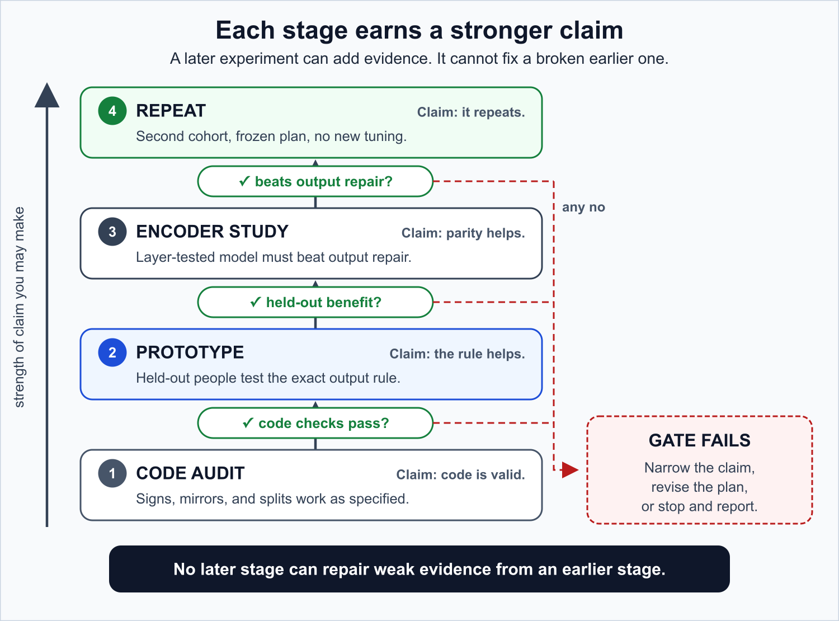
EXPERIMENTS
Each dataset answers one question—and no more
Dataset | Scientific role | Hard claim limit
GAVD | Code + geometry audit | Transductive; no participant IDs; coordinate-derived target
AMASS | Nonclinical pretraining | No clinical or fall-risk claim
MoVi | Calibrated real-view sensitivity | Geometry/robustness only
Stroke cohort | Primary signed force test | Utility on held-out participants
Parkinson cohort | Locked replication | Replication, not zero-shot transfer
Future falls cohort | Prospective outcome validation | Required before a fall-risk claim
​
Only independent, participant-held-out force can establish utility.
GaitParity
13
Notes:
The ladder prevents a common narrative error: using exact geometry or a transductive audit to imply clinical utility.
[Sources]
- /Users/theodoremui/dev/alexpose/experiments/sjepa/gavd6/notes/research/programs/gait_parity/METHODOLOGY.md
- /Users/theodoremui/dev/alexpose/experiments/sjepa/gavd6/notes/research/programs/gait_parity/METHODOLOGY_LONG_TERM.md
- /Users/theodoremui/dev/alexpose/experiments/sjepa/gavd6/notes/research/programs/gait_parity/images/research-ladder.svg
- https://doi.org/10.1038/s41597-023-02767-y
- https://doi.org/10.1109/ICCV.2019.00553
- https://doi.org/10.1371/journal.pone.0253157

Slide 14
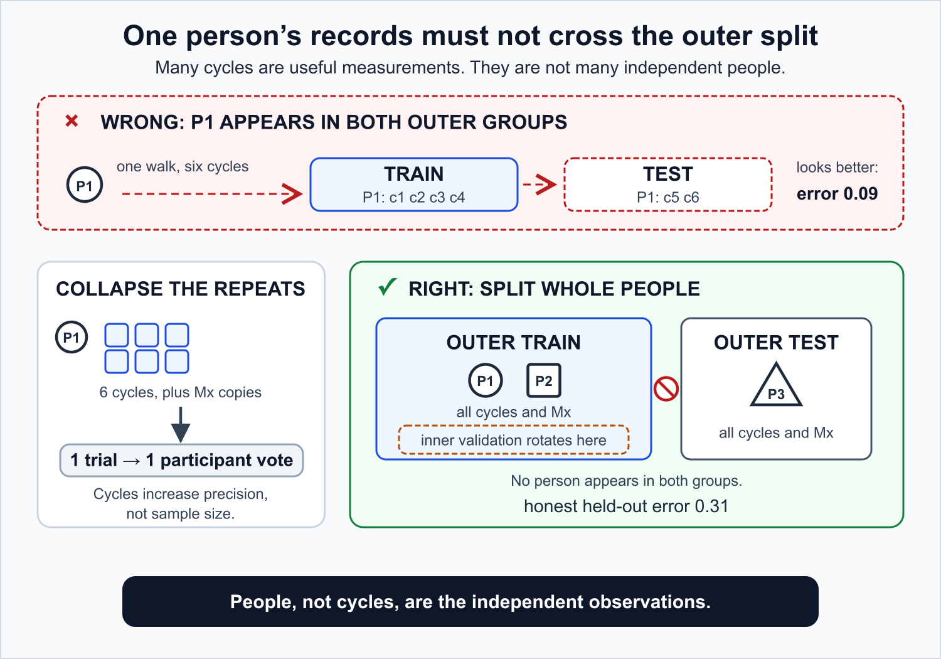
EXPERIMENTS
Generalization is tested on people—not clips
​
​
Nested participant split
Outer fold holds out one participant group. Inner grouped folds tune the readout. The outer person never influences preprocessing, representation selection, or hyperparameters.
​
​
Label-efficiency ladder
Use nested 4, 8, 16, and all-participant training prefixes; repeat fixed side/severity-stratified orderings and average repeats within participant.
​
​
One independent unit
Score original and synthetic mirror equally, average to one participant-orbit loss, then resample whole participants for uncertainty.
​
Force gate: ≥30 eligible stroke participants after all screens, with ≥4 usable contacts per side for repeatability.
GaitParity
14
Notes:
Random clip splits are unacceptable because clips from the same person and capture setting can leak across evaluation. The inferential unit is the participant.
[Sources]
- /Users/theodoremui/dev/alexpose/experiments/sjepa/gavd6/notes/research/programs/gait_parity/METHODOLOGY.md
- /Users/theodoremui/dev/alexpose/experiments/sjepa/gavd6/notes/research/programs/gait_parity/METHODOLOGY_LONG_TERM.md
- /Users/theodoremui/dev/alexpose/experiments/sjepa/gavd6/notes/research/programs/gait_parity/images/participant-safe-split.svg

Slide 15
EXPERIMENTS
Success is predeclared as a chain of evidence
​
​
​
​
G1 • Exact geometry
G2 • Alive representation
Layerwise swap residuals in train/eval mode; output oddness for every signed model.
Variance, effective rank, cosine similarity, even/odd energy, JEPA prediction quality.
​
​
​
​
G3 • Predictive signal
G4 • Robust utility
Participant-orbit force MAE primary; NMAE, R², CCC, sign accuracy, calibration secondary.
Label-budget AULC, real-view drift, coordinate/missingness/temporal corruption, schema reduction.
​
Tier 5 decision
At the full label budget, equivariant_encoder must lower participant-orbit force MAE versus both odd_output and paired_unconstrained, using simultaneous 97.5% intervals and a reliability-based δMAE threshold.
GaitParity
15
Notes:
Do not compress the result to one conjunctive pass/fail. Report the highest supported tier and the specific gate that failed.
[Sources]
- /Users/theodoremui/dev/alexpose/experiments/sjepa/gavd6/notes/research/programs/gait_parity/METHODOLOGY_LONG_TERM.md
- /Users/theodoremui/dev/alexpose/experiments/sjepa/gavd6/notes/research/programs/gait_parity/README_LONG_TERM.md

Slide 16
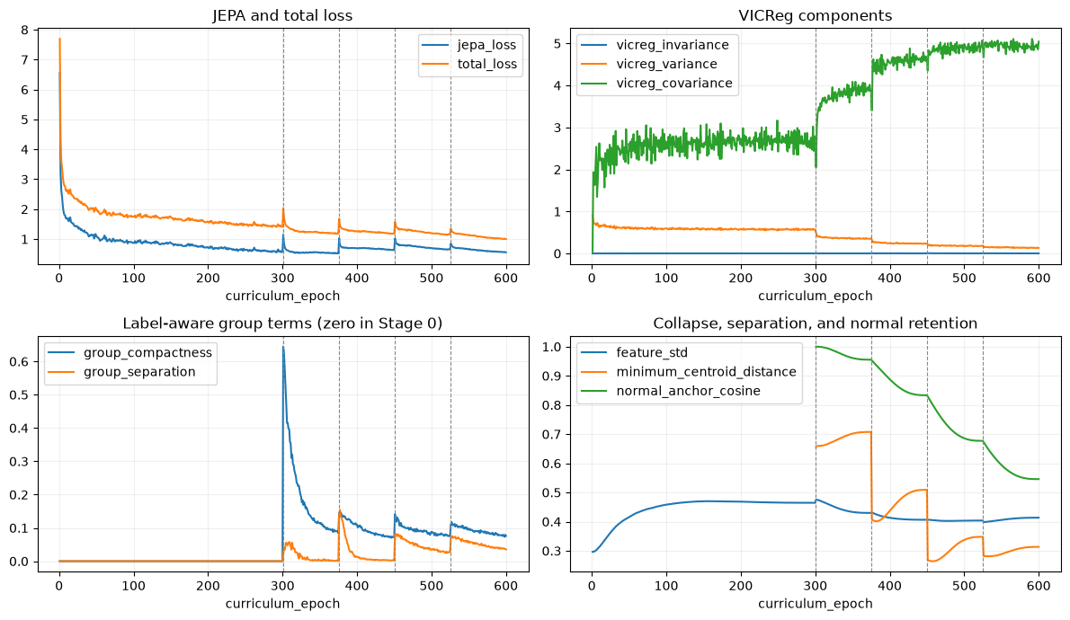
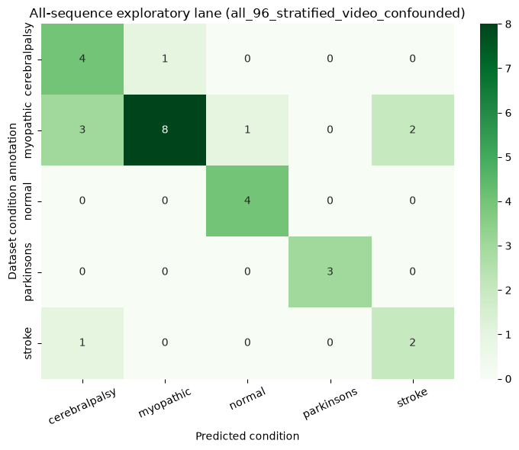
CURRENT EVIDENCE
First result: self-supervised training learns nontrivial motion
What this supports
•
Optimization loss moves in the expected direction.
•
Feature variation persists; the encoder is not obviously constant.
•
Folder-label separation remains confounded by source, camera, and exposure.
Exact notebook outputs • development collection • not unseen-person or force evidence
GaitParity
16
Notes:
The first result is optimization competence, not disease understanding. State that boundary before discussing the classifier visualization.
[Sources]
- /Users/theodoremui/dev/alexpose/experiments/sjepa/gavd6/notebooks/foundations/04_pretrain_sjepa_on_normal.ipynb
- /Users/theodoremui/dev/alexpose/experiments/sjepa/gavd6/notebooks/foundations/06_capstone_health_condition_classifiers.ipynb
- /Users/theodoremui/dev/alexpose/experiments/sjepa/gavd6/notes/research/programs/gait_parity/tutorials/01-foundations-notebooks-00-06.md
- /Users/theodoremui/dev/alexpose/experiments/sjepa/gavd6/notes/research/programs/gait_parity/tutorials/04-notebook-graph-guide.md
- /Users/theodoremui/dev/alexpose/experiments/sjepa/gavd6/notes/research/programs/gait_parity/tutorials/images/notebook-04-curriculum-diagnostics.png
- /Users/theodoremui/dev/alexpose/experiments/sjepa/gavd6/notes/research/programs/gait_parity/tutorials/images/notebook-06-all-sequence-confusion.png

Slide 17
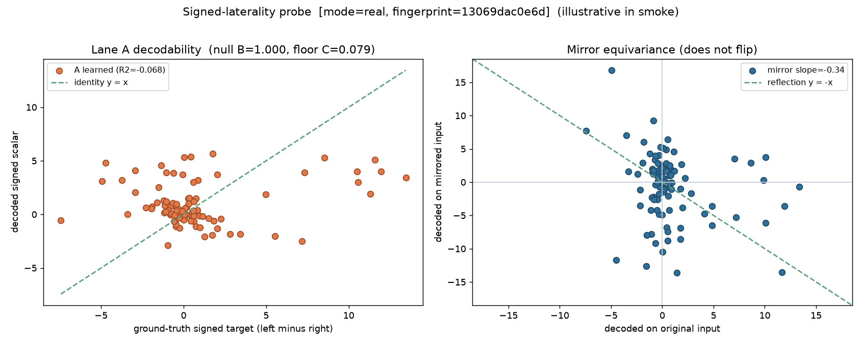
CURRENT EVIDENCE
Second result: the historical representation lacks a signed axis
Test | Saved result
Held-out-source decoding | R² = −0.068
Mirror slope | −0.34; target ≈ −1
Verdict | Informative null
Claim ceiling | Transductive audit
​
Why the null matters
This checkpoint + simple readout did not recover a useful signed direction. The result justifies a representation whose parity is explicit and testable.
Exact output from idea05_signed_laterality/01_probe.ipynb
GaitParity
17
Notes:
Treat the null as a scientific result: it rules out the easiest story that the old representation already contained a clean signed gait direction.
[Sources]
- /Users/theodoremui/dev/alexpose/experiments/sjepa/gavd6/notebooks/experiments/idea05_signed_laterality/01_probe.ipynb
- /Users/theodoremui/dev/alexpose/experiments/sjepa/gavd6/notes/research/programs/gait_parity/tutorials/02-current-direction-and-results.md
- /Users/theodoremui/dev/alexpose/experiments/sjepa/gavd6/notes/research/programs/gait_parity/tutorials/04-notebook-graph-guide.md
- /Users/theodoremui/dev/alexpose/experiments/sjepa/gavd6/notes/research/programs/gait_parity/tutorials/images/notebook-05a-signed-laterality-probe.png

Slide 18
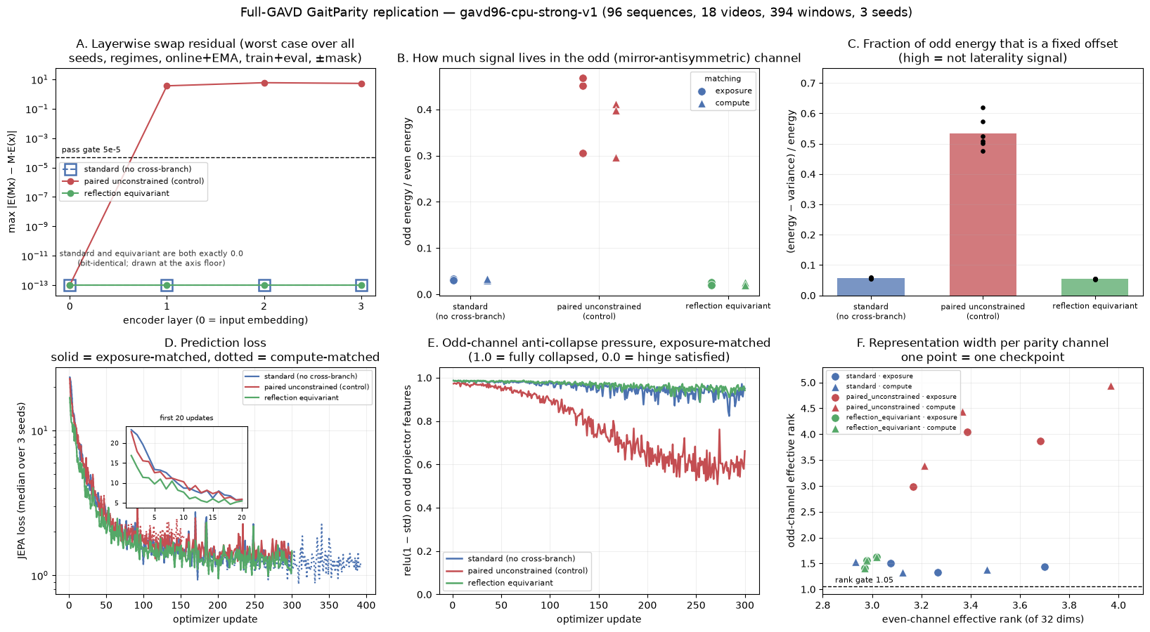
CURRENT EVIDENCE
Third result: the controlled audit detects broken geometry
​
​
​
0.0
≈5.9
96 / 18 / 394
Equivariant residual • worst checked
Unconstrained residual • audit power
Sequences / videos / windows • 3 seeds
Geometry is validated locally; force utility, unseen-person generalization, and fall-risk value remain unknown.
GaitParity
18
Notes:
The unrestricted control is crucial: it proves that the audit can fail when the geometry is actually broken. This is feasibility, not utility.
[Sources]
- /Users/theodoremui/dev/alexpose/experiments/sjepa/gavd6/notebooks/experiments/idea09_reflection_equivariance/05_gavd_audit.ipynb
- /Users/theodoremui/dev/alexpose/experiments/sjepa/gavd6/notebooks/experiments/idea09_reflection_equivariance/06_cpu_replication.ipynb
- /Users/theodoremui/dev/alexpose/experiments/sjepa/gavd6/work/artifacts/gait_parity/real/gavd96-cpu-strong-v1/exposure/checkpoint_audit.json
- /Users/theodoremui/dev/alexpose/experiments/sjepa/gavd6/work/artifacts/gait_parity/real/gavd96-cpu-strong-v1/exposure/checkpoint_geometry.csv
- /Users/theodoremui/dev/alexpose/experiments/sjepa/gavd6/notes/research/programs/gait_parity/tutorials/02-current-direction-and-results.md
- /Users/theodoremui/dev/alexpose/experiments/sjepa/gavd6/notes/research/programs/gait_parity/tutorials/04-notebook-graph-guide.md
- /Users/theodoremui/dev/alexpose/experiments/sjepa/gavd6/notes/research/programs/gait_parity/tutorials/images/notebook-09f-full-gavd-audit.png

Slide 19
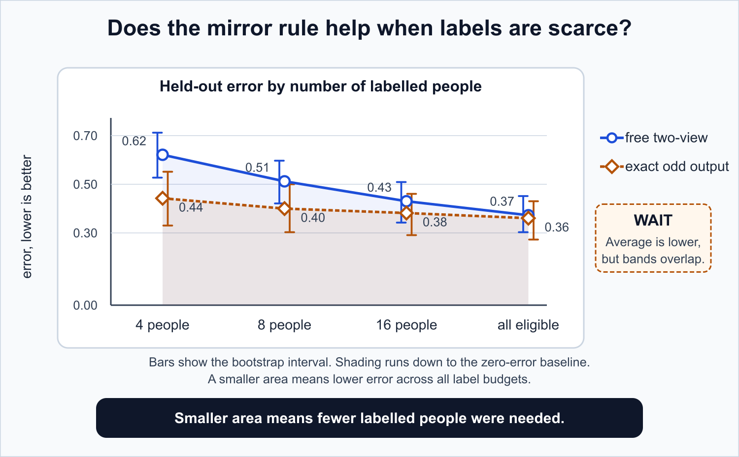
FUTURE WORK
The decisive experiment moves from geometry to force
​
Audit force
1
Verify bilateral contacts, repeatability, and ≥30 eligible stroke participants.
​
Freeze encoders
2
Complete matched AMASS Stage 1 + BABEL walking Stage 2 checkpoints.
​
Run the primary test
3
Nested held-out stroke force prediction versus odd_output and paired_unconstrained.
​
Stress the measurement
4
MoVi real views, coordinate/missingness/temporal corruption, and reduced joint sets.
​
Extend the claim
5
Locked Parkinson replication; only then design prospective fall-outcome validation.
​
Stop rule: if equivariance does not beat both decisive controls on independent force, do not elevate it to a fall-risk model.
GaitParity
19
Notes:
Future fall validation should ask whether force-informed, side-aware gait signatures add prospective information beyond established gait and balance measures—not assume that they will.
[Sources]
- /Users/theodoremui/dev/alexpose/experiments/sjepa/gavd6/notes/research/programs/gait_parity/README_LONG_TERM.md
- /Users/theodoremui/dev/alexpose/experiments/sjepa/gavd6/notes/research/programs/gait_parity/METHODOLOGY_LONG_TERM.md
- /Users/theodoremui/dev/alexpose/experiments/sjepa/gavd6/notes/research/programs/gait_parity/images/label-efficiency.svg
- https://pubmed.ncbi.nlm.nih.gov/9063277/
- https://pmc.ncbi.nlm.nih.gov/articles/PMC2709543/

Slide 20
​
CLOSING THESIS
GaitParity is not a fall detector.
It is the representation test required before side-aware video gait can become a credible balance measure.
Balance
Parity
Independent force
→
→
needs side-specific mechanics
supplies predictable geometry
decides whether it is useful
Geometry first. Force next. Falls only after prospective validation.
Notes:
End on the scientific sequence. The contribution is credible only if the talk preserves the distinction between a geometrically correct representation, a useful biomechanical estimator, and a clinically validated fall-risk tool.
[Sources]
- /Users/theodoremui/dev/alexpose/experiments/sjepa/gavd6/notes/research/programs/gait_parity/README_LONG_TERM.md
- /Users/theodoremui/dev/alexpose/experiments/sjepa/gavd6/notes/research/programs/gait_parity/METHODOLOGY_LONG_TERM.md

