Slide 1
ADVANCED HIGH-SCHOOL RESEARCH TALK
GaitParity: Teaching AI Which Side of the Body Is Which
A mirror test for movement models—and a path from video skeletons toward trustworthy biomechanics.
Question → physical rule → controlled audit → force-plate study → physics-grounded world model
Notes:
Open with the scientific question: can a movement model keep left and right straight when the body is mirrored?
[Sources]
- /Users/theodoremui/Downloads/GaitParity Study.pdf
- /Users/theodoremui/dev/alexpose/experiments/sjepa/gavd6/notes/research/programs/gait_parity/tutorials/02-current-direction-and-results.md

Slide 2
MOTIVATION
Why left and right are not interchangeable
The same movement can look similar while each leg contributes very differently.
BIOMECHANICS
AMBIENT INTELLIGENCE
Balance is often a side-to-side problem
Cameras can create a false side change
After stroke, one leg may push less or support the body differently.
Force plates measure that difference. Video alone can hide it.
A flipped feed, a new viewpoint, or a missing heel can make the same person look different.
A useful room-scale system must separate anatomy from observation.
A body mirror should flip a signed asymmetry. A camera move should not.
02
Notes:
[Sources]
- /Users/theodoremui/Downloads/GaitParity Study.pdf
- /Users/theodoremui/dev/alexpose/experiments/sjepa/gavd6/notes/research/programs/gait_parity/METHODOLOGY.md

Slide 3
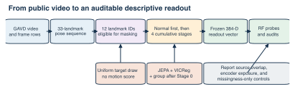
PREVIOUS WORK
The earlier project built a complete motion pipeline
Public gait video became a fixed-length skeleton sequence, then a self-supervised motion representation.
96 canonical sequences came from 18 source videos. The source video—not the clip—is the real independence boundary.
03
Notes:
[Sources]
- /Users/theodoremui/dev/alexpose/experiments/sjepa/gavd6/notebooks/foundations/01_gavd_manifest_and_youtube.ipynb
- /Users/theodoremui/dev/alexpose/experiments/sjepa/gavd6/slides/gait_parity_decks/images/prior-sjepa-pipeline.svg

Slide 4
METHOD
S-JEPA learns by predicting what was hidden
The model does not reconstruct pixels. It predicts a useful representation of missing movement.
01
02
03
04
Observe
Hide
Predict
Audit
→
→
→
64 frames
33 body landmarks
visibility carried along
Mask selected joints and times without inventing a fake injury
Use visible motion to predict the hidden target features
Check feature variation, confounds, splits, and downstream readouts
The objective teaches motion structure. It does not automatically teach physics or left–right meaning.
04
Notes:
[Sources]
- /Users/theodoremui/dev/alexpose/experiments/sjepa/gavd6/notebooks/foundations/04_pretrain_sjepa_on_normal.ipynb
- /Users/theodoremui/dev/alexpose/experiments/sjepa/gavd6/notes/research/programs/gait_parity/METHODOLOGY.md

Slide 5
PREVIOUS RESULTS
The training run learned—but did not become a diagnosis
The representation stayed varied and the prediction loss fell substantially.
6.56 → 0.59
.296 → .465
0.414
JEPA loss
feature spread
final feature std
Normal-only Stage 0, 300 epochs
Evidence against total constant collapse
After five condition-aware stages
What this supports
The learning system ran correctly and produced nontrivial features. These are training-health results—not clinical validation.
05
Notes:
[Sources]
- /Users/theodoremui/dev/alexpose/experiments/sjepa/gavd6/notebooks/foundations/04_pretrain_sjepa_on_normal.ipynb

Slide 6
PREVIOUS RESULTS
Condition labels were readable inside the exposed corpus
The harder question is whether the same signal survives new source videos and new people.
READ CAREFULLY
Useful signal, limited claim
All-96 five-class accuracy: 0.724
Grouped normal-vs-abnormal: 0.843
The encoder had still seen every held-out classifier row. This is not unseen-person performance.
06
Notes:
[Sources]
- /Users/theodoremui/dev/alexpose/experiments/sjepa/gavd6/notebooks/foundations/06_capstone_health_condition_classifiers.ipynb

Slide 7
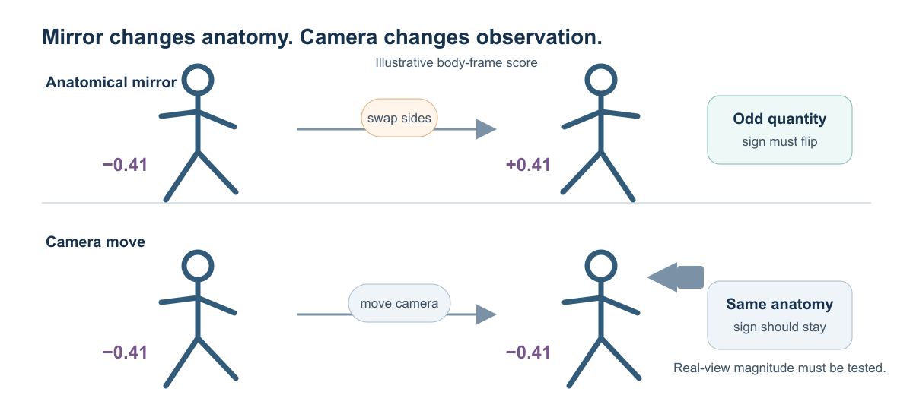
GAITPARITY
The anatomical mirror creates a testable rule
Mirroring the body exchanges anatomy. Moving the camera only changes how the same anatomy is observed.
Overall pace should stay similar. A right-minus-left quantity must reverse sign.
07
Notes:
[Sources]
- /Users/theodoremui/dev/alexpose/experiments/sjepa/gavd6/notes/research/programs/gait_parity/METHODOLOGY.md
- /Users/theodoremui/dev/alexpose/experiments/sjepa/gavd6/slides/gait_parity_decks/images/mirror-versus-camera.svg

Slide 8
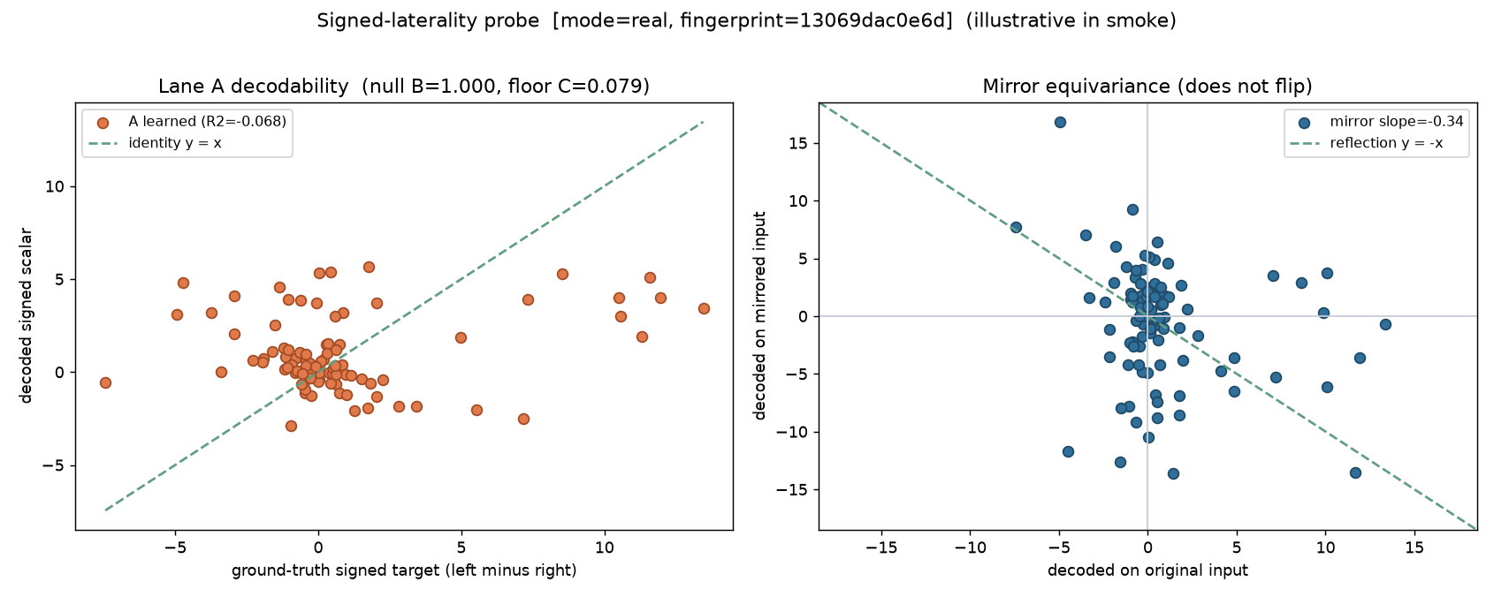
GAITPARITY RESULT 1
The first signed-laterality test failed
A simple reader could not recover the constructed left–right score from the old representation.
Learned R² = −0.068 · mirror slope = −0.337, not near −1 · sign consistency = 0.444
08
Notes:
Call this an informative null result: it stops the project from presenting a weak side signal as a discovery.
[Sources]
- /Users/theodoremui/dev/alexpose/experiments/sjepa/gavd6/artifacts/notebook_runs/organized-2026-08-23/experiments/idea05_signed_laterality/01_probe.ipynb
- /Users/theodoremui/dev/alexpose/experiments/sjepa/gavd6/slides/gait_parity_decks/images/notebook-05a-signed-laterality-probe.png

Slide 9
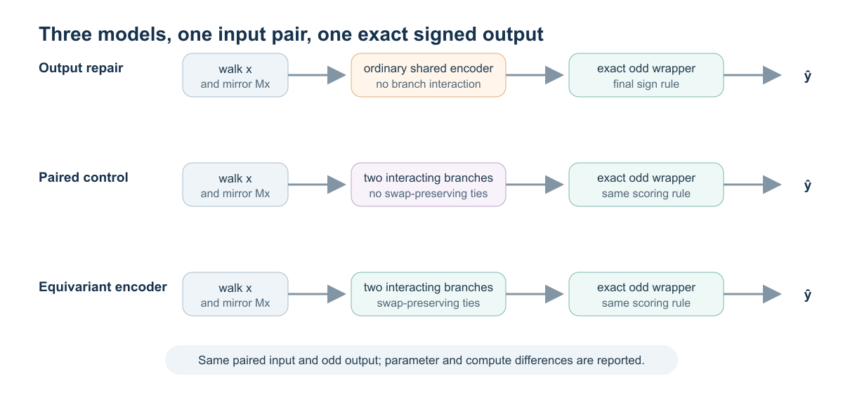
GAITPARITY METHOD
The next experiment compares three matched models
The hard baseline is not an ordinary model. Three lines of arithmetic can already force the final answer to flip.
The equivariant model must beat output repair and equally capable two-branch fusion—not merely a weaker one-view model.
09
Notes:
[Sources]
- /Users/theodoremui/dev/alexpose/experiments/sjepa/gavd6/notes/research/programs/gait_parity/README_LONG_TERM.md
- /Users/theodoremui/dev/alexpose/experiments/sjepa/gavd6/slides/gait_parity_decks/images/model-comparisons.svg

Slide 10
GAITPARITY RESULT 2
The controlled audit can detect broken mirror geometry
Across matched runs, the equivariant encoder followed the rule exactly; the unrestricted control did not.
CHANNEL HEALTH
Exact—and non-empty
Odd/even energy ratio 0.022
Odd effective rank 1.532
All registered health gates passed
BOUNDARY
A geometry result
96 sequences · 18 videos · 394 windows · 3 seeds
No force target. No participant-held-out clinical endpoint.
Lower is better; pass gate = 5×10⁻⁵
10
Notes:
[Sources]
- /Users/theodoremui/dev/alexpose/experiments/sjepa/gavd6/artifacts/notebook_runs/organized-2026-08-23/experiments/idea09_reflection_equivariance/06_cpu_replication.ipynb
- /Users/theodoremui/dev/alexpose/experiments/sjepa/gavd6/slides/gait_parity_decks/images/notebook-09f-full-gavd-audit.png

Slide 11
DISCUSSION
What the current evidence supports—and where it stops
Passing a rule is not the same as solving a biomechanical task.
SUPPORTED NOW
NOT YET SUPPORTED
A trustworthy research instrument
A useful clinical measurement
✓ Correct anatomical reflection
✓ Exact layerwise swap behavior
✓ Audit catches the unrestricted control
✓ Odd channel passes registered health gates
No force-plate target
No participant-held-out endpoint
No balance or diagnosis result
No GPU replication result
The honest claim is engineering feasibility plus a clear reason to run the force-plate study.
11
Notes:
[Sources]
- /Users/theodoremui/dev/alexpose/experiments/sjepa/gavd6/artifacts/notebook_runs/organized-2026-08-23/experiments/idea09_reflection_equivariance/06_cpu_replication.ipynb
- /Users/theodoremui/dev/alexpose/experiments/sjepa/gavd6/notes/research/programs/gait_parity/tutorials/02-current-direction-and-results.md

Slide 12
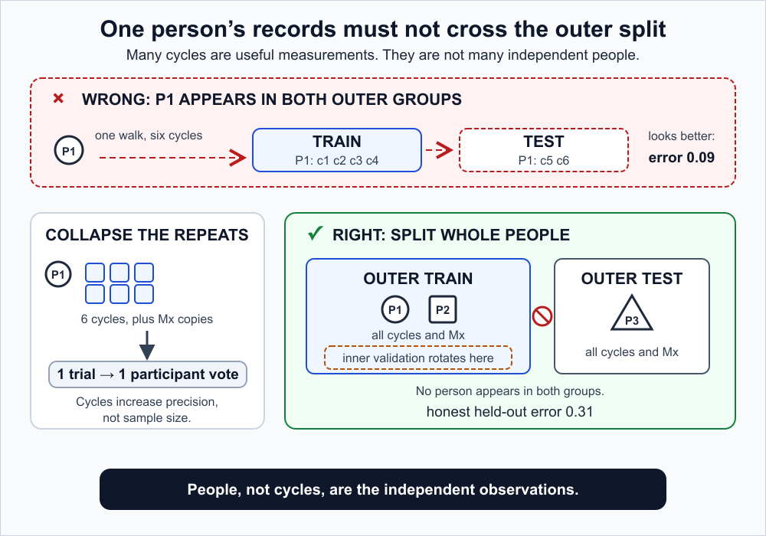
PLANNED STUDY
The decisive study gives one person one vote
All cycles from one participant stay together during training, tuning, and testing.
Primary question: does the equivariant encoder reduce participant-level force MAE beyond output repair and the paired control?
12
Notes:
[Sources]
- /Users/theodoremui/dev/alexpose/experiments/sjepa/gavd6/notes/research/programs/gait_parity/METHODOLOGY.md
- /Users/theodoremui/dev/alexpose/experiments/sjepa/gavd6/notes/research/programs/gait_parity/tutorials/03-planned-research-direction.md
- /Users/theodoremui/dev/alexpose/experiments/sjepa/gavd6/slides/gait_parity_decks/images/participant-safe-split.svg

Slide 13
FUTURE WORK
Future direction: a physics-grounded movement world model
GaitParity can become one structural rule inside a larger Biomech-JEPA that represents the body, scene, contact, dynamics, and uncertainty.
OBSERVE
CANONICAL STATE
BIOMECH-JEPA
PHYSICS CHECK
ACT
RGB video
Depth
Wearables
→
Body · scene
Contact · dynamics
Uncertainty
→
Mask and predict
Future state
Counterfactual state
→
OpenSim / robot sim
Force residuals
Groundedness
→
Estimate
Generate
Ask tools
The first decisive experiment should start from clean biomechanical state—not raw video.
Then bridge to ambient video with depth, segmentation, monocular motion, simulation teachers, and an active Qwen tool agent.
13
Notes:
[Sources]
- User-provided research mentor meeting notes, 2026-08-23
- /Users/theodoremui/dev/alexpose/experiments/sjepa/gavd6/notes/research/programs/gait_parity/README_LONG_TERM.md
- /Users/theodoremui/dev/alexpose/experiments/sjepa/gavd6/notes/research/programs/gait_parity/tutorials/03-planned-research-direction.md

Slide 14
CONCLUSION
The mirror rule turns a vague goal into a falsifiable study
We are not yet estimating force from everyday video. We now have a precise rule, a model that follows it, and an experiment that can decide whether it matters.
LEARNED
FIXED
NEXT
Motion structure
Left–right geometry
Physical meaning
Earlier S-JEPA runs produced nontrivial but confounded representations.
The equivariant encoder passes the exact mirror contract across matched audits.
Force plates and new participants must test whether structure becomes useful.
A stronger claim requires a stronger gate.
14
Notes:
[Sources]
- /Users/theodoremui/dev/alexpose/experiments/sjepa/gavd6/notes/research/programs/gait_parity/tutorials/02-current-direction-and-results.md
- /Users/theodoremui/dev/alexpose/experiments/sjepa/gavd6/notes/research/programs/gait_parity/tutorials/03-planned-research-direction.md
- User-provided research mentor meeting notes, 2026-08-23

