Slide 1
GENERAL AUDIENCE RESEARCH BRIEFING
GaitParity: From Movement Video to Trustworthy Left–Right Gait Measures
A reflection-aware world model for biomechanics and ambient intelligence—built with explicit tests for what it knows.
Current result: exact mirror geometry. Next test: participant-held-out force-plate prediction.
Notes:
[Sources]
- /Users/theodoremui/Downloads/GaitParity Study.pdf
- /Users/theodoremui/dev/alexpose/experiments/sjepa/gavd6/notes/research/programs/gait_parity/tutorials/02-current-direction-and-results.md

Slide 2
MOTIVATION
The opportunity is measurement outside the lab
Ambient cameras can observe many more steps than a short clinical visit—but observation is not mechanics.
SCALE
MEANING
TRUST
Everyday movement
Which side contributes?
Separate body from camera
Homes and clinics could observe how gait changes across days, fatigue, medication, or recovery.
Balance and propulsion depend on what each leg does—not only where landmarks appear in the image.
A flipped image, new viewpoint, or occluded heel must not become a false biomechanical change.
The system needs physical movement understanding, not just pose tracking.
02
Notes:
[Sources]
- /Users/theodoremui/Downloads/GaitParity Study.pdf
- /Users/theodoremui/dev/alexpose/experiments/sjepa/gavd6/notes/research/programs/gait_parity/METHODOLOGY.md

Slide 3
MOTIVATION
A side error has two different consequences
BIOMECHANICS / BALANCE
AMBIENT INTELLIGENCE
Wrong sign, wrong interpretation
Wrong cause, wrong action
A right-minus-left measure tells us which side contributes more. If the sign silently flips, the result can point to the wrong limb or hide compensation.
An ambient system must know whether the person changed, the camera changed, or the pose estimator simply lost a landmark.
GaitParity isolates the first requirement with an anatomical-mirror test.
03
Notes:
[Sources]
- /Users/theodoremui/dev/alexpose/experiments/sjepa/gavd6/notes/research/programs/gait_parity/METHODOLOGY.md
- /Users/theodoremui/dev/alexpose/experiments/sjepa/gavd6/notes/research/programs/gait_parity/README_LONG_TERM.md

Slide 4
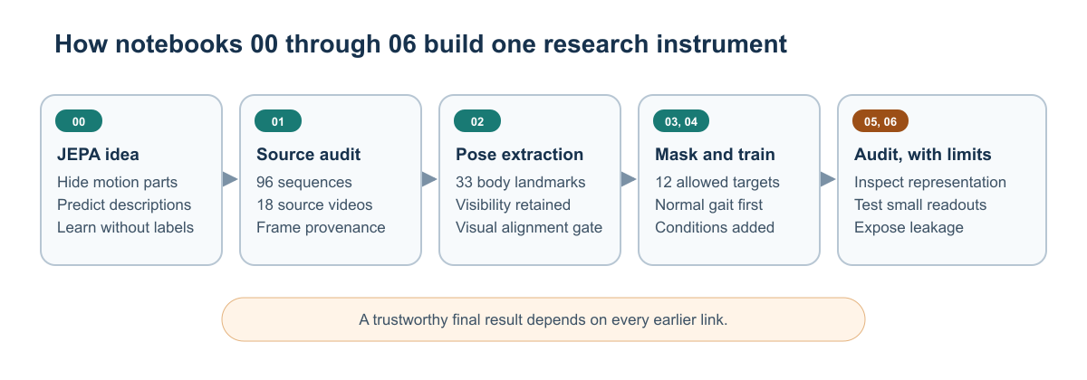
PREVIOUS WORK
Previous work established the full learning pipeline
Video → skeletons → masked motion prediction → fixed representations → audited readouts.
The pipeline is valuable as a research instrument; its data boundaries prevent clinical claims from the current corpus.
04
Notes:
[Sources]
- /Users/theodoremui/dev/alexpose/experiments/sjepa/gavd6/notebooks/foundations/01_gavd_manifest_and_youtube.ipynb
- /Users/theodoremui/dev/alexpose/experiments/sjepa/gavd6/notebooks/foundations/04_pretrain_sjepa_on_normal.ipynb
- /Users/theodoremui/dev/alexpose/experiments/sjepa/gavd6/notebooks/foundations/05_inspect_latent_motion.ipynb
- /Users/theodoremui/dev/alexpose/experiments/sjepa/gavd6/notebooks/foundations/06_capstone_health_condition_classifiers.ipynb
- /Users/theodoremui/dev/alexpose/experiments/sjepa/gavd6/slides/gait_parity_decks/images/foundations-pipeline.svg

Slide 5
PREVIOUS RESULTS
The earlier model learned motion structure
Training remained finite, feature variation stayed healthy, and condition information was readable.
0.558
0.414
0.724
final JEPA loss
final feature std
all-96 accuracy
After the five-stage curriculum
No obvious total constant collapse
Descriptive; source-exposed and label-informed
Interpretation
The system found structure in the corpus. It did not establish performance on a new source video, new patient, or physical outcome.
05
Notes:
[Sources]
- /Users/theodoremui/dev/alexpose/experiments/sjepa/gavd6/notebooks/foundations/04_pretrain_sjepa_on_normal.ipynb
- /Users/theodoremui/dev/alexpose/experiments/sjepa/gavd6/notebooks/foundations/06_capstone_health_condition_classifiers.ipynb

Slide 6
PREVIOUS RESULTS
The main limitation was not model size—it was evidence design
Many clips can still come from the same source video, and the encoder had seen every classifier-test row.
WHAT LOOKED PROMISING
WHY CLAIMS STAY NARROW
Grouped normal-vs-abnormal
Encoder-transductive
Accuracy 0.843
Macro-F1 0.821
ROC-AUC 0.952
The classifier split by source video.
All 159 rows—including classifier-test rows—were used during representation training. The result is in-corpus signal, not unseen-source generalization.
The new study moves the independence boundary to the participant before any fitting.
06
Notes:
[Sources]
- /Users/theodoremui/dev/alexpose/experiments/sjepa/gavd6/notebooks/foundations/06_capstone_health_condition_classifiers.ipynb
- /Users/theodoremui/dev/alexpose/experiments/sjepa/gavd6/notes/research/programs/gait_parity/METHODOLOGY.md

Slide 7
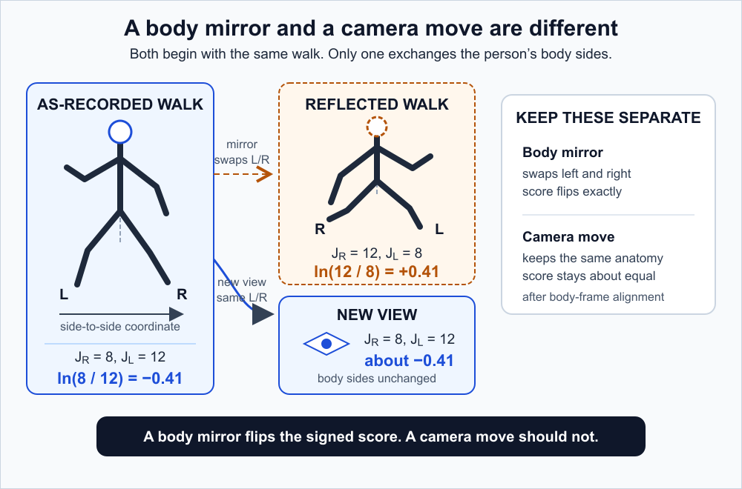
GAITPARITY
The mirror rule separates anatomy from observation
A body mirror swaps left and right. A camera move observes the same left and right from somewhere else.
Invariant to camera change. Equivariant—predictably sign-flipping—under anatomical reflection.
07
Notes:
[Sources]
- /Users/theodoremui/dev/alexpose/experiments/sjepa/gavd6/notes/research/programs/gait_parity/METHODOLOGY.md
- /Users/theodoremui/dev/alexpose/experiments/sjepa/gavd6/slides/gait_parity_decks/images/gait-parity-core.svg

Slide 8
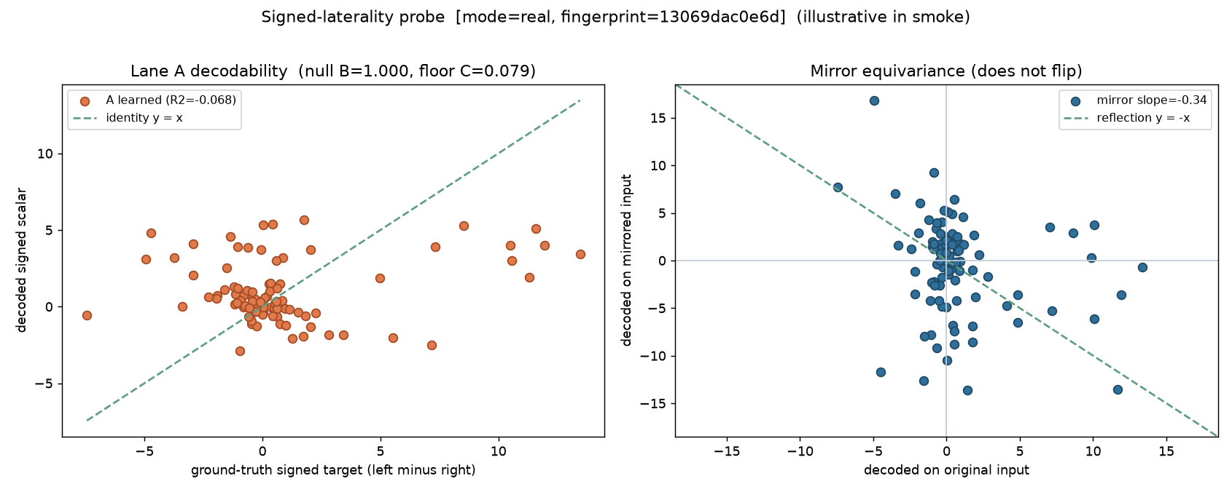
GAITPARITY RESULT 1
The old representation failed the signed mirror test
This was an informative null result, not a reason to abandon the question.
Learned R² = −0.068 · mirror slope = −0.337 · sign consistency = 0.444
08
Notes:
[Sources]
- /Users/theodoremui/dev/alexpose/experiments/sjepa/gavd6/artifacts/notebook_runs/organized-2026-08-23/experiments/idea05_signed_laterality/01_probe.ipynb
- /Users/theodoremui/dev/alexpose/experiments/sjepa/gavd6/slides/gait_parity_decks/images/notebook-05a-signed-laterality-probe.png

Slide 9
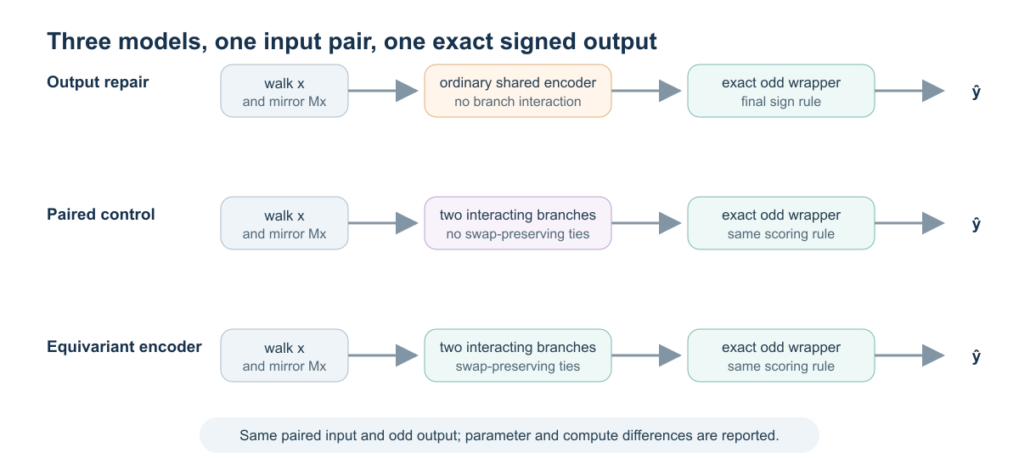
METHOD
Three models isolate what the mirror-aware architecture adds
Every serious comparison sees the original walk and its mirror and returns an exactly sign-flipping output.
Only the equivariant model is forced to keep the mirror rule organized throughout its internal layers.
09
Notes:
[Sources]
- /Users/theodoremui/dev/alexpose/experiments/sjepa/gavd6/notes/research/programs/gait_parity/README_LONG_TERM.md
- /Users/theodoremui/dev/alexpose/experiments/sjepa/gavd6/slides/gait_parity_decks/images/model-comparisons.svg

Slide 10
GAITPARITY RESULT 2
The new encoder passes the exact geometry audit
The deliberately unrestricted model breaks the rule. The equivariant model satisfies it across layers, regimes, and seeds.
CHANNEL HEALTH
Exact—and non-empty
Odd/even energy ratio 0.022
Odd effective rank 1.532
All registered health gates passed
BOUNDARY
A geometry result
96 sequences · 18 videos · 394 windows · 3 seeds
No force target. No participant-held-out clinical endpoint.
Lower is better; pass gate = 5×10⁻⁵
10
Notes:
[Sources]
- /Users/theodoremui/dev/alexpose/experiments/sjepa/gavd6/artifacts/notebook_runs/organized-2026-08-23/experiments/idea09_reflection_equivariance/06_cpu_replication.ipynb
- /Users/theodoremui/dev/alexpose/experiments/sjepa/gavd6/slides/gait_parity_decks/images/notebook-09f-full-gavd-audit.png

Slide 11
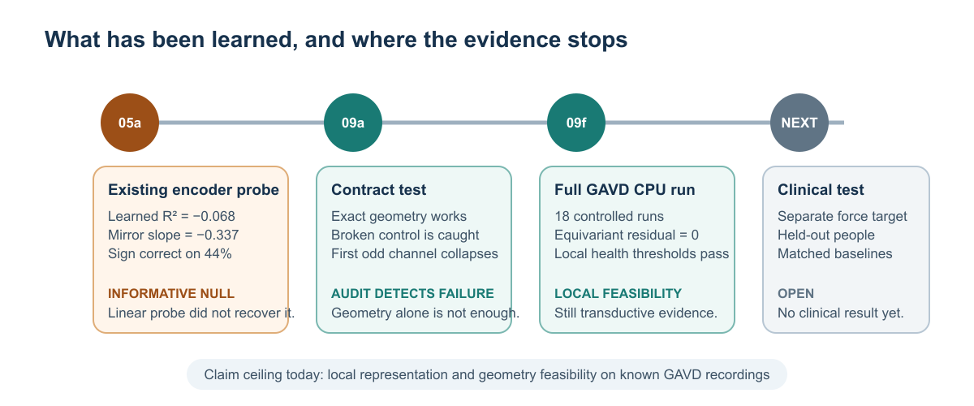
DISCUSSION
The evidence has advanced one rung—not the entire ladder
The project now has a checked instrument and a successful local feasibility audit.
The next meaningful claim requires force measurements and people the model has not encountered.
11
Notes:
[Sources]
- /Users/theodoremui/dev/alexpose/experiments/sjepa/gavd6/notes/research/programs/gait_parity/tutorials/02-current-direction-and-results.md
- /Users/theodoremui/dev/alexpose/experiments/sjepa/gavd6/slides/gait_parity_decks/images/current-evidence-status.svg

Slide 12
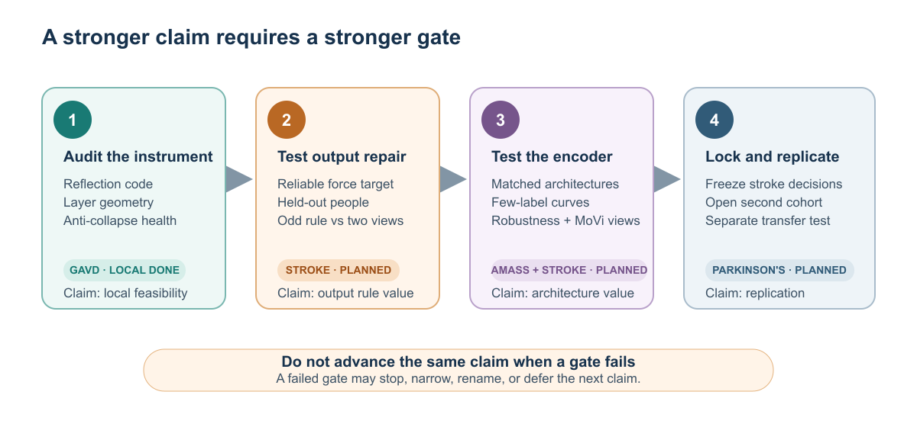
PLANNED STUDY
The planned study tests usefulness, not just correctness
Force plates provide an independent signed propulsion target. People—not gait cycles—define the outer split.
Success requires a practically meaningful force-MAE advantage over output repair and matched two-branch fusion.
12
Notes:
[Sources]
- /Users/theodoremui/dev/alexpose/experiments/sjepa/gavd6/notes/research/programs/gait_parity/tutorials/03-planned-research-direction.md
- /Users/theodoremui/dev/alexpose/experiments/sjepa/gavd6/notes/research/programs/gait_parity/README_LONG_TERM.md
- /Users/theodoremui/dev/alexpose/experiments/sjepa/gavd6/slides/gait_parity_decks/images/planned-research-ladder.svg

Slide 13
FUTURE WORK
Beyond GaitParity: Biomech-JEPA
The larger research direction is a typed human-motion world model that can estimate, generate, and judge whether movement is physically grounded.
OBSERVE
CANONICAL STATE
BIOMECH-JEPA
PHYSICS CHECK
ACT
RGB video
Depth
Wearables
→
Body · scene
Contact · dynamics
Uncertainty
→
Mask and predict
Future state
Counterfactual state
→
OpenSim / robot sim
Force residuals
Groundedness
→
Estimate
Generate
Ask tools
Simulation should teach and adjudicate; the learned model should amortize the pipeline.
A Qwen agent can actively call depth, segmentation, monocular motion, and physics tools when uncertainty justifies the cost.
13
Notes:
[Sources]
- User-provided research mentor meeting notes, 2026-08-23
- /Users/theodoremui/dev/alexpose/experiments/sjepa/gavd6/notes/research/programs/gait_parity/README_LONG_TERM.md
- /Users/theodoremui/dev/alexpose/experiments/sjepa/gavd6/notes/research/programs/gait_parity/tutorials/03-planned-research-direction.md

Slide 14
CONCLUSION
A trustworthy movement model must respect anatomy before claiming mechanics
GaitParity converts left–right understanding into a rule that can fail, a control that should fail, and a study that can decide whether the rule improves physical measurement.
CURRENT
LIMIT
PROMISE
Exact geometry
No force claim
A stronger world model
The equivariant implementation passes the intended mirror contract.
Current GAVD evidence is local, transductive, and outcome-free.
Body, scene, contact, dynamics, and uncertainty can become one predictive state.
The right next step is the participant-held-out force-plate study.
14
Notes:
[Sources]
- /Users/theodoremui/dev/alexpose/experiments/sjepa/gavd6/notes/research/programs/gait_parity/tutorials/02-current-direction-and-results.md
- /Users/theodoremui/dev/alexpose/experiments/sjepa/gavd6/notes/research/programs/gait_parity/tutorials/03-planned-research-direction.md
- User-provided research mentor meeting notes, 2026-08-23

