Slide 1
TECHNICAL LAB MEETING
GaitParity: Reflection-Equivariant S-JEPA for Signed Gait Asymmetry
Why physical movement understanding requires selective symmetry—and how a controlled mirror study leads toward a biomechanics-grounded world model.
Problem → motivation → prior evidence → parity experiment → force-plate decision → Biomech-JEPA
Notes:
Today I will describe GaitParity, a controlled study of whether a movement model preserves left and right anatomy when a body is mirrored. This is a small but important test within a larger goal: learning physical movement from ordinary video, rather than stopping at pose or joint trajectories.
I will begin with the gap between what a camera observes and what biomechanics needs. I will then summarize the earlier S-JEPA results, explain the signed-laterality failure that motivated this study, present the controlled parity experiment, and end with the force-plate study and Biomech-JEPA research direction.
[Sources]
- /Users/theodoremui/dev/alexpose/experiments/sjepa/gavd6/notebooks/foundations/04_pretrain_sjepa_on_normal.ipynb
- /Users/theodoremui/dev/alexpose/experiments/sjepa/gavd6/artifacts/notebook_runs/organized-2026-08-23/experiments/idea05_signed_laterality/01_probe.ipynb
- /Users/theodoremui/dev/alexpose/experiments/sjepa/gavd6/artifacts/notebook_runs/organized-2026-08-23/experiments/idea09_reflection_equivariance/06_cpu_replication.ipynb
- /Users/theodoremui/dev/alexpose/experiments/sjepa/gavd6/notes/research/programs/gait_parity/README_LONG_TERM.md

Slide 2
MOTIVATION
Ambient video does not directly reveal physical causes
Pose estimation gives projected kinematics. Biomechanics asks about contact, force, control, and uncertainty—quantities that are not uniquely visible in pixels.
OBSERVED
NORMALIZED
LATENT PHYSICS
DECISION
Pixels and pose
Body-frame motion
?
Contact and dynamics
Meaningful output
→
→
Projection
Landmark confidence
Occlusion
Joint trajectories
Anatomical identity
Cycle phase
Ground contact
External force
Mass and control
Asymmetry
Groundedness
Uncertainty
The inverse problem
A useful world model must represent the hidden physical state and know when the observation is insufficient.
02
Notes:
The central problem is that video gives us an observation of movement, not a direct measurement of the physical causes. Two people can produce similar joint trajectories while using different muscle strategies, distributing weight differently, or contacting the ground in different ways. Even for one person, partial occlusion can make several physical explanations consistent with the same image.
That means the model should not behave like a deterministic simulator that claims one certain answer from pixels. It should estimate a hidden physical state, express uncertainty when the video is ambiguous, and use additional tools or measurements when the observation is not sufficient.
[Sources]
- /Users/theodoremui/dev/alexpose/experiments/sjepa/gavd6/notes/research/programs/gait_parity/METHODOLOGY.md
- /Users/theodoremui/dev/alexpose/experiments/sjepa/gavd6/notes/research/programs/gait_parity/tutorials/03-planned-research-direction.md
- User-provided research mentor meeting notes, 2026-08-23

Slide 3
MOTIVATION
The missing physics matters in biomechanics and balance
The clinical quantity is often not simply how far a joint moved, but how the body generated and controlled that movement.
SETTING
PHYSICAL QUESTION
FAILURE IF SIDE OR PHYSICS IS WRONG
Stroke gait
Which leg contributes less propulsion—and how does the person compensate?
A sign error can reverse the inferred side. A kinematic proxy can also miss force redistribution.
Balance
Where is support, contact, and recoverable stability changing over time?
A model that ignores the ground may describe pose while missing a physically unstable transition.
Longitudinal care
Did the person change, or did the camera and pose estimator change?
Observation drift can masquerade as recovery, decline, fatigue, or treatment response.
Signed laterality is a concrete entry point because the expected transformation is known exactly.
03
Notes:
This gap matters because the clinical question is often about how movement is produced, not simply what the pose looks like. In stroke gait, for example, we may care about how much each leg contributes to forward propulsion. In balance assessment, we need to know where support and contact are changing, especially near a loss of stability.
We also need to separate a measured direction from a clinical interpretation. A negative right-minus-left propulsion value tells us which side produced less force in that measurement. It does not, by itself, identify the impaired side, because people may compensate in ways that redistribute force. Keeping those concepts separate prevents a mathematically correct sign from becoming an incorrect clinical claim.
[Sources]
- /Users/theodoremui/Downloads/GaitParity Study.pdf
- /Users/theodoremui/dev/alexpose/experiments/sjepa/gavd6/notes/research/programs/gait_parity/METHODOLOGY.md
- /Users/theodoremui/dev/alexpose/experiments/sjepa/gavd6/notes/research/programs/gait_parity/tutorials/03-planned-research-direction.md

Slide 4
MOTIVATION
Ambient intelligence introduces its own failure modes
A room-scale model must distinguish changes in the body from changes in how the body is observed.
SETTING
PHYSICAL QUESTION
FAILURE IF SIDE OR PHYSICS IS WRONG
New viewpoint
Same anatomy, different projection and occlusion
A left–right estimate should remain stable after body-frame handling—not follow the camera.
Mirrored feed
Anatomical labels are exchanged by the transformation
A signed asymmetry must reverse. Treating the mirror as ordinary augmentation erases meaning.
Missing joints
Visibility changes without a physical side change
Uncertainty should increase; the predicted sign should not flip because one heel disappeared.
Selective symmetry is the requirement: invariant to nuisance, equivariant to anatomy, sensitive to true dynamics.
04
Notes:
Ambient intelligence adds another layer of difficulty: the camera and the environment change even when the person does not. A new viewpoint changes projection and occlusion. A mirrored video exchanges anatomical left and right. A missing heel or knee should increase uncertainty, but it should not automatically reverse the estimated side.
These cases require different model responses. The representation should ignore camera-related nuisance changes, transform predictably when anatomy is mirrored, and remain sensitive to genuine changes in dynamics. One generic instruction to “make every augmented view look the same” cannot express all three requirements. We need selective symmetry, where the response depends on what the transformation means physically.
[Sources]
- /Users/theodoremui/dev/alexpose/experiments/sjepa/gavd6/notes/research/programs/gait_parity/METHODOLOGY.md
- /Users/theodoremui/dev/alexpose/experiments/sjepa/gavd6/notes/research/programs/gait_parity/README_LONG_TERM.md
- User-provided research mentor meeting notes, 2026-08-23

Slide 5
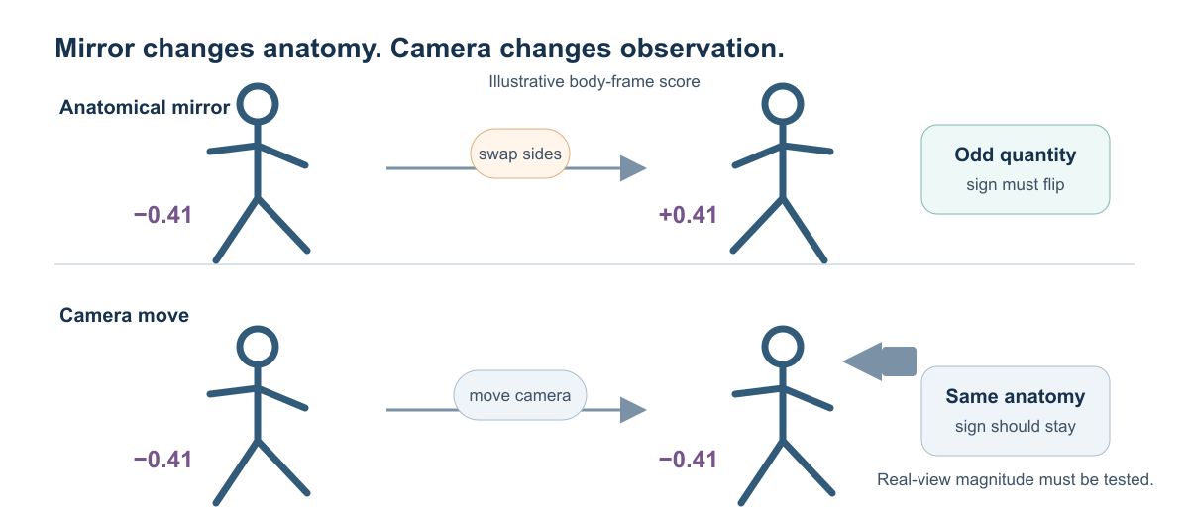
MOTIVATION
A body mirror and a camera move require opposite responses
Reflection exchanges the body's sides. Viewpoint change preserves anatomy while changing projection, visibility, and estimation error.
Odd target: y(Mx) = −y(x) · even target: y(Mx) = y(x) · viewpoint nuisance: y(Vx) ≈ y(x)
05
Notes:
This slide makes the distinction concrete. If we reflect the body, left and right anatomy exchange roles. A signed quantity such as right-minus-left propulsion should therefore reverse sign. We call that an odd target. A quantity such as overall walking pace should stay the same under reflection, so it is an even target.
A camera move is different. It changes the image coordinates and may hide different joints, but it does not exchange the person’s anatomy. After we place the motion in a consistent body-centered coordinate system, both pace and anatomical propulsion difference should remain stable. This simple rule becomes the measurement contract for the rest of the study.
[Sources]
- /Users/theodoremui/dev/alexpose/experiments/sjepa/gavd6/notes/research/programs/gait_parity/METHODOLOGY.md
- /Users/theodoremui/dev/alexpose/experiments/sjepa/gavd6/notes/research/programs/gait_parity/README_LONG_TERM.md
- /Users/theodoremui/dev/alexpose/experiments/sjepa/gavd6/slides/gait_parity_decks/images/mirror-versus-camera.svg

Slide 6
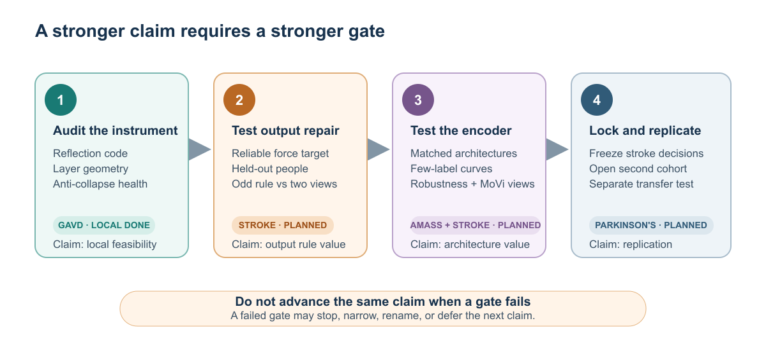
RESEARCH QUESTION
The project separates geometry, information, and utility
Each rung supports a stronger claim; passing a lower rung cannot substitute for the next experiment.
Current position: exact local geometry + registered representation health. Next gate: participant-held-out force prediction.
06
Notes:
We separate the evidence into four levels because each level supports a different claim. First, does the architecture obey the mirror rule exactly? Second, do the left-right channels contain nontrivial, participant-varying information rather than collapsing to zero? Third, does that organization improve prediction of a meaningful physical target on people who were not used for fitting? Finally, does the result survive new views and an independent replication cohort?
The current work reaches the first two levels locally. The decisive question is still ahead: does internal reflection structure improve force prediction beyond a simple sign-corrected output or a generic two-view model?
[Sources]
- /Users/theodoremui/dev/alexpose/experiments/sjepa/gavd6/notes/research/programs/gait_parity/README_LONG_TERM.md
- /Users/theodoremui/dev/alexpose/experiments/sjepa/gavd6/notes/research/programs/gait_parity/tutorials/03-planned-research-direction.md
- /Users/theodoremui/dev/alexpose/experiments/sjepa/gavd6/slides/gait_parity_decks/images/planned-research-ladder.svg

Slide 7
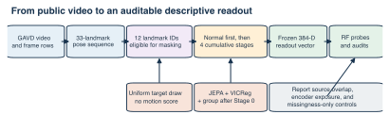
FOUNDATION
Previous work established an auditable S-JEPA pipeline
Public gait video became fixed-length skeleton motion, self-supervised features, and explicitly audited readouts.
96 canonical sequences · 18 source videos · 64 frames · 33 context landmarks · 12 mask-eligible landmark identities
07
Notes:
The earlier S-JEPA work established the pipeline that makes this question testable. Public gait videos were converted into tracked skeleton sequences, normalized into fixed 64-frame windows, and divided into context landmarks and masked target landmarks. The model then learned to predict missing motion features without using a clinical label for every training step.
The key bookkeeping unit is the source video. The dataset contains 96 canonical sequences derived from only 18 uploaded recordings, so several clips can share the same person, camera, and environment. Treating those clips as independent would overstate generalization. Every later evaluation therefore needs to respect the source or participant boundary before any component is fitted.
[Sources]
- /Users/theodoremui/dev/alexpose/experiments/sjepa/gavd6/notebooks/foundations/01_gavd_manifest_and_youtube.ipynb
- /Users/theodoremui/dev/alexpose/experiments/sjepa/gavd6/notebooks/foundations/04_pretrain_sjepa_on_normal.ipynb
- /Users/theodoremui/dev/alexpose/experiments/sjepa/gavd6/slides/gait_parity_decks/images/prior-sjepa-pipeline.svg

Slide 8
FOUNDATION EVIDENCE
The foundation learned motion structure—but not clean diagnoses
The final label-aware checkpoint produced 96 × 384 pooled embeddings after a five-stage curriculum.
0.558
0.414
0.0278
final JEPA loss
feature std
cosine silhouette
Stage 0 began at 6.557; training remained finite
Evidence against total constant collapse
Five condition groups overlap strongly
Interpretation
The encoder learned nontrivial motion features. Low silhouette and substantial representation drift argue against treating the latent space as a clean clinical taxonomy.
08
Notes:
The foundation model trained successfully in the narrow engineering sense. Its prediction loss fell from 6.557 at the beginning of the curriculum to 0.558, and the final feature standard deviation of 0.414 argues against the entire representation becoming constant.
However, successful optimization is not the same as scientific understanding. The cosine silhouette score is only 0.0278, which means the five condition groups overlap strongly in the learned space. These results support a limited statement: the encoder learned nontrivial motion structure. They do not show that it recovered a physical variable, separated diagnoses cleanly, or generalized to a new patient.
[Sources]
- /Users/theodoremui/dev/alexpose/experiments/sjepa/gavd6/notebooks/foundations/04_pretrain_sjepa_on_normal.ipynb
- /Users/theodoremui/dev/alexpose/experiments/sjepa/gavd6/notebooks/foundations/05_inspect_latent_motion.ipynb

Slide 9
FOUNDATION EVIDENCE
Earlier readouts exposed the central evidence problem
Condition information was readable, but the representation had already seen every classifier-test row.
IN-CORPUS SIGNAL
CLAIM LIMIT
Promising numbers
Encoder-transductive
Grouped normal-vs-abnormal
Accuracy 0.843
Macro-F1 0.821
ROC-AUC 0.952
Five-class pooled macro-F1 0.622
All 159 rows entered representation training. Later stages were label-aware. The grouped split applied only to the readout—not to representation learning.
The next study must split sources or participants before every fitted component—not only before the final classifier.
09
Notes:
The earlier classification results looked promising at first glance. A grouped normal-versus-abnormal readout reached 0.843 accuracy, 0.821 macro-F1, and 0.952 ROC-AUC. But the representation encoder had already trained on every row later used by the classifier test, and later curriculum stages also used condition labels.
So these numbers demonstrate that condition information is readable within this corpus; they do not establish prospective performance. A clean split at the final classifier is not enough if the encoder has already seen the evaluation examples. This lesson directly shapes GaitParity: sources or participants must be separated before every fitted stage, not only before the last readout.
[Sources]
- /Users/theodoremui/dev/alexpose/experiments/sjepa/gavd6/notebooks/foundations/06_capstone_health_condition_classifiers.ipynb
- /Users/theodoremui/dev/alexpose/experiments/sjepa/gavd6/notes/research/programs/gait_parity/METHODOLOGY.md

Slide 10
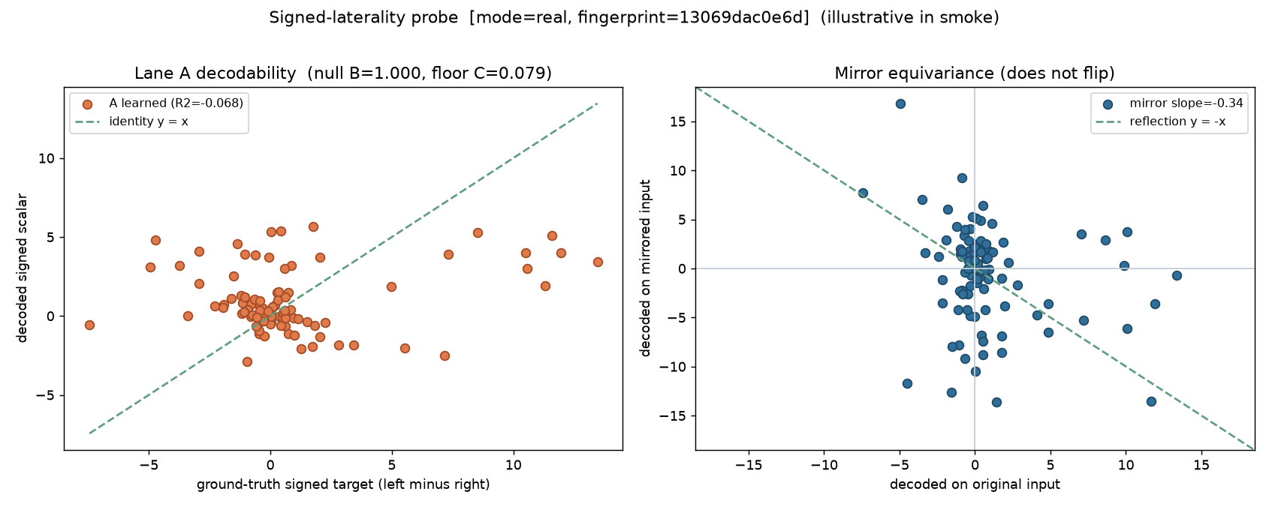
GAITPARITY MOTIVATION
The saved representation failed the signed-laterality test
A five-fold source-disjoint ridge readout tested a constructed pose-coordinate target and the required mirror response.
learned R² −0.0678 · MAE 2.596 · pooled latent R² −0.304 · sign consistency .444 · mirror slope −0.337
10
Notes:
We next asked whether the saved representation preserved a simple signed left-right signal. A ridge model was trained in five source-disjoint folds to predict a target constructed directly from pose coordinates. The same target was nearly recoverable from the raw coordinates, so the decoding task itself was feasible.
The learned features did not preserve it: cross-validated R-squared was −0.0678, sign consistency was 0.444, and the response to mirroring had a slope of −0.337 instead of the required −1. This is an informative null result. It does not say that clinically meaningful force asymmetry is impossible; it says that the existing representation should not be presented as if signed anatomy emerged automatically.
[Sources]
- /Users/theodoremui/dev/alexpose/experiments/sjepa/gavd6/artifacts/notebook_runs/organized-2026-08-23/experiments/idea05_signed_laterality/01_probe.ipynb
- /Users/theodoremui/dev/alexpose/experiments/sjepa/gavd6/slides/gait_parity_decks/images/notebook-05a-signed-laterality-probe.png

Slide 11
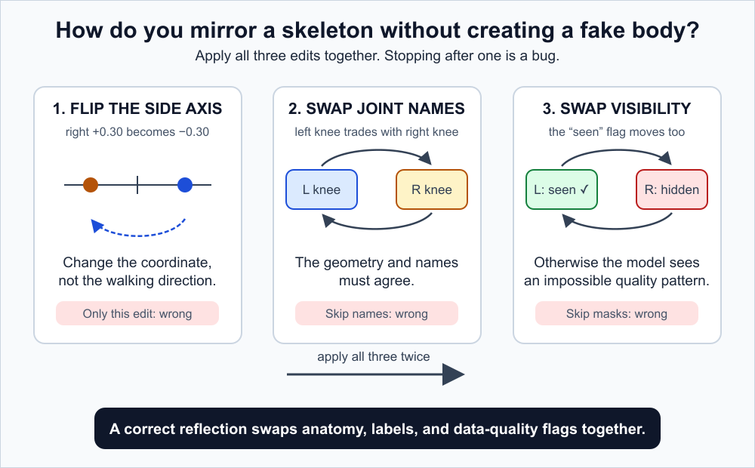
PARITY METHODOLOGY
The reflection operator is part of the measurement contract
M must transform geometry, identities, visibility, and confidence together; M(Mx) = x is necessary but not sufficient.
Negating the wrong axis twice can still pass involution. Odd/even target checks and real-data fixtures are also required.
11
Notes:
To test parity rigorously, reflection has to be defined as part of the measurement process. We negate the mediolateral coordinate, swap every paired left-right landmark identity, and also swap the corresponding visibility and confidence values. Time, forward motion, and vertical direction remain unchanged.
That last visibility step is easy to miss. If the coordinates are reflected but the missingness pattern stays attached to the old side, the model sees an impossible body and can exploit that shortcut. Applying reflection twice should recover the original input, but that involution test is only a starting check. We also test known odd and even targets on real examples.
[Sources]
- /Users/theodoremui/dev/alexpose/experiments/sjepa/gavd6/notes/research/programs/gait_parity/METHODOLOGY.md
- /Users/theodoremui/dev/alexpose/experiments/sjepa/gavd6/slides/gait_parity_decks/images/reflection-operator-steps.svg

Slide 12
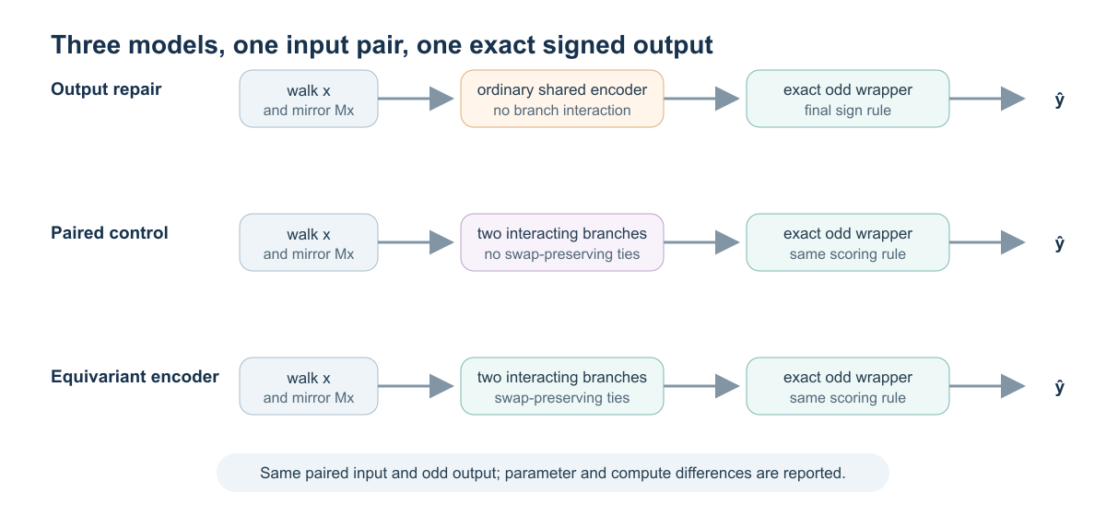
PARITY METHODOLOGY
Architecture isolation requires two strong controls
The output baseline guarantees oddness: qodd(x) = [q(E(x)) − q(E(Mx))] / 2.
Co-primary comparisons: equivariant vs odd_output, and equivariant vs paired_unconstrained with matched exposure, compute, tuning, and seeds.
12
Notes:
The experiment compares three architectures so that we can identify what, if anything, internal parity contributes. The first is an output-repair baseline: it evaluates the original and mirrored inputs and subtracts the two predictions, which guarantees the final sign flip with a few lines of arithmetic.
The second model processes both views jointly but places no constraint on how their features interact. This controls for the extra view, extra capacity, and cross-view communication. The third model uses the same information but constrains its internal even and odd channels to respond correctly when the branches are exchanged. The co-primary comparisons tell us whether that internal organization adds value beyond either cheap output repair or generic two-view fusion.
[Sources]
- /Users/theodoremui/dev/alexpose/experiments/sjepa/gavd6/notes/research/programs/gait_parity/README_LONG_TERM.md
- /Users/theodoremui/dev/alexpose/experiments/sjepa/gavd6/slides/gait_parity_decks/images/model-comparisons.svg

Slide 13
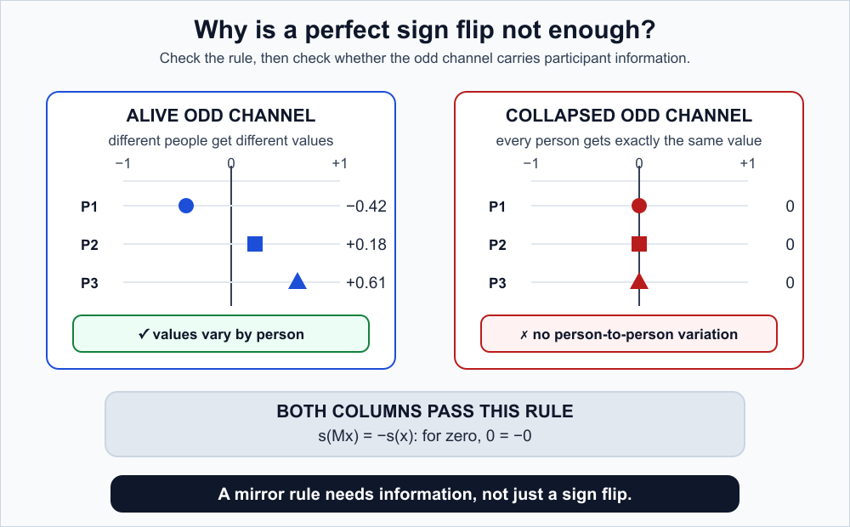
VALIDATION GATES
Exact oddness is necessary—and can still be useless
An all-zero odd channel satisfies s(Mx) = −s(x) perfectly.
Required gates: layerwise commutation, finite prediction loss, odd energy/variance, effective rank, offset fraction, and positive controls.
13
Notes:
An exact transformation rule is not enough, because a useless representation can satisfy it. An odd channel that is always zero passes the equation perfectly: zero is equal to its own negative. We therefore treat exact parity as a contract test, not as evidence of useful information.
Before any downstream interpretation, the audit checks whether the odd channel has measurable energy and variance, whether that variation spans more than one trivial direction, and whether a common offset dominates the signal. We also include positive controls that should fail when the implementation is intentionally broken. These gates prevent an empty or shortcut solution from being mistaken for a scientific result.
[Sources]
- /Users/theodoremui/dev/alexpose/experiments/sjepa/gavd6/notes/research/programs/gait_parity/README_LONG_TERM.md
- /Users/theodoremui/dev/alexpose/experiments/sjepa/gavd6/slides/gait_parity_decks/images/collapse-trap.svg

Slide 14
CONTROLLED EXPERIMENT
The GAVD experiment isolates mirror geometry
The variants use the same real GAVD windows and are compared under both equal exposure and closely matched compute.
96
18
394
3
Seeds 7 · 19 · 31
sequences
source videos
windows
paired seeds
Compared run-for-run—not best against best
EXPOSURE-MATCHED
COMPUTE-MATCHED
CAPACITY ACCOUNTING
Same data budget
Same compute proxy
Report—not pretend—matching
300 updates per model
2,400 orbit exposures
Original and reflected views matched
≈183.2–183.7B
Standard 393 updates
Paired 155 · Equivariant 300
Standard 41,696 params
Paired 84,256
Equivariant 50,272
This experiment asks whether the implementation and audit are trustworthy. It contains no independent force target.
14
Notes:
The controlled GAVD experiment uses 96 sequences from 18 source videos, producing 394 training windows. Each architecture is trained with seeds 7, 19, and 31. We compare one regime with equal exposure—300 updates and 2,400 example presentations—and another with a closely matched compute proxy of roughly 183 billion operations.
The models are not falsely described as having equal parameter counts: they contain 41,696, 84,256, and 50,272 parameters. Instead, we report those differences and control the comparisons through matched data exposure, closely matched computation, and paired random seeds. This experiment isolates implementation geometry; it does not contain an independent force target.
[Sources]
- /Users/theodoremui/dev/alexpose/experiments/sjepa/gavd6/artifacts/notebook_runs/organized-2026-08-23/experiments/idea09_reflection_equivariance/06_cpu_replication.ipynb
- /Users/theodoremui/dev/alexpose/experiments/sjepa/gavd6/notes/research/programs/gait_parity/README_LONG_TERM.md

Slide 15
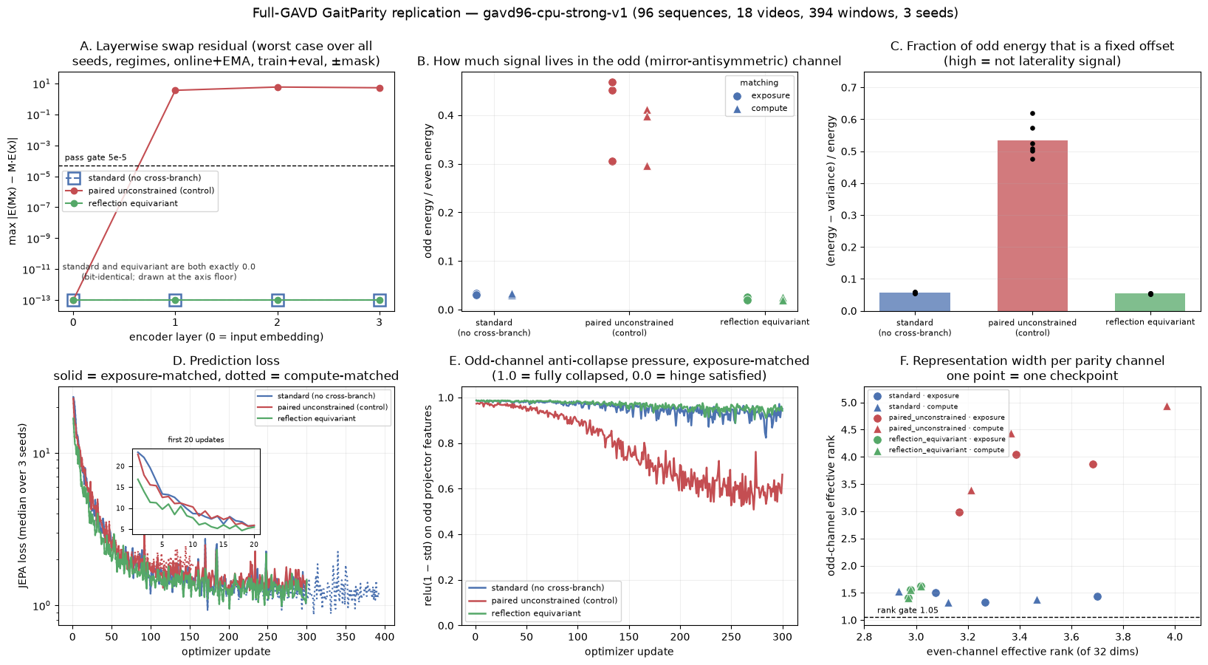
PARITY RESULTS
Full-GAVD replication: geometry is exact; utility is untested
Nine checkpoints per matching regime; 96 sequences, 18 videos, 394 windows, 3 seeds.
Equivariant residual 0 · paired residual 5.900 exposure / 5.286 compute · equivariant odd/even energy .022 · odd rank 1.532
15
Notes:
The main result is in panel A. The commutation residual measures the mismatch between two routes: mirror the input and then encode it, or encode it first and then swap the model’s left-right channels. Across both matching regimes, that mismatch is exactly zero for the constrained encoder. The unrestricted two-view control has residuals of 5.900 under equal exposure and 5.286 under matched compute.
The remaining panels test whether the internal channels are alive. The registered gates pass, including positive controls, but the odd-to-even energy ratio is only 0.022 and the effective odd-channel rank is 1.532. So the correct conclusion is exact, nonempty geometry with modest internal diversity—not demonstrated biomechanical utility.
[Sources]
- /Users/theodoremui/dev/alexpose/experiments/sjepa/gavd6/artifacts/notebook_runs/organized-2026-08-23/experiments/idea09_reflection_equivariance/06_cpu_replication.ipynb
- /Users/theodoremui/dev/alexpose/experiments/sjepa/gavd6/slides/gait_parity_decks/images/notebook-09f-full-gavd-audit.png

Slide 16
DISCUSSION
Implementation passes; physical utility remains open
All variants train under matched exposure and closely matched compute, but prediction loss is not gait utility.
SUPPORTED
OPEN
Exact, inspectable parity
Meaningful biomechanics
Equivariant worst residual = 0
Unrestricted control residual > 5
All registered health gates passed
Audit survives save/reload and masks
No force target
No participant holdout
No robustness advantage
No label-efficiency advantage
No GPU replication
Odd-channel energy is low and rank is modest; downstream physical supervision is the decisive test.
16
Notes:
At this point, the supported claim is precise: we have an inspectable model and audit that enforce the intended anatomical reflection rule, survive saving and reloading, handle masks consistently, and distinguish the constrained model from a strong unrestricted control.
Several stronger claims remain open. There is no force target in this experiment, no held-out participant cohort, no demonstrated robustness or label-efficiency advantage, and no GPU replication. The low odd-channel energy and modest rank make the next experiment especially important. We now need to test whether this organization improves a physical measurement, rather than assuming that correct geometry automatically creates useful biomechanics.
[Sources]
- /Users/theodoremui/dev/alexpose/experiments/sjepa/gavd6/artifacts/notebook_runs/organized-2026-08-23/experiments/idea09_reflection_equivariance/06_cpu_replication.ipynb
- /Users/theodoremui/dev/alexpose/experiments/sjepa/gavd6/notes/research/programs/gait_parity/tutorials/02-current-direction-and-results.md

Slide 17
PLANNED STUDY
The force study is designed to decide whether parity is useful
Pretraining broadens the motion prior; force plates then provide an independent signed propulsion target on held-out people.
01
02
03
04
AMASS
BABEL walking
Force cohort
MoVi + replicate
→
→
→
Broad SMPL-H pretraining with parity-preserving masks and corruptions
Walking-focused continuation without clinical outcome labels
Outer participant split before fitting; right-minus-left propulsion target
Test real viewpoint stability, then repeat a frozen analysis in a sealed cohort
GAVD remains an implementation audit only. People—not gait cycles—are the independent observations in the force claim.
17
Notes:
The planned study separates the research stages so that one dataset is not asked to support every claim. AMASS provides broad human-motion pretraining. BABEL walking examples narrow the motion prior toward gait without introducing the final clinical outcome. A force-plate cohort then supplies the signed right-minus-left propulsion target, with participants split before any task-specific fitting.
MoVi provides a separate test of real viewpoint stability, and a sealed cohort is reserved for replication after the analysis is frozen. GAVD remains an implementation audit only. For the force claim, the independent observations are people—not individual gait cycles extracted from the same person.
[Sources]
- /Users/theodoremui/dev/alexpose/experiments/sjepa/gavd6/notes/research/programs/gait_parity/tutorials/03-planned-research-direction.md
- /Users/theodoremui/dev/alexpose/experiments/sjepa/gavd6/notes/research/programs/gait_parity/README_LONG_TERM.md

Slide 18
DECISION RULE
The outcome table prevents a positive-spin interpretation
Primary unit: participant. Primary metric: participant-orbit-averaged force MAE.
BEATS BOTH
TIES OUTPUT REPAIR
WIDE OR UNHEALTHY
Encoder parity adds value
Prefer three lines
Defer the claim
Meaningful MAE advantage over odd_output and paired_unconstrained on simultaneous intervals.
Exact final parity helps, but organized internal parity adds no detectable practical benefit.
Inconclusive intervals, broken commutation, or weak parity channels require more evidence—not a softened headline.
Secondary analyses explain the result: sign accuracy, calibration, label efficiency, corruption robustness, and MoVi view stability.
18
Notes:
The outcome table is defined in advance to keep the interpretation honest. The primary unit is the participant, and the primary metric is mean absolute force error averaged over each participant’s original and mirrored examples. The equivariant model must show a meaningful advantage over both the output-repair baseline and the unrestricted two-view model.
If it ties output repair, then the simple arithmetic solution is preferable for this task. If the uncertainty intervals are wide, the result is inconclusive rather than evidence of equivalence. Secondary measures—sign accuracy, calibration, label efficiency, corruption robustness, and view stability—help explain the primary result but do not replace it.
[Sources]
- /Users/theodoremui/dev/alexpose/experiments/sjepa/gavd6/notes/research/programs/gait_parity/README_LONG_TERM.md
- /Users/theodoremui/dev/alexpose/experiments/sjepa/gavd6/notes/research/programs/gait_parity/METHODOLOGY.md

Slide 19
FUTURE DIRECTION
Biomech-JEPA extends parity into physical movement understanding
The proposed model predicts a typed state rather than a single undifferentiated embedding, supporting estimation, generation, groundedness, and uncertainty.
RGB
depth
segmentation
monocular motion
wearables
↓
TYPED WORLD STATE
body · scene · object keypoints · contact · dynamics · uncertainty
↓
BIOMECH-JEPA predicts masked state, future state, and counterfactual state
DISCRIMINATIVE
GENERATIVE
PHYSICS + AGENT
forces · asymmetry
groundedness · confidence
SMPL / body keypoints
object trajectories
OpenSim / robot simulation
Qwen tool policy with RL
19
Notes:
If GaitParity clears the force-prediction gate, the larger direction is Biomech-JEPA: a world model that represents the body, scene, objects, contacts, dynamics, and uncertainty as related parts of one physical state. That shared state can support both discriminative questions—such as whether a movement is physically grounded—and generative predictions of future body and object keypoints.
Depth estimation, segmentation, and monocular body reconstruction provide additional observations. OpenSim or robot simulation can provide a correction signal during training and flag predictions that violate physical constraints. A Qwen-based policy can learn when an expensive tool call is worth making, but it should route evidence rather than invent biomechanical truth.
[Sources]
- User-provided research mentor meeting notes, 2026-08-23
- /Users/theodoremui/dev/alexpose/experiments/sjepa/gavd6/notes/research/programs/gait_parity/README_LONG_TERM.md
- /Users/theodoremui/dev/alexpose/experiments/sjepa/gavd6/notes/research/programs/gait_parity/tutorials/03-planned-research-direction.md

Slide 20
RESEARCH PROGRAM
The collaboration aligns measurement, environment, and world models
The project becomes strongest when biomechanics defines the physical target, ambient intelligence defines real observation conditions, and ML connects them with auditable state.
BIOMECHANICS
AMBIENT INTELLIGENCE
WORLD-MODEL CORE
Delp lab collaboration
Stanford HAI collaboration
Shared research program
Force-plate endpoint
Contact and ground reaction
OpenSim teacher / adjudicator
Participant protocol
Real camera variation
Depth and segmentation
Scene and object context
Uncertainty-aware sensing
Typed latent state
JEPA objectives and generation
Physics residual learning
Active tool routing with RL
Research order: finish force GaitParity → build PhysMoveBench → learn clean state → bridge to ambient video → train active tool use.
20
Notes:
This research program naturally combines three kinds of expertise. The Delp biomechanics lab can define the physical targets, force-plate protocol, OpenSim comparisons, and clinically meaningful error measures. The HAI ambient intelligence lab can define realistic variation in viewpoint, depth, scene context, occlusion, and uncertainty. The world-model effort connects those measurements through an auditable representation and an active tool-use policy.
I see this as a proposed structure rather than a fixed division of labor. A strong first shared deliverable would be PhysMoveBench: one benchmark where force, contact, viewpoint, occlusion, and uncertainty are evaluated under a frozen protocol. That gives the collaboration a common measurement language before scaling the model.
[Sources]
- User-provided research mentor meeting notes, 2026-08-23
- /Users/theodoremui/dev/alexpose/experiments/sjepa/gavd6/notes/research/programs/gait_parity/tutorials/03-planned-research-direction.md
- /Users/theodoremui/dev/alexpose/experiments/sjepa/gavd6/notes/research/programs/gait_parity/README_LONG_TERM.md

Slide 21
CONCLUSION
GaitParity is the first gate—not the final system
The project now has a precise anatomical rule, an exact implementation, a control that fails for the right reason, and a force study that can determine whether structure becomes useful.
WHY
NOW
NEXT
Physics is latent
Geometry is exact
Utility must be earned
Pixels and pose do not uniquely reveal contact, force, control, or balance.
The reflection-equivariant encoder passes matched local audits without empty channels.
Held-out people, force plates, real views, and replication define the next claims.
If GaitParity clears that gate, Biomech-JEPA becomes a credible path beyond OpenCap/OpenSim-style pipelines.
21
Notes:
The project began with a simple gap: observing a skeleton is not the same as understanding the physical process that produced it. GaitParity now gives us a precise anatomical rule, an implementation that satisfies that rule exactly, a control that fails for the expected reason, and health checks that rule out an empty odd channel.
The next step is to earn the stronger claim with held-out people, force plates, real viewpoint changes, and independent replication. The long-term goal is not to replace physics with a language model. It is to learn an efficient physical state estimator whose symmetry, uncertainty, and tool calls remain measurable and testable.
[Sources]
- /Users/theodoremui/dev/alexpose/experiments/sjepa/gavd6/notes/research/programs/gait_parity/tutorials/02-current-direction-and-results.md
- /Users/theodoremui/dev/alexpose/experiments/sjepa/gavd6/notes/research/programs/gait_parity/tutorials/03-planned-research-direction.md
- User-provided research mentor meeting notes, 2026-08-23

