Slide 1
TECHNICAL LAB MEETING
GaitParity: Reflection-Equivariant S-JEPA for Signed Gait Asymmetry
A controlled test of whether movement representations preserve anatomical left and right.
Current result: exact mirror geometry. Next decision: held-out force prediction.
Notes:
Today I will describe GaitParity, a controlled study of whether a movement model preserves left and right anatomy when a body is mirrored. This is a small but important test within a larger goal: learning physical movement from ordinary video, rather than stopping at pose or joint trajectories.
I will begin with the gap between what a camera observes and what biomechanics needs. I will then summarize the earlier S-JEPA results, explain the signed-laterality failure that motivated this study, present the controlled parity experiment, and end with the force-plate study and Biomech-JEPA research direction.
[Sources]
- /Users/theodoremui/dev/alexpose/experiments/sjepa/gavd6/notebooks/foundations/04_pretrain_sjepa_on_normal.ipynb
- /Users/theodoremui/dev/alexpose/experiments/sjepa/gavd6/artifacts/notebook_runs/organized-2026-08-23/experiments/idea05_signed_laterality/01_probe.ipynb
- /Users/theodoremui/dev/alexpose/experiments/sjepa/gavd6/artifacts/notebook_runs/organized-2026-08-23/experiments/idea09_reflection_equivariance/06_cpu_replication.ipynb
- /Users/theodoremui/dev/alexpose/experiments/sjepa/gavd6/notes/research/programs/gait_parity/README_LONG_TERM.md

Slide 2
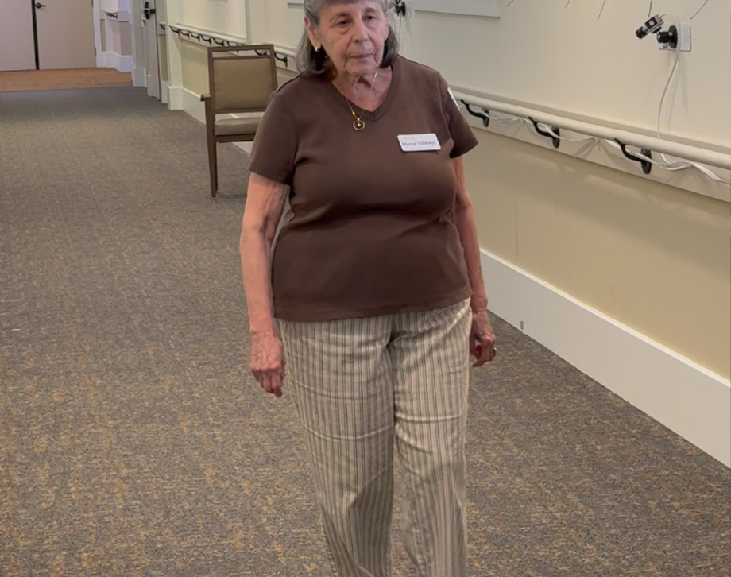
MOTIVATION
Video shows movement—not the forces behind it
Ambient cameras can observe walking in natural settings, but they do not directly measure the physical state.
WHAT THE CAMERA MISSES
The same visible motion can have different causes
• Video gives pixels and projected joints
• Force, contact, and muscle control stay hidden
• Occlusion can support several physical explanations
Infer the hidden physics—and report when the evidence is weak.
02
Notes:
The central problem is that video gives us an observation of movement, not a direct measurement of the physical causes. Two people can produce similar joint trajectories while using different muscle strategies, distributing weight differently, or contacting the ground in different ways. Even for one person, partial occlusion can make several physical explanations consistent with the same image.
That means the model should not behave like a deterministic simulator that claims one certain answer from pixels. It should estimate a hidden physical state, express uncertainty when the video is ambiguous, and use additional tools or measurements when the observation is not sufficient.
[Sources]
- /Users/theodoremui/dev/alexpose/experiments/sjepa/gavd6/notes/research/programs/gait_parity/METHODOLOGY.md
- /Users/theodoremui/dev/alexpose/experiments/sjepa/gavd6/notes/research/programs/gait_parity/tutorials/03-planned-research-direction.md
- User-provided research mentor meeting notes, 2026-08-23
- https://health.ucdavis.edu/news/headlines/innovative-research-looks-at-walking-and-healthy-aging/2024/08
- UC Davis Health photograph: Patten_URC_exwidebody1.jpg

Slide 3
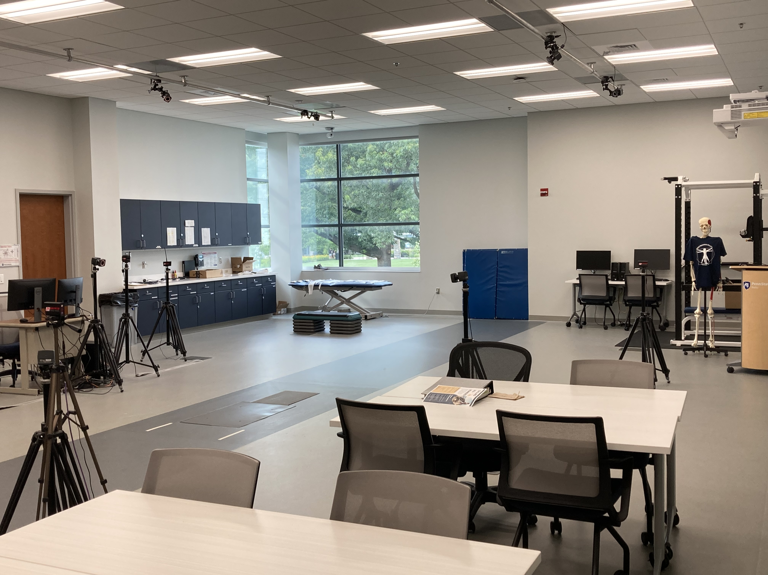
MOTIVATION
Biomechanics asks what generated the motion
A joint trajectory describes motion. A biomechanical measurement explains support, force, and control.
WHY THE PHYSICS MATTERS
A pose can look right while the conclusion is wrong
• Stroke: which leg contributes less propulsion?
• Balance: is the body still recoverably stable?
• Follow-up care: did the person change—or the camera?
Signed left–right differences are a clear first test because mirroring should reverse them.
03
Notes:
This gap matters because the clinical question is often about how movement is produced, not simply what the pose looks like. In stroke gait, for example, we may care about how much each leg contributes to forward propulsion. In balance assessment, we need to know where support and contact are changing, especially near a loss of stability.
We also need to separate a measured direction from a clinical interpretation. A negative right-minus-left propulsion value tells us which side produced less force in that measurement. It does not, by itself, identify the impaired side, because people may compensate in ways that redistribute force. Keeping those concepts separate prevents a mathematically correct sign from becoming an incorrect clinical claim.
[Sources]
- /Users/theodoremui/Downloads/GaitParity Study.pdf
- /Users/theodoremui/dev/alexpose/experiments/sjepa/gavd6/notes/research/programs/gait_parity/METHODOLOGY.md
- /Users/theodoremui/dev/alexpose/experiments/sjepa/gavd6/notes/research/programs/gait_parity/tutorials/03-planned-research-direction.md
- https://commons.wikimedia.org/wiki/File:Biomechanics_lab_with_force_plate.jpg
- Photo: Apfriesen, CC BY-SA 4.0

Slide 4
MOTIVATION
Ambient settings change the observation—not always the person
The model needs a different response for each kind of change.
VIEW
New camera angle
• Keep the anatomical answer stable after body-frame normalization.
MIRROR
Mirrored video
• Reverse a signed left–right measurement because anatomy is exchanged.
MASK
Missing joint
• Increase uncertainty; do not flip the predicted side because a heel disappears.
One rule for every video augmentation is not enough.
04
Notes:
Ambient intelligence adds another layer of difficulty: the camera and the environment change even when the person does not. A new viewpoint changes projection and occlusion. A mirrored video exchanges anatomical left and right. A missing heel or knee should increase uncertainty, but it should not automatically reverse the estimated side.
These cases require different model responses. The representation should ignore camera-related nuisance changes, transform predictably when anatomy is mirrored, and remain sensitive to genuine changes in dynamics. One generic instruction to “make every augmented view look the same” cannot express all three requirements. We need selective symmetry, where the response depends on what the transformation means physically.
[Sources]
- /Users/theodoremui/dev/alexpose/experiments/sjepa/gavd6/notes/research/programs/gait_parity/METHODOLOGY.md
- /Users/theodoremui/dev/alexpose/experiments/sjepa/gavd6/notes/research/programs/gait_parity/README_LONG_TERM.md
- User-provided research mentor meeting notes, 2026-08-23

Slide 5
MOTIVATION
A body mirror and a camera move mean different things
A reflection changes anatomical identity. A viewpoint change only changes how anatomy is observed.
L ↔ R
same person camera moves →
Mirror the body
Move the camera
• Left and right exchange
• Signed difference flips
• Anatomy stays fixed
• Physical answer stays stable
Right-minus-left propulsion flips under a body mirror, but not under a camera move.
05
Notes:
This slide makes the distinction concrete. If we reflect the body, left and right anatomy exchange roles. A signed quantity such as right-minus-left propulsion should therefore reverse sign. We call that an odd target. A quantity such as overall walking pace should stay the same under reflection, so it is an even target.
A camera move is different. It changes the image coordinates and may hide different joints, but it does not exchange the person’s anatomy. After we place the motion in a consistent body-centered coordinate system, both pace and anatomical propulsion difference should remain stable. This simple rule becomes the measurement contract for the rest of the study.
[Sources]
- /Users/theodoremui/dev/alexpose/experiments/sjepa/gavd6/notes/research/programs/gait_parity/METHODOLOGY.md
- /Users/theodoremui/dev/alexpose/experiments/sjepa/gavd6/notes/research/programs/gait_parity/README_LONG_TERM.md

Slide 6
RESEARCH QUESTION
Each experiment earns one stronger claim
Passing a lower step cannot substitute for the next test.
1
2
3
4
→
→
→
Rule
Information
Utility
Replication
• Does mirroring produce the exact response?
• Are the parity channels non-empty?
• Does parity improve held-out force prediction?
• Does it survive new views and a new cohort?
Current position: rule + information. Next gate: force utility.
06
Notes:
We separate the evidence into four levels because each level supports a different claim. First, does the architecture obey the mirror rule exactly? Second, do the left-right channels contain nontrivial, participant-varying information rather than collapsing to zero? Third, does that organization improve prediction of a meaningful physical target on people who were not used for fitting? Finally, does the result survive new views and an independent replication cohort?
The current work reaches the first two levels locally. The decisive question is still ahead: does internal reflection structure improve force prediction beyond a simple sign-corrected output or a generic two-view model?
[Sources]
- /Users/theodoremui/dev/alexpose/experiments/sjepa/gavd6/notes/research/programs/gait_parity/README_LONG_TERM.md
- /Users/theodoremui/dev/alexpose/experiments/sjepa/gavd6/notes/research/programs/gait_parity/tutorials/03-planned-research-direction.md

Slide 7
FOUNDATION
The earlier S-JEPA pipeline made the test possible
The model learns motion by predicting hidden landmarks from the visible context.
1
2
3
4
→
→
→
Video
Skeleton
Mask + predict
Audit
• Public gait clips grouped by source video
• 64-frame body-centered motion windows
• 33 context landmarks predict 12 eligible targets
• Readouts test information and transformation rules
96 sequences come from only 18 videos—so source boundaries matter.
07
Notes:
The earlier S-JEPA work established the pipeline that makes this question testable. Public gait videos were converted into tracked skeleton sequences, normalized into fixed 64-frame windows, and divided into context landmarks and masked target landmarks. The model then learned to predict missing motion features without using a clinical label for every training step.
The key bookkeeping unit is the source video. The dataset contains 96 canonical sequences derived from only 18 uploaded recordings, so several clips can share the same person, camera, and environment. Treating those clips as independent would overstate generalization. Every later evaluation therefore needs to respect the source or participant boundary before any component is fitted.
[Sources]
- /Users/theodoremui/dev/alexpose/experiments/sjepa/gavd6/notebooks/foundations/01_gavd_manifest_and_youtube.ipynb
- /Users/theodoremui/dev/alexpose/experiments/sjepa/gavd6/notebooks/foundations/04_pretrain_sjepa_on_normal.ipynb

Slide 8
FOUNDATION EVIDENCE
The foundation learned motion structure—not a diagnosis
Three numbers separate training health from scientific meaning.
0.558
0.414
0.0278
final prediction loss
feature variability
condition separation
Training improved from 6.557 and stayed stable.
The full representation did not collapse to one constant.
The five condition groups still overlap strongly.
Interpretation
• The optimization worked
• The features contain motion variation
• The latent space is not a clean clinical taxonomy
08
Notes:
The foundation model trained successfully in the narrow engineering sense. Its prediction loss fell from 6.557 at the beginning of the curriculum to 0.558, and the final feature standard deviation of 0.414 argues against the entire representation becoming constant.
However, successful optimization is not the same as scientific understanding. The cosine silhouette score is only 0.0278, which means the five condition groups overlap strongly in the learned space. These results support a limited statement: the encoder learned nontrivial motion structure. They do not show that it recovered a physical variable, separated diagnoses cleanly, or generalized to a new patient.
[Sources]
- /Users/theodoremui/dev/alexpose/experiments/sjepa/gavd6/notebooks/foundations/04_pretrain_sjepa_on_normal.ipynb
- /Users/theodoremui/dev/alexpose/experiments/sjepa/gavd6/notebooks/foundations/05_inspect_latent_motion.ipynb

Slide 9
FOUNDATION EVIDENCE
Strong readout scores did not prove prospective performance
Condition information was readable, but the evaluation split happened too late.
WHAT WE SAW
WHY THE CLAIM IS LIMITED
Readable condition signal
The encoder saw the test rows
• Accuracy: 0.843
• Macro-F1: 0.821
• ROC-AUC: 0.952
• All 159 rows entered representation training
• Later stages used condition labels
• Only the final readout was grouped
Split people or sources before every fitted stage—not only before the last classifier.
09
Notes:
The earlier classification results looked promising at first glance. A grouped normal-versus-abnormal readout reached 0.843 accuracy, 0.821 macro-F1, and 0.952 ROC-AUC. But the representation encoder had already trained on every row later used by the classifier test, and later curriculum stages also used condition labels.
So these numbers demonstrate that condition information is readable within this corpus; they do not establish prospective performance. A clean split at the final classifier is not enough if the encoder has already seen the evaluation examples. This lesson directly shapes GaitParity: sources or participants must be separated before every fitted stage, not only before the last readout.
[Sources]
- /Users/theodoremui/dev/alexpose/experiments/sjepa/gavd6/notebooks/foundations/06_capstone_health_condition_classifiers.ipynb
- /Users/theodoremui/dev/alexpose/experiments/sjepa/gavd6/notes/research/programs/gait_parity/METHODOLOGY.md

Slide 10
GAITPARITY MOTIVATION
The saved representation did not preserve signed laterality
The mirror response should have a slope of −1. The learned features were far from that rule.
Expected
Learned
• Raw pose coordinates contain the constructed signal
• The learned embedding does not decode it
• Sign consistency is only 44.4%
−1.000
→
−0.337
mirror slope
mirror slope
R² = −0.0678
The embedding predicts worse than a constant baseline.
This is a representation failure—not a clinical conclusion.
10
Notes:
We next asked whether the saved representation preserved a simple signed left-right signal. A ridge model was trained in five source-disjoint folds to predict a target constructed directly from pose coordinates. The same target was nearly recoverable from the raw coordinates, so the decoding task itself was feasible.
The learned features did not preserve it: cross-validated R-squared was −0.0678, sign consistency was 0.444, and the response to mirroring had a slope of −0.337 instead of the required −1. This is an informative null result. It does not say that clinically meaningful force asymmetry is impossible; it says that the existing representation should not be presented as if signed anatomy emerged automatically.
[Sources]
- /Users/theodoremui/dev/alexpose/experiments/sjepa/gavd6/artifacts/notebook_runs/organized-2026-08-23/experiments/idea05_signed_laterality/01_probe.ipynb

Slide 11
PARITY METHODOLOGY
A correct mirror changes more than coordinates
Reflecting coordinates alone can create an anatomically impossible example.
1
2
3
→
→
Flip the axis
Swap identities
Swap confidence
• Negate the left–right coordinate
• Exchange every paired left and right landmark
• Move visibility and confidence with the landmark
Applying the mirror twice should recover the original—but real odd/even checks are also required.
11
Notes:
To test parity rigorously, reflection has to be defined as part of the measurement process. We negate the mediolateral coordinate, swap every paired left-right landmark identity, and also swap the corresponding visibility and confidence values. Time, forward motion, and vertical direction remain unchanged.
That last visibility step is easy to miss. If the coordinates are reflected but the missingness pattern stays attached to the old side, the model sees an impossible body and can exploit that shortcut. Applying reflection twice should recover the original input, but that involution test is only a starting check. We also test known odd and even targets on real examples.
[Sources]
- /Users/theodoremui/dev/alexpose/experiments/sjepa/gavd6/notes/research/programs/gait_parity/METHODOLOGY.md

Slide 12
PARITY METHODOLOGY
Three models isolate what internal parity contributes
The strongest comparison is not structured versus unstructured—it is structured versus two strong alternatives.
FIX
Output repair
• Force the final prediction to flip sign with simple arithmetic.
PAIR
Paired, unrestricted
• Give the model both views and the same opportunity to interact.
PARITY
Equivariant encoder
• Require internal even and odd channels to obey the mirror rule.
The question is whether organized internal parity beats both alternatives.
12
Notes:
The experiment compares three architectures so that we can identify what, if anything, internal parity contributes. The first is an output-repair baseline: it evaluates the original and mirrored inputs and subtracts the two predictions, which guarantees the final sign flip with a few lines of arithmetic.
The second model processes both views jointly but places no constraint on how their features interact. This controls for the extra view, extra capacity, and cross-view communication. The third model uses the same information but constrains its internal even and odd channels to respond correctly when the branches are exchanged. The co-primary comparisons tell us whether that internal organization adds value beyond either cheap output repair or generic two-view fusion.
[Sources]
- /Users/theodoremui/dev/alexpose/experiments/sjepa/gavd6/notes/research/programs/gait_parity/README_LONG_TERM.md

Slide 13
VALIDATION GATES
Perfect symmetry can still hide an empty representation
An odd channel that is always zero satisfies the equation exactly.
0 = −0
Before using the representation, check:
• Does the odd channel vary across people?
• Does it carry more than one trivial direction?
• Do deliberately broken controls fail?
Perfect symmetry. No information.
Treat exact parity as a contract test—not proof of useful information.
13
Notes:
An exact transformation rule is not enough, because a useless representation can satisfy it. An odd channel that is always zero passes the equation perfectly: zero is equal to its own negative. We therefore treat exact parity as a contract test, not as evidence of useful information.
Before any downstream interpretation, the audit checks whether the odd channel has measurable energy and variance, whether that variation spans more than one trivial direction, and whether a common offset dominates the signal. We also include positive controls that should fail when the implementation is intentionally broken. These gates prevent an empty or shortcut solution from being mistaken for a scientific result.
[Sources]
- /Users/theodoremui/dev/alexpose/experiments/sjepa/gavd6/notes/research/programs/gait_parity/README_LONG_TERM.md

Slide 14
CONTROLLED EXPERIMENT
The GAVD experiment isolates mirror geometry
Every model sees the same real windows and is compared under two fairness checks.
96
18
394
3
sequences
source videos
windows
paired seeds
Fair comparison
• Equal data exposure
• Closely matched compute
• Run-for-run seed pairing
• Parameter counts reported, not hidden
This experiment tests the implementation and audit. It does not test force prediction.
14
Notes:
The controlled GAVD experiment uses 96 sequences from 18 source videos, producing 394 training windows. Each architecture is trained with seeds 7, 19, and 31. We compare one regime with equal exposure—300 updates and 2,400 example presentations—and another with a closely matched compute proxy of roughly 183 billion operations.
The models are not falsely described as having equal parameter counts: they contain 41,696, 84,256, and 50,272 parameters. Instead, we report those differences and control the comparisons through matched data exposure, closely matched computation, and paired random seeds. This experiment isolates implementation geometry; it does not contain an independent force target.
[Sources]
- /Users/theodoremui/dev/alexpose/experiments/sjepa/gavd6/artifacts/notebook_runs/organized-2026-08-23/experiments/idea09_reflection_equivariance/06_cpu_replication.ipynb
- /Users/theodoremui/dev/alexpose/experiments/sjepa/gavd6/notes/research/programs/gait_parity/README_LONG_TERM.md

Slide 15
PARITY RESULTS
The constrained encoder obeys the mirror rule exactly
The audit compares the mirror-rule error of the unrestricted control and the equivariant encoder.
What this means
• Equivariant error: exactly 0
• Paired-control error: 5.900
• Health gates pass, but odd-channel energy is small
Mirror-rule error: lower is better
Exact, non-empty geometry—physical utility still untested.
15
Notes:
The main result is in panel A. The commutation residual measures the mismatch between two routes: mirror the input and then encode it, or encode it first and then swap the model’s left-right channels. Across both matching regimes, that mismatch is exactly zero for the constrained encoder. The unrestricted two-view control has residuals of 5.900 under equal exposure and 5.286 under matched compute.
The remaining panels test whether the internal channels are alive. The registered gates pass, including positive controls, but the odd-to-even energy ratio is only 0.022 and the effective odd-channel rank is 1.532. So the correct conclusion is exact, nonempty geometry with modest internal diversity—not demonstrated biomechanical utility.
[Sources]
- /Users/theodoremui/dev/alexpose/experiments/sjepa/gavd6/artifacts/notebook_runs/organized-2026-08-23/experiments/idea09_reflection_equivariance/06_cpu_replication.ipynb

Slide 16
DISCUSSION
Mirror geometry passes; physical utility remains open
A correct transformation rule is useful only if it improves a meaningful physical measurement.
SUPPORTED
NOT YET SUPPORTED
Exact, inspectable parity
Meaningful biomechanics
• Worst mirror-rule error is zero
• Strong unrestricted control fails
• All registered health gates pass
• No force target
• No held-out participants
• No demonstrated robustness advantage
The next experiment must test force on people the model has never fitted.
16
Notes:
At this point, the supported claim is precise: we have an inspectable model and audit that enforce the intended anatomical reflection rule, survive saving and reloading, handle masks consistently, and distinguish the constrained model from a strong unrestricted control.
Several stronger claims remain open. There is no force target in this experiment, no held-out participant cohort, no demonstrated robustness or label-efficiency advantage, and no GPU replication. The low odd-channel energy and modest rank make the next experiment especially important. We now need to test whether this organization improves a physical measurement, rather than assuming that correct geometry automatically creates useful biomechanics.
[Sources]
- /Users/theodoremui/dev/alexpose/experiments/sjepa/gavd6/artifacts/notebook_runs/organized-2026-08-23/experiments/idea09_reflection_equivariance/06_cpu_replication.ipynb
- /Users/theodoremui/dev/alexpose/experiments/sjepa/gavd6/notes/research/programs/gait_parity/tutorials/02-current-direction-and-results.md

Slide 17
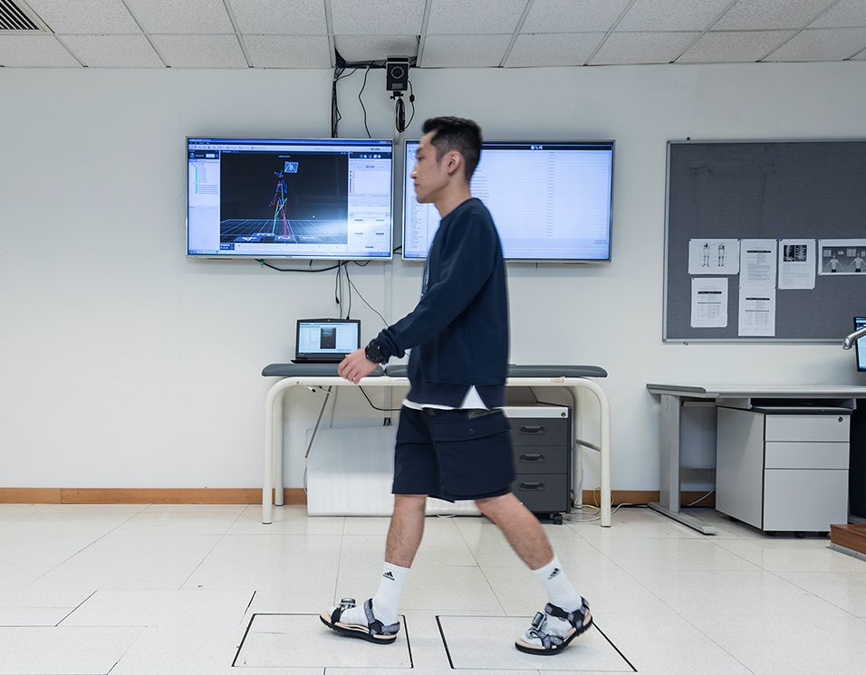
PLANNED STUDY
The force study makes parity compete on a physical target
Force plates provide the independent target that video alone cannot reveal.
FOUR-STAGE STUDY
Each dataset answers one question
• AMASS: broad motion pretraining
• BABEL: walking-focused continuation
• Force cohort: held-out participant prediction
• MoVi + sealed cohort: view test and replication
People—not individual gait cycles—are the independent test units.
17
Notes:
The planned study separates the research stages so that one dataset is not asked to support every claim. AMASS provides broad human-motion pretraining. BABEL walking examples narrow the motion prior toward gait without introducing the final clinical outcome. A force-plate cohort then supplies the signed right-minus-left propulsion target, with participants split before any task-specific fitting.
MoVi provides a separate test of real viewpoint stability, and a sealed cohort is reserved for replication after the analysis is frozen. GAVD remains an implementation audit only. For the force claim, the independent observations are people—not individual gait cycles extracted from the same person.
[Sources]
- /Users/theodoremui/dev/alexpose/experiments/sjepa/gavd6/notes/research/programs/gait_parity/tutorials/03-planned-research-direction.md
- /Users/theodoremui/dev/alexpose/experiments/sjepa/gavd6/notes/research/programs/gait_parity/README_LONG_TERM.md
- https://www.polyu.edu.hk/bme/research/research-laboratories-and-facilities/
- Hong Kong Polytechnic University Department of Biomedical Engineering photograph

Slide 18
DECISION RULE
The decision rule is fixed before the force results arrive
Primary unit: participant. Primary metric: force error averaged over original and mirrored examples.
WIN
Beats both controls
• Internal parity adds measurable value for force prediction.
TIE
Ties output repair
• Prefer the simpler three-line sign correction for this task.
WAIT
Wide or unhealthy result
• Call the study inconclusive and collect stronger evidence.
Secondary measures explain the result; they do not replace the primary force test.
18
Notes:
The outcome table is defined in advance to keep the interpretation honest. The primary unit is the participant, and the primary metric is mean absolute force error averaged over each participant’s original and mirrored examples. The equivariant model must show a meaningful advantage over both the output-repair baseline and the unrestricted two-view model.
If it ties output repair, then the simple arithmetic solution is preferable for this task. If the uncertainty intervals are wide, the result is inconclusive rather than evidence of equivalence. Secondary measures—sign accuracy, calibration, label efficiency, corruption robustness, and view stability—help explain the primary result but do not replace it.
[Sources]
- /Users/theodoremui/dev/alexpose/experiments/sjepa/gavd6/notes/research/programs/gait_parity/README_LONG_TERM.md
- /Users/theodoremui/dev/alexpose/experiments/sjepa/gavd6/notes/research/programs/gait_parity/METHODOLOGY.md

Slide 19
FUTURE DIRECTION
Biomech-JEPA turns video into a testable physical state
The model should represent body, objects, contact, dynamics, and uncertainty—not one opaque embedding.
Observe
Build state
Check physics
Answer or act
• RGB video
• depth
• segmentation
→
• body + objects
• contact
• uncertainty
→
• OpenSim
• robot simulation
• groundedness
→
• estimate
• generate
• call a tool
Qwen chooses which tool to call. Physics tools judge plausibility; they remain the source of physical supervision.
19
Notes:
If GaitParity clears the force-prediction gate, the larger direction is Biomech-JEPA: a world model that represents the body, scene, objects, contacts, dynamics, and uncertainty as related parts of one physical state. That shared state can support both discriminative questions—such as whether a movement is physically grounded—and generative predictions of future body and object keypoints.
Depth estimation, segmentation, and monocular body reconstruction provide additional observations. OpenSim or robot simulation can provide a correction signal during training and flag predictions that violate physical constraints. A Qwen-based policy can learn when an expensive tool call is worth making, but it should route evidence rather than invent biomechanical truth.
[Sources]
- User-provided research mentor meeting notes, 2026-08-23
- /Users/theodoremui/dev/alexpose/experiments/sjepa/gavd6/notes/research/programs/gait_parity/README_LONG_TERM.md
- /Users/theodoremui/dev/alexpose/experiments/sjepa/gavd6/notes/research/programs/gait_parity/tutorials/03-planned-research-direction.md

Slide 20
RESEARCH PROGRAM
The collaboration connects physical truth to real-world sensing
Each group owns a different part of the measurement problem.
DELP
Biomechanics
• Define force targets, OpenSim checks, participant protocols, and meaningful error.
HAI
Ambient intelligence
• Define viewpoint, depth, occlusion, scene context, and sensing uncertainty.
SHARED
World-model core
• Build the typed state, JEPA objectives, benchmark, and active tool policy.
First shared deliverable: PhysMoveBench with a frozen physical and sensing protocol.
20
Notes:
This research program naturally combines three kinds of expertise. The Delp biomechanics lab can define the physical targets, force-plate protocol, OpenSim comparisons, and clinically meaningful error measures. The HAI ambient intelligence lab can define realistic variation in viewpoint, depth, scene context, occlusion, and uncertainty. The world-model effort connects those measurements through an auditable representation and an active tool-use policy.
I see this as a proposed structure rather than a fixed division of labor. A strong first shared deliverable would be PhysMoveBench: one benchmark where force, contact, viewpoint, occlusion, and uncertainty are evaluated under a frozen protocol. That gives the collaboration a common measurement language before scaling the model.
[Sources]
- User-provided research mentor meeting notes, 2026-08-23
- /Users/theodoremui/dev/alexpose/experiments/sjepa/gavd6/notes/research/programs/gait_parity/tutorials/03-planned-research-direction.md
- /Users/theodoremui/dev/alexpose/experiments/sjepa/gavd6/notes/research/programs/gait_parity/README_LONG_TERM.md

Slide 21
CONCLUSION
GaitParity is the first gate—not the final system
The project now has a precise mirror rule and a controlled way to test whether that structure becomes useful.
• Video alone does not reveal physical causes
• The equivariant encoder passes the mirror audit exactly
• Held-out force prediction is the next decisive test
If the force study succeeds, Biomech-JEPA becomes a credible path toward ambient physical movement understanding.
21
Notes:
The project began with a simple gap: observing a skeleton is not the same as understanding the physical process that produced it. GaitParity now gives us a precise anatomical rule, an implementation that satisfies that rule exactly, a control that fails for the expected reason, and health checks that rule out an empty odd channel.
The next step is to earn the stronger claim with held-out people, force plates, real viewpoint changes, and independent replication. The long-term goal is not to replace physics with a language model. It is to learn an efficient physical state estimator whose symmetry, uncertainty, and tool calls remain measurable and testable.
[Sources]
- /Users/theodoremui/dev/alexpose/experiments/sjepa/gavd6/notes/research/programs/gait_parity/tutorials/02-current-direction-and-results.md
- /Users/theodoremui/dev/alexpose/experiments/sjepa/gavd6/notes/research/programs/gait_parity/tutorials/03-planned-research-direction.md
- User-provided research mentor meeting notes, 2026-08-23

