Slide 1
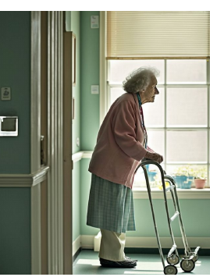
GAITPARITY
Can a camera tell which leg needs help?
Teaching video models to preserve left-right gait asymmetry
Theodore Mui
Reflection-equivariant S-JEPA
Notes:
[Sources]
- User-provided GaitParity Presentation.pdf, slides 1 and 6 (title, project framing, and home gait visual).
[/Sources]

Slide 2
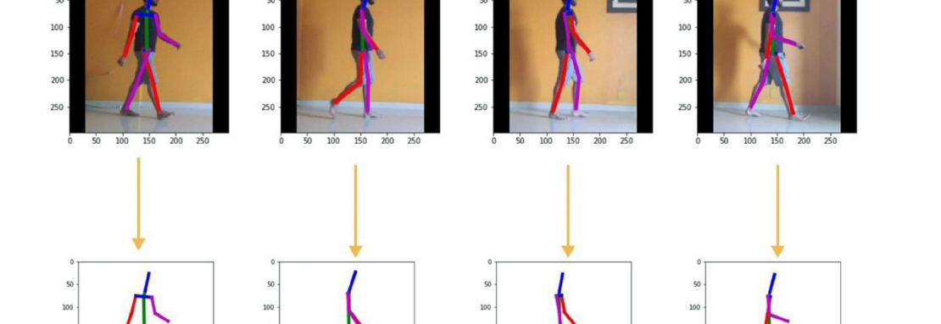
THE STARTING POINT
A walk becomes 11 moving points
Pose estimation removes appearance and keeps the changing geometry of the body.
02
Notes:
[Sources]
- User-provided GaitParity Presentation.pdf, slide 2.
[/Sources]

Slide 3
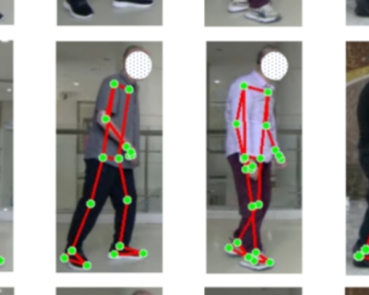
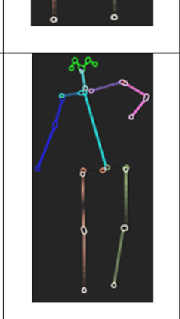
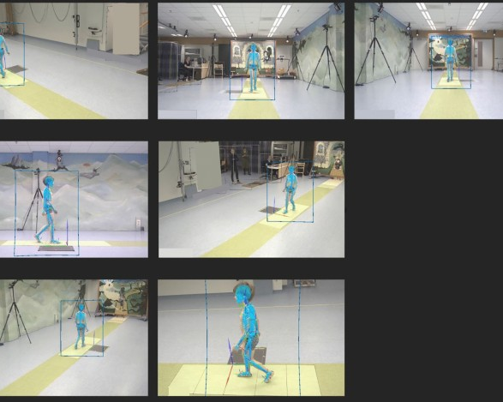
WHY GAIT MATTERS
Different conditions leave different gait signatures
Stroke
Parkinson's
Cerebral palsy
Side-to-side propulsion can become unequal.
Steps can shorten while posture and arm swing change.
Joint flexion and foot position can follow distinct patterns.
03
Notes:
[Sources]
- Stroke figure: https://link.springer.com/article/10.1186/s12984-025-01726-5
- Parkinson's figure: https://link.springer.com/article/10.1007/s44196-025-01071-4
- Cerebral palsy figure: https://www.nature.com/articles/s41598-024-62119-7
- Condition summaries adapted from user-provided GaitParity Presentation.pdf, slide 3.
[/Sources]

Slide 4
THE GAP
Pose tells us what moved - not what caused it
VISIBLE IN VIDEO
NEEDED FOR BIOMECHANICS
Where each joint went
How the movement was produced
->
Joint positions
Foot-ground contact
Walking speed
Force and propulsion
Timing and posture
Balance and uncertainty
04
Notes:
[Sources]
- User-provided GaitParity Presentation.pdf, slides 4 and 5.
[/Sources]

Slide 5
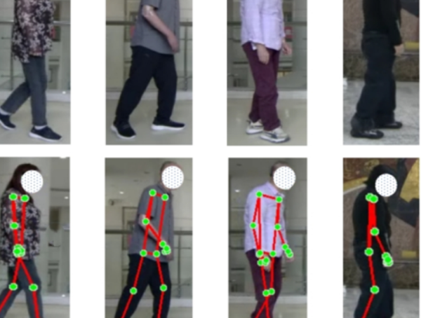
THE CLINICAL MOTIVATION
A faster walk can still hide the wrong kind of recovery
After a stroke, speed may improve because...
the affected leg recovered
OR
the stronger leg compensated
Those outcomes look similar in speed, but they imply different care.
05
Notes:
[Sources]
- Compensation framing adapted from user-provided GaitParity Presentation.pdf, slide 7.
- Stroke figure: https://link.springer.com/article/10.1186/s12984-025-01726-5
[/Sources]

Slide 6
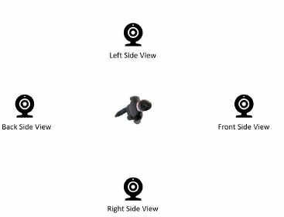
THE GOAL
The opportunity: gait insight from ordinary video
Accessible
Use video captured in clinics or at home.
Consistent
Keep left-right meaning stable across viewpoints and mirrors.
Longitudinal
Separate changes in the person from changes in the camera.
06
Notes:
[Sources]
- User-provided GaitParity Presentation.pdf, slides 5 and 6.
[/Sources]

Slide 7
THE RESEARCH QUESTION
Can a video-derived skeleton reveal which side propels less?
GaitParity tests whether a model built to respect reflection can recover a signed right-versus-left force target for a person it has never seen.
If the input is mirrored, the answer must reverse.
07
Notes:
[Sources]
- User-provided GaitParity Presentation.pdf, slide 7.
[/Sources]

Slide 8
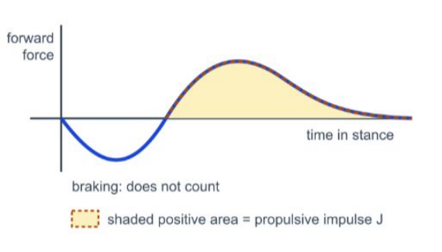
GROUND TRUTH
The answer comes from the force under each foot
A force plate measures forward propulsion during stance.
Right impulse
versus
Left impulse
signed target = ln(JR / JL)
The sign identifies the stronger side; the magnitude shows how unequal they are.
08
Notes:
[Sources]
- User-provided GaitParity Presentation.pdf, slide 8.
[/Sources]

Slide 9
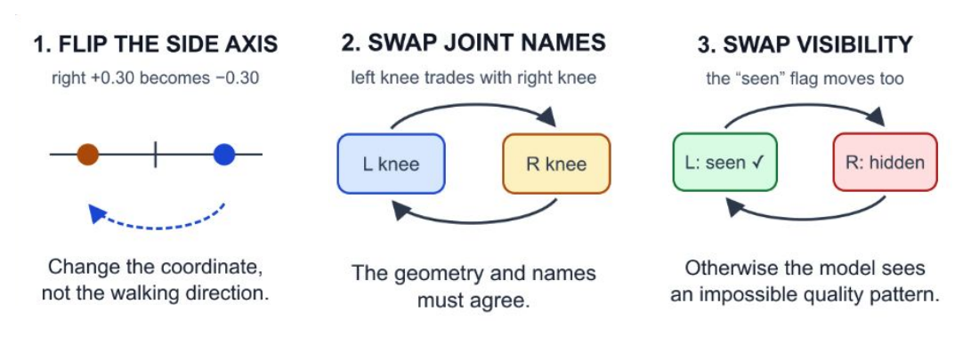
THE SYMMETRY RULE
A mirror should reverse the answer
A valid anatomical reflection requires three coordinated changes.
The geometry, the joint names, and the visibility flags must all agree.
09
Notes:
[Sources]
- User-provided GaitParity Presentation.pdf, slide 9.
[/Sources]

Slide 10
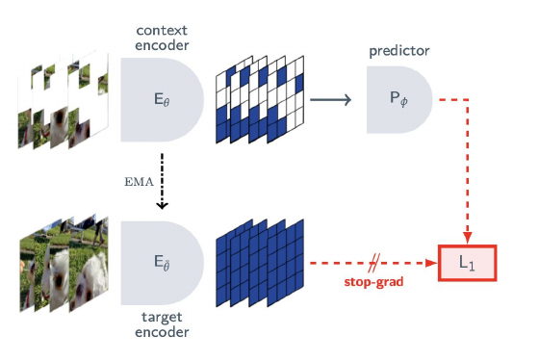
SELF-SUPERVISED LEARNING
The model learns by predicting hidden motion
1
Hide pieces
Mask some joints across time.
2
Predict the missing motion
Use the visible context to estimate the hidden representation.
3
Learn structure without labels
Repeated prediction teaches a compact model of movement.
10
Notes:
[Sources]
- User-provided GaitParity Presentation.pdf, slide 10.
[/Sources]

Slide 11
THE GAITPARITY IDEA
GaitParity sees every walk in two matched views
1 MATCHED INPUTS
2 SHARED LEARNING
3 FEATURE SPLIT
ORIGINAL VIEW x
ONE SHARED
ENCODER E
EVEN FEATURES h_even
>
>
What stays
the same
h_even(Mx) =
h_even(x)
Measured joint
motion
Learns patterns
across joints + time
pace | gait phase | identity
MIRRORED VIEW M(x)
ODD FEATURES h_odd
same weights
h_odd(Mx) =
-h_odd(x)
Swap left/right
joints
>
>
What changes
direction
same masks and
normalization
+ reflect the body axis
left-right contribution
v
4 SIGNED READOUT
s(x) = w^T h_odd
s(Mx) = -s(x)
Mirror consistency is guaranteed by construction.
11
Notes:
[Sources]
- User-provided GaitParity Presentation.pdf, slides 8, 11, and 12 (paired-view architecture and signed readout).
[/Sources]

Slide 12
THE READOUT
One signed score: which side contributes more?
ln(JR / JL)
negative
zero
positive
left > right
equal propulsion
right > left
Mirroring the skeleton should multiply this score by -1.
12
Notes:
[Sources]
- User-provided GaitParity Presentation.pdf, slides 8 and 12.
[/Sources]

Slide 13
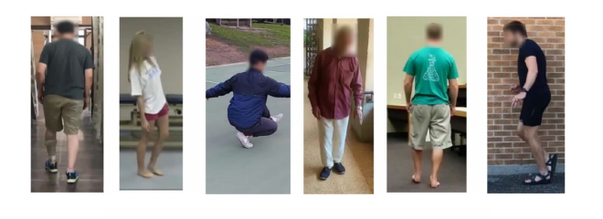
DATA STAGE 1
We start with 96 real-world abnormal gait videos
96
5
gait videos
gait categories
Normal
Parkinson's
Stroke
Myopathic
Cerebral palsy
A small, varied set is useful for geometry checks - not yet for clinical claims.
13
Notes:
[Sources]
- User-provided GaitParity Presentation.pdf, slide 13.
[/Sources]

Slide 14
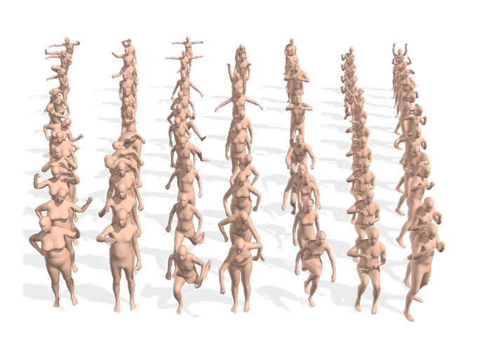
DATA STAGE 2
Scale motion learning with 10,941 walking sequences
AMASS supplies diverse 3D motion before force labels are introduced.
10,941
3D
walking sequences
body motion converted to joint keypoints
Purpose: learn broad movement structure first, then specialize to biomechanics.
14
Notes:
[Sources]
- User-provided GaitParity Presentation.pdf, slide 14.
[/Sources]

Slide 15
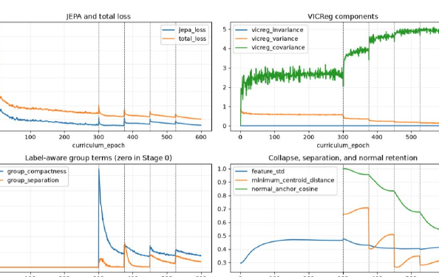
EARLY EVIDENCE
Checkpoint 1: the model learned nontrivial motion
Loss fell
The prediction objective moved in the expected direction.
Features varied
The encoder did not settle on the same representation for every walk.
Meaning: the self-supervised stage learned nontrivial motion structure.
15
Notes:
[Sources]
- User-provided GaitParity Presentation.pdf, slide 15.
[/Sources]

Slide 16
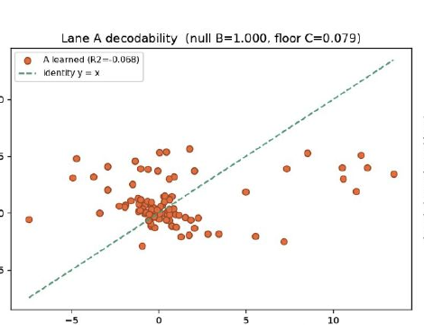
BASELINE FAILURE
Checkpoint 2: a standard model loses left versus right
R² = -0.07
No useful signed direction
The baseline can encode motion and still fail to know which side is which.
That failure motivates building symmetry into the representation itself.
16
Notes:
[Sources]
- User-provided GaitParity Presentation.pdf, slide 16.
[/Sources]

Slide 17
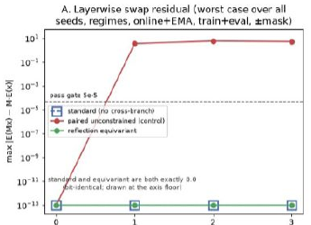
WHAT THE EARLY TESTS SAY
The symmetry works. Clinical usefulness is still open.
PASSED
Mirror consistency
The reflection-equivariant encoder follows the intended swap rule exactly in the geometry audit.
STILL TO PROVE
Force prediction on unseen people
Architecture check first; biomechanical validation next.
17
Notes:
[Sources]
- User-provided GaitParity Presentation.pdf, slide 17.
[/Sources]

Slide 18
NEXT
From tracking movement toward explaining it
1. Pretrain
2. Ground
3. Validate
Finish large-scale AMASS motion pretraining.
Connect motion to force, contact, and uncertainty.
Test signed predictions on unseen people and viewpoints.
Long-term vision: ordinary video that supports biomechanical understanding, not just pose tracking.
18
Notes:
[Sources]
- User-provided GaitParity Presentation.pdf, slide 18, with the roadmap expanded from the stated AMASS and biomechanical-JEPA next steps.
[/Sources]

