Slide 1
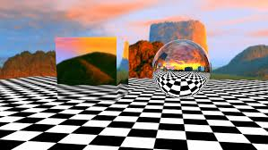
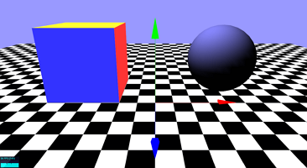
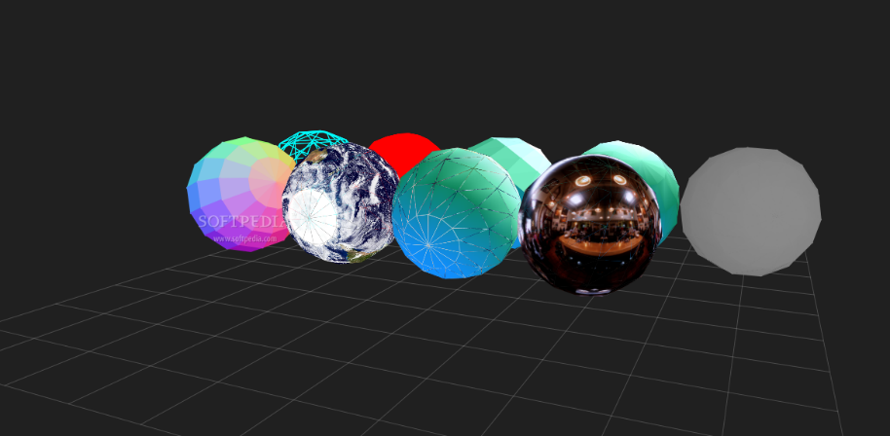
Getting Started with Three.js
Brian Luu

Slide 2
What is Three.JS?
“Three.js is a library that makes WebGL - 3D in the browser - easy to use. While a simple cube in raw WebGL would turn out hundreds of lines of Javascript and shader code, a Three.js equivalent is only a fraction of that.”
threejs.org
Documentation, example code, projects
Created by Ricardo Cabello, released around 2010
Why?
Display 3D graphics in browser, easy to learn
No plugins!

Slide 3
Who are you?
Familiar with HTML/CSS and JavaScript, GitHub
Interested in creating 3D graphics in browser
Want to learn something fun!

Slide 4
Let’s get started!
Fork my repo at https://github.com/briluu/teachingchallenge
Open up index.html and start.js
Ending code will be in end.js

Slide 5
Overview
Scene, camera, renderer
“A renderer is what makes an object appear on the screen.”
Creating a geometry (shape), creating material, and applying them to mesh
Render loop
Camera controls
Adding light

Slide 6
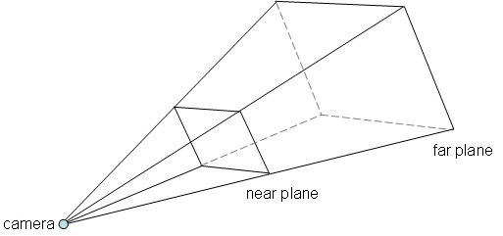
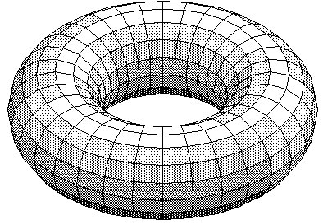

Slide 7
What now?
Look at more examples!
Create something!
Look at documentation!
Have fun!

