Slide 1
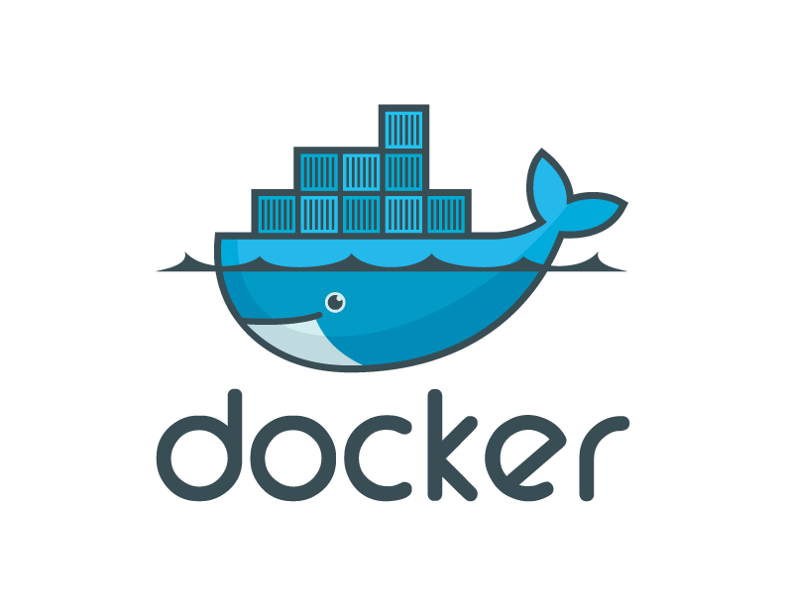
Docker, Containers, and the Future of Application Delivery
Stolen from:
docker.io/learn_more

Slide 2
Who am I?
I am Matt Robinson.
I tweet from @brimston3.
You can follow along via github.com/brimstone/intro-to-docker and
To play with the demo, vagrant up.

Slide 3
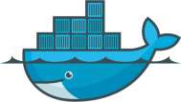
Contents
The challenge
The solution
Why Docker and Containers Matter?
How They Work?
Alternative/Complementary Approaches

Slide 4

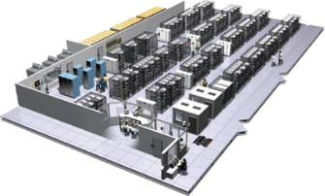
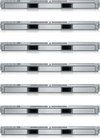
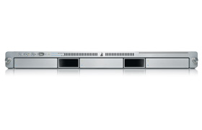
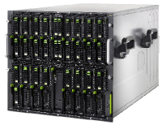

The Challenge
User DB
Static website
postgresql + pgv8 + v8
Queue
Analytics DB
nginx 1.5 + modsecurity + openssl + bootstrap 2
Redis + redis-sentinel
hadoop + hive + thrift + OpenJDK
Do services and apps interact appropriately?
Multiplicity of Stacks
Background workers
Web frontend
Python 3.0 + celery + pyredis + libcurl + ffmpeg + libopencv + nodejs + phantomjs
Ruby + Rails + sass + Unicorn
API endpoint
Python 2.7 + Flask + pyredis + celery + psycopg + postgresql-client
Production Cluster
Development VM
Public Cloud
Multiplicity of hardware environments
QA server
Can I migrate smoothly and quickly?
Disaster recovery
Customer Data Center
Contributor’s laptop
Production Servers

Slide 5
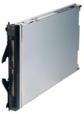
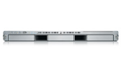
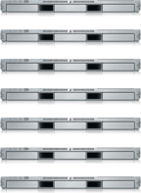

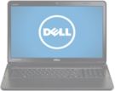
Results in N X N compatibility nightmare
? | ? | ? | ? | ? | ? | ?
? | ? | ? | ? | ? | ? | ?
? | ? | ? | ? | ? | ? | ?
? | ? | ? | ? | ? | ? | ?
? | ? | ? | ? | ? | ? | ?
? | ? | ? | ? | ? | ? | ?
Static website
Web frontend
Background workers
User DB
Analytics DB
Queue
 | Development VM | QA Server | Single Prod Server | Onsite Cluster | Public Cloud | Contributor’s laptop | Customer Servers

Slide 6
A useful analogy…

Slide 7
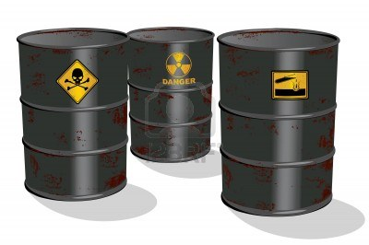
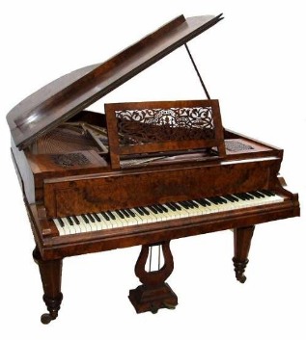

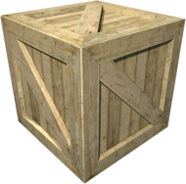
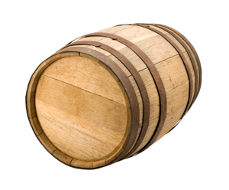
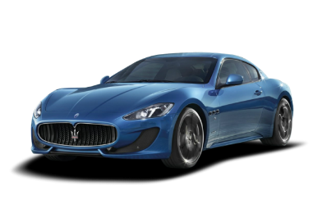
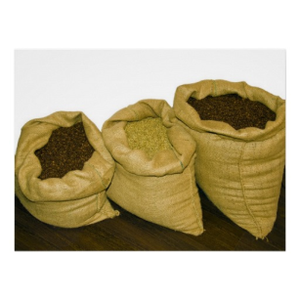

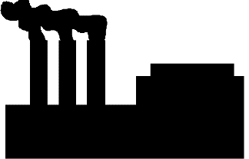

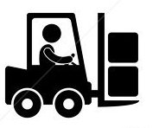
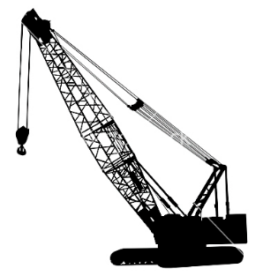
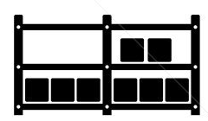

Cargo Transport Pre-1960
Do I worry about how goods interact (e.g. coffee beans next to spices)
Multiplicity of Goods
Multipilicity of methods for transporting/storing
Can I transport quickly and smoothly
(e.g. from boat to train to truck)

Slide 8
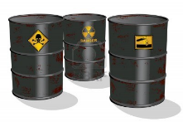

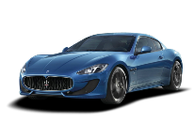


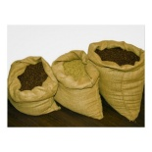


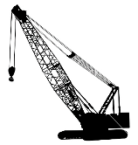



Also an NxN Matrix
 | ? | ? | ? | ? | ? | ? | ?
 | ? | ? | ? | ? | ? | ? | ?
 | ? | ? | ? | ? | ? | ? | ?
 | ? | ? | ? | ? | ? | ? | ?
 | ? | ? | ? | ? | ? | ? | ?
 | ? | ? | ? | ? | ? | ? | ?

Slide 9
Contents
The challenge
The solution
Why Docker and Containers Matter?
How They Work?
Alternative/Complementary Approaches

Slide 10

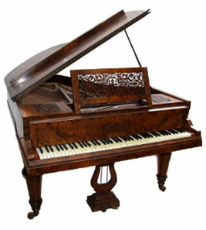

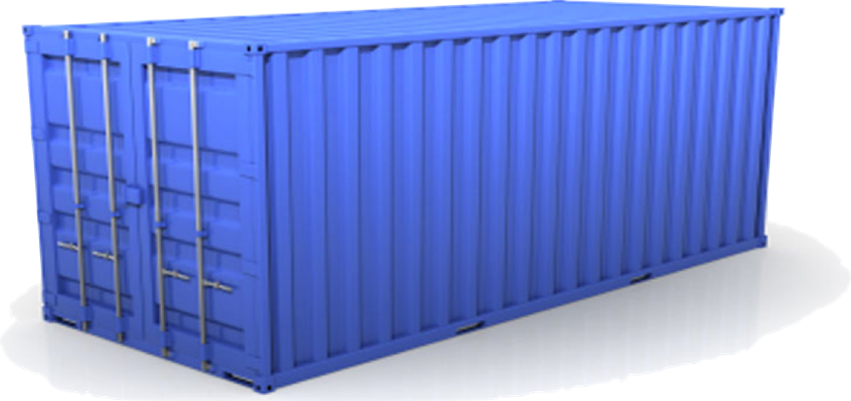
Solution: Intermodal Shipping Container
Do I worry about how goods interact (e.g. coffee beans next to spices)
Multiplicity of Goods
A standard container that is loaded with virtually any goods, and stays sealed until it reaches final delivery.
…in between, can be loaded and unloaded, stacked, transported efficiently over long distances, and transferred from one mode of transport to another
Multiplicity of methods for transporting/storing
Can I transport quickly and smoothly
(e.g. from boat to train to truck)

Slide 11


This eliminated the NXN problem…

Slide 12
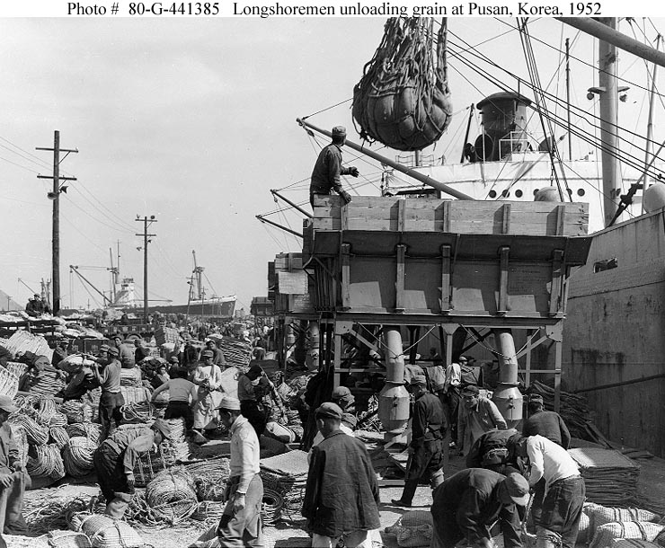
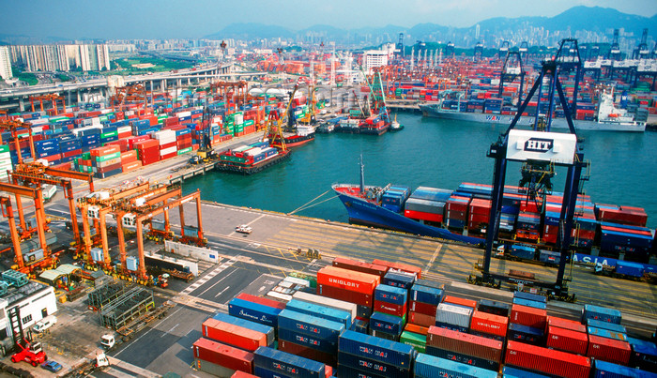
and spawned an Intermodal Shipping Container Ecosystem
90% of all cargo now shipped in a standard container
Order of magnitude reduction in cost and time to load and unload ships
Massive reduction in losses due to theft or damage
Huge reduction in freight cost as percent of final goods (from >25% to <3%)
massive globalizations
5000 ships deliver 200M containers per year

Slide 13
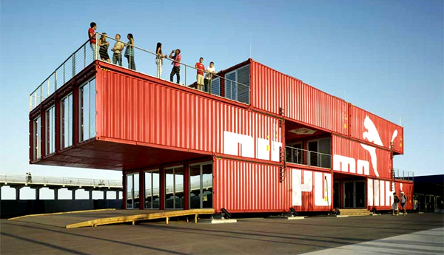
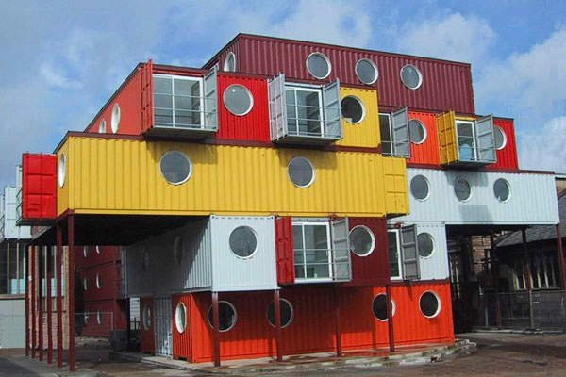
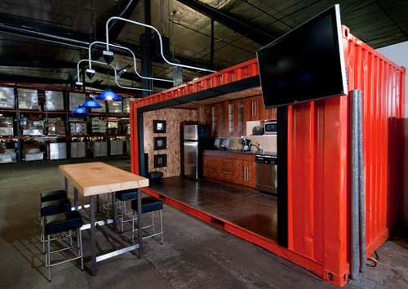
and more
http://vectroave.com/2010/01/shipping-container-architecture/

Slide 14
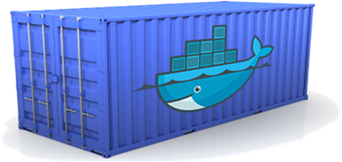
Docker is a shipping container system for code
Static website
User DB
Web frontend
Queue
Analytics DB
Do services and apps interact appropriately?
Multiplicity of Stacks
An engine that enables any payload to be encapsulated as a lightweight, portable, self-sufficient container…
…that can be manipulated using standard operations and run consistently on virtually any hardware platform
Multiplicity of hardware environments
Can I migrate smoothly and quickly
Development VM
QA server
Customer Data Center
Public Cloud
Production Cluster
Contributor’s laptop

Slide 15
Or…put more simply
Static website
User DB
Web frontend
Queue
Analytics DB
Do services and apps interact appropriately?
Multiplicity of Stacks
Developer: Build Once, Run Anywhere (Finally)
Operator: Configure Once, Run Anything
Multiplicity of hardware environments
Can I migrate smoothly and quickly
Development VM
QA server
Customer Data Center
Public Cloud
Production Cluster
Contributor’s laptop

Slide 16

Docker solves the NXN problem
Static website
Web frontend
Background workers
User DB
Analytics DB
Queue
 | Development VM | QA Server | Single Prod Server | Onsite Cluster | Public Cloud | Contributor’s laptop | Customer Servers

Slide 17
Contents
The challenge
The solution
Why Docker and Containers Matter?
How They Work?
Alternative/Complementary Approaches

Slide 18
Why containers matter
 | Physical Containers | Docker
Content Agnostic | The same container can hold almost any type of cargo | Can encapsulate any payload and its dependencies
Hardware Agnostic | Standard shape and interface allow same container to move from ship to train to semi-truck to warehouse to crane without being modified or opened | Using operating system primitives (e.g. LXC) can run consistently on virtually any hardware—VMs, bare metal, openstack, public IAAS, etc.—without modification
Content Isolation and Interaction | No worry about anvils crushing bananas. Containers can be stacked and shipped together | Resource, network, and content isolation. Avoids dependency hell
Automation | Standard interfaces make it easy to automate loading, unloading, moving, etc. | Standard operations to run, start, stop, commit, search, etc. Perfect for devops: CI, CD, autoscaling, hybrid clouds
Highly efficient | No opening or modification, quick to move between waypoints | Lightweight, virtually no perf or start-up penalty, quick to move and manipulate
Separation of duties | Shipper worries about inside of box, carrier worries about outside of box | Developer worries about code. Ops worries about infrastructure.

Slide 19
Why Developers Care
Build once…run anywhere
  A clean, safe, hygienic and portable runtime environment for your app.
  No worries about missing dependencies, packages and other pain points during subsequent deployments.
  Run each app in its own isolated container, so you can run various versions of libraries and other dependencies for each app without worrying
  Automate testing, integration, packaging…anything you can script
  Reduce/eliminate concerns about compatibility on different platforms, either your own or your customers.
  Cheap, zero-penalty containers to deploy services? A VM without the overhead of a VM? Instant replay and reset of image snapshots? That’s the power of Docker

Slide 20
Why Devops Cares?
Configure once…run anything
  Make the entire lifecycle more efficient, consistent, and repeatable
  Increase the quality of code produced by developers.
  Eliminate inconsistencies between development, test, production, and customer environments
  Support segregation of duties
  Significantly improves the speed and reliability of continuous deployment and continuous integration systems
  Because the containers are so lightweight, address significant performance, costs, deployment, and portability issues normally associated with VMs

Slide 21
Contents
The challenge
The solution
Why Docker and Containers Matter?
How They Work
Alternative/Complementary Approaches

Slide 22
Containers vs. VMs
App
A
App
A’
App
B
Containers are isolated,
but share OS and, where
appropriate, bins/libraries
Bins/
Libs
Bins/
Libs
Bins/
Libs
VM
Guest
OS
Guest
OS
Guest
OS
Guest
OS
Guest
OS
App A
App A’
App B
App B’
App B’
App B’
Container
Docker
Hypervisor (Type 2)
Bins/Libs
Bins/Libs
Host OS
Host OS
Server
Server

Slide 23
Why are Docker containers lightweight?
VMs
Containers
App
A
App
A
App
A’
App
A
App
A
App Δ
Bins/
Libs
Bins/
Libs
Bins/
Libs
Bins/
Libs
Bins/
Guest
OS
Guest
OS
Guest
OS
Guest
OS
Original App
(No OS to take
up space, resources,
or require restart)
Copy of
App
No OS. Can
Share bins/libs
Modified App
Union file system allows
us to only save the diffs
Between container A and container
A’
VMs
Every app, every copy of an
app, and every slight modification
of the app requires a new virtual server

Slide 24
What are the basics of the Docker system?
Container A
Docker
Container
Image Registry
Push
Search
Pull
Source Code Repository
Run
Build
Dockerfile
For
A
Container A
Container B
Container C
Docker
Docker Engine
Host 1 OS (Linux)
Host 2 OS 2 (Linux)

Slide 25
Changes and Updates
Docker
Container
Image Registry
App
A
Push
App Δ
Bins/
Libs
Bins/
Base
Container
Image
Container Mod A’
Container Mod A’’
App Δ
Update
App
A
Bins/
App
A’’
Bins/
Libs
Bins/
Libs
Bins/
Docker Engine
Docker Engine
Host is now running A’’
Host running A wants to upgrade to A’’. Requests update. Gets only diffs

Slide 26
Contents
The challenge
The solution
Why Docker and Containers Matter?
How They Work
Alternative/Complementary Approaches

Slide 27
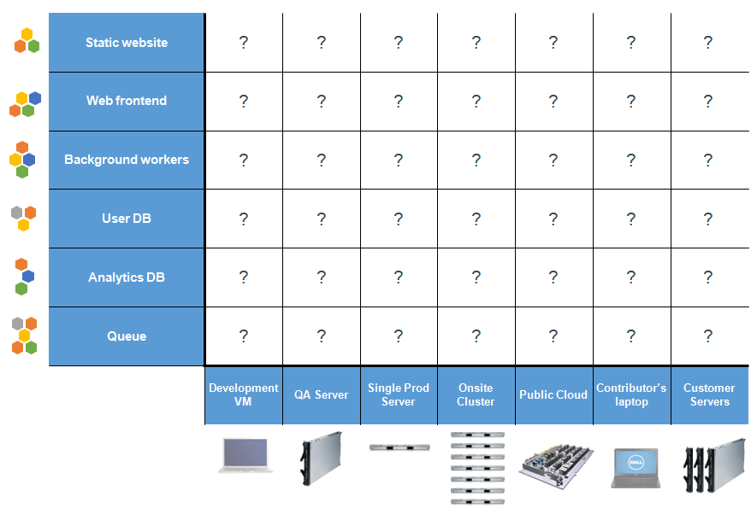
Alternatives/Complementary Approaches
Policy
Reduce Rows
Configuration Management
Reduce Columns
Traditional HW Virtualization
Packaging Automation

Slide 28
Alternative 1: Impose Consistent Dev Environment
Description:
  Try to impose a consistent development environment
Challenges:
  Goes against 20 years of development trends
  Can’t predict what will be needed for next app
  Doesn’t work outside confines of the enterprise (e.g. at customer sites)
Reduce # rows via policy

Slide 29
Alternative 2: Configuration Mgt/Automation
Description:
  Automate creation of consistent runtime environment for different machines
Challenges:
  Chef/Puppet etc. are extremely useful for creating more consistent machine configuration
  But…has to be redone for each new application or version
  Brittle
  Doesn’t work easily outside confines of the enterprise (e.g. at customer sites)
Reduce # Columns via Chef/Puppet/etc.

Slide 30

Alternative 3: Hardware Virtualization
Description:
  Create a virtual server for each app
Challenges:
  HW Virtualization great for many uses cases (e.g. server consolidation)
  But.. heavyweight/expensive/slow
  Need different VM for different hypervisor environments
  Has to be completely redone for each new application or version
  Not good for scale out, hybrid clouds, massive clustering, iterative development

Slide 31
Alternative 4: Package Automation
Description:
  Automate creation of different VMs for different
Challenges:
  A great solution for certain distribution challenges, but…
  VMs are still heavyweight/expensive
  Has to be completely redone for each new application or version
  Better idea: combine containers plus automation

Slide 32
But what IS docker?
/usr/bin/docker
Registry
REST API
netfilter
AUFS
Linux Containers

Slide 33
Linux Containers
Control Groups
2006, Google
Kernel 2.6.24
A way to limit:
    CPU
    memory
    disk I/O
Similar tech:
    openvz
    vserver
    BSD Jails
    Solaris Zones

Slide 34
AUFS
Layer 1
/usr
/bin
/etc
/var
Layer 2
/www
Layer 3
/usr
/bin
/etc
/var
/www
+
=

Slide 35
But what IS docker?
/usr/bin/docker
Registry
REST API
netfilter
AUFS
AUFS, devmapper, BTRFS*
Linux Containers

Slide 36
Demo time!
# Pull and run a container
$ docker run -t -i ubuntu bash
# List containers
$ docker ps [-a] [-q]
# List images
$ docker images

Slide 37
Use Cases—From Our Community
Use Case | Examples | Link
Build your own PaaS | Dokku - Docker powered mini-Heroku. The smallest PaaS implementation you’ve ever seen | http://bit.ly/191Tgsx
Web Based Environment for Instruction | JiffyLab – web based environment for the instruction, or lightweight use of, Python and UNIX shell | http://bit.ly/12oaj2K
Easy Application Deployment | Deploy Java Apps With Docker = Awesome | http://bit.ly/11BCvvu
 | Running Drupal on Docker | http://bit.ly/15MJS6B
 | Installing Redis on Docker | http://bit.ly/16EWOKh
Create Secure Sandboxes | Docker makes creating secure sandboxes easier than ever | http://bit.ly/13mZGJH
Create your own SaaS | Memcached as a Service | http://bit.ly/11nL8vh
Automated Application Deployment | Push-button Deployment with Docker | http://bit.ly/1bTKZTo
Continuous Integration and Deployment | Next Generation Continuous Integration & Deployment with dotCloud’s Docker and Strider | http://bit.ly/ZwTfoy
Lightweight Desktop Virtualization | Docker Desktop: Your Desktop Over SSH Running Inside Of A Docker Container | http://bit.ly/14RYL6x

Slide 38
More links!
Jan 18 2013 Docker's first commit
Docker on Raspberry Pi
Jan 22 2014 $15 million in Series B
Turnkey Linux Docker builds
Quay – Private Docker Registry
Shipyard – Management interface for Docker
OpenShift's announcement about shifting to Docker
Docker client for OS X
Mesos
Linode's Docker images
Digital Ocean's Docker images

