Slide 1


Campus to Company:
An insight into the Interview Process
Your Roadmap to Professional Success
VIPAR

Slide 2


ROADMAP TO SUCCESS
Session Agenda
1
2
3
4
The Selection Funnel
Aptitude
&
Coding rounds Preparation
Technical Interview process
&
preparation
Resume Readiness
&
Strategy

Slide 3

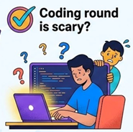

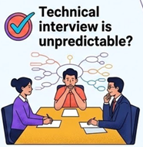

LET’S GET STARTED
Quick Question

Slide 4

LET’S GET STARTED
What Companies Actually Look For
✔ Technical fundamentals
✔ Problem solving
✔ Communication
✔ Confidence
✔ Learning attitude
✔ Cultural fit / Collaboration
Knowledge + Skills + Attitude = Selection

Slide 5


Aptitude Tests
1
Recruitment Process
The Journey
Coding Interviews
2
Technical Interviews
3

Slide 6
OVERVIEW OF SELECTION ROUNDS
The Selection Funnel
Recruitment stages
Resume Screening: Applicant Tracking Systems (ATS) to match keywords and basic qualifications.
Aptitude Tests: Evaluates quantitative, logical, and verbal reasoning skills under strict time limits.
Coding Assessment: Tests core domain knowledge and coding proficiency through automated platforms like Hackeranck.
Technical Interviews: Includes technical deep-dives to evaluate concept understanding and knowledge
Other rounds include
Group Discussions
HR Interviews
Resume Screening
Aptitude Tests
Coding Assessments
Technical Interviews

Slide 7

OVERVIEW OF SELECTION ROUNDS
Interview Process
Round 1
Aptitude Tests
Round 2
Coding Assessments
(e.g., HackerRank)
Round 3
Technical Interviews
Remember: Every round is an elimination round

Slide 8
ROUND 1
Aptitude Tests - The First Hurdle
Acts as the primary elimination round.
Tests Quantitative and Logical reasoning skills
Requires a balance of speed and accuracy.

Slide 9
ROUND 1
Aptitude Tests - Keys Assessment topics
1
2
Logical Reasoning
Pattern recognition
Puzzles
Seating arrangements
Syllogisms
Blood relations
Patterns & Series
3
Verbal Ability
English proficiency
Reading comprehension
Grammar correction
Vocabulary tests.
Quantitative Aptitude
Mathematical foundations
Percentages
Ratios & Proportion
Time & work
Time & Distance
Probability
Wage Problems

Slide 10
ROUND 1
Preparation Strategy - Aptitude
✔ Practice daily (30–45 mins)
✔ Use timed exercises
✔ Learn shortcuts & formulas
✔ Analyze mistakes
✔ Improve speed gradually
✔ Identify Time Sinks
Shortcut Tricks:
Learn mental math tricks and approximation methods to bypass long calculations.

Slide 11
ROUND 1
Preparation Strategy – Shortcut tips (examples)
10% & 1% method
24% of 510
Squaring numbers ending in 5
85 X 85
10% of 510 -- > 51
20% -> 102
1% - 5.1
4% -> 20.4
8 + 1 = 9
5 X 5 = 25
8 X 9 = 72
122.4
7225

Slide 12
ROUND 1
Preparation Strategy – Shortcut tips (examples)
Two-Worker Fast Formula
Others
Divisibility Rules
Calendar days calculation
Unit digit elimination
Estimation techniques
2 persons take A and B hours to complete. Find combined hours.
Product A X B
Time Together = ------------ = ----------
Sum A + B
6 X 12 6 X 12
Time together = --------- = ---------- = 4
6 + 12 18

Slide 13

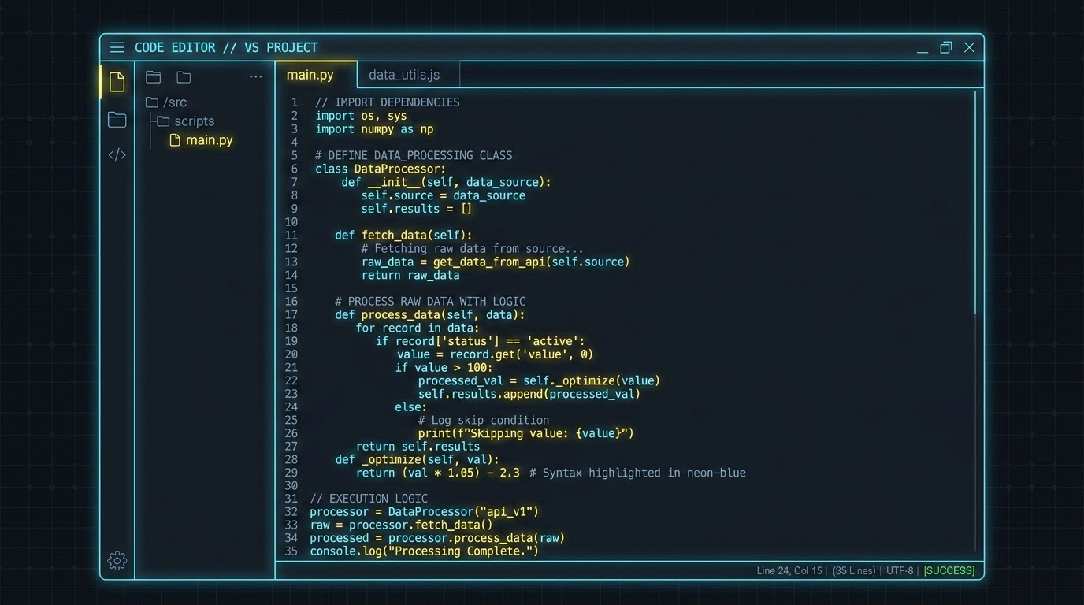
ROUND 2
Coding Assessments
Platform Examples: HackerRank, LeetCode, CodeChef
Typical Questions
Data Structures & Algorithms
Arrays, LinkedList, Maps
Stacks, Queues
Strings & Functions
Loops
Searching
Sorting
Logic Building
Focuses on algorithmic thinking.
Tests your ability to convert logic into clean, functional code.

Slide 14

ROUND 2
Coding Assessments & Evaluation
Automated Evaluation:
Hidden Test Cases
Edge Cases
Performance Metrics:
Time complexity (execution speed)
Space complexity (memory usage)
Efficiency:
Handle large Data sets without timing out
Code Quality:
Naming convention and coding style
Code Modularity
Integrity checks:
Tab Switching
Copy Pasting
AI Usage

Slide 15
ROUND 2
Preparation Strategy - Coding Interviews
1
2
3
Start Easy
Move to Medium
Attempt Hard
✔ Pick your comfortable language
✔ Write code regularly
✔ Debug errors
✔ Understand logic
✔ Convert ideas into code
CONSISTENCY:
Solving 2-3 problems daily is far more effective than cramming 20 problems on a weekend.

Slide 16

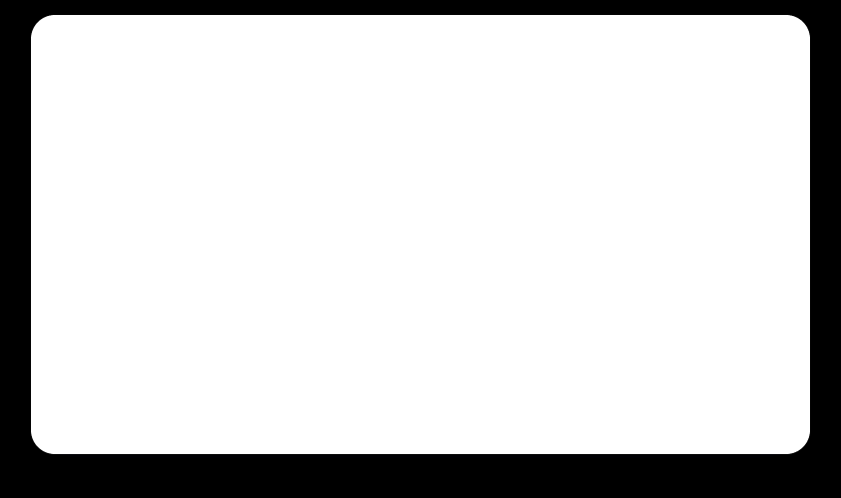




CODING METHODS
Traditional Practice vs. Vibe Coding
Traditional
Focuses on syntax and manual logic building.
Deep Understanding & Maintainability
Deterministic Quality & Security
Architectural Mastery
Vibe Coding (AI-Assisted)
Faster prototyping, but risks masking fundamental gaps.
Unmatched Velocity
Lower Barrier to Entry
Boilerplate Elimination

Slide 17



ROUND 3
Technical Interviews
Deep dive into technical knowledge
Behavioral & Personality assessment
Assessment of communication skills
Evaluation of team fit and problem-solving approach
Common Interview Style - “Difference Between” Questions

Slide 18
ROUND 3
Technical Interviews - Assessment areas
Data Structures & Algorithms
Core Structures - Arrays, Strings, Linked
Lists, Stacks, Queues
Basic Algorithms - Sorting & Searching
Complexity - Time and Space
Advanced Topics - Trees, Graphs,
Dynamic Programming
DBMS and OOPS
OOPS components - Class, Objects,
Interfaces
4 Pillars of OOPS - Abstraction,
Encapsulation, Inheritance, Polymorphism
Design Patterns - Singleton, Factory
SQL fundamentals - CRUD, joins, aggregates
DBMS concepts - Relationships, Indexing
Java & Python basics

Slide 19
ROUND 3
Technical Interviews - Assessment areas (Cont..)
AI & DS
Mathematical concepts - Linear Algebra, Probabality
Statistical Concepts - Mean/Median/Mode, Standard
Deviation, Distributions
Core ML concepts - Supervised / Unsupervised
Learning / Gen AI / LLMs
Key Algorithms - Regression, Classification, Clustering
Model Evalutions - Precision, Recall, Accuracy
Python Libraries - pandas, numpy, scikit
Other topics
OS - Process management and
Memory management
Networks - Protocols, Security
SDLC - Waterfall & Agile
System Design
Version Control

Slide 20
ROUND 3
Technical Interviews - Standard Behavioral Questions
Tell me about yourself
Explain project XYZ
Tell me about a technical challenge you overcame during the Internship / Projects.
What is your most significant accomplishment across your projects?
Where do you see yourself in next 5 years ?
Why do you want to join our company ?
How do you manage conflict within the team ?
Do you have any question for me or the company ?

Slide 21
ROUND 3
Preparation Strategy - Technical Interview
✔ Master 1 or 2 Programming Languages
✔ Revise CS fundamentals and Practice DSA problems daily
✔ Understand the underlying mechanics, not just syntax.
✔ Identify weakspot and strengthen those areas
✔ Prepare for real world examples and discussions
✔ Prepare and rehearse standard behavioral questions
Remember:
Understanding basics and revising fundamentals regularly gives immense confidence.

Slide 22
Keep formatting simple and neat.
1
Resume Readiness
The Power of First Impressions
Avoid confusing acronyms.
2
Easy to read
3
Showcase your strengths
3
Your resume should drive the interview

Slide 23


RESUME STRATEGY
Organizing the resume
Organize the resume for interviewer to easily spot the below items -
Education - Major, CGPA
Skills - Technical Skills
Projects - College / Own projects
Internship / Experience - Internship projects
Other achievements - Paper presentation, Hackathon
Certifications - Certified course completions

Slide 24
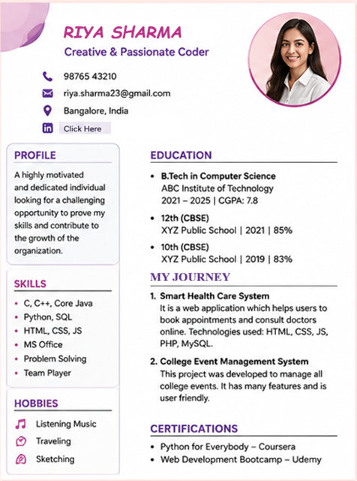
RESUME STRATEGY
Embracing Simple & Neat Layouts
Complex Layout – Multiple columns, images, graphics
Creative Headings – MyJourney, ToolBox
Inconsistent Formatting – Differences in bullets and fonts
Unnecessary Sections – More personal info
Hidden Links – LinkedIn link hidden under text

Slide 25
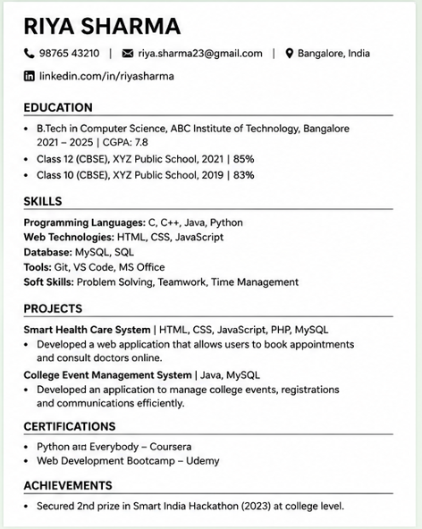
RESUME STRATEGY
Embracing Simple & Neat Layouts
Clean & Simple Layout – Avoids complex graphics, multi-column layouts, or heavy colours.
Standard Headings – Chronologically ordered sections with clear, bold standard headers
Consistent Formatting – Same font and bullet style throughout
Relevant Information – Emphasizes on academic and technical expertise and excludes hobbies and profile summary
Visible Links – Links are clearly visible
Concise Length: Restrict your resume to a single page for entry-level campus recruitment.

Slide 26
RESUME STRATEGY
Embracing Simple & Neat Layouts
ATS-Friendly Optimization
Optimize for both human recruiters and Applicant Tracking Systems (ATS).
Aspect | DONTs | DOs
Layout | Avoid multi-columns, split panels | Single column, top-to-bottom reading
 | Avoid flashing colors, images, photos, borders | Use clean & Clear plain text
 | Avoid placing contact info like phone numbers and links in document headers / footers | Place all contact details on top section of document
Hyperlinks | Avoid hiding URLs under custom text like Click Here or using long URLs. | Anchor clean URLs to identifiable text: https://linkedin.com/in/username or https://github.com/username

Slide 27
RESUME STRATEGY
Embracing Simple & Neat Layouts
Aspect | Regular | ATS Compatible
Styling and Formatting | Avoid custom web fonts, decorative scripts | Use standard fonts like Arial, Calibri, Times New Roman
 | Avoid tiny font sizes to fit more content | Use legible uniform font sizes for headers and content
 | Avoid fancy fonts and symbols for bullets | Use common standard circular or hyphen
Headings and Sections | Avoid creative headings like “ToolBox”, “My Journey” etc | Use standard headings like “Skills”, “Projects”, “Experience” etc
 | Avoid passive summaries ("Responsible for developing a website") | Use action-based summaries "Built a full-stack portal using React & Node.js, reducing query response times by 30%")
 | Avoid plain abbreviations like ML, DS | Spell out along with abbreviations like Machine Learning (ML), Data Science(DS)

Slide 28

RESUME STRATEGY
Showcasing Your Projects for Impact
Place your most important and strongest projects at the top.
Key Project Elements
1
Core Problem Solved
Briefly explain the objective or the real-world problem that the project actively addresses.
Be ready to explain the project deeply
2
Beneficiary
Who is benefitted by the project or who are the potential users of the project outcome.
Only list technologies you can confidently explain in detail.
Project Title, Role & Tech Stack
State what you built, your contribution, experience and languages or tools used (e.g., React, Node.js, MongoDB).
3
Avoid repeating the same skills across multiple projects.
4
Quantifiable Impact
Highlight outcomes using metrics (e.g., 'Reduced load time by 20%' or 'Handled 500+ daily users').

Slide 29
RESUME STRATEGY
Showcasing Your Projects for Impact
Online Book Store Project – Typical Version
Developed an online book store web application where users can register, login, get books. The application also includes an admin module. Worked on database design, user modules, cart functionality and payment integration using HTML, CSS, JavaScript, React, Node.js, Express.js and MySQL. The application reduced the average book-search time by approximately 60% during testing.
Online Book Store Project – Improved, Impact-Focused Version
Built an online bookstore for ABC School to simplify search and issue of books to their students. As a Full Stack Developer, developed the search, filtering, cart and online payment functionality using React, Node.js and MySQL. The application supported 1000+ books and has currently serviced 1800 students in a 3-month period.

Slide 30
RESUME STRATEGY
Showcasing Your Projects for Impact
Student Performance Prediction System (AI/ML Project) – Typical Version
Developed a ML project to predict student performance using Python, Pandas, NumPy and Scikit-learn. Collected and preprocessed the data, performed data analysis, implemented different machine learning algorithms and compared their accuracy. Used Random Forest to predict student performance and created graphs using Matplotlib.
Student Performance Prediction System(AI/ML Project) – Improved, Impact-Focused Version
Developed a machine learning solution to identify students who may require additional academic support based on attendance, previous scores, study time and assignment completion. Processed 5,000+ student records, performed data preprocessing & feature selection, and implemented. Compared Logistic Regression, Decision Tree and Random Forest models using Scikit-learn and achieved prediction accuracy of 82% using Random Forest model.

Slide 31
RESUME STRATEGY
Strategic Focus and Top-Value Entries
CGPA & Coursework
Prominently display your CGPA/GPA, core courses, and academic achievements.
Minimize Personal Info
Minimize Personal Info like Place etc, Keep only those required for contact.
Competitions & Hackathons
Showcase coding competitions and hackathons, and paper presentation.
Remove Obsolete Data
Exclude high school grades unless requested.
Leadership & Open Source
Highlight open-source contributions or activities that demonstrate active technical passion.
Minimize Hobbies
Omit generic hobbies. Only keep those showing leadership/tech passion
GitHub URL
Project source Code or any other code you developed of your interest
Do NOT Repeat Yourself
Avoid repeating similar information across projects
Prioritizing academic and professional milestones over generic personal details.

Slide 32

RESUME STRATEGY
Common Resume Mistakes
❌ Too many personal details
❌ Complex design
❌ Too many acronyms
❌ Fake technologies
❌ Mentioning tools without knowledge

Slide 33

PROACTIVE INTERVIEW STRATEGY
Steering the Conversation: Drive Your Own Interview
Anticipate questions based on your resume.
Pivot answers to highlight your strongest skills.
Guide the interviewer toward your areas of expertise.

Slide 34



Final Takeaways, Q&A, and Next Steps
"Your resume is your roadmap; own it."
Takeaway 1
Preparation builds confidence.
Takeaway 2
Practice consistently.
?
Next Step
Open floor for Questions.

