Slide 1
Returns on a Fixed Deposit
Let us assume a fixed return of 8% p.a.
Rs. 100,000 invested grows to Rs. 108,000 in 365 Days
Daily Returns are approximately (8/365) % ~ 0.02%
Note - Daily returns are Fixed
 | Day 1 | Day 2 | Day 3 |  | Day 365
Value of FD | 100,000 | 100,020 | 100,040 |  | 108,000
Daily Returns | ~0.02%
Calculation | Day_{N+1} = Day_{N} x (1 + Daily Returns/100)

Slide 2
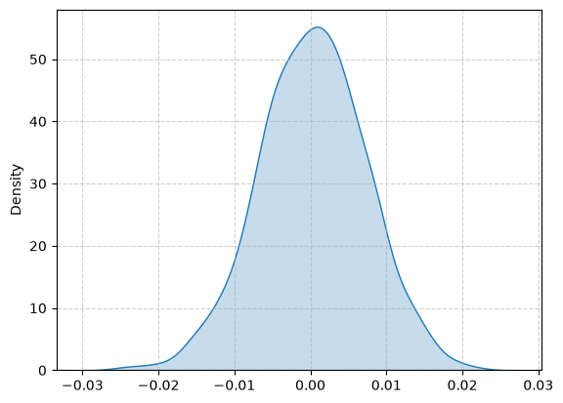
Returns from the Stock Market
Daily Returns are variable depending on market sentiment, company performance
Returns on any day could be either positive (profit) or negative (loss)
 | Day 1 | Day 2 | Day 3 |  | Day 365
Value of Stock Portfolio | 100,000 | 100,030 | 99,970 | ... | ...
Daily Returns | 0.03% | -0.06% | ... | ... | ...
Calculation | Day_{N+1} = Day_{N} x (1 + Daily Returns/100)
mean = 0.001
std = 0.7

